Slide 1


Self-organizing map classification of
the boundary layer profile –
a refinement of Eastern Mediterranean
winter synoptic regimes
Sigalit Berkovic¹, Oz Yosef Mendelsohn², Eyal Ilotoviz² and Shira Raveh-Rubin²,
(1) IIBR, Ness Ziona, Israel, (2) Weizmann Institute of Science, Rehovot, Israel
Berkovic, S., Mendelsohn, O.Y., Ilotoviz, E., Raveh-Rubin, S.
Self-organizing map classification of the boundary layer profile: A refinement of Eastern Mediterranean winter synoptic regimes.
Int J Climatol. 2021; 41: 3317 - 3338.

Slide 2

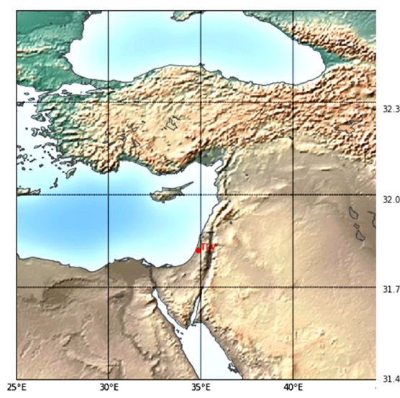
Beit-Dagan, coastal plain, Israel, Eastern Mediterranean atmospheric profile regimes
Radiosonde data
DJF 12Z, 3km 100m dz,
Composite variables: u, v, q, T, P
Research questions:
dominant, recurring regimes?
quantitative characteristics of their parameters?
links between the various BL regimes and the regional synoptic-scale patterns?

Slide 3
30 multi-variable profile regimes, exhibiting the main regimes of the BL profile during winter:

Slide 4
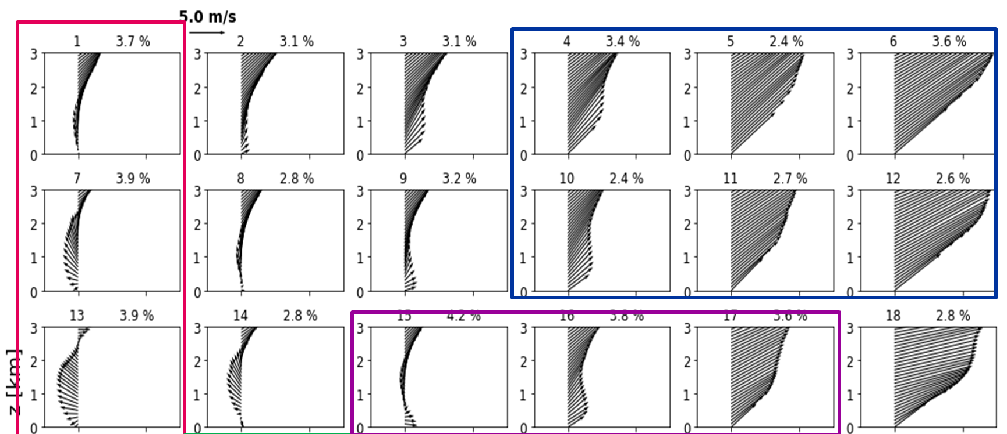
Wind profile
Westerly
Easterly
Direction shear
Int J Climatol. 2021; 41: 3317 - 3338

Slide 5
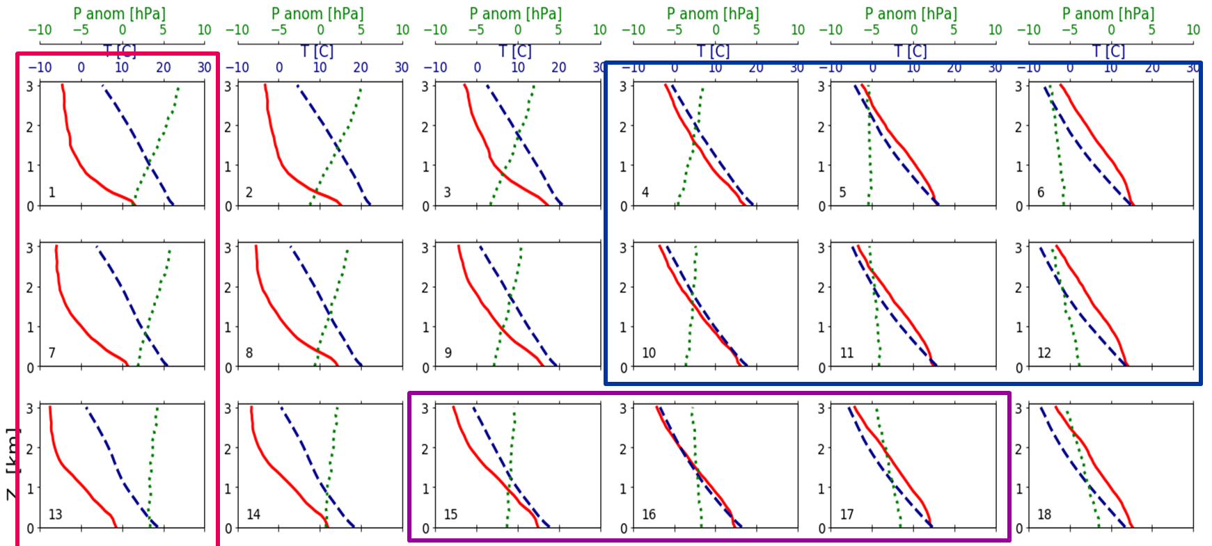
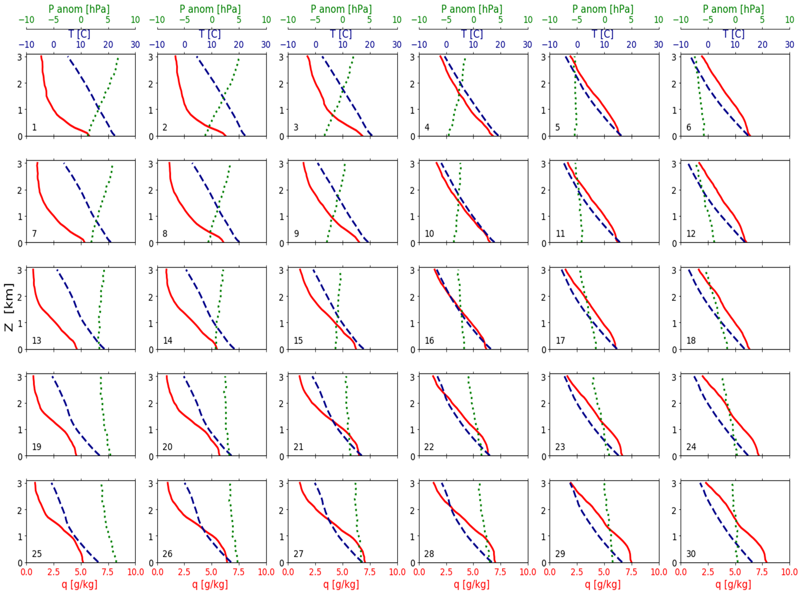
Q T P profile
P
T
q
SeasonalPressure anomaly
Temperature
Specific
humidity
Wet and cold
Dry and warm
Int J Climatol. 2021; 41: 3317 - 3338

Slide 6
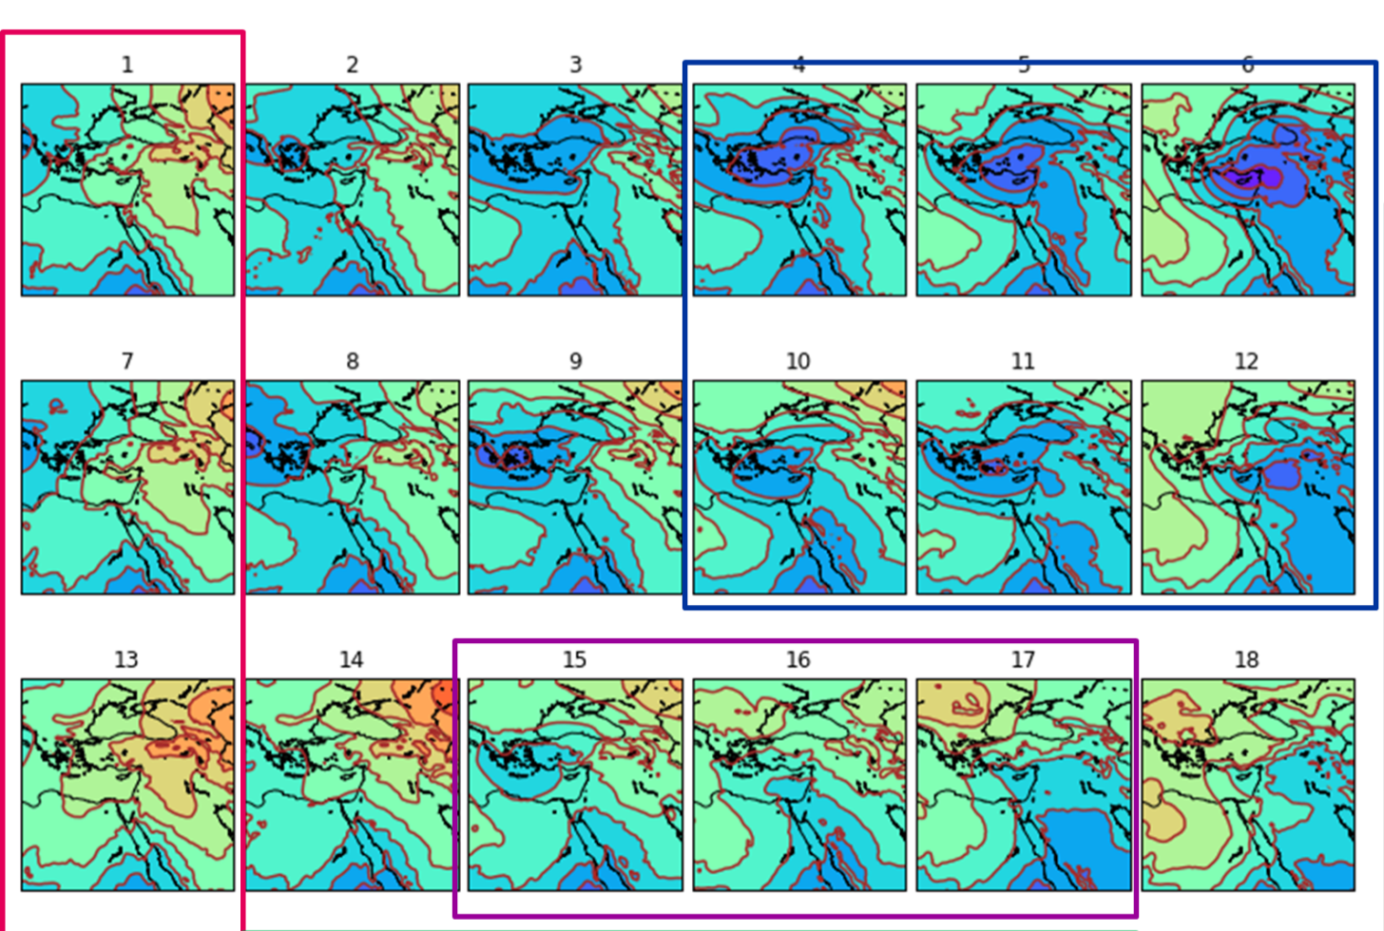

Composites – ERA5 SLP
Cyprus cyclone
Migration of cyclones to the E
High from the N
High from the E
[mbar]
Red sea trough
Red sea trough
Int J Climatol. 2021; 41: 3317 - 3338

Slide 7
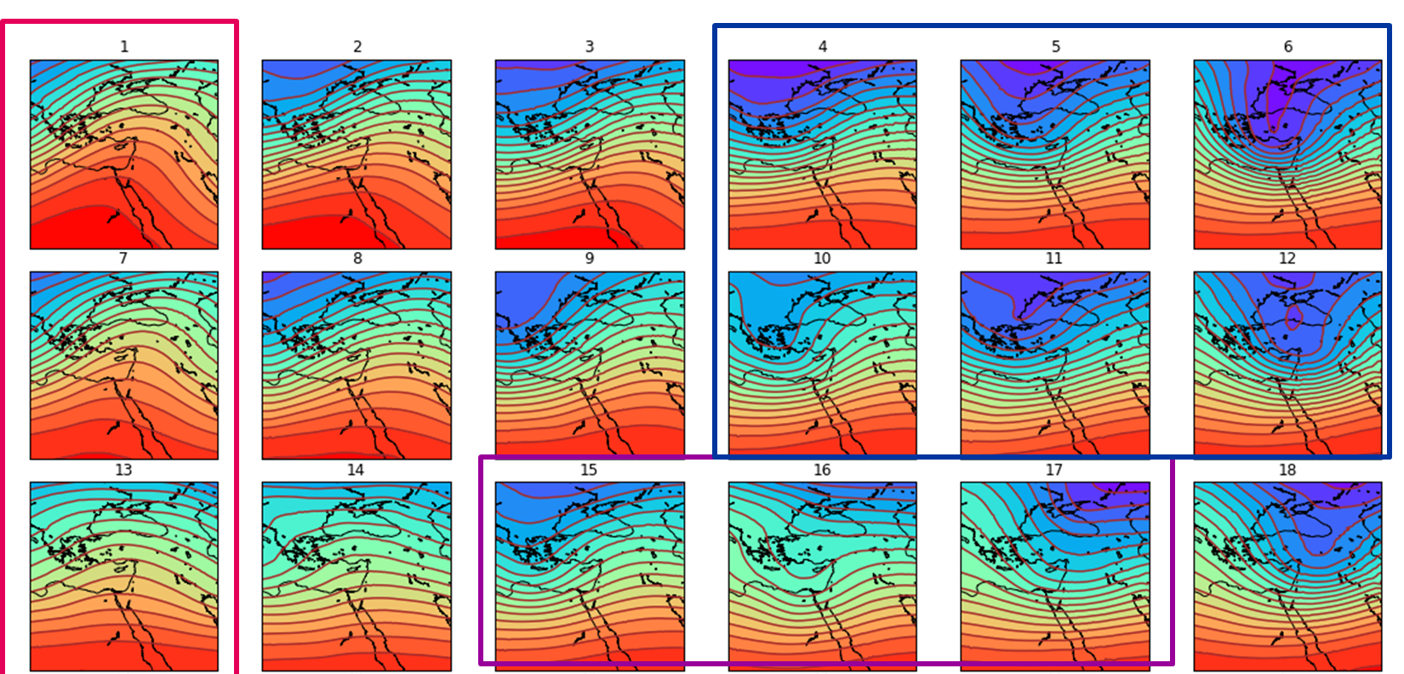
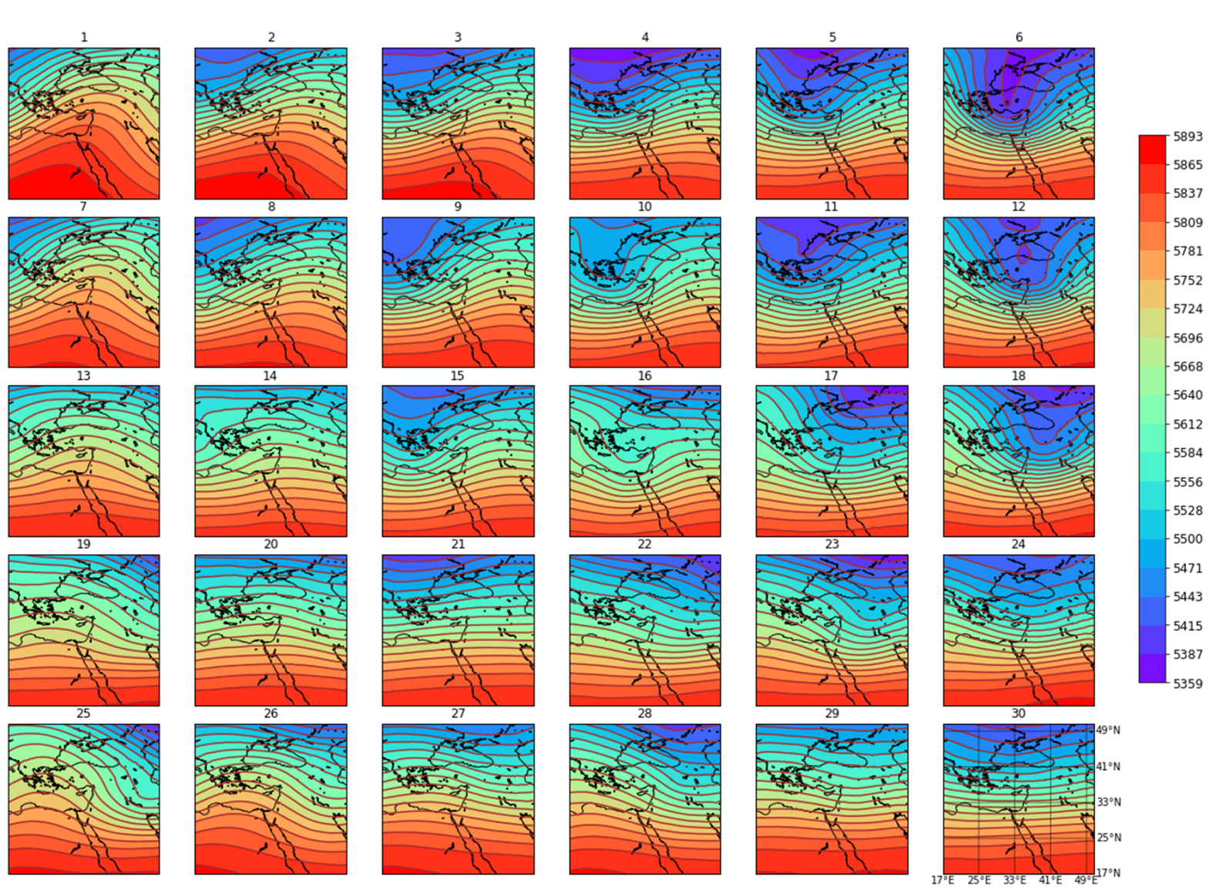
Composites – ERA5 GPH 500 mbar
Migration of northerly trough
(Cyprus low surface)
Southerly ridge
[m]
Northerly trough (Red sea trough surface)
Int J Climatol. 2021; 41: 3317 - 3338

Slide 8
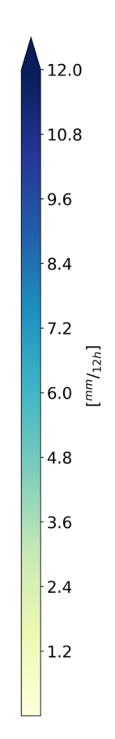

Composites – ERA5 precipitation
Cyprus low
Active Red sea trough
Int J Climatol. 2021; 41: 3317 - 3338

Slide 9
Distinct categories of thermal stability, BL height and turbulence.
The relation to synoptic conditions is consistent with previous knowledge about BL characteristics.
A first objective classification of active RST.
Enables further direct classification of the synoptic regimes.

Slide 10
Four major synoptic classes :
1. Strong winter highs and Red Sea trough (RST) with an upper southerly ridge, moderate easterly wind up to 1-2 km and wind direction shear. The extreme hot and dry regime is a member of this group.
2. Deep winter lows with strong SW to NW winds, high turbulence and precipitation.
3. Moderate pressure gradients under shallow lows, high to the west and RST to the east of Israel.
4. Active RST, accompanied by an upper northern trough leading to enhanced upward motion and unstable conditions. Convective storms -> heavy showers and thunderstorms at the eastern and southern parts of Israel.

Slide 11
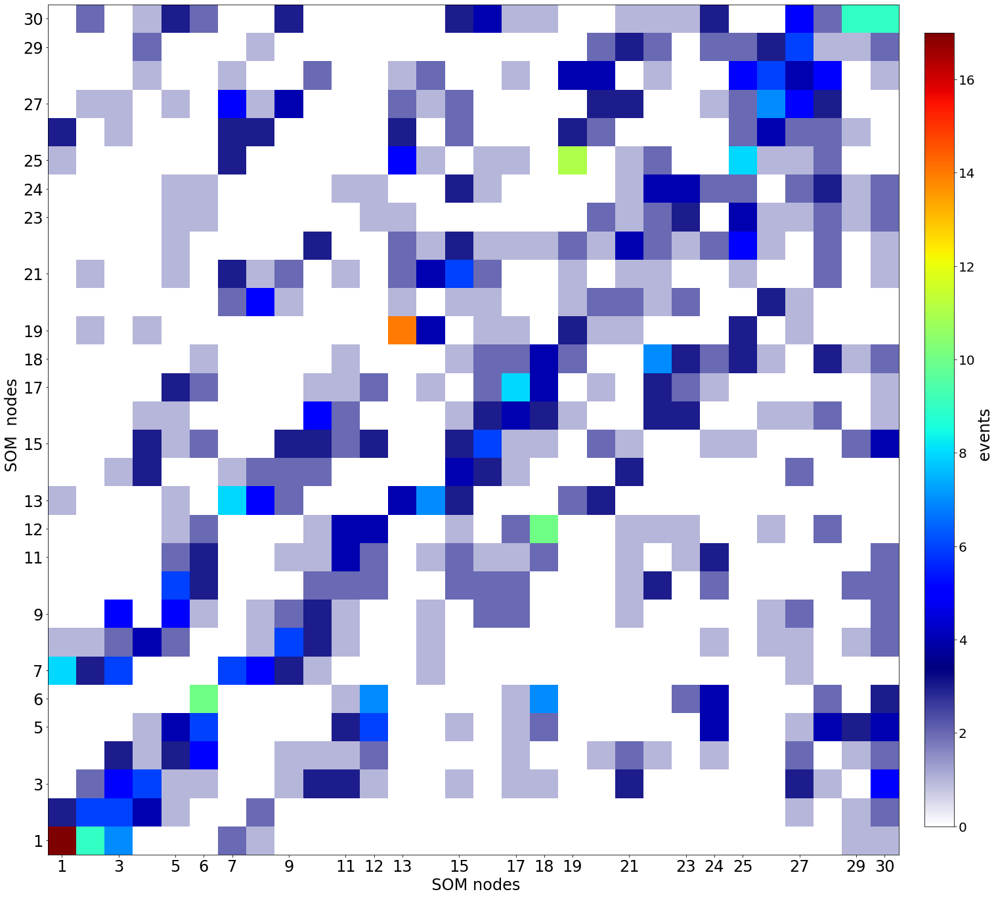
Transition probabilities - Persistent regimes
Groups 1,2,7, -
Highs RSTs:
warm and dry regimes
1->1 17 events, 1-> 9 events, 7->1 8 events,
1->3 7 events, 7->3 6 events
Groups 13,19,25 -
Cold highs
19->13 14 events, 25->19 11 events
Groups 6,12,18 -
Winter lows
6->6 , 12->18 10 events
EGU22-683 | Presentations | AS1.30
Persistent warm and dry extremes over
the Eastern Mediterranean during
winter: the role of upstream Rossby
wave pattern
Shira Raveh-Rubin and Sigalit Berkovic
Fri, 27 May, 15:20–15:25 Room 0.11/12
QJRMS https://doi.org/10.1002/qj.4308

Slide 12


(takehomemessage.com)
The automatic objective classification of profile data from a single station is a sensitive discriminator of winter synoptic regimes in the Eastern Mediterranean.

