Slide 1
Topographic analysis of debris flow gullies affected by tectonic activities on the edge of Qinghai-Tibet Plateau
EGU22-6857
Reporter: Xinyue Liang
Institution: Institute of Mountain Hazards and Environment,CAS
Time: 2022.05.26

Slide 2


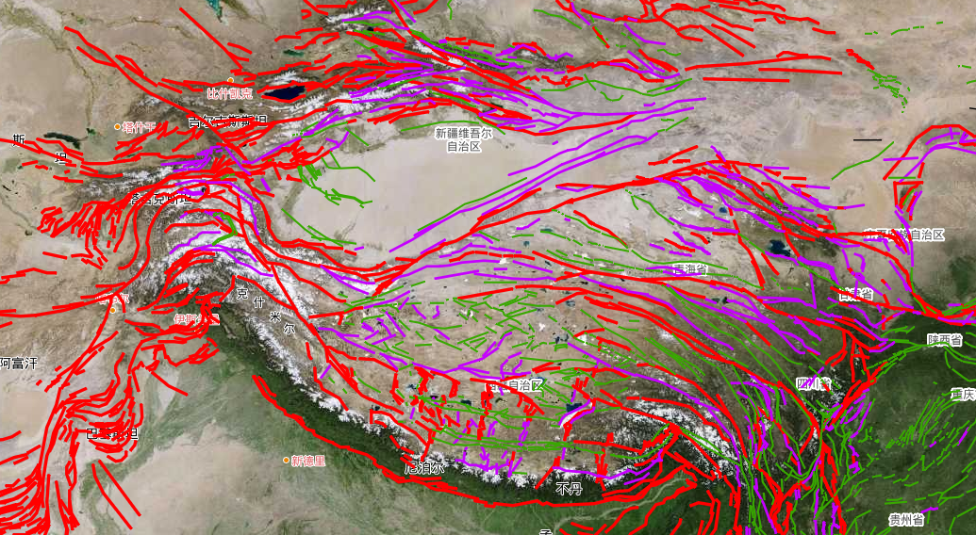
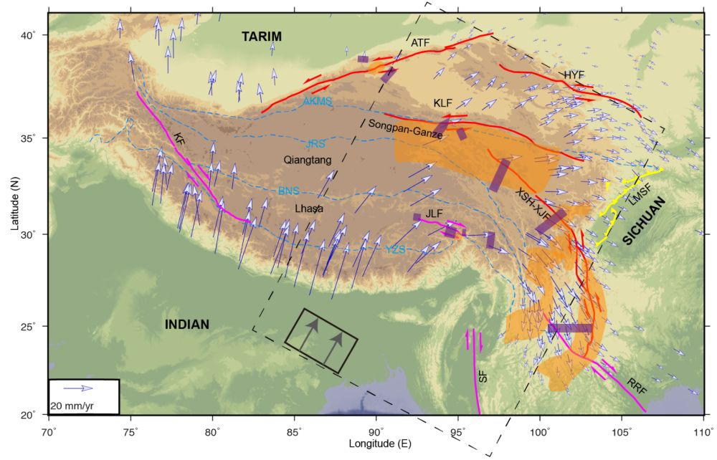
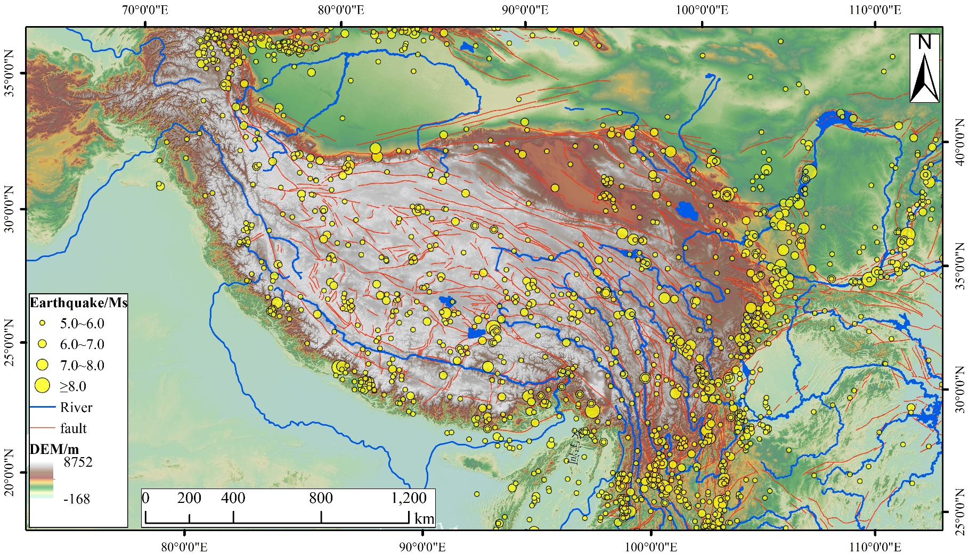
1.Background
2.Method
3.Result
4.Conclusion
Tectonic features of the Qinghai-Tibetan Plateau
Extrusion deformation on surrounding region
Large number of Holocene faults
Earthquake activity is frequent
（Yang, et al）
Yang J, Kaus B, Li Y, Leloup P, Popov A, Lu G, Wang K, Zhao L*. Lower crustal rheology controls the development of large offset strike-slip faults during the Himalayan-Tibetan orogeny [J]. Geophysical Research Letters, 2020, 47: e2020GL089435.

Slide 3
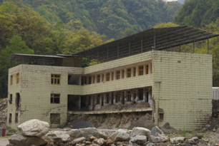
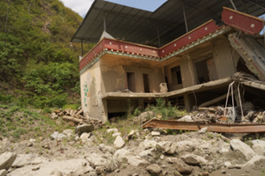
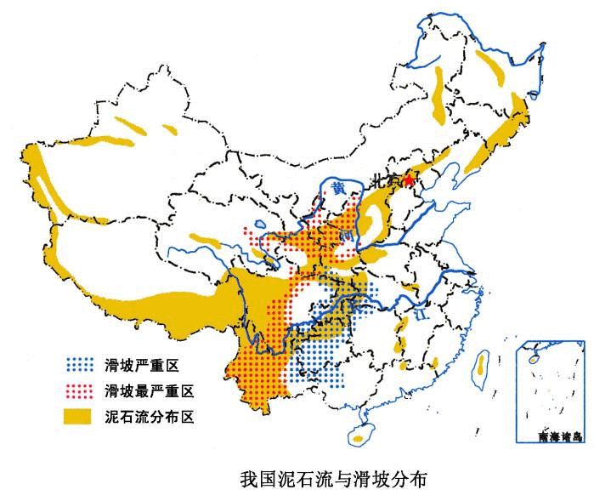
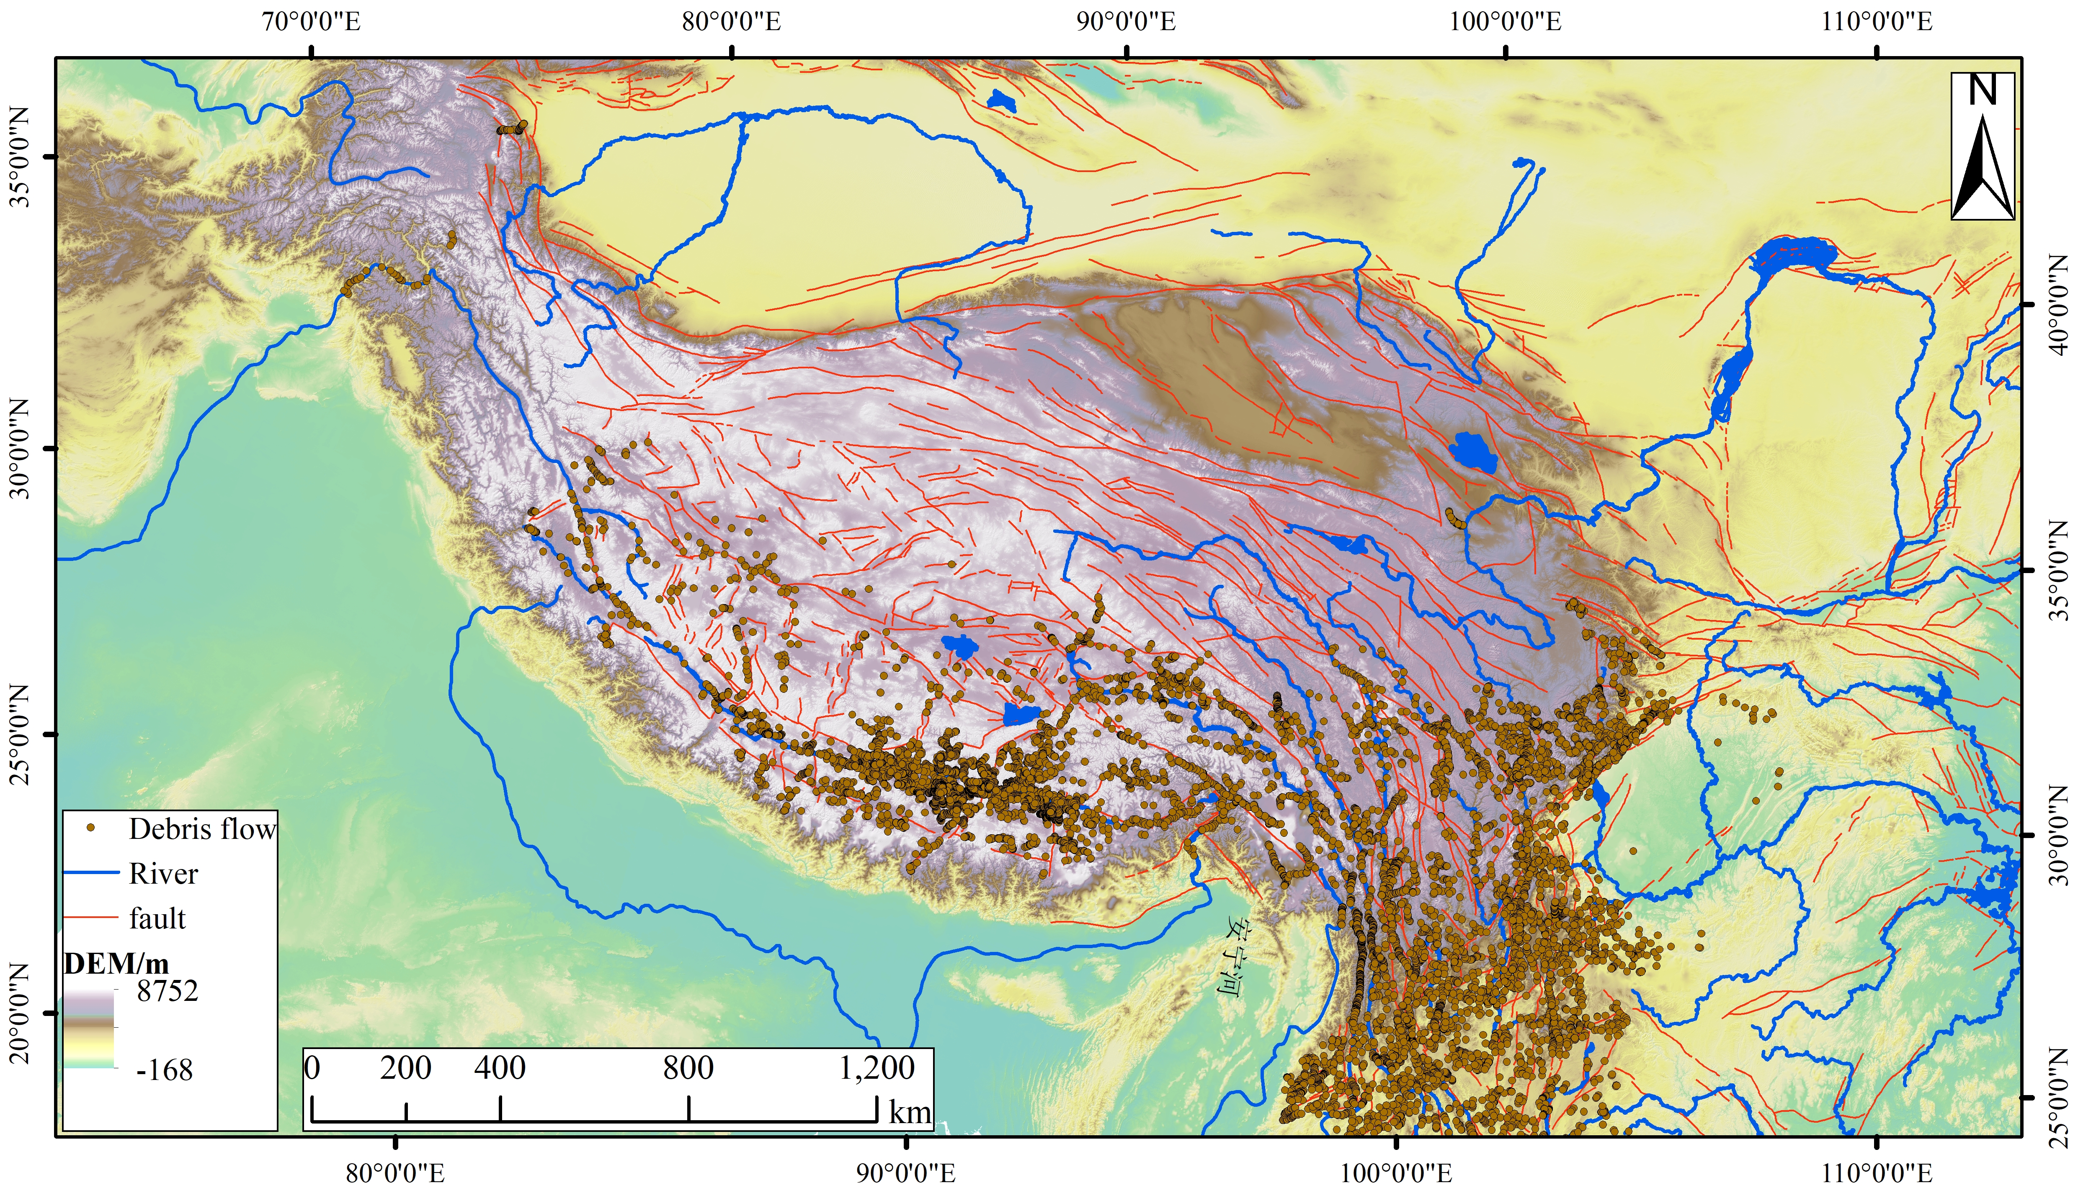
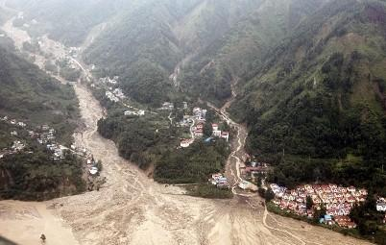
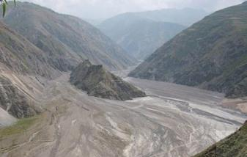
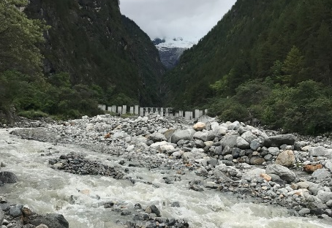
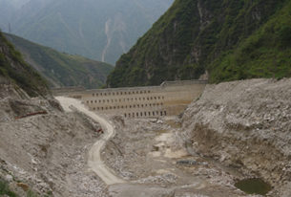
1.Background
2.Method
3.Result
4.Conclusion
Spatial characteristics of Debris flow
Characteristics
Mainly concentrated on the edge of the Qinghai-Tibet Plateau
Sudden
Rapid
Destructive
There is a linear distribution along the fault
It is distributed around strong earthquakes
Zonality, relative concentration and group-occurring
Debris flow on the active fault belt
Sanyanyu Gully
Jiangjia gully
Guxiang gully
Cutou gully

Slide 4
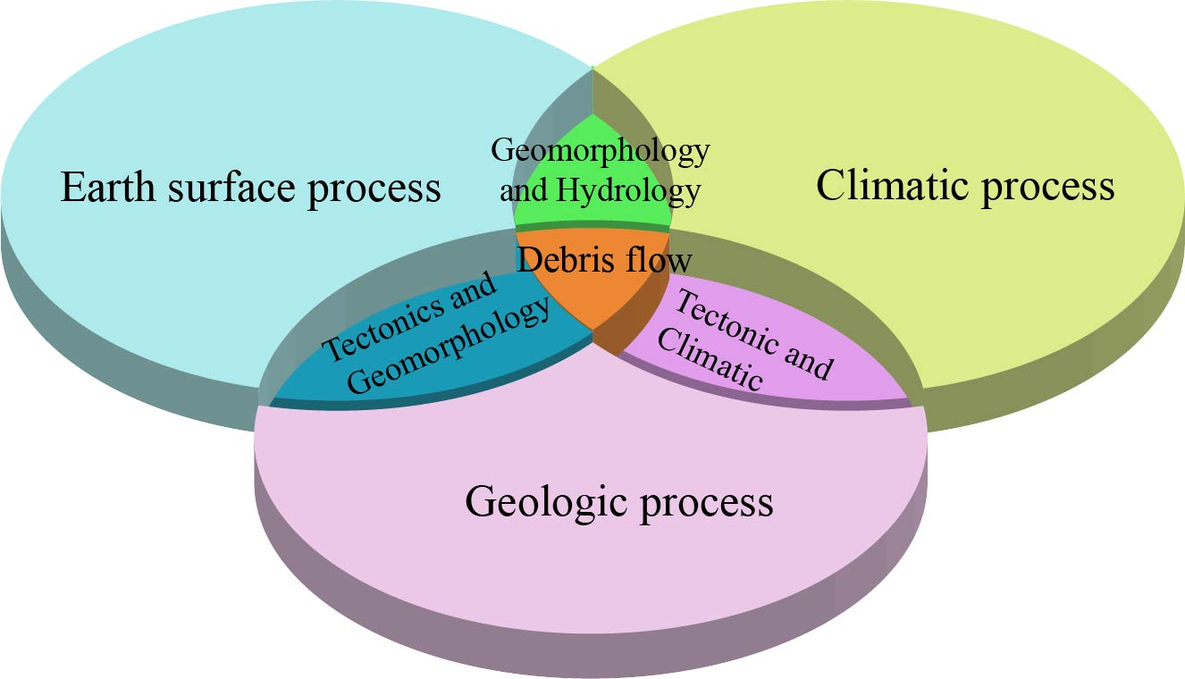

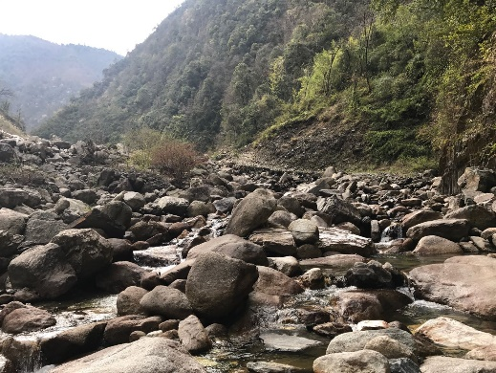
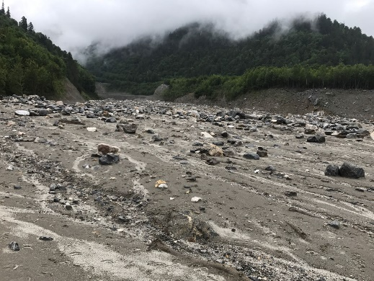
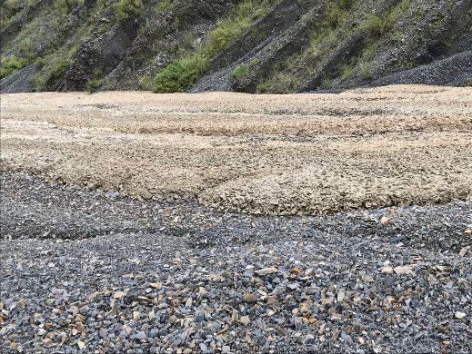
1.Background
2.Method
3.Result
4.Conclusion
Internal and External Dynamics of Debris Flow Formation
Formation conditions
Material, water
The development of debris flow is affected by geology, geomorphology and climate.
Gully morphology
hillslope, valley
Debris flow classification
Material composition
Viscous, diluted, transitional
Source area
Hazard level
Scale volume, economic loss
The process of surface runoff and the supply of material sources
……
……
circulation area
Bibili gully
Tianmo gully
Jiangjia gully
Identify debris flow types and explore formation mechanisms
sedimentary area
Susceptibility of debris flow

Slide 5
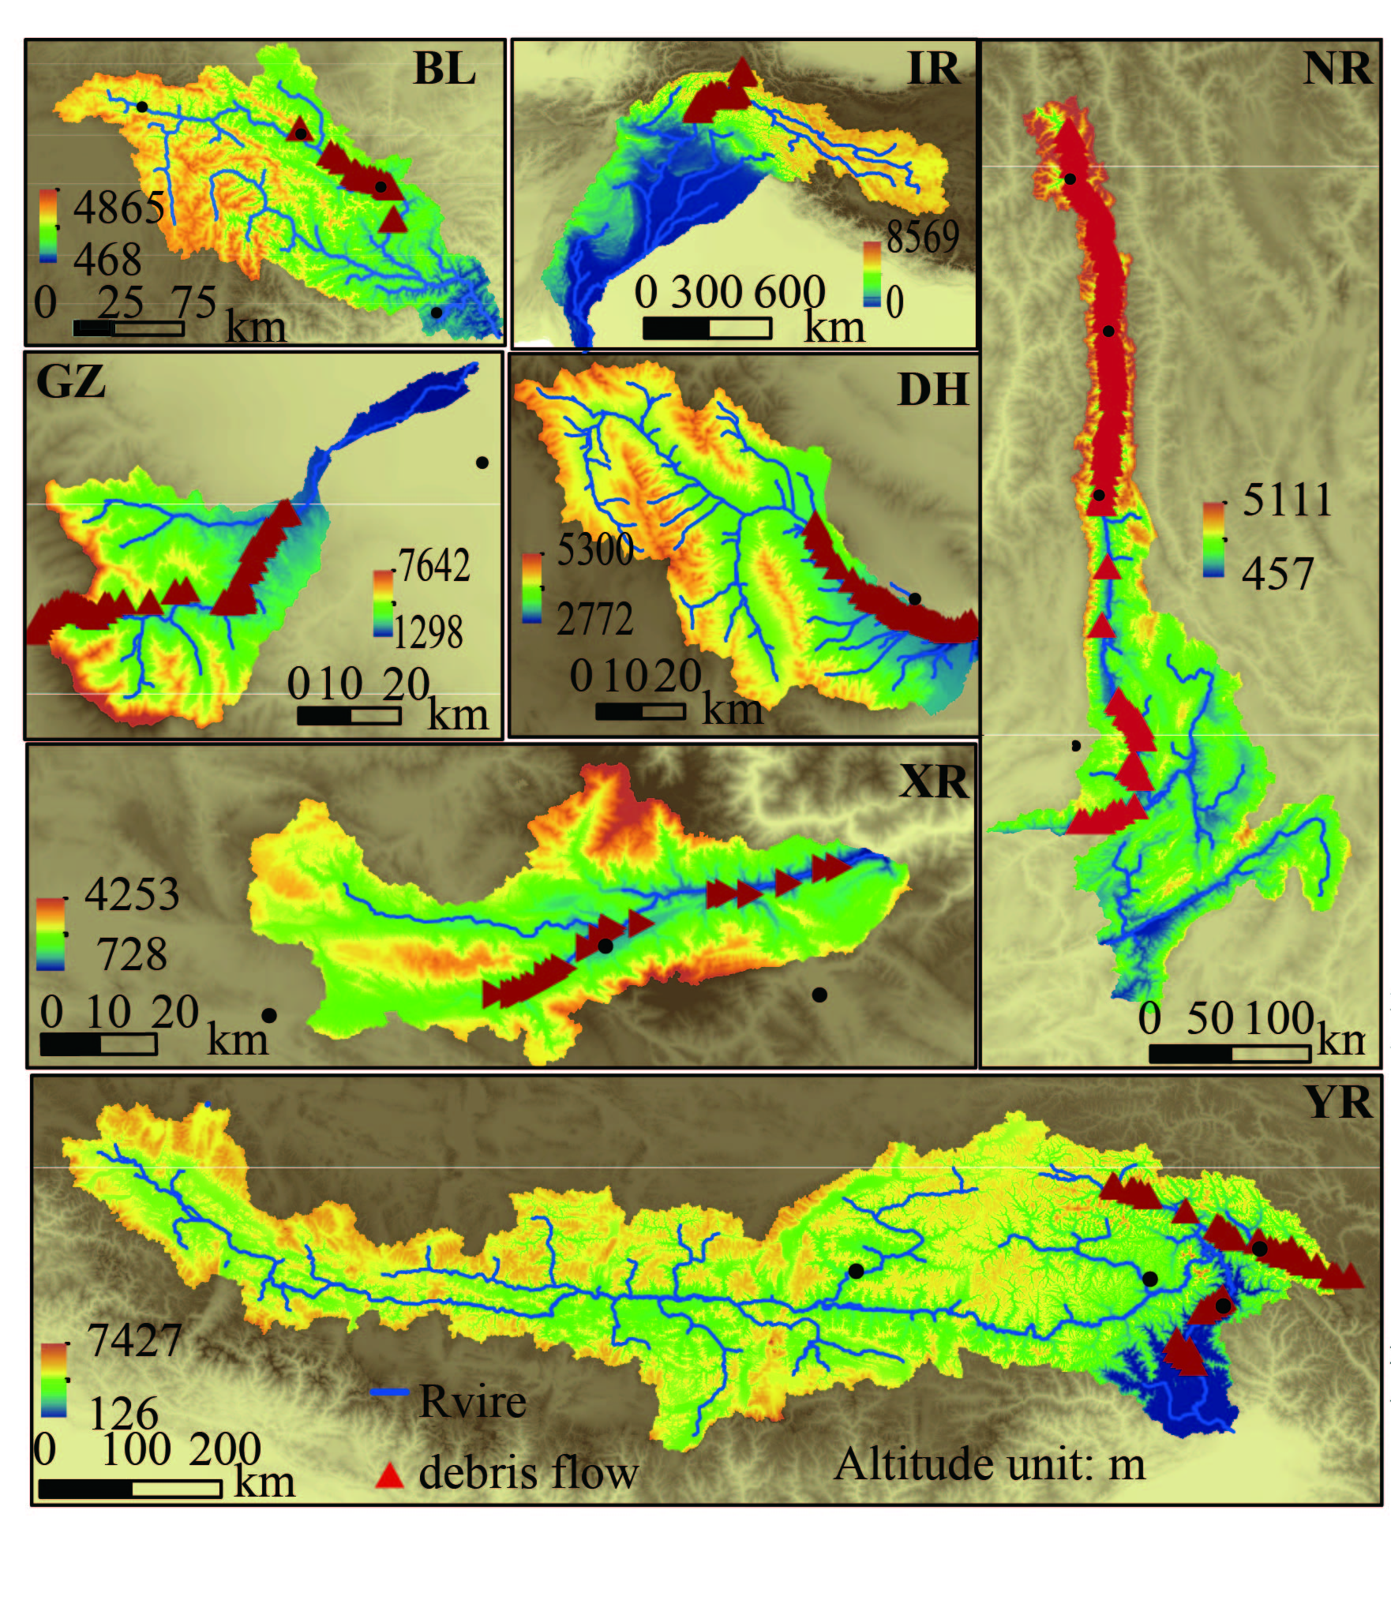
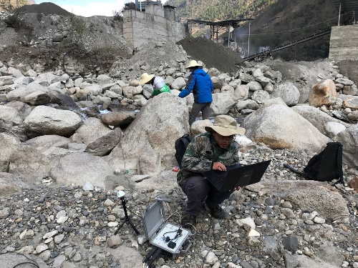
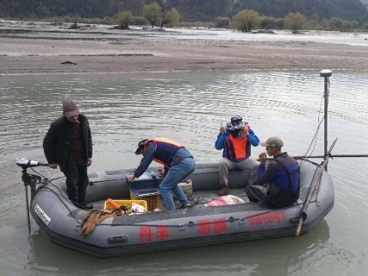
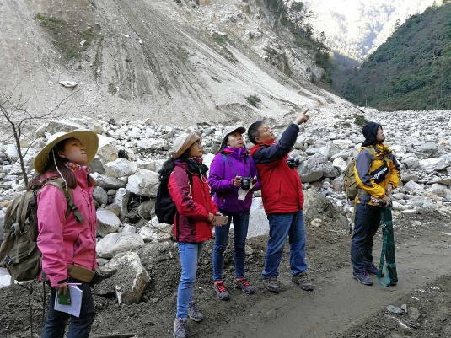
1.Background
2.Method
3.Result
4.Conclusion
Study area
Field investigation
sediment thickness measurement
Yarlung zangbo river
Landform
Nu River
Vegetation biodiversity survey
Deposition
Xiao River
Underwater terrain survey
Barrage lake
…
UAV measuring terrain

Slide 6
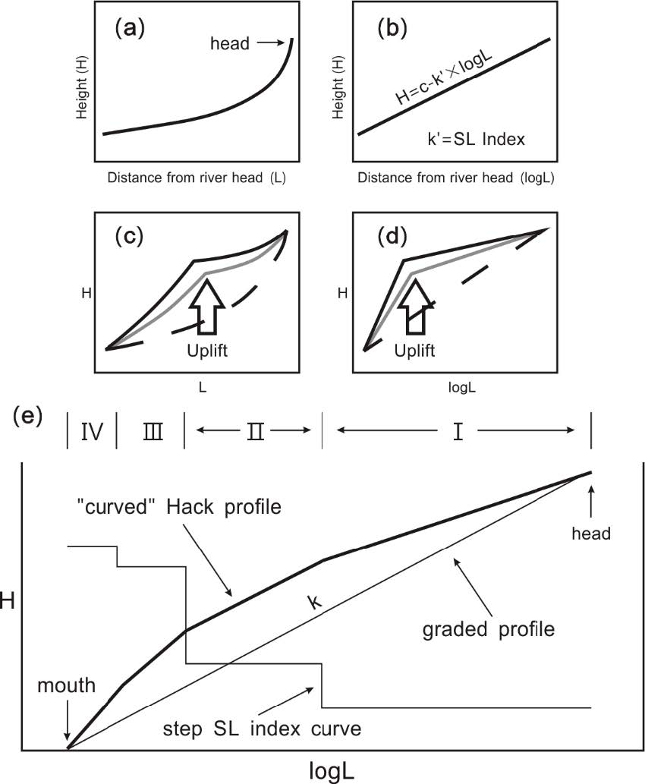
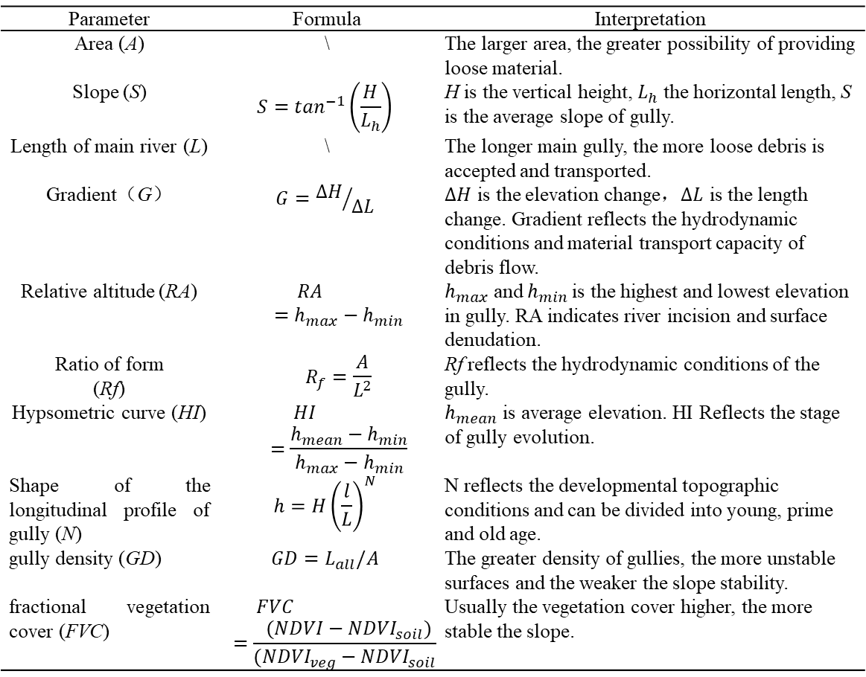

1.Background
2.Method
3.Result
4.Conclusion
Main factors of debris flow
Parameter | Formula | Interpretation
Area (A) | \ | The larger area, the greater possibility of providing loose material.
Slope (S) | $$S=\tan^{−1}\left(\frac{H}{L_{h}}\right)$$ | H is the vertical height,${ L}_{h}$ the horizontal length, S is the average slope of gully.
Length of main river (L) | \ | The longer main gully, the more loose debris is accepted and transported.
Gradient（G） | $$G={∆H}/{∆L}$$ | $∆H$ is the elevation change，$∆L$ is the length change. Gradient reflects the hydrodynamic conditions and material transport capacity of debris flow.
Relative altitude (RA) | $$RA=h_{max}−h_{min}$$ | $h_{max} \text{and} h_{min}$is the highest and lowest elevation in gully. RA indicates river incision and surface denudation.
Ratio of form (Rf) | $$R_{f}=\frac{A}{L^{2}}$$ | Rf reflects the hydrodynamic conditions of the gully.
Hypsometric curve (HI) | $$HI=\frac{h_{mean}−h_{min}}{h_{max}−h_{min}}$$ | $h_{mean}$ is average elevation. HI Reflects the stage of gully evolution.
Shape of the longitudinal profile of gully (N) | $$h={H\left(\frac{l}{L}\right)}^{N}$$ | N reflects the developmental topographic conditions and can be divided into young, prime and old age.
gully density (GD) | $$GD=L_{all}/A$$ | The greater density of gullies, the more unstable surfaces and the weaker the slope stability.
fractional vegetation cover (FVC) | $$FVC=\frac{(NDVI−{NDVI}_{soil})}{({NDVI}_{veg}−{NDVI}_{soil})}$$ | Usually the vegetation cover higher, the more stable the slope.
Hydraulic characteristic
Stream power index(SPI)：
$$SPI=Ln(A_{S}\tan\left(β\right))$$
Topographic wetness index (TWI)：
$$TWI=Ln(A_{S}/\tan\left(β\right))$$
Stream length-gradient index
Reflecting tectonic activities differences of local sections in medium-small scale
Hack, 1973

Slide 7
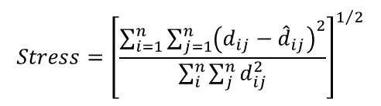

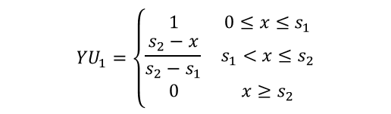
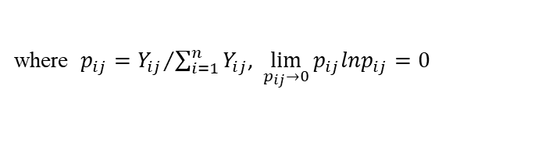


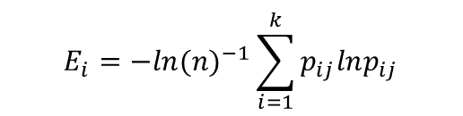
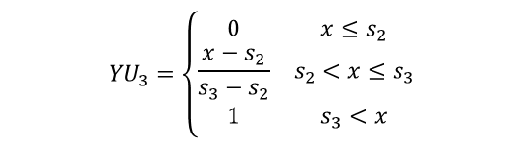
1.Background
2.Method
3.Result
4.Conclusion
𝐸_𝑖 indicates that the greater the degree of variation in the value of the indicator, the greater the amount of information provided
Nonmetric multidimensional scaling(NMDS)
Entropy weight
𝐸_{𝑖} shows that the greater the variability of indicators, the more information they provide
Unconstrained sorting
reduction dimension
classification
Information entropy
$$E_{i}=−{ln⁡(n)}^{−1}\sum_{i=1}^{k}{p_{ij}lnp_{ij}}$$
Calculation of dissimilarity δ_{ij} between debris flow gullies by Euclidean distance
where $p_{ij}={Y_{ij}}/{\sum_{i=1}^{n}{Y_{ij}}}$, $\lim_{p_{ij}→0}{p_{ij}lnp_{ij}=0}$
The entropy method is an objective assignment method that uses information entropy to calculate the entropy weight of each index, and the weight of each index is corrected by the entropy weight
weight
Threat strength coefficient is used to measure the goodness of two-dimensional sorting points fitting the original entity :
$$W_{i}=\frac{1−E_{i}}{k−\sum{E_{i}}}(i=1,2,⋯,k)$$
$$Stress={\left[\frac{\sum_{i=1}^{n}{\sum_{j=1}^{n}{{\left(d_{ij}−{\hat{d}}_{ij}\right)}^{2}}}}{\sum_{i}^{n}{\sum_{j}^{n}{d_{ij}^{2}}}}\right]}^{1/2}$$
Fuzzy Mathematics
Fuzzy Mathematics
$${YU}_{2}=\left\{\begin{aligned}&\begin{matrix}0 & x≤s_{1} \\ \frac{x−s_{1}}{s_{2}−s_{1}} & s_{1}<x≤s_{2} \\ \frac{s_{3}−x}{s_{3}−s_{2}} & s_{2}<x≤s_{3}\end{matrix} \\ &\begin{matrix} 0 & x≥s_{3}\end{matrix}\end{aligned}\right.$$
$${YU}_{3}=\left\{\begin{matrix}0 & x≤s_{2} \\ \frac{x−s_{2}}{s_{3}−s_{2}} & s_{2}<x≤s_{3} \\ 1 & s_{3}<x\end{matrix}\right.$$
$${YU}_{1}=\left\{\begin{matrix}1 & 0≤x≤s_{1} \\ \frac{s_{2}−x}{s_{2}−s_{1}} & s_{1}<x≤s_{2} \\ 0 & x≥s_{2}\end{matrix}\right.$$
Nonparametric tests
Infer whether the median or distribution pattern of samples from multiple aggregates is differentially significant.
Significance tests of geomorphic factors for different types of debris flow gullies.
$s_{1}$，$s_{2}$，$s_{3}$ is boundary values of each level.
Fuzzy mathematics is a method of evaluation based on multiple variables, and is a way to delineate fuzzy boundaries between things in terms of affiliation.

Slide 8
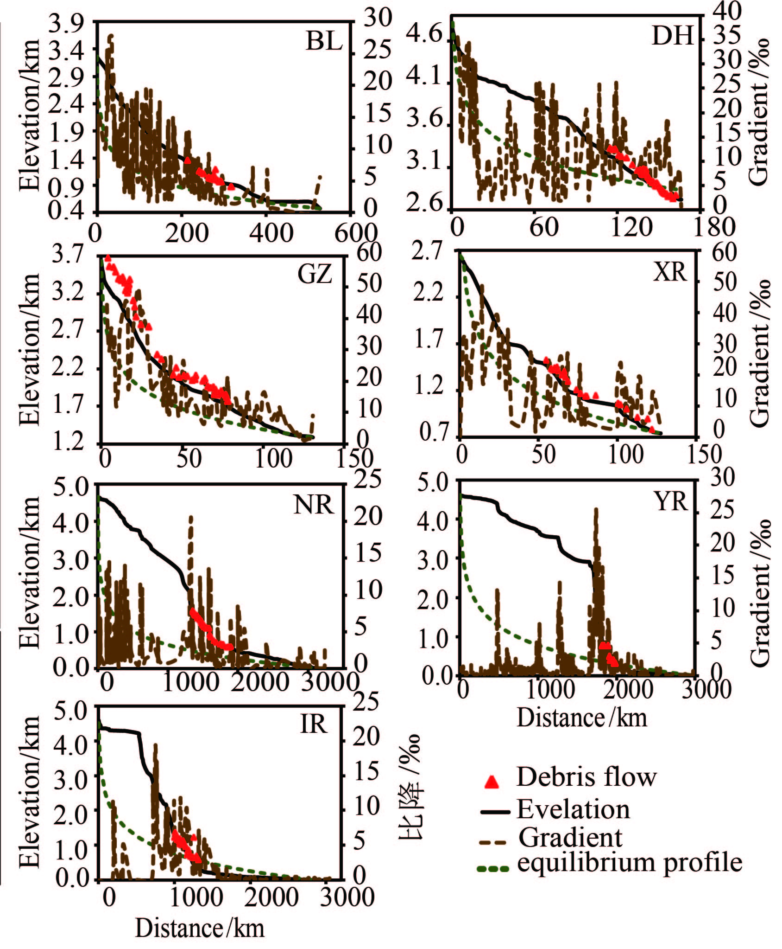
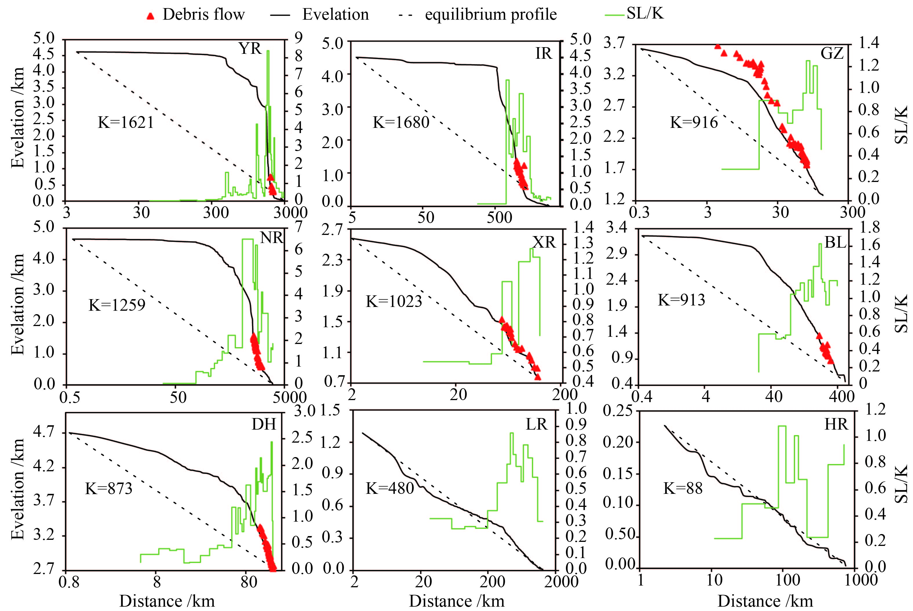
1.Background
2.Method
3.Result
4.Conclusion
Impact of tectonic activities on debris flow group
Significant differences of tectonic activity between upstream and downstream within the seven basins
Debris flow group is distributed in the strongest tectonic uplift in main river
Debris flow group is mainly distributed in the largest gradient of main river

Slide 9
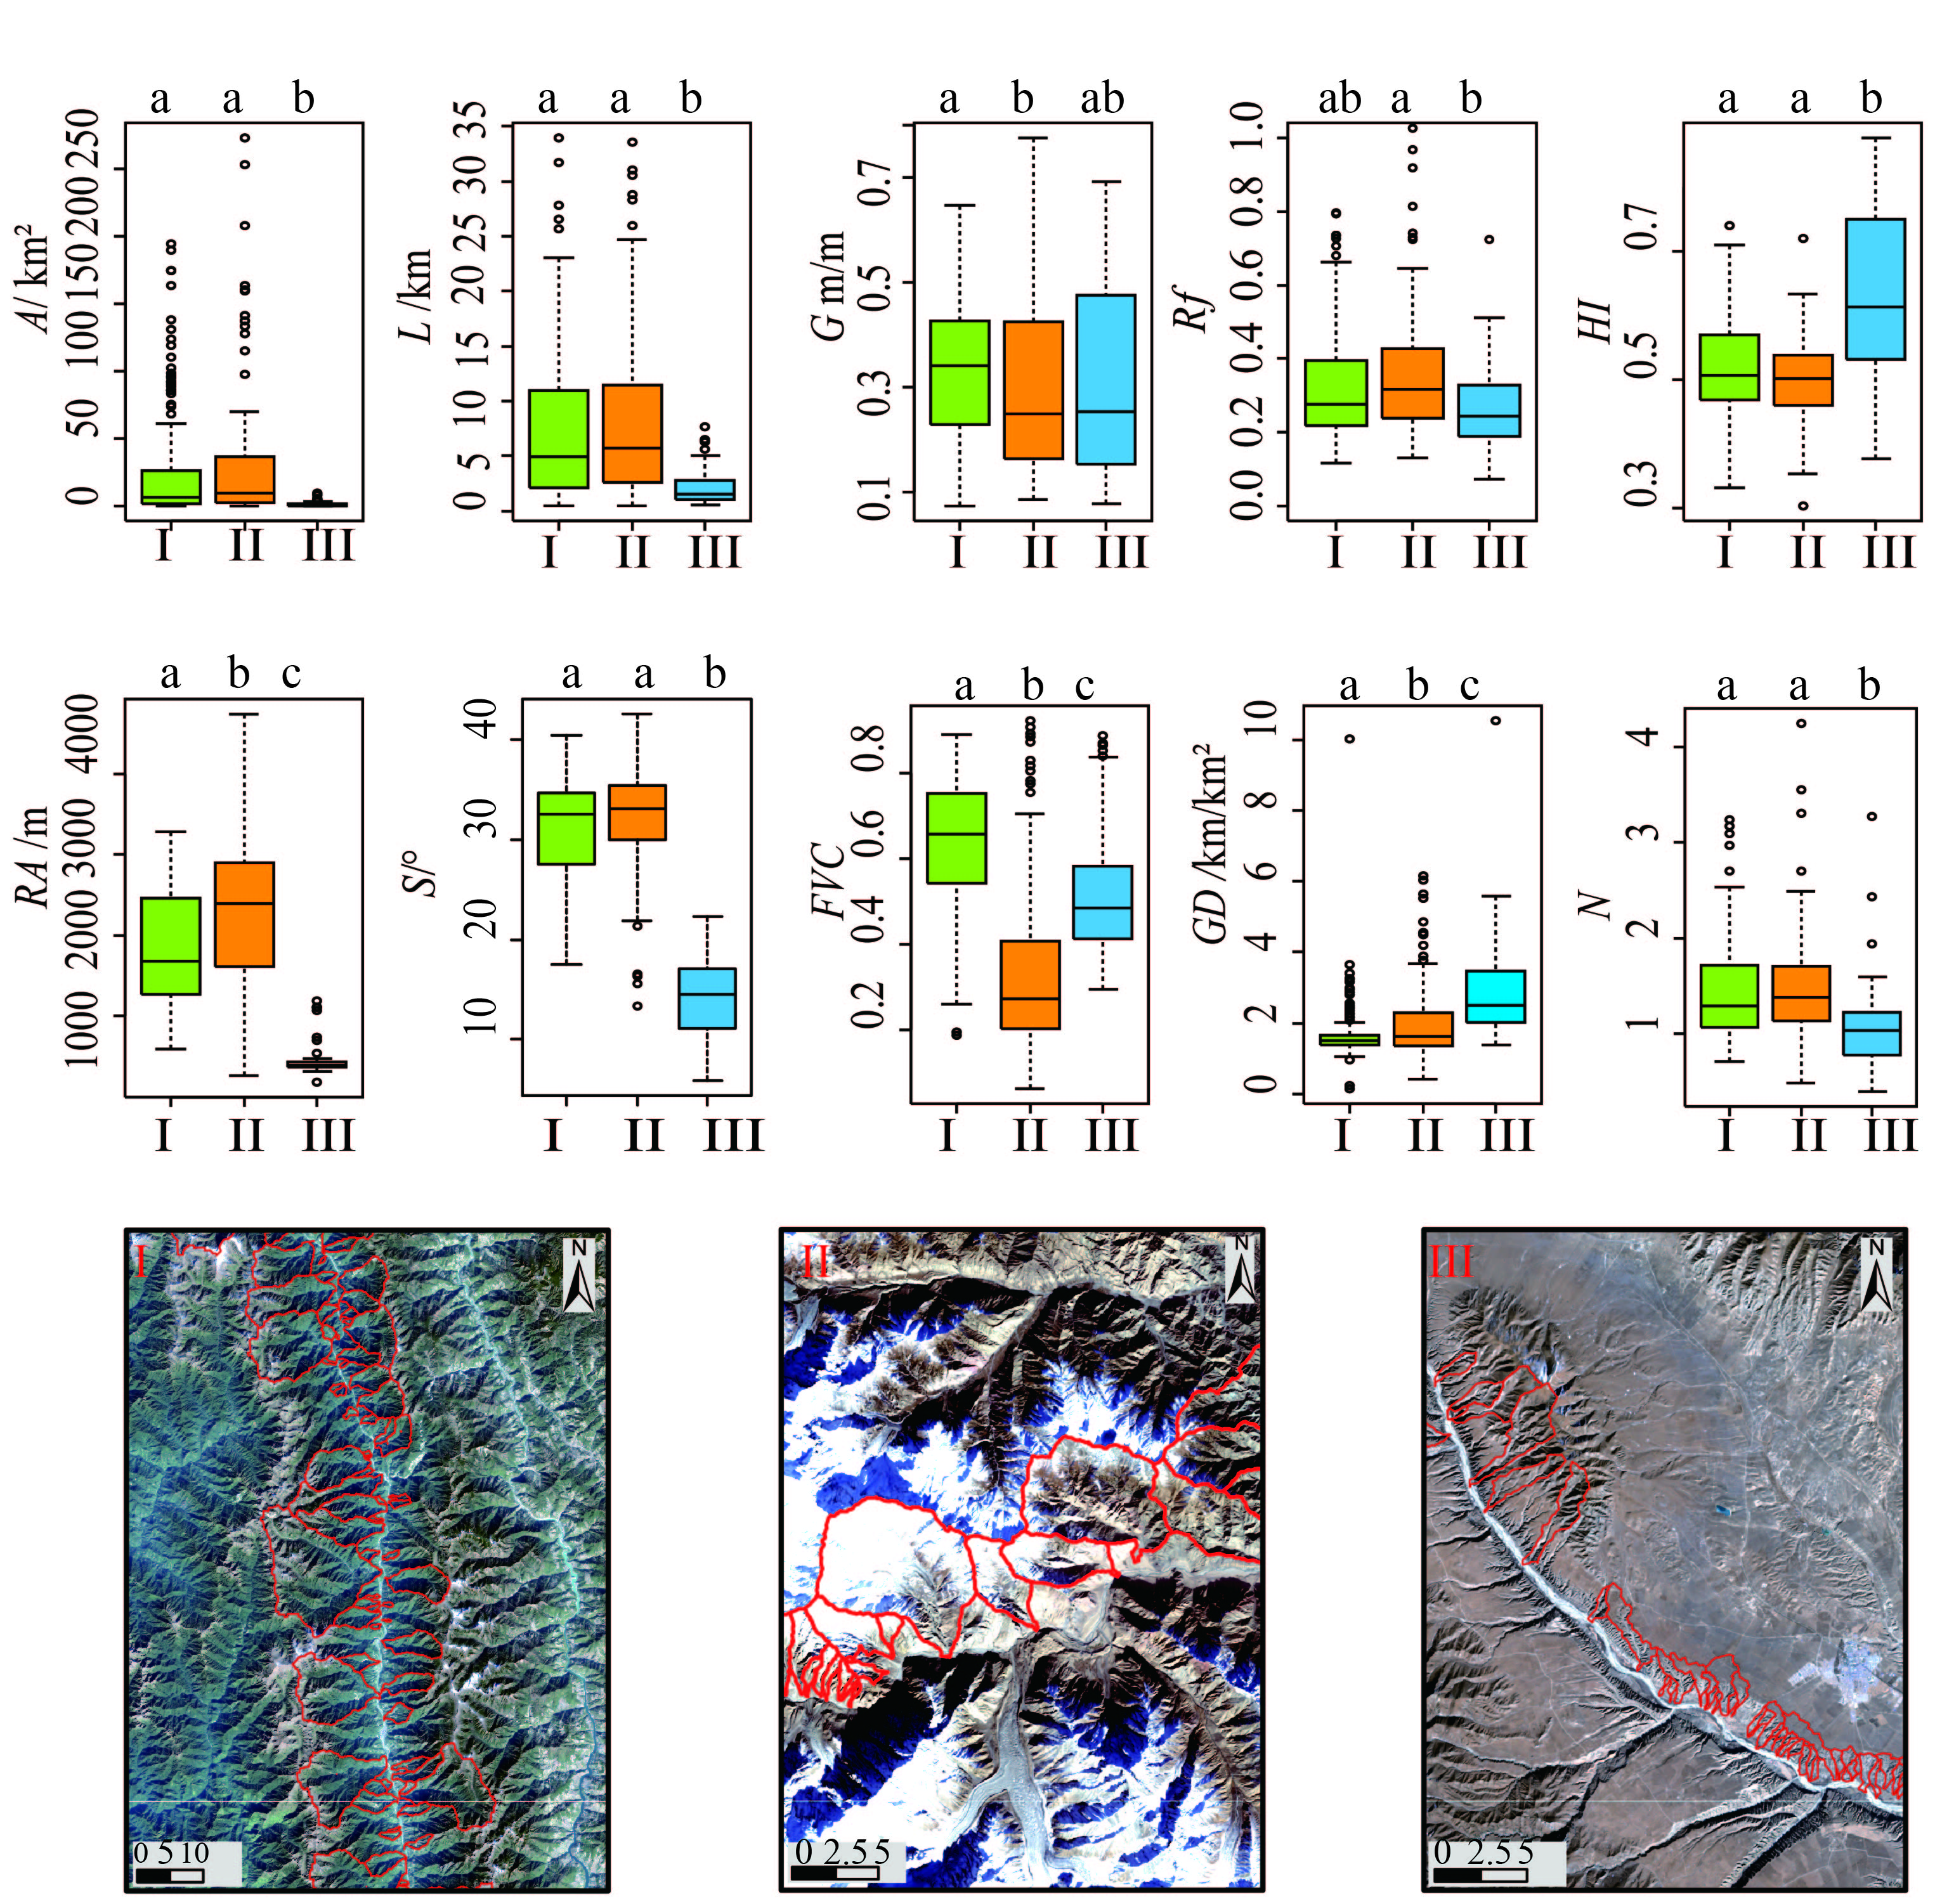
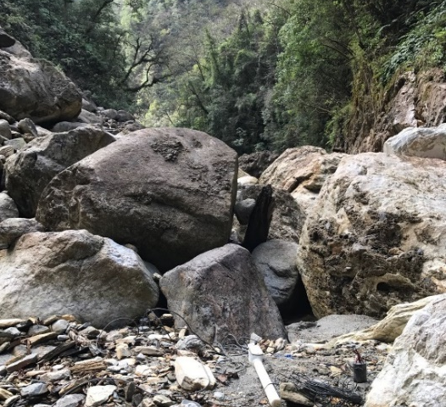
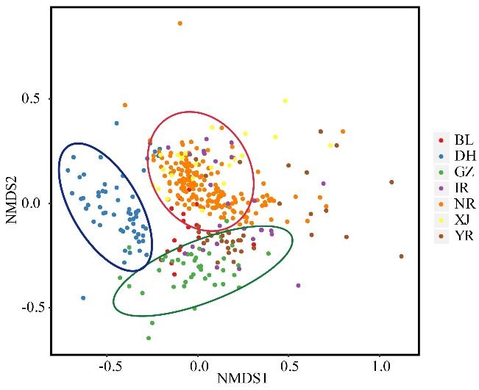
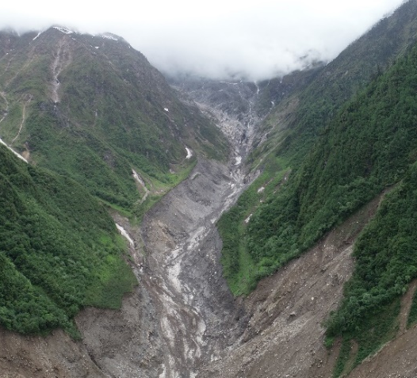
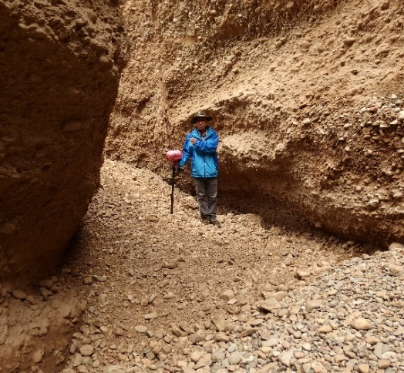
1.Background
2.Method
3.Result
4.Conclusion
Debris flow gully classification
Three types of debris flow topography have obvious indigenous differences
Debris flow is divided into three types by NDMS
Type I
Type II
Type III
Type I: rainstorms in exposed bedrock areas.
TypeII : glaciers in exposed bedrock areas.
Type III: rainstorms in depositional areas.

Slide 10
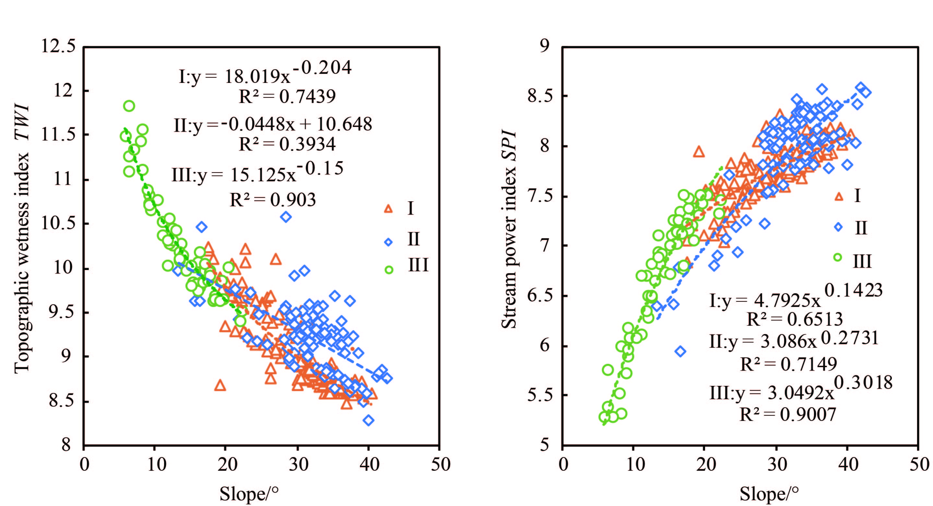
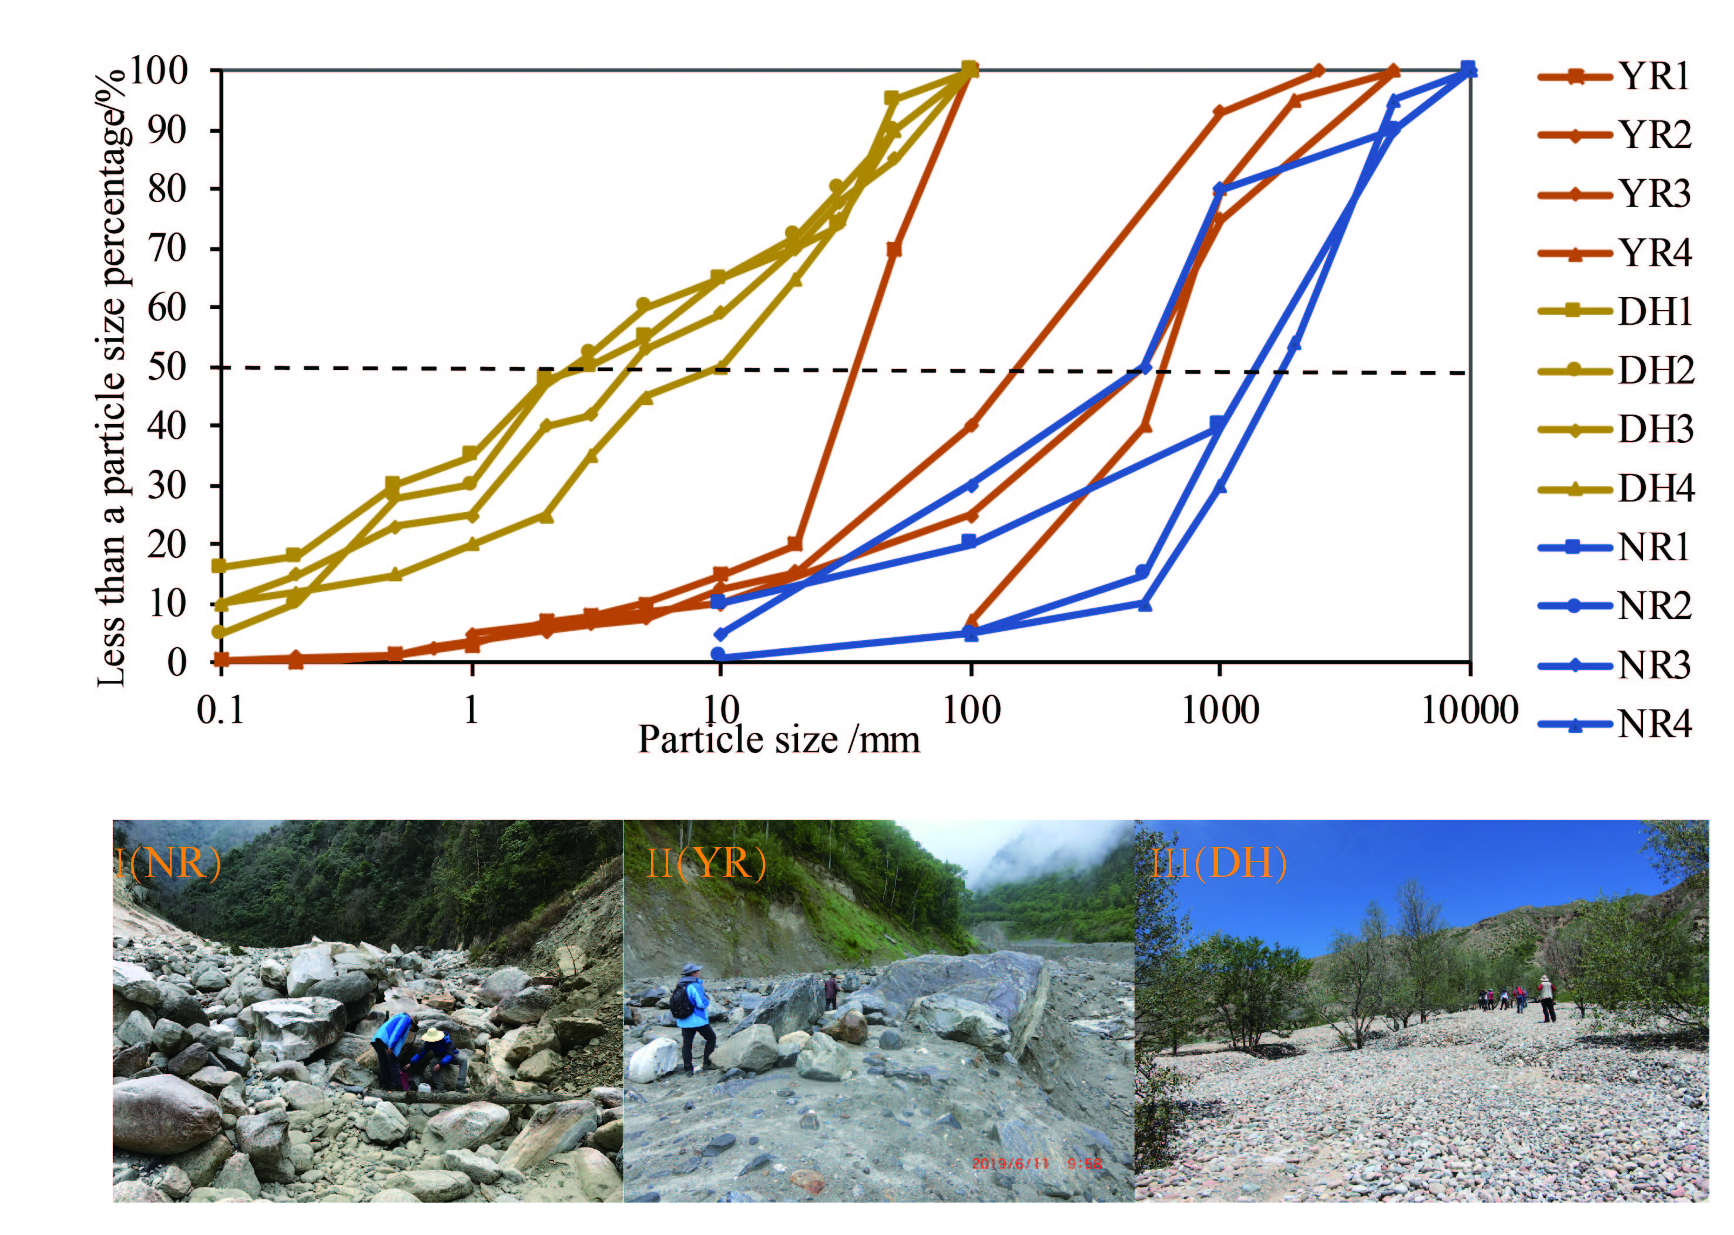
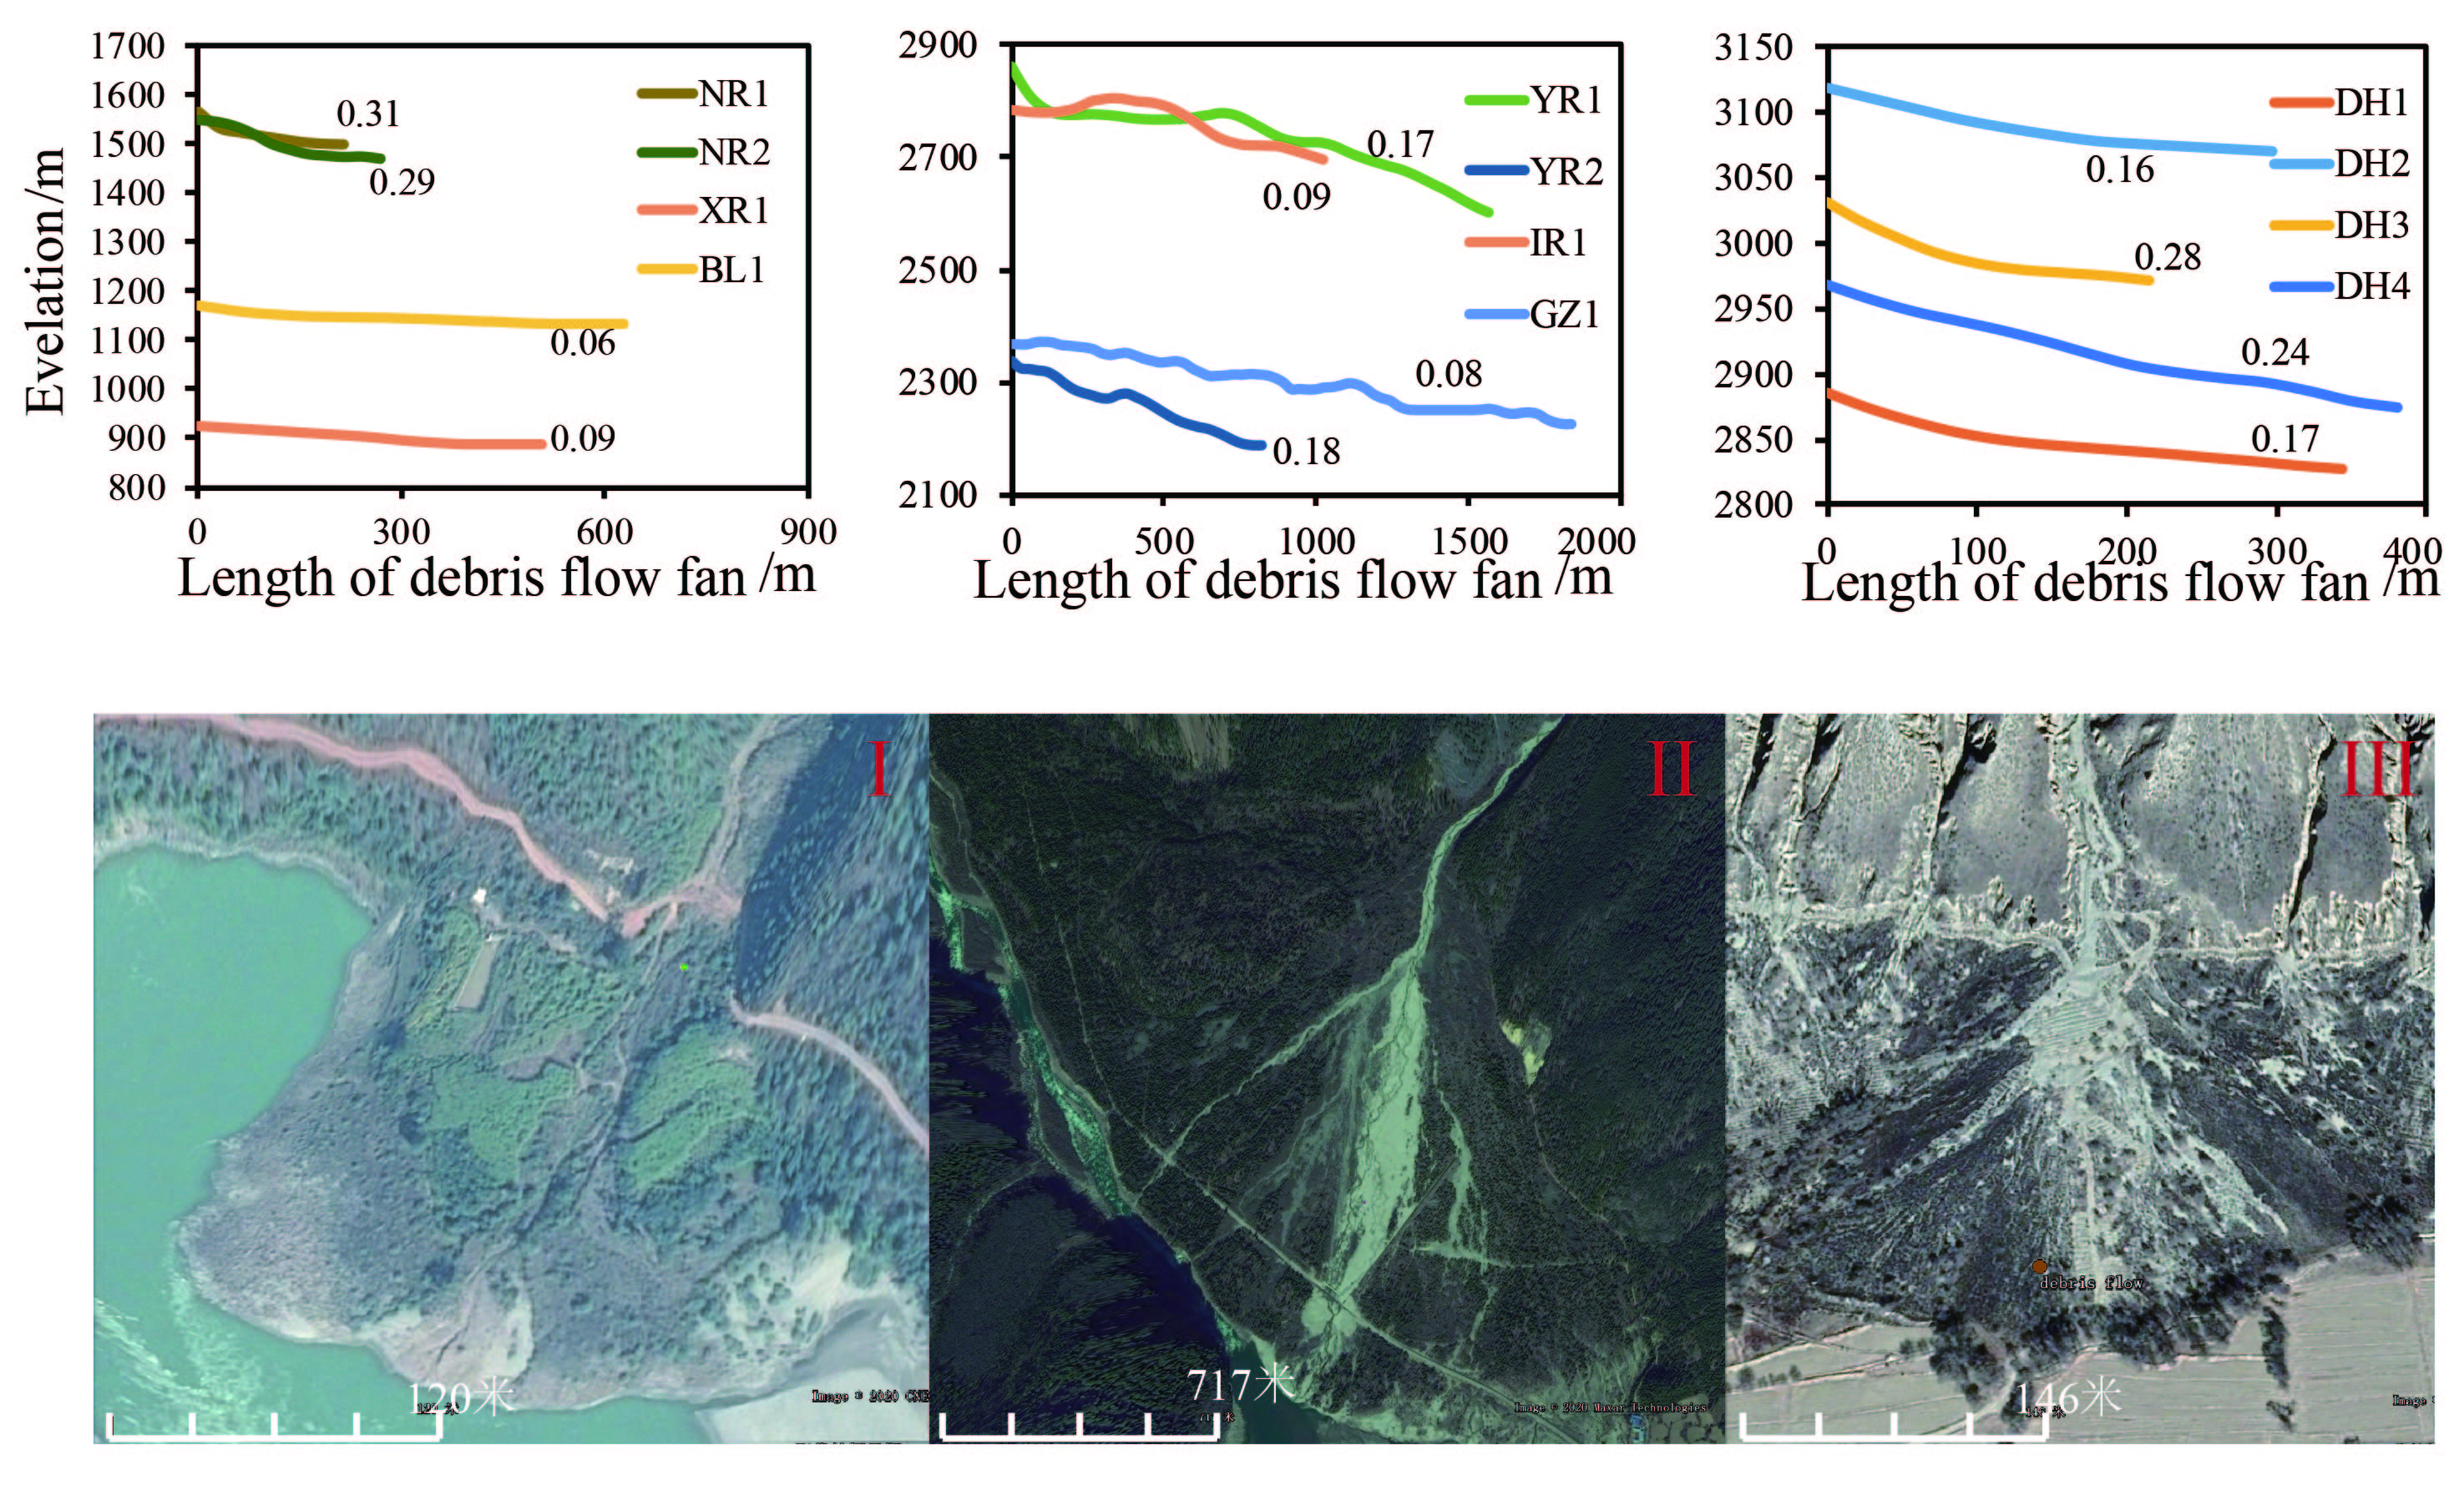
1.Background
2.Method
3.Result
4.Conclusion
Characteristics of the three types of debris flow fans
Type I and II hydraulic capacity is large, and its carrying particles are large
Type III debris flow have weak erosion force and carry small particles
Morphological characteristics of debris flow fan
Characteristics of particle size distribution on debris flow fan

Slide 11
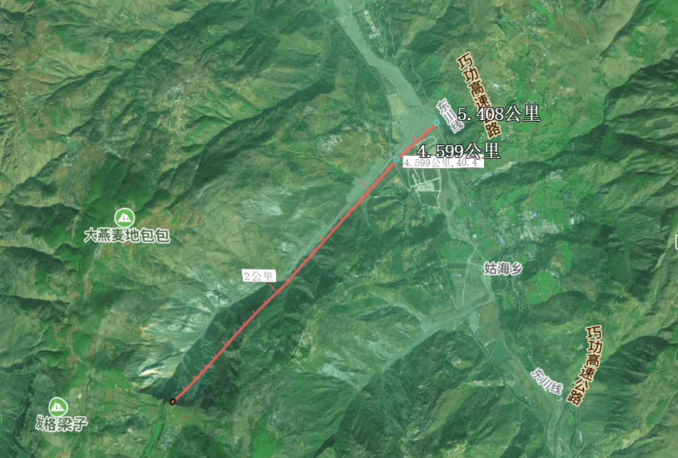
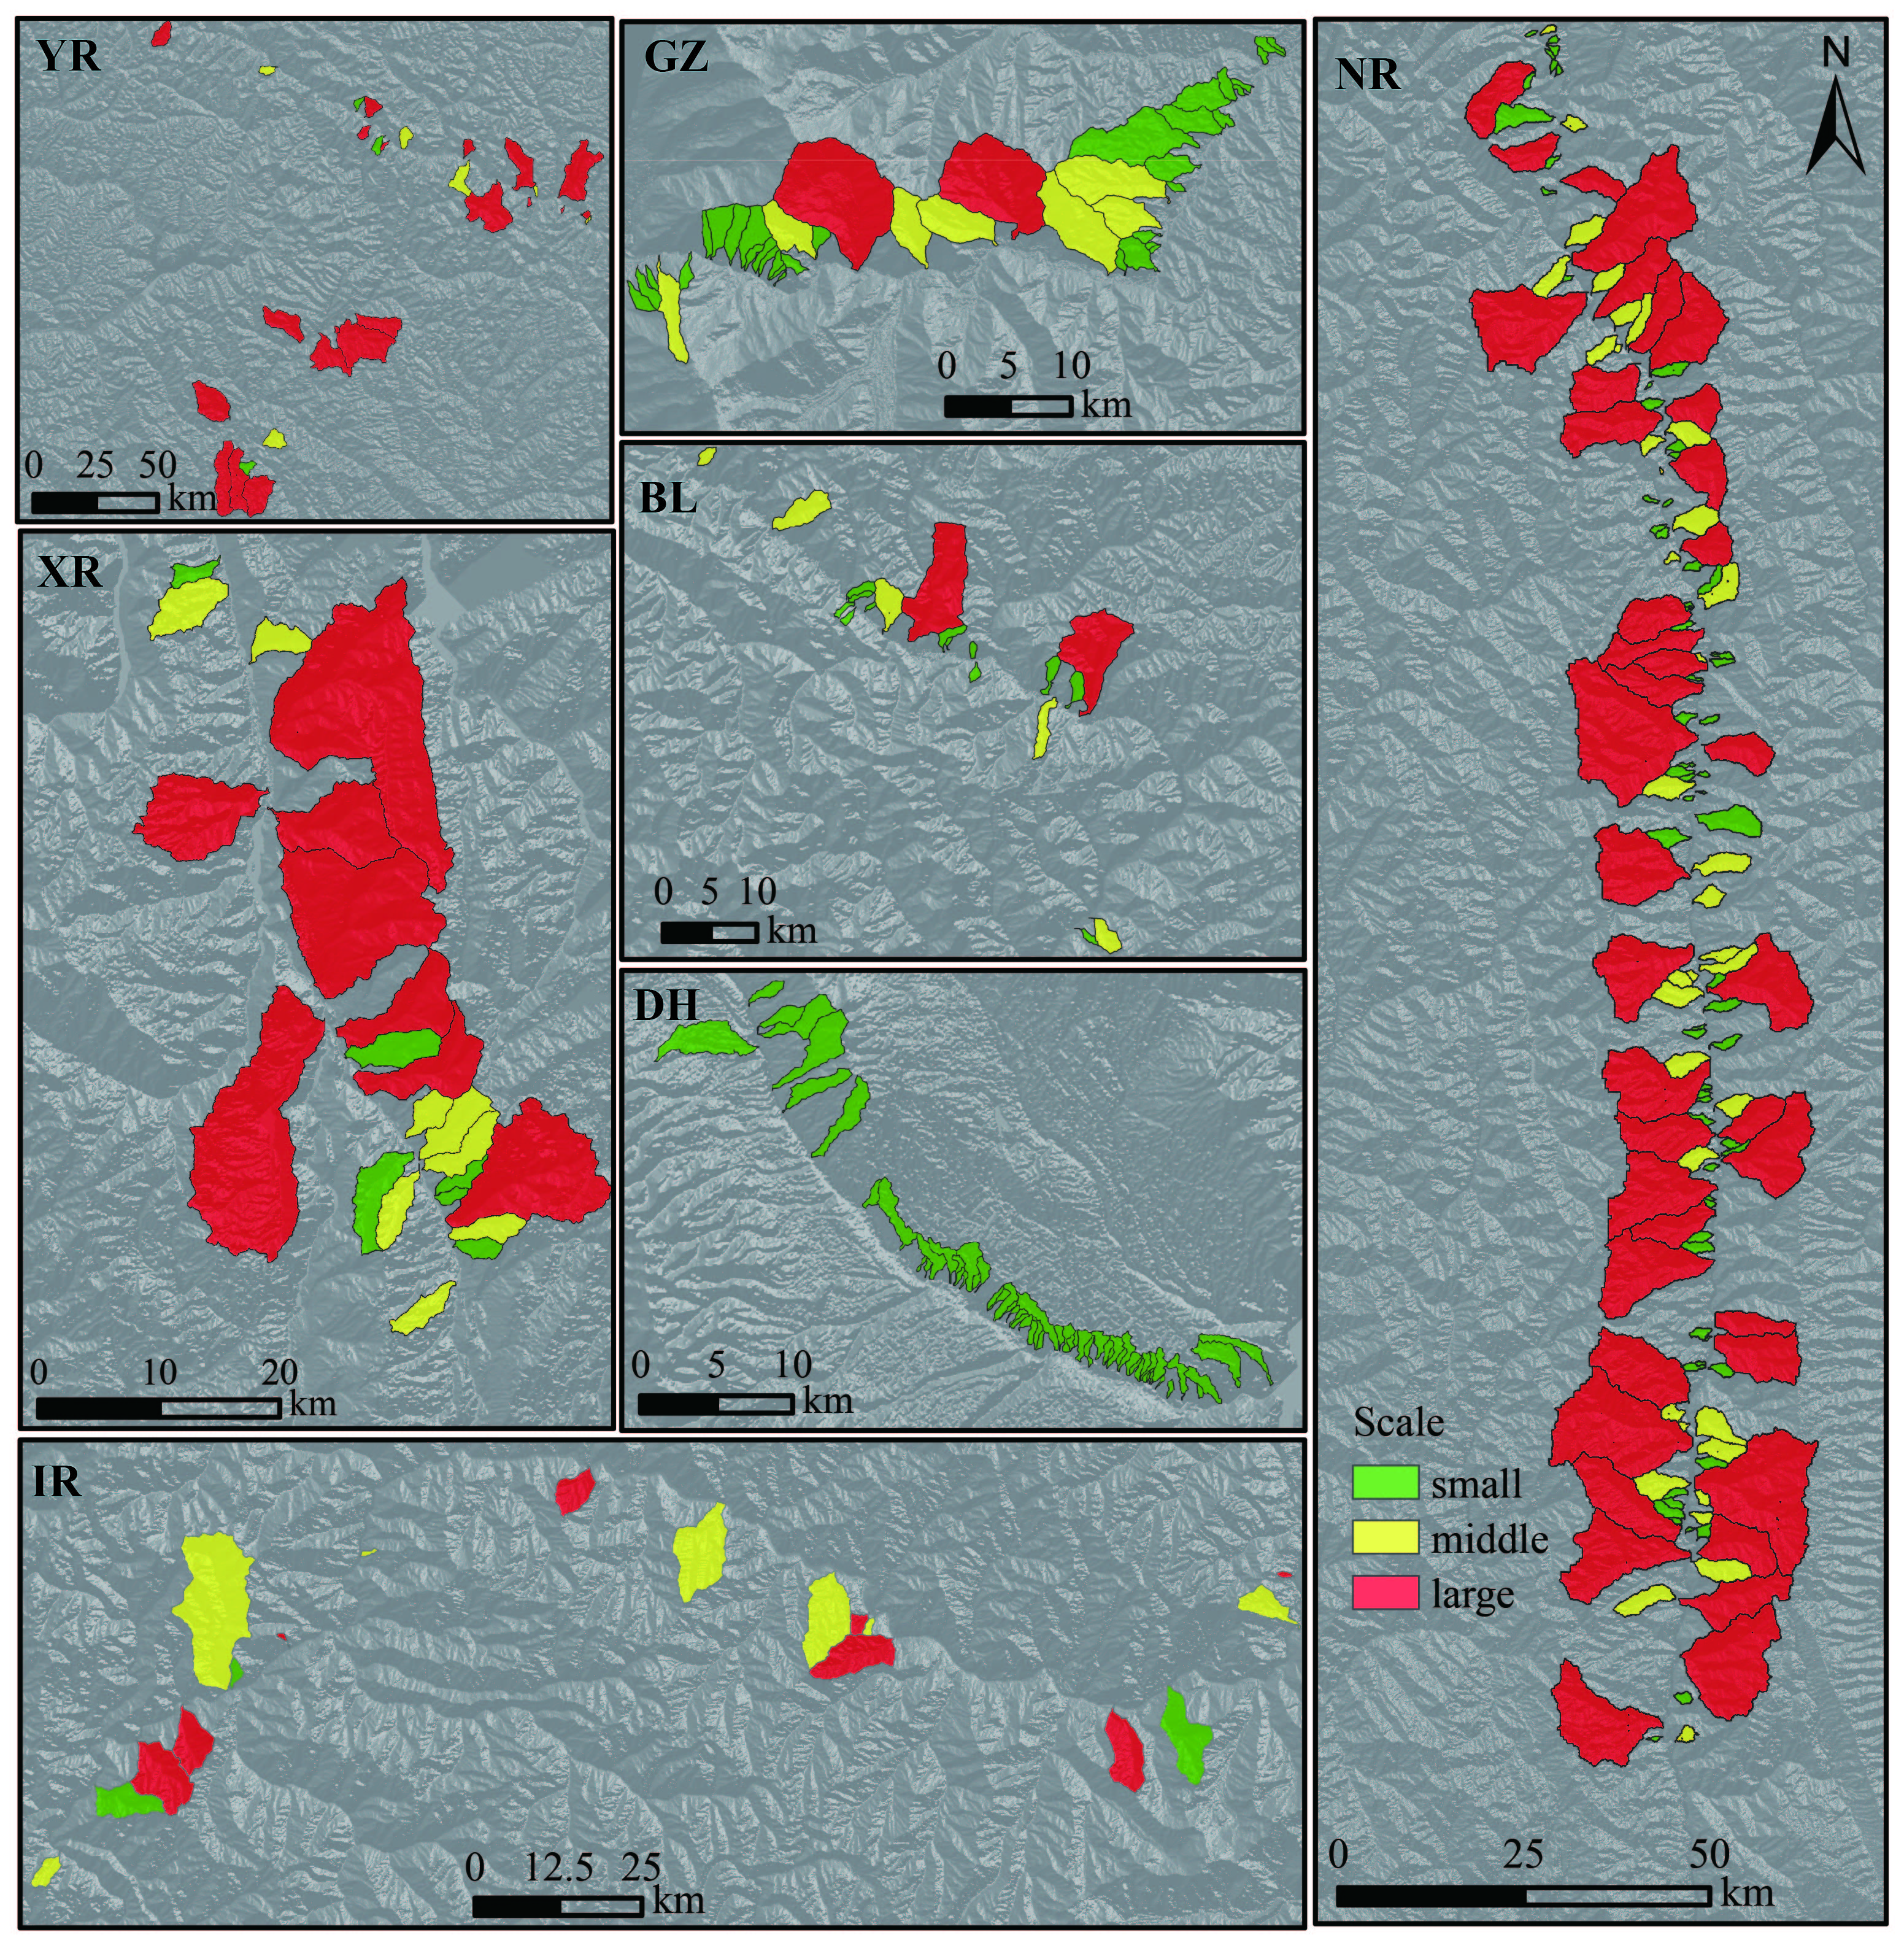
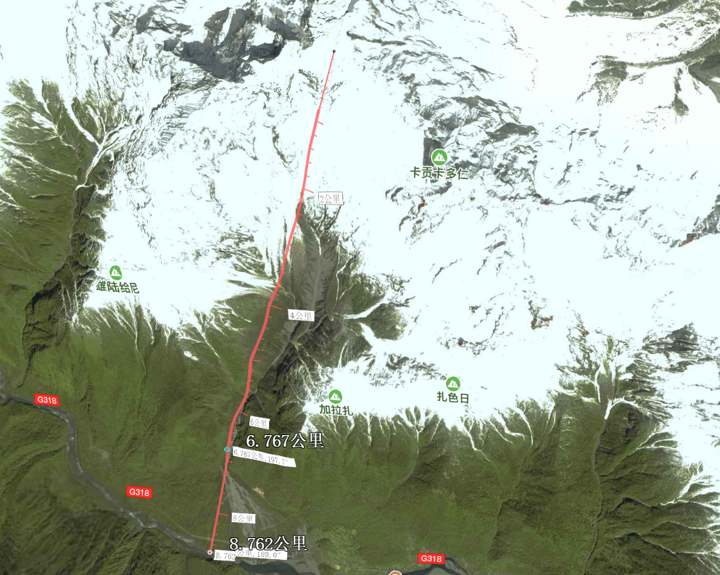
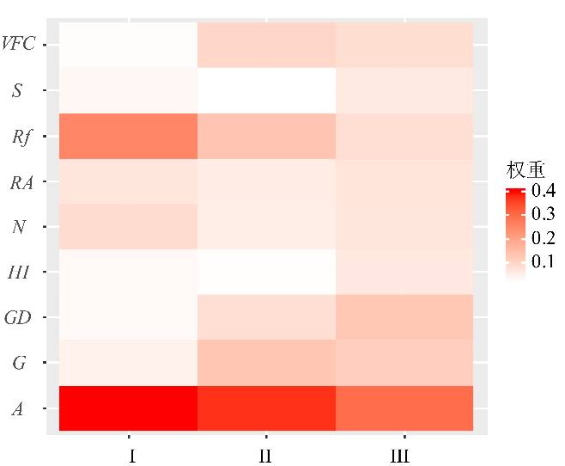
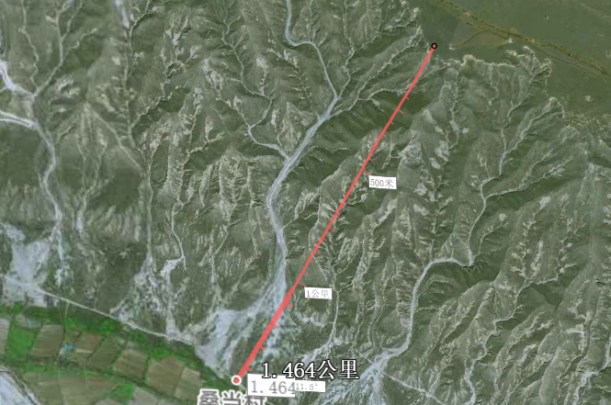

1.Background
2.Method
3.Result
4.Conclusion
Evaluation of debris flow scale
Type1: middle scale
Entropy Weight Method - Fuzzy Mathematics
Spatial distribution of debris flow scale evaluation
$$P=\sum{W_{i}×{Y_{i}U}_{j}}$$
Scale：
Factor Weight of Three Types of Debris Flow
Type2: large scale
weight
Type3: low scale

Slide 12
1.Background
2.Method
3.Result
4.Conclusion
Seven typical basins on the edge of the Qinghai-Tibetan Plateau were classified into three categories: rainstorms in exposed bedrock areas (Type I ), glaciers in exposed bedrock areas (Type II ), rainstorms in depositional areas (Type III).
The difference between type II and type III is greater than that between type I and type II.
Type I is mainly small and middle-scale debris flow, Type III is small-scale debris flow, and Type II has a greater possibility of large-scale debris flow.

Slide 13
Thank you for your attention

