Slide 1


Characteristics analysis and correction of GPS precise products in analysis centers based on Lomb-Scargle periodogram
Yangfei HOU^{1,2}, Junping CHEN^{2,3}, Yize ZHANG^{2,3}
1.College of Surveying and Geo-Informatics，Tong ji University
2.Shanghai Astronomical Observatory，Chinese Academy of Sciences
3. Shanghai Key Laboratory of Space Navigation and Positioning Techniques，Shanghai Astronomical Observatory,
Chinese Academy of Sciences

Slide 2
Research Content
The Lomb-Scargle periodogram was used to analyze the systematic deviation and the periodical deviation.
A deviation correction model was established based on the least square method.

Slide 3
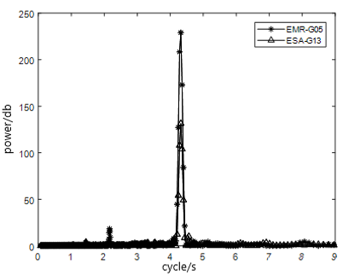
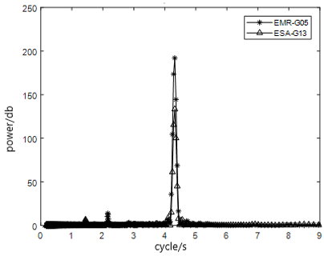
Spectrum analysis
Clock
Orbit
The deviation of precision products in different analysis centers has significant periodic difference, and the peak value appears around 43200 s,which is related to GPS operation cycle.

Slide 4
Deviation correction
model
Fourier series transformation:
Use least squares to estimate $a_{0}$, $a_{1}$,$b_{1}$

Slide 5
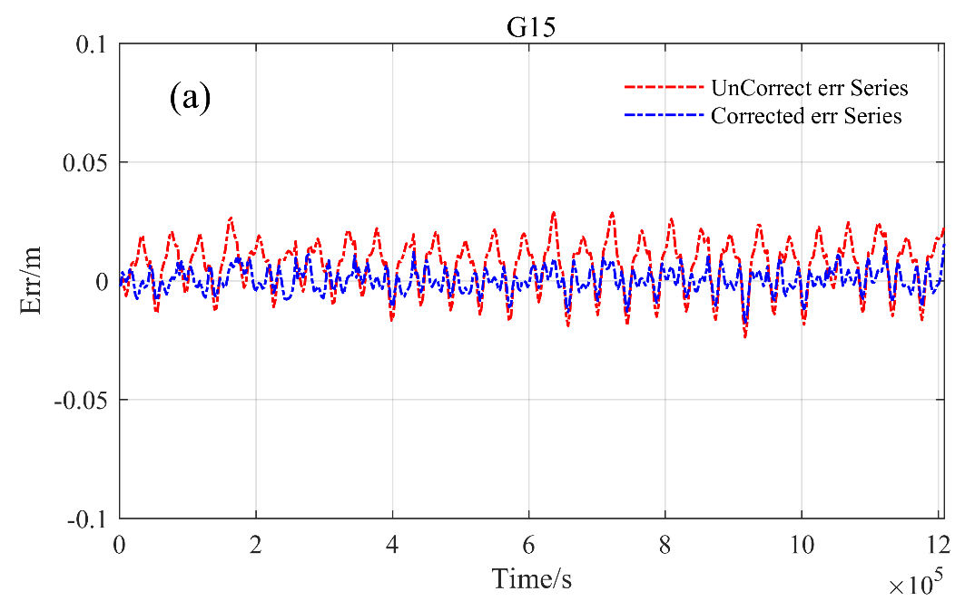
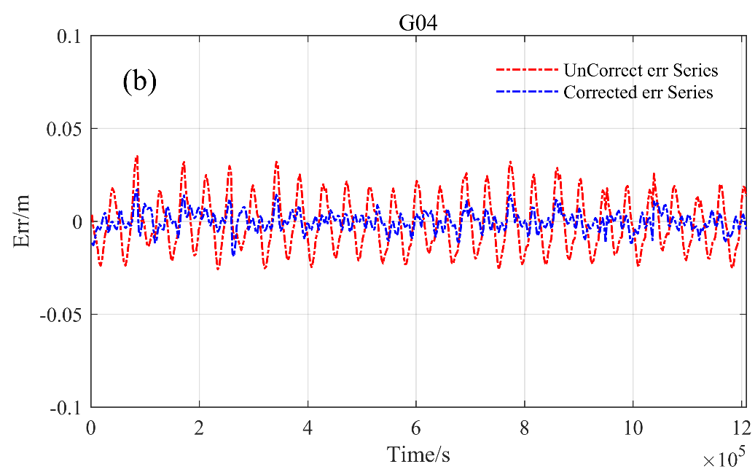
Deviation correction
result
Clock
Orbit
The standard deviation of the precise clock decreases by 15.4% on average.
The standard deviation of the orbit decreases by 33.3% on average.

Slide 6
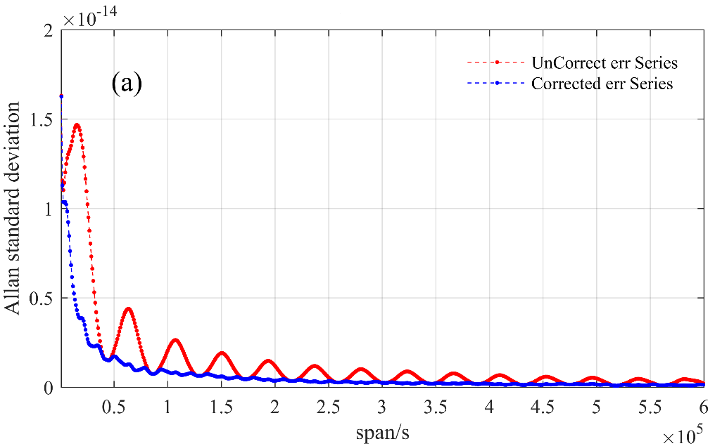
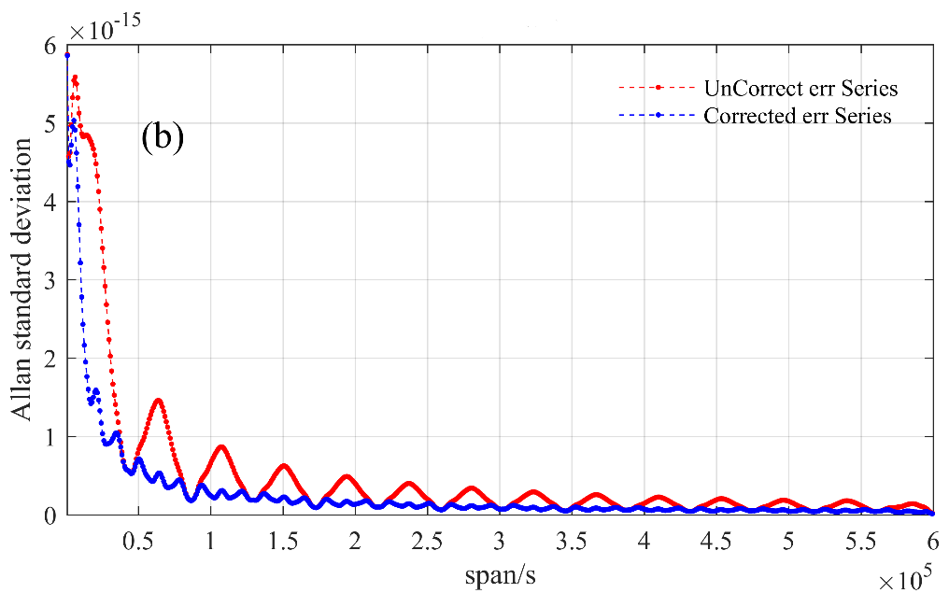
Allan standard
deviation
Clock
Orbit
After correction, the Allan standard deviation change significantly.

Slide 7
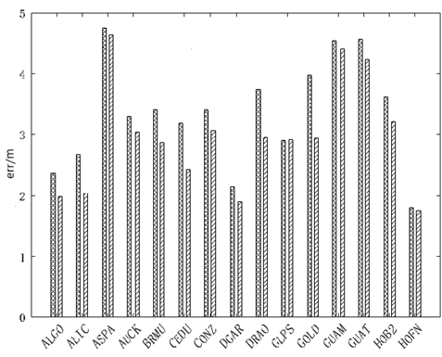
PPP result
After correction, the consistency between the positioning errors using the analysis center products and positioning errors using the IGS products increased by 14.3%

Slide 8
Summary
There is a periodical difference of 43200s between ACs products and IGS final products.
The deviation correction model can effectively improve the consistency between Acs products and IGS final products.

Slide 9
THANK YOU !

