Slide 1


I3S Adoption in Open Standards and FOSS Community
Tamrat Belayneh, Principal Technology Evangelist

Slide 2

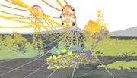


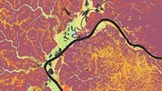


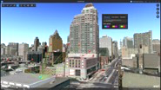

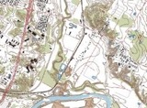





GIS & 3D are Advancing
… but what is the underlying technology, what are the use cases, and what are the trends
Buildings (BIM)
Networks
Landscapes
Cities
Utilities / Telecom
Facilities / Indoors
Pipelines
Plants / Structures
Roads and Highways
Smart City
Environment
Topographic
Digital Twin
Planning
Oceans
Geospatial Infrastructure

Slide 3









Data Components
Scene Layers
3D Objects, 3D Points, Integrated Meshes, Point clouds
Building Scene Layer (LOD4/BIM)
Feature Layers
Points, Lines, or Polygons
Stream Layers (Real-time Feeds)
Imagery
Imagery Layers, Tile Caches, and Map Image Layers
Author
Publish
Consume
Maintain
Notes:
Behind the scenes ---- we have some basic ingredients that make up the main components of our 3D mapping platform
Scene layers allow users to author and visualize large volumes of 3D content ---- and to combine this 3D content with other data types in visualization and analysis.
Scene layers can be combined with feature layers as well as imagery --- and then displayed and explored (with high performance) by a variety of out of the box apps --- and your own custom applications
Together --- Scene layers, feature layers, and imagery make up the primary components for --- Content Creation, Editing and Data Management

Slide 4


Scene Layers: I3S
Community Standard
Indexed 3D Scene (I3S) layer specification
OPEN: OGC Open specification for 3D layers
EFFICIENT: Large heterogenous 3D data streamed over the web
SCALABLE: Multiple Levels of Detail
MOBILE: Stream to Mobile devices or use Mobile Scene Package
FLEXIBLE: Many Scene Layer types to support experiences
ADVANCED: Support for material definitions such as physically-based materials
EVOLVING: Recent updates include DRACO Geometry compression and KTX2.0 Imagery Compression

Slide 5
Scene Layers
Storing and streaming large volumes of 3D content
3D Objects
Integrated Mesh Scene Layer
Point Cloud Scene Layer
3D Shapes
Trees
Buildings
Infrastructure
Skin of the Earth
Textured with imagery
Captured by Drone2Map or other methods
LiDAR
Photogrammetric points
Style by elevation, color, classification
Building Scene Layer
Detailed building models
Read directly from Revit
Filter categories and floors
Point Scene Layer
Point locations
Symbolize with 3D Object Styling
Can visualize attributes by size and color
Voxel Scene Layer
Discreet or Continuous
Isosurfaces, Sections, Transparent Volumes
Scientific data, 3D Interpolation, Space time cubes
Can be time-enabled

Slide 6


Indexed 3D Scene Layers (I3S)
I3S is an OGC Community Standard http://www.opengeospatial.org/standards/i3s
The open community GitHub version of this Standard:
https://github.com/Esri/i3s-spec

Slide 7
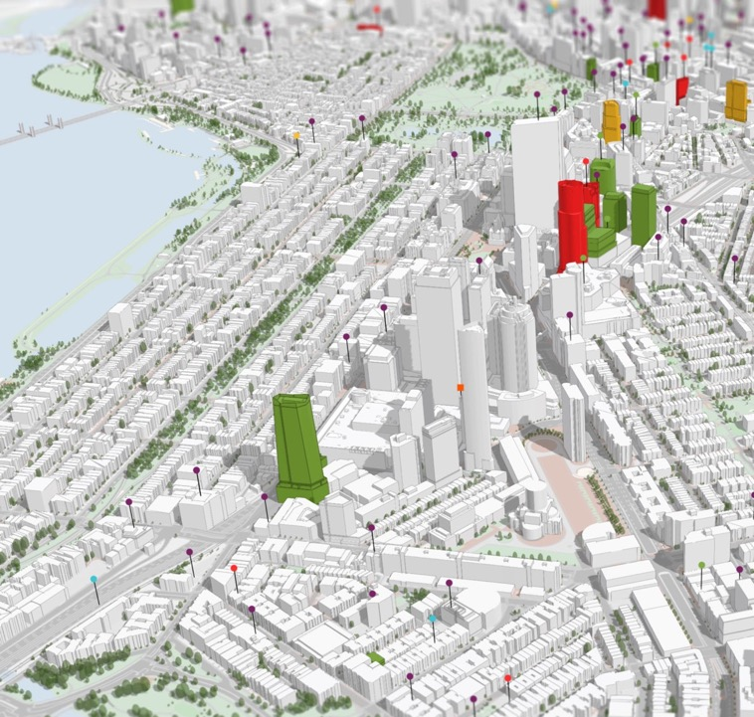
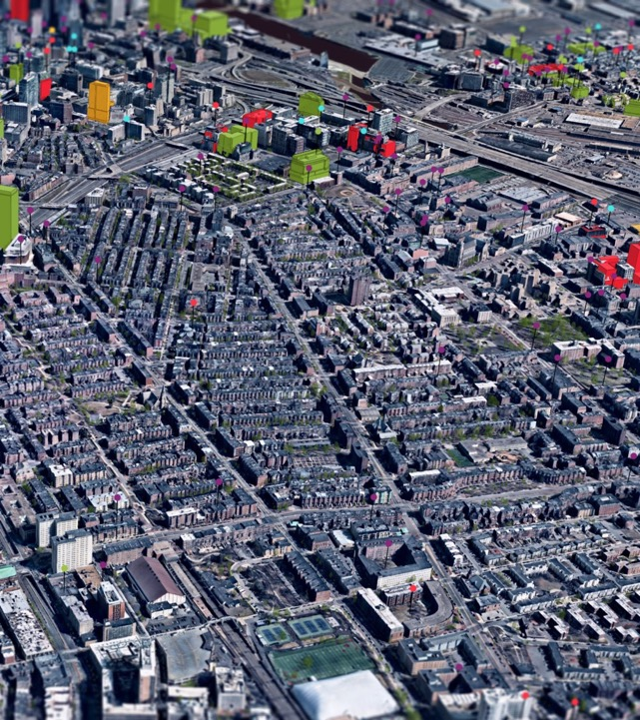
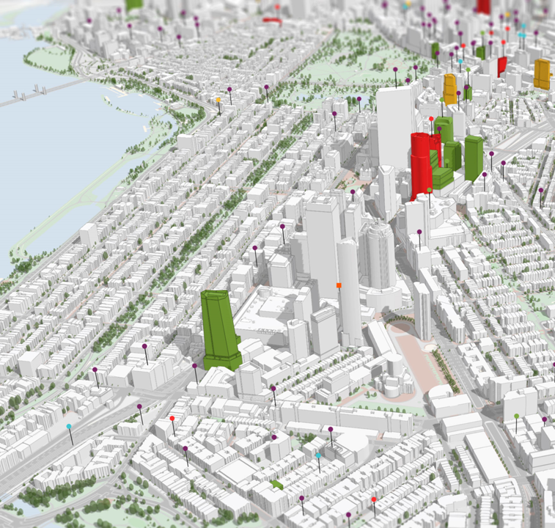
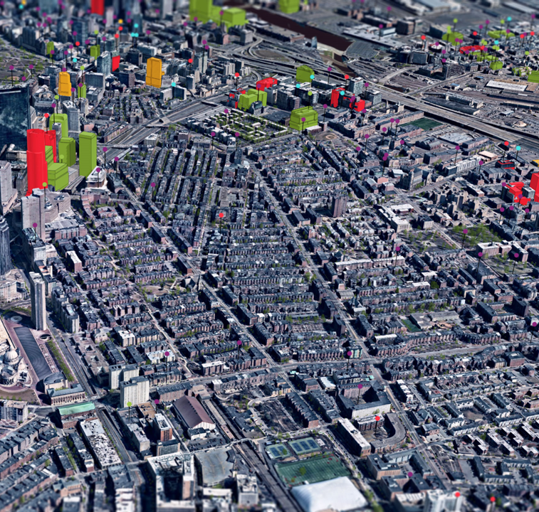
3D Web GIS | Full 3D Visual Experience on the Web
3D Features
3D Mesh
Database Driven
Reality Capture
Notes:
3D basemaps feature-based and mesh-based are the replication of the existing built environment – a basis from which to design future scenarios
Here is how this works. The textured 3D mesh you see on the right in the city of Boston can now be integrated to enrich the 3D features in the system of record, like the 3D buildings as shown on the left. Often users update feature by feature areas of interest in these 3D systems of record. By being able to integrate the two together, you can create an immersive, photorealistic, smart and useful 3D visualization experience – and all these can be done on the Web!

Slide 8
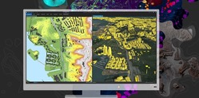


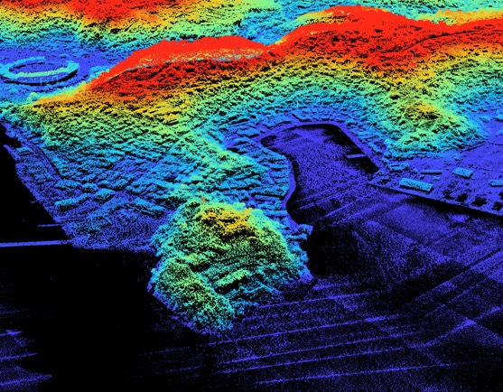
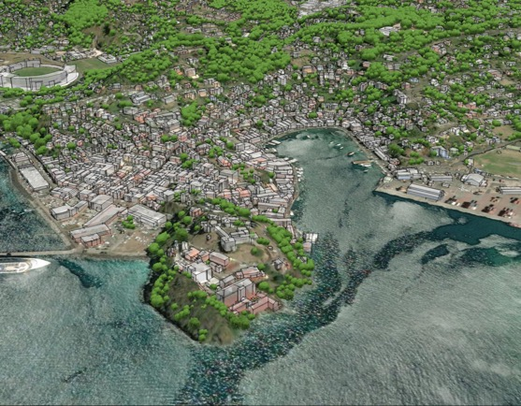
Extracting Features
+
ArcGIS Pro
3D Basemaps Solution
LiDAR
Extract 3D Basemap Content
Notes:
You can also take advantage of ArcGIS Pro and the 3D Basemaps Solution to help streamline the workflow of Classifying your LiDAR data, and extracting your 3D basemap data for your Digital Twin.

Slide 9
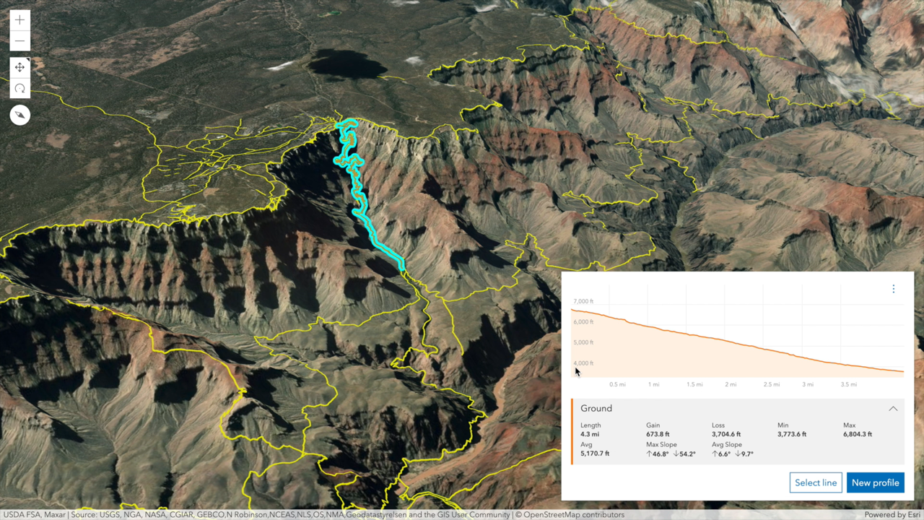
3D Web GIS | 3D Terrain Analysis
Notes:
3D Web GIS also means preforming 3D analytics on the web… In this case we see 3D Terrain Analysis

Slide 10
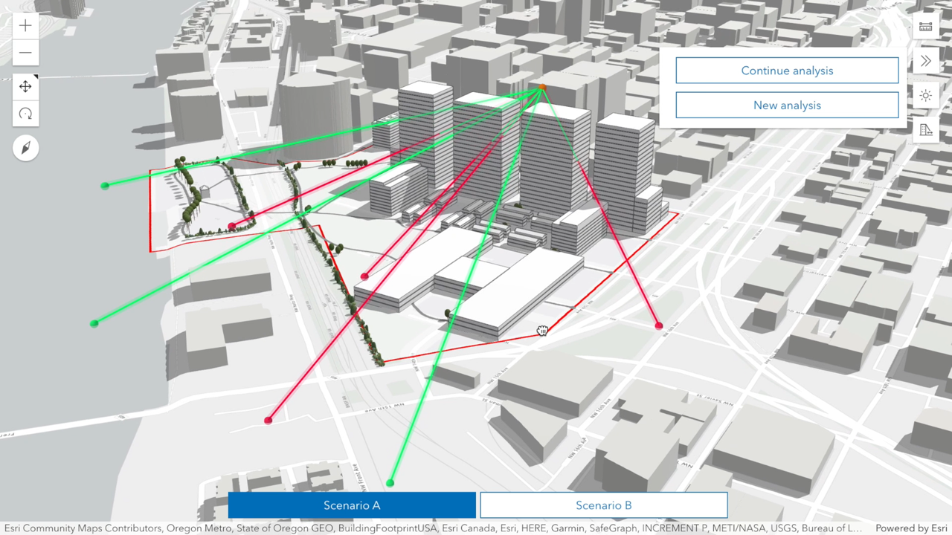
3D Web GIS | Line of Sight + Shadow Analysis
Urban Redevelopment Analysis
Line of Sight + Shadow Casting
Notes:
3D Web GIS is also making in roads in Urban Redevelopment Analysis – In this case we see a Web Scene Showcasing Line of Sight (Scenario A vs Scenario B) and Shadow Casting Analysis

Slide 11
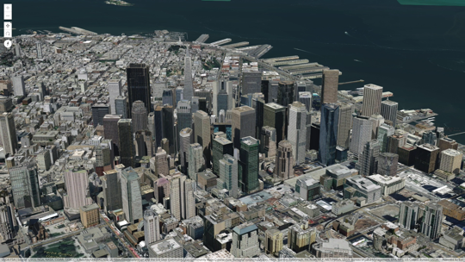
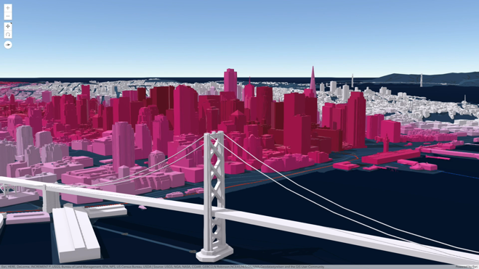
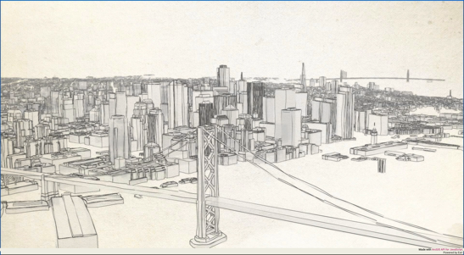
3D Web GIS | 3D City Visualization
Realistic
Schematic
Hand-drawn
The same I3S 3D Object Layer dynamically stylized
Notes:
3D Web GIS is also capable in marrying Realistic Scenes (which captures reality as is), with Schematic (thematic representation highlighting a particular feature) or Artistic/Hand drawn effects

Slide 12
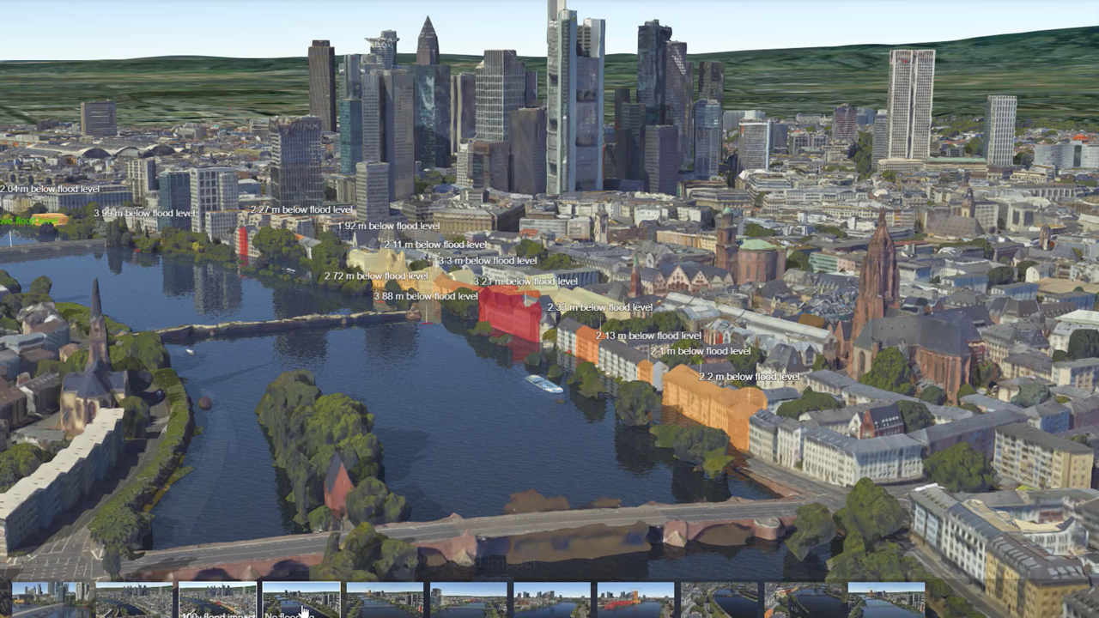
Climate Change & Disaster Response
Flood simulation
3D Mesh Integrated With Feature Database
Notes:
This is an example from Frankfurt, Germany, where an aerial photography mission was processed in a few hours to create this pictorial depiction of the city as an Interactive 3D Mesh. As you can see integrated with the 3D Mesh are 3D Features representing flood risks at various heights above the flood level.

Slide 13
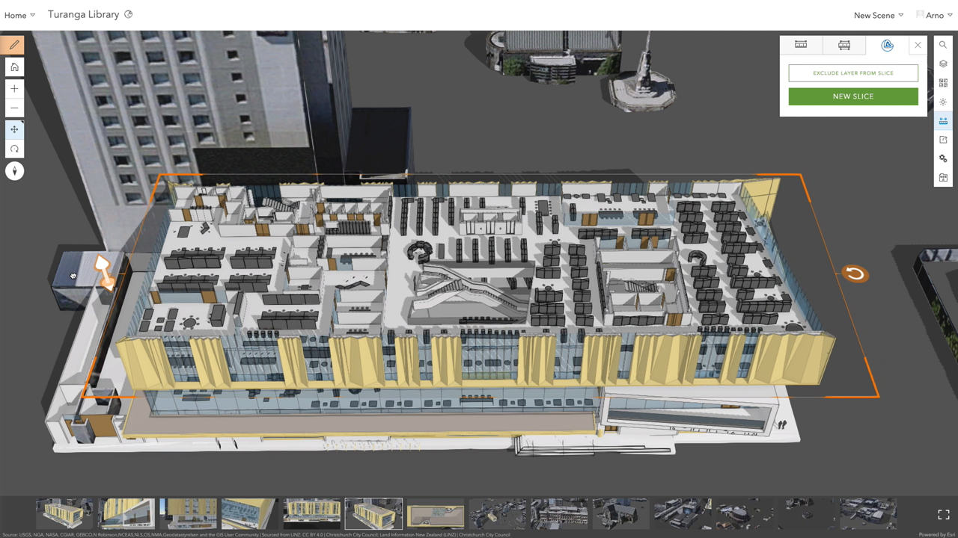
BIM Data in Geo Context
e.g. for visualization or facility management
Notes:
Yet another Area, I3S and 3D GIS has been making vast progress is in the Area of BIM data in Geo Context. This example is 3D Visualization in the context of facility management. What you are seeing is the Turanga Library in Christchurch, New Zealand, as an I3S Building Scene Layer. Notice the ability to peel-thru (reveal) layers of information with an intuitive digital slider/slicer peeling layers of feature that make up this layer. Also notice the ability to isolate, mensurate a particular feature of interest.

Slide 14
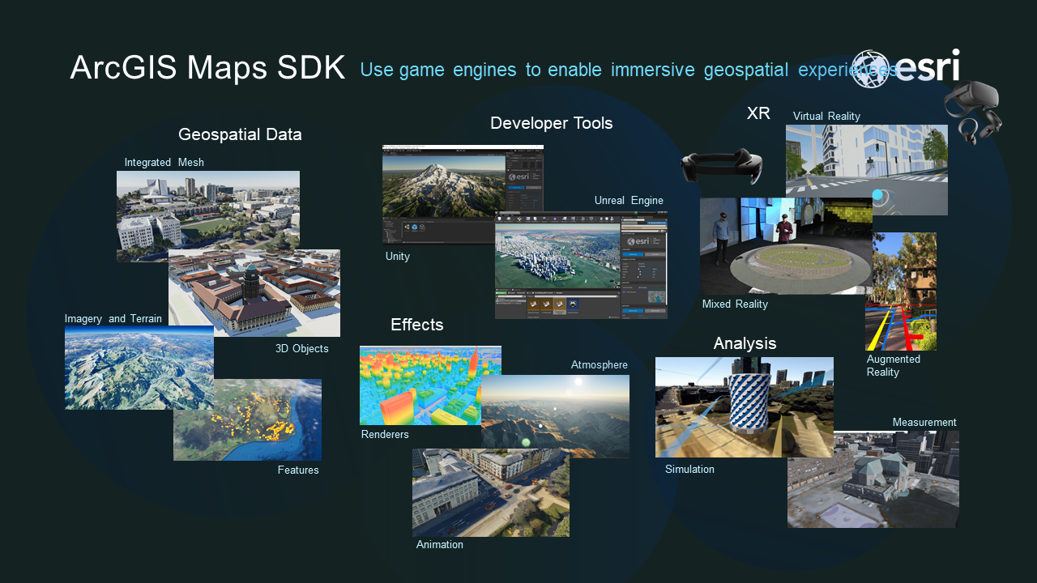

Slide 15
Agenda
I3S: Evolution and Standardization efforts
I3S: Khronos KTX2 Universal Basis texture format
I3S: Support in open visualization framework: loaders.gl & deck.gl
I3S: 3DTiles ⇔ I3S Conversion
I3S: Support of I3S 1.7 in Cesium.JS

Slide 16
I3S | OGC Adopted I3S as V1.2
I3S was adopted as an OGC standard fall 2017 as I3S 1.0
Point Cloud Scene Layer (PCSL) adopted by OGC as I3S 1.1 Community Standard in Feb. 2020
OGC I3S 1.2 is equivalent to the I3S 1.8 released at Esri github
I3S 1.2 was adopted by OGC in Dec. 2021, incorporating :
Paged Node access pattern – reduces client-server traffic
More compact Geometry – supports Draco compression
Better material support – gltf feature compatible
More optimal Selection Strategy - standardizes on OBBs
Ktx2 (basis) compressed texture support

Slide 17
I3S | OGC Updates I3S to V1.2
Node pages meta-data:
nodes per page, lod metric.
Texture-set definitions
Replaces sharedResources
Simpler definition of available compressed formats
Material definitions
Replaces sharedResources
glTF equivalency (metallic-roughness material model)
Mesh definitions
replaces defaultGeometrySchema
replaces sharedResources.
Describes compressed geometry
I3S OGC 1.2 Structure
unchanged
added to specs v1.7
deprecated
+--3DSceneLayer.json (with added fields)
+--nodes
| +--0
| | +--3dNodeIndexDocument
| | +--features
| | +--attributes
| | | +--0
| | | +--(...)
| | +--geometries
| | | +--0
| | | +--1
| | +--shared
| | | +--sharedResource
| | +--textures
| | | +--0 (e.g. "jpeg")
| | | +--1 (e.g. "dds")
| | | +--(...)
+-- materialDefinitions
+-- textureSetDefinitions
+-- geometryDefinitions
+--nodepages
| +--0
| +--1
| +--(...)
+-- statistics
Compressed geometry buffer (Draco)
Paged-nodes

Slide 18
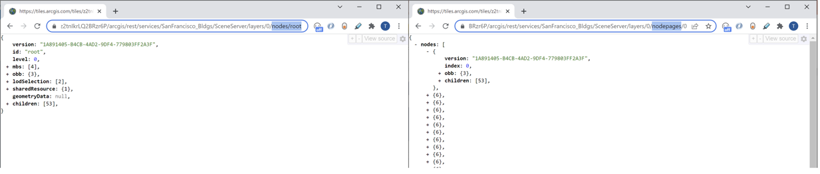
I3S | OGC Adopted I3S as V1.2
paged nodes reduce server-client chatter
Although traversal pattern is simplar, Expanded Nodes result in a chatty, server-client request pattern where each node is fetched as an individual resource
Grouping of nodes into pages of nodes allows client application to get a group of nodes within a single request (64 nodes per page is the default)

Slide 19

I3S | OGC Adopted I3S as V1.2
Using Draco compression reduces the I3S geometry payload by about ~20-30%
https://github.com/google/draco

Slide 20

I3S | OGC Adopted I3S as V1.2
I3S - Texture support including various compressions
Some empirical Testing results:
ETC2 textures are generally sized somewhere between 4-6x that of the JPG (similar to DDS)
Depending on the texture size (square textures for example) ETC2 textures might be bigger than DDS (gzip compressed)

Slide 21
I3S | Basis in KTX 2.0 Container Supported
Ambient Occlusion
Improved Materials
Notes:
https://tamrat-b.github.io/i3sBasisKTX20/?stats=true

Slide 22
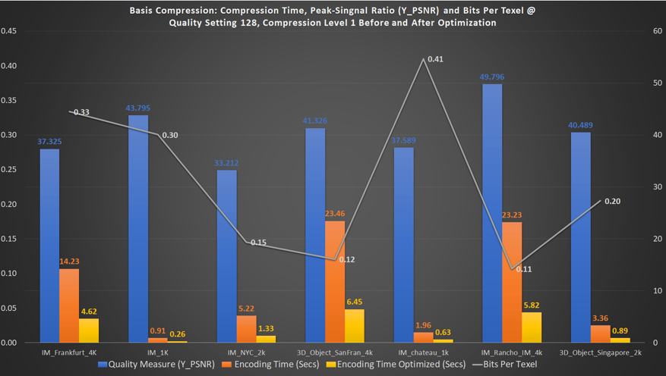
I3S | Esri-Binomial Collaboration
Reduce the encoding and supercompressing speed of the binomial library
Create a ready to use web/c++ API to output and consume basis in Ktx2 format
Basis encoding Version 1.12 compared to Version 1.13: Plots Quality (measured as a function of a Y-PSNR (db), Encoding times (seconds) and Bits Per Texel (basis file size in bits/Texel Count*Num Channels) – where Texel count is texture.width*texture.height for each of the 7 use cases and the basis encoder setting for quality was set to 128 and compression level to 1. Note the difference between Basis Ver. 1.12 Encoding Time (in seconds – orange bars) vs Basis Ver 1.13 Encoding Time using the Optimized code base Version 1.13 (In seconds – yellow bars).

Slide 23
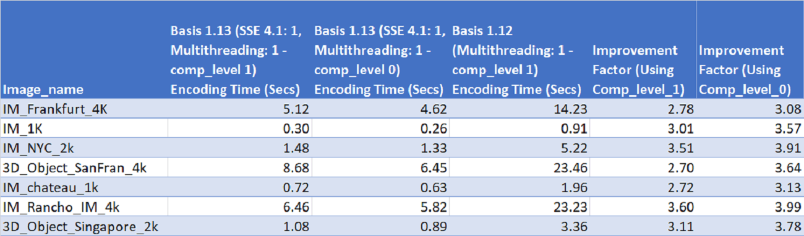
I3S | Esri-Binomial Collaboration
Encoding speed has been improved by ~4X
Compares the Encoding Optimization gained for various I3S datasets: Basis 1.13 added a new geospatial focused compression level 0.
Notes:
https://www.esri.com/arcgis-blog/products/arcgis/3d-gis/esri-collaborates-with-binomial-to-improve-basis-universal-texture-compression-speeds

Slide 24
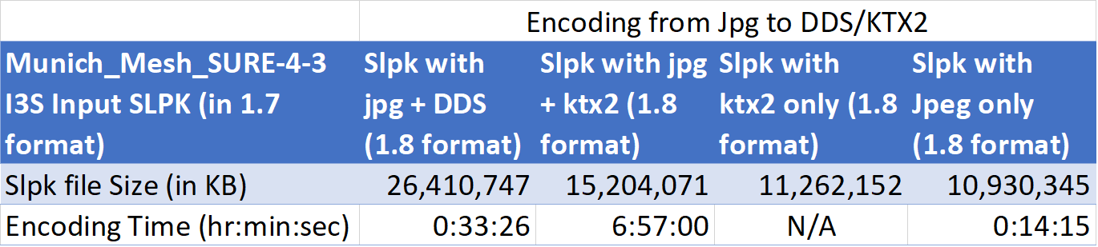
I3S | Esri-Binomial Collaboration
Slpk size is ~ 42% less in size
1.8 SLPK Version compared to I3S 1.7:
42.3% (10.7GB!) smaller than equivalent 1.7 version (with DDS & Jpg textures)
Would be 57.35% (14.5GB) smaller than equivalent 1.7 version if we drop Jpeg
Notes:
https://www.esri.com/arcgis-blog/products/arcgis/3d-gis/esri-collaborates-with-binomial-to-improve-basis-universal-texture-compression-speeds

Slide 25
I3S | Esri-Binomial Collaboration
Encoding rate improvements of upto 10X using GPU in Versoin 1.16
Using OpenCL based basis univesal GPU encoders upto 10X encoding performance improvement:
Currently work ongoing to intergreate these changes with I3S converter tool as well as ArcGIS Pro GP IM and 3D Object cooking tools
Notes:
https://www.esri.com/arcgis-blog/products/arcgis/3d-gis/esri-collaborates-with-binomial-to-improve-basis-universal-texture-compression-speeds

Slide 26
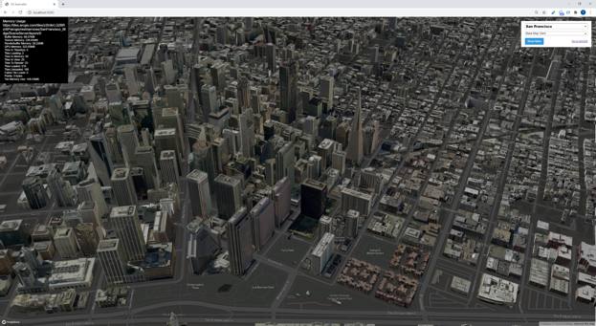

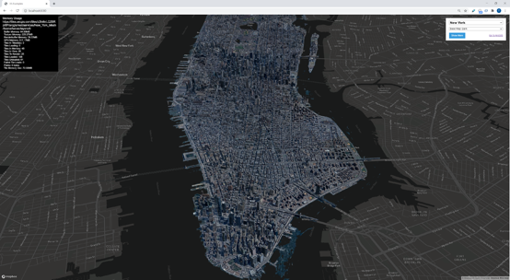
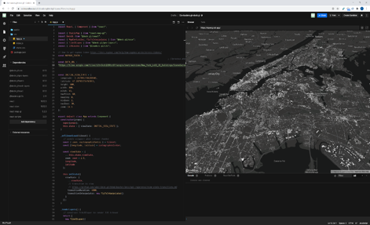
I3S | Support in open framework solutions: loaders.gl
The Vis.gl open framework now has support for I3S consumption (IM & 3D Object layers) using deck.gl & loaders.gl modules.
https://loaders.gl/examples/i3s​
Vis.gl
Frameworks for WebGL-powered large-scale data visualization
Notes:
NYC Loaders: https://loaders.gl/examples/i3s?url=https://tiles.arcgis.com/tiles/z2tnIkrLQ2BRzr6P/arcgis/rest/services/New_York_Mesh/SceneServer/layers/0
Frankfurt Loaders: https://loaders.gl/examples/i3s?url=https://tiles.arcgis.com/tiles/z2tnIkrLQ2BRzr6P/arcgis/rest/services/Frankfurt_3dTiles_I3S/SceneServer/layers/0
https://codesandbox.io/dashboard/home?workspace=dfd095f3-e4af-4715-8d29-79345f60097e

Slide 27
I3S | Loaders.gl based I3S debugging tool
Features of loaders.gl based I3S Debugging tool:
Advanced (Semantic) Validation
Bounding volume (spheres, boxes, etc) visualization
Selection Criteria Validation
Geometries and textures validation
Normal display
Bounding volume hierarchy consistency (Is Parent-Child tile relationship valid/enclosed)

Slide 28
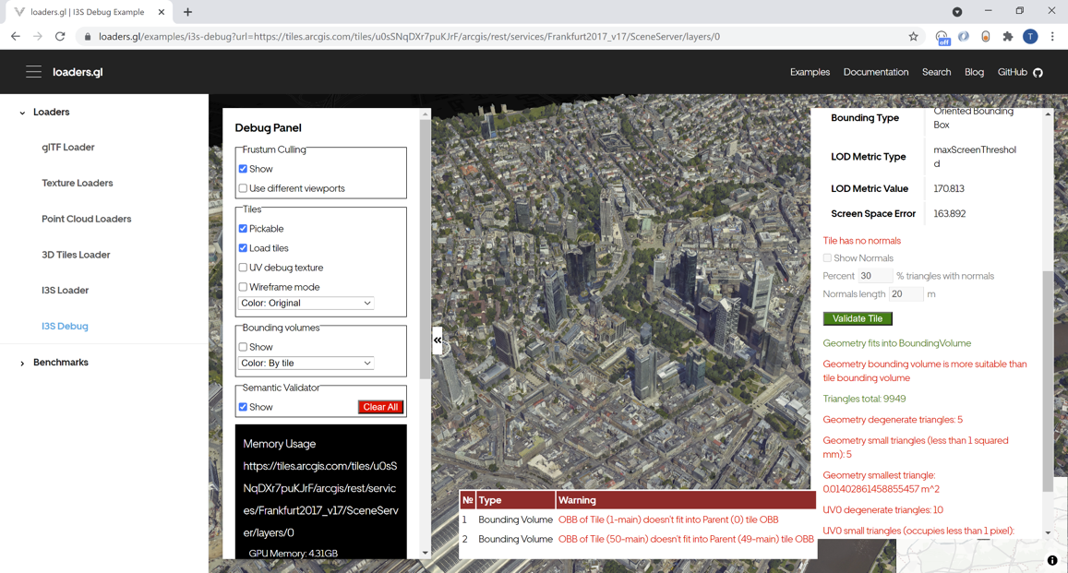
I3S | Loaders.gl based I3S debugging tool: Validator
Notes:
NYC Loaders: https://loaders.gl/examples/i3s-debug?url=https://tiles.arcgis.com/tiles/z2tnIkrLQ2BRzr6P/arcgis/rest/services/New_York_Mesh/SceneServer/layers/0
Frankfurt Loaders: https://loaders.gl/examples/i3s-debug?url=https://loaders.gl/examples/i3s-debug?url=https://tiles.arcgis.com/tiles/u0sSNqDXr7puKJrF/arcgis/rest/services/Frankfurt2017_v17/SceneServer/layers/0
https://codesandbox.io/dashboard/home?workspace=dfd095f3-e4af-4715-8d29-79345f60097e

Slide 29
I3S | Loaders.gl based I3S debugging tool
“The node is out of range of the parent node”.
Bounding volume hierarchy. Check that all children node bounding volumes don’t exceed parent bounding volume;
“Node geometry is out of node volume”.
Bounding volume <-> geometry. Check that node geometry don’t cross bounding volume of the node;
“Empty node”.
The node doesn’t have both children and 3d content;
“Incorrect coordinate system/coordinates”.
Check latitude and longitude ranges for Global scene layer (WSG84, wkid: 4326);
“The node is hard to see”.
The lod metric and bounding volume of the node are quite the same with the parent node so this node will be refined just after checking its lod metric;
“The child nodes don’t cover the volume of the parent node”.
Sum bounding volumes of children nodes and compare it with bounding volume of the parent node;
“Texture is too large/too small for the node geometry”.
Compare the surface area in relation with “maxScreenThreshold” - with texture size;
“Incorrect average elevation of layer”. (not implemented)
Compare layer elevation with some world topographic information

Slide 30
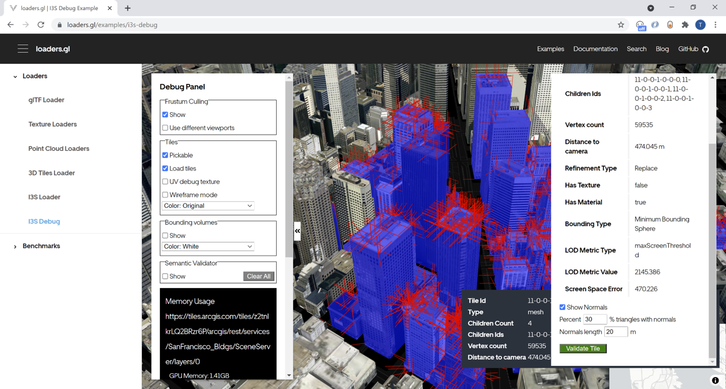
I3S | Loaders.gl based I3S debugging tool: Normal Display
Notes:
NYC Loaders: https://loaders.gl/examples/i3s-debug?url=https://tiles.arcgis.com/tiles/z2tnIkrLQ2BRzr6P/arcgis/rest/services/New_York_Mesh/SceneServer/layers/0
Frankfurt Loaders: https://loaders.gl/examples/i3s-debug?url=https://loaders.gl/examples/i3s-debug?url=https://tiles.arcgis.com/tiles/u0sSNqDXr7puKJrF/arcgis/rest/services/Frankfurt2017_v17/SceneServer/layers/0
https://codesandbox.io/dashboard/home?workspace=dfd095f3-e4af-4715-8d29-79345f60097e

Slide 31
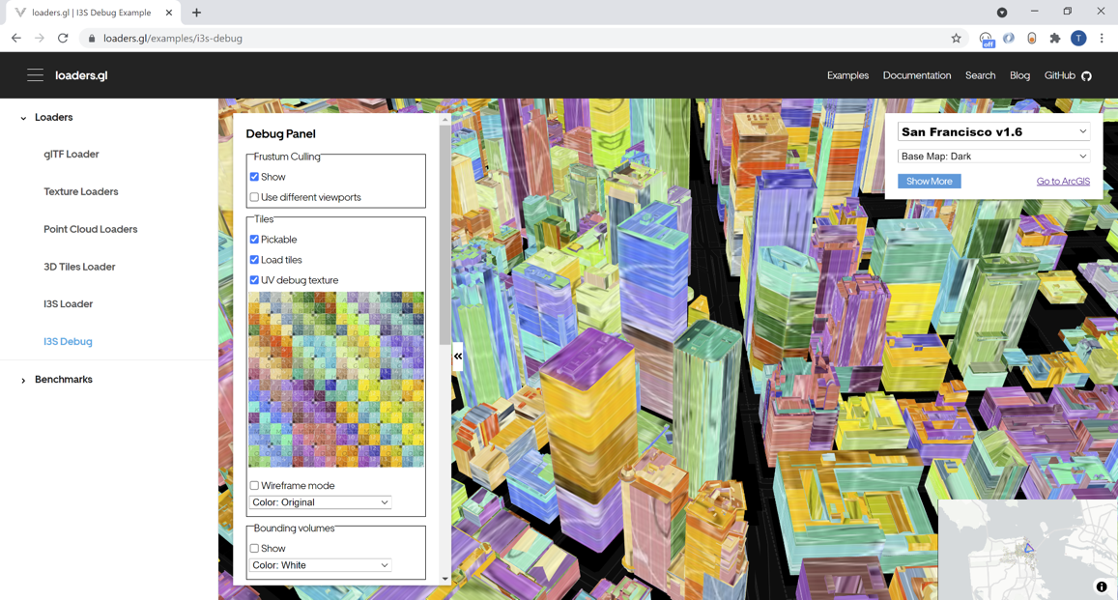
I3S | Loaders.gl based I3S debugging tool: UV debug texture

Slide 32
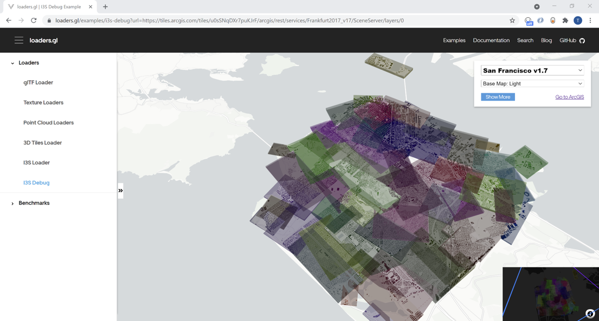
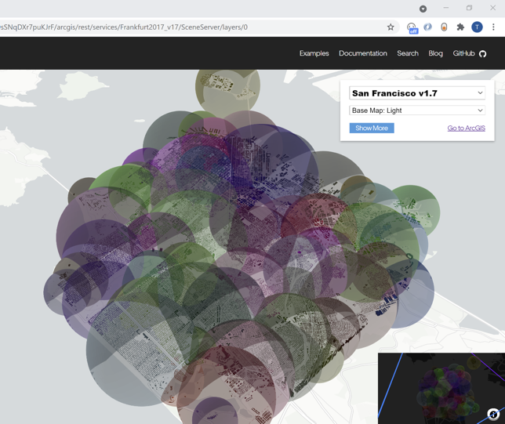
I3S | Loaders.gl based I3S debugging tool: Bounding Volume/s

Slide 33
I3S | Import/Export
3DTiles ⇔ I3S Conversion
A loaders.gl based converter between I3S and 3D tiles tilesets.
Supports the following types of conversion (2-way)
3DTiles Batched3DModel ⇔ I3S IntegratedMesh Scene Layer
3DTiles Batched3DModel + Hierarchy extension ⇔ I3S 3D Object Scene Layer
Ability to batch convert a 3D Tiles content (from cesium ion or file based) to Scene Layer Package (SLPK) and Indexed 3D Scene Layer REST (i3sREST)
Handles correct gravity models by converting between orthometric (i3s prefered height model) to ellipsoidal (cesium preferred)
Notes:
https://loaders.gl/modules/tile-converter/docs/cli-reference/tile-converter

Slide 34
I3S | 3DTiles ⇔ I3S Conversion cont’d
Ability to batch convert an I3S 1.7 in Scene Layer Package (SLPK) and Indexed 3D Scene Layer REST (i3sREST) format to 3D Tiles
Support for: 3DTiles version 1.0, embedded glTF version 2.0
Has experimental support for glTF 1.0 as it still seems prevalent in the marketplace
Coordinates: supports WGS84 as that’s the only supported 3D Tiles CRS
Handles correct gravity models by converting between orthometric (i3s prefered height model) to ellipsoidal (cesium prefered)

Slide 35
I3S | 3DTiles ⇔ I3S Conversion cont’d
Supports all I3S 1.7 features including:
Convert glTF scenegraphs to “MeshPyramid” geometries
Styling: Preserve 3D Tiles metadata so that user can style via I3S
Draco compression of geometries
Preserve PBR materials as I3S 1.7 properties when converting glTF
Generate node pages per I3S 1.7 spec
Transparency - 3D Tiles with transparency split into separate I3S nodes

Slide 36
I3S | 3DTiles ⇔ I3S Conversion cont’d
The converter is delivered in 3 options and runs in both Linux and Windows
As a CLI module:
node converter.min.js --input-type 3dtiles --tileset ../Frankfurt-3d-tiles/cesiumJpg/tileset.json --name Frankfurt_completed_bundle --output data --max-depth 6 --slpk --egm /home/user/pgm/egm2008-5/geoids/egm2008-5.pgm
node converter.min.js --input-type 3dtiles --tileset https://assets.cesium.com/29328/tileset.json --name CairoLayer --egm /home/user/pgm/egm2008-5/geoids/egm2008-5.pgm --slpk
node converter.min.js --input-type i3s --tileset https://tiles.arcgis.com/tiles/z2tnIkrLQ2BRzr6P/arcgis/rest/services/Rancho_Mesh_mesh_v17_1/SceneServer/layers/0 --name Rancho --max-depth 4 --egm /home/user/pgm/egm2008-5/geoids/egm2008-5.pgm
Requirements:
NodeJs
location of Earth Gravity Model *.pgm file to convert heights from ellipsoidal to gravity-related format. A model file can be downloaded from GeographicLib https://geographiclib.sourceforge.io/html/geoid.html
External archiver (for slpk mode):
Linux/Ubuntu: apt install zip
Windows: 7-Zip. Default 7-zip location is "C:\Program Files\7-Zip\7z.exe" but there is option "--7zExe" that can be used for setup "7z.exe" location manually.
Notes:
https://loaders.gl/modules/tile-converter/docs/cli-reference/tile-converter

Slide 37
I3S | 3DTiles ⇔ I3S Conversion cont’d
2. As an npm package using npx:
npx converter --input-type <I3S | 3DTILES> --tileset <tileset> --name <tileset name> [--output <output folder>] [--no-draco] [--max-depth 4] [--slpk] [--7zExe <path/to/7z.exe>] [--token <ION token>] [--egm <path/to/*.pgm>]
Requirements:
NodeJs
location of Earth Gravity Model *.pgm file to convert heights from ellipsoidal to gravity-related format. A model file can be downloaded from GeographicLib https://geographiclib.sourceforge.io/html/geoid.html
External archiver (for slpk mode):
Linux/Ubuntu: apt install zip
Windows: 7-Zip. Default 7-zip location is "C:\Program Files\7-Zip\7z.exe" but there is option "--7zExe" that can be used for setup "7z.exe" location manually.

Slide 38
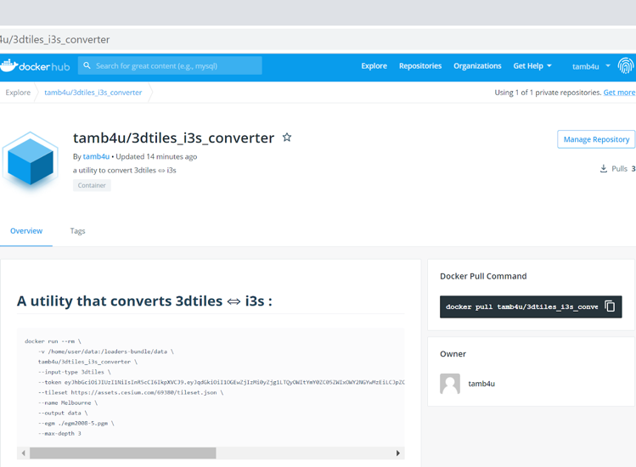
I3S | 3DTiles ⇔ I3S Conversion cont’d
3. As a docker image:
docker run --rm \
-v /home/user/data:/loaders-bundle/data \
tamb4u/3dtiles_i3s_converter \
--input-type 3dtiles \
--token eyJhbGciOiJIUzI1NiIsInR5cCI6I...
--tileset https://assets.cesium.com/69380/tileset.json \
--name Melbourne \
--output data \
--egm ./egm2008-5.pgm \
--max-depth 3
Notes:
https://hub.docker.com/r/visgl/tile-converter
docker pull visgl/tile-converter

Slide 39
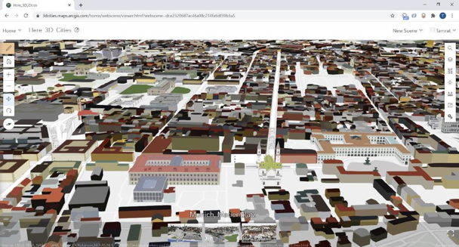
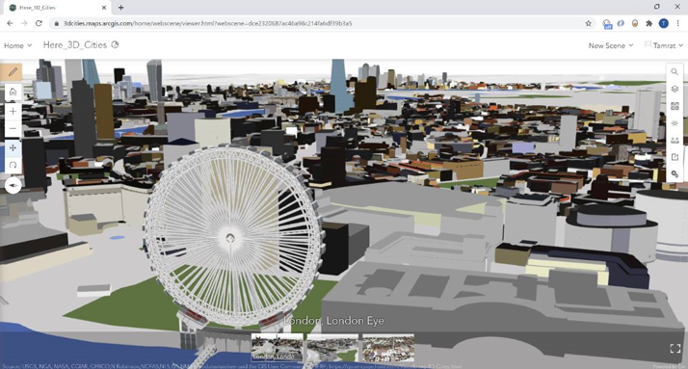
I3S | 3DTiles ⇔ I3S Conversion cont’d
Data Partners are Leveraging the converter to convert data from one format to another
Example: 3D Tiles data from HERE converted to I3S

Slide 40
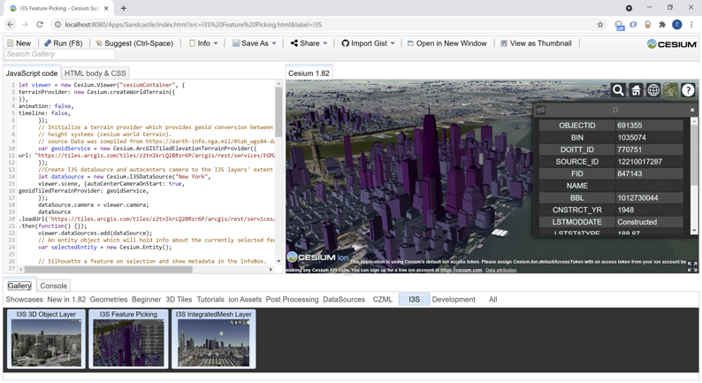
I3S | Support of I3S 1.7 in Cesium.JS
An I3S 1.7 IntegratedMesh Scene Layer loaded in cesium.js
Supports IntegratedMesh and 3D Object Scene Layers in OGC I3S 1.2 standard
Modeled after ArcGISTiledElevationTerrainProvider module that consumes arcgis tiled elevation layers
Pull request under review: https://github.com/CesiumGS/cesium/pull/9634

