Slide 1

EGU22-6876
General Assembly 2022
Characteristics and Risk Assessment of Debris Flow Disasters along the Northern line of Sichuan-Tibet Highway
Yuqing Sun
Institute of Mountain Hazards and Environment, CAS
sunyuqing@imde.ac.cn
26, May 2022

Slide 2

Contents
Background
Methodology
Results
Conclusions

Slide 3





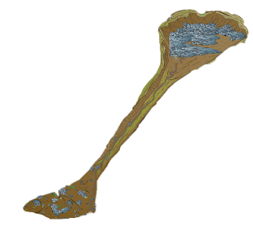


Background
Research significance
Debris flows occur frequently in mountainous areas
Highway is a linear structure that is extended.
Need more quantitative risk assessment of linear highways.
Research status
The natural attributes of the disaster-causing are mature in a quantitative way.
The social attributes of the disaster-affected are difficult to quantify and the expression is not uniform.
Fig.1 A Example of the linear highway was hit by disaster

Slide 4
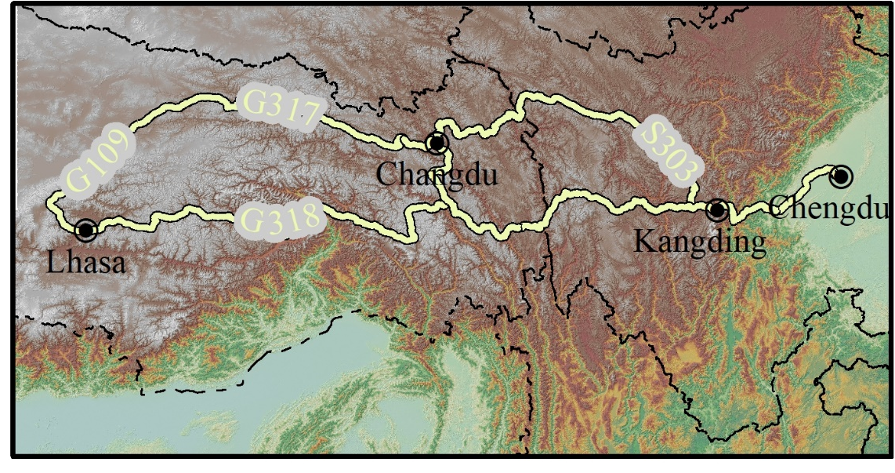
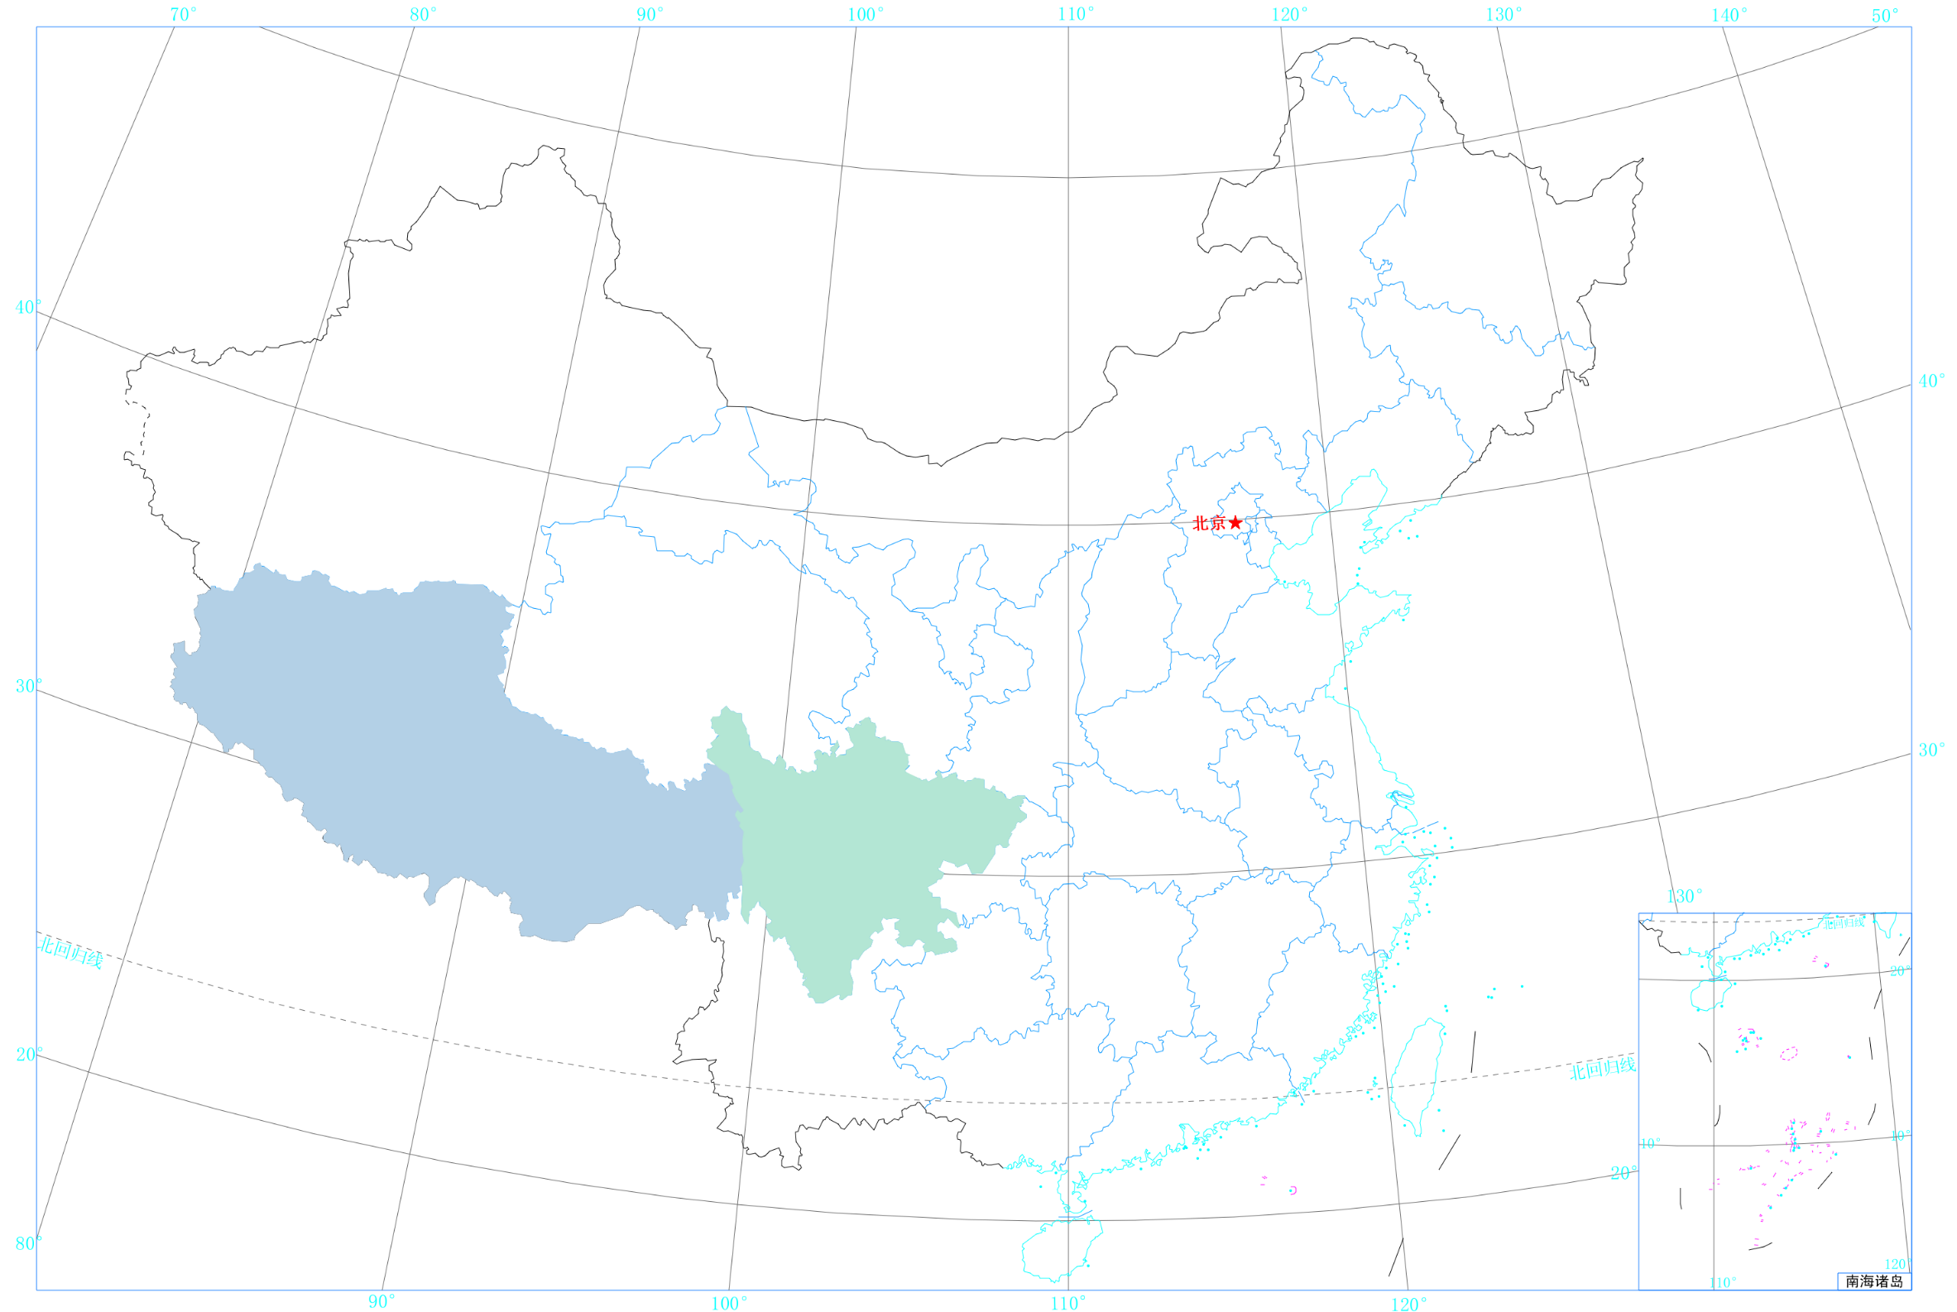




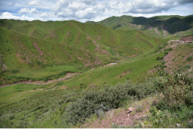
Environmental conditions
Geomorphology
Qinghai-Tibet Plateau and Sichuan basin
Climate
Plateau climate with large temperature difference and less rainfall
Geological structure
Qiangtang-Sanjiang orogenic system
Earthquake
Fifteen earthquakes with a magnitude > 5(since 1963)
Xianshuihe fult
Fig.2 Complicated geographical and geological conditions
A
B
C
D
Fig.3 Four typical landforms

Slide 5
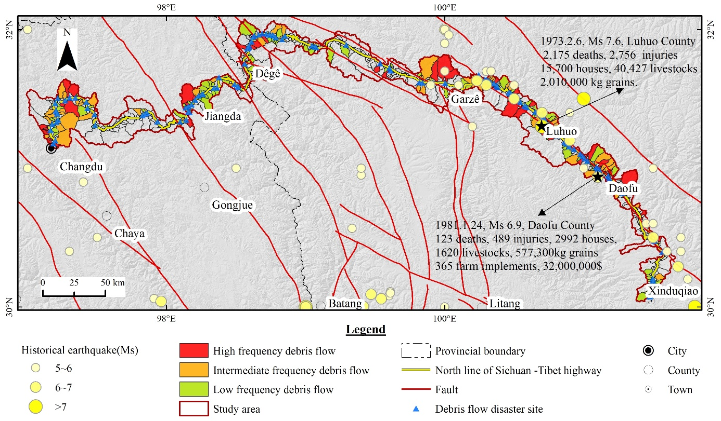
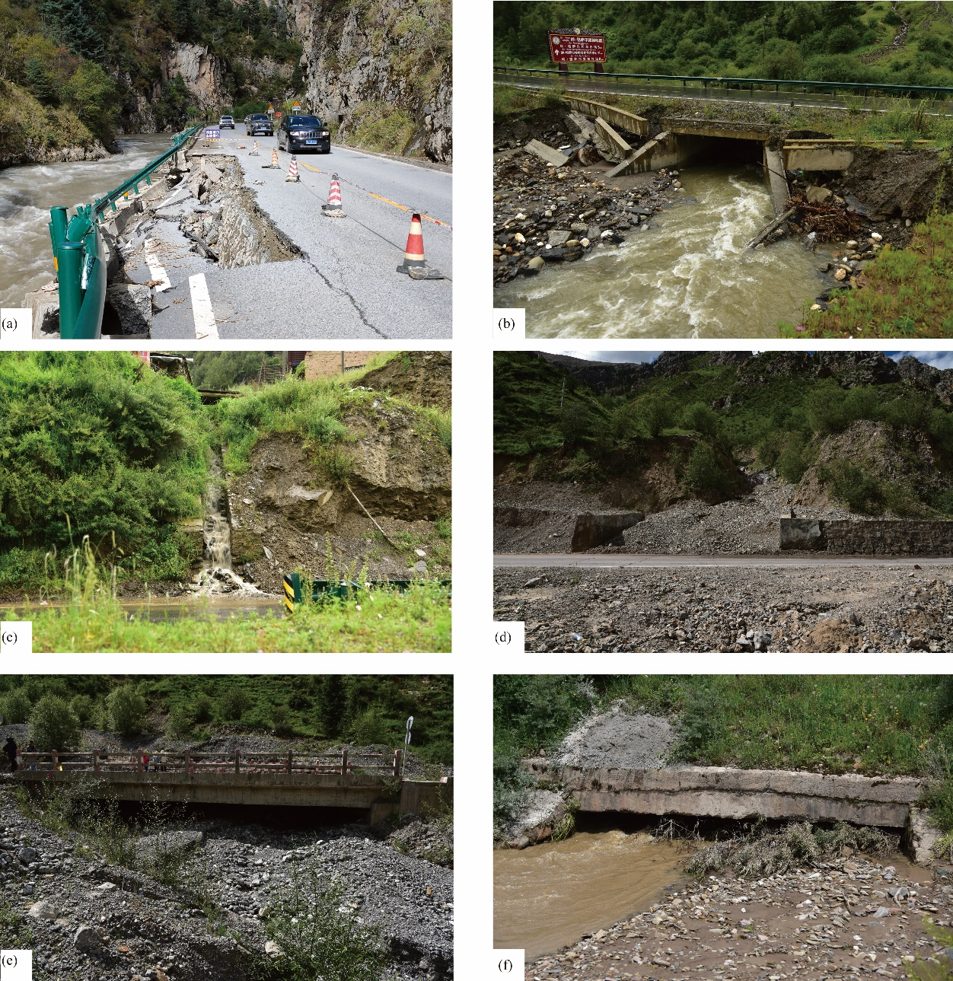
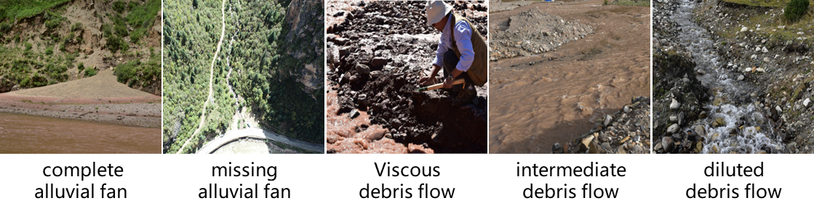
Debris flow disasters characteristics
Debris flows(235): high-frequency(66), moderate (67), low(102)
Debris flow disasters (136): culverts(44%), bridges(39%), pavements(17%)
brush
Fig.6 The highway damaged by debris flow
bury
Fig.4 Geological environment and debris flow distribution
Fig.3 Geological environment
silt up
Fig.5 Basin shape and debris flow fluid property

Slide 6
Methodology
Evaluation system
landcover
rainfall
PGA
Hazard
Vulnerability
Risk
slope
fault
lithology
Fig.7 Hazard evaluation indexes
Evaluation unit
Raster
Linear
Evaluation index
Topography, water, provenance
Exposure, attribute, resilience
Evaluation method
Weight Evidence Analysis
Analytic Hierarchy Process
Evaluation results
Hazard history
ROC
Fig.8 Vulnerability evaluation indexes

Slide 7
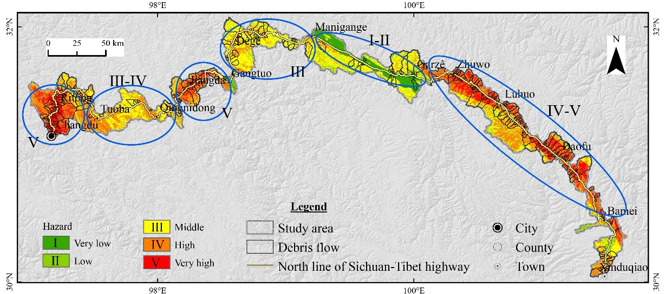
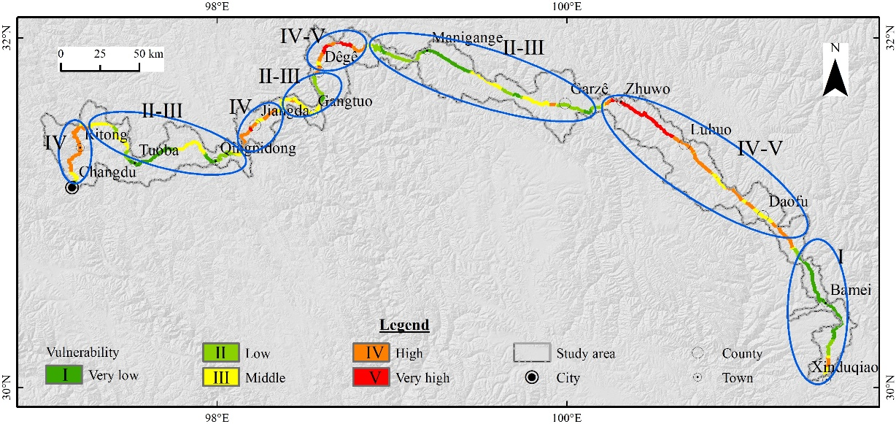
Results
Hazard
Hazard Level | Study area/km² | Proportion/%（G_{i}） | Debris flow /km² | Proportion/%（S_{i}） | R=G_{i}/S_{i}
Very low (I) | 636.09 | 5.71 | 51.13 | 1.23 | 0.2154
Low (Ⅱ) | 762.98 | 6.85 | 189.12 | 4.55 | 0.6642
Middle (Ⅲ) | 4239.3 | 38.06 | 1423.36 | 34.28 | 0.9007
High (Ⅳ) | 4140.19 | 37.17 | 1740.12 | 41.91 | 1.1275
Very high (Ⅴ) | 1360.94 | 12.22 | 748.65 | 18.03 | 1.4755
Fig.9 ROC test curve
Vulnerability
Vulnerability Level | Highway length/km | Proportion/%
Very low (I) | 163.63 | 19.25
Low (Ⅱ) | 130.00 | 15.29
Middle (Ⅲ) | 217.44 | 25.58
High (Ⅳ) | 244.07 | 28.71
Very high (Ⅴ) | 94.86 | 11.16
Insufficient
Deviation
Inadequate
Imperfect
Fig.10 Causes of damage to highway structures

Slide 8
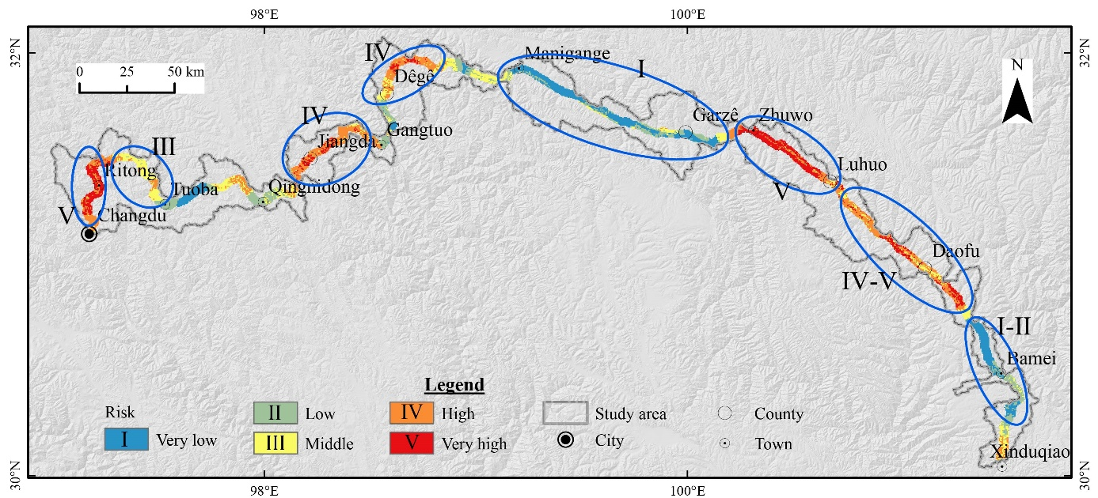
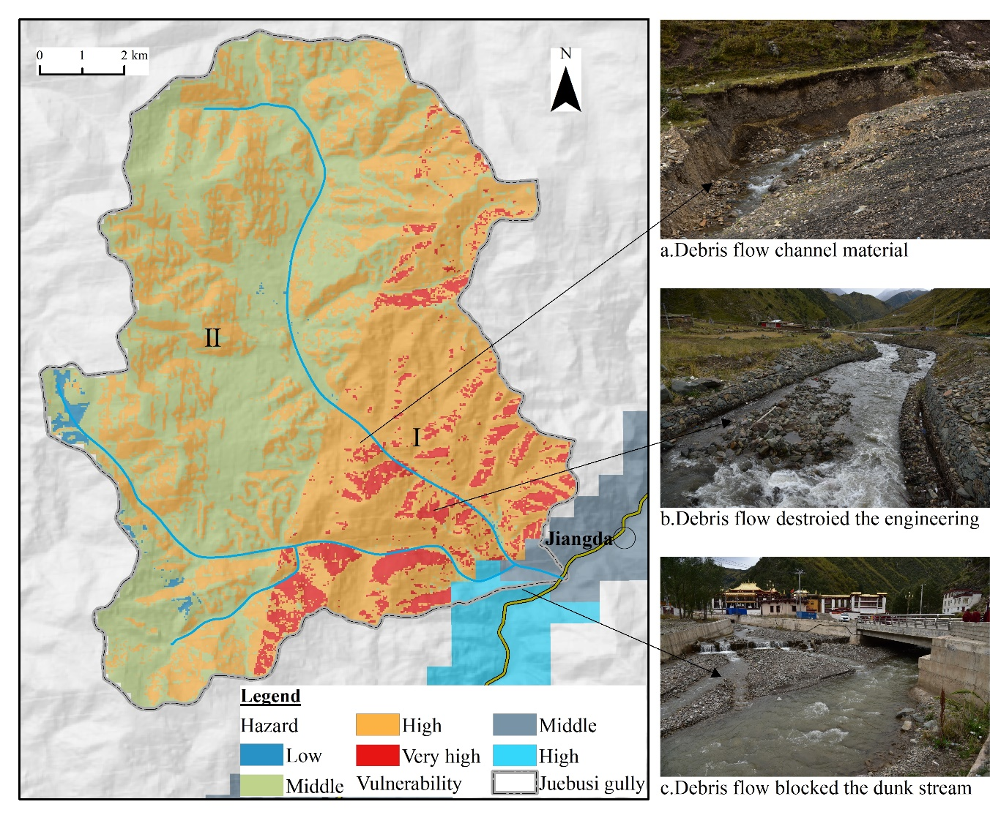
Risk
Typical example
Fig.11 Assessment results and debris flow in “Juebusi” gully
Risk Level | Road length/km | Proportion/% | Debris flow | Distribution density（debris flow/km）
Very low (I) | 171.52 | 20.18 | 21 | 0.002
Low (Ⅱ) | 140.40 | 16.52 | 19 | 0.135
Middle (Ⅲ) | 166.31 | 19.57 | 51 | 0.307
High (Ⅳ) | 253.34 | 29.80 | 88 | 0.347
Very high (Ⅴ) | 118.43 | 13.93 | 56 | 0.473
On 8 July 2017, 3.2×10⁴ m³ of solid material blocked the bridge of “317 National Highway” and the Maiqu River, flooding the downstream, and causing about 10 million economic losses.

Slide 9
Conclusions
Risk zoning of debris flows along the Northern Sichuan-Tibet Highway
Hazard assessment: the soft and hard clastic rocks with a slope of 35 ~ 45° in the area of greater PGA are most likely to form debris flow
Vulnerability assessment: location and structure of a disaster-affected object(highway structures), disaster resilience, and exposure probability of mobile disaster-affected object(vehicle)
Risk assessment: the middle and high-risk road sections account for 63.30%, distributed in Changdu County, Jiangda County, Dege County, and Daofu county

Slide 10

Thanks for your attention!

