Slide 1




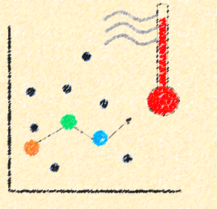

Estimation of air surface temperature using MODIS land surface temperature over data-scarce Banas River basin, Western India
IIT Bombay
Abstract QR code
Neetu Singh^{1,3}, Ian Cartwright², and Pennan Chinnasamy¹
¹Centre for Technology Alternatives for Rural Areas, Indian Institute of Technology Bombay, Mumbai, India
²School of Earth, Atmosphere and Environment, Monash University, Victoria, Australia
³IITB - Monash Research Academy, Indian Institute of Technology Bombay, Mumbai, India

Slide 2


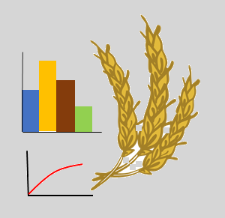


INTRODUCTION
Air temperature – Temperature measured at 2 m above the ground
Global population under risk of flooding - 25% rise from year 2000
In last two decades economic loss due to drought - 124 billion USD
Weather
forecasting
2/3rd world population –SEVERE water scarcity for at least 1 month every year
Hydrological
studies
Agricultural water requirement
70% of fresh water resource
40% - lost to environment due to poor irrigation management
Population increase – over 10 billion by 2050
Agricultural production need to expand by 70%
Crop yield prediction
Evapotranspiration estimation
Between 2030 and 2050-
250 000 additional deaths per year due to malnutrition, malaria, diarrhoea and heat stress
Climate change investigation
Source: Balsom, 2020; McGrath, 2021; Mekonnen and Hoekstra, 2016; Tebor, 2021; The World Bank, 2020; WHO, 2021

Slide 3
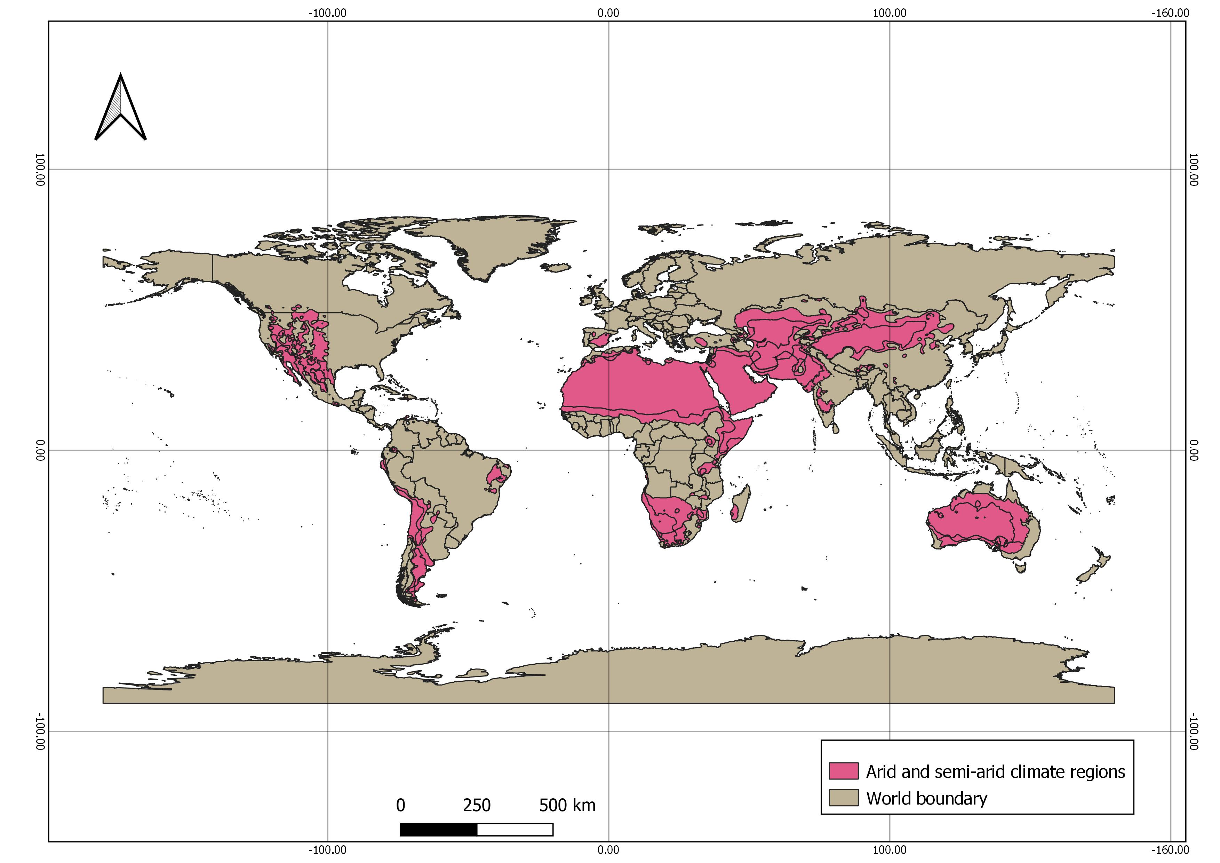
INTRODUCTION
Total global meteorological stations- 7988
Meteorological stations in arid and semi-arid regions – 1278
Iran
Stations- 58
Area – 1.4 x 10⁶ Km²
USA
Stations- 202
Area – 6.7 x 10⁵ Km²
India
Stations- 62
Area – 1.3 x 10⁵ Km²
Egypt
Stations- 22
Area – 1 x 10⁶ Km²
Argentina
Stations- 15
Area – 2.6 x 10⁵ Km²
Australia
Stations- 186
Area – 4.5 x 10⁵ Km²
Figure 1. Location of arid and semi-arid regions defined by Köppen-Geiger climate classification
Source: Peel et al., 2007
Source: Colson , 2018

Slide 4
INTRODUCTION
Earth observation (EO) satellites
Moderate Resolution Imaging Spectroradiometer (MODIS) sensor
Thermal infrared (TIR) data
Land Surface Temperature (LST) at high temporal (daily) and spatial resolution (1 km)
LST
Essential parameter of physical processes occurring on the Earth's surface
LST and air temperature Similar spatial and temporal variability, and consistent patterns at global scale
Statistical approaches
Simple and site specific
Air temperature (T_{a}) estimation using LST
Temperature–vegetation index (TVX) approaches
Relationship between vegetation index and LST
Energy balance approaches
Complex and time consuming
Source: Hereher and El Kenawy, 2020; Kitsara et al., 2018; Otgonbayar et al., 2019; Shwetha and Nagesh, 2018; Yoo et al., 2018

Slide 5
Objectives
To examine the correlation between MODIS Land Surface Temperature and air temperature data of a semi-arid river basin
To develop a multi-variate statistical model to estimate maximum and minimum air temperature using LST and other satellite-derived data
To investigate the spatial distribution of maximum and minimum temperature in the river basin

Slide 6
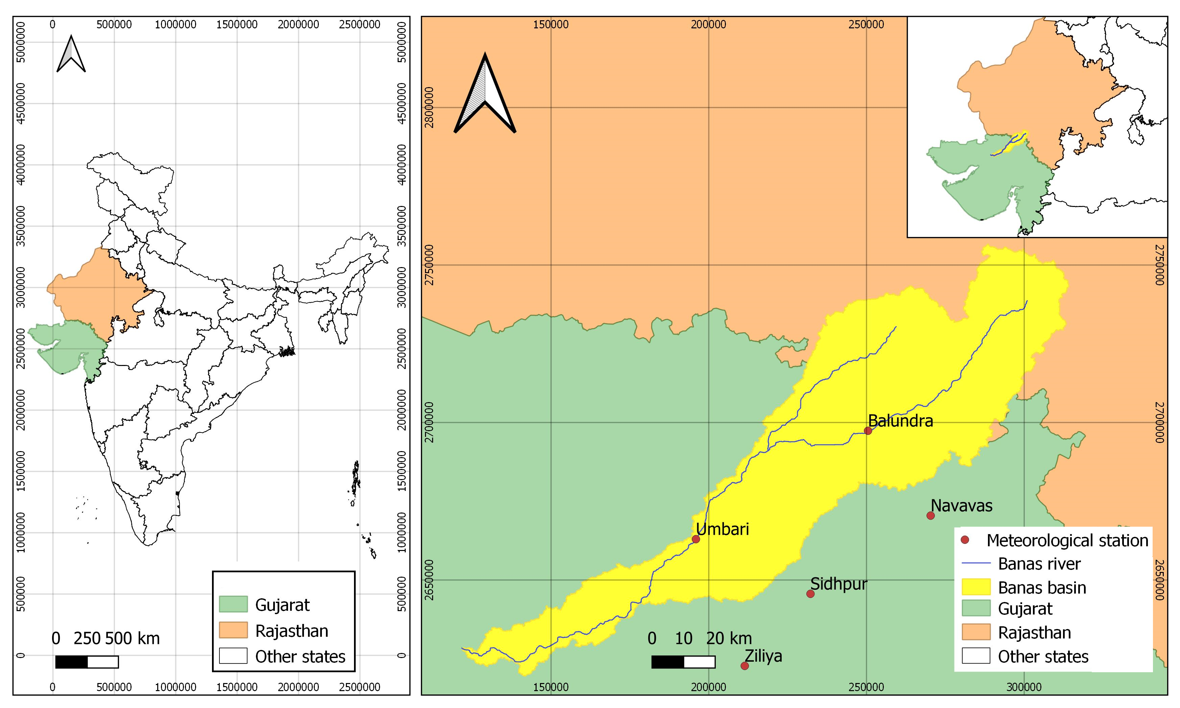
Study area
Basin area - 6,707 km² (43 % in Rajasthan and 57 % in Gujarat)
Length of the river is 225 km
Climate - semi-arid (Köppen-Geiger climate classification)
Annual mean temperature - 29º C
Accumulated annual rainfall - 669 mm
Agriculture provide livelihood to 60-70% of population
Prime source of irrigation - Groundwater
Water related issues in basin:
Groundwater development more than 100%
Floods of year 2007, 2015 and 2017 disrupted lives in the basin
Figure 2. Banas river basin in Rajasthan and Gujarat states of India
Source: CGWB, 2020; Fu et al., 2018

Slide 7
Data
Table 1 . Details of data used in this study
Data | Spatial resolution | Temporal resolution | Data provider | Citation
MODIS Land Surface Temperature (LST) | 1000 m | 1 day | NASA LP DAAC at the USGS EROS Center | Wan et al., 2015
Normalized Difference Vegetation Index (NDVI) | 463 m | 1 day | NASA LP DAAC at the USGS EROS Center | Vermote and Wolfe, 2015
Shuttle Radar Topography Mission (SRTM) Digital Elevation Model (DEM) | 30 m | - | NASA LP DAAC at the USGS EROS Center | NASA JPL, 2013
Latitude and longitude | - | - | NASA LP DAAC at the USGS EROS Center | Wan et al., 2015
In-situ maximum and minimum air temperature (T_{amax} ,T_{amin} ) | Station based | 1 day | Water Resources Department Gujarat | WRDG, 2021

Slide 8

Data and Methodology
Test scheme design
Modelling and evaluation
Dependent variables
In-situ temperature data
MODIS Terra and Aqua LST data
Multivariate regression modelling
Filtering of LST based on correlation coefficient
Calibration and validation
Independent variables
Final models
Auxiliary variables (NDVI, Elevation, Latitude, Longitude)
Test schemes
Air temperature maps

Slide 9
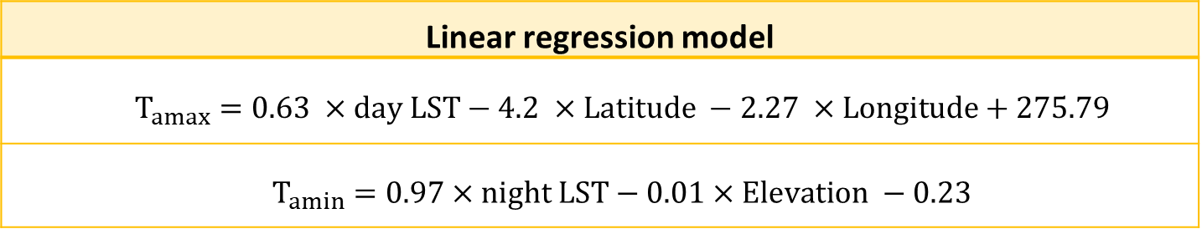
Results
Table 2. Calibrated linear regression models of in-situ temperature data
Linear regression model
$T_{amax}=0.63 ×day LST−4.2 ×Latitude −2.27 ×Longitude+275.79$
$T_{amin}=0.97×night LST−0.01×Elevation −0.23$
Table 3. Calibration and validation results of linear regression models of in-situ temperature data and MODIS LST data
Data | Adjusted R² | Pearson correlation coefficient (r) | Root Mean Square Error (RMSE)
T_{amax} | 0.60 | 0.72 | 3.2º C
T_{amin} | 0.81 | 0.84 | 3.02º C

Slide 10
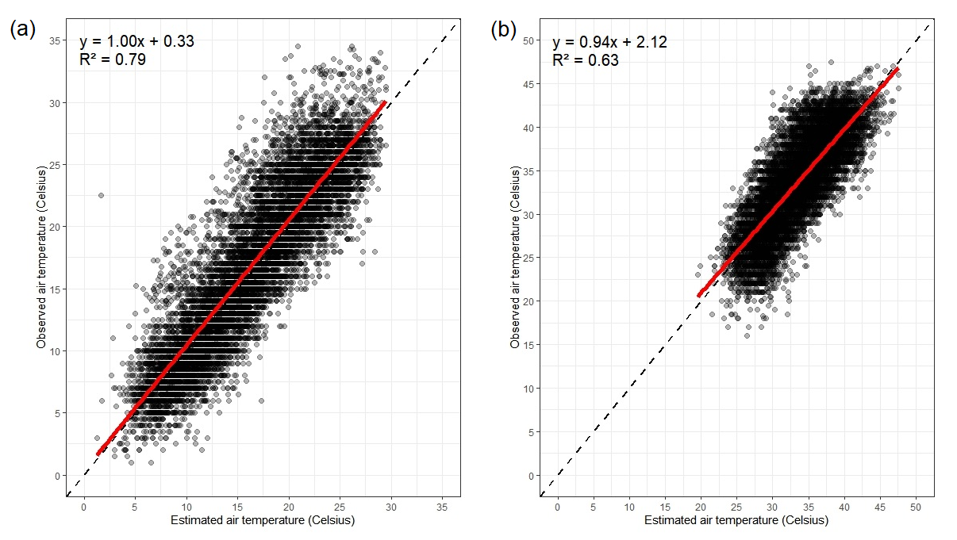
Results
Figure 3. Scatter plots between (a) estimated and observed minimum air temperatures and (b) (a) estimated and observed maximum air temperatures. Black dashed lines represent the line of identity (y = x) and red solid lines show the regression line

Slide 11
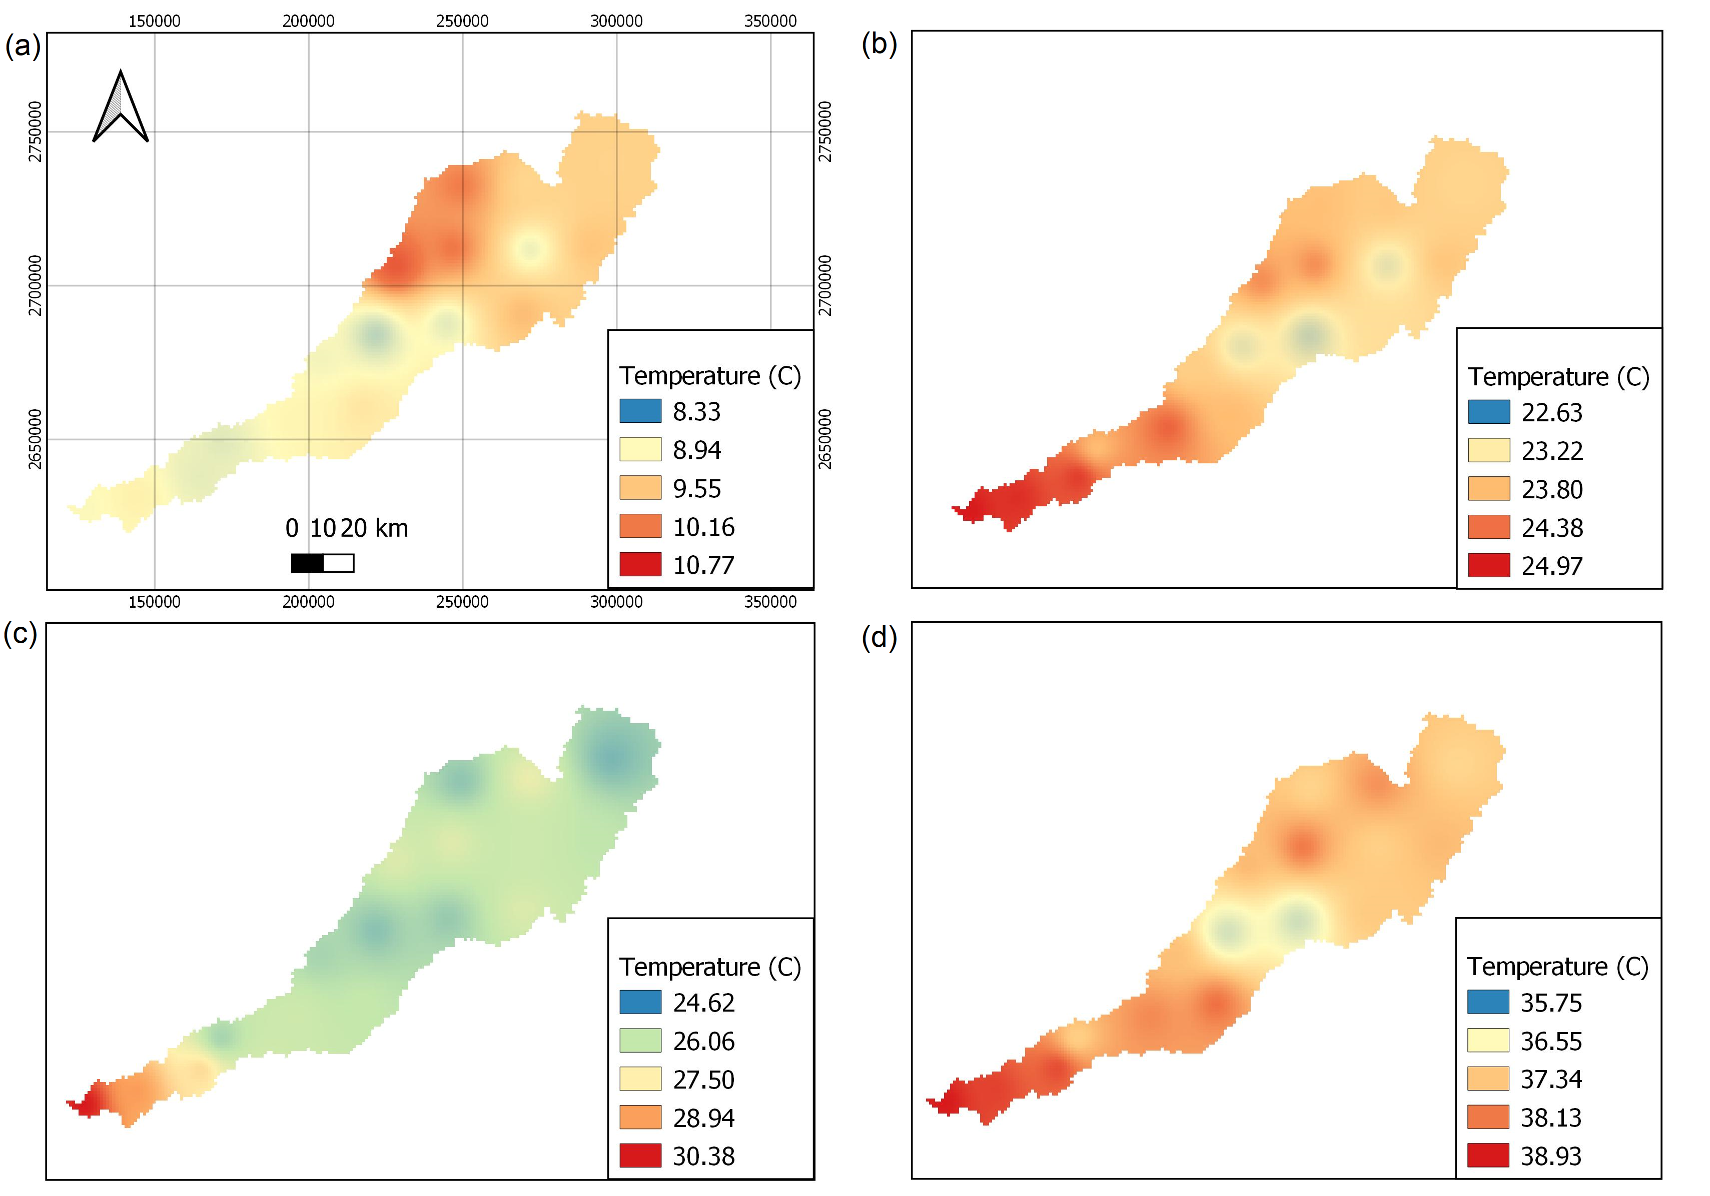
Results
Significant variation between maximum and minimum temperature in January
High maximum and minimum temperature in May
Figure 4. Spatial distribution of (a) average minimum temperature (2001-2016) for January, (b) average minimum temperature (2001-2016) for May, (c) and (d) for maximum temperature derived from the MODIS LST data

Slide 12
Conclusion
Air temperature is an important parameter for weather forecasting, crop yield prediction, hydrological studies, and climate change predictions
Coarse spatial resolution of air temperature observation restricts its application
MODIS LST data and in-situ air temperature data showed good correlation with correlation coefficient 0.75 and 0.86
Multi-variate regression model calibration and validation to predict air temperature using MODIS LST data along with NDVI, elevation, latitude and longitude data
The developed models showed good to excellent performance in predicting the air temperature with adjusted R² value (p<0.01) 0.60 and 0.81 for maximum and minimum temperature respectively
The developed model were used to obtain the spatial distribution of air temperature data at a resolution of 1000 m

Slide 13
References
Balsom, P. (2020, September 28). Water Usage In The Agricultural Industry. High Tide Technologies. https://htt.io/water-usage-in-the-agricultural-industry/.
Colson, L. (2018). WMO Weather Stations [Data set]. USDA FAS. Accessed 2022-05-12 from http://geo.fas.usda.gov/arcgis2/rest/services/G_Overlay/WMO_Station_Overlay/MapServer
Hereher, M. E., & El Kenawy, A. (2020). Extrapolation of daily air temperatures of Egypt from MODIS LST data. Geocarto International, 1-17.
Kitsara, G., Papaioannou, G., Retalis, A., Paronis, D., & Kerkides, P. (2018). Estimation of air temperature and reference evapotranspiration using MODIS land surface temperature over Greece. International journal of remote sensing, 39(3), 924-948.
McGrath, M. (2021, August 4). Floods: Research shows millions more at risk of flooding. BBC. https://www.bbc.com/news/science-environment-58087479#:~:text=They%20estimate%20that%20by%202030,change%2C%22%20said%20Dr%20Tellman.
Mekonnen, M. M., & Hoekstra, A. Y. (2016). Four billion people facing severe water scarcity. Science advances, 2(2), e1500323.
NASA JPL. (2013). NASA Shuttle Radar Topography Mission Global 1 arc second [Data set]. NASA EOSDIS Land Processes DAAC. Accessed 2022-05-12 from https://doi.org/10.5067/MEaSUREs/SRTM/SRTMGL1.003
Otgonbayar, M., Atzberger, C., Mattiuzzi, M., & Erdenedalai, A. (2019). Estimation of climatologies of average monthly air temperature over mongolia using MODIS land surface temperature (LST) time series and machine learning techniques. Remote Sensing, 11(21), 2588.
Peel, M. C., Finlayson, B. L., & McMahon, T. A. (2007). Updated world map of the Köppen-Geiger climate classification. Hydrology and earth system sciences, 11(5), 1633-1644.
Tebor, C. (2021, July 16). The current drought is worldwide. Here’s how different places are fighting. Los Angeles Times. https://www.latimes.com/world-nation/story/2021-07-16/drought-water-use-strategies.
The World Bank. (2020). Water in Agriculture. https://www.worldbank.org/en/topic/water-in-agriculture#1.
Vermote, E., Wolfe, R. (2015). MOD09GA MODIS/Terra Surface Reflectance Daily L2G Global 1kmand 500m SIN Grid V006 [Data set]. NASA EOSDIS Land Processes DAAC. Accessed 2022-05-12 from https://doi.org/10.5067/MODIS/MOD09GA.006
Wan, Z., Hook, S., Hulley, G. (2015). MOD11A1 MODIS/Terra Land Surface Temperature/Emissivity Daily L3 Global 1km SIN Grid V006 [Data set]. NASA EOSDIS Land Processes DAAC. Accessed 2022-05-12 from https://doi.org/10.5067/MODIS/MOD11A1.006
World Health Organisation. (2021). Climate change and health. http://www.who.int/mediacentre/factsheets/fs266/en/.
Yoo, C., Im, J., Park, S., & Quackenbush, L. J. (2018). Estimation of daily maximum and minimum air temperatures in urban landscapes using MODIS time series satellite data. ISPRS journal of photogrammetry and remote sensing, 137, 149-162.

