Slide 1





First analysis of shallow tremors
In the Guerrero seismic gap.
Raymundo Plata-Martinez, Yoshihiro Ito
May 24, 2022. EGU22-6888
Notes:
Thank you all for being here

Slide 2
Objective
Search and characterize
shallow tremors
at the Guerrero seismic gap
Focal mechanism
+
Radiated seismic energy
Notes:
The objective of my research has been to:
Search and characterize shallow tremors at the Guerrero seismic gap.
To do so we have been analysis their focal mechanism and radiated seismic energy.

Slide 3
Introduction Guerrero seismic gap
Kotoglodov and Pacheco (1999)
Notes:
To start off we go to the Mexican subduction zone and focus into the Guerrero region.
Here is the Guerrero seismic gap, an area where no large earthquake has happened in more than 110 years.
We analyzed the shallow plate interface of the Guerrero seismic gap in search of shallow slow earthquakes to keep improving our knowledge of the seismic gap.

Slide 4
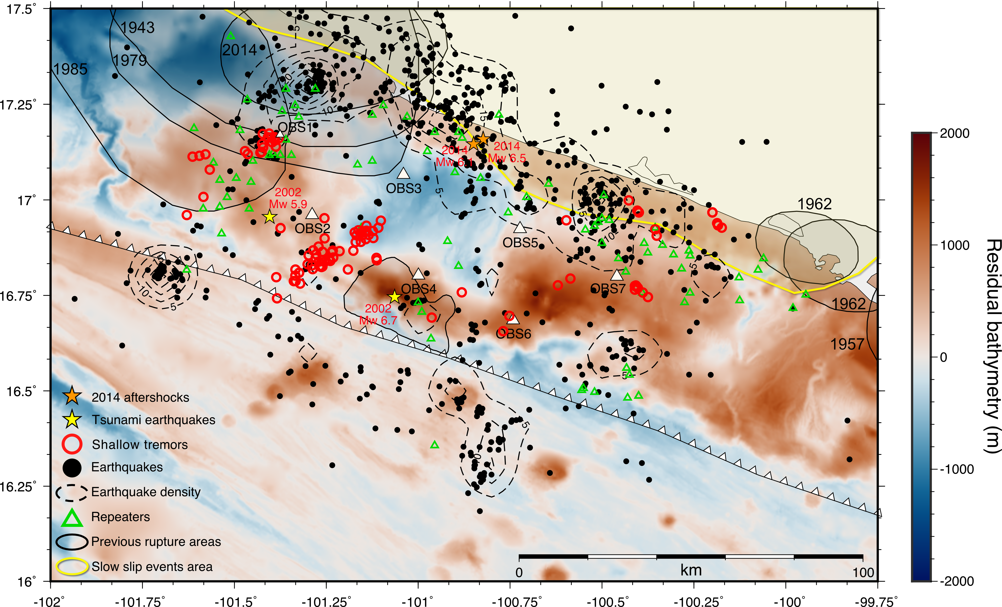

Introduction
Guerrero gap offshore observations
Residual bathymetry [m]
2000
1000
0
-1000
-2000
Episodic Shallow tremors
Repeaters
Seismicity
SSE
“Silent zone” is locked – unlocked ? close to stable sliding domain
SSE
Shallow Tremors
Plata-Martinez et al. (2021)
Plata-Martinez et al. (2021)
Notes:
To do so we deployed an array of offshore seismic stations at the gap.
We have the first observation of shallow tremors in Mexico, shown in red circles.
We also detected repeaters that correlate very nicely with shallow tremors, shown in green
With black circles we show detected small seismicity and with contour lines showing density of events.
On the background we have residual bathymetry, useful to interpret topography at the plate interface such as subducting seamounts, that can be interpreted with positive anomalies.
very interesting is A SILENT ZONE, this region which is absent of most seismic activity.
An important questions would be: Is this silent zone completely locked or unlocked?
Given the low plate coupling in the gap, and our shallow observations, we have proposed that the silent zone is closer to a stable sliding domain.
So now that we have the first observation of shallow tremors, we would like to learn as much as we can about them.

Slide 5
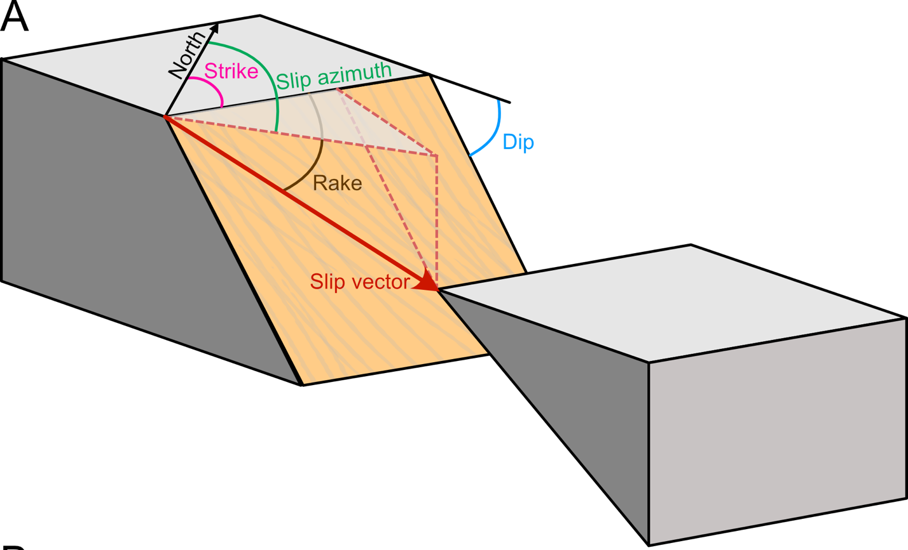
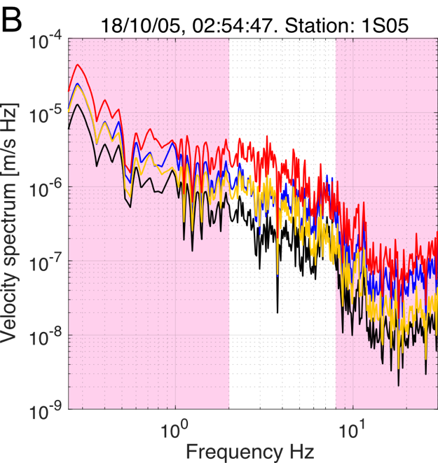
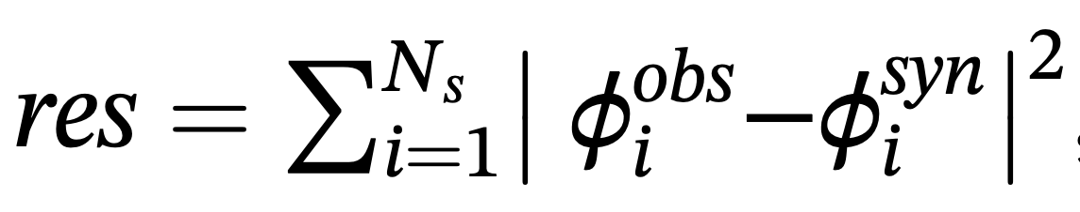
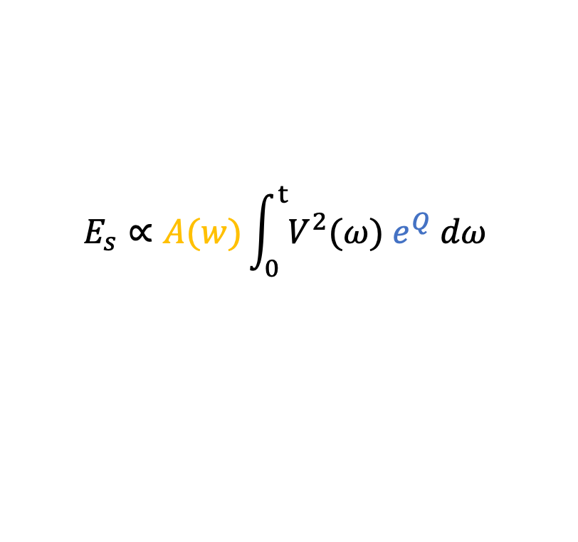
Method Shallow tremor analysis
Focal Mechanism
Seismic Energy
S wave source polarization
2-8 Hz
(Imanishi et. al., 2015; Ohta et. al., 2019)
$$E_{s}∝A(w)\int_{0}^{t}{V^{2}(ω) e^{Q} dω}$$
Singh and Ordaz (1992)
Yabe et. al. (2019)
Shallow tremor spectrum [2 – 8 Hz]
Observed spectrum
Site effect corr.
Attenuation corr.
Corrected spectrum
Synthetic S wave polarizations
[2 – 8 Hz]
* 180˚ rake ambiguity *
Scaling parameter: tremor duration
Notes:
To do so we are analyze shallow tremors focal mechanism and seismic energy
For focal mechanism we are using S wave source polarization.
In this method we propose parameters to describe a focal mechanism, to calculate a synthetic S wave polarization.
Then we will only need to find the best parameters solution that will minimize the residual between an observed and synthetic polarization.
One disadvantage of this method is that we have “A” 180 degrees rake ambiguity.
On the other side; we know we know that seismic energy is proportional to an energy flux, and then corrected by site effect and attenuation.
Here we have an example of an observed shallow tremor spectrum in black
That can be corrected by site effect and attenuation.
Then the corrected spectrum can be used to estimate energy in a frequency band between 2-8 HZ.
As a scaling parameter for energy, we are using tremor duration.

Slide 6
Results Shallow tremors focal mechanisms
Different directions of faulting
Very low or high dip angle (~20˚or ~80˚)
Subduction strike as reference
Principal nodal plane
Auxiliary nodal plane
Dip direction
Slip azimuth
Plate motion
CO-NA
(Morvel 56)
Shallow tremors tend to:
Have a slip azimuth following the plate motion
Rupture at the plate interface
Notes:
Here are the results of shallow tremors focal mechanisms.
We can see different directions of faulting, with a very low or very high dip angles depending on which nodal plane we choose.
Using the trench strike as a reference we can get two possible solutions for principal and auxiliary nodal planes.
Both solutions are shown in these polar histograms, with their dip direction in blue, and slip azimuth in red.
Over here I’m showing the plate motion of Cocos plate with respect of the North American plate and comparing it with the two nodal planes solutions.
We can see that the plate motion and the focal mechanisms directions agree very nicely, so we can conclude that shallow tremors tend to have a slip azimuth following the plate motion, therefore they rupture at the plate interface.

Slide 7
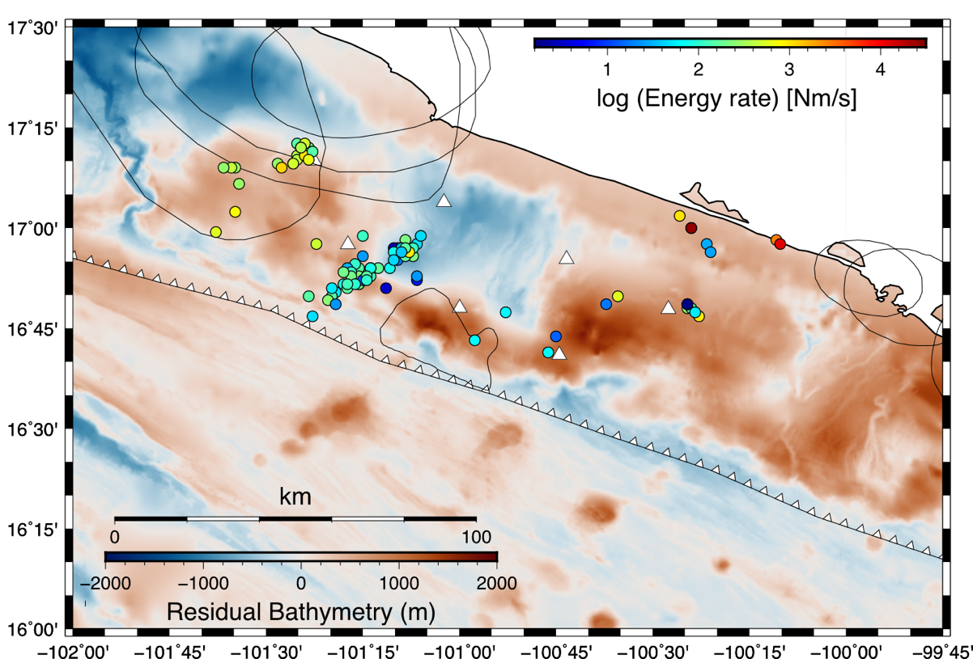
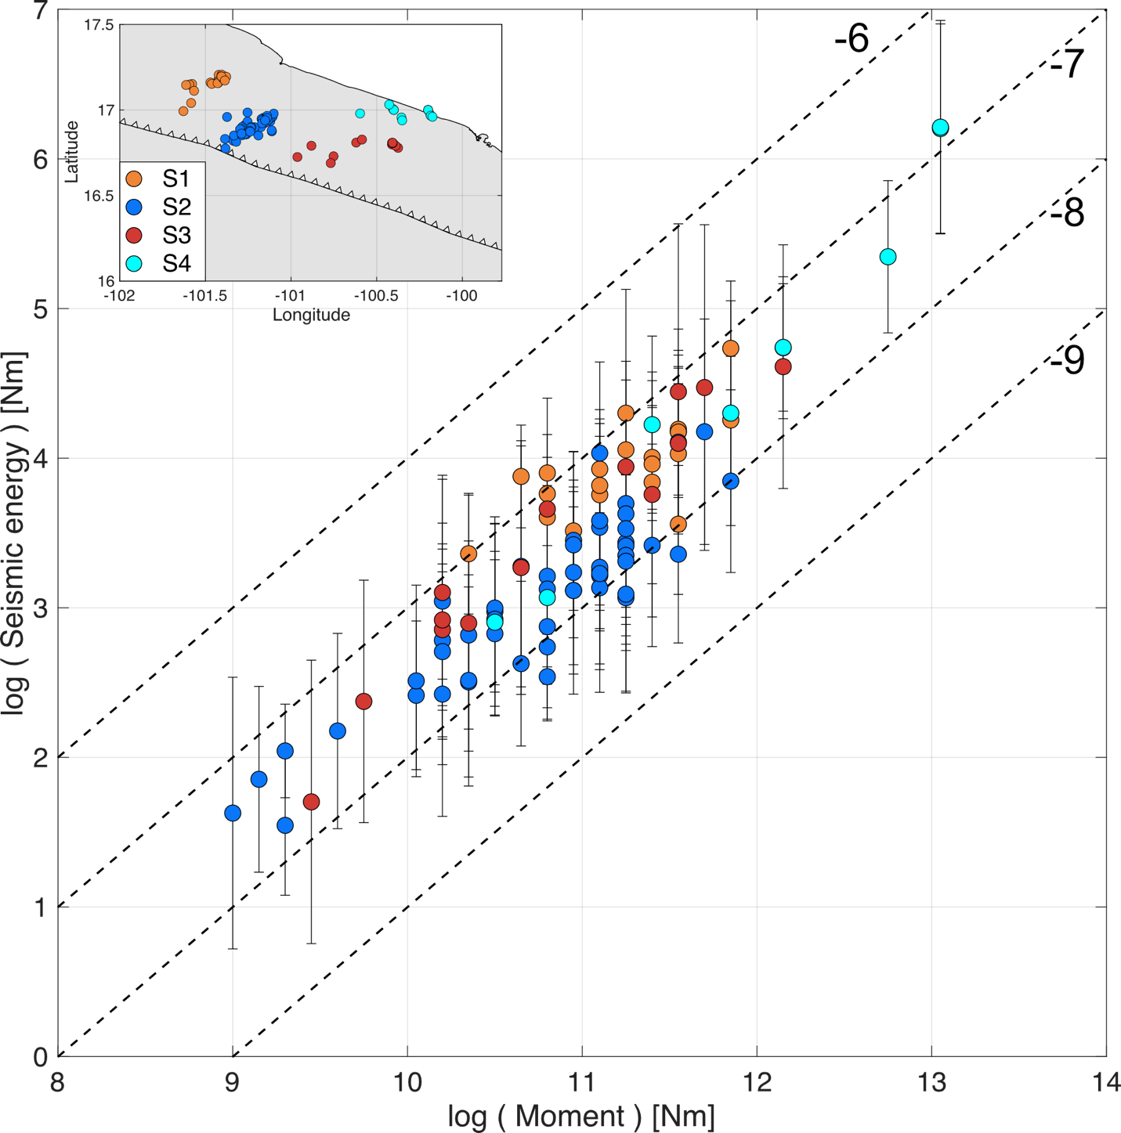
Results Shallow tremors radiated seismic energy
Tremor clusters
S1
S2
S1
Outside the GG
Over large rupture areas
Higher coupling
Recurrence: 3 months
Higher energies
Longer recurrence
S2
Inside the GG
Next to a stable sliding region
Lower coupling
Recurrence: 1 month
Lower energies
Shorter recurrence
Long recurrence period has higher frictional strength, which can support higher stress and radiated more energy
(Brudzinski & Allen, 2007; Yabe & ide, 2014; Yabe at al, 2021)
Notes:
Lastly, we have seismic energy results.
I am separating tremors into four different clusters shown with different colors.
This plot is showing seismic energy versus a relative seismic moment. We can see how different clusters have different energy behavior.
Here we see distribution of energy rate.
it is clear how cluster S1 has larger energies compared to cluster S2 with smaller energies.
This can be interpreted as a very heterogeneous energy release along the plate interface.
Tremors in S1 are outside the Guerrero seismic gap, over large previous rupture areas, where we expect higher coupling. We also saw tremor episodes with a longer recurrence period of 3 months.
On the other hand, tremors in S2 are inside the Guerrero gap, next to a stable sliding region, with low coupling, and tremor episodes have a shorter recurrence period of 1 month.
Therefore, we see a correlation of higher energies with long recurrence period and lower energies with short recurrence period.
Finally this can be explained considering that long recurrence period has higher frictional strength, which can support higher stress and radiated more energy.

Slide 8
Thank you for
your attention
Raymundo Plata-Martínez, Yoshihiro Ito
raymundo.plata@jamstec.go.jp
May 24, 2022. EGU22-6888
Notes:
With that I will finish my short presentation.
Thank you for your attention, questions and comments.

