Slide 1
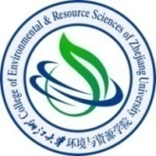

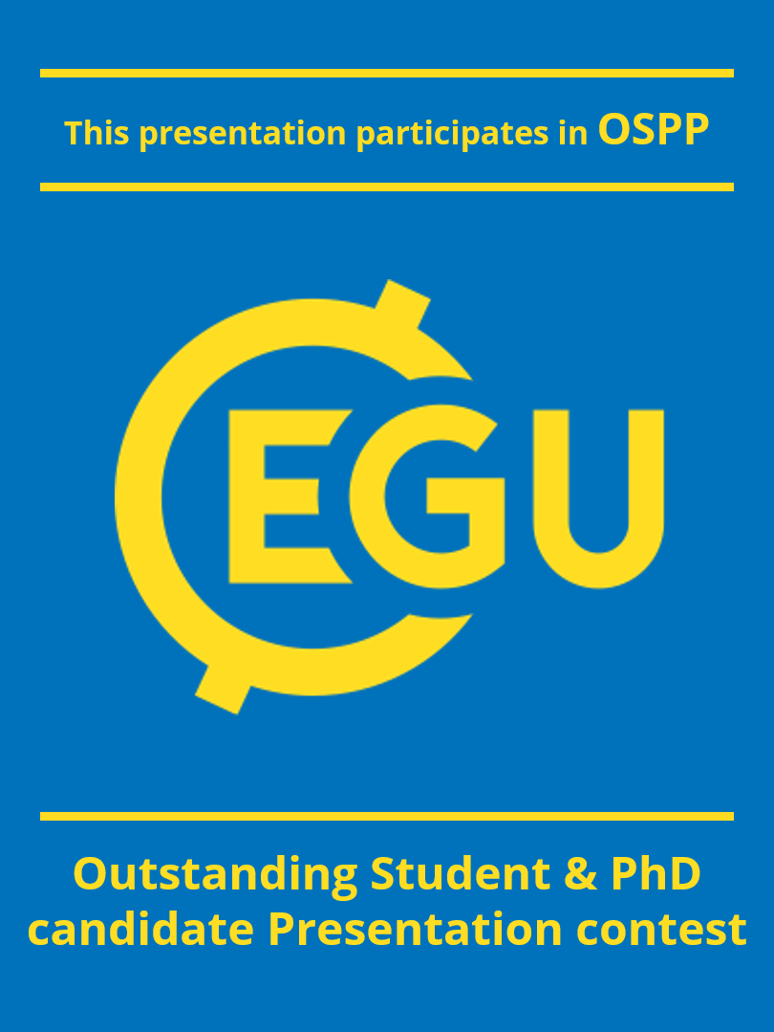

2022.5.25
How the Air Clean Plan and carbon mitigation measures co-benefited China in the environment and health from 2014 to 2020
Zhige Wang
zgwang@zju.edu.cn
Institute of Agricultural Remote Sensing and Information Technology Application, Zhejiang University, Hangzhou, 310058, China.

Slide 2
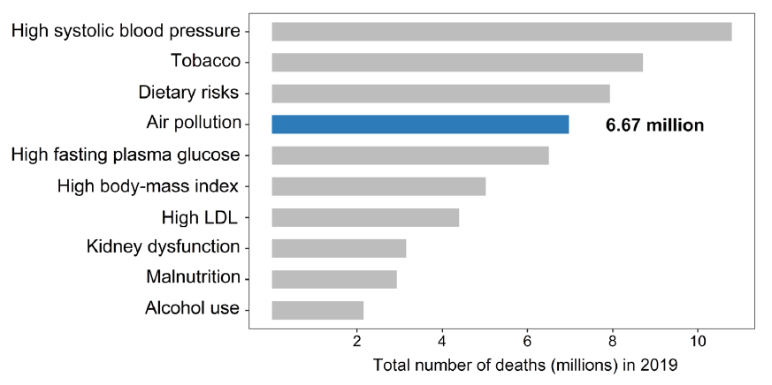
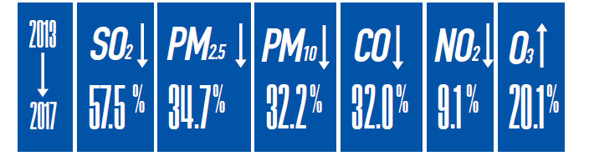

研 究 背 景
Exposure to ambient PM_{2.5} has caused over 4 million death around the world
Exposure to ambient PM_{2.5} (fine particulate matter with an aerodynamic diameter ≤ 2.5 μm) increases the premature death from cause-specific diseases, which has caused over 4 million death globally in 2019
Over the past 7 years, Chinese government launched the strict Air Clean Plan (ACP) to address the problem of severe air pollution. At present, reducing concentrations of air pollutants to the levels recommended by the World Health Organization (also the “Beautiful China” vision in China) is the next, and more difficult challenge for China
Changes of major air pollutants in China in 2017 compared with 2013
Global ranking of risk factors by total number of death from all causes in 2019
(Murray et al. 2020, Lancet)
The blue sky in Beijing and Shanghai, China

Slide 3
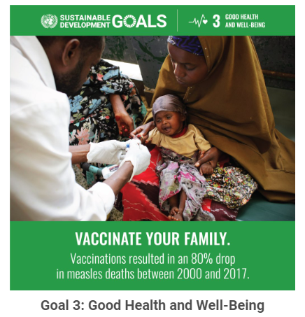
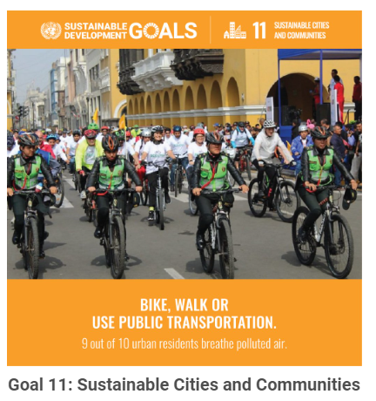
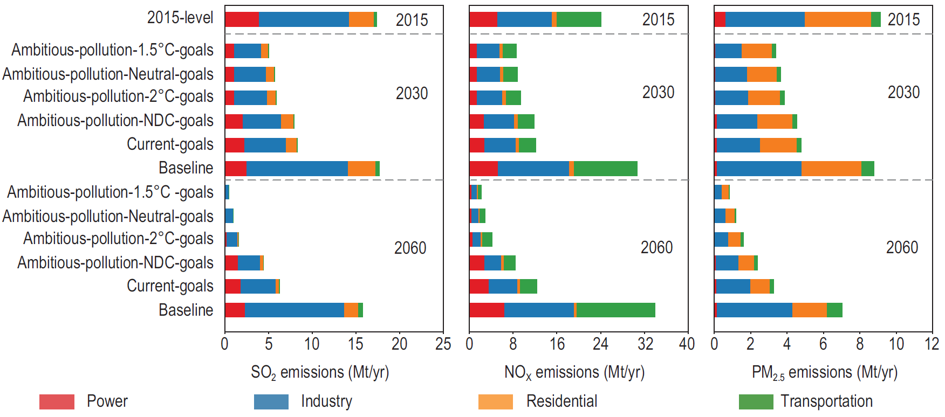
Carbon mitigation can synergistically improve air quality and reduce related death
CO₂ and PM_{2.5} precursors have the analogous sources, mainly from the process of coal combustion. As a results, policies aimed at CO₂ mitigations could bring health co-benefits from abated air pollution
Facing dual pressures from air clean and GHGs mitigation, evaluating the benefits of ACP and clarifying the co-benefits of carbon mitigation are of great significance for achieving the goals of “Beautiful China” and the UN’s SDG target.
Sustainable Development Goals (SDG) related to environment and health
The primary PM_{2.5} emission can simultaneously reduce under different carbon reduction pathways
(Cheng et al. 2021, Nat. Sci. Rev.)

Slide 4
How the Air Clean Plan and carbon mitigation measures co-benefited China in environment and health?
APPCAP
APWBSD
2014
2017
2020
Environment benefits
Air Clean Plan
PM_{2.5} concentrations
Carbon mitigation
Assessment
Decomposition
Health benefits
Socio-economic factors
Attributable death
Vulnerability factors

Slide 5
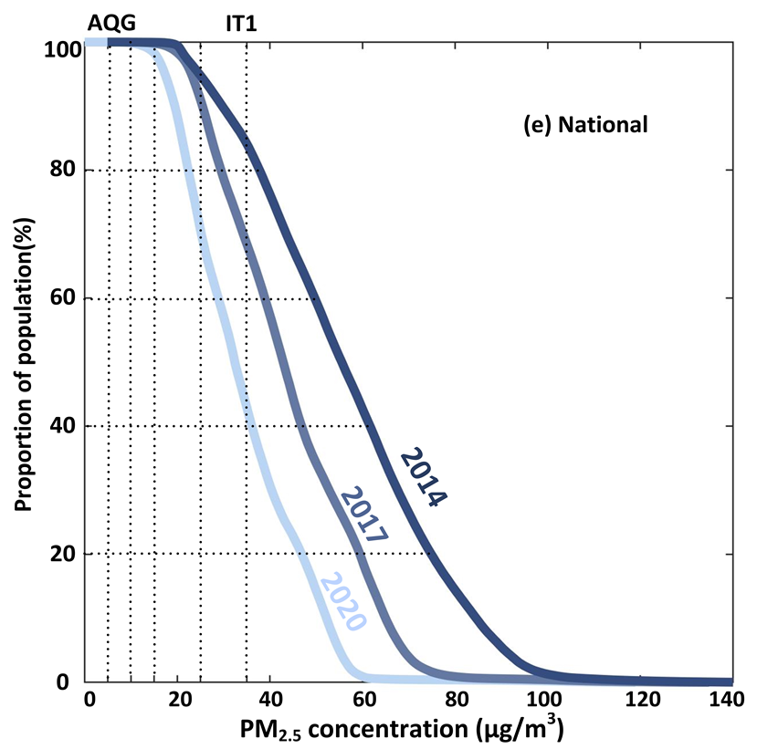
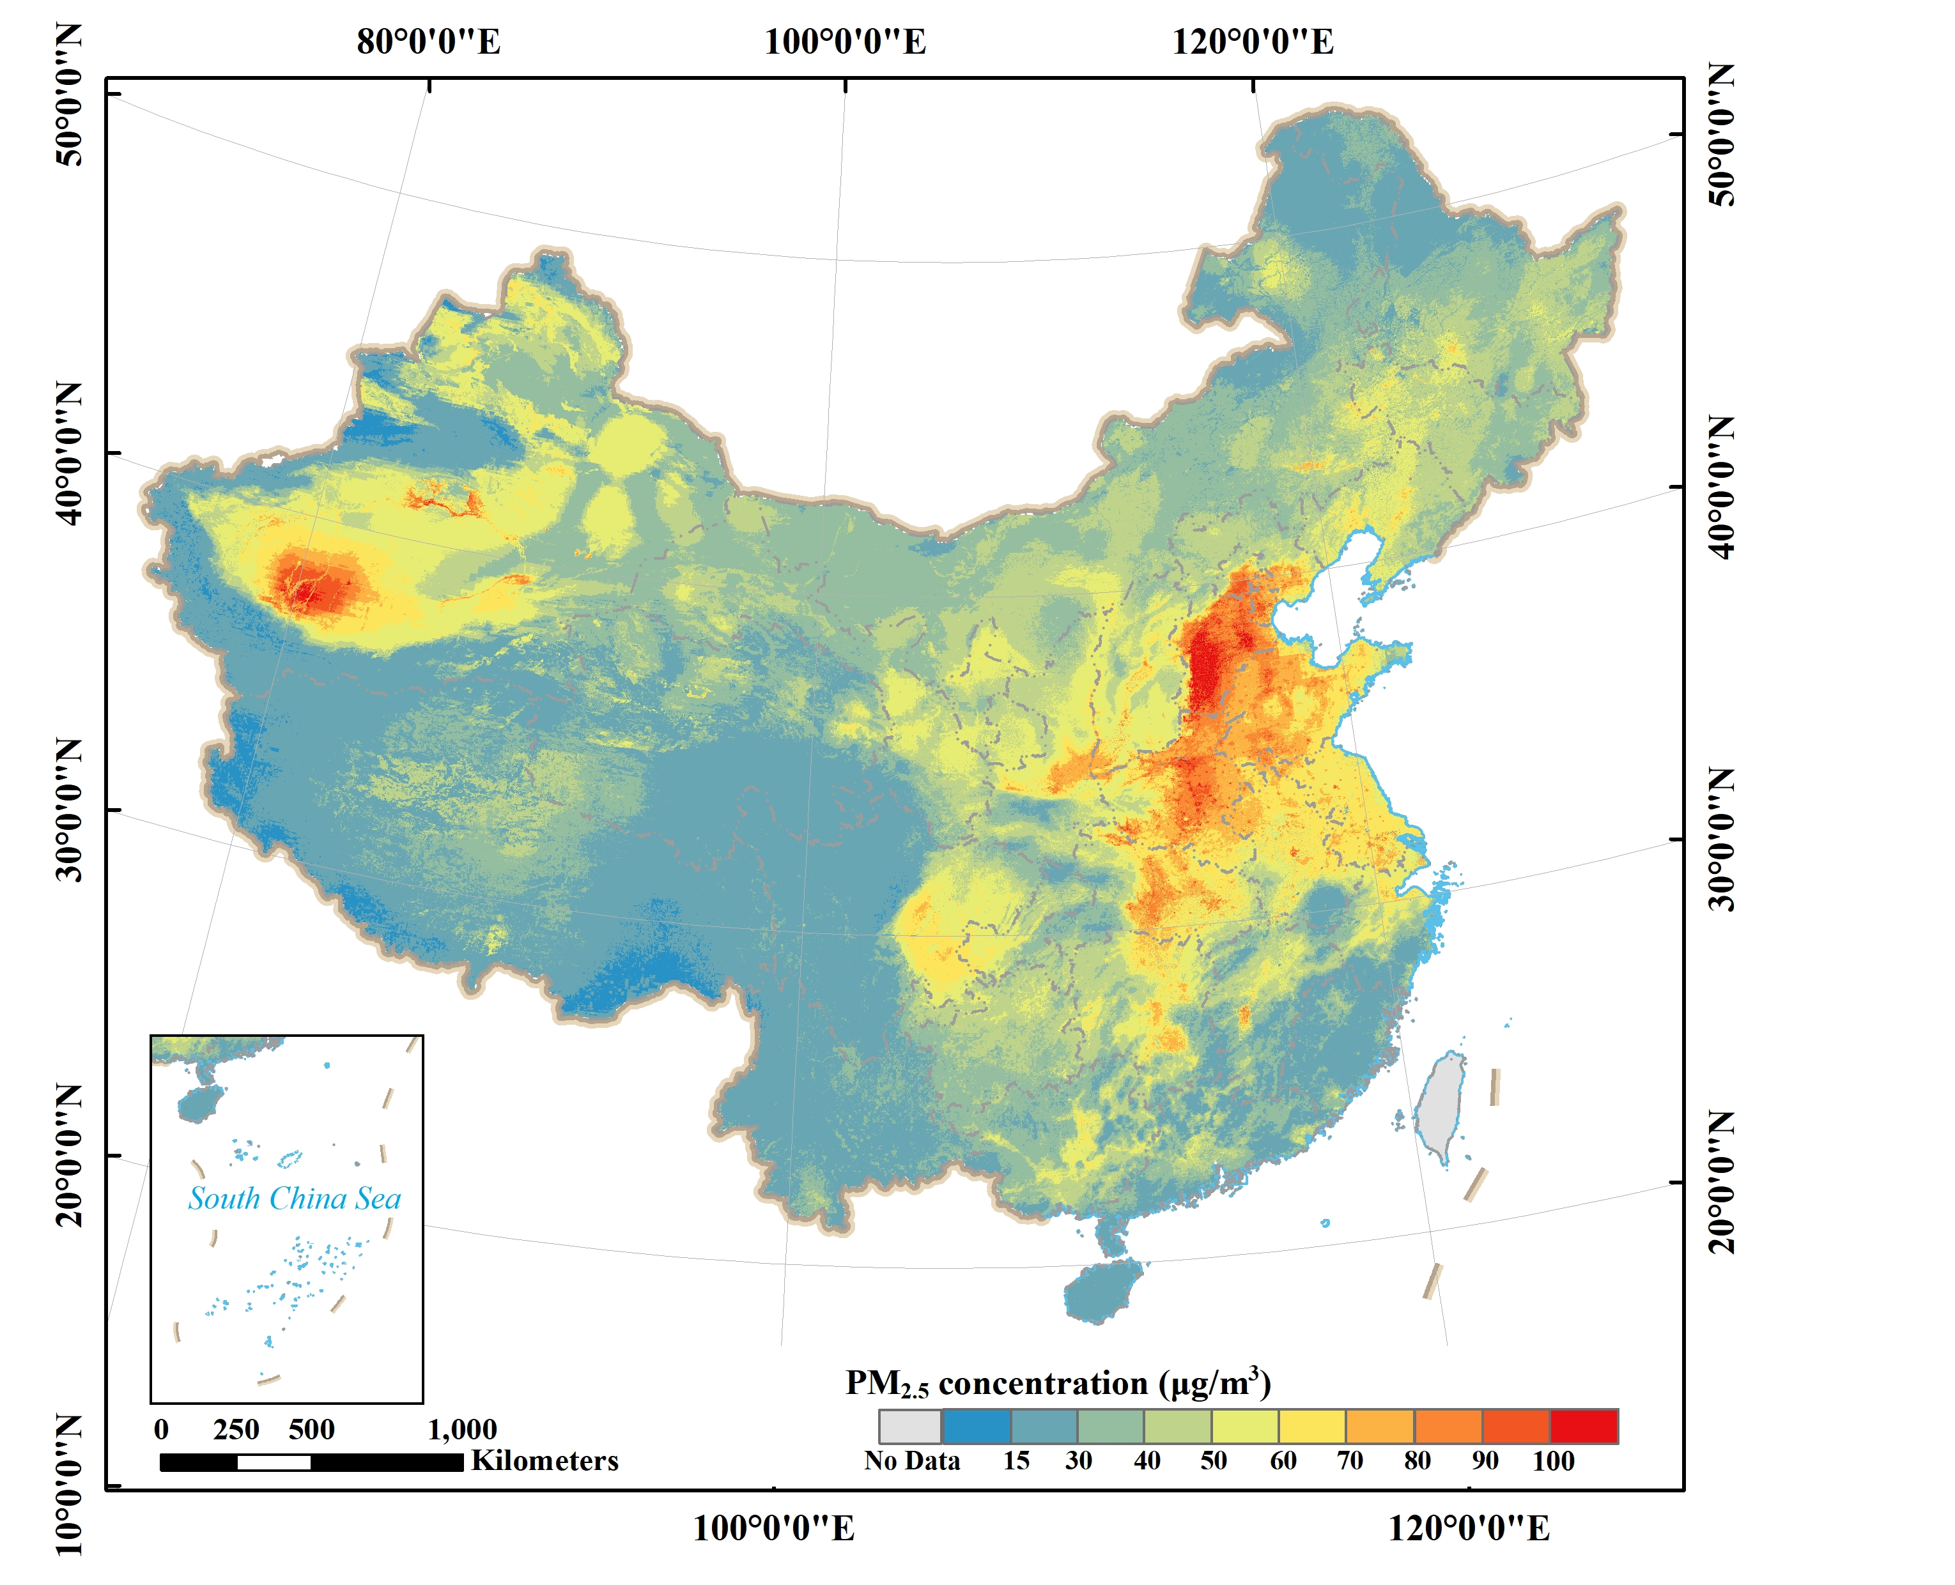
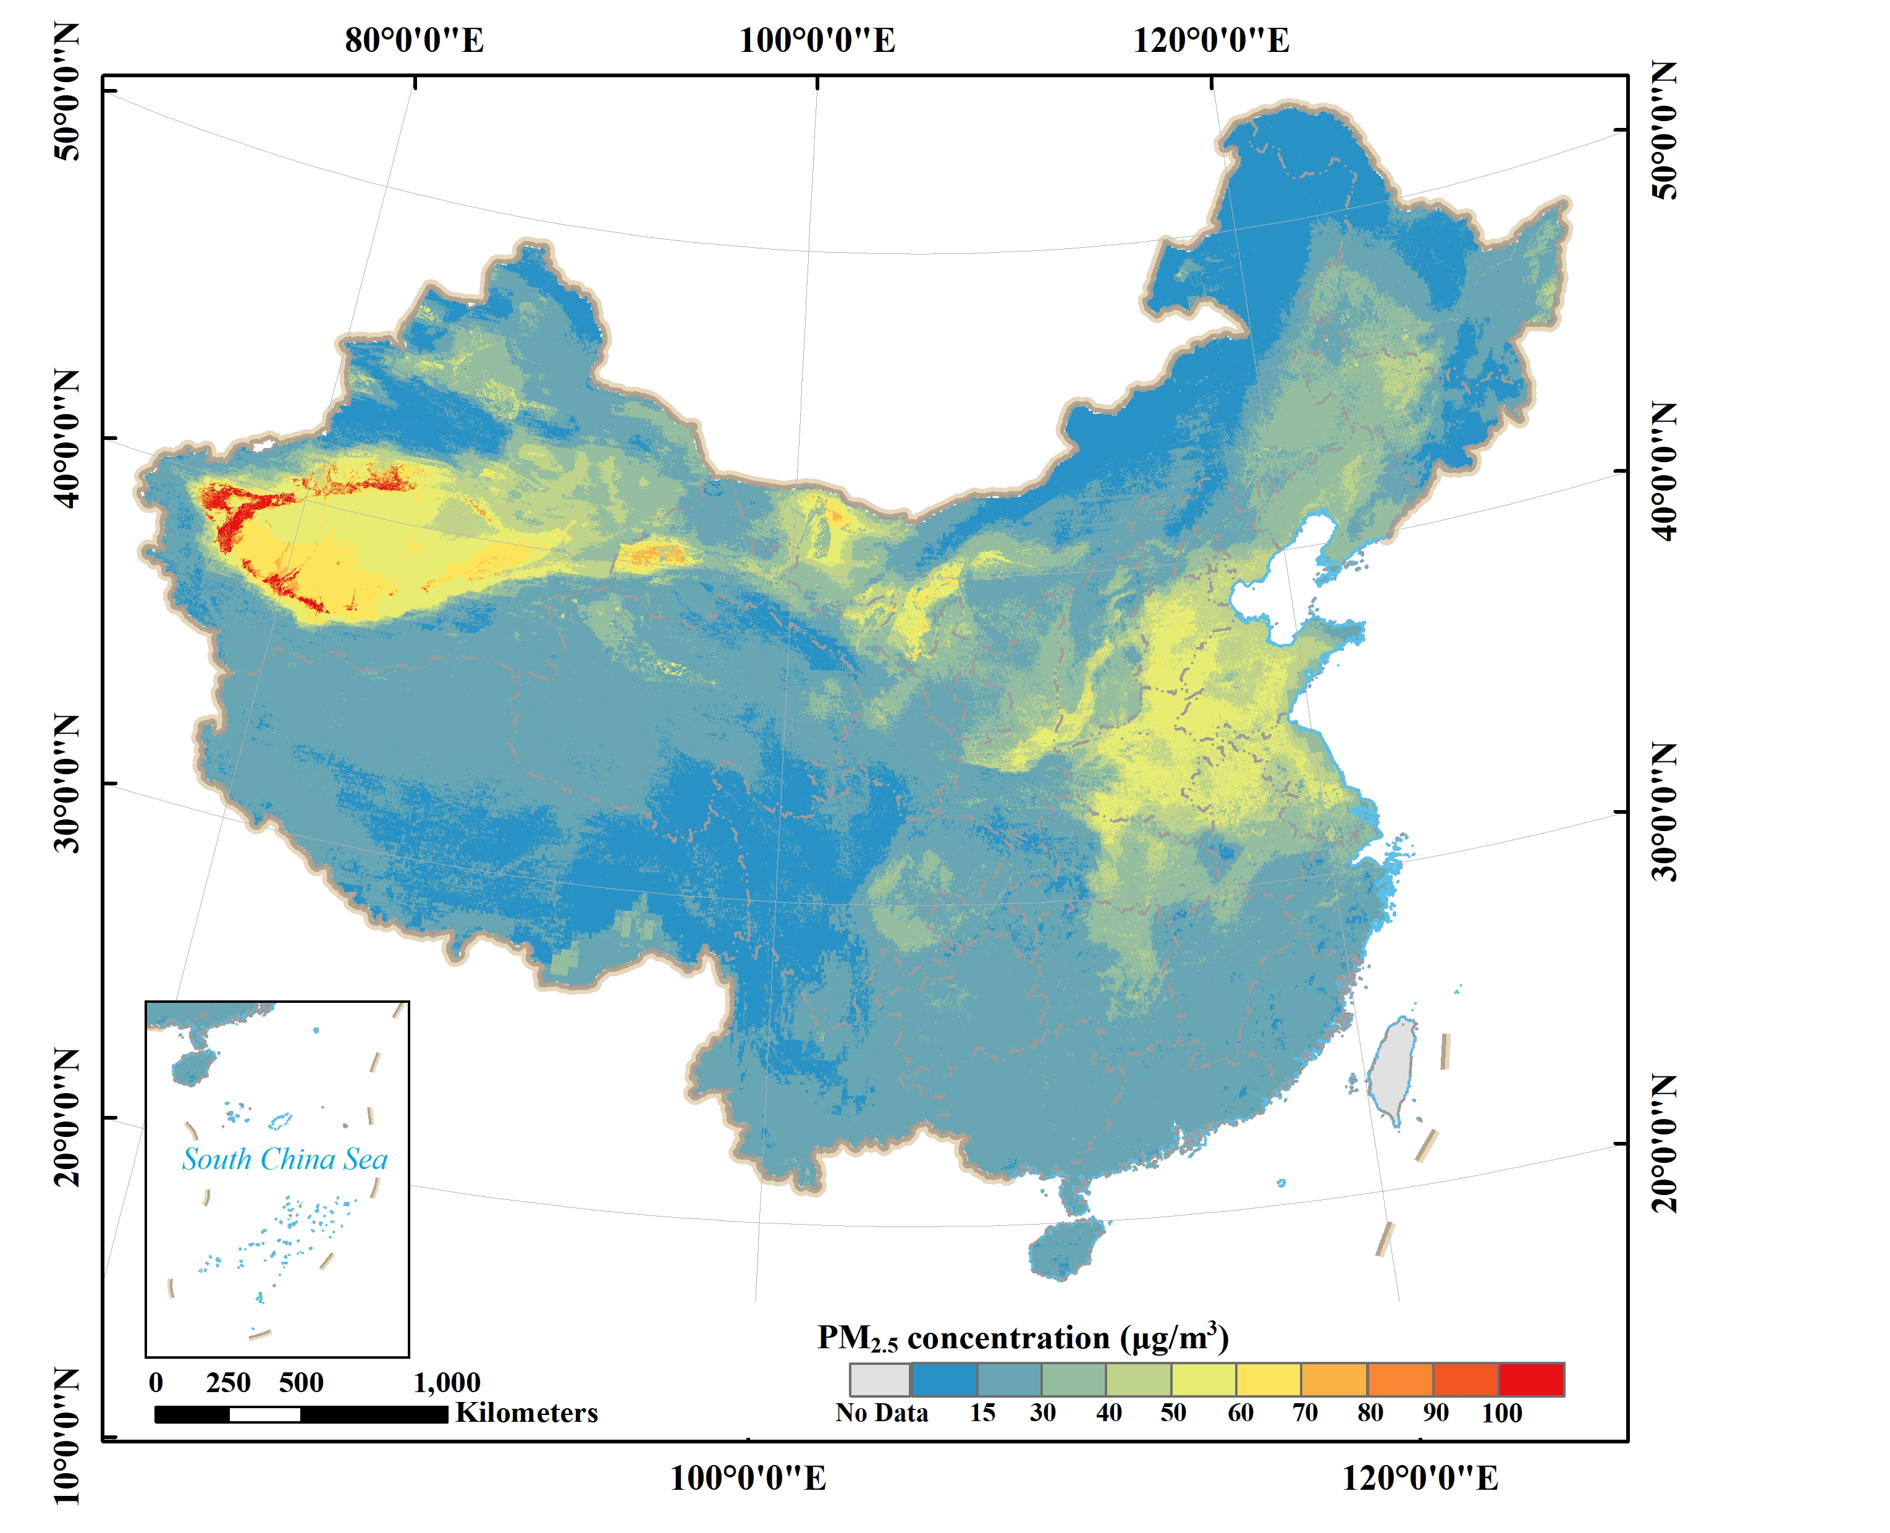
Environment benefits: Change in PM_{2.5} concentrations
Pixel/National level
Population exposure risk
With seven-year efforts of ACP, the mean PM_{2.5} concentrations clearly decreased (13.41μg m⁻³, 33.65%) in China.
High concentrations were observed mainly in northwest China, northern China, and a small proportion of central China.
In 2014, over 80% of Chinese people lived in areas with PM_{2.5} exceeding WHO IT-1 (35 μg m⁻³).
In 2020, the proportion decreased to 40%. However, almost all populations (~98%) still lived above the WHO IT-3 (15 μg m⁻³) in 2020, not to mention the WHO AQG (5 μg m⁻³) standard.
2014
2020
The annual mean PM_{2.5} concentrations
Proportion of people exposed to PM_{2.5}

Slide 6
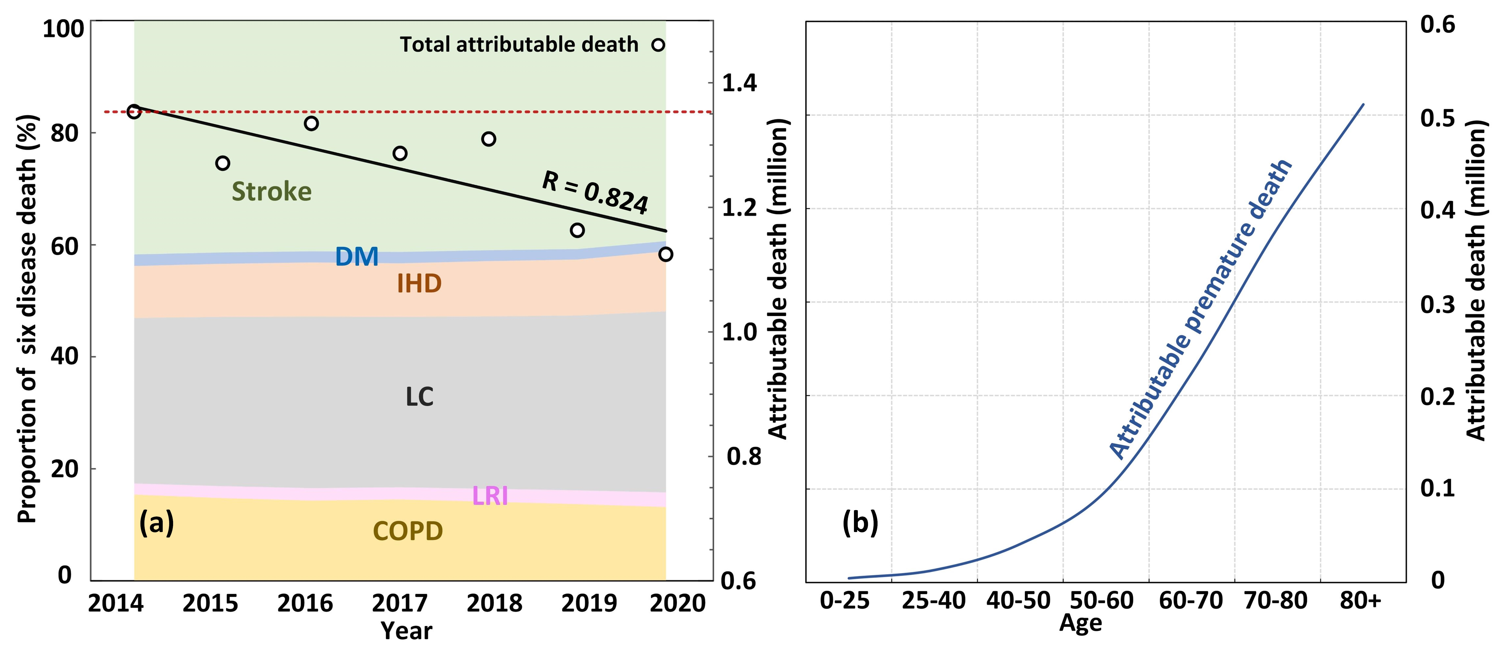
Health benefits : Change in PM_{2.5} attributable death
The ambient PM_{2.5} attributable deaths showed a distinctive decrease trend, from 1.35 million (95% CI: 1.06-1.78) to 1.12 million (95% CI: 0.79-1.56) in 2020, accounting for ~27.05% of global ambient PM_{2.5}-related death.
The PM_{2.5} attributable deaths were primarily caused by Stroke and lung cancer (LC) in China, which accounted for 41.12% and 30.55% of total premature death, respectively.
The attributable death increased remarkably with the increase of age.
(a) The number of attributable death and proportion of 6 diseases in total deaths, (b) the number of deaths in different ages.(Stroke: cerebrovascular disease; DM: type Ⅱ diabetes; IHD: ischemic heart disease; LC: lung cancer; LRI: lower respiratory infections; COPD: chronic obstructive pulmonary disease)

Slide 7
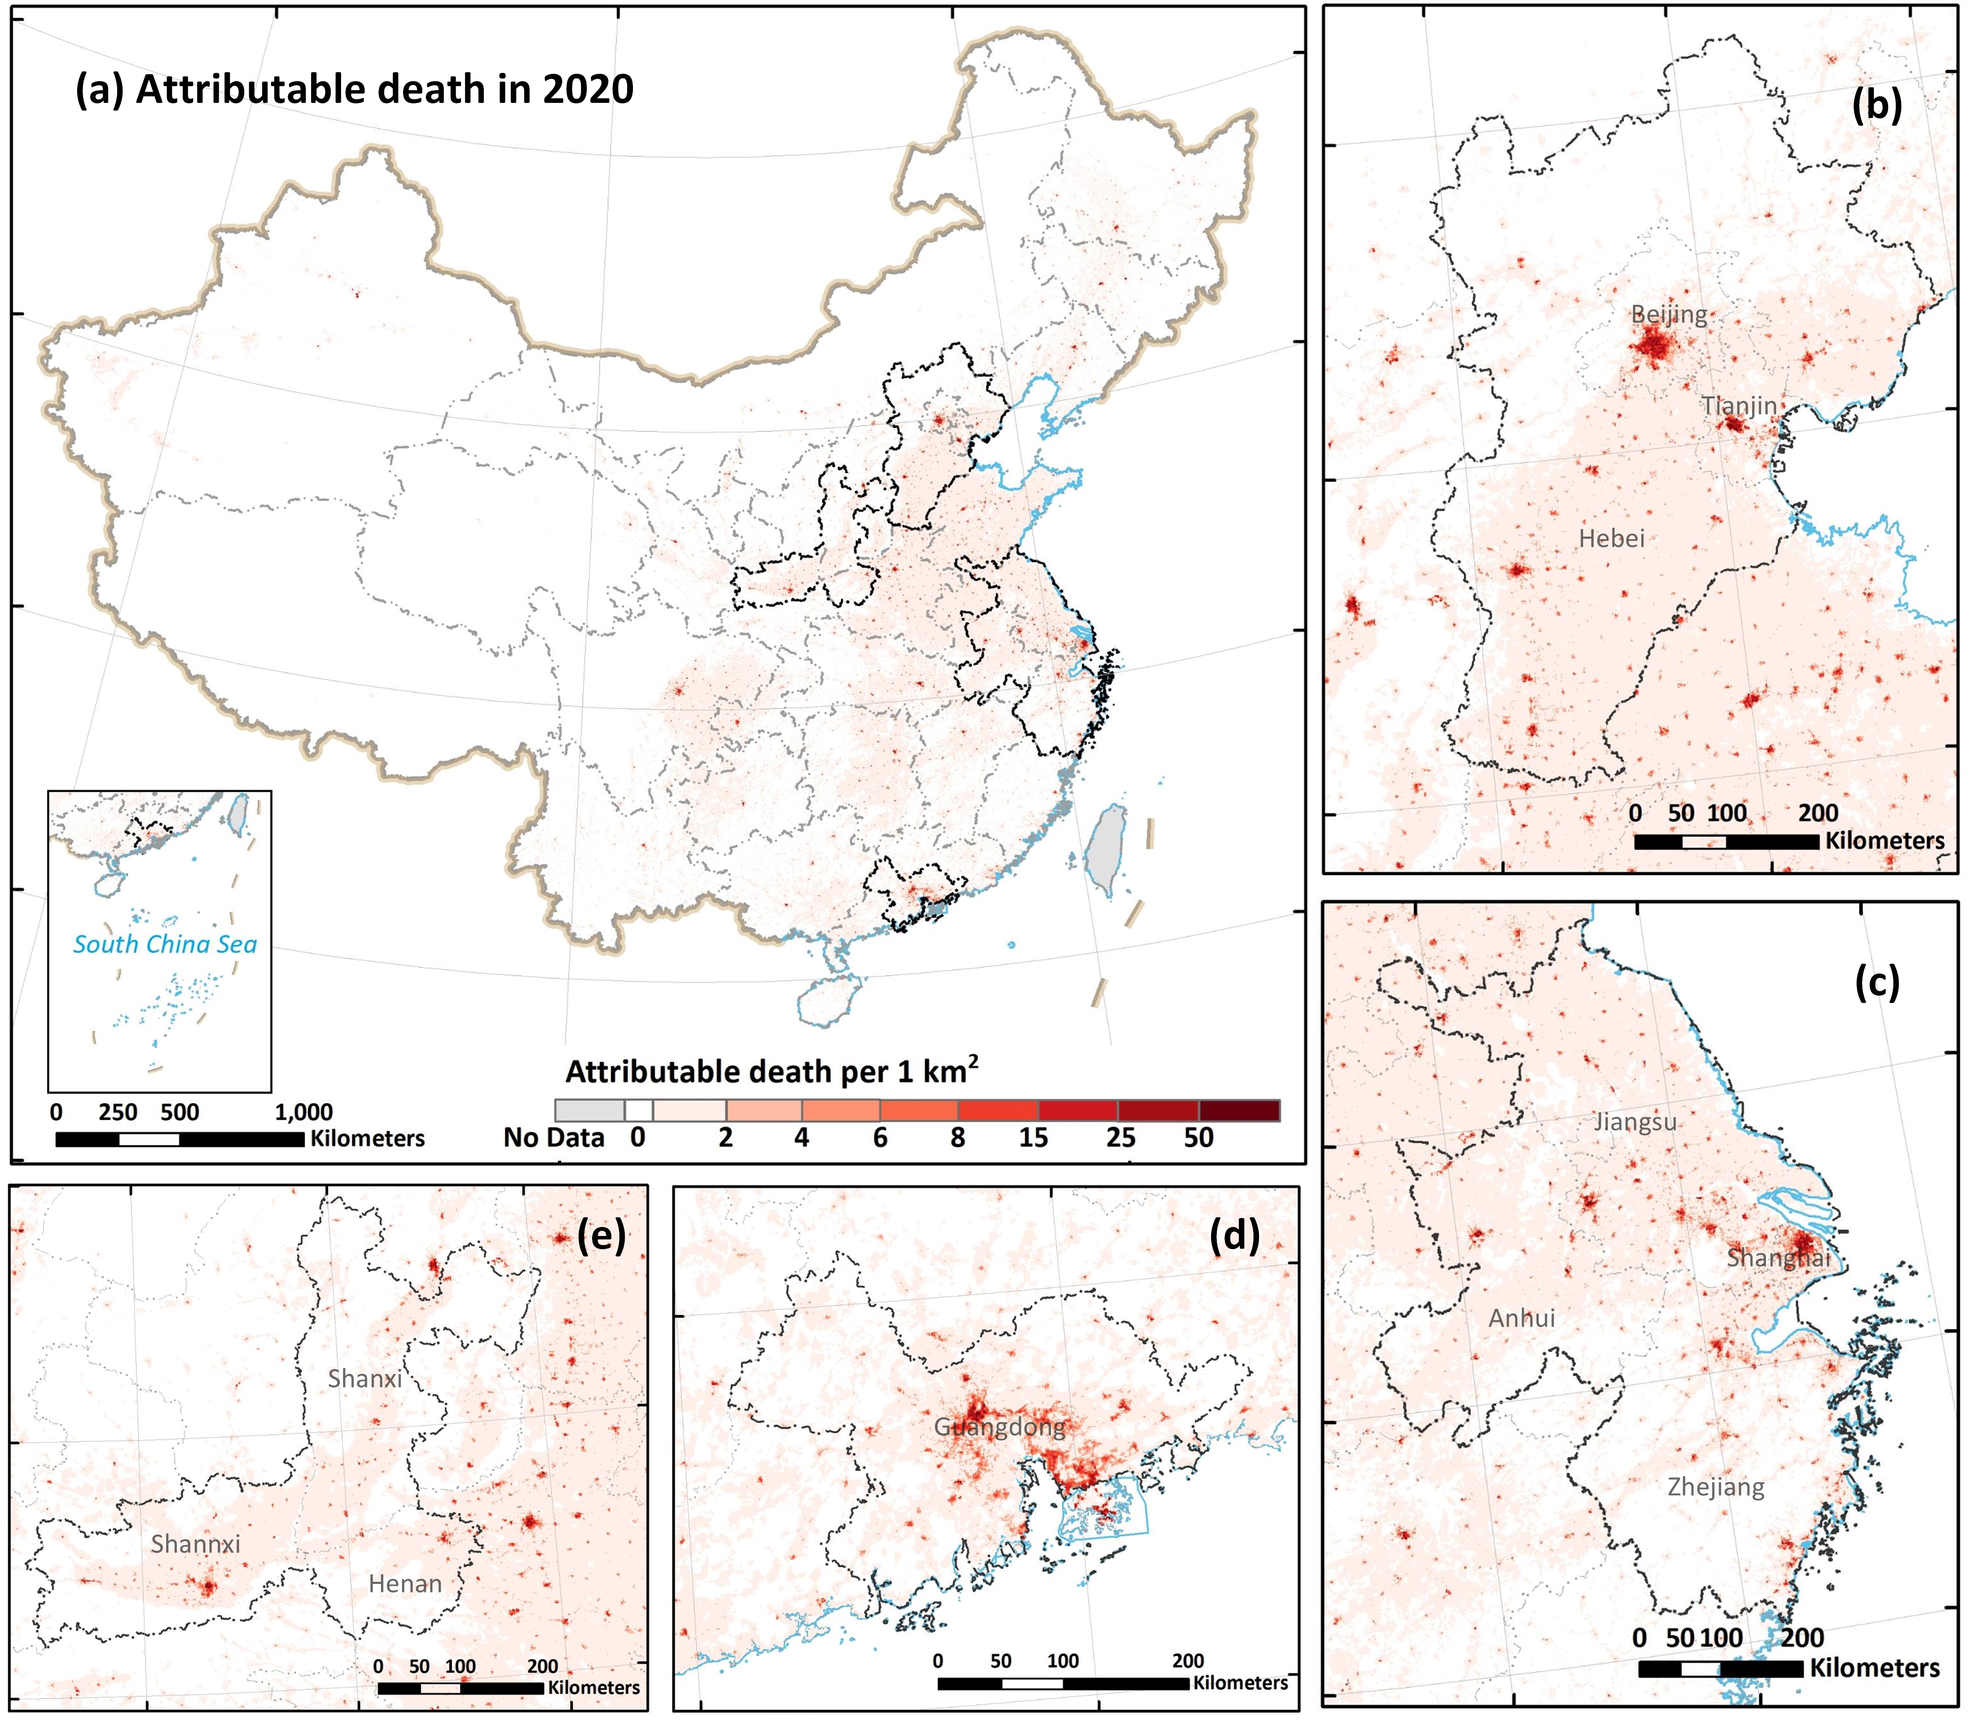
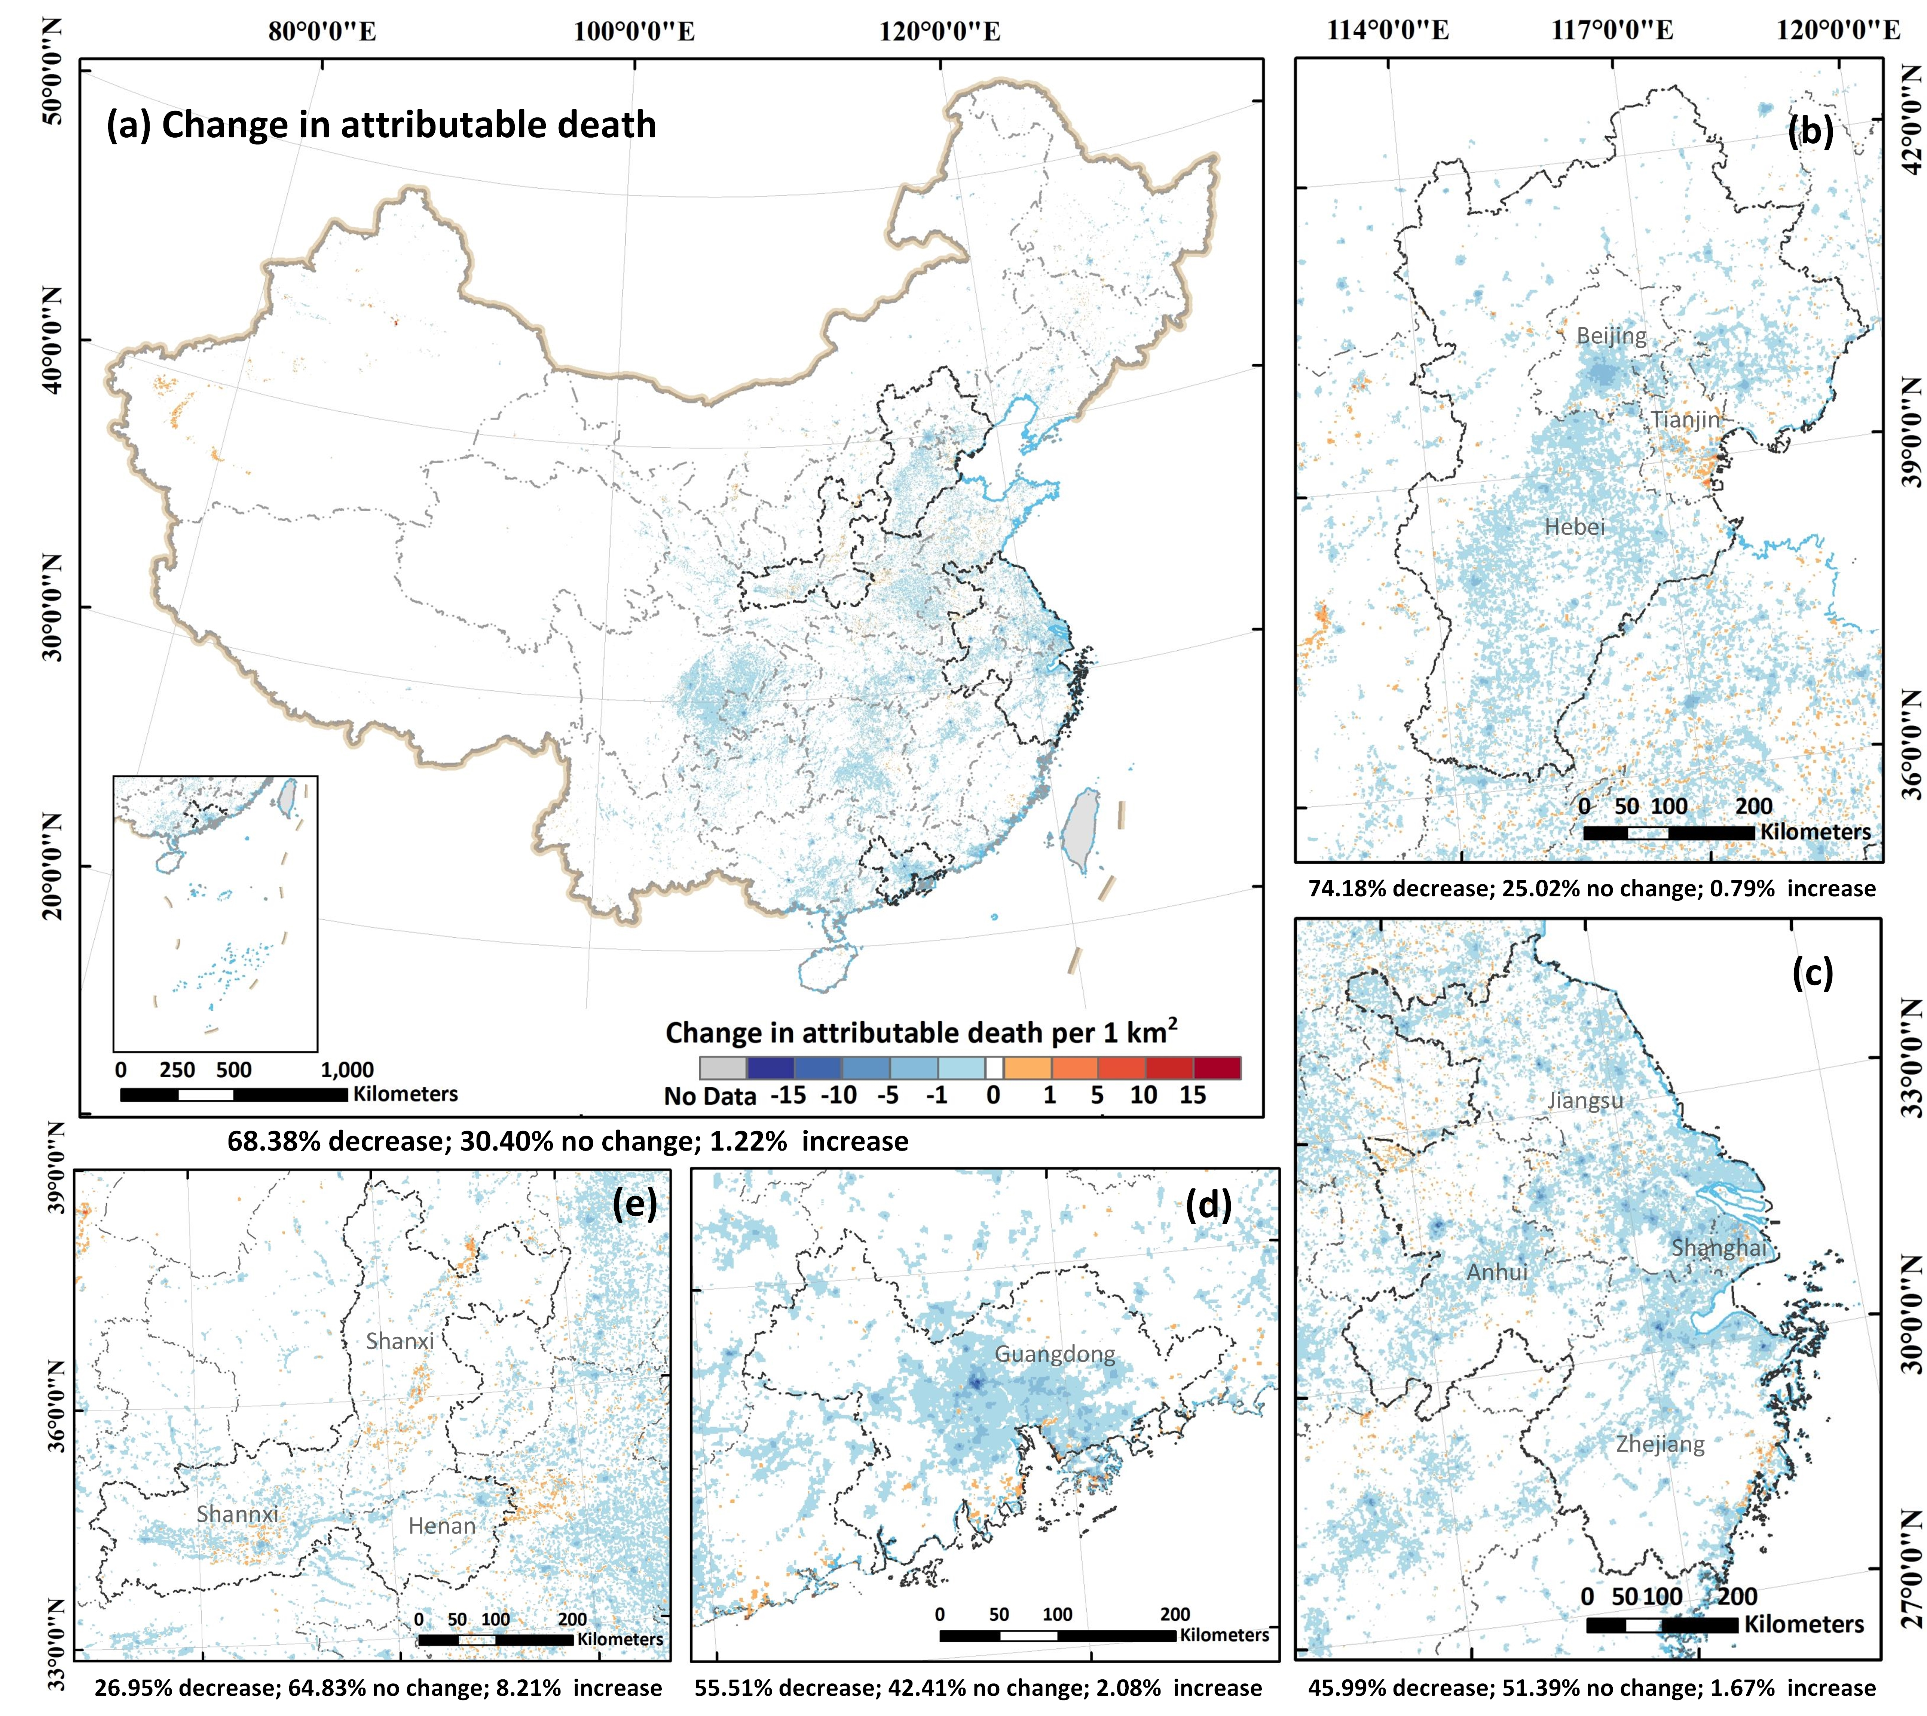
Health benefits : Change in PM_{2.5} attributable death
The attributable deaths in most areas (~99.5%) of China are less than 4 cases per 1 km² in 2020.
Severe PM_{2.5} attributable deaths were identified in the dense population and advanced industry areas.
The attributable deaths have been reduced in 68.38% areas of mainland China.
Spatial distribution (1 km) of PM_{2.5}-related death in mainland China, and the priority control regions in 2020
Spatial distribution (1 km) of change in PM_{2.5}-related death in mainland China and the priority control regions in 2020
The environment and health benefits of China ACP are not fully synergistic in spatial pattern, with the best health benefits detected in Yangtze River Delta region and the best environment benefits identified in Beijing-Tianjin-Hebei region.

Slide 8
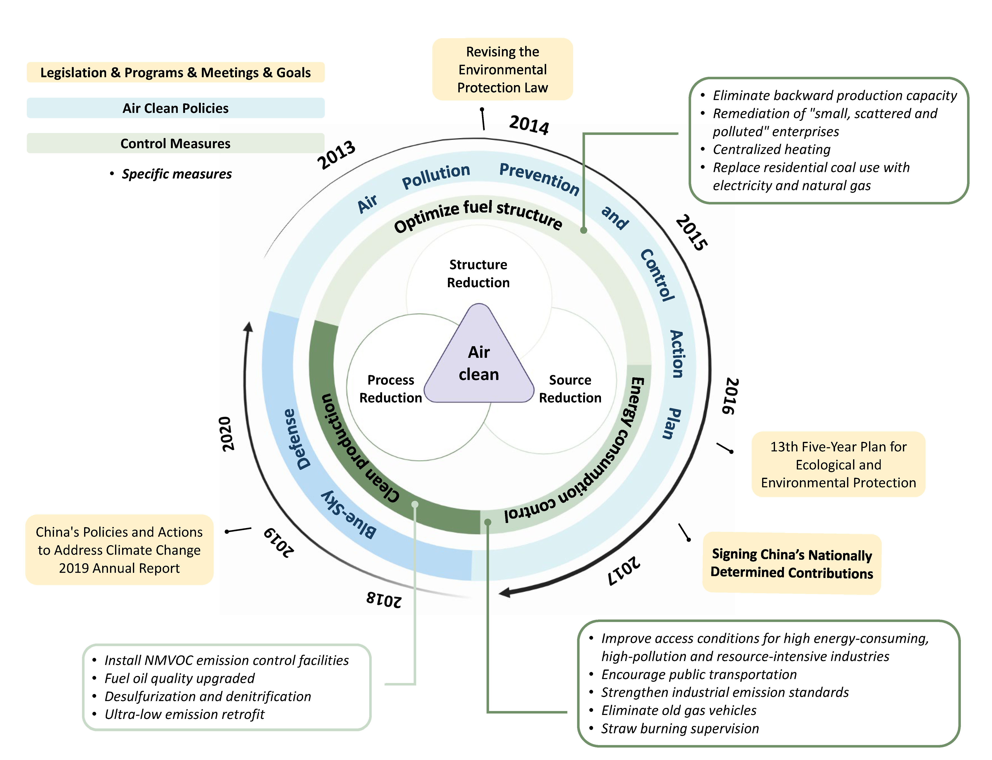
Air clean plan measures
Process control measure—Clean production
(e.g., using end-of-pipe devices in coal-fired power plants)
Install desulfurization facilities and denitrification facilities in coal-fired power plants.
Implement ultra-low emission transformation of steel and other industries
Source control measure—Energy consumption control
Stringent industry emission standards were enacted to limit the energy and industrial emissions (e.g., thermal power, iron and steel, and cement) for controlling the energy consumption
Structure control measure—Optimize fuel structure
(e.g., remediation of “small, scattered and polluted” enterprises, replacing residential coal with electricity and natural gas)
Major air pollution control goals, policies, and measures in China from the end of 2013 to 2020.

Slide 9
Contribution of different drivers to PM_{2.5} and related death change
The first phase of ACP
The second phase of ACP
The first phase of ACP
The second phase of ACP
Contribution of different factors to the change of PM_{2.5}
Contribution of different factors to the change of PM_{2.5}-related death
Amongst all air pollution control measures, clean production made the largest contribution.
The co-effect of carbon and PM_{2.5} became one of the main drivers for PM_{2.5} decrease since 2017.
Population and economic growth are major obstacles for controlling PM_{2.5} and related deaths.
Their negative impacts are unavoidable when societies expand, but were largely offset by the ACP control policies and improvements in health care

Slide 10
Summary & Policy implications
Refined strategies considering geographically difference can bring more synergistic co-benefits in environment and health.
The climate policies and carbon mitigation have substantial environment and health co-benefits, the future air clean actions should focus more on carbon abatement and energy structure optimization, especially under the background of global climate change mitigation.
With the advent of an aging society, it is necessary to enhance health care level in China continuously to protect public health.

Slide 11
2022.5.25
Thank you for listening!
Zhige Wang
zgwang@zju.edu.cn
Institute of Agricultural Remote Sensing and Information Technology Application, Zhejiang University, Hangzhou, 310058, China.

