Slide 1
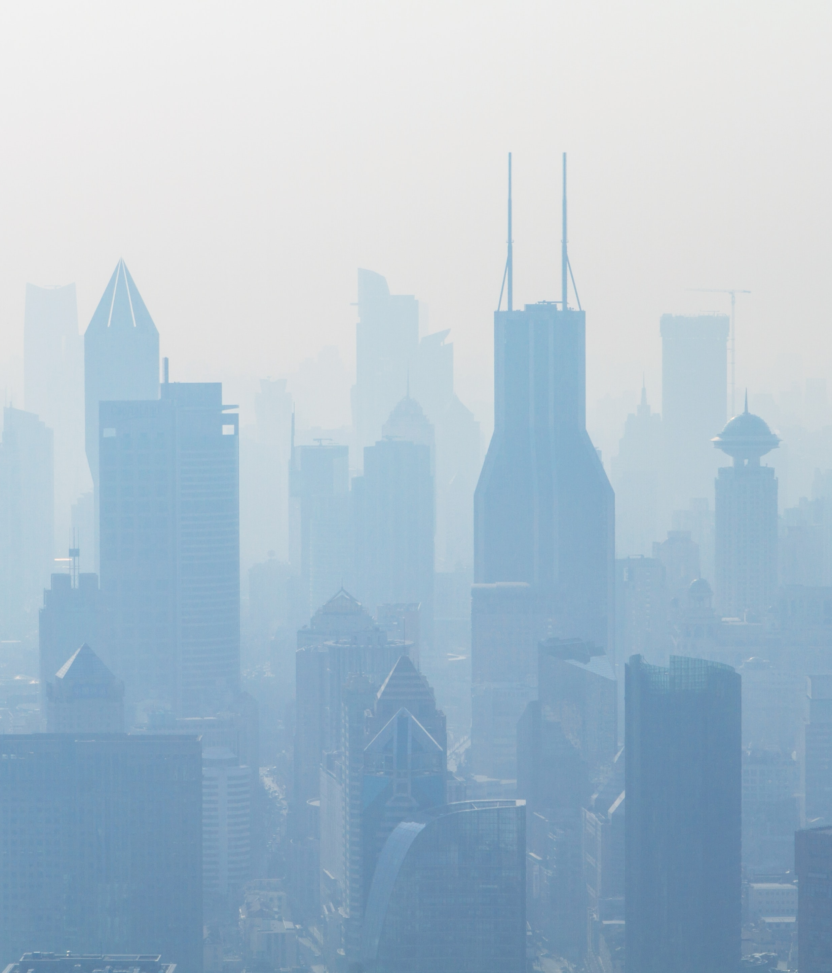
Rapidly evolving anthropogenic aerosol emissions induce strong and regionally heterogeneous climate impacts on the way to a net-zero world
Bjørn H. Samset, Geeta Persad, Laura Wilcox
on behalf of the regional aerosol community
(Robert J. Allen, Massimo A. Bollasina, Ben B. B. Booth, Celine Bonfils, Manoj Joshi, Marianne T. Lund, Kate Marvel, Joonas Merikanto, Kalle Nordling, Sabine Undorf, Daniel M. Westervelt, Alcide Zhao, +++)
EGU 2022, EGU22-6910
Vienna, 23.05.2022
Photo by Photoholgic on Unsplash
Notes:
https://unsplash.com/photos/wZTiKB6rQYY?utm_source=unsplash&utm_medium=referral&utm_content=creditShareLink

Slide 2
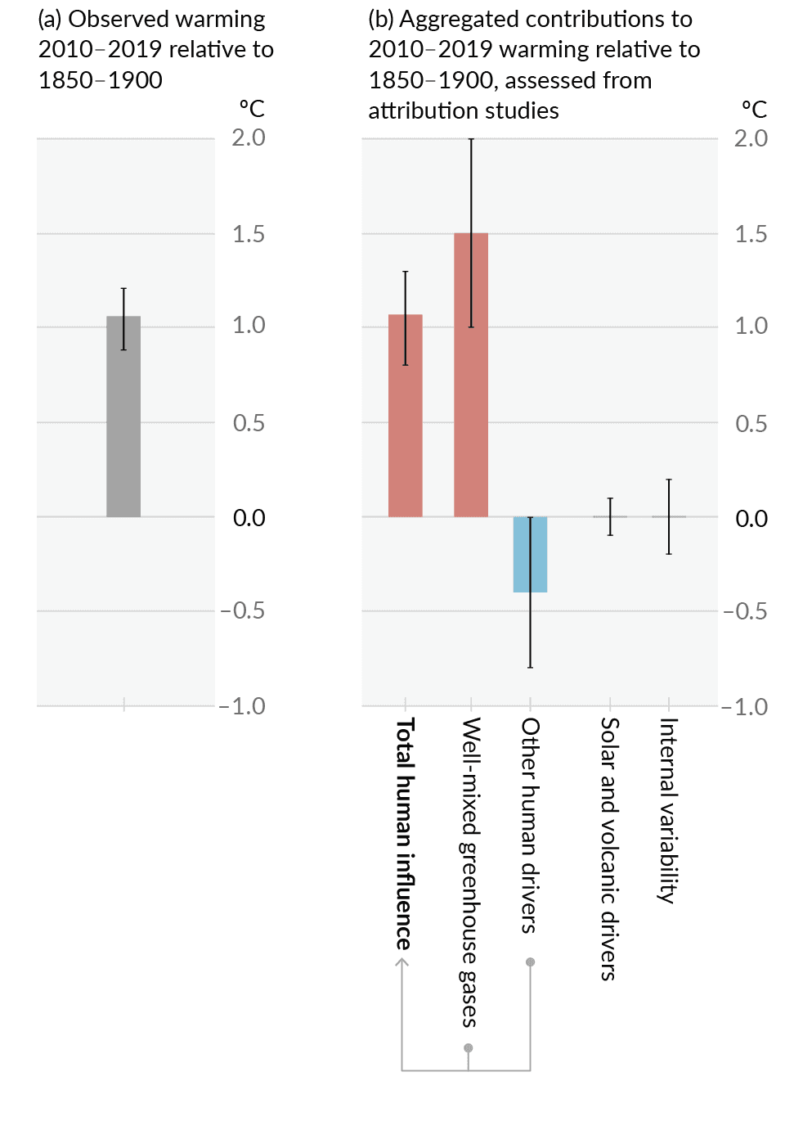
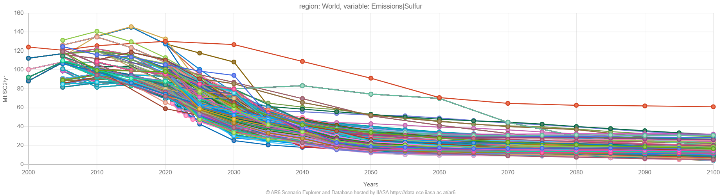
Aerosol emissions have a marked climate impact
Strong near-term trends are expected in all Paris compatible scenarios
IPCC AR6
WG1 SPM
AR6 Scenario Explorer, IIASA
All scenarios compatible with
1.5° or 2° warming, with limited
or no overshoot (700 scen.)

Slide 3
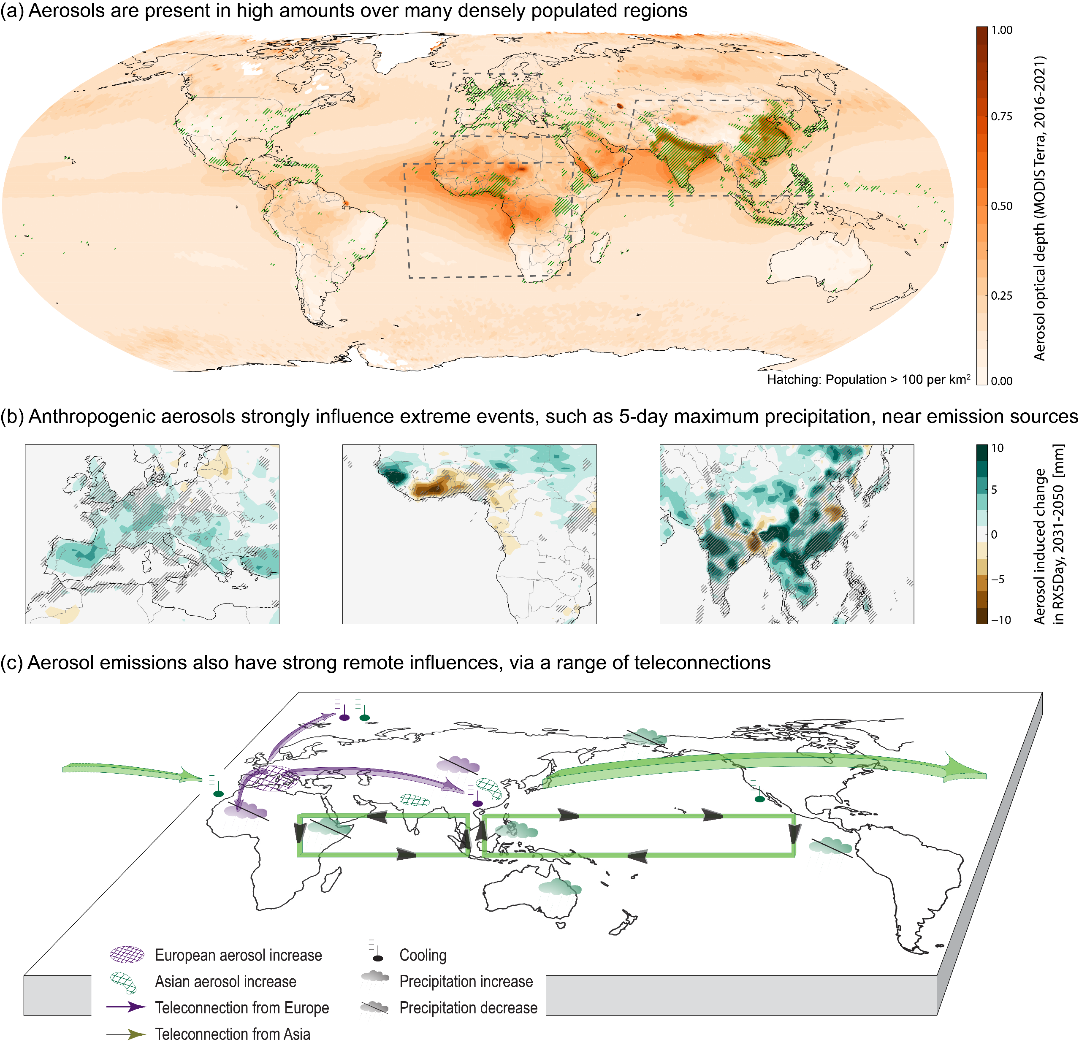
Aerosol emissions…
…are located near populated regions with a geographical pattern that can, and does, shift on decadal timescales and in response to the choices made in order to get to net zero
E.g. Samset et al., Nature Geoscience, 2019
…have strong local effects on weather and extreme events with trends that can be markedly stronger than those from GHGs, in particular in low-warming scenarios
E.g. Zhao et al., GRL / Clim. Dyn., 2019
…have teleconnection patterns that differ from greenhouse gases with consequences for weather, variability and a range of hazards far from emission hotspots
E.g. Wilcox et al., ACP, 2019
Persad et al., 2022, in prep.

Slide 4
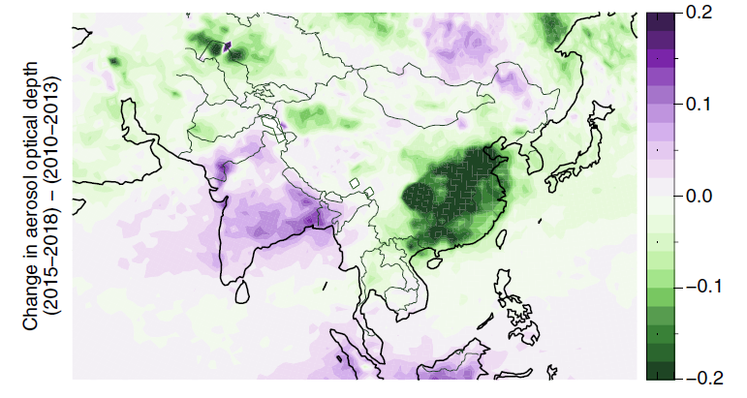
Regional climate risk due to aerosol emission changes on the way to net zero is still a blindspot
The «Asian Aerosol Dipole» currently in development
AOD from MODIS.
Samset et al. 2019
Ways forward:
Near-term aerosol emission trends are expected to drive strong trends in temperature, hydroclimate and extreme events, with a pattern that differs to the response to GHG, and potentially stronger rates of change
In risk assessments, aerosol impacts are still mainly treated as a perturbation to global surface temperature, or as a GHG-like pattern effect
Future changes in (notably) Asia and Africa, in emission patterns and composition of aerosol types, are underexplored in the current scenario literature
Under-resourced, highly-populated regions often bear the brunt of the aerosols’ climate effects amplifying risk through heightened exposure and vulnerability.
Increased scenario diversity, notably in regional patterns and composition of aerosol emissions
Dedicated modelling setups:
Regional Aerosol MIP (RAMIP)
Wilcox et al., EGU22-5540,
Thursday May 26th, 08:30, F1
Pattern and variability aware emulators for translating ESM results into a larger scenario space
Aerosol aware impact modelling and risk assessment
Thank you. For details, see upcoming community
perspective article (Persad et al., 2022; in prep.)

