Slide 1



A data-driven approach to isolate the role of radiative heating in tropical cyclone intensification
Frederick Iat-Hin Tam, Tom Beucler (Université de Lausanne)
James Ruppert Jr. (Unversity of Oklahoma)
EGU General Assembly
Vienna, Austria
15.05.2022
Notes:
Thank you for lasting till the last day of the conference!

Slide 2
Radiative heating in an individual convective system…
Motivation | Our approach | Findings
Heating
Heating
longwave radiation
$$\frac{∂ρ}{∂x}∼0$$
1
Heating and TC circulation | Sawyer-Eliassen Equation | Current tools
Notes:
Recent modeling efforts suggest that CRF has a first order effect on TC intensification.
Here we show two WRF simulations on Hurricane Maria. The simulation on the right is without CRF. Maria without CRF is unable to organize into a major cyclone.

Slide 3
LW radiation drives secondary circulation, helps intensify tropical cyclones
Motivation | Our approach | Findings
Moisture
Inflow
Secondary
Circulation
TC deepening!
$$\frac{∂ρ}{∂x}∼0$$
2
Ref: Ruppert et al. 2020
Heating and TC circulation | Sawyer-Eliassen Equation | Current tools
Notes:
Recent modeling efforts suggest that CRF has a first order effect on TC intensification.
Here we show two WRF simulations on Hurricane Maria. The simulation on the right is without CRF. Maria without CRF is unable to organize into a major cyclone.

Slide 4

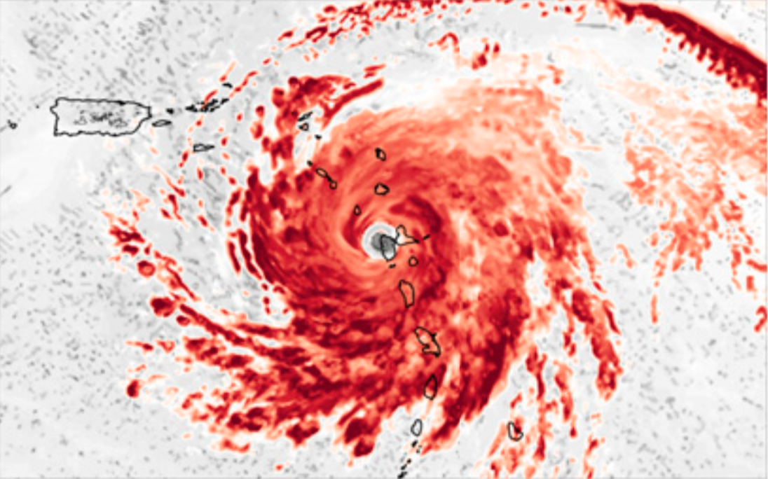
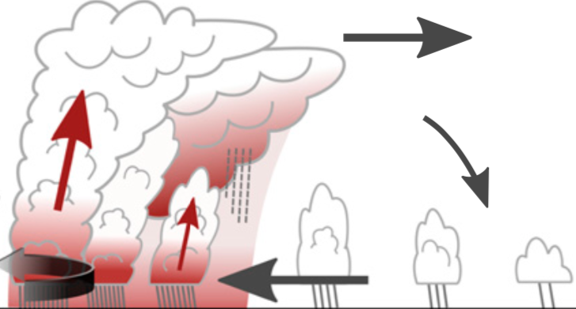



Ruppert et al. (2020) used azimuthal mean heating to get secondary circulation in radial-height space
Motivation | Our approach | Findings
Cloud longwave radiation
Diagnose heating-induced circulation
Sawyer-Eliassen Equation
$$SEO(∇^{2}ψ,∇ψ)=∇H$$
Get azimuthal mean heating
3
Ref: Pendergrass and Willoughby 2009
Heating and TC circulation | Sawyer-Eliassen Equation | Asymmetry
Notes:
A reasonable subsequent next step when we know about this first order effect is to quantify and understand it.
One of the available tools we can use to quantify this effect is the Sawyer-Eliassen Equation framework. This framework allows us to diagnose the axisymmetric circulation in radial-height coordinate with any given axisymmetric heat structures.
The color contours in the example on the right is the axisymmetric heating associated with CRF. SEQ suggests that this heating created a low-tropospheric updraft that can help intensify the TC.

Slide 5

Horizontal variability in heating: hard to address with SEQ framework
Motivation | Our approach | Findings
+
-
Yellow: Positive heating anomaly
Light blue: Negative heating anomaly
4
Heating and TC circulation | Sawyer-Eliassen Equation | Asymmetry
Notes:
A reasonable subsequent next step when we know about this first order effect is to quantify and understand it.
One of the available tools we can use to quantify this effect is the Sawyer-Eliassen Equation framework. This framework allows us to diagnose the axisymmetric circulation in radial-height coordinate with any given axisymmetric heat structures.
The color contours in the example on the right is the axisymmetric heating associated with CRF. SEQ suggests that this heating created a low-tropospheric updraft that can help intensify the TC.

Slide 6



Horizontal variability in heating: hard to address with SEQ framework
Motivation | Our approach | Findings
Dunno.
-
Which of these scenarios favors TC intensification more?
+
Yellow: Positive heating anomaly
Light blue: Negative heating anomaly
4
Heating and TC circulation | Sawyer-Eliassen Equation | Asymmetry
Notes:
A reasonable subsequent next step when we know about this first order effect is to quantify and understand it.
One of the available tools we can use to quantify this effect is the Sawyer-Eliassen Equation framework. This framework allows us to diagnose the axisymmetric circulation in radial-height coordinate with any given axisymmetric heat structures.
The color contours in the example on the right is the axisymmetric heating associated with CRF. SEQ suggests that this heating created a low-tropospheric updraft that can help intensify the TC.

Slide 7
Our method
Motivation | Our approach | Findings
$$u$$
1
WRF outputs
4 WRF simulations on Maria [1 CTRL + 3 CRF denial experiments]
20-member ensemble on Haiyan
$$v$$
$$w$$
Extract variables in storm-relative framework
$$θ$$
$${\overset{·}{Q}}_{rad}$$
Hourly outputs
$${\overset{·}{Q}}_{LH}$$
5
Heating and TC circulation | Sawyer-Eliassen Equation | Asymmetry
Notes:
A reasonable subsequent next step when we know about this first order effect is to quantify and understand it.
One of the available tools we can use to quantify this effect is the Sawyer-Eliassen Equation framework. This framework allows us to diagnose the axisymmetric circulation in radial-height coordinate with any given axisymmetric heat structures.
The color contours in the example on the right is the axisymmetric heating associated with CRF. SEQ suggests that this heating created a low-tropospheric updraft that can help intensify the TC.

Slide 8
Motivation | Our approach | Findings
$$u$$
$$u_{PC1,...}$$
6 hr, 24 hr, …
$$v$$
$$v_{PC1,...}$$
MLR
$${\overset{·}{u}}_{PC1,...}$$
$$w$$
$$w_{PC1,...}$$
Dimensionality
reduction
$${\overset{·}{v}}_{PC1,...}$$
$$θ$$
$$θ_{PC1,...}$$
$${\overset{·}{w}}_{PC1,...}$$
$${\overset{·}{Q}}_{rad,PC1,...}$$
$${\overset{·}{Q}}_{rad}$$
$${\overset{·}{θ}}_{PC1,...}$$
$${\overset{·}{Q}}_{LH}$$
$${\overset{·}{Q}}_{LH,PC1,...}$$
6
Goal | Schematic Diagram | FFS
Notes:
The linear operator is obtained with a 5 steps procedure. First, we gathered some WRF simulations that we will use to train our model. Currently we have a model that is trained on 4 high resolution simulations on Maria, and a separate model on 20 EnKF ensemble Haiyan simulations.
We extracted 6 variables from our WRF data for pre-processing.

Slide 9
Reconstruction
Motivation | Our approach | Findings
$$\overset{·}{u}(t,x,y,p)$$
$$\overset{·}{v}(t,x,y,p)$$
$$\overset{·}{w}(t,x,y,p)$$
$$\overset{·}{θ}(t,x,y,p)$$
Predicted MLR TC kinematic/thermodynamic changes
7
Goal | Schematic Diagram | FFS
Notes:
we used a multiple linear regression model to forecast the changes in kinematic and thermodynamic changes in PC space in 6 hours/24 hours etc.
We can easily convert the time evolution in PC sample back to cartesian space. This constitutes the final step of our model.

Slide 10
Model performance
Motivation | Our approach | Findings
Greedy algorithm to create a sparser and interpretable model.
Despite model sparsity, our model got a R^2 of ~0.6 for surface winds
Using our model to address scientific questions…
Which radiative heating structures are important to multiple linear model predictions?
How does radiative heating impact surface wind asymmetries?
8
Goal | Schematic Diagram | FFS
Notes:
we used a multiple linear regression model to forecast the changes in kinematic and thermodynamic changes in PC space in 6 hours/24 hours etc.
We can easily convert the time evolution in PC sample back to cartesian space. This constitutes the final step of our model.

Slide 11
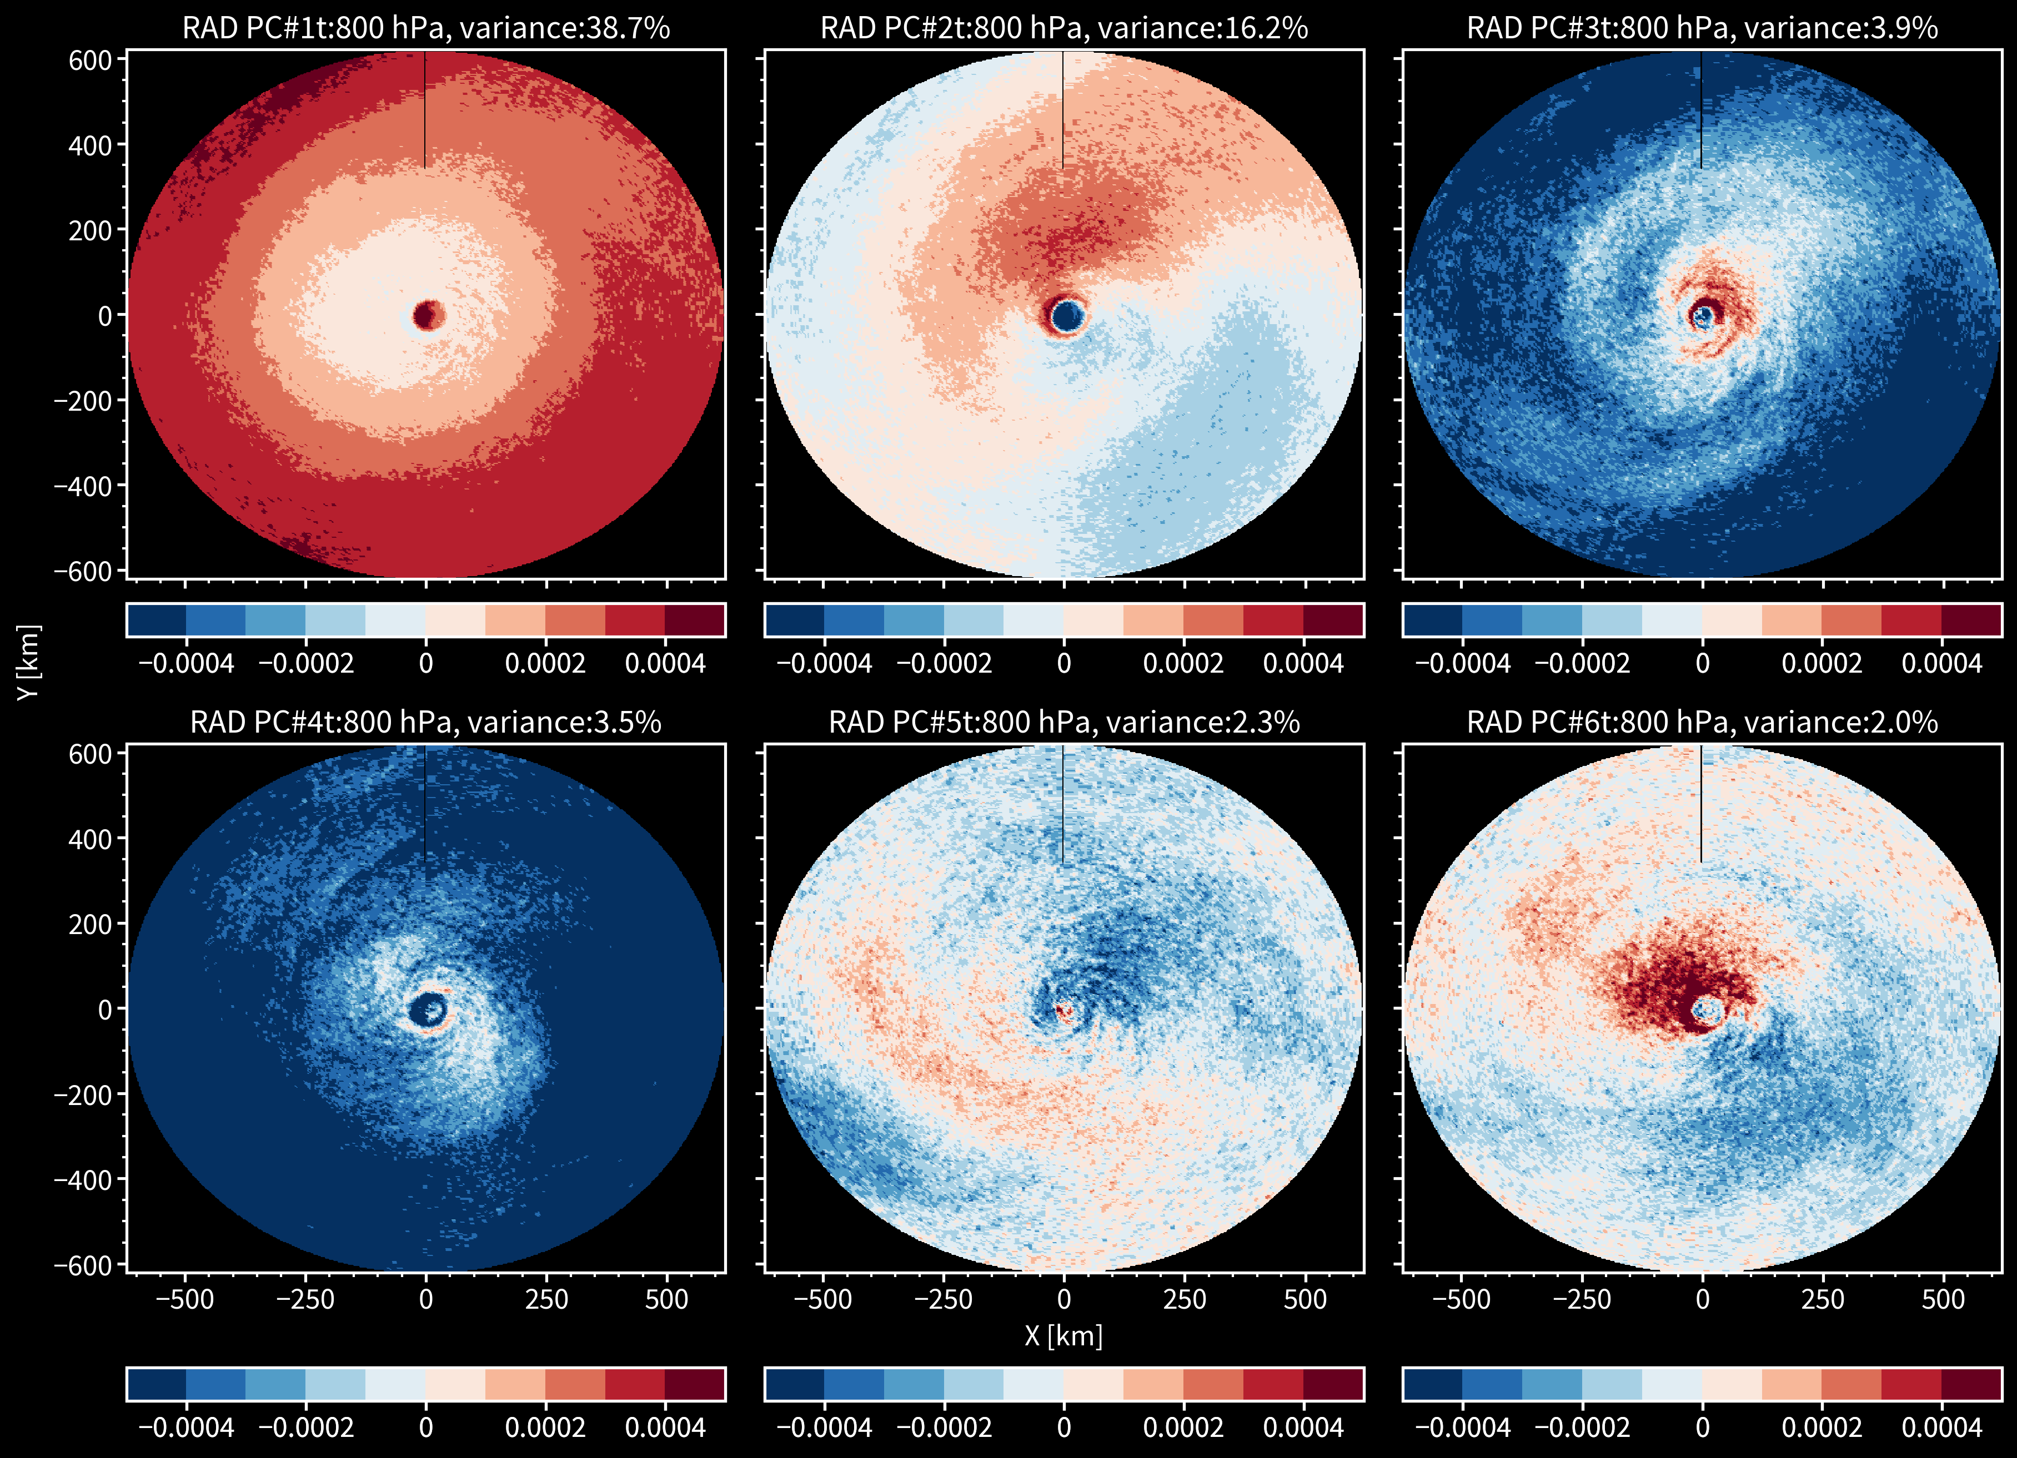
Which radiative heating structure is critical to intensification prediction?
Motivation | Our approach | Findings
represent most
variabilities in input…
Symmetric
Asymmetric
represent less
variabilities in input…
9
FFS | Decomposition | Conclusions
Notes:
Shown in the figure are six radiative structures that explain the most variabilities in our data.
Which structures are important to predicting TC intensification.
Surprisingly, our MLR model placed larger linear weights on the 2nd and 6th features. These features only explain ˜18% of the variabilities in our data. The most common rad heating feature in our data, feature 1, was pegged as not critical to our forecasts.

Slide 12
Asymmetric radiative heating maximized N & W of the TC center were selected
Motivation | Our approach | Findings
Y (km)
RAD terms selected
Positive
anomaly
X (km)
K s-1
Positive heating SE of TC center critical to 24 hr TC surface wind intensification
10
FFS | Decomposition | Conclusions
Notes:
Zooming in on the two important structures, you will find that they both featured positive heating anomalies in the northern and eastern half of the cyclone. Both the inner core and outer core heat asymmetries are important.

Slide 13
Take-home message
Motivation | Our approach | Findings
Developed a statistical prediction model on three-dimensional TC intensification rates
Feature importance: Asymmetric cloud radiative heating structures are critical to model prediction. Symmetrical heating structures are less critical to prediction
Positive radiative heating anomaly SE of TC center —> correlates to more rapid 24-hr TC surface wind intensification
11
FFS | Decomposition | Conclusions

Slide 14
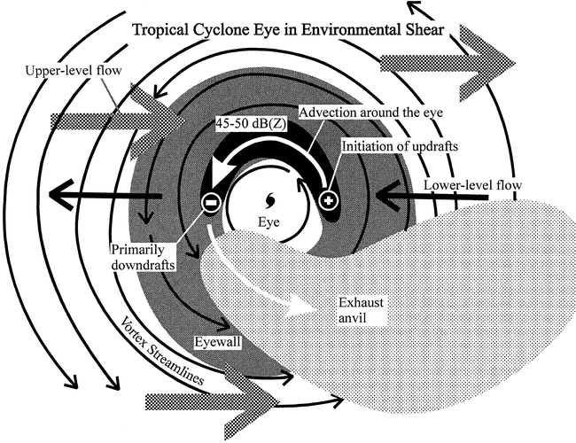
Motivation | Our approach | Findings
Future work
Compare radiative heating patterns to shear orientation, moisture distributions, and cloud types
12
Ref: Black et al. 2002
FFS | Decomposition | Conclusions
Notes:
Zooming in on the two important structures, you will find that they both featured positive heating anomalies in the northern and eastern half of the cyclone. Both the inner core and outer core heat asymmetries are important.

Slide 15
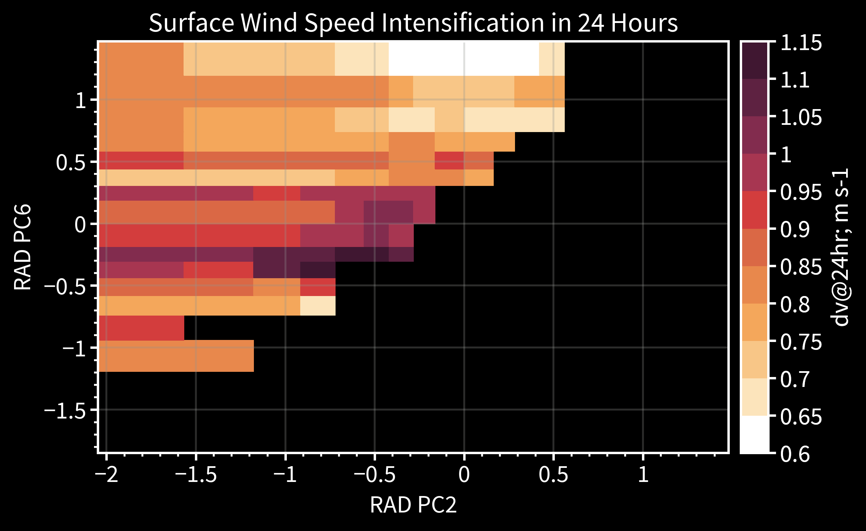
TC surface wind intensification in RAD PC2-PC6 parameter space
Motivation | Our approach | Findings
Negative
13
For faster TC surface wind intensification
FFS | Decomposition | Conclusions
Notes:
Shown in the figure are six radiative structures that explain the most variabilities in our data.
Which structures are important to predicting TC intensification.
Surprisingly, our MLR model placed larger linear weights on the 2nd and 6th features. These features only explain ˜18% of the variabilities in our data. The most common rad heating feature in our data, feature 1, was pegged as not critical to our forecasts.

