Slide 1



Application of satellite and reanalysis precipitation products for hydrological modeling in the data-scarce Porijõgi catchment, Estonia
Desalew Meseret Moges, Alexander Kmoch, and Evelyn Uuemaa
Department of Geography, Institute of Ecology and Earth Sciences, University of Tartu, Vanemuise 46, Tartu 51003, Estonia
Vienna, Austria | 27 May 2022

Slide 2
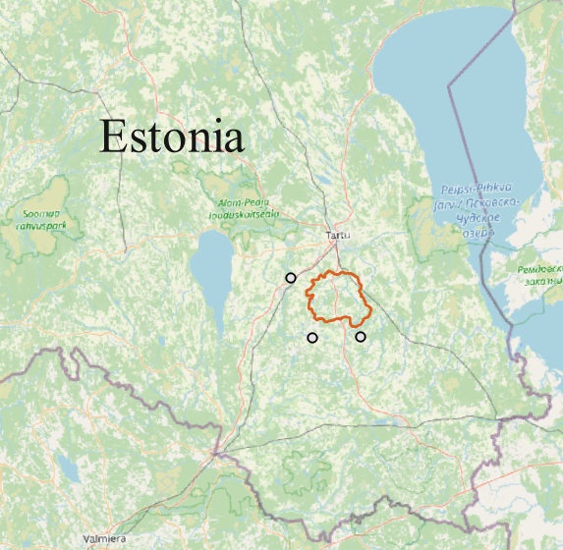
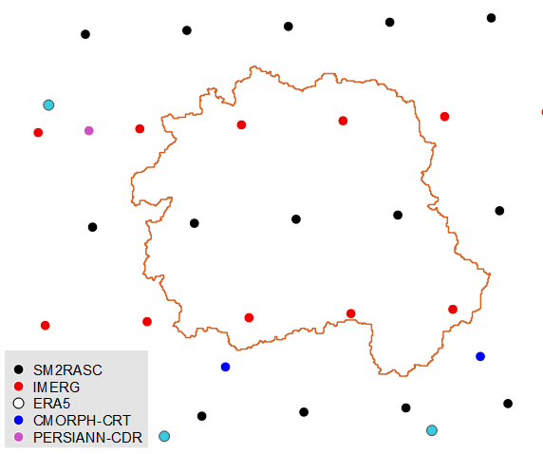
Motivation
Accurate and adequate precipitation for hydrological modeling
Gauge-based observations - scarce + unevenly distributed
Satellite and reanalysis precipitation (SRP) products as best alternative
Evaluation of SRP products is crucial
How accurate can SRP products estimate precipitation events compared with gauge data?
How reliable are SRP products in simulating streamflow?

Slide 3
Methodology
Selection of SRP products
Four satellite precipitation
SM2RASC (0.1º)
IMERG (0.1º)
PERSIANN-CDR (0.25º)
CMORPH-CRT (0.25º)
One reanalysis precipitation
ERA5 (~ 0.7º)
Precipitation evaluation
Three temporal scales
daily, monthly, seasonal
Three categorical metrics
POD, FAR, CSI
Four continuous metrics
r, RMSE, RB, MAE
Prob. density functions (PDFs)
Taylor diagrams
Hydrological modeling
We used SWAT model for streamflow simulation (2008-2019)
Six models were built (one for each P product)
SWAT-CUP was used for model calibration and validation (monthly)
Evaluation metrics
NSE (objective function)
P-value and t-test (parameter sensitivity analysis)
P-factor, R-factor (model uncertainty)

Slide 4
Results: Daily precipitation comparison
Low intensity (<1 mm/d)
Moderate intensity (1-5 mm/d)
High intensity (>5 mm/d)
More than 60% of precipitation occurred within a range of <1 mm/day
Occurrence frequency decreased with increasing intensity
All products exhibited low detection accuracies at all intensities
low median POD and CSI values (< 0.5)
high FAR (>0.5)
IMERG performed best and CMORPH-CRT was worst

Slide 5
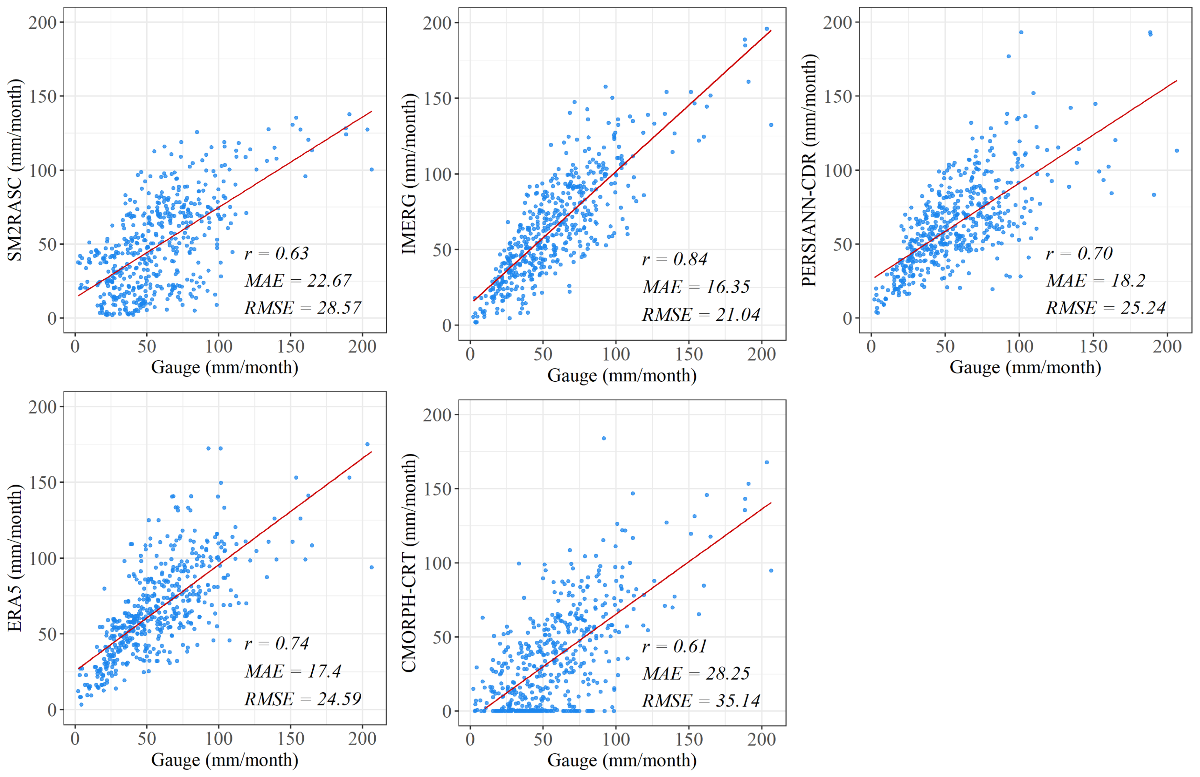
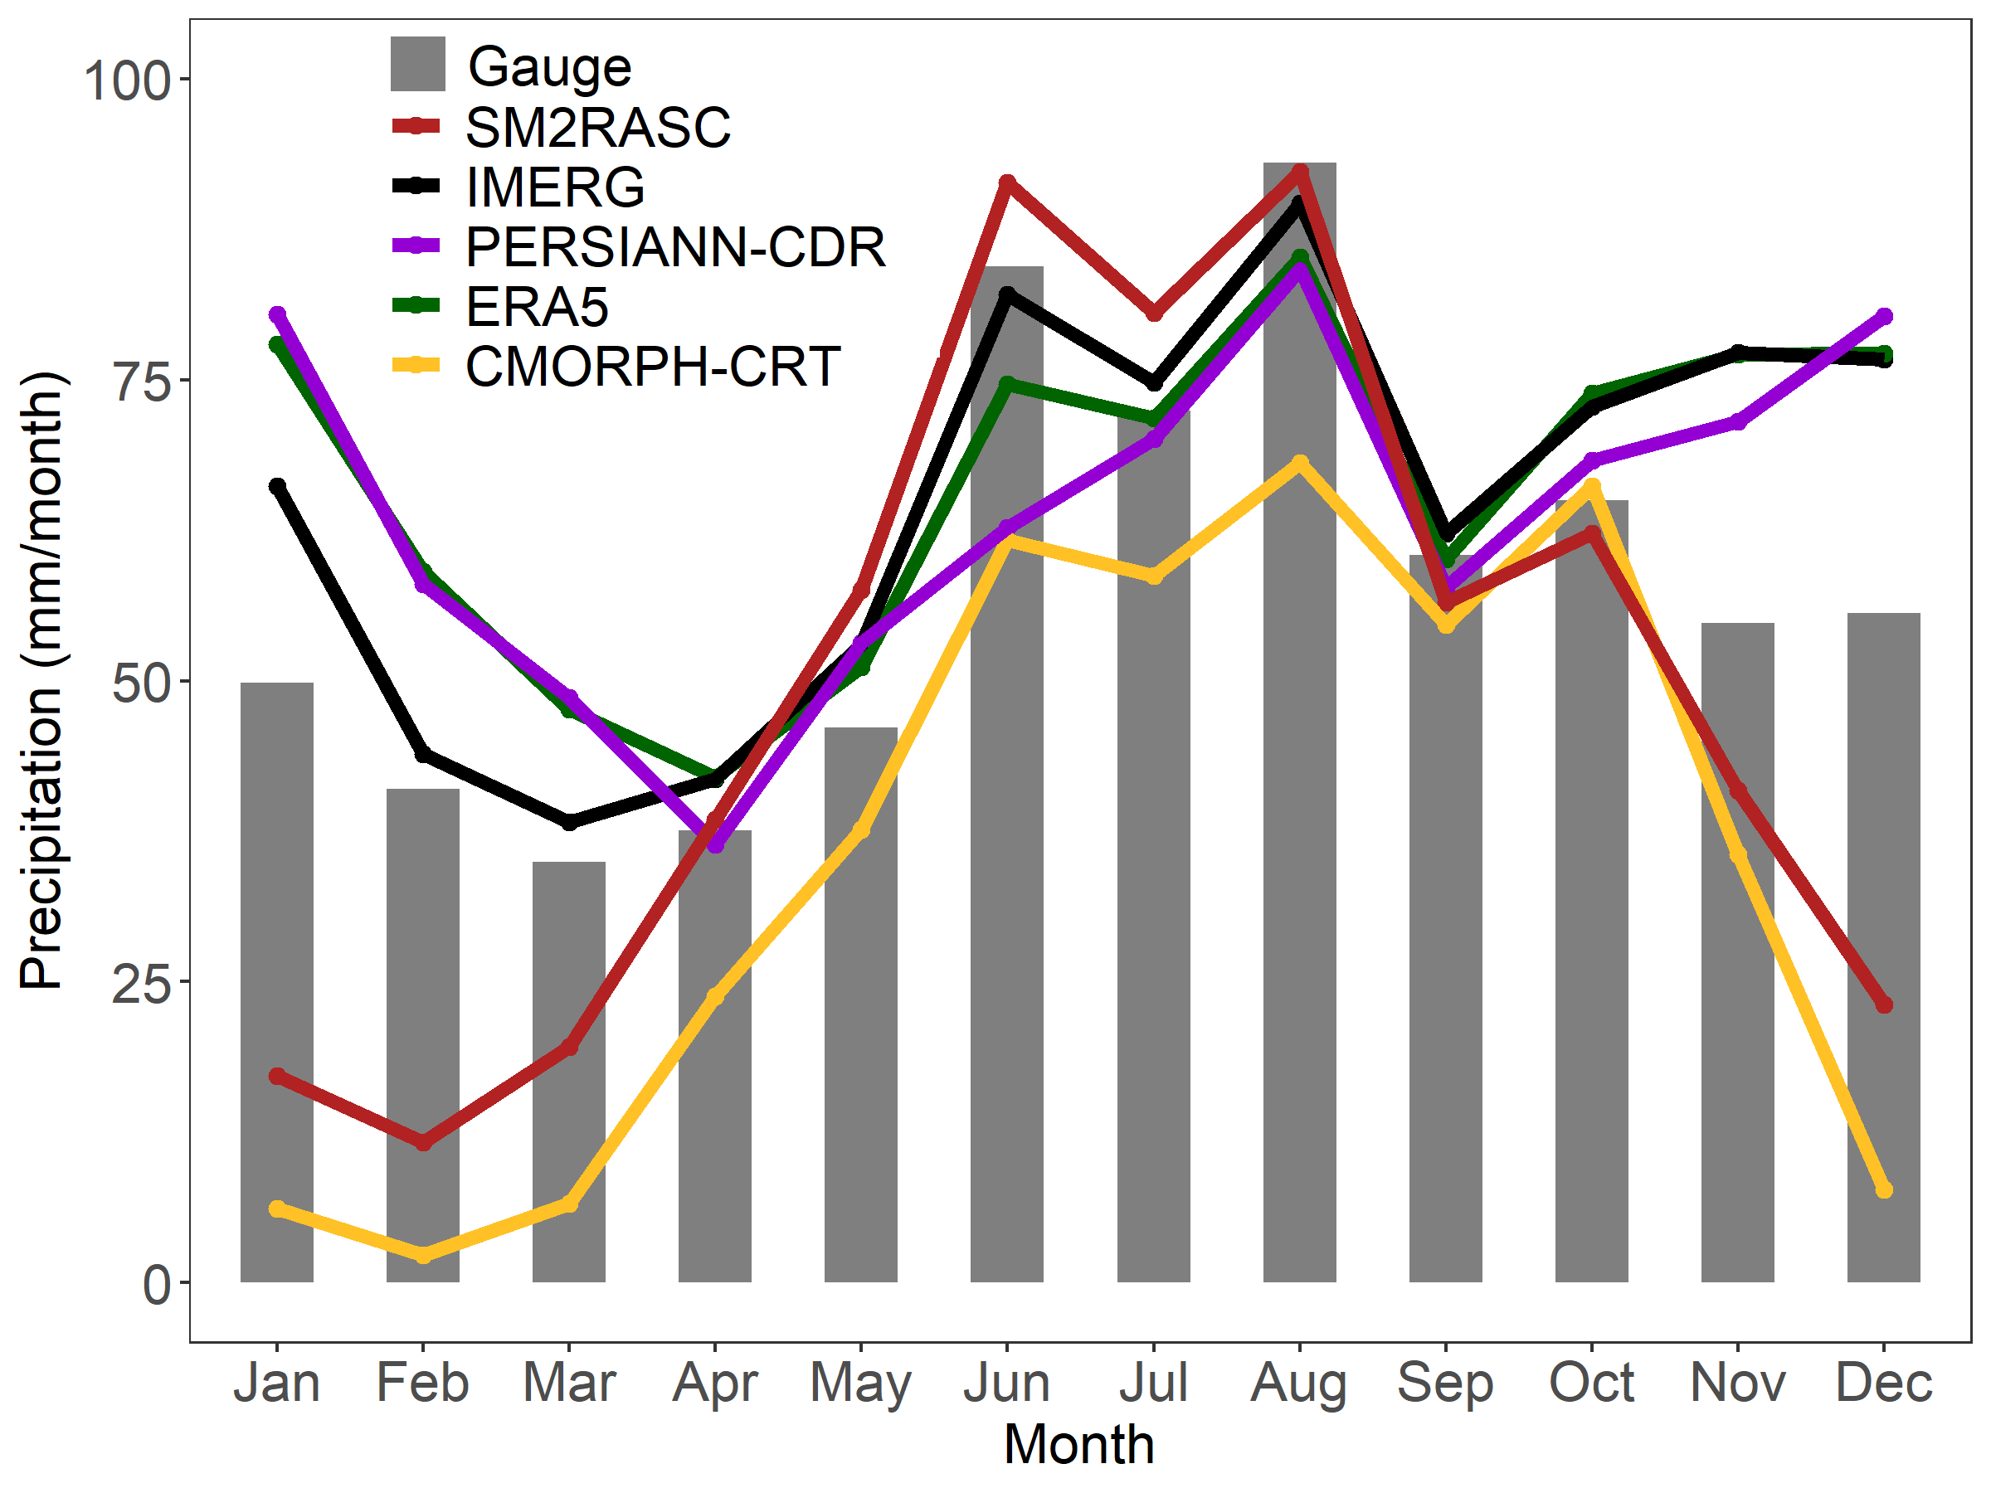
Results: Monthly precipitation comparison
All products showed better performance in summer (JJA) and weaker in winter (JFD)
IMERG was best and CMORPH-CRT was worst

Slide 6
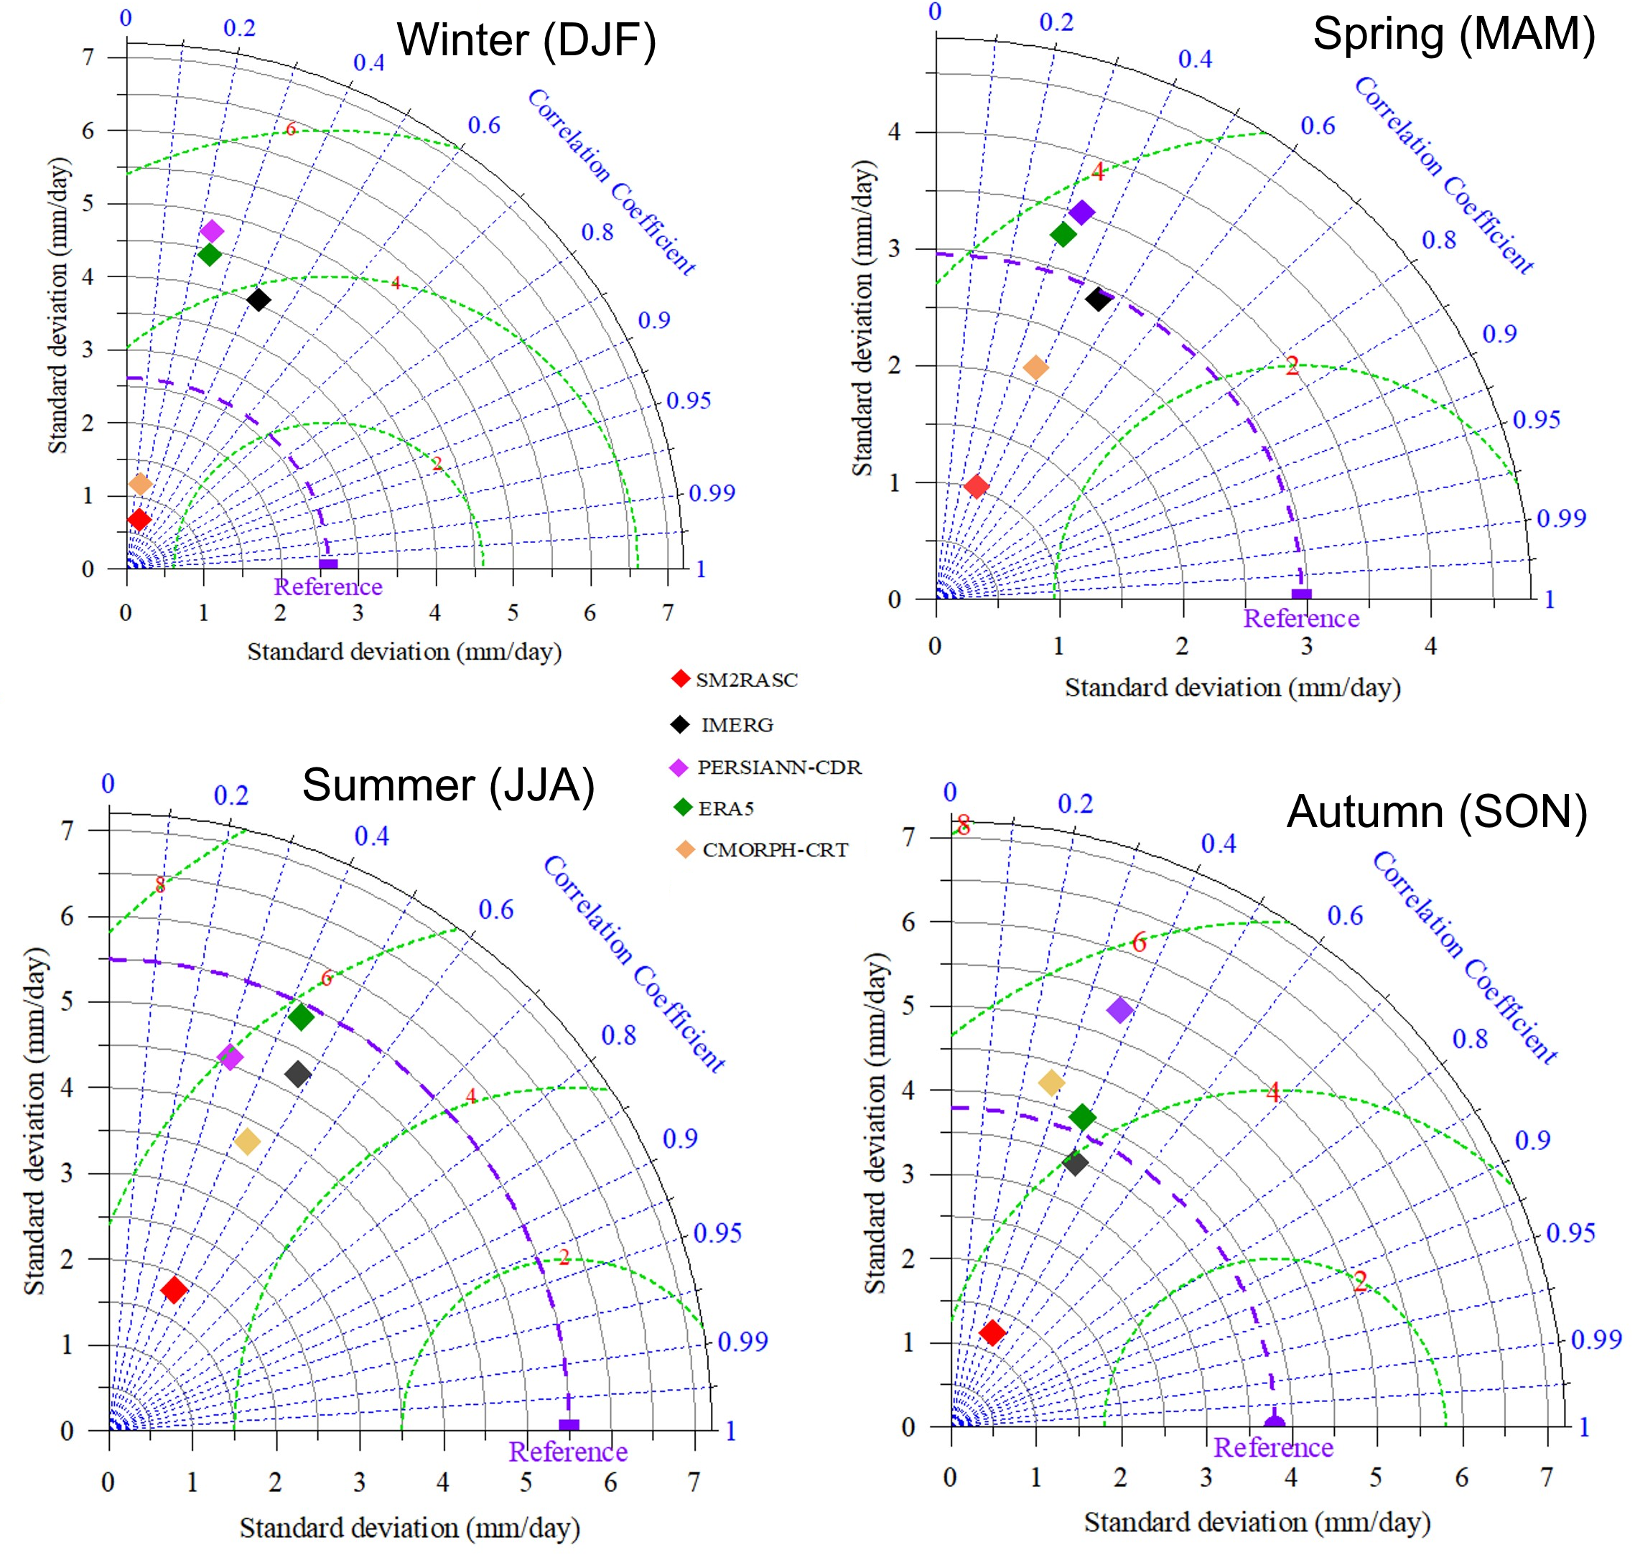
Results: Seasonal precipitation comparison
All products showed best performance in summer and worst in winter
IMERG and ERA5 revealed better performance
SM2RASC and CMORPH-CRT tended to underestimate
RMSE
RMSE
RMSE
RMSE

Slide 7
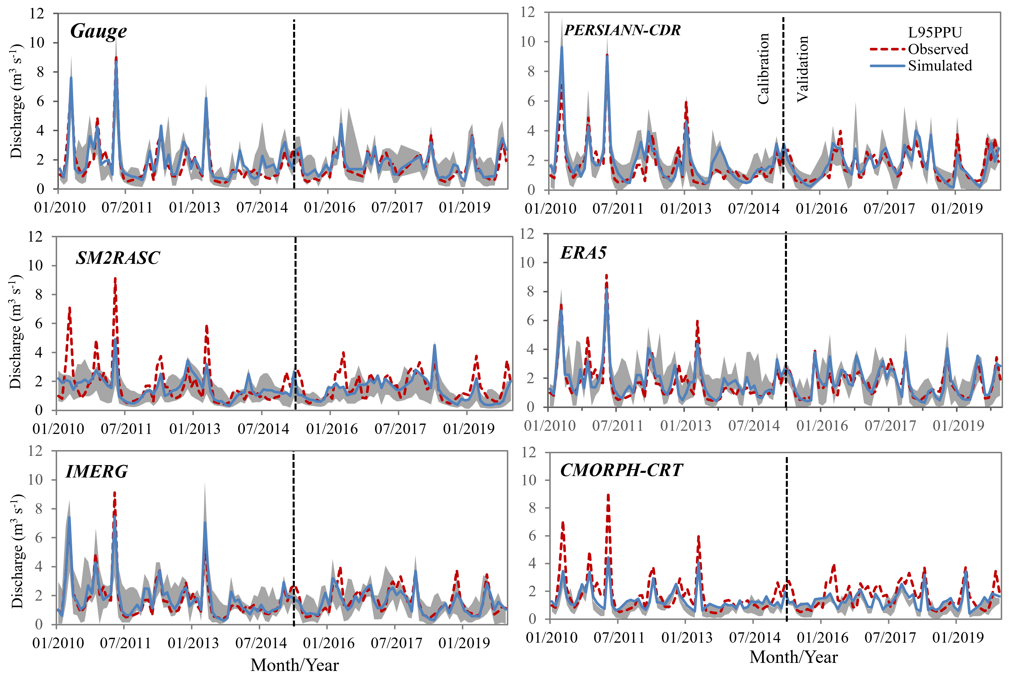
Results: Impact on hydrological modeling
Model | NSE |  | R² |  | PBIAS |  | P factor |  | R factor
 | Cal. | Val. | Cal. | Val. | Cal. | Val. | Cal. | Val. | Cal. | Val.
Gauge | 0.83 | 0.75 | 0.85 | 0.78 | -10.5 | -7.9 | 0.67 | 0.85 | 0.78 | 1.23
SM2RASC | 0.48 | 0.38 | 0.54 | 0.49 | 8.6 | 17.1 | 0.8 | 0.70 | 1.37 | 0.99
IMERG | 0.90 | 0.68 | 0.91 | 0.69 | -8.4 | 8.0 | 0.88 | 0.84 | 1.13 | 1.06
PERSIANN-CDR | 0.77 | 0.66 | 0.81 | 0.69 | -10.7 | 1.4 | 0.72 | 0.37 | 0.72 | 0.48
ERA5 | 0.80 | 0.76 | 0.80 | 0.81 | -6.7 | -3.3 | 0.72 | 0.84 | 0.96 | 1.16
CMORPH-CRT | 0.56 | 0.20 | 0.71 | 0.36 | 19.2 | 21.9 | 0.22 | 0.43 | 0.22 | 0.66
IMERG better captured both peak and base flows
SM2RASC and CMORPH-CRT strongly underestimated peak flow

Slide 8
Summary
All products tended to better capture monthly precipitation than daily estimates
Precipitation data uncertainties were directly reflected in streamflow simulations
IMERG performed best in capturing all series of streamflow while SM2RASC and CMORPH-CRT tended to significantly underestimate the peak flow
Our approach can simulate streamflow well in poorly-gauged or ungauged catchments

Slide 9
Thank you!

