Slide 1







Spatiotemporal Analysis of the Causes and Effects of Wildfire by Satellite Imagery and in situ Data: Case studies of Taiwan and California, USA
Date: 2022/05/24
Yu-Jen Tung¹ and Christina W. Tsai²
¹ Research Assistant, Department of Civil Engineering, National Taiwan University, Taiwan
² Distinguished Professor, Department of Civil Engineering, National Taiwan University, Taiwan
E-mail: r09521307@ntu.edu.tw, cwstsai@ntu.edu

Slide 2

Table of Contents
01
Introduction
03
Results and Discussions
02
Methodology
04
Conclusions and Ongoing Works
Study Areas
Objectives
Framework
Data Acquisition
Time Frequency analysis
Multi-dimensional Complementary Ensemble Empirical Mode Decomposition (MCEEMD)

Slide 3

01
Introduction
Study Areas, Objectives, Framework, Data Acquisition

Slide 4

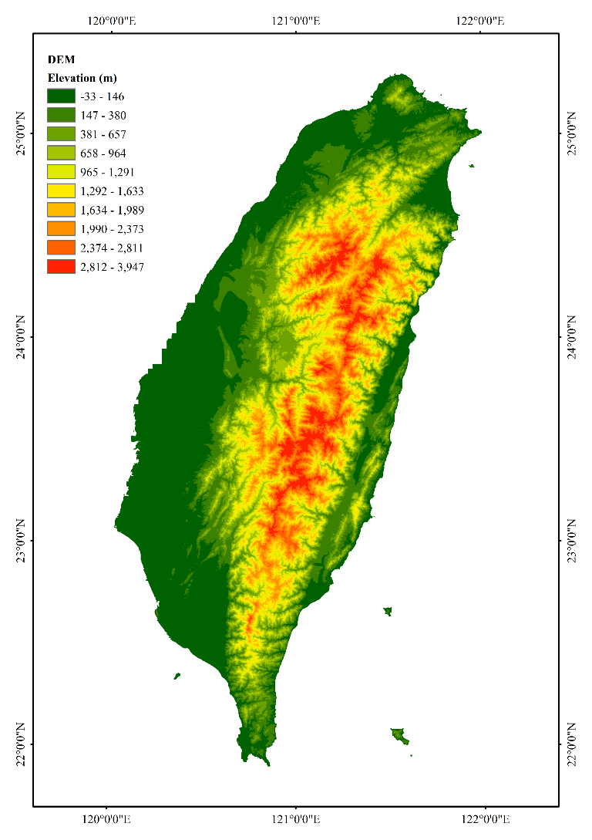

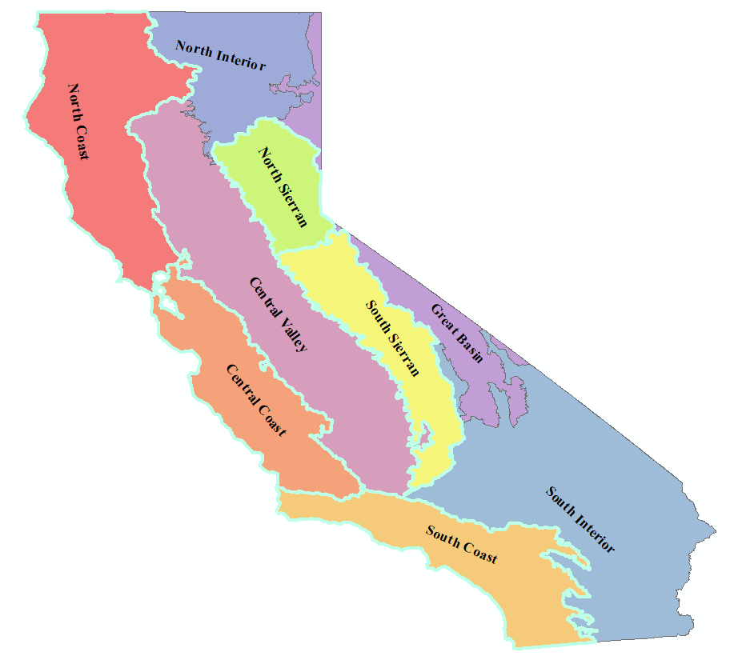

Study Area
Investigate the whole Taiwan.
Little research on wildfire issues.
Diverse topography
2 Monsoons affect rainfall seasons.
Northeast monsoon
(winter)
Focus on 4 regions
Southwest monsoon
(summer)
California, USA
(Vegetation classification and mapping)
Taiwan
Introduction/ Methodology/ Results and Discussions/ Conclusions and Ongoing Works

Slide 5

Study Area
 | California, USA | Taiwan
Area | 423,970 km² | 36,197 km²
Climate Types | (Coastal) warm-summer Mediterranean climate (Southwestern) subtropical semi-arid or steppe climate (Southeastern) hot arid climate | Tropical Climate
Precipitation | 350~2500 mm | 2500 mm
Wind | Santa Ana winds | seasonal monsoon typhoons (tropical cyclones)
Forest Coverage | 30.84% (USA) | 60.71%
Nature-Caused Wildfire | 10-15% | 2%
Anthropogenic activities | Firearms and explosives use | Burning paper money
Introduction/ Methodology/ Results and Discussions/ Conclusions and Ongoing Works

Slide 6


Objectives
To investigate the trend and the variability of wildfire occurrences time series, by using a time-frequency tool, Complementary Ensemble Empirical Mode Decomposition (CEEMD).
To identify the wildfire influence on forest vegetation distribution, detected by satellite image time-series data, through multi-dimensional Complementary Ensemble Empirical Mode Decomposition (MCEEMD). To compare the variation of the wildfire occurrences trend and influence in Taiwan and California, USA.
Introduction/ Methodology/ Results and Discussions/ Conclusions and Ongoing Works

Slide 7
Framework
Dry weather
Spatiotemporal Analysis
causes
High temperature
IMFs
Trends/ Variability
Wildfire occurrences
Official records
TDIC
MCEEMD/ CEEMD
Forest burnt
Satellite image time series (SITS)
Study area:
Taiwan
Study area:
California, USA
Forest recovery
consequences
Soil moisture
Comparison
Air pollution
Health impacts
Introduction/ Methodology/ Results and Discussions/ Conclusions and Ongoing Works

Slide 8
 | Variables | Sources | Data Duration | Frequency | Resolution/ Scale | Indices | Analysis Methods | Objective
Wildfire Occurrences | Occurrence Time series | MTBS (US), Forestry Bureau (TW) | 1984~2020 (US), 2010~2021 (TW) | daily | - | Times, Burnt area | CEEMD | -
Burnt Area | Vegetation Cover | Landsat series MODIS | 1984~2021 2000.03~2021 | Yearly Monthly | 30 m 0.1 degrees | NDVI | MCEEMD | Forest Recovery
Anthropogenic Activity | Religious activities (Taoism) | National Religion Information Network | 2010~2021 (TW) | daily | - | - | CEEMD | Occurrence
Meteorological Variables | temperature | Climatology Lab (US), TCCIP (TW) | 1979~2021 (US), 1960~2020 (TW) | daily | ~4-km, 1 km | - | MCEEMD | Occurrence
 | precipitation | Climatology Lab (US), TCCIP (TW) | 1979~2021 (US), 1960~2020 (TW) | daily | ~4-km, 1 km | Rainfall intensity, SPI | MCEEMD | Occurrence
 | Humidity | Climatology Lab (US), TCCIP (TW) | 1979~2021 (US), 1980~2020 (TW) | daily | ~4-km, 2 km | Relative humidity | CEEMD/ MCEEMD | Occurrence
 | Soil Moisture | Climate Data Store | 2006~2020 (US) | monthly | 0.25 degrees | - | CEEMD/ MCEEMD | Occurrence
 | El Niño | BOM (au), NOAA | 1984~2021 | monthly | - | SOI, ONI | CEEMD | Occurrence
Air pollution | PM2.5, PM10 | EPA (US), EPA (TW) | 2000~2020 (US), 2010~2021 (TW) | daily | - | - | CEEMD | Impact area/ Health impacts
Health Impacts | ED contact/ Hospitalizations | Ministry of Health and Welfare (TW) | 2000~2018 (TW) | - | - | - | CEEMD | Health impacts
Introduction/ Methodology/ Results and Discussions/ Conclusions and Ongoing Works

Slide 9
02
Methodology
Multi-dimensional Complementary Ensemble EMD

Slide 10

Empirical mode decomposition (EMD)
A data-driven technique: the basis functions are derived from the signal itself
Analyzing data from nonstationary and nonlinear processes
A local and adaptive method
Instantaneous frequency
Intrinsic mode functions (IMFs)
EMD
Huang et al.
Ensemble EMD
Wu and Huang
Complementary Ensemble EMD
Yeh et al.
1998
2009
2010
Multi-dimensional EEMD
Wu and Huang
Introduction/ Methodology/ Results and Discussions/ Conclusions and Ongoing Works

Slide 11
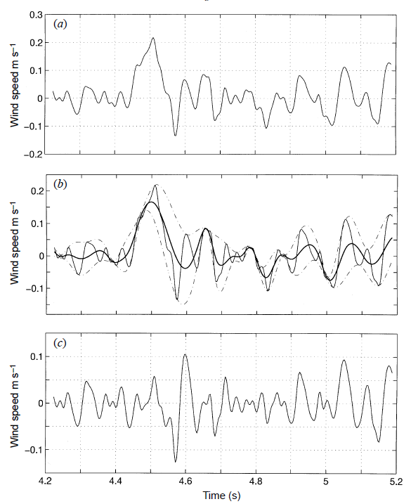
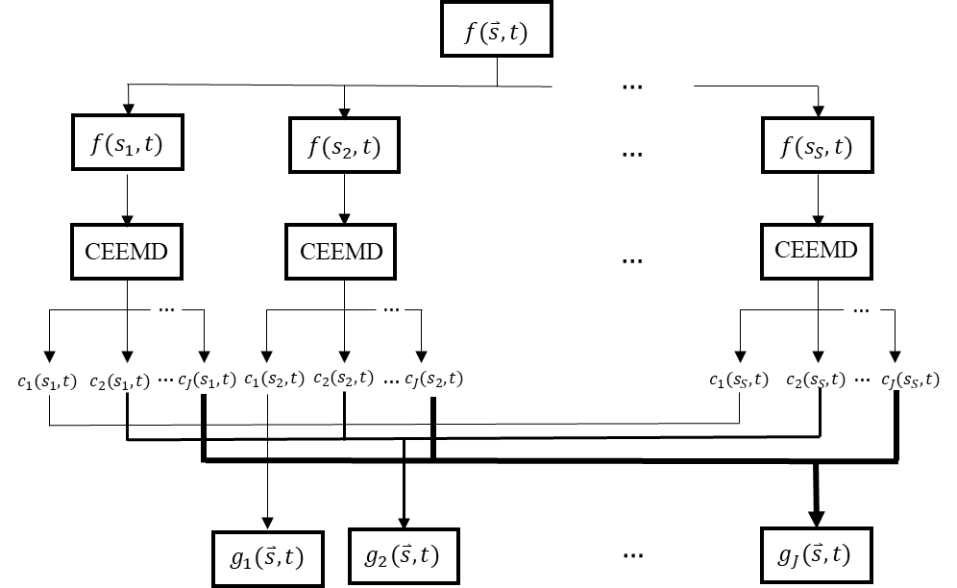

Empirical mode decomposition (EMD)
Empirical mode decomposition $X\left(t\right)=\sum_{t=1}^{n}{c_{i}}+r_{n}$
Multi-dimensional Complementary Ensemble Empirical Mode Decomposition (MCEEMD)
Sifting process of EMD
IMFs
Trend : extrema <=1
Lin (2020)
Introduction/ Methodology/ Results and Discussions/ Conclusions and Ongoing Works
Huang et al. (1998)

Slide 12
03
Results and Discussions
Time Frequency analysis:
California, USA
Taiwan

Slide 13

California, USA
Wildfire severity
Causes:
Precipitation
Relative Humidity
Temperature
Effects:
Vegetation Cover
Soil Moisture
Introduction/ Methodology/ Results and Discussions/ Conclusions and Ongoing Works

Slide 14
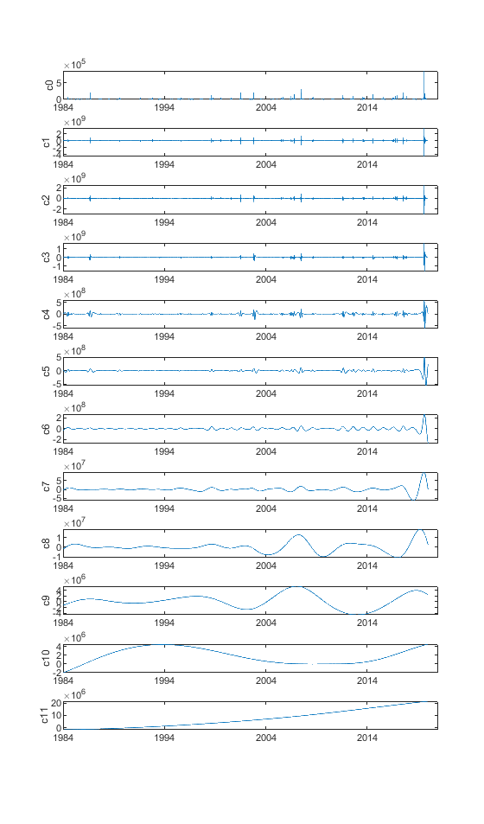
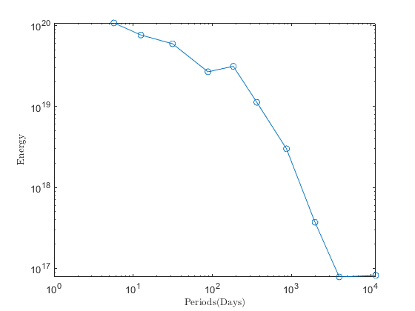
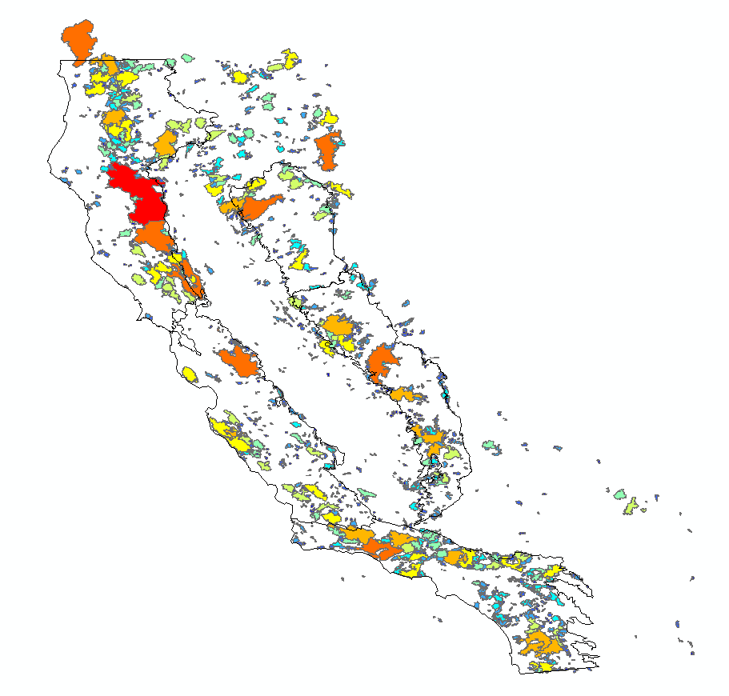
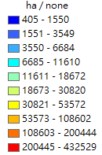
Time Frequency analysis of Wildfires in California
Wildfire Severity 1984~2020 (daily)
Severity (ha/day) burnt area/ day
Characteristic timescale The timescale of high energy IMFs
IMFs/ characteristic timescale of wildfire time series in California
Energy concentration
Distribution of wildfire in California
IMF | (days) | (yrs)
1 | 5.7 | 0
2 | 12.5 | 0
3 | 31.3 | 0
4 | 87.8 | 0
5 | 183.6 | 1
6 | 363.8 | 1
7 | 861.9 | 2
8 | 1975.4 | 5
9 | 4004.1 | 11
10 | 11566.9 | 32
Introduction/ Methodology/ Results and Discussions/ Conclusions and Ongoing Works

Slide 15
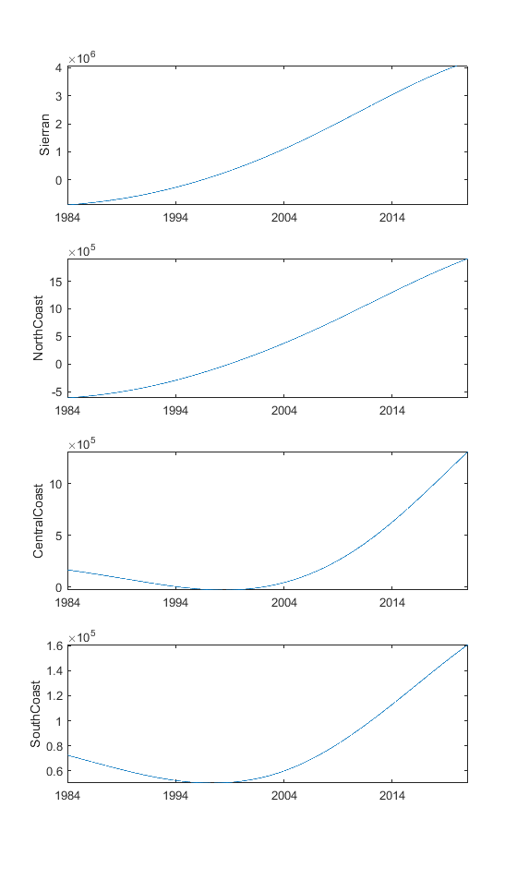
Time Frequency analysis of Wildfires in California
Wildfire Severity 1984~2020 (daily) (i.e., burnt area)
Trend of wildfire in 4 selected California regions
IMF | Sierran |  | North Coast |  | Central Coast |  | South Coast
 | (days) | (yrs) | (days) | (yrs) | (days) | (yrs) | (days) | (yrs)
1 | 6.0 | 0 | 7.1 | 0 | 6.2 | 0 | 6.5 | 0
2 | 14.1 | 0 | 14.9 | 0 | 16.2 | 0 | 18.0 | 0
3 | 34.4 | 0 | 35.9 | 0 | 38.6 | 0 | 43.3 | 0
4 | 82.8 | 0 | 95.2 | 0 | 97.2 | 0 | 88.7 | 0
5 | 175.5 | 0 | 206.1 | 1 | 206.5 | 1 | 189.5 | 1
6 | 365.3 | 1 | 405.0 | 1 | 423.7 | 1 | 416.0 | 1
7 | 936.7 | 3 | 882.1 | 2 | 1023.9 | 3 | 1092.2 | 3
8 | 1838.4 | 5 | 2006.8 | 5 | 2207.0 | 6 | 2470.8 | 7
9 | 4714.2 | 13 | 3999.0 | 11 | 5317.0 | 15 | 5332.3 | 15
10 | 9064.2 | 25 | 11636.6 | 32 | 10228.0 | 28 | 10131.8 | 28
Introduction/ Methodology/ Results and Discussions/ Conclusions and Ongoing Works

Slide 16
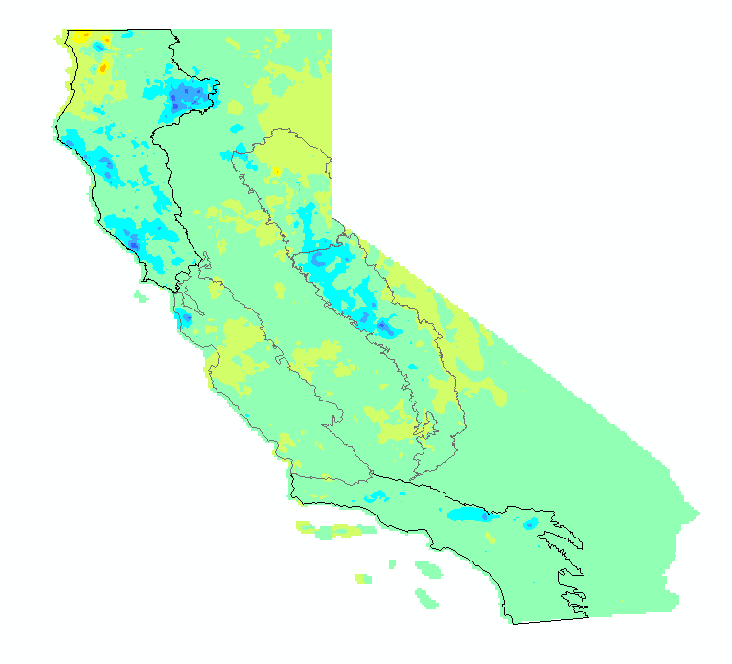
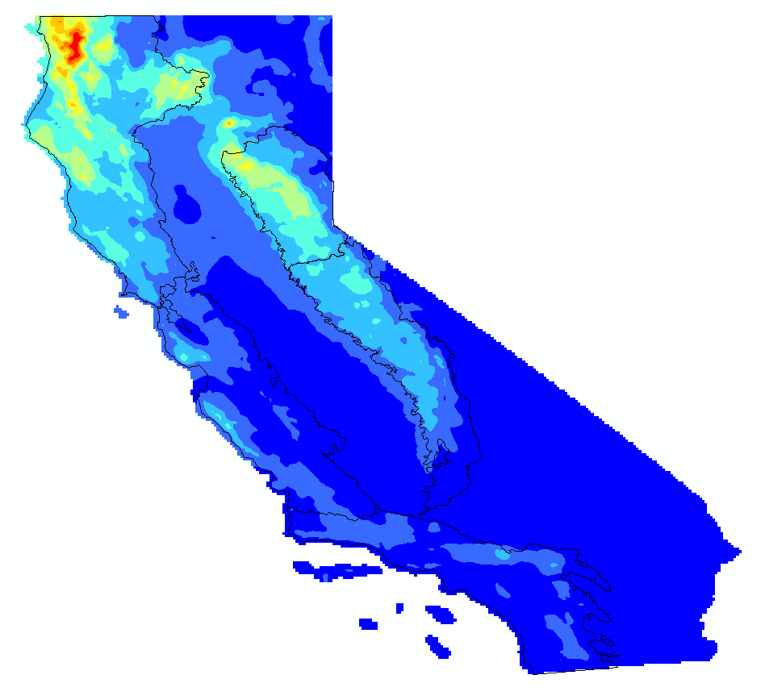


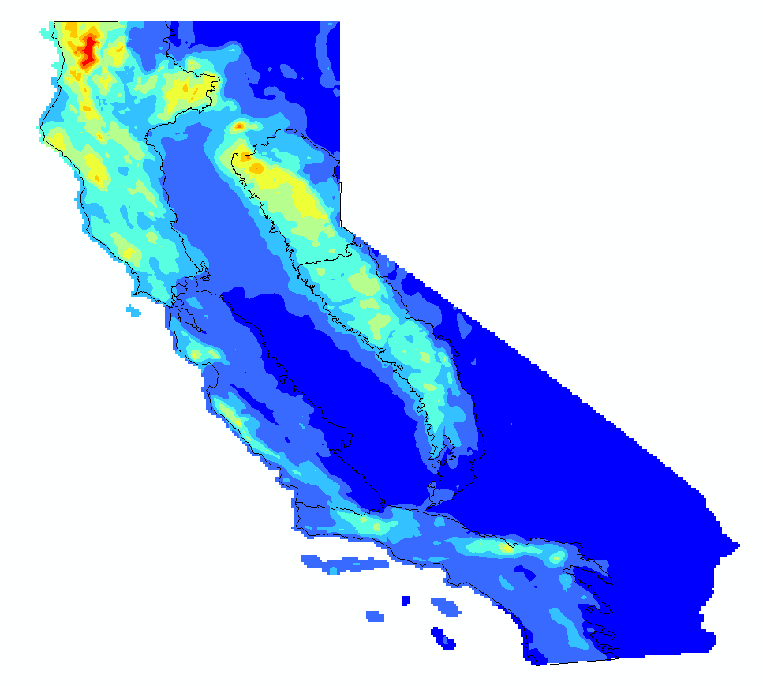
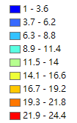
Time Frequency analysis of Wildfires in California-Causes
Precipitation(mm) 1979~2021 (daily)
Evolution of the variable
Trend_{CEEMD} = R_{n}(2019) – R_{n}(1979)
More precipitation
Higher variability
Evolution of precipitation
decrease
Standard
Deviation
mean
2019
Introduction/ Methodology/ Results and Discussions/ Conclusions and Ongoing Works

Slide 17
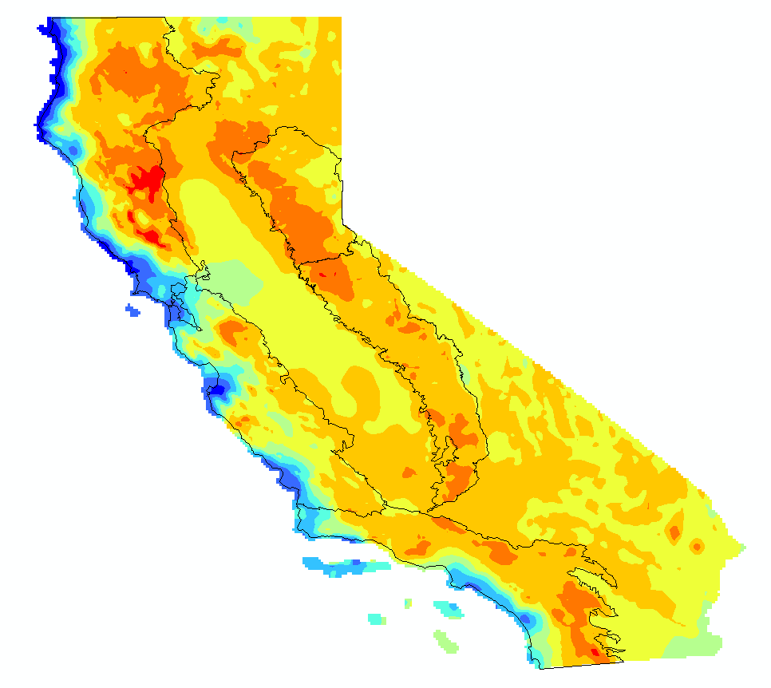
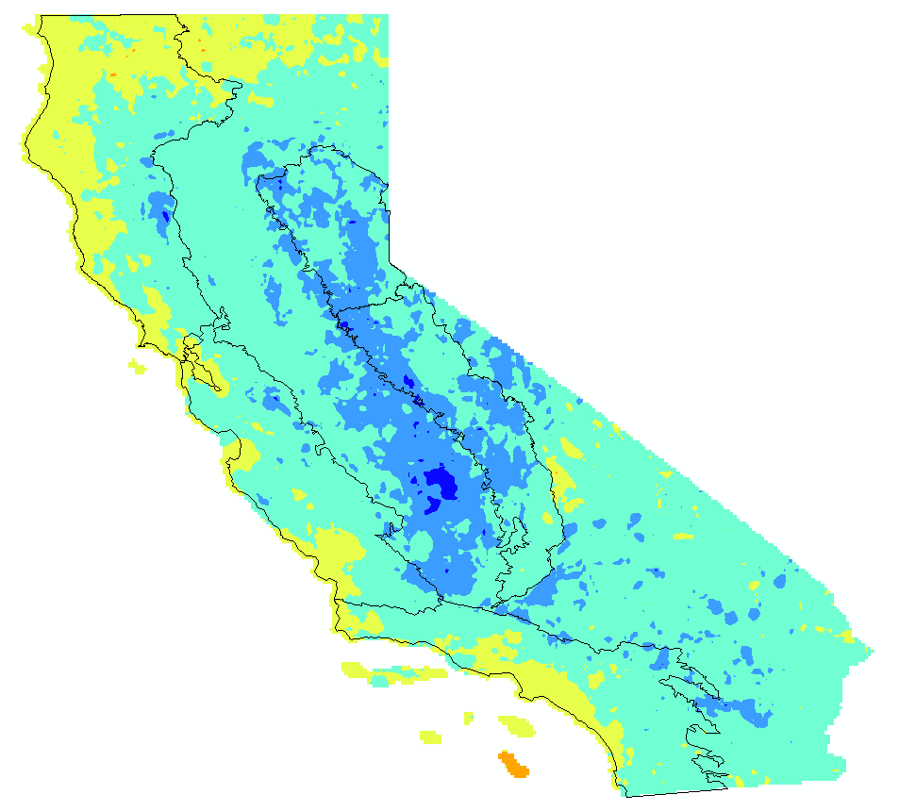
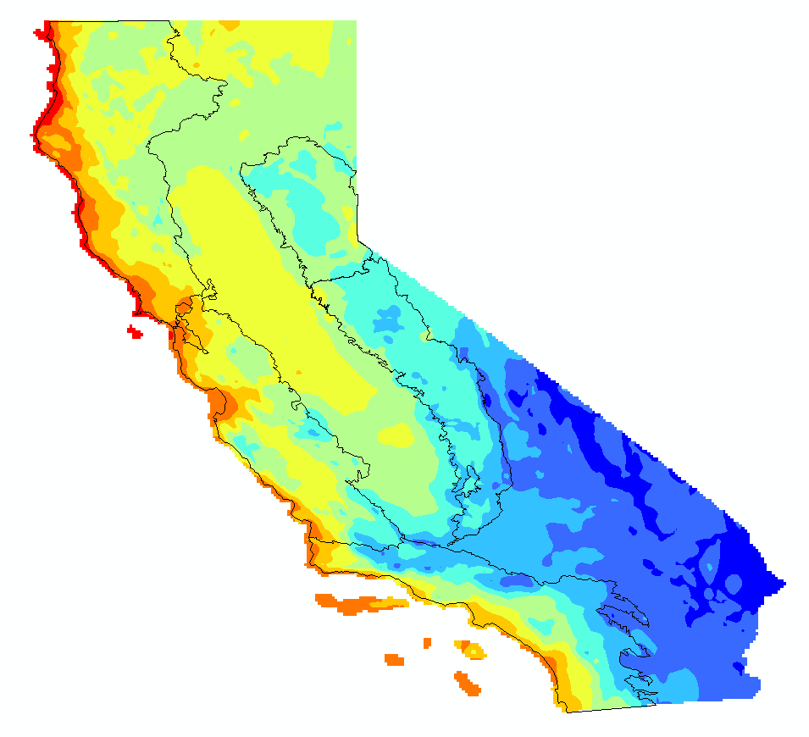
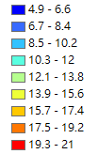
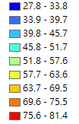

Time Frequency analysis of Wildfires in California-Causes
Mean Relative Humidity (%) 1979~2021 (daily)
Evolution of the variable
Trend_{CEEMD} = R_{n}(2019) – R_{n}(1979)
Unstable
Evolution of Humidity
decrease
2019
Higher
Stable
Standard
Deviation
mean
Introduction/ Methodology/ Results and Discussions/ Conclusions and Ongoing Works

Slide 18
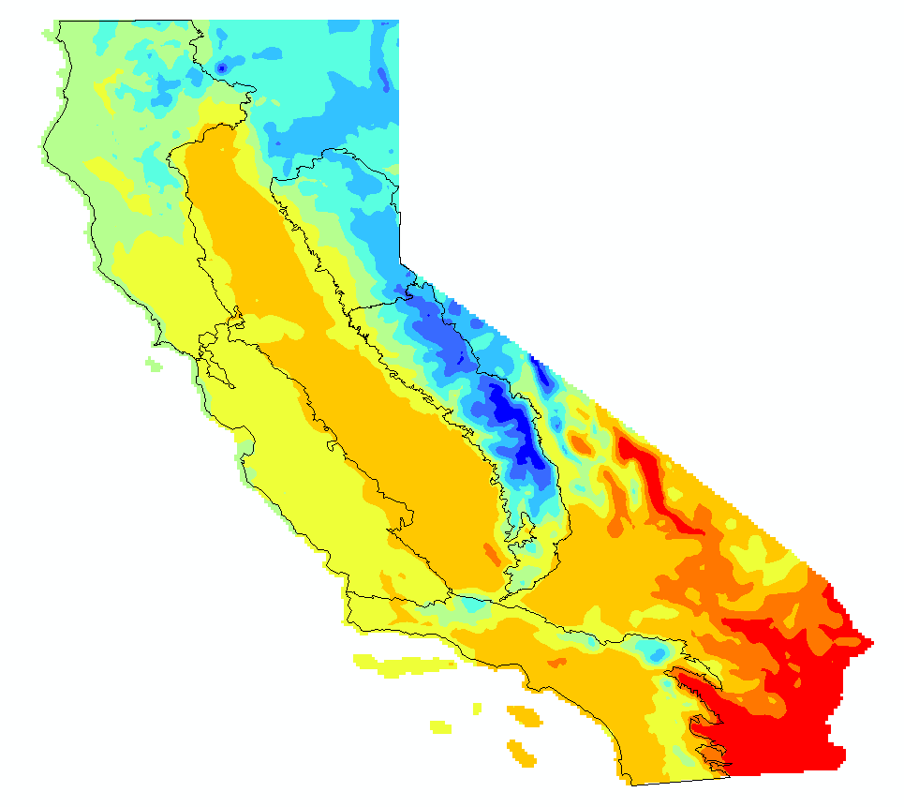
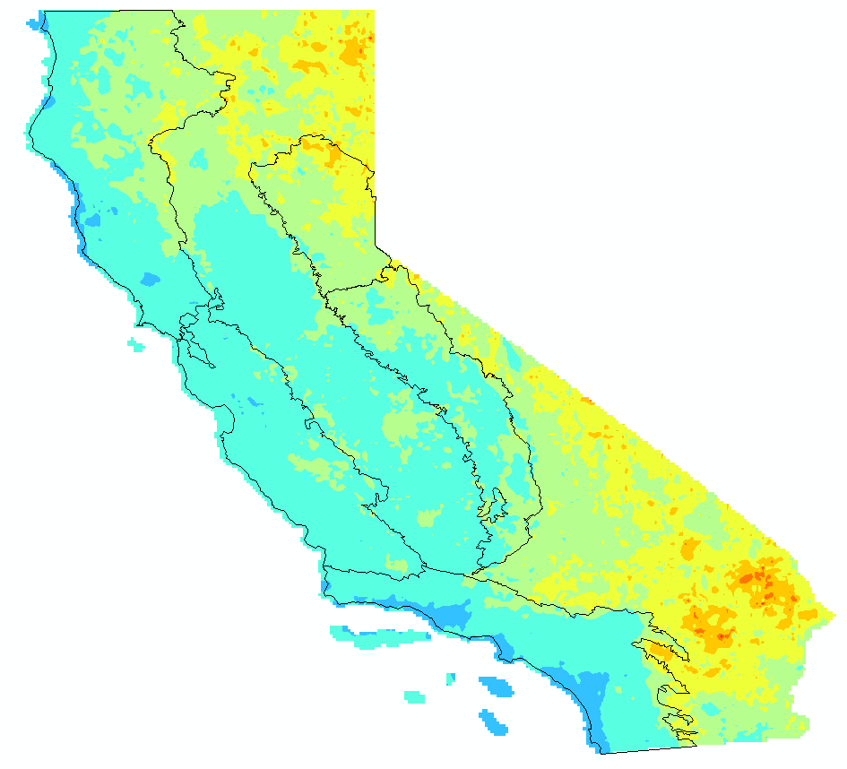
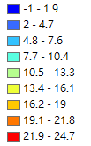
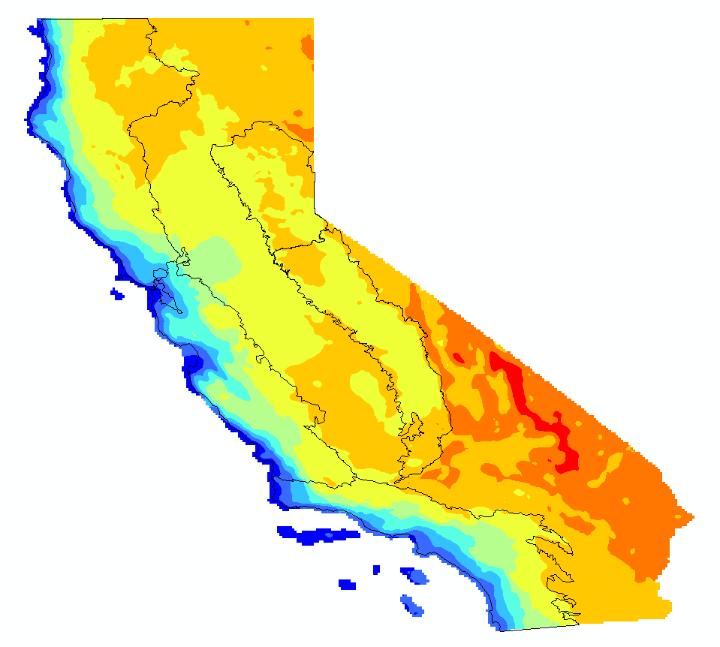


Time Frequency analysis of Wildfires in California-Causes
Mean Temperature (ºC) 1979~2021 (daily)
Evolution of the variable
Trend_{CEEMD} = R_{n}(2019) – R_{n}(1979)
Low temperature
Evolution of temperature
Increase
2019
Stable
Standard
Deviation
mean
Introduction/ Methodology/ Results and Discussions/ Conclusions and Ongoing Works

Slide 19
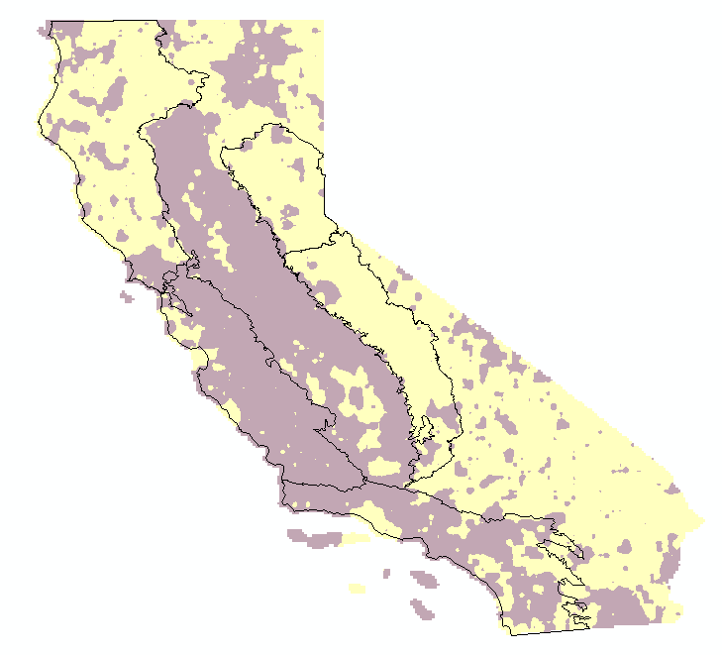
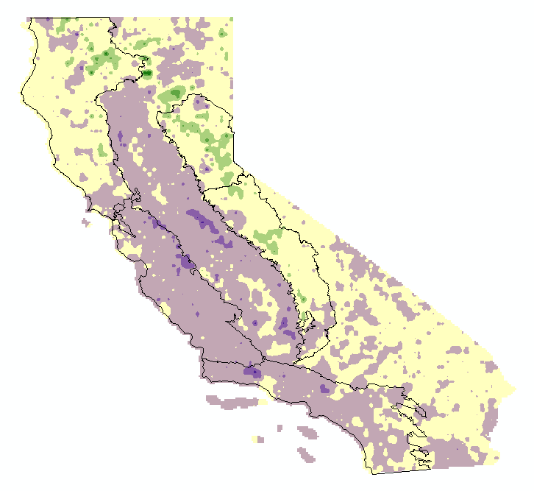
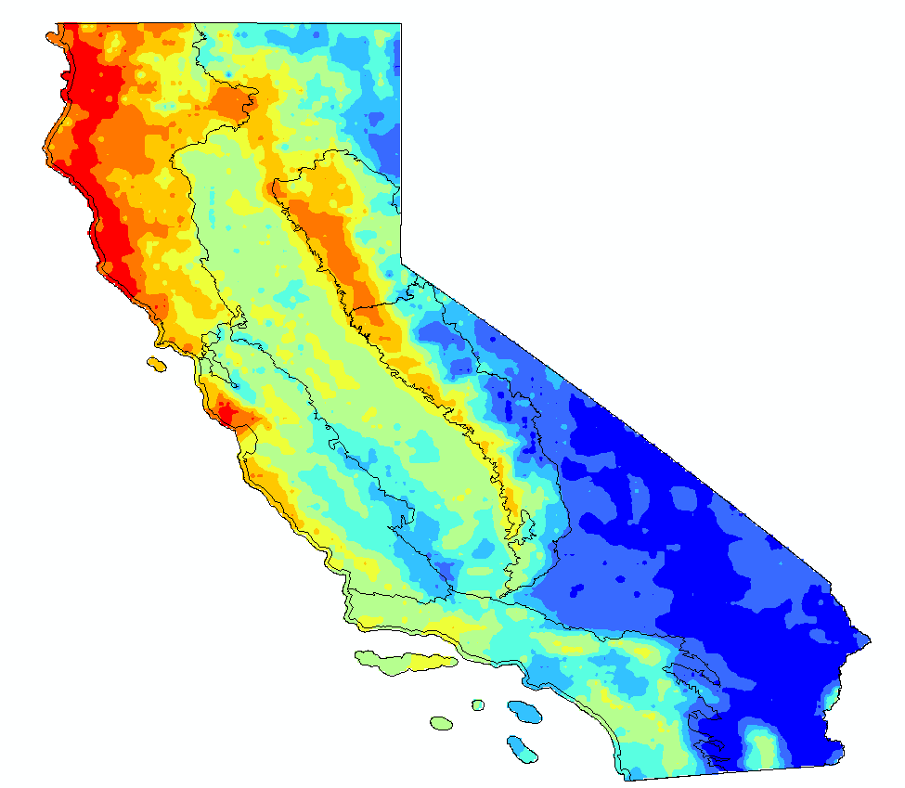

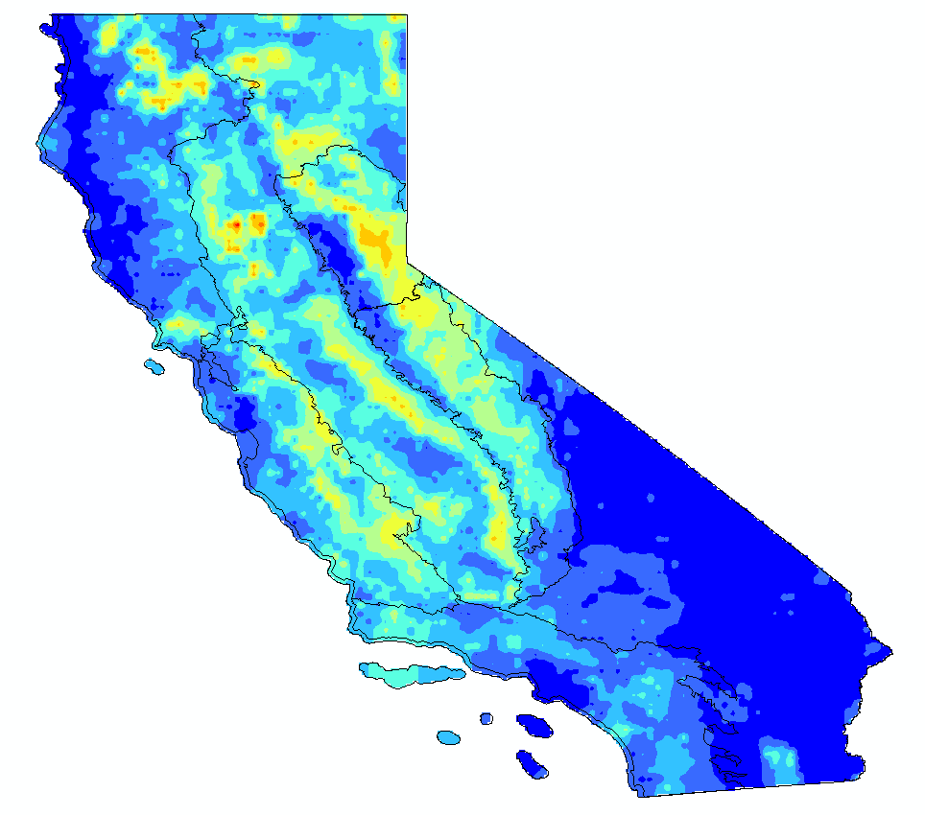

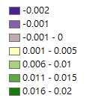
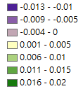

Time Frequency analysis of Wildfires in California-Effects
Vegetation Cover Analysis 2001~2021 (monthly)
NDVI (Normalized Difference Vegetation Index) (MODIS)
$$NDVI=(NIR−RED)/(NIR+RED)$$
Evolution of the variable
Trend_{CEEMD} = R_{n}(T) – R_{n}(2001)
Evolution of NDVI
Higher coverage rate
Higher variability
Increase
2011
2021
Standard
Deviation
mean
decrease
Introduction/ Methodology/ Results and Discussions/ Conclusions and Ongoing Works

Slide 20
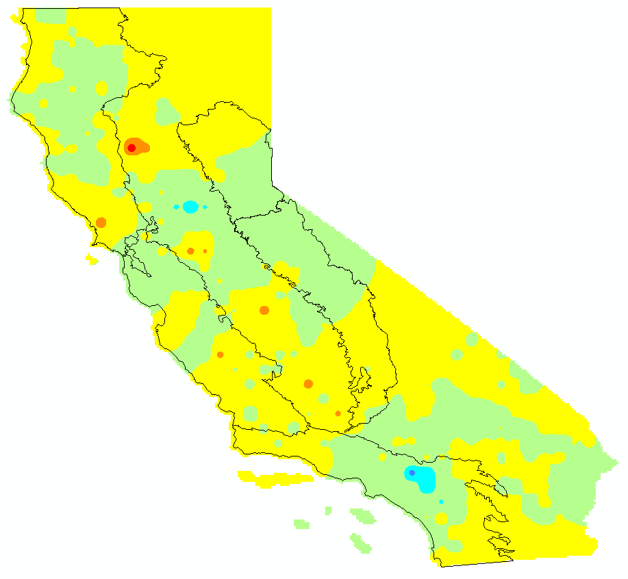
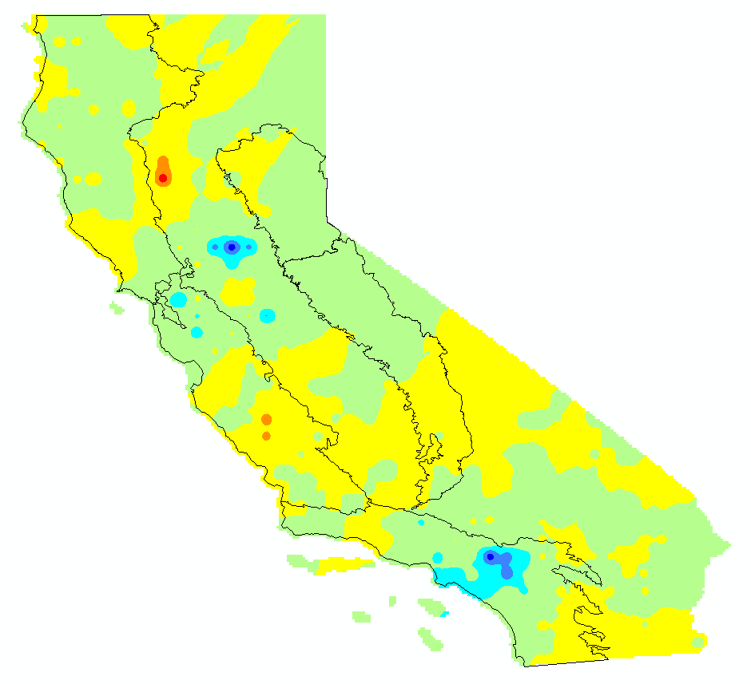

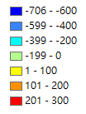
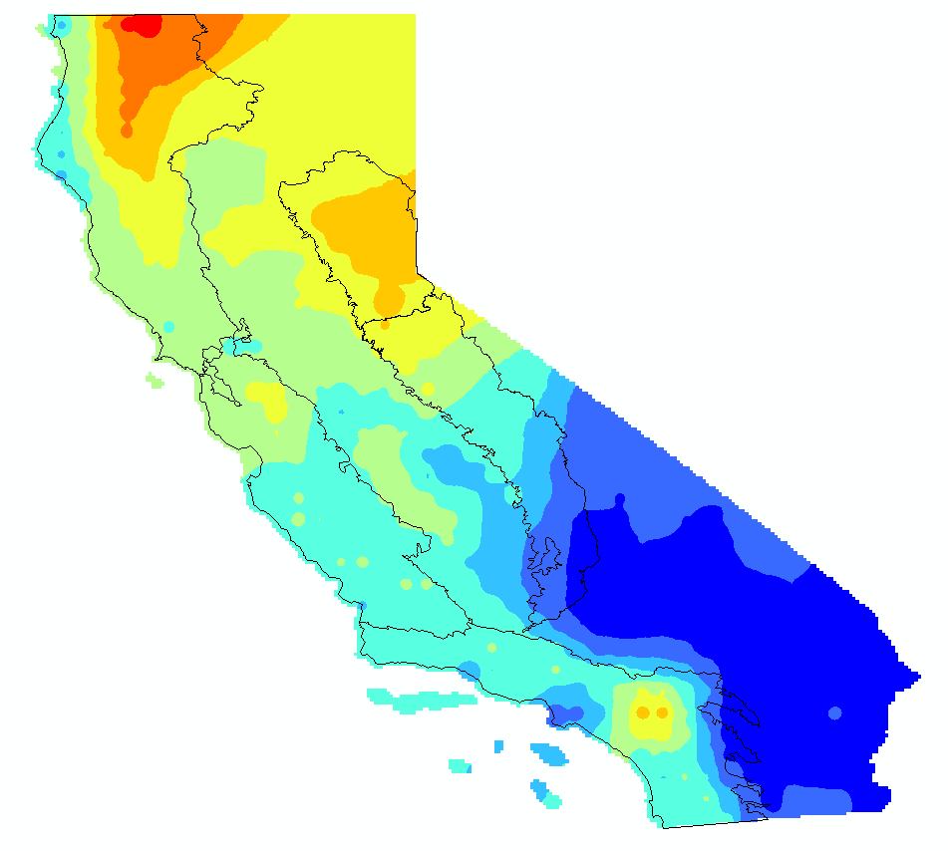

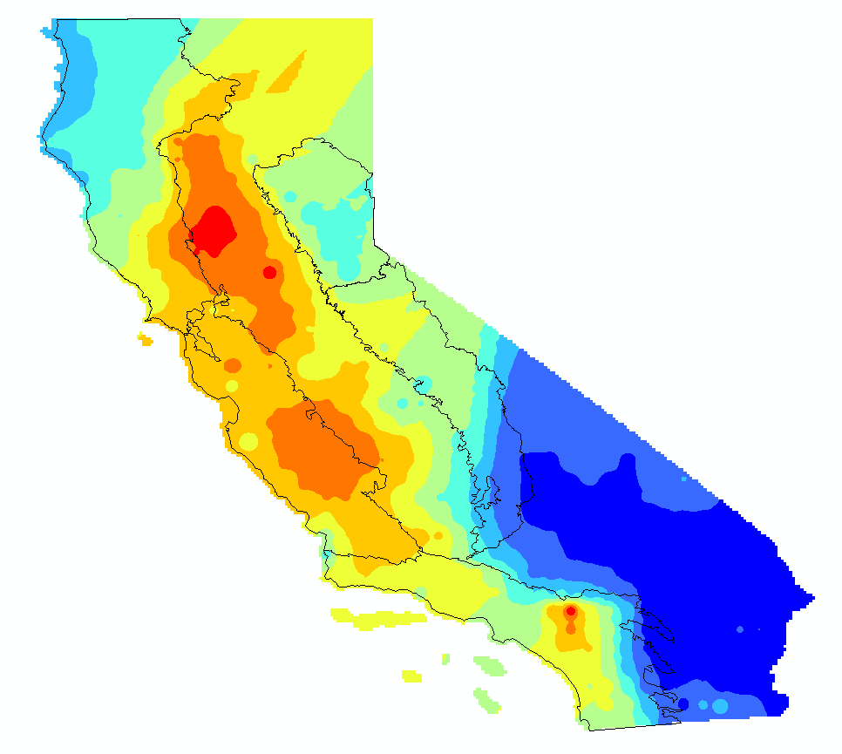
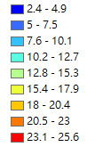
Time Frequency analysis of Wildfires in California-Effects
Soil Moisture (%) 2006~2020 (monthly)
Evolution of the variable
Trend_{CEEMD} = R_{n}(T) – R_{n}(2006)
Evolution of NDVI
Higher moisture
Unstable
Standard
Deviation
2011
decrease
decrease
mean
2016
Introduction/ Methodology/ Results and Discussions/ Conclusions and Ongoing Works

Slide 21
Taiwan
Wildfire severity
Causes:
Precipitation
Relative Humidity
Temperature
Religious activities
Effects:
Vegetation Cover
Introduction/ Methodology/ Results and Discussions/ Conclusions and Ongoing Works

Slide 22
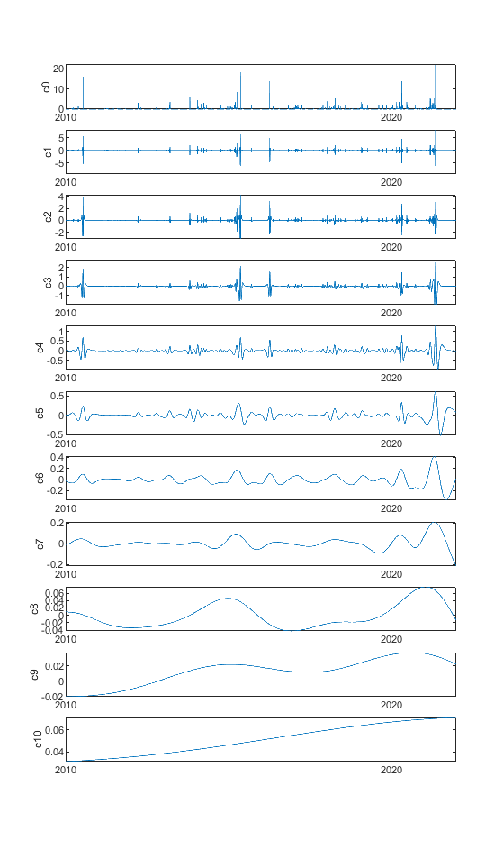
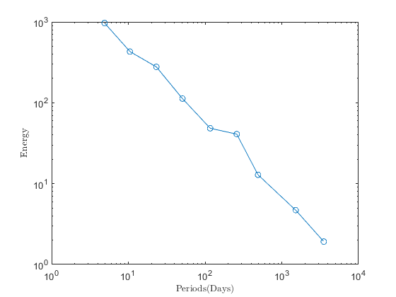
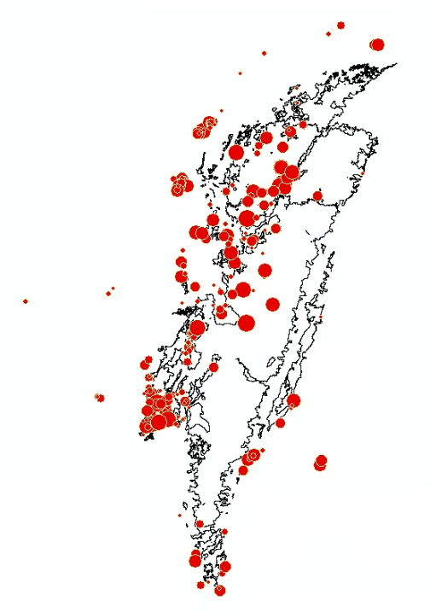
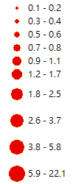
Time Frequency analysis of Wildfires in Taiwan
Wildfire Severity 2010~2021 (daily)
Severity (ha/day) burnt area/ day
Characteristic timescale The timescale of high energy IMFs
IMFs/ characteristic timescale of wildfire time series in Taiwan
Distribution of wildfire in Taiwan
Energy concentration
IMF | (days) | (yrs)
1 | 4.9 | 0
2 | 10.5 | 0
3 | 23.2 | 0
4 | 50.7 | 0
5 | 116.7 | 0
6 | 258.6 | 1
7 | 490.1 | 1
8 | 1517.5 | 4
Introduction/ Methodology/ Results and Discussions/ Conclusions and Ongoing Works

Slide 23
Time Frequency analysis of Wildfires in Taiwan-Causes
2010~2021 The causes of Wildfire occurrence in Taiwan
Littering cigarette butts | 8%
Other Anthropogenic effects | 13%
garbage burning | 13%
Accidental use of fire in mountain activities | 15%
Inadvertent use of fire in folk rituals | 11%
deliberate arson | 10%
under investigation | 0%
Farmland set fire accidentally | 28%
Natural factors such as lightning strikes | 3%
Introduction/ Methodology/ Results and Discussions/ Conclusions and Ongoing Works

Slide 24
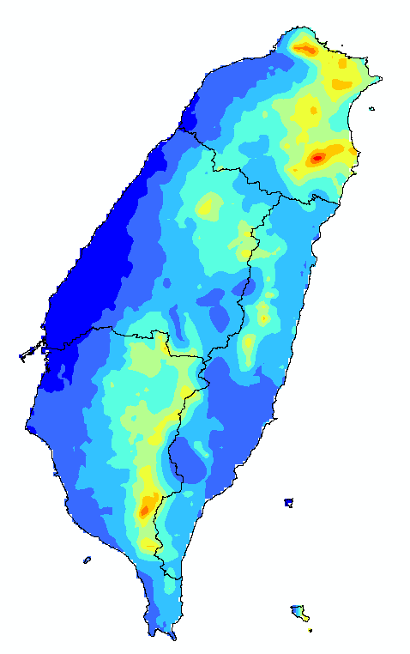
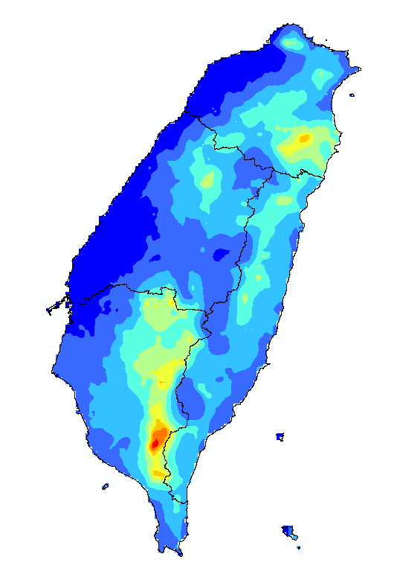
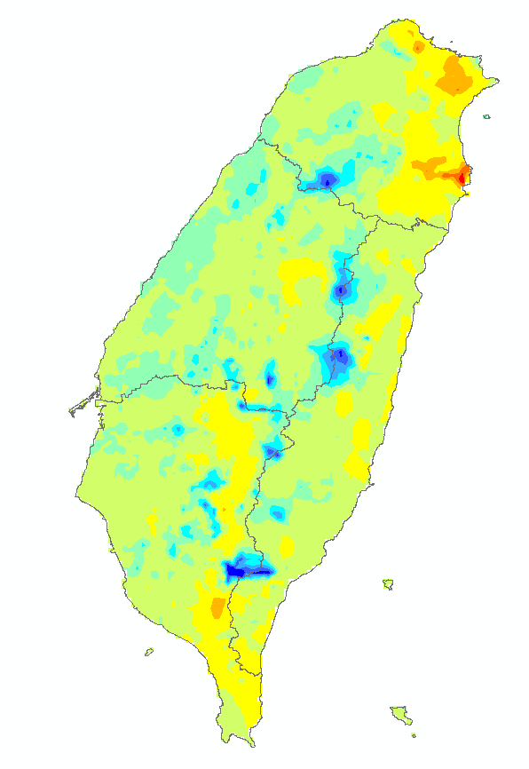

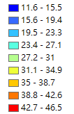
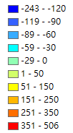
Time Frequency analysis of Wildfires in Taiwan-Causes
Precipitation (mm) 1960~2020 (daily)
Evolution of the variable
Trend_{CEEMD} = R_{n}(2020) – R_{n}(1960)
Evolution of precipitation
More precipitation
Higher variability
Increase
Standard
Deviation
mean
2020
Introduction/ Methodology/ Results and Discussions/ Conclusions and Ongoing Works

Slide 25
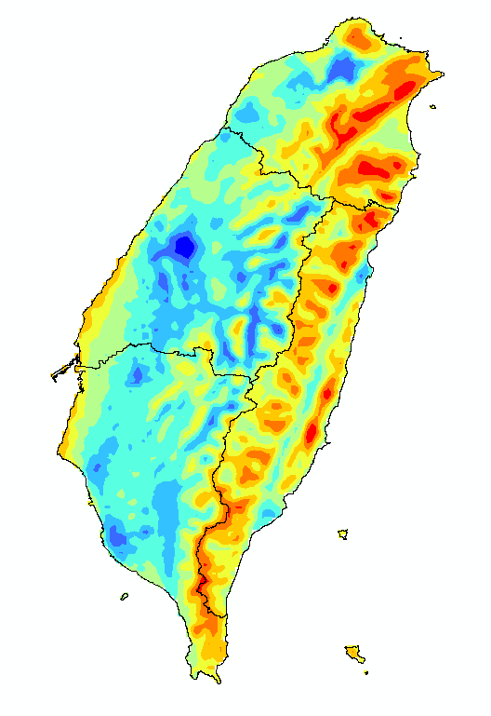
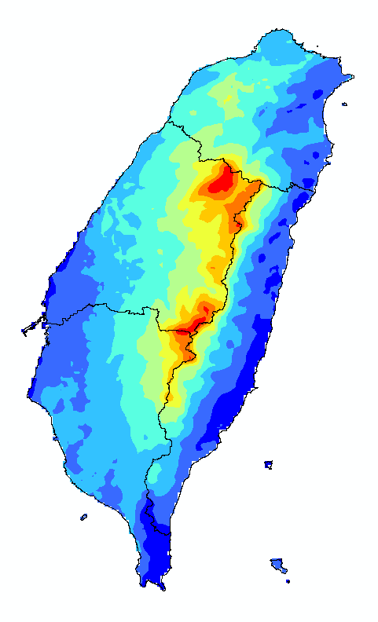



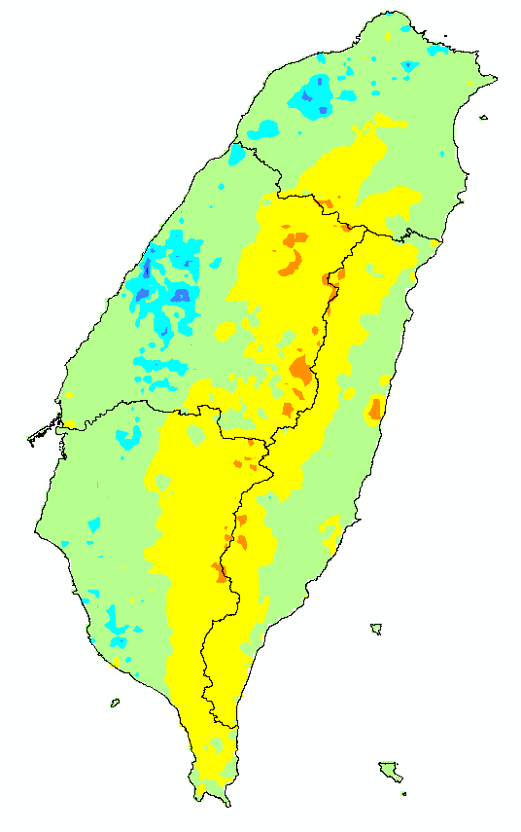
Time Frequency analysis of Wildfires in Taiwan-Causes
Mean Relative Humidity (%) 1980~2020 (daily)
Evolution of the variable
Trend_{CEEMD} = R_{n}(2020) – R_{n}(1980)
Evolution of Humidity
Decrease
Very wet
unstable
Standard
Deviation
mean
2020
Introduction/ Methodology/ Results and Discussions/ Conclusions and Ongoing Works

Slide 26

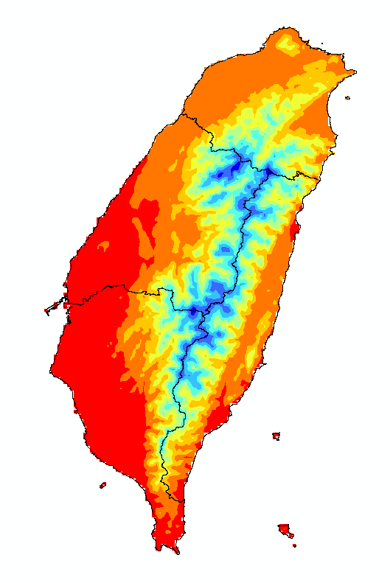
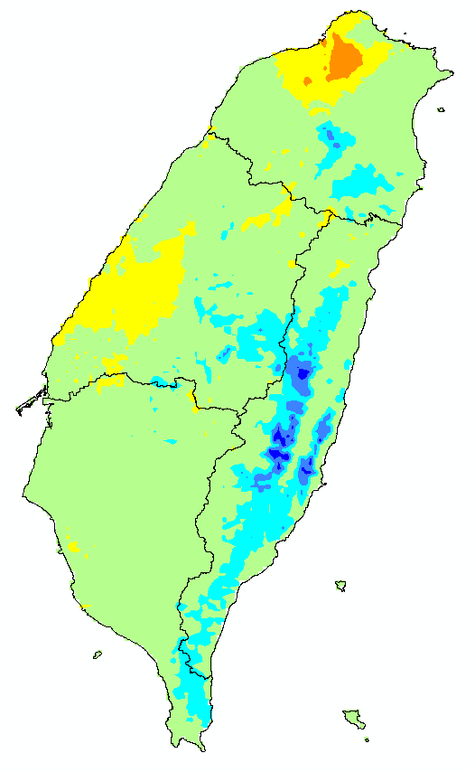
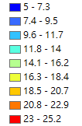
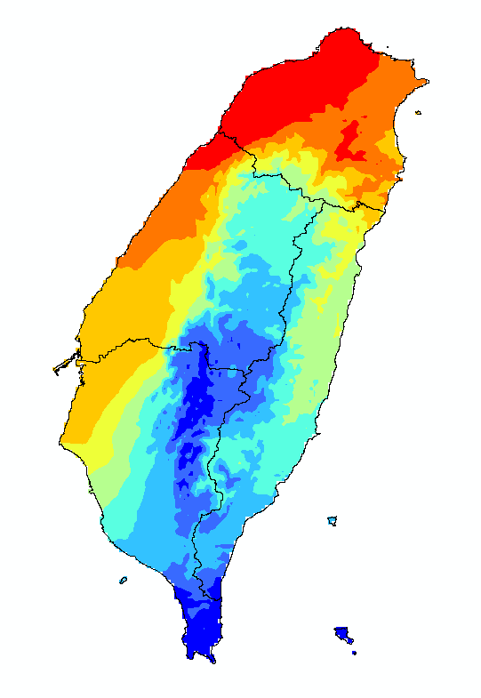

Time Frequency analysis of Wildfires in Taiwan-Causes
Mean Temperature (ºC) 1960~2020 (daily)
Evolution of the variable
Trend_{CEEMD} = R_{n}(2020) – R_{n}(1960)
Evolution of Temperature
Increase
unstable
hottest
Decrease
Standard
Deviation
mean
2020
Introduction/ Methodology/ Results and Discussions/ Conclusions and Ongoing Works

Slide 27






Time Frequency analysis of Wildfires in Taiwan-Causes
Times of Taoism activities
Religious activities (Taoism) 2010~2021 (daily)
Times of Taoism activities in Taiwan
Timescale Identification
IMF | (days) | (yrs)
1 | 4.6 | 0
2 | 8.7 | 0
3 | 20.1 | 0
4 | 43.7 | 0
5 | 152.8 | 0
6 | 311.1 | 1
7 | 623.7 | 2
8 | 1576.4 | 4
Introduction/ Methodology/ Results and Discussions/ Conclusions and Ongoing Works

Slide 28









Time Frequency analysis of Wildfires in Taiwan-Effects
Vegetation Cover Analysis 2001~2021 (monthly)
NDVI (Normalized Difference Vegetation Index) (MODIS)
$$NDVI=(NIR−RED)/(NIR+RED)$$
Evolution of the variable
Trend_{CEEMD} = R_{n}(T) – R_{n}(2001)
Evolution of NDVI
decrease
Higher coverage rate
Low variability
2011
2021
mean
Standard Deviation
Introduction/ Methodology/ Results and Discussions/ Conclusions and Ongoing Works

Slide 29
Time Frequency analysis of Wildfires in Taiwan
Intensity: burnt area/ hr
Duration: 1, 2, 3, 6, 12, 24 hours
Frequency (return period): 2, 5, 10, 25, 50, 100 years
 | 1 | 2 | 3 | 6 | 12 | 24
mean | 0.51 | 0.73 | 0.26 | 0.76 | 0.17 | 0.09
SD | 0.48 | 0.60 | 0.18 | 1.09 | 0.13 | 0.06
Cs | 2.17 | 0.80 | 0.86 | 1.68 | 0.74 | 0.06
6 hr
Introduction/ Methodology/ Results and Discussions/ Conclusions and Ongoing Works

Slide 30
04
Conclusions and Ongoing Works

Slide 31
Conclusions-California
Variables |  |  | Sierran | North Coast | Central Coast | South Coast
Causes | Precipitation | Mean | High | High | High | High
 |  | SD | High | High | High | High
 |  | Trend | Decrease↓ | Decrease↓ | - | -
 | Relative Humidity | Mean | - | - | - | -
 |  | SD | High | High | - | -
 |  | Trend | Decrease↓ | - | - | -
 | Temperature | Mean | Low | Low | - | -
 |  | SD | - | Low | Low | Low
 |  | Trend | - | - | - | -
Effects | Vegetation Cover | Mean | High | High | - | -
 |  | SD | High | High | High | -
 |  | Trend | Increase↑ | - | Decrease↓ | Decrease↓
 | Soil Moisture | Mean | High | High | - | -
 |  | SD | - | - | High | -
 |  | Trend | - | - | - | Decrease↓
Distribution of wildfire in California
North Coast
Sierran
Central Coast
South Coast
Introduction/ Methodology/ Results and Discussions/ Conclusions and Ongoing Works

Slide 32
Conclusions-Taiwan
Variables |  |  | Mountain | Other
Causes | Precipitation | Mean | High | -
 |  | SD | High
 |  | Trend | - | -
 | Relative Humidity | Mean | High | -
 |  | SD | High | -
 |  | Trend | - | -
 | Temperature | Mean | Low | High
 |  | SD | - | -
 |  | Trend | - | -
Effects | Vegetation Cover | Mean | High | Low
 |  | SD | Low | High
 |  | Trend | - | -
Distribution of wildfire in Taiwan
Introduction/ Methodology/ Results and Discussions/ Conclusions and Ongoing Works

Slide 33
Conclusions
Both in the cases of wildfire in Taiwan and California, the increasing tendency was indicated by CEEMD.
After analyzing the evolution of potential cause and effect factors, the following hypotheses can be proposed：
The probability of wildfire occurrences in north California is positively correlated to precipitation and relative humidity.
The probability of wildfire occurrences in Taiwan’s mountain areas is correlated to meteorological factors (precipitation, relative humidity, and temperature).
The probability of wildfire occurrences in Taiwan’s non-mountain areas is affected more by human activities.
Introduction/ Methodology/ Results and Discussions/ Conclusions and Ongoing Works

Slide 34


Ongoing works
Evaluating public health potential harm by utilizing a medical database in Taiwan.
Developing the correlation between wildfire events and other factors by TDIC/ TDICC.
Establishing risk maps of wildfire occurrences of Taiwan and California, USA.
Contact us
Conference poster:
Tung, Y.-J and Tsai, C. W. (2022): Spatiotemporal Analysis of Wildfire Occurrences in Taiwan and California, USA, 2022 Soil Hydrology and Water Resources Management Modeling Summit, Taichung, Taiwan, 19-20 March 2022.
E-mail:
r09521307@ntu.edu.tw, cwstsai@ntu.edu
Abstract & slides
Introduction/ Methodology/ Results and Discussions/ Conclusions and Ongoing Works

Slide 35







Acknowledgements
Stochastic Environmental
Hydraulics and Hydrology
MOST 110-2628-E-002-008-

Slide 36
Wildfire in 2 Study Areas
California
 | California | Taiwan
Trend | Increase↑ | Increase↑
Characteristic Timescale | ½ year | 1 year
Nature-Caused Wildfire | 10-15% | 2%
Anthropogenic activities | Firearms and explosives use | Burning paper money
Taiwan
Introduction/ Methodology/ Results and Discussions/ Conclusions and Ongoing Works

Slide 37
What is IDF-Curve?
Intensity-Duration-Frequency Curve
An idea inspired from Hydrology, which typically applied in rainfall.
Select annual maximum intensity in different burnt duration.
Fit Log-Pearson Type 3 distribution.
P=1/T (exceed probability)
X_{Tr}= σ + k T_{r}
 | 1 | 2 | 3 | 6 | 12 | 24
2010 | 0.56 | 0.64 | 0.30 | 0.15 | 0.04 | 0.02
2011 | 0.56 | 0.02 | 0.22 | 0.70 | 0.02 | 0.10
2012 | 0.56 | 0.64 | 0.30 | 0.14 | 0.20 | 0.04
2013 | 0.56 | 0.41 | 0.05 | 0.14 | 0.03 | 0.18
2014 | 0.21 | 0.21 | 0.30 | 0.52 | 0.44 | 0.10
2015 | 0.30 | 0.35 | 0.35 | 3.17 | 0.31 | 0.15
2016 | 0.30 | 0.38 | 0.16 | 0.44 | 0.10 | 0.07
2017 | 0.70 | 0.70 | 0.41 | 0.42 | 0.15 | 0.18
2018 | 0.08 | 0.71 | 0.71 | 0.46 | 0.08 | 0.12
2019 | 0.40 | 1.11 | 0.23 | 0.07 | 0.23 | 0.11
2020 | 1.90 | 1.90 | 0.29 | 2.93 | 0.05 | 0.05
2021 | 0.42 | 1.75 | 0.04 | 0.22 | 0.30 | 0.04
mean | 0.51 | 0.73 | 0.26 | 0.76 | 0.17 | 0.09
SD | 0.48 | 0.60 | 0.18 | 1.09 | 0.13 | 0.06
Cs | 2.17 | 0.80 | 0.86 | 1.68 | 0.74 | 0.06
2 yr | 0.4 | 0.7 | 0.3 | 0.3 | 0.1 | 0.1
5 yr | 0.8 | 1.3 | 0.4 | 1.0 | 0.3 | 0.1
10 yr | 1.1 | 1.5 | 0.5 | 1.9 | 0.4 | 0.2
25 yr | 1.4 | 1.7 | 0.6 | 3.9 | 0.6 | 0.2
50 yr | 1.7 | 1.7 | 0.7 | 6.4 | 0.7 | 0.2
100 yr | 2.0 | 1.7 | 0.7 | 10.4 | 0.9 | 0.3
Curve

Slide 38





Time Frequency analysis of Wildfires in Taiwan
Wildfire Severity 1984~2020 (daily) (i.e. burnt area)
Trend of wildfire in 4 Taiwan regions
IMF | (days) | (yrs)
1 | - | -
2 | 10.7 | 0
3 | 25.5 | 0
4 | 54.2 | 0
5 | 111.4 | 0
6 | 245.7 | 1
7 | 501.9 | 1
8 | 1190.4 | 3
9 | 2383.7 | 7
IMF | (days) | (yrs)
1 | 6.3 | 0
2 | 12.1 | 0
3 | 28.1 | 0
4 | 58.1 | 0
5 | 112.7 | 0
6 | 241.6 | 1
7 | 558.8 | 2
8 | 1471.6 | 4
9 | 2833.5 | 8
IMF | (days) | (yrs)
1 | 4.9 | 0
2 | 10.4 | 0
3 | 23.9 | 0
4 | 53.3 | 0
5 | 129.8 | 0
6 | 280.2 | 1
7 | 526.0 | 1
8 | 1044.5 | 3
9 | 2412.5 | 7
IMF | (days) | (yrs)
1 | 5.2 | 0
2 | 8.9 | 0
3 | 20.1 | 0
4 | 48.1 | 0
5 | 112.0 | 0
6 | 253.3 | 1
7 | 622.7 | 2
8 | 1204.4 | 3
9 | 3579.8 | 10
Introduction/ Methodology/ Results and Discussions/ Conclusions and Ongoing Works

