Slide 1





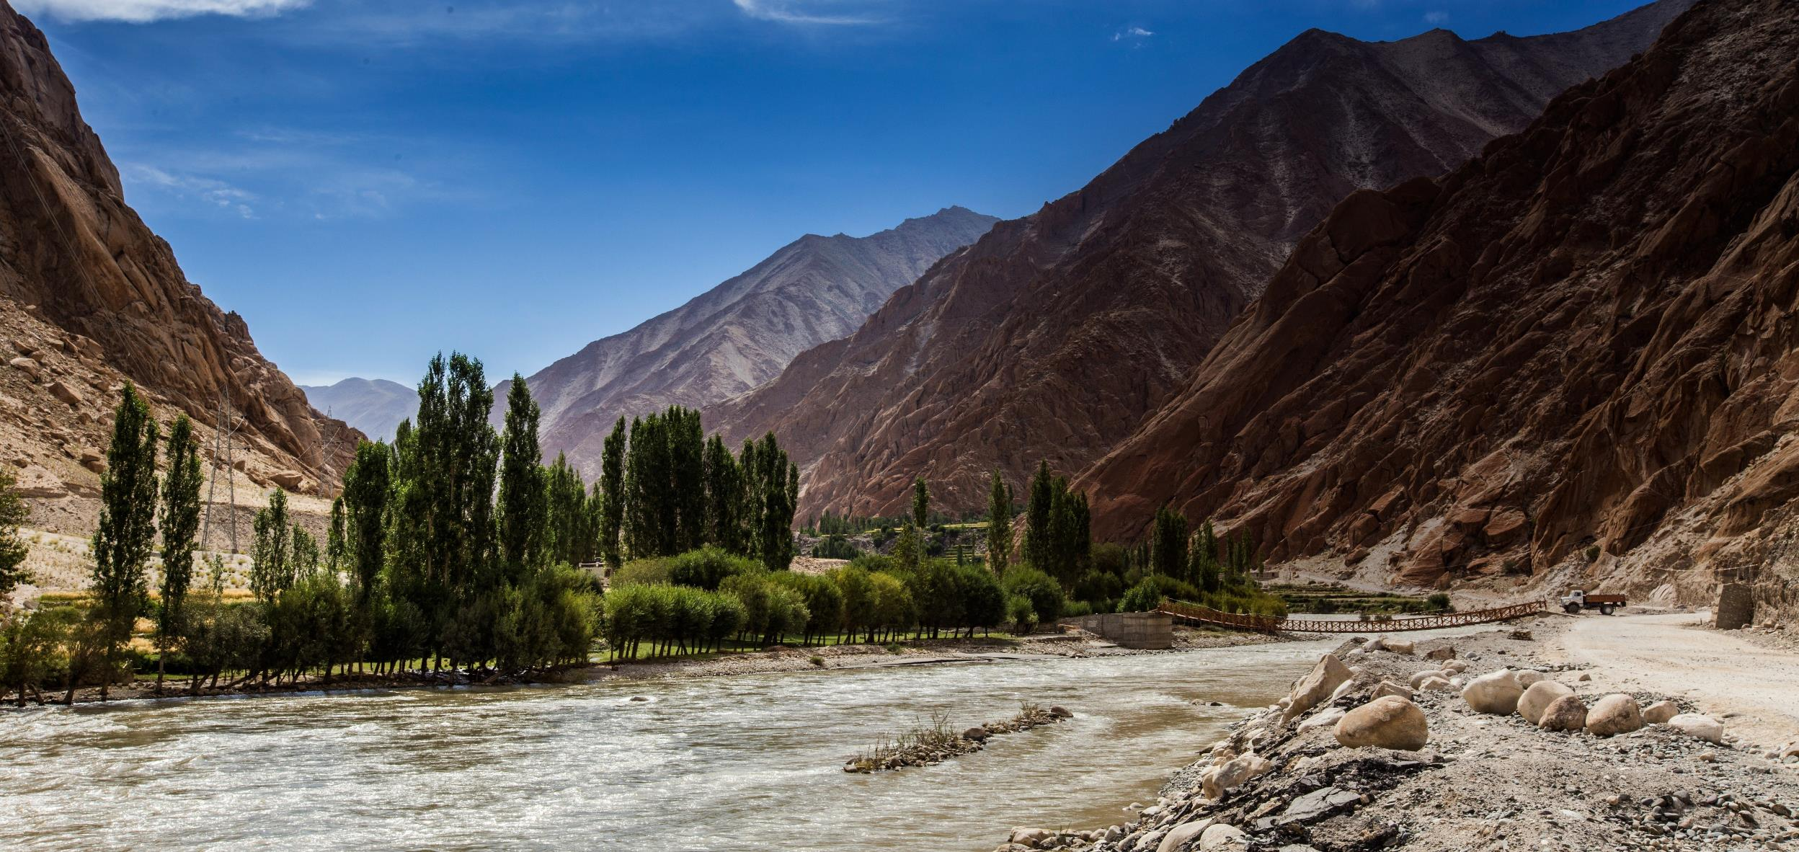


Exploration of the theoretical, financial, technical and sustainable hydropower generation potential in the Upper Indus basin
Sanita Dhaubanjar, Arthur Lutz, David Gernaat, Santosh Nepal, Saurav Pradhananga, Sonu Khanal, Arun Bhakta Shrestha, Walter Immerzeel
EGU General Assembly 2022
23 May 2022
HS5.2 Innovation in Hydropower Operations and Planning to integrate renewable energy sources and optimize the Water-Energy Nexus

Slide 2




Objective
Framework
What is the realistically achievable run-of-river (RoR) hydropower potential - now and in the future of the Upper Indus basin?
THEORETICAL
TECHNICAL
Existing 2020
Planned
Motivation
Indus is a water stressed basin and a major hotspot for climate change
By 2080, energy security requirements will more than triple (Smolenaars et al. 2020)
Four-fold expansion in current hydropower generation
Basin scale assessment is necessary for sustainable hydropower development
FINANCIAL
SUSTAINABLE
VISUALIZED
REMAINING
Notes:
Covering over 1 million km2, the Indus is one of the most heavily glaciated basins in the
This is important because indus is…
Framework: We combined literate review and a series of stakeholder discussions to develop a framework to quantify 4 classes of potential.
Theoretical potential assumes all available discharge and head is used for hydropower
Technical potential considers the feasibility of hydropower development considering two RoR plant configuration
Fin potential looks at plants with production cost less than 10 cents per kWh
While Sust pot considers other usage of land and water resources as well as aversion of geo-hazard risks
Evaluate potential under a variety of policy scenarios

Slide 3
Current potential at the basin scale
River power Diversion
Theoretical = 1564 TWh/yr
Drop from technical to sustainable potential is dominated by nexus water consumption and geo-hazard risk aversion
Mixed search identifies higher potential and more projects
Notes:
All these potentials are just 2-19% of theoretical pot in the mixed search technical potential case and as low as 4% for the Tech Large case
Theory as current use
Keep only mixed scenario
Large vs medium

Slide 4
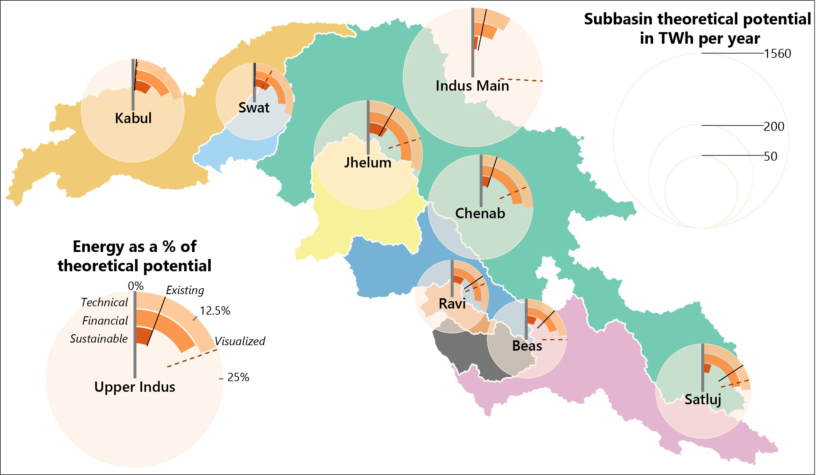
Current potential at the sub-basin scale
Indus main has the highest theoretical potential, but only 2% is sustainable
Jhelum has the highest sustainable potential
Kabul and Swat have high proportion of sustainable but low visualized potential
Ravi has the highest per capita and per area potential
Notes:
Here we explore the distribution of potential across the subbasins. Circle sizes indicate magnitude of theory pote while radial bars in orange show the tech, fin and sust pot as % of the sub-basin theoretical value

Slide 5
Next steps: Future energy requirements and potential
3 future narratives
Energy requirements
  Domestic electricity for SDG7
  Population growth
CMIP6 GCM projections
  Quantile mapping bias correction and downscaling
  4 GCMs selected per narrative
  Selection based on historical skill score + range of projections
Hydropower potential
Energy Security Requirements
All Indus
Notes:
Next, we look at how current potential evolves under three future narratives
We start w an estimation of energy security reqs considering pop growth and minimum domestic electricity reqs for SDG7. Current energy security reqs can easily be met by financial potential. But will this potential remain steady in the future?
To evaluate future potentials, we are preparing future climate and hydrology projections. We are using quantile mapping bias corrections to downscale CMIP6 GCM projections.

Slide 6

Conclusions
Interactive storymap: https://edu.nl/h8xwd
Achievable potential is only a small portion of the theoretical potential (2-19%)
Combination of small & large projects maximizes sustainable potential
Kabul and Swat sub-basins are underutilized
Financial potential can fulfill energy security requirements in the Indus
Sustainable and financial potential may decline in the future
Consensus should be established for defining “sustainable” potential
Follow us at:
s.dhaubanjar@uu.nl
https://www.sustaindus.org/
Notes:
Here I summarise the major conclusions.
I end with highlighting that our definition of sustainable potential remains debatable consensus needs to be established globally to push forth sustainability in hydropower development.

