Slide 1





23–27 May 2022
Sensitivity analysis of Radiative Transfer model towards leaf biophysical and biochemical parameter retrieval
Presented by- Prachi Singh
Senior Research Scholar
Abstract ID- EGU22-69
Session CL3.2.5 - Impact of climate change on agriculture
Institute of Environment & Sustainable Development ,
Banaras Hindu University, Varanasi -India
Email: prachisingh10@bhu.ac.in

Slide 2
Introduction
Sensitivity analysis evaluates the relative importance of each input parameter and can be used to identify the most influential parameters in determining the variability of model outputs.
1. Local sensitivity analysis (LSA): “One-factor-at-a-time”: changing one input parameter at a time whilst holding all other at their central values .
LSA methods do not cover the whole input parameter space.
Inadequate for analyzing complex models which may have many parameters and may be high-dimensional and/or non-linear.
2. Global sensitivity analysis (GSA): Explores the full input parameter space, i.e. all input parameters are changed together.

Slide 3
GSA techniques, which quantify the relative importance of each input parameter to model outputs, can help set safe default values for those less influential input parameters.
GSA can greatly simplify model calibration through enabling the most influential parameters to be targeted for data acquisition and refinement.
Variance based method (SOBOL):-
Variance-based sensitivity analysis (VBSA) measures the sensitivity to a given input by its contribution to the variance of the model output.
It is the sum of contributions of each individual input parameter and the interactions between different parameters.
More robust measures of sensitivity in the presence of nonlinearity and nonmonotonicity.
RADIATIVE TRANSFER MODELS AND ARTMO
ARTMO toolbox, freely downloadable at http://ipl.uv.es/artmo, was essentially developed to streamline the use of a variety of leaf, canopy RTMs in one scientific GUI toolbox.
Total sensitivity (S_{Ti}) will be calculated using the leaf model PROSPECT-4 and the leaf and canopy model PROSAIL (coupled with the canopy model SAIL).

Slide 4
Prospect
The leaf optical PROSPECT model (Jacquemoud et al., 2009) are most popular leaf RTM with availability and low number of input variables.
The model calculates leaf reflectance and transmittance as a function of its biochemistry structure.
SAIL (Scattering by Arbitrary Inclined Leaves)
SAIL is based on a four-stream approximation of the RT equation, in which case one distinguishes two direct fluxes and two diffuse fluxes (Verhoef et al., 2007).
SAIL inputs consist of leaf area index (LAI), leaf angle distribution (LAD), ratio of diffuse and direct radiation, soil coefficient, hot spot, and sun-target-sensor geometry.

Slide 5
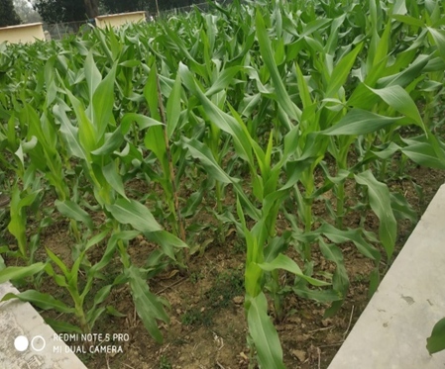
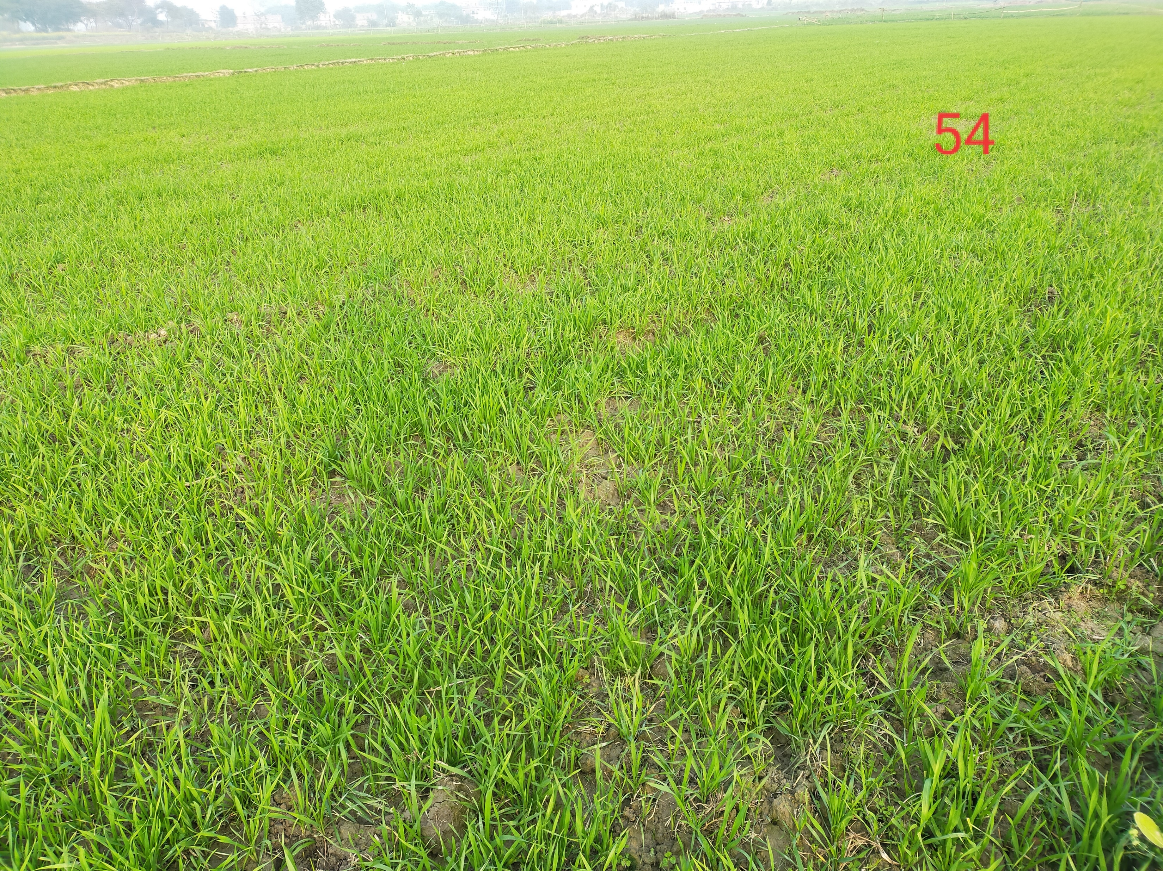
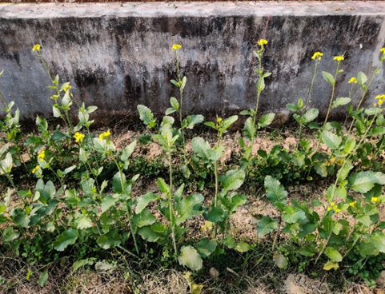
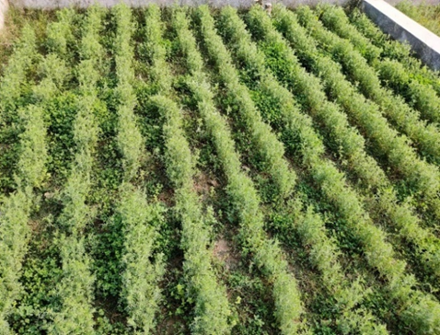
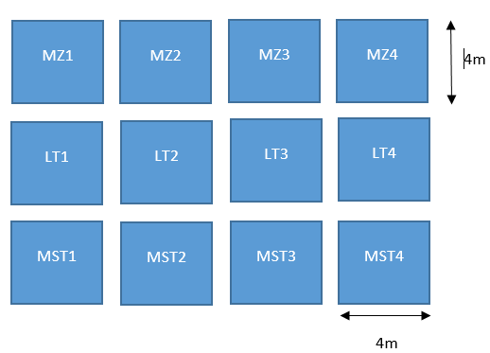
Study site
Agriculture farm of Banaras Hindu University, Varanasi district (Uttar Pradesh, India) was chosen as a sampling area.
The sowing of the Mustard -December 5th, 2019.
The sowing of the Maize -December 1st, 2019.
The sowing of the lentils - December 6th, 2019.
sampling for the crop was started after 40 days.
Figure 2. Lentils, mustard and maize crops
Figure 2: Schematic of the plots.
WH1
WH1
WH1
WH1
4m

Slide 6
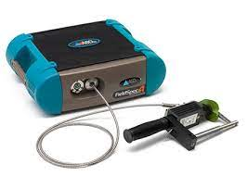
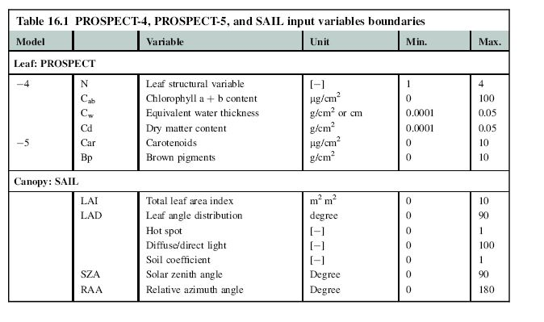
Methodology & Data used
ASD FieldSpec 4 Hi-Res NG
spectroradiometer
Flow chart of methodology
PROSPECT-4, and SAIL input variables boundaries

Slide 7
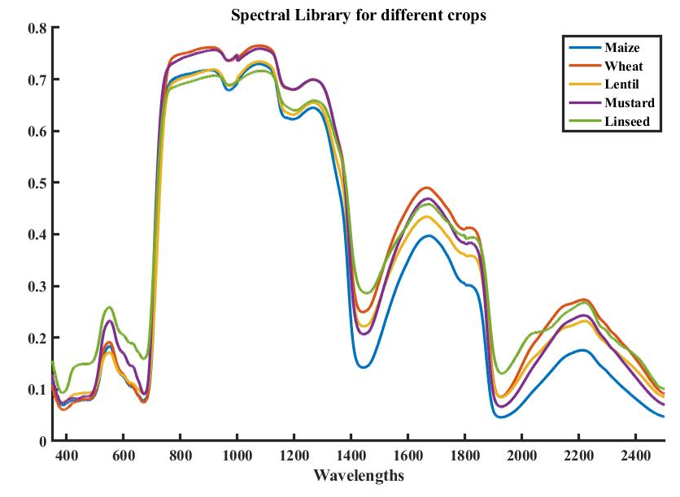
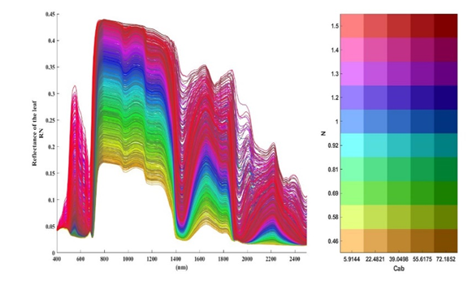
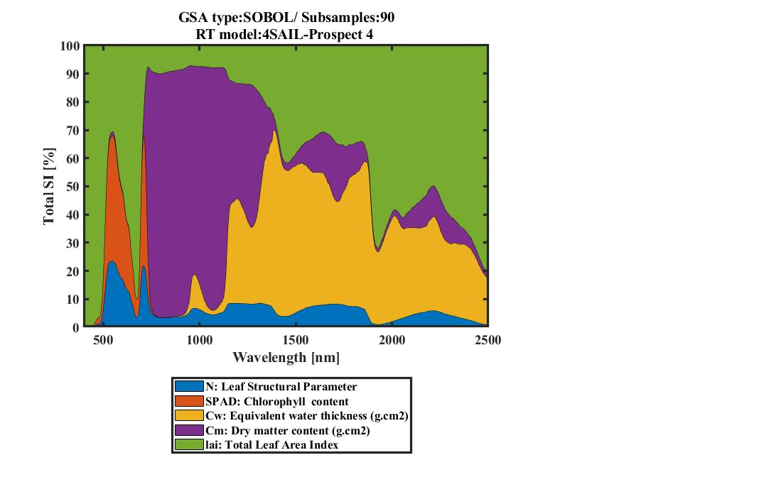
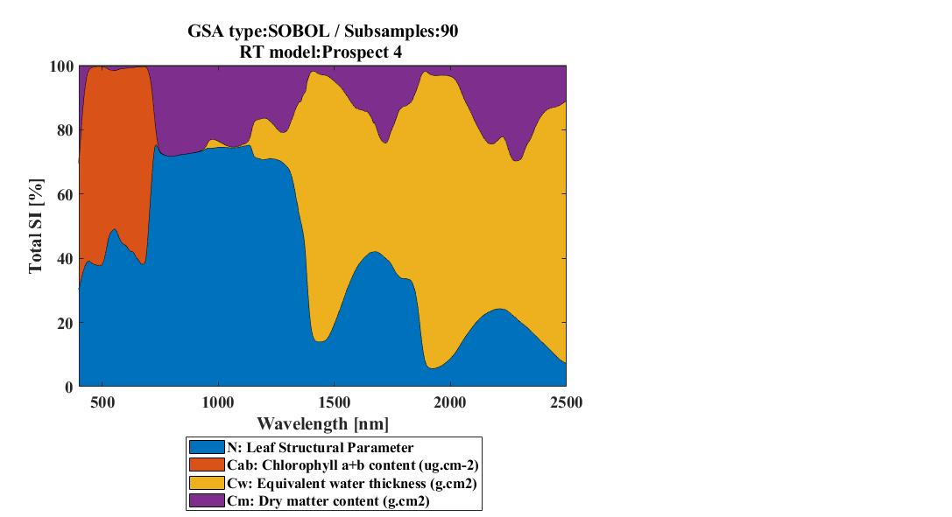
Results

Slide 8
Conclusions
GSA enables to gain insight into the functioning of RTMs by identifying the driving input variables of RTM spectral outputs such as reflectance, fluorescence, or radiance.
GSA toolbox implemented into ARTMO. It calculates SOBOL’s first and total order sensitivity for a variety of RTMs.
RTM spectral outputs were generated for hyperspectral data within the spectral range of 350-2500 nm.
PROSPECT-4 model reveal that the role of biochemical parameter chlorophyll content in the visible region and the influence of the other biophysical parameters such as Leaf structure and dry matter across the whole spectral range.
Coupling the leaf PROSPECT-4 model with SAIL model, reference PROSAIL S_{Ti} results showed that the LAI variable shows 50% of the total variability, especially in the SWIR region.

Slide 9
References
Shah, D. and T. Zaveri (2019). A Novel Geo-Stat Endmember Extraction Algorithm. TENCON 2019-2019 IEEE Region 10 Conference (TENCON), IEEE.
Savitzky, A., Golay, M.J.E., 1964. Smoothing and differentiation of data by simplified least squares procedures. Analytical Chemistry 36 (8), 1627–1639.
Shah, S. H., Y. Angel, R. Houborg, S. Ali and M. F. McCabe (2019). "A Random Forest Machine Learning Approach for the Retrieval of Leaf Chlorophyll Content in Wheat." Remote Sensing 11(8): 920.
Tsai, F., Philpot, W., 1998. Derivative analysis of hyperspectral data. Remote Sensing of Environment 66 (1), 41–51
Srivastava, P. K., et al. (2014). "Assessment of SMOS soil moisture retrieval parameters using tau–omega algorithms for soil moisture deficit estimation." Journal of Hydrology 519: 574-587.
Wigneron, J.-P., et al. (2006). L-MEB: a simple model at L-band for the continental areas-application to the simulation of a half-degree resolution and global scale dataset, The Institution of Engineering and Technology.

Slide 10
Thank you….

