Slide 1
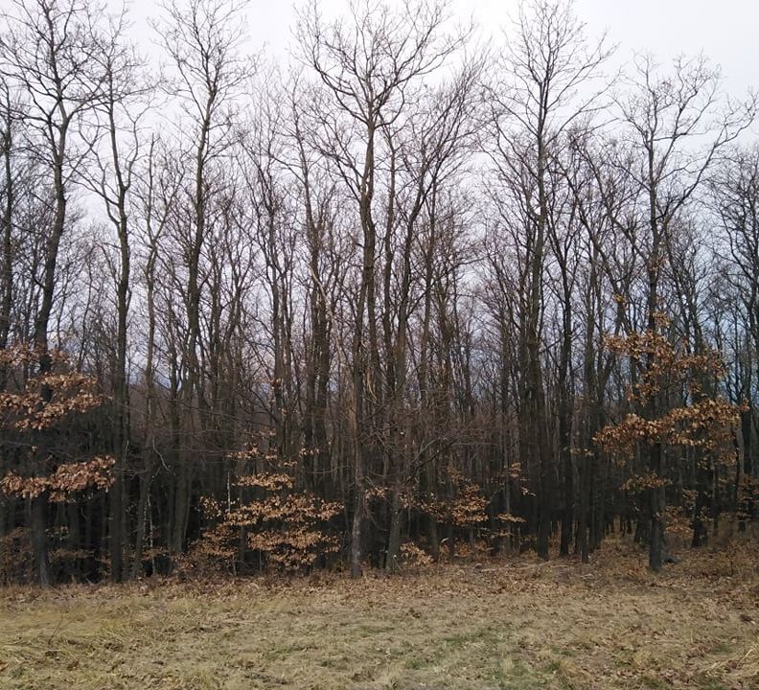
Interception and groundwater dynamics of an alder forest and a neighbouring wet meadow
Holik Blanka1,
Nevezi Csenge1,
Kamila Hlavčová2,
Kalicz Péter1,
Gribovszki Zoltán1
1 University of Sopron, Faculty of Forestry, Institute of Geomatics and Civil Engineering
2 Slovak University of Technology in Bratislava, Faculty of Civil Engineering, Department of Land and Water Resources Managemen

Slide 2
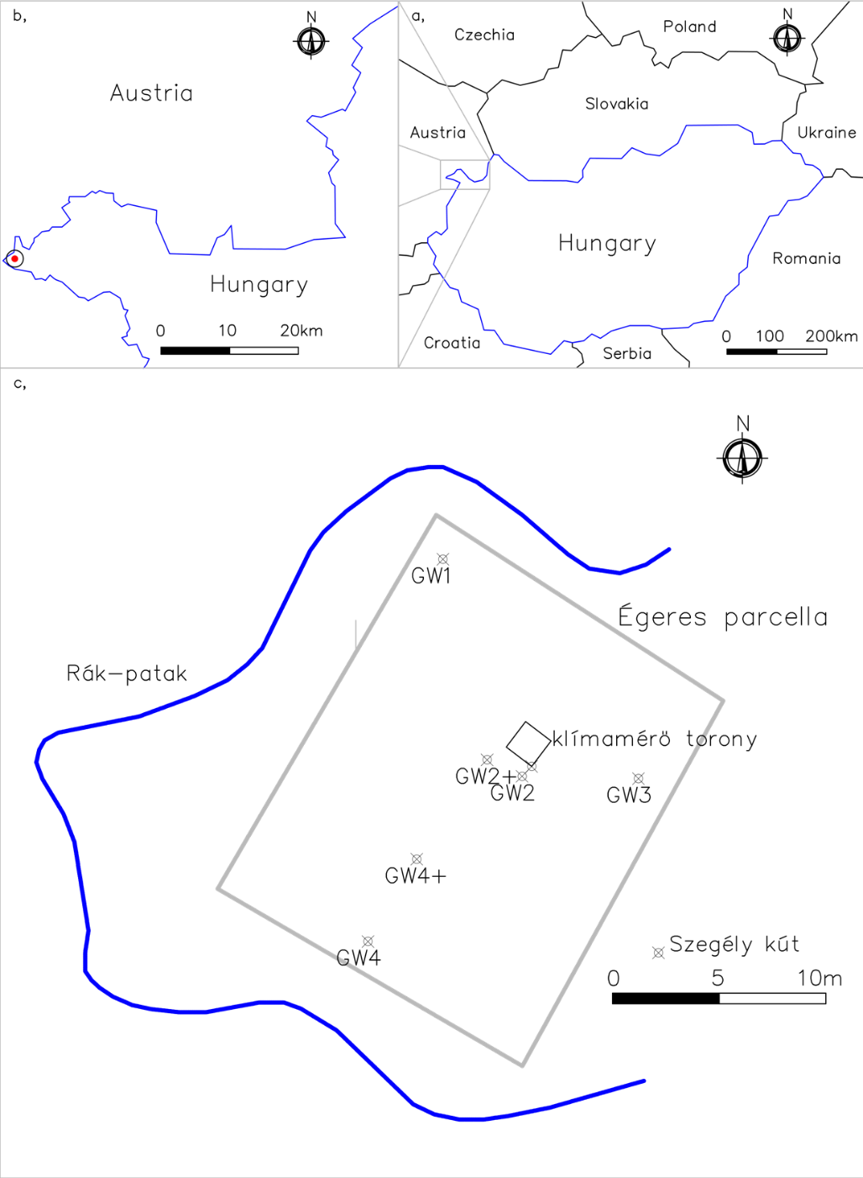
Hidegvíz-valley experimental catchment at the eastern foothills of the Alps
Hydrological conditions of an alder dominated forest ecosystem
Sub-alpine climate
Average temperature 9.2 ᵒC
Annual precipitation 750 mm
Tertiary fluvial sediments mostly sandy type
Groundwater monitoring system (depth (1-2 m))

Slide 3
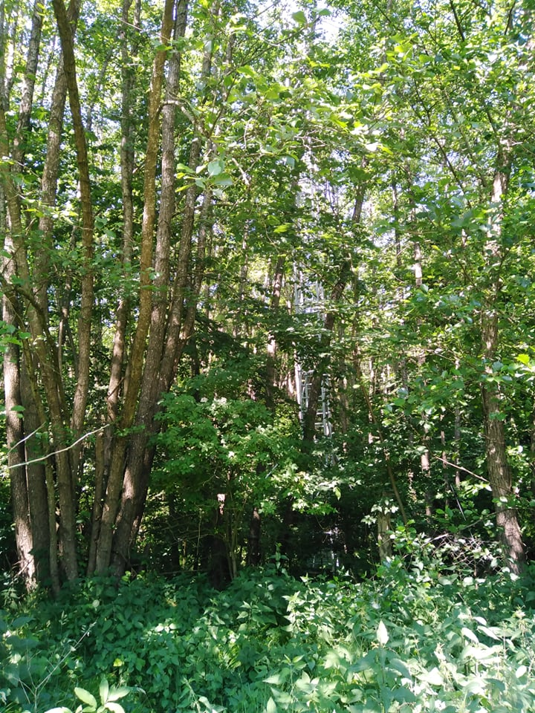
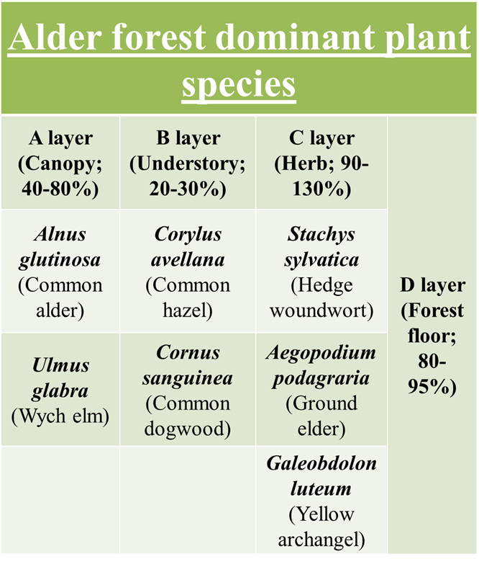
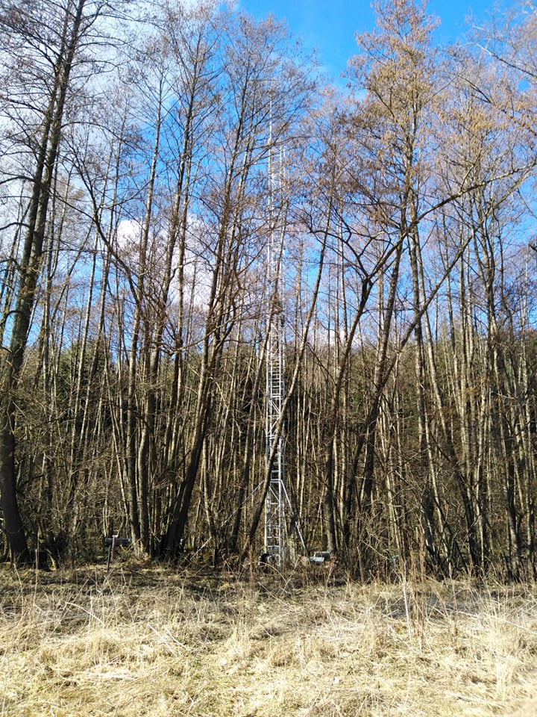
Alder LAI | 7 m²/m²
Height of dominant trees | 22,2 m
Breast height diameter | 18-20 cm

Slide 4
 | Annual rainfall amount (mm/year) | Annual average temperature (Celsius)
2017 | 711 | 9,2
2018 | 831 | 9,8
2019 | 746 | 10,1
2020 | 597 | 9,6
2021 | 629 | 9

Slide 5
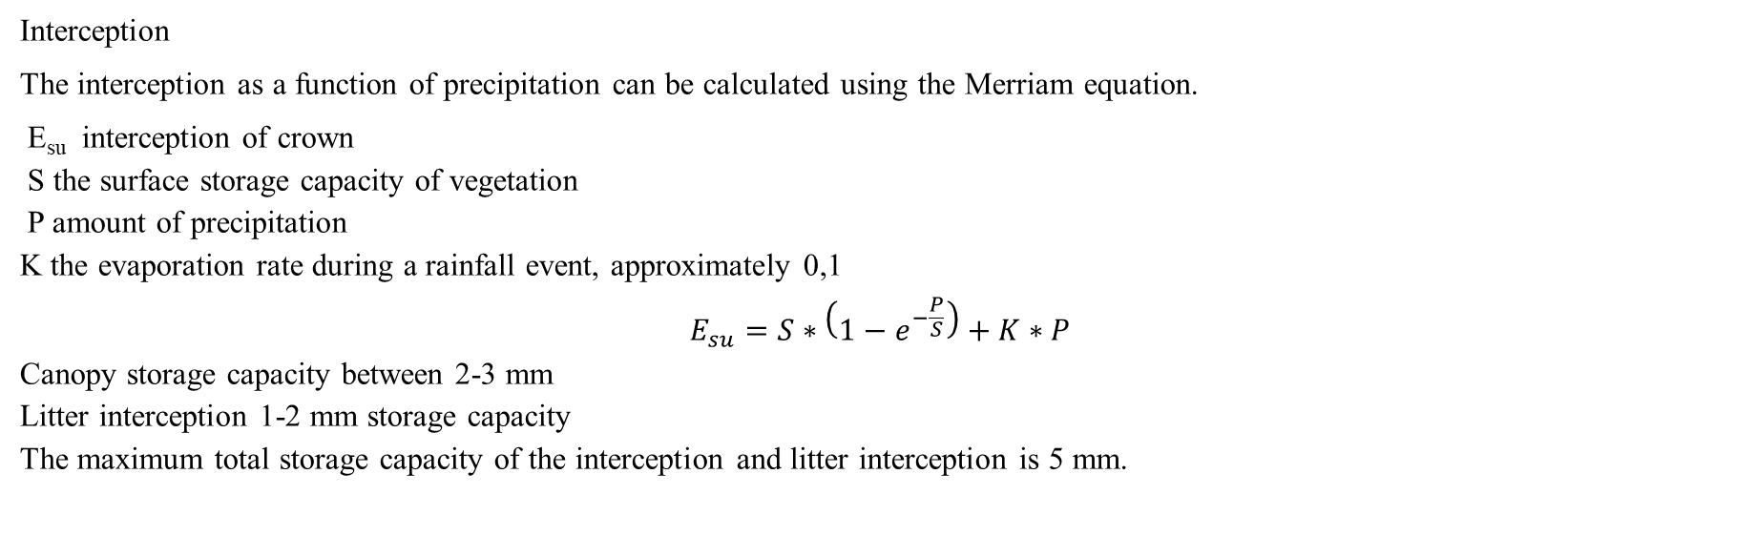
Interception
The interception as a function of precipitation can be calculated using the Merriam equation.
E_{su} interception of crown
S the surface storage capacity of vegetation
P amount of precipitation
K the evaporation rate during a rainfall event, approximately 0,1
$$E_{su}=S∗\left(1−e^{−\frac{P}{S}}\right)+K∗P$$
Canopy storage capacity between 2-3 mm
Litter interception 1-2 mm storage capacity
The maximum total storage capacity of the interception and litter interception is 5 mm.

Slide 6
Seasonal GW amplitude | 1 | 2 | 2+ | 3 | 4 | 4+ | Edging GW
Mean (m) | 0,10 | 0,15 | 0,15 | 0,16 | 0,13 | 0,12 | 0,16
SD (m) | 0,05 | 0,05 | 0,05 | 0,06 | 0,06 | 0,04 | 0,01

Slide 7
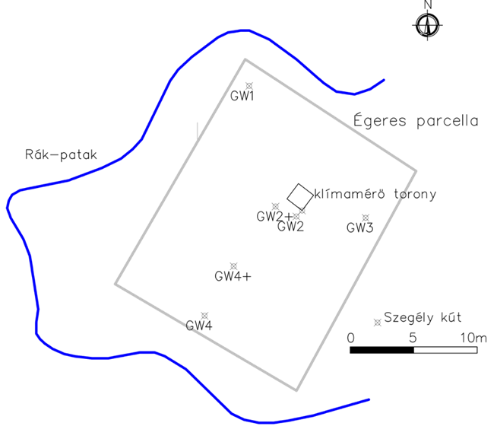

Slide 8
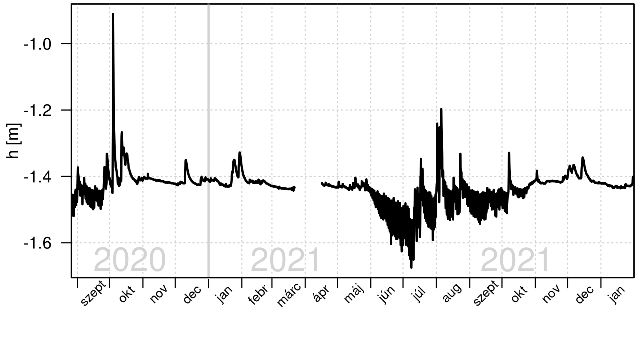
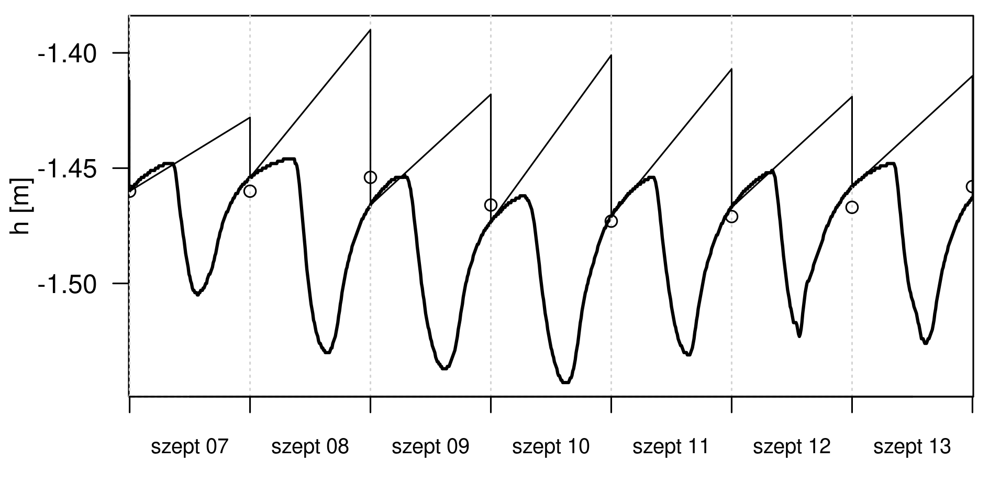
White method
ET_GW=(24*r±s)*Sy
24r
-s
s

Slide 9
 | May | June | July | August | September | October
Mean (mm/day) | 0,42 | 4,05 | 5,17 | 1,90 | 2,44 | 1,18
SD (mm/day) | 0,41 | 1,92 | 2,46 | 0,82 | 0,73 | 0,98

Slide 10
ET_GW=(24*r±s)*Sy
PET=29,8*D*(ea*/(Ta+273,2))

Slide 12
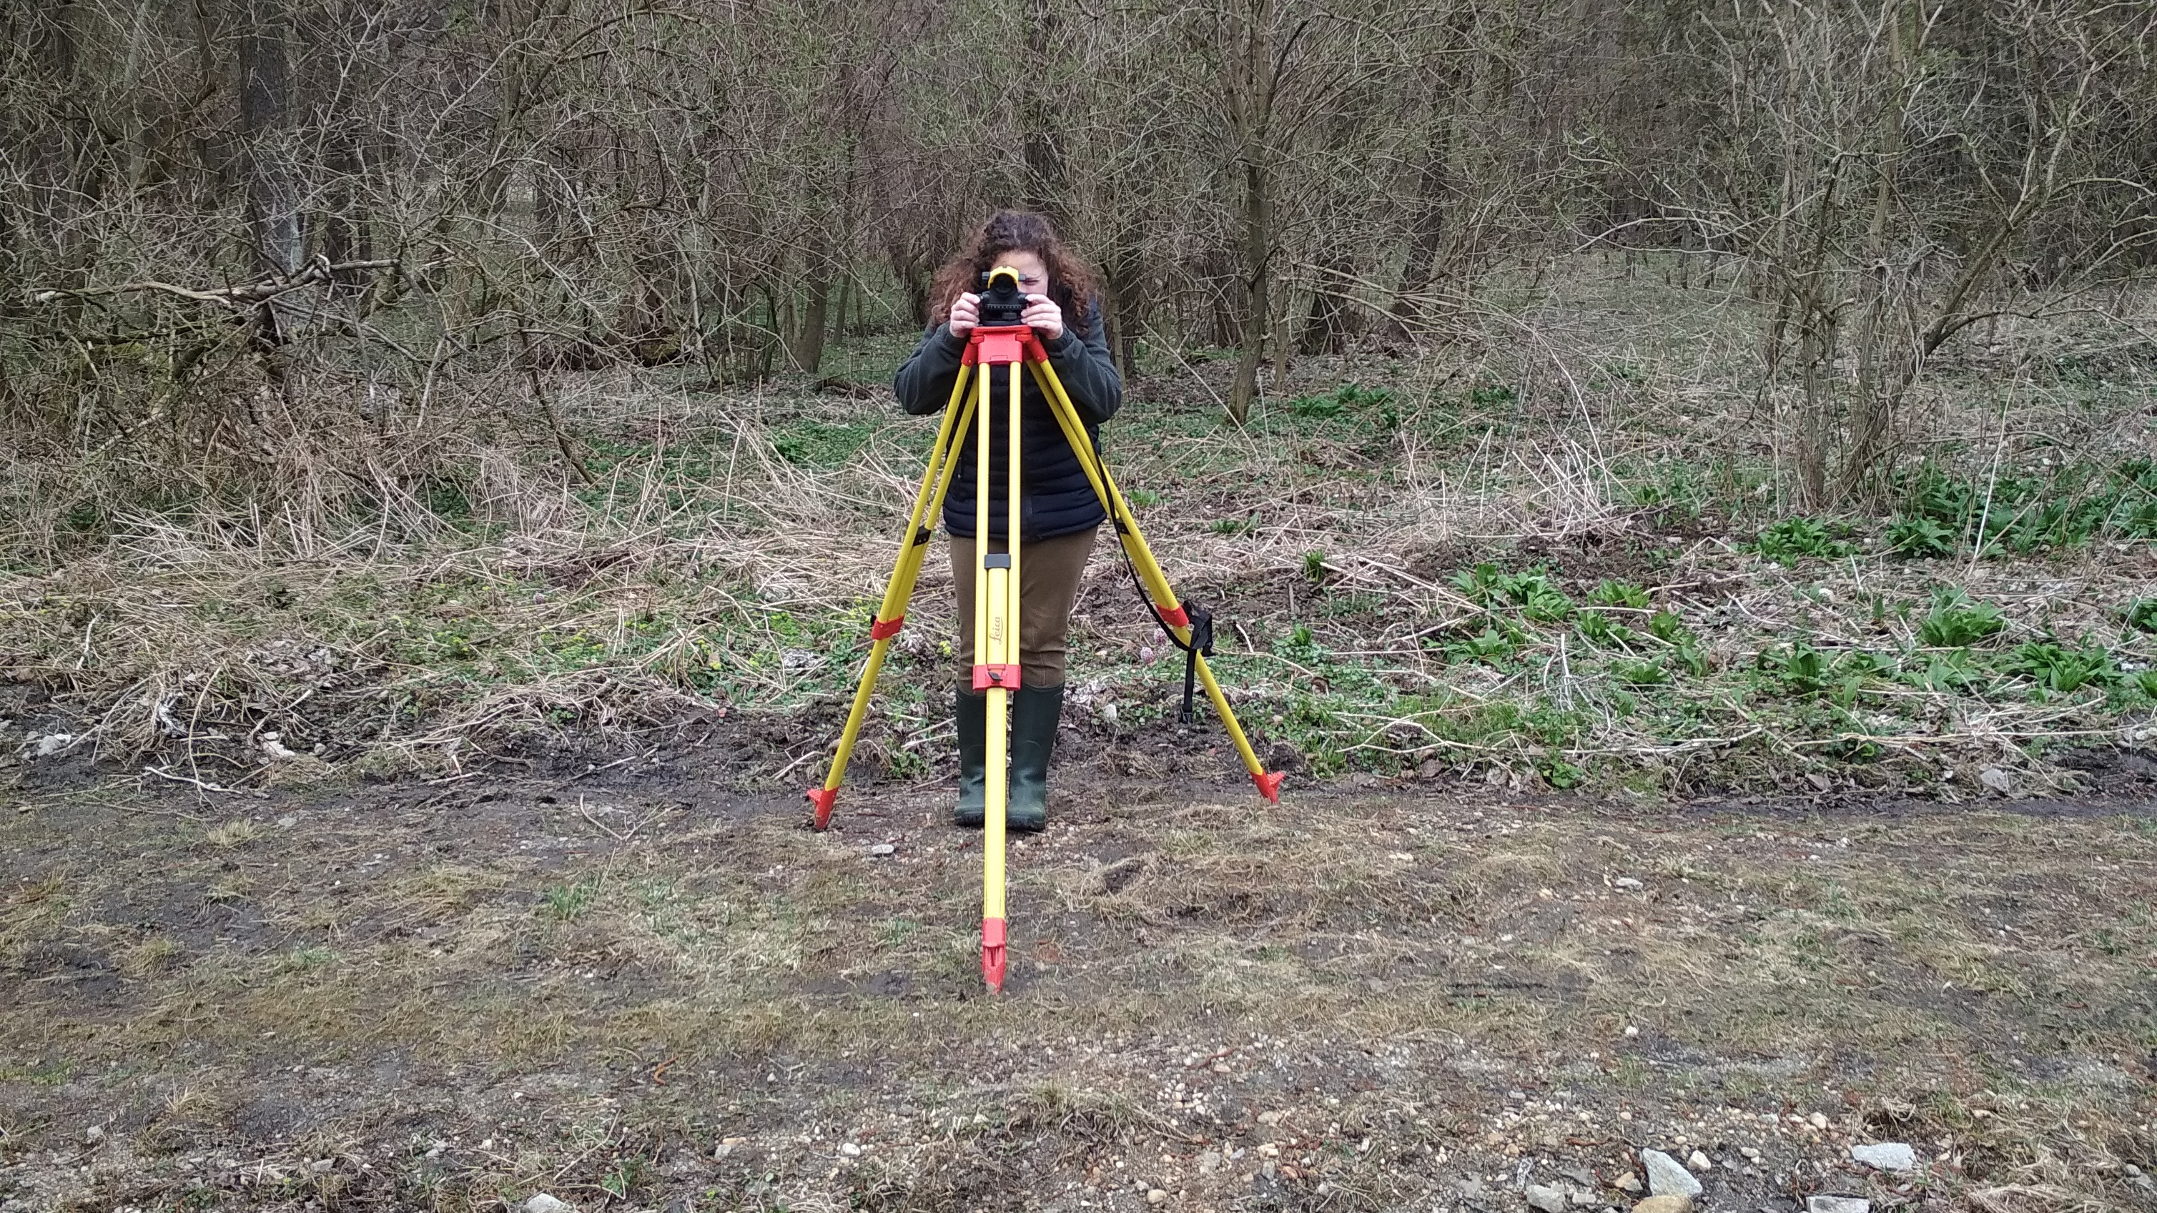
Thank you for your attention!

