Slide 1

Probabilistic prediction of the time to hard freeze using seasonal weather forecasts and survival time methods
https://nr.no/en/
https://www.climatefutures.no/en/home-en/
Thea Roksvåg, Alex Lenkoski, Michael Scheuerer, Claudio Heinrich-Mertsching and Thordis L. Thorarinsdottir
27.05.2022

Slide 2
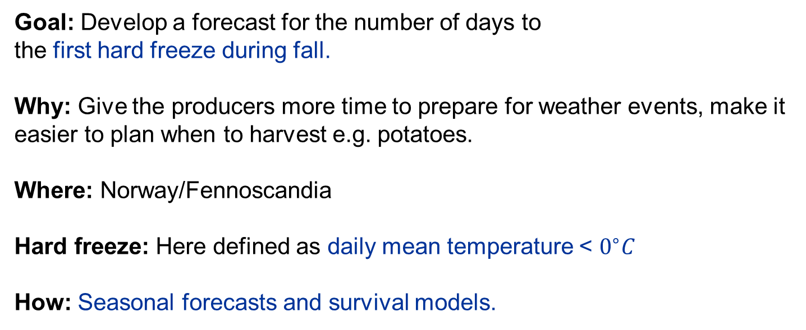
Our project
Goal: Develop a forecast for the number of days to
the first hard freeze during fall.
Why: Give the producers more time to prepare for weather events, make it easier to plan when to harvest e.g. potatoes.
Where: Norway/Fennoscandia
Hard freeze: Here defined as daily mean temperature < $0^{∘}C$
How: Seasonal forecasts and survival models.

Slide 3
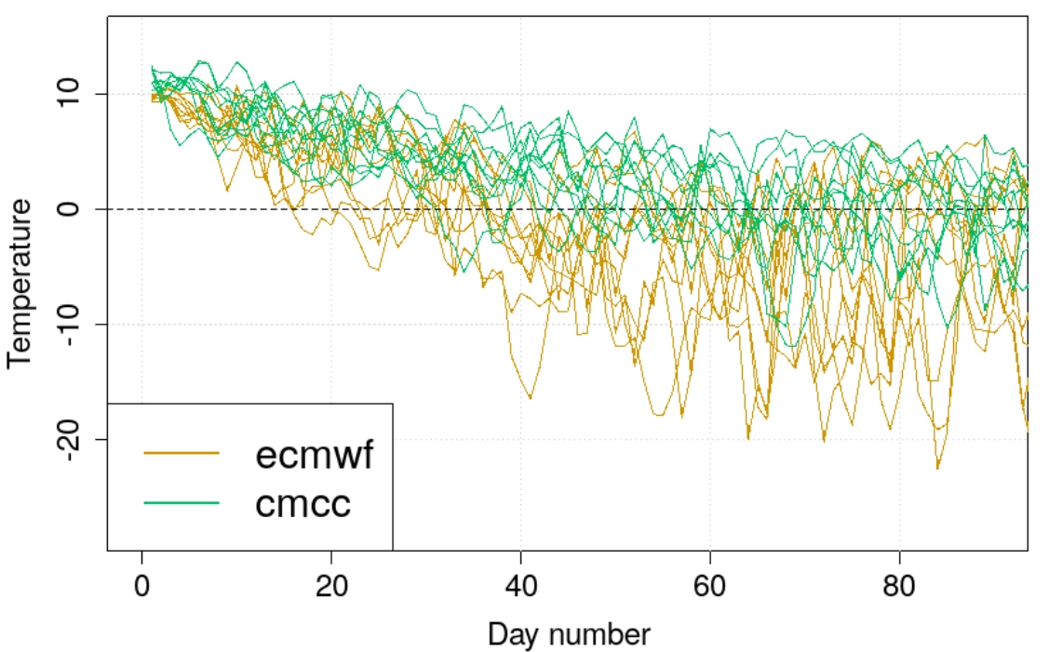
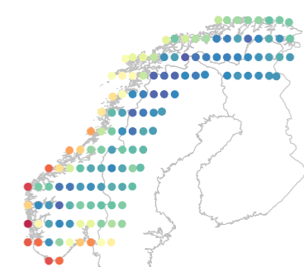
Seasonal forecasts
Ensemble forecasts of mean daily temperature from the copernicus climate data store, initialized October 1st: ECMWF, CMCC, Météo Fr., UK Met Office
~100 temperature scenarios per year, 1-150 days into the future, 1993-2020
Temperature scenarios from October 1 to December 31, 2006, north of Trondheim

Slide 4
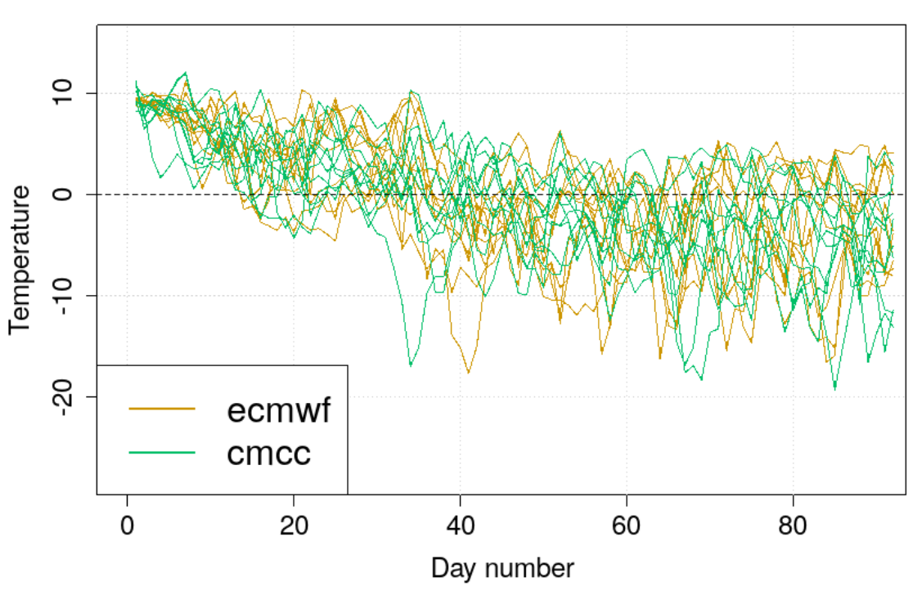
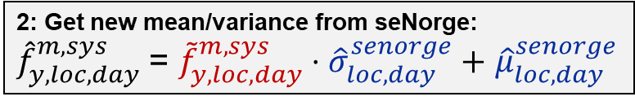
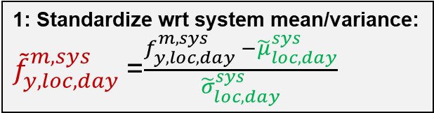
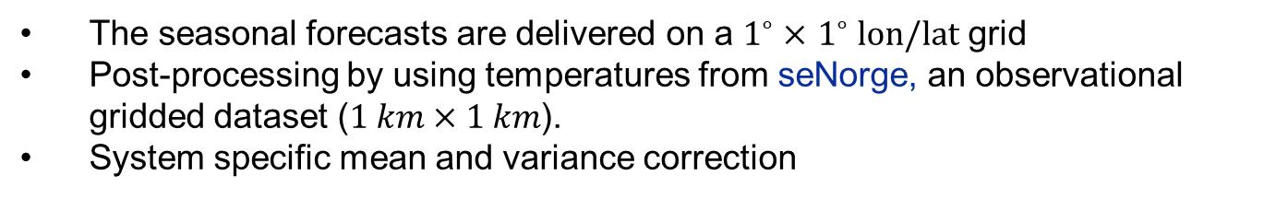
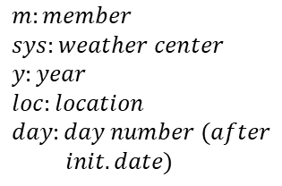
Post-processing the ensemble
The seasonal forecasts are delivered on a $1^{∘}×$ $1^{∘} lon/lat$ grid
Post-processing by using temperatures from seNorge, an observational gridded dataset ($1 km×1 km$).
System specific mean and variance correction
1: Standardize wrt system mean/variance:
${\tilde{f}}_{y,loc,day}^{m,sys}$=$\frac{f_{y,loc,day}^{m,sys} −{\tilde{μ}}_{loc,day}^{sys}}{{\tilde{σ}}_{loc,day}^{sys}}$
2: Get new mean/variance from seNorge:
${\hat{f}}_{y,loc,day}^{m,sys}$= ${\tilde{f}}_{y,loc,day}^{m,sys}⋅{\hat{σ}}_{loc,day}^{senorge}+$ ${\hat{μ}}_{loc,day}^{senorge}$
Original (raw) temperature scenarios
Post-processed version
$$m:member \\ sys:weather center \\ y:year \\ loc:location \\ day:day number (after \\ init. date)$$

Slide 5
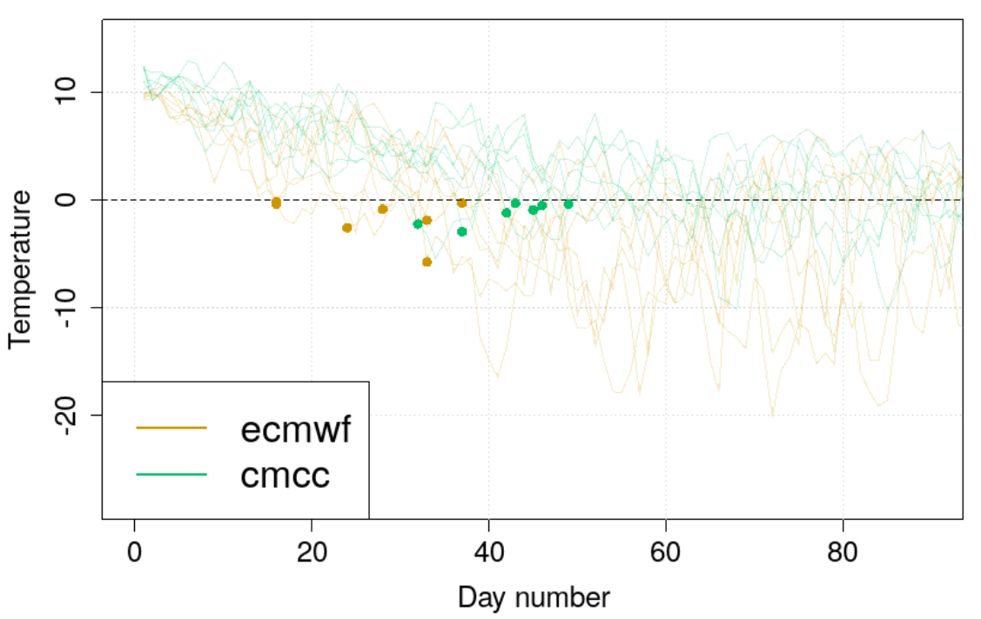
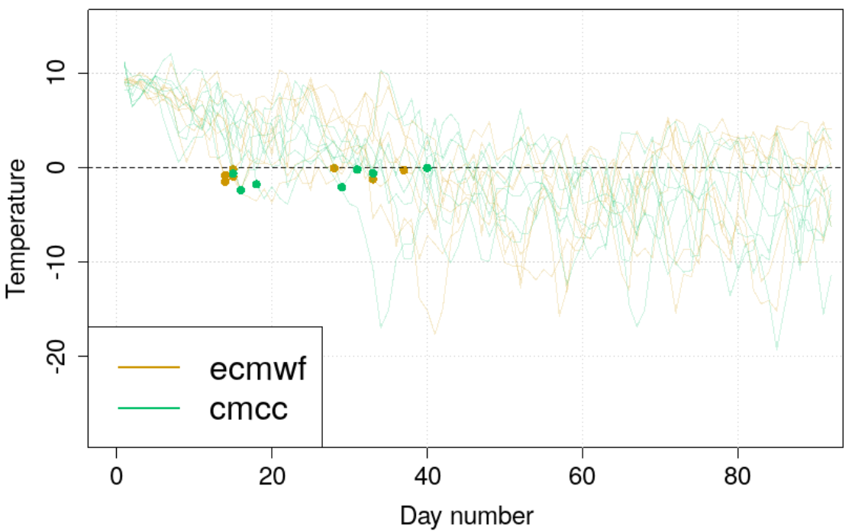
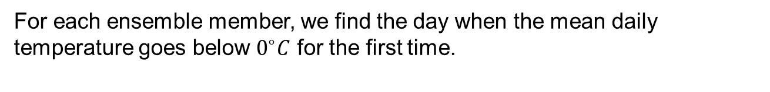
Making time to hard freeze datasets
For each ensemble member, we find the day when the mean daily temperature goes below $0^{∘}C$ for the first time.
Original time to hard freeze scenarios
Post-processed time to hard freeze scenarios

Slide 6
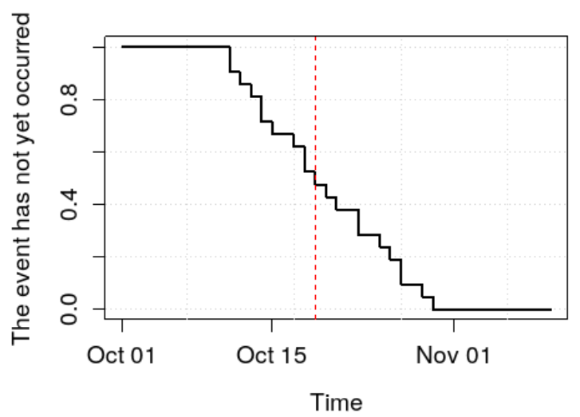
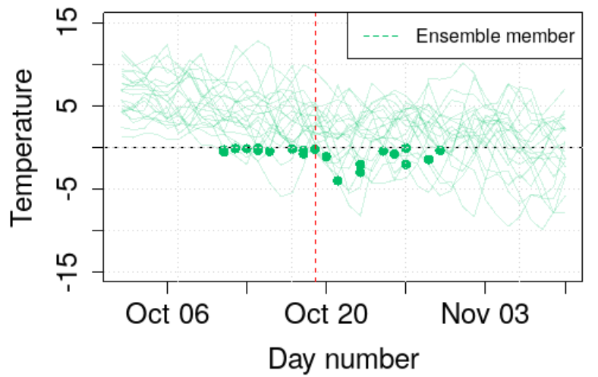
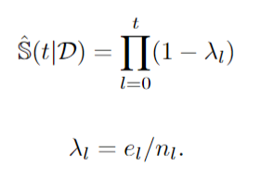

Survival models
Commonly used in biostatistics to model survival probability
Ensemble forecast
Kaplan-Meier estimator
Time to hard freeze forecast
$$n_{l}:At risk, e_{l}:event occurred$$
Models the probability that the event has not
yet occurred
Each curve drop: Hard freeze occurred for at least one ensemble member

Slide 7
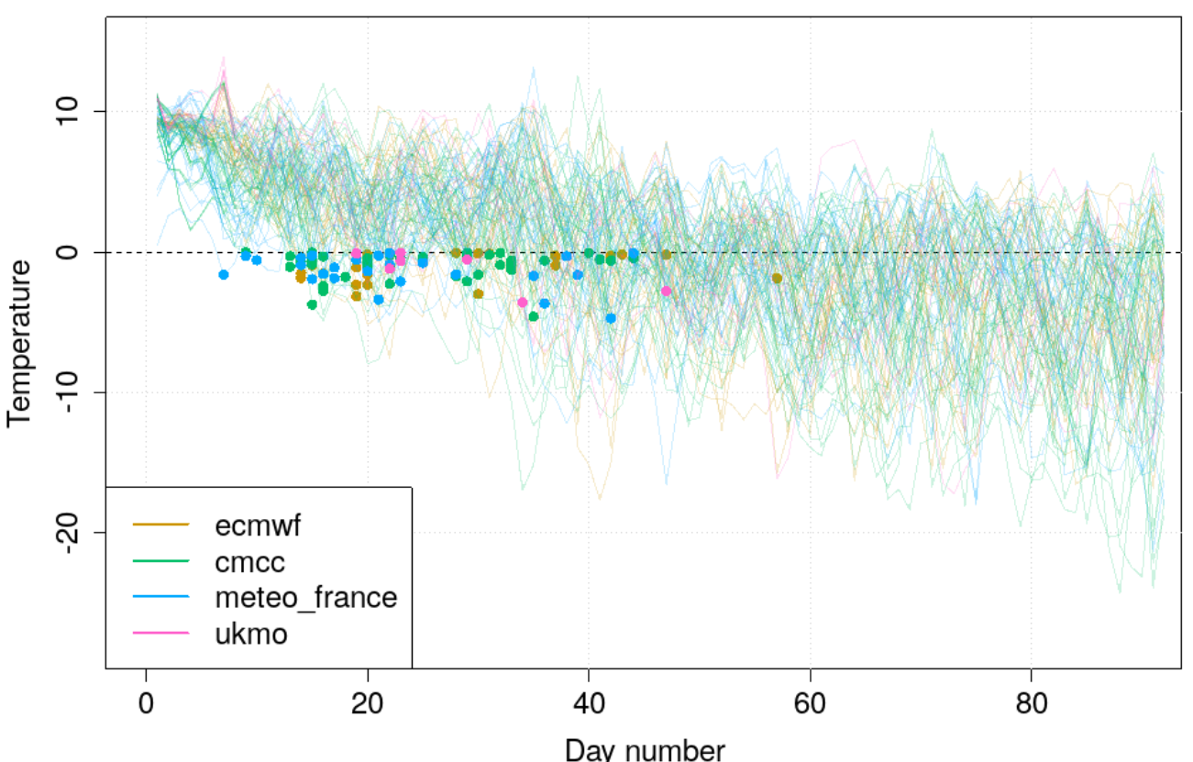
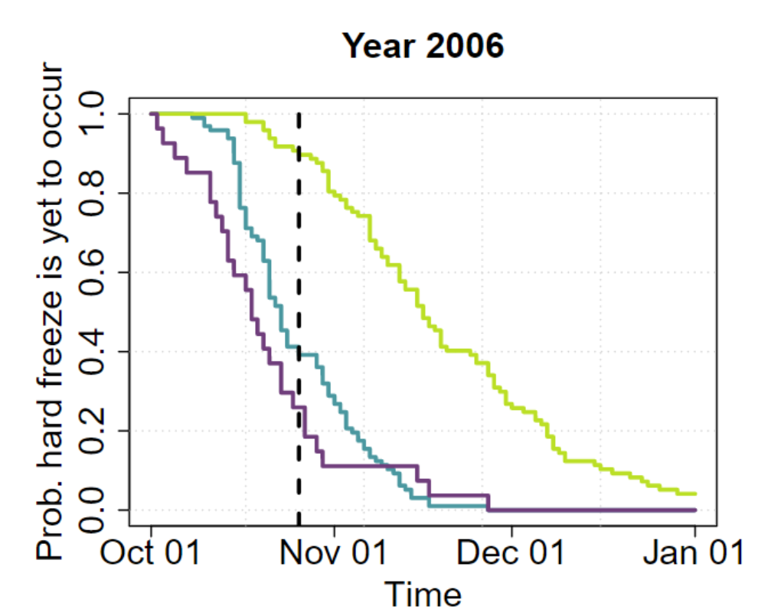
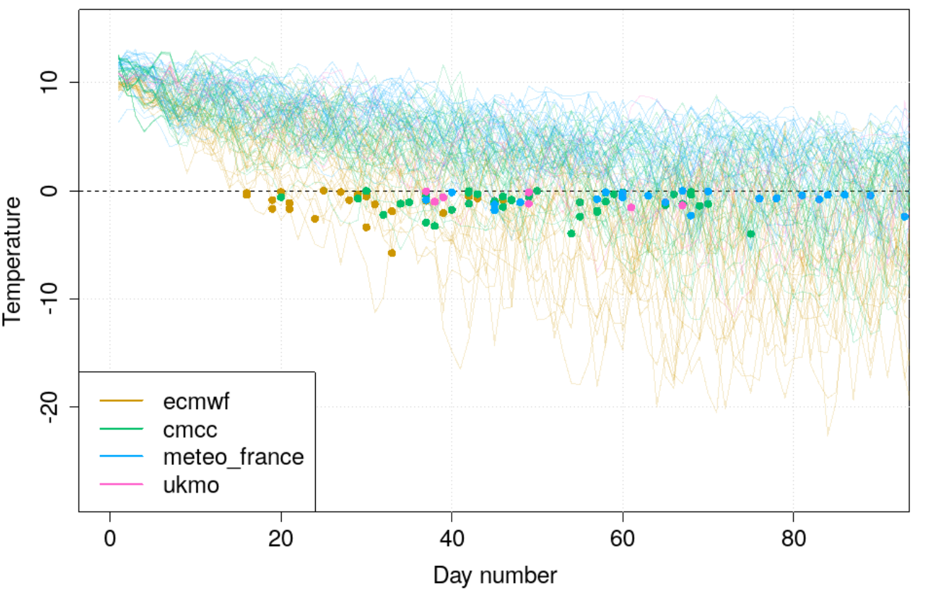
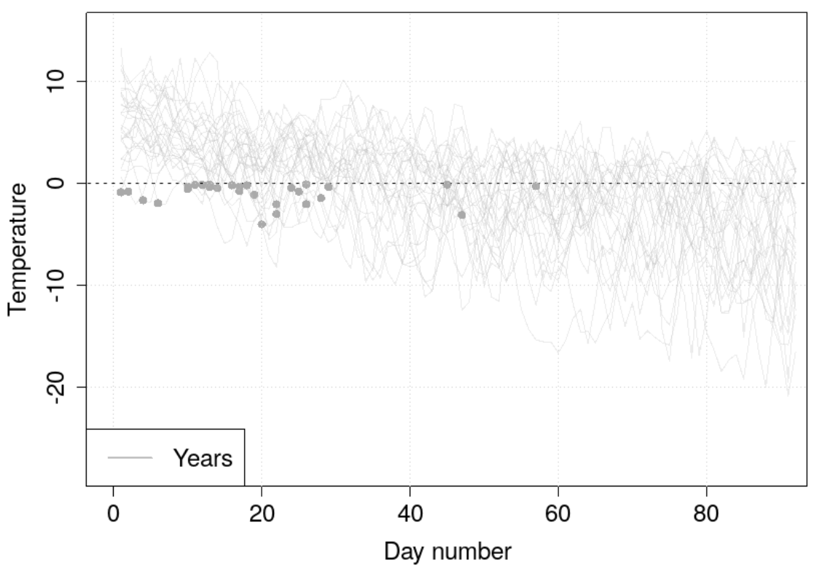
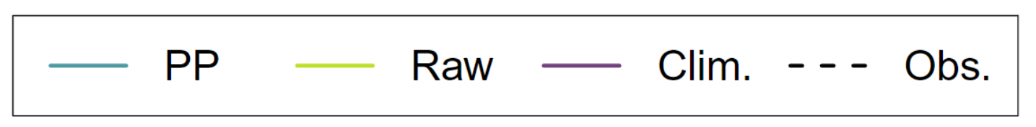
Post-processed (PP) ensemble
Forecasts for a location north of Trondheim,
from October 1, 2006
KM estimator
Raw ensemble
KM estimator
Climatology (historical years)
KM estimator

Slide 8
Forecast evaluation
How well can we predict the time to hard freeze
from October 1?
We tested this for 135 locations for 1993-2020.

Slide 9
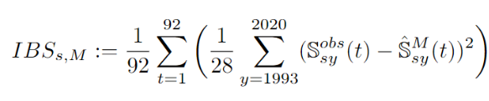

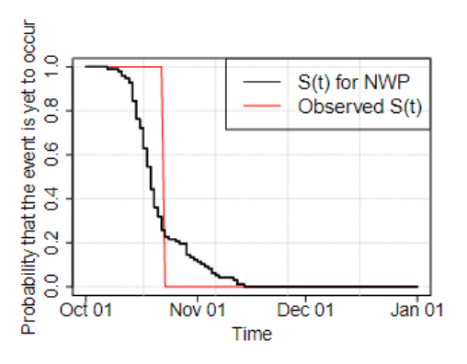

Evaluation scores
Integrated Brier score
Skill score with climatology as ref.
92: Number of study days (1.Oct – 31.Dec)
$S^{obs}$ is the observed survival curve (red).
$\hat{S^{M}}$ is our forecast (black).

Slide 10
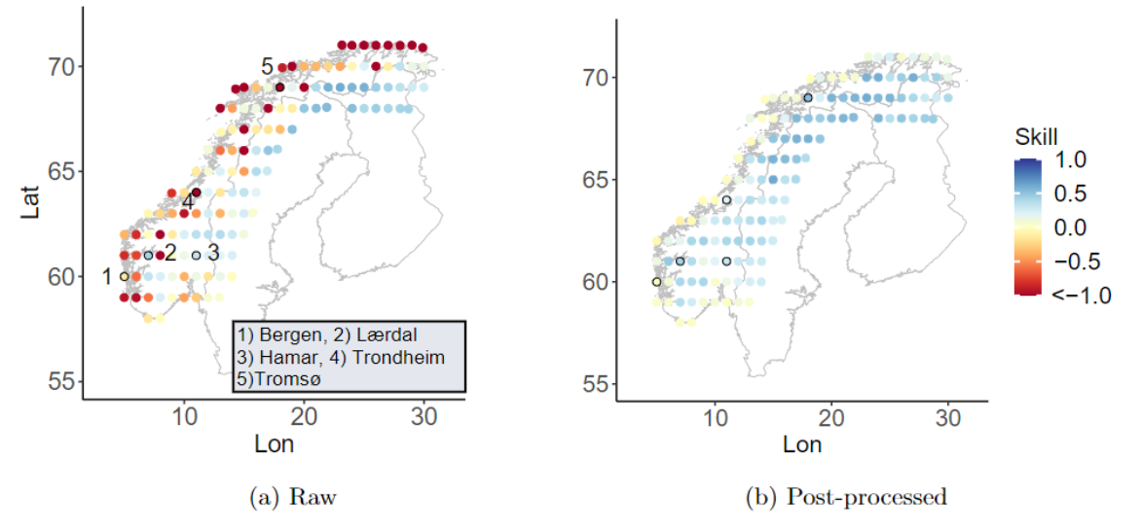
Location specific skill score
Skill score: Forecasts from October 1, 1993-2020 for 135 locations

Slide 11
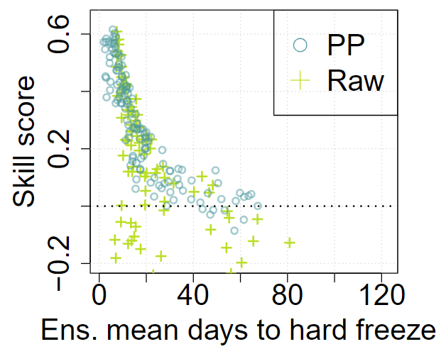
Location specific skill score
Skill score: Forecasts from October 1, 1993-2020 for 135 locations
The forecasts are skillfull at locations where the average predicted time to hard freeze is less than 30 days after the initialization date
Ensemble mean predicted days to hard freeze (1993-2020) for each study location

Slide 12
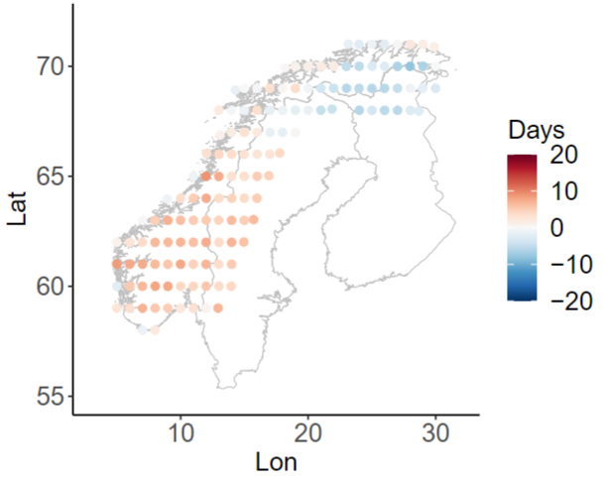
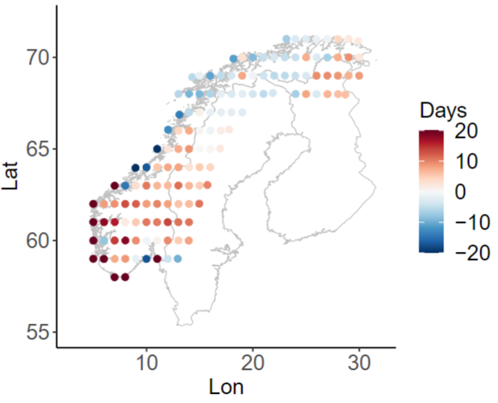
Example from 2006
Ensemble mean 2006 – historical mean
Obs 2006 – historical mean
Post-processed forecast (left) compared to the truth (right), year 2006

Slide 13
Ongoing work and next steps

Slide 14
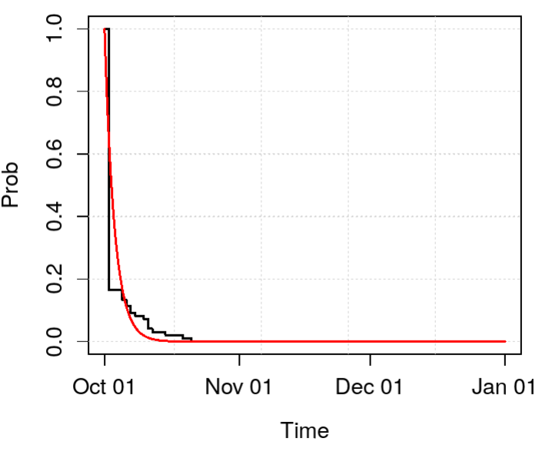
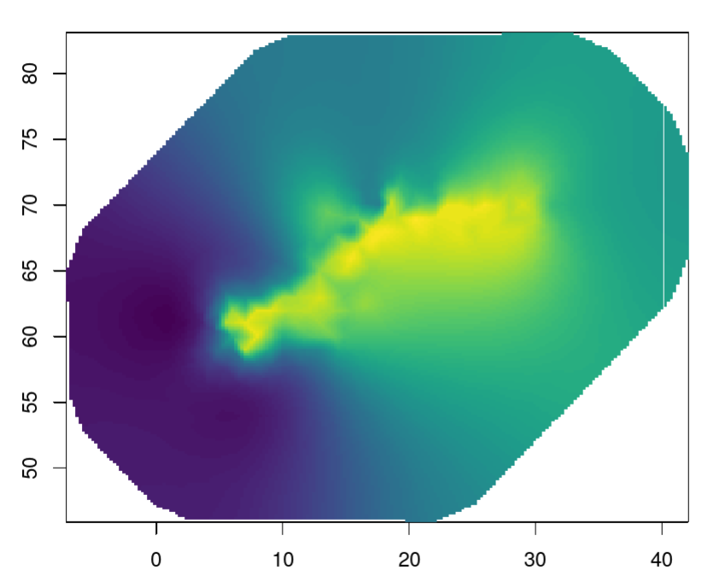
Goal: Make the forecasts operational
Challenge: The seasonal forecast are produced only once a month and published «late». Can we make forecasts more often?
Combine subseasonal and seasonal forecasts?
Update the seasonal forecast as new observations become available?
Use more advanced survival models, e.g. a Weibull parametric model and/or a spatial model
Current non-parametric model
Parametric model (red)
Spatial model

Slide 15
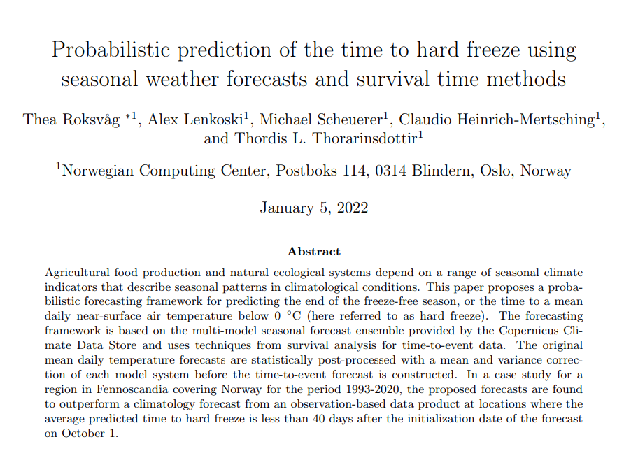

Preprint on arxiv
https://nr.no/en/
https://www.climatefutures.no/en/home-en/
https://arxiv.org/pdf/2201.01121.pdf

