Slide 1

Ensemble Empirical Mode Decomposition of the variability of precipitation over the Tianshan Mountains, Central Asia
Xuefeng Guan¹, Junqiang Yao², Christoph Schneider¹
¹ Geography Department, Humboldt-Universität zu Berlin, Germany
Institute of Desert Meteorology, China Meteorological Administration, China
guan.xuefeng@geo.hu-berlin.de
EGU General Assembly 2022

Slide 2
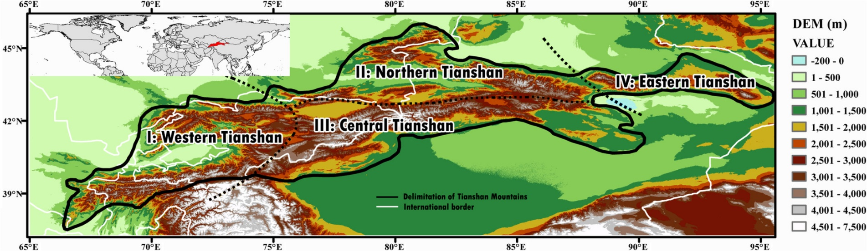
Study area, data
Study area
Tianshan Mountains –
“Water tower” of Central Asia
Linear trend of annual precipitation
Dataset
  Precipitation: the Global Precipitation Climatology Centre (GPCC) V.2018 (V.8)
  Resolution: 0.25°
  1950-2016
Notes:
Most parts of Tianshan experienced increasing annual precipitation during 1950–2016
Western Tianshan, which is the wettest region, faced a downtrend of precipitation

Slide 3
1. Time series
The overall annual precipitation of Tianshan shows weakly increasing trend
Tianshan entered a period of excessive precipitation after 1986

Slide 4
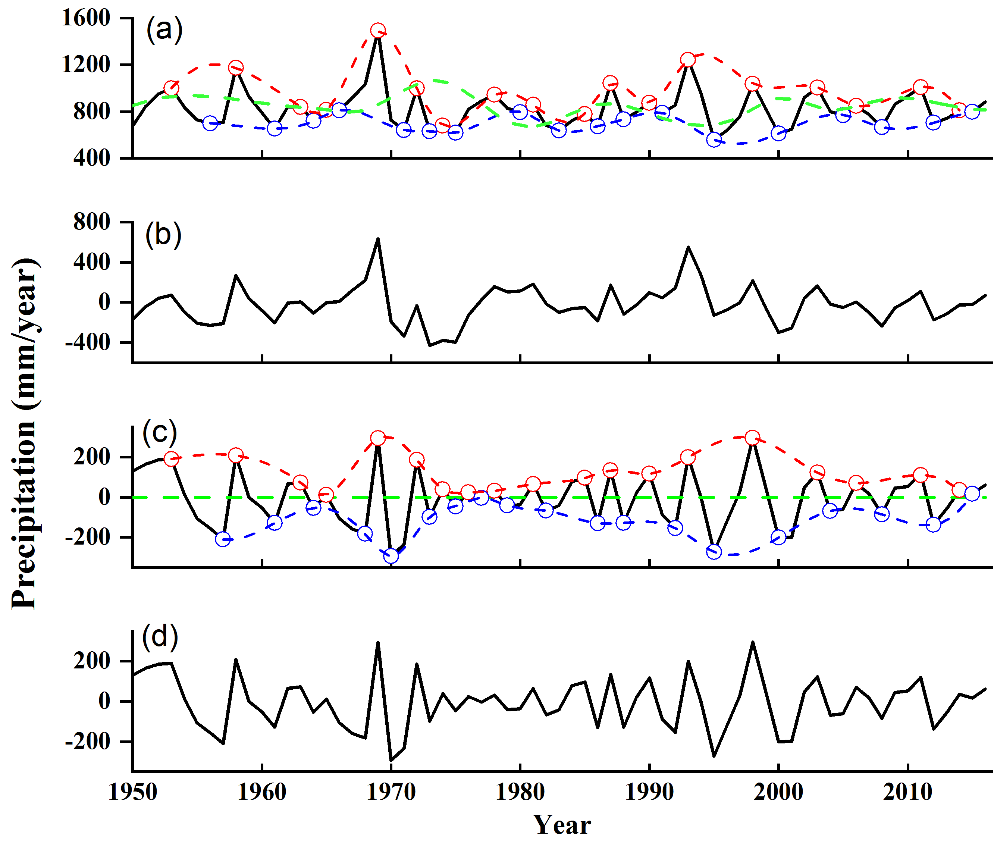
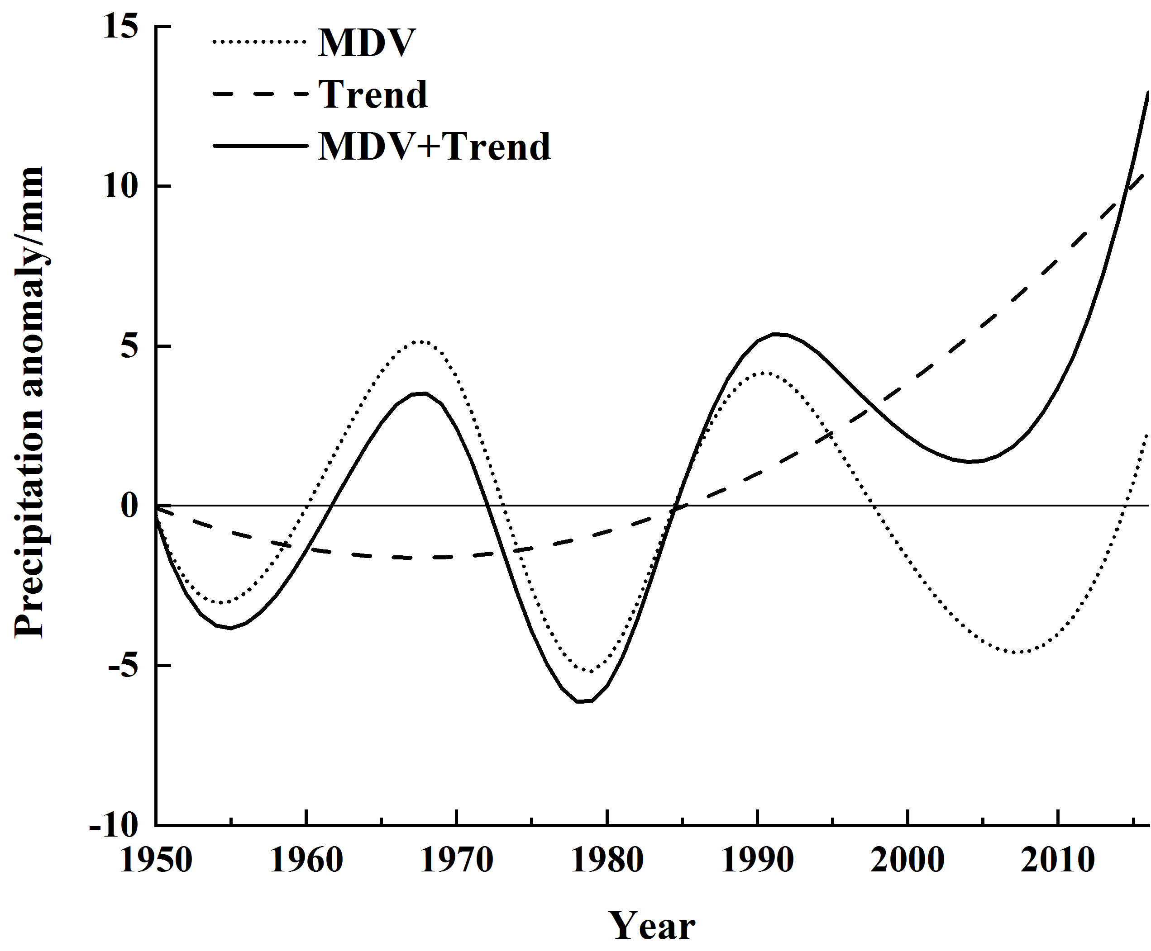
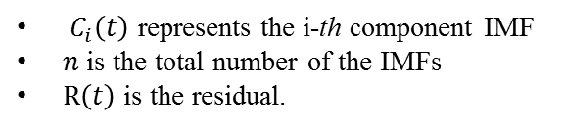
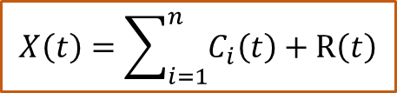
2. Method: the Ensemble Empirical Mode
Decomposition (EEMD)
Multi-timescale variations of precipitation
Nonlinear & nonstationaly data
→Different feature-specific timescales
Study area |  | IMF1 | IMF2 | IMF3 | IMF4 | IMF5 | Trend
Entire Tianshan | Period / year | 3.3 | 6.4 | 12.2 | 26.8 | /
 | Variance contribution /% | 55.2 | 22.4 | 11.5 | 4.3 | / | 6.5
$$X\left(t\right)=\sum_{i=1}^{n}{C_{i}\left(t\right)+R\left(t\right)}$$
$C_{i}\left(t\right)$ represents the i-th component IMF
$n$ is the total number of the IMFs
$R\left(t\right)$ is the residual.
Annual precipitation in Tianshan has oscillation periods of 3.3, 6.4, 12.2, and 26.8 years
IMF1 and IMF2 reflect components on an inter-annual timescale
Process of EEMD
the decadal signals with periods of more than 20 years are treated as multi-decadal variability (MDV)
precipitation anomaly changed to a positive phase after 1986

Slide 5
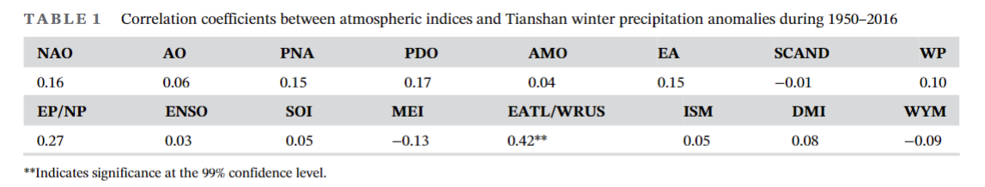
3. Association between atmospheric circulation and precipitation (in winter)
A significantly positive correlation with winter precipitation and EATL/WRUS
The regression pattern of the 500 hPa geopotential height anomaly and 700 hPa horizontal wind anomaly onto winter precipitation anomaly reflect the EATL/WRUS pattern
Notes:
We analysed both summer and winter seasons. However, in this presentation I choose the example of winter precipitation only.

Slide 6
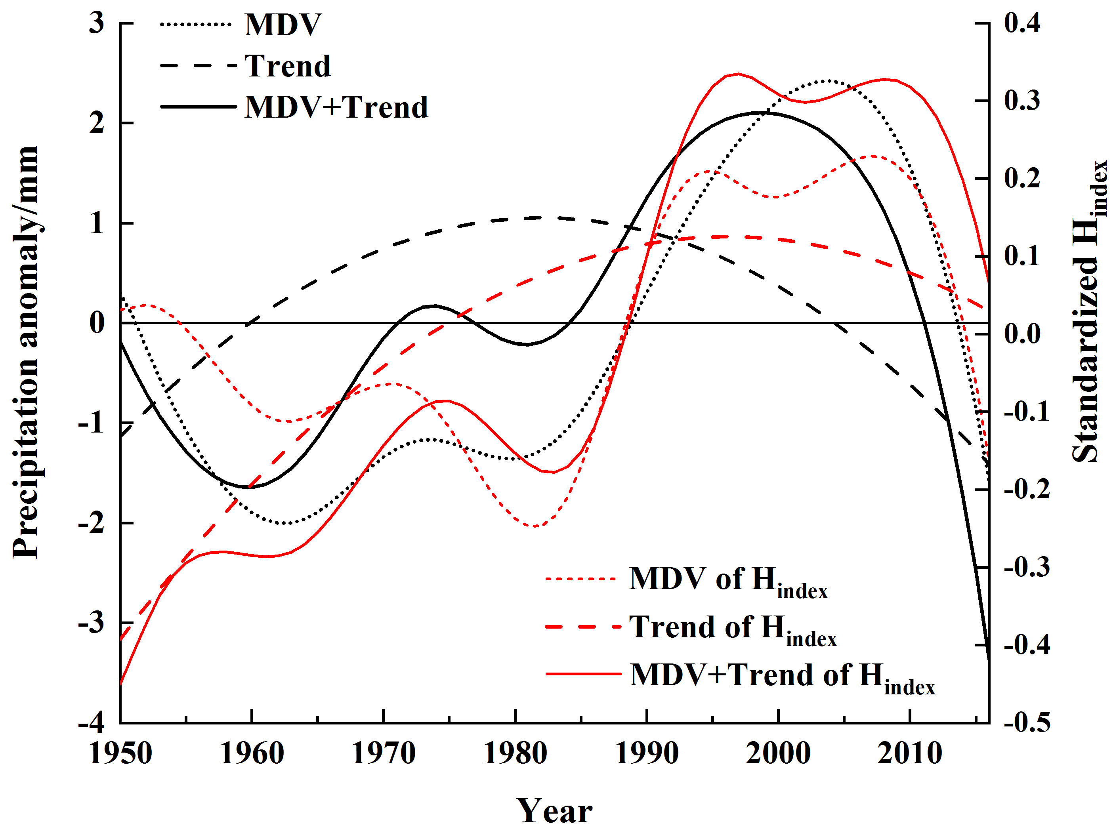
3. Association between atmospheric circulation and precipitation (in winter)
: Multi-decadal variability.
: Multi-decadal
change
Time series
analysis
1988
Multi-decadal characteristics
Period with dry conditions in winter before1988
Period with humid conditions from 1989 to 2013
MDV of EATL/WRUS as well shows a shift in 1988
Notes:
We analysed both summer and winter seasons. However, in this presentation I choose the example of winter precipitation only.

Slide 7
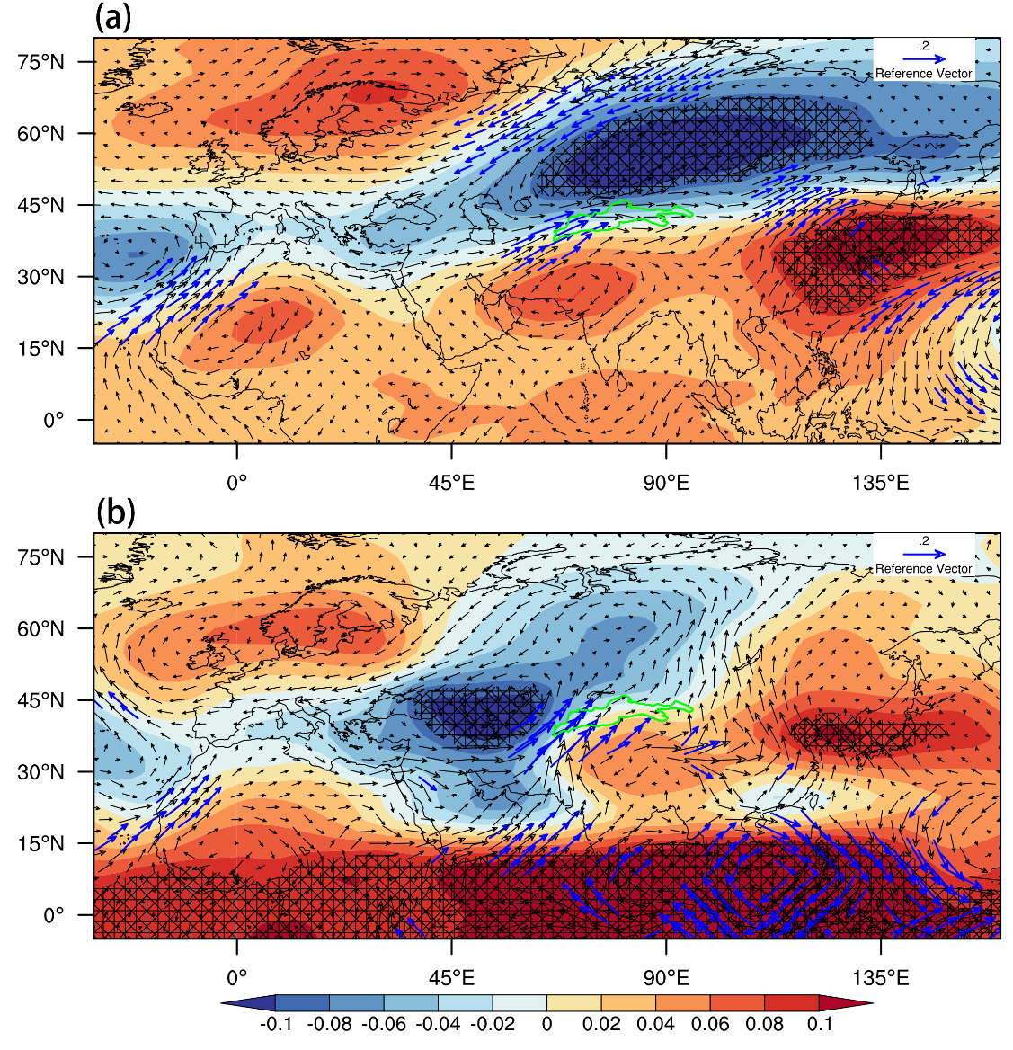
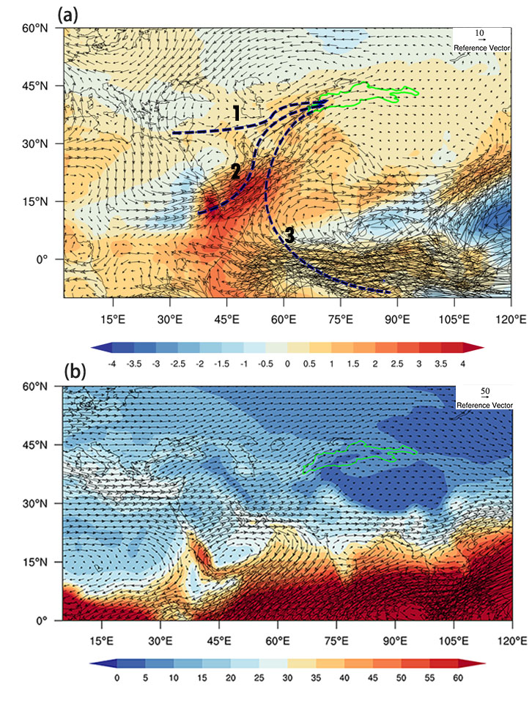
3. Association between atmospheric circulation and precipitation (in winter)
Spatial pattern analysis
500 hPa ph & 700 hPa wind anomalies
wvf & pwc
(a) Period 1: 1950-1989
(b) Period 2: 1989-2013
The meridional feature of EATL/WRUS enhanced in period 2
More water vapour from low-latitude ocean areas to enter the Tianshan Mountains
Notes:
500 hPA pressure

Slide 8
Summary and outlook
The annual precipitation in the Tianshan Mountains has exhibited high-frequency variations with 3- and 6-year quasi-periods and low-frequency variations with 12- and, 27-year quasi-periods.
After 1988, the enhanced meridional feature of the EATL/WRUS pattern causes water vapour from low-latitude ocean areas to enter the Tianshan Mountains.
[Apart from SCAND, SRP and EAP also impacted Tianshan summer precipitation during the different periods.] (not shown)
A more detailed investigation of the association of Indian summer monsoon with Tianshan precipitation is worthy of further investigation.
The relationships between ISM, ENSO, PDO and precipitation, as well as water vapour transport in sub-Tianshan regions will be the focus of follow-up studies.

Slide 9


Thank you!

Slide 10
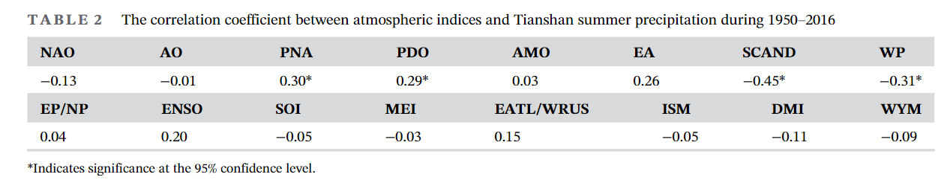
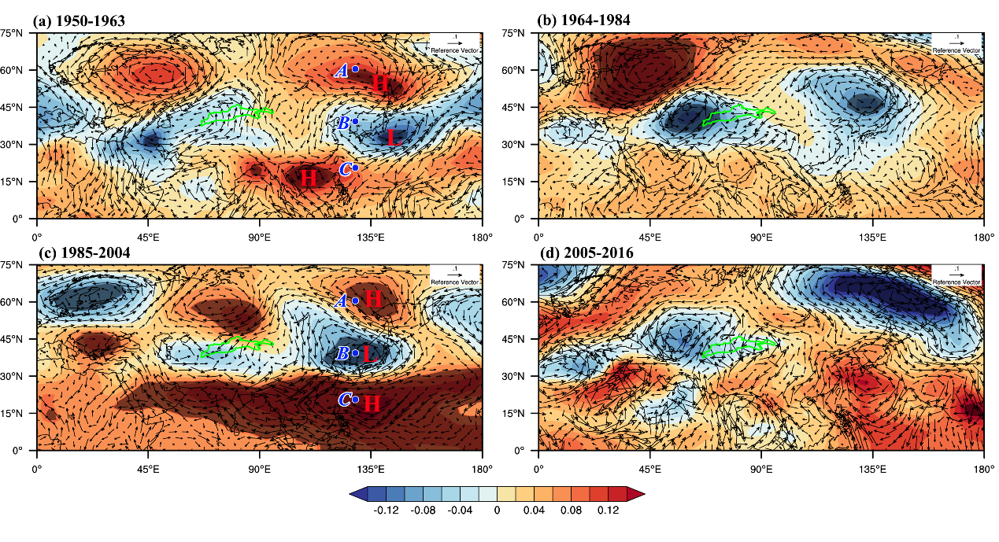
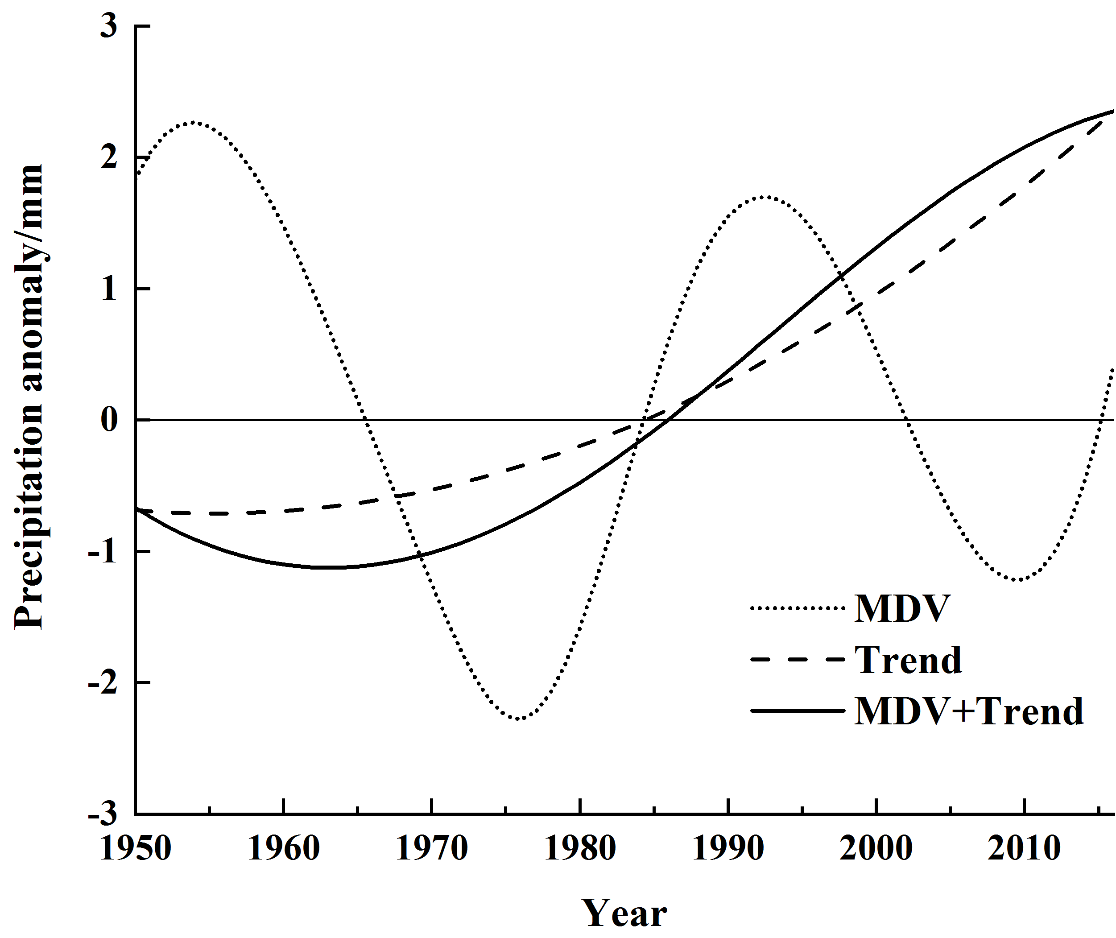
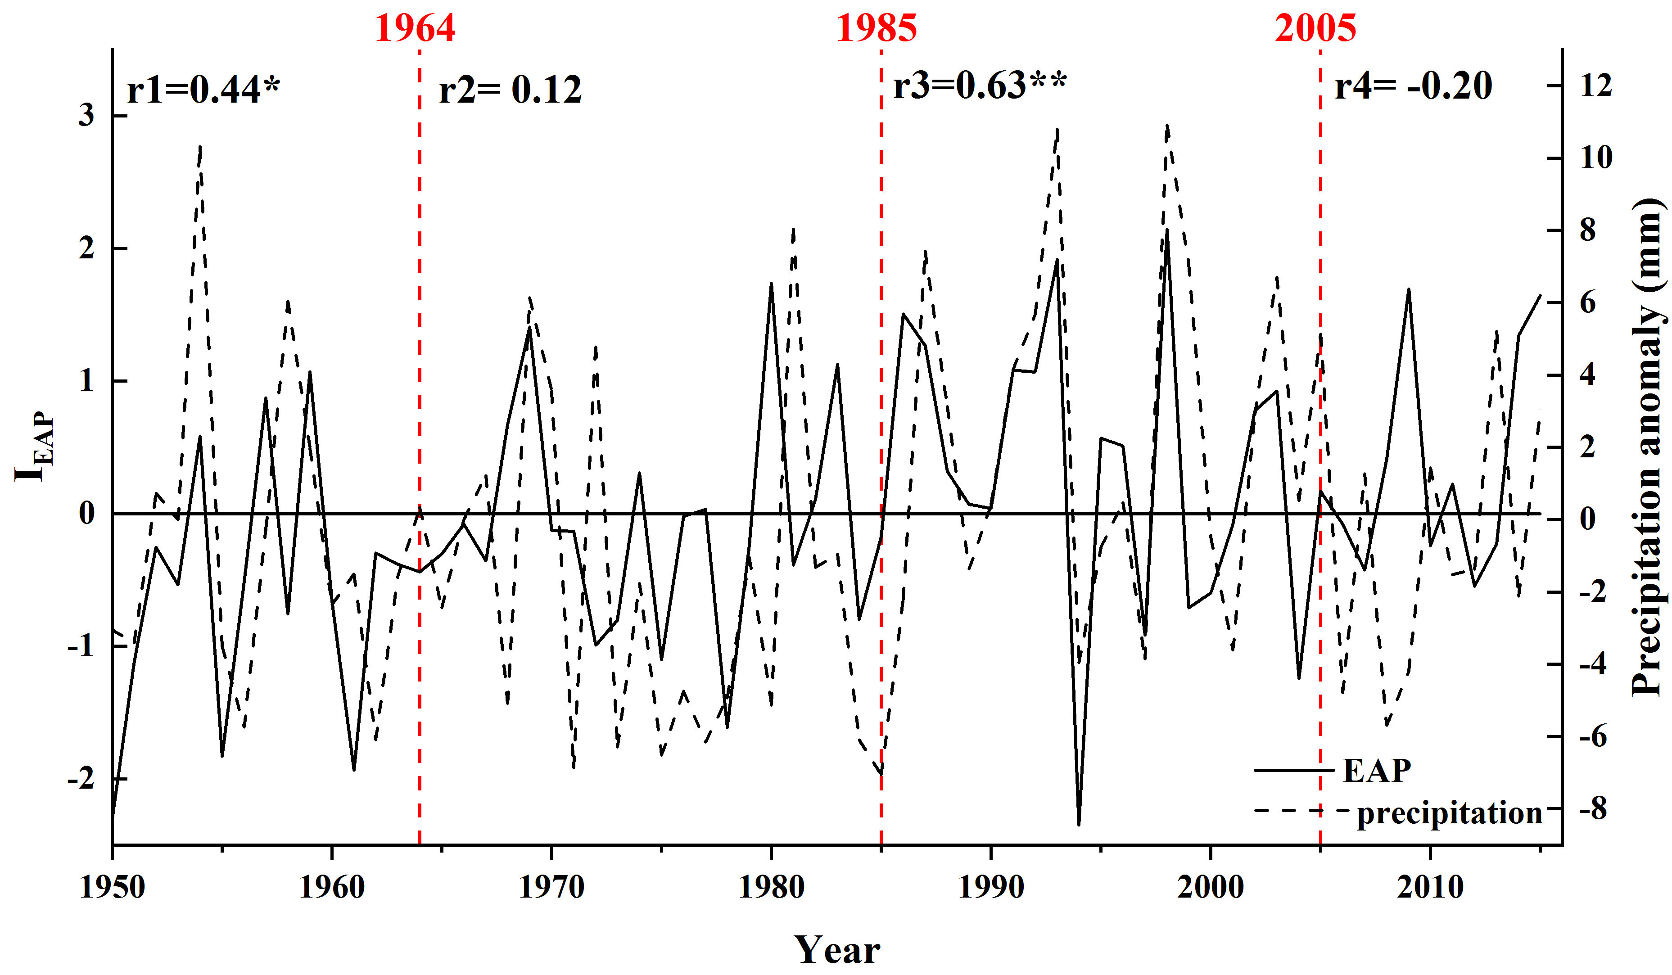
4. Atmospheric circulation anomaly and the variability of summer precipitation
A significantly positive correlation with summer precipitation and SCAND (Scandinavia patter)
During 1985-1963 and 1985-2004, Tianshan summer precipitation was also affected by the EAP pattern
Period 1: 1950-1963
Multi-decadal characteristics
Period 3: 1985-2004
A significant positive correlation between the I_{EAP} and the summer precipitation during 1950-1963 and 1985-2004
Summer precipitation in the Tianshan Mountains has an obvious multi-decadal scale of 33.5 year

Slide 11
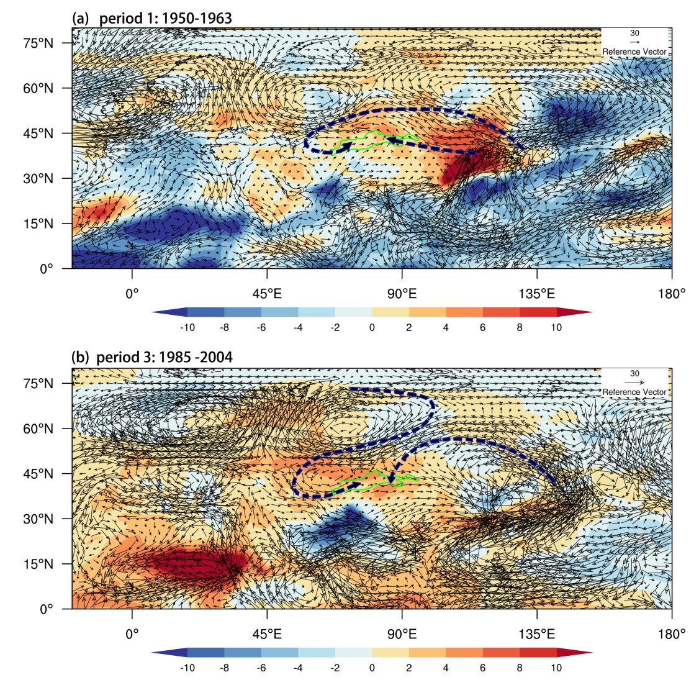
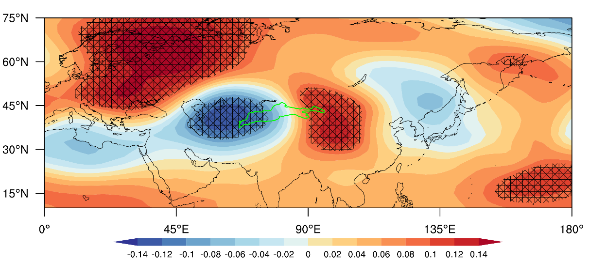
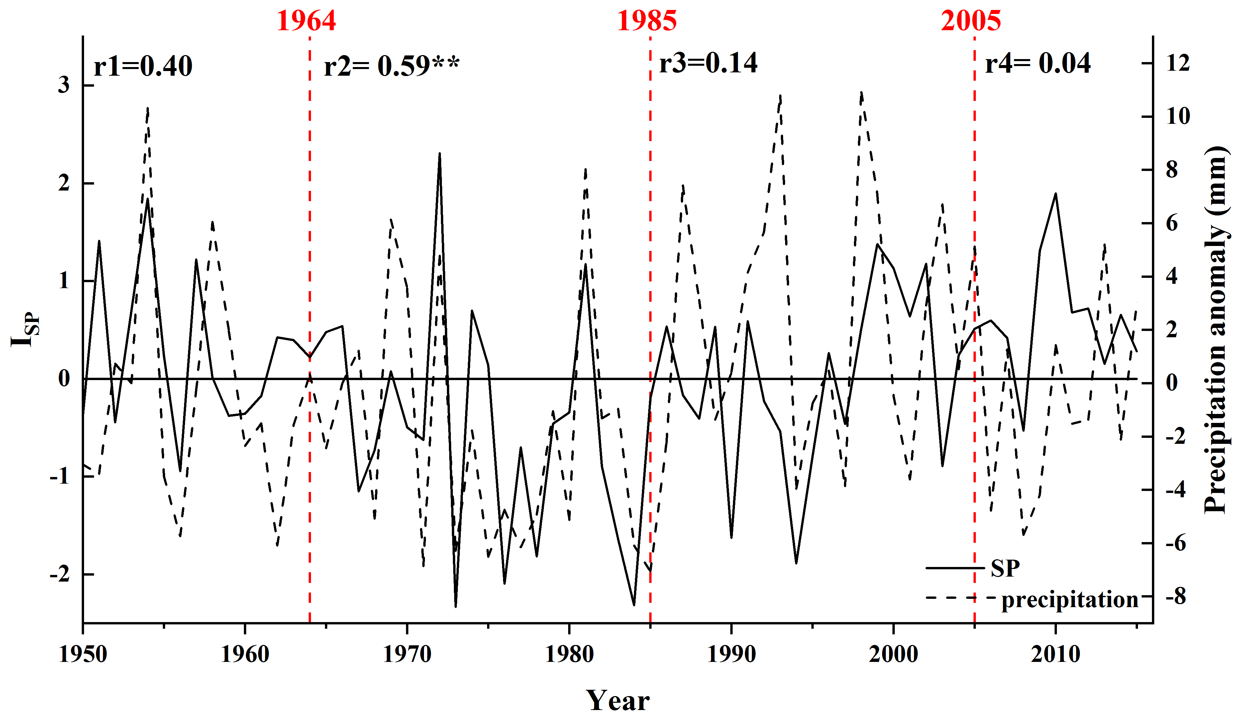
4. Atmospheric circulation anomaly and the variability of summer precipitation
(a) Period 1: 1950-1963
A negative SRP (Silk Road pattern) phase during 1964-1984
(b) Period 3: 1985-2004
An enhanced flux of water vapour in period 1 and period 3 occurred eastward from East Asia to the Tianshan Mountains.
SRP pattern had a significant impact on summer precipitation during 1964–1984.

