Slide 1

Scale-dependent blending of ensemble rainfall nowcasts with NWP in the open-source pysteps library
Ruben Imhoff^{1,2}, Lesley De Cruz^{3,4}, Wout Dewettinck⁵, Carlos Velasco-Forero⁶, Daniele Nerini⁷, Michiel Van Ginderachter³, Claudia Brauer², Klaas-Jan van Heeringen¹, Remko Uijlenhoet⁸ & Albrecht Weerts^{1,2}
¹Deltares, the Netherlands; ²Wageningen University, the Netherlands; ³Royal Meteorological Institute, Belgium; ⁴Vrije Universiteit Brussel, Belgium; ⁵Ghent University, Belgium; ⁶Bureau of Meteorology, Australia; ⁷Meteoswiss, Switzerland; ⁸Delft University of Technology, the Netherlands

Slide 2
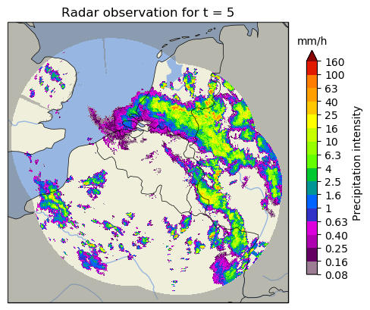
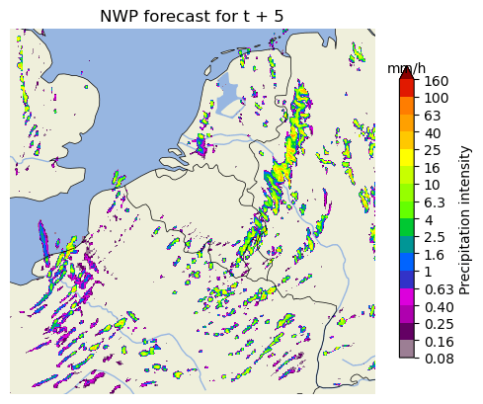
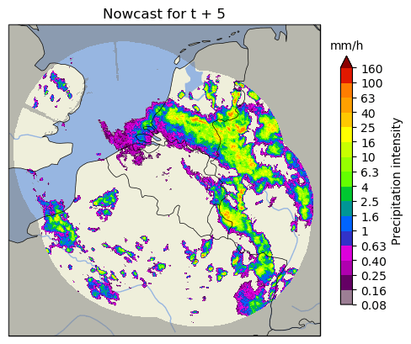
Flood early warning in small and quickly responding catchments needs: improved rainfall forecasts up to several hours in the future
Radar rainfall nowcasting as a possible solution

Slide 3
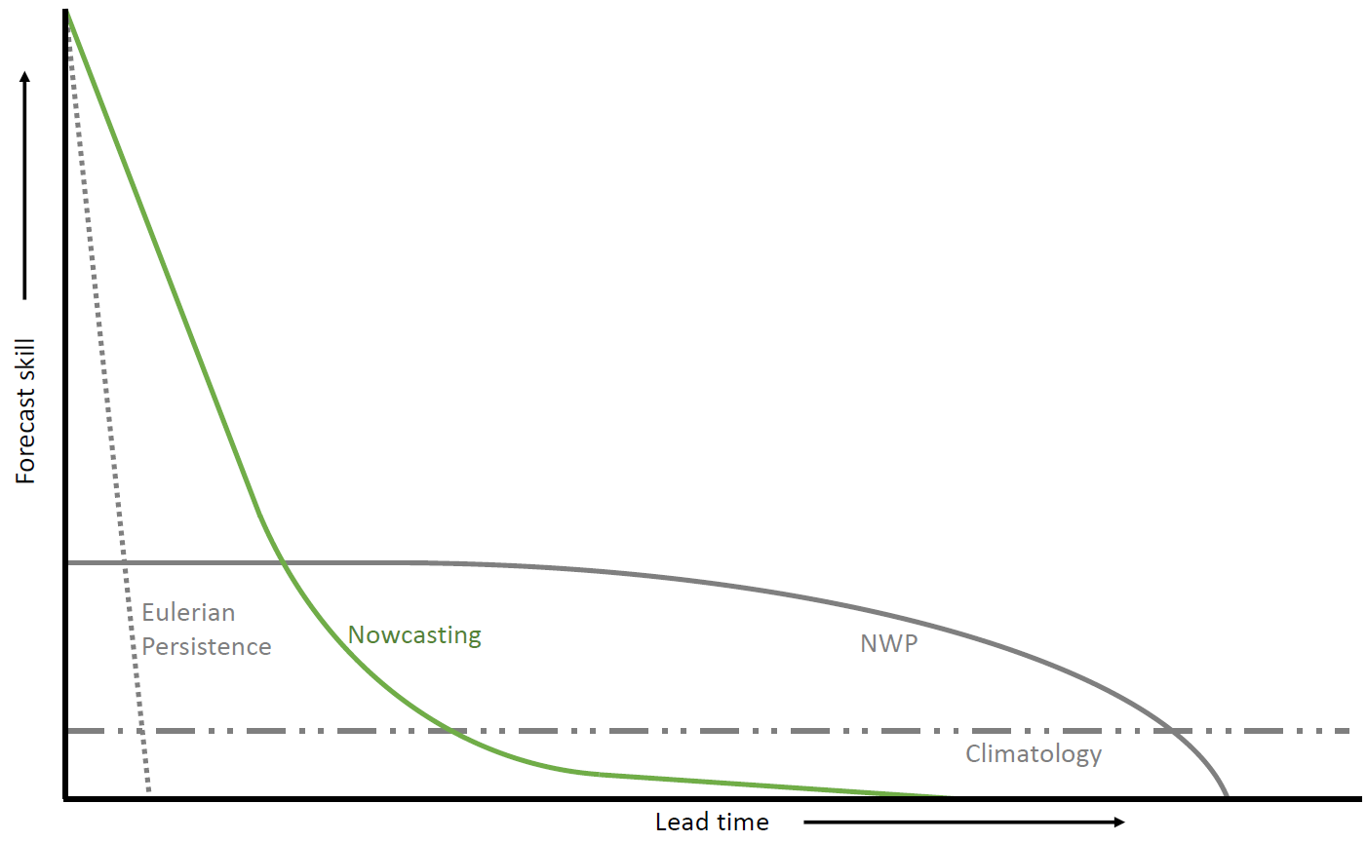
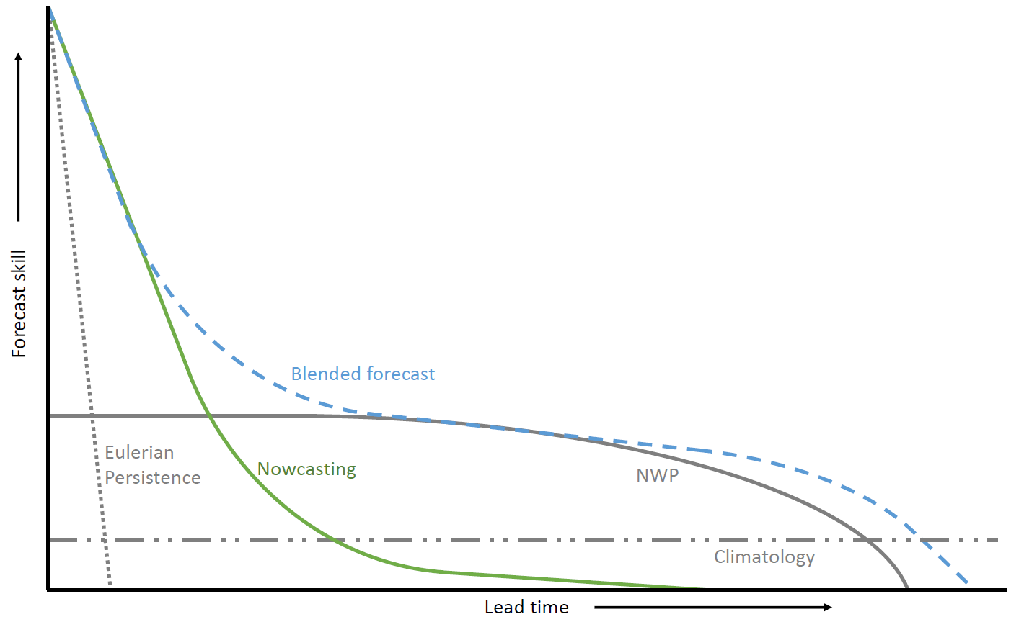
Flood early warning in small and quickly responding catchments needs: improved rainfall forecasts up to several hours in the future
Nowcasting up to approx. 2h ahead more skillful than NWP, but that is not enough
How to improve the rainfall forecasts up to 6h or more ahead?

Slide 4
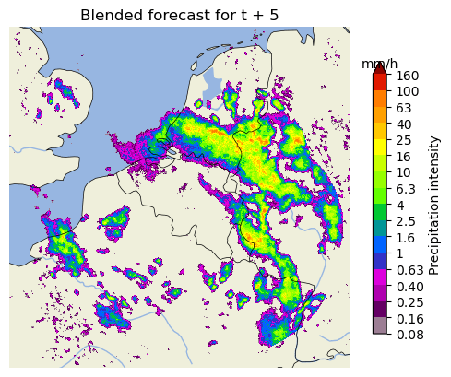
Flood early warning in small and quickly responding catchments needs: improved rainfall forecasts up to several hours in the future
Solution:
Implementation of a scale-dependent blending framework in pysteps, based on the original STEPS scheme
But how to merge a case like this?

Slide 5
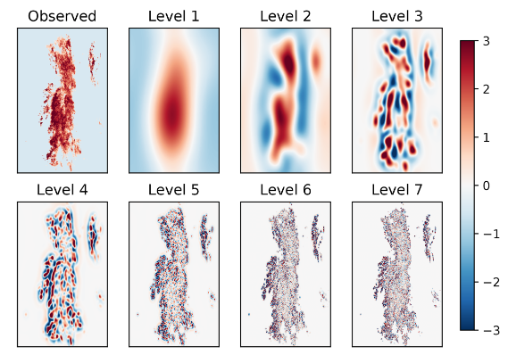
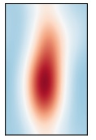
A scale-dependent blending method
Fast-Fourier transform to different spatial scales
Per ensemble member:
Level 1
Level 2
Level 7
Extrapolated radar obs
W₁e x
W₂e x
[…]
W₇e x
+
+
+
NWP
W₁^{n} x
+
W₂^{n} x
+
[…]
+
W₇^{n} x
+
+
+
Pulkkinen et al., 2019, GMD
Correlated noise
W₁^{ε} x
W₂^{ε} x
[…]
W₇^{ε} x
Weights depend on initial and expected future skill
Notes:
Open-source implementation in the pysteps framework
Added functionalities, different from Bowler et al. (2006) and Seed et al. (2013):
Skill NWP component regresses over the forecast horizon to the skill of the past days
Two weights methods
To constrain the (dis)appearance of rain th eensemble members to regions around the rainy areas, we have developed a Lagrangian blended probability matching scheme and incremental masking strategy. Something that is present in pysteps, but not in the original STEPS blending approach. Hence, this is adjusted to work in the blending framework.

Slide 6
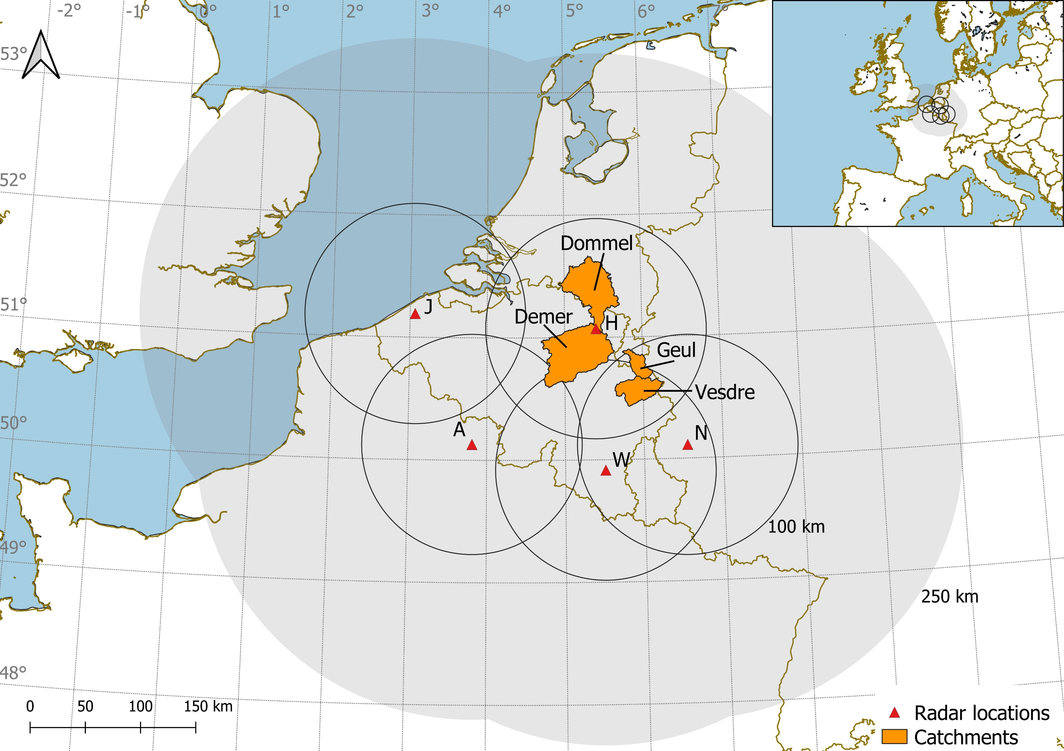
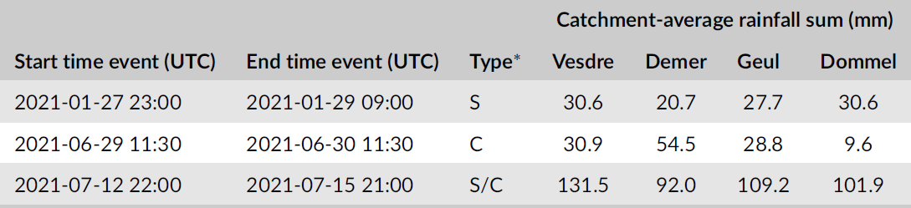
Evaluation of the method
Focus on domain scale and catchment scale
Blended forecasts for every 5-min step in three events:
48 ens. members
12-h forecast horizon
1-km resolution
Three methods as benchmark:
Ensemble nowcasts with pysteps (48 members)
NWP forecast of RMI (deterministic)
Linear blending method between ensemble nowcast and NWP
Notes:
Comparison with observed radar rainfall

Slide 7
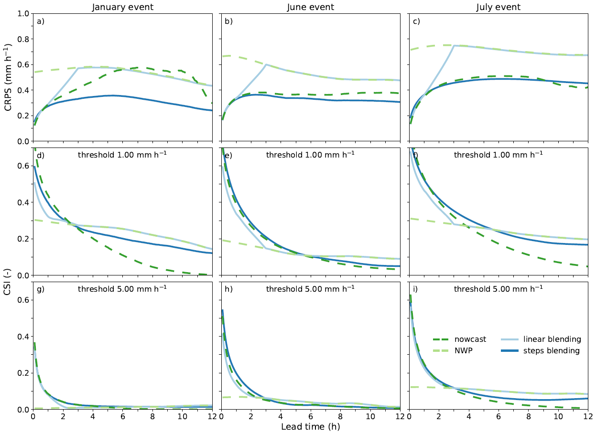
Results on the domain scale

Slide 8

Main take-home messages:
Implementation of STEPS blending procedure in the open-source pysteps framework
New functionalities added
Domain scale
STEPS blending method produces rainfall forecasts that are as good as or better than all three benchmarks
Catchment scale (not shown here)
STEPS blending outperforms all other methods for the January and July events
The difference between STEPS blending and linear blending reduces for cumulative sums on the catchment scale
Contact:
Ruben Imhoff (ruben.imhoff@deltares.nl)
Notes:
Would you like to contribute to the blending approaches in the pysteps framework or just try it out? Come talk to me afterwards!

Slide 9
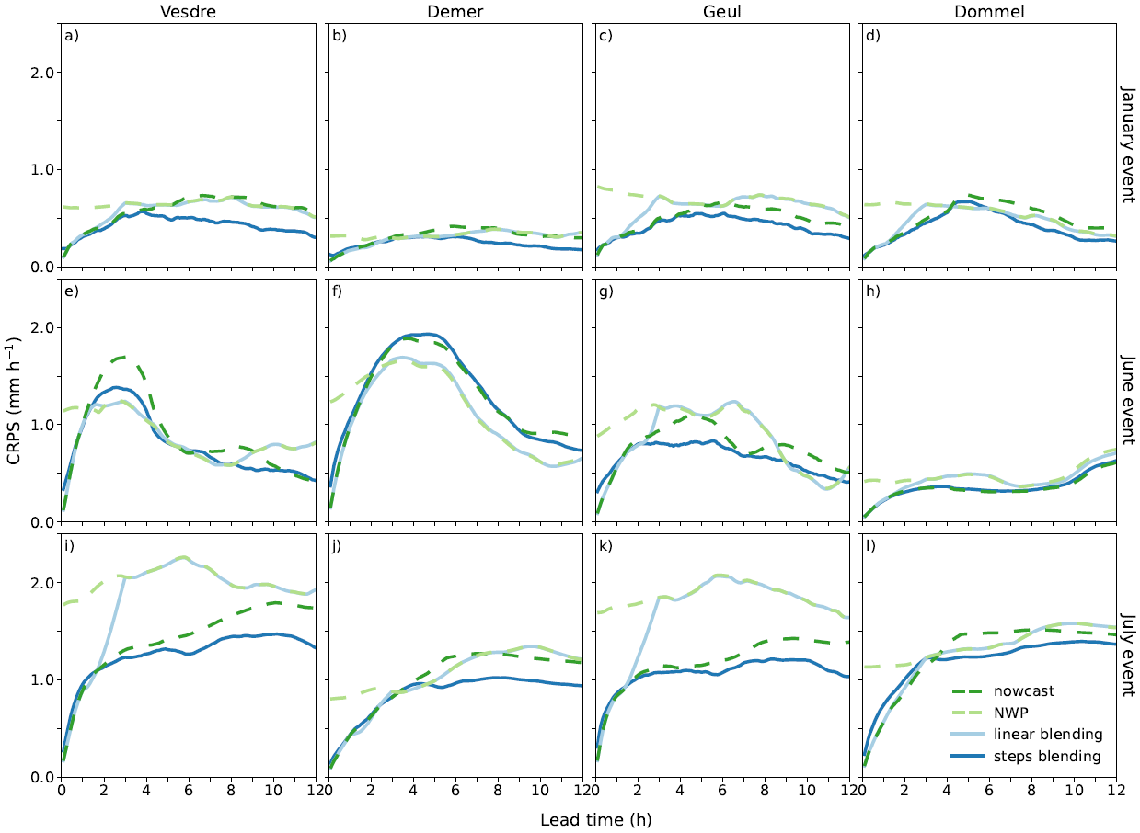
Extra slides: results on the catchment scale

Slide 10
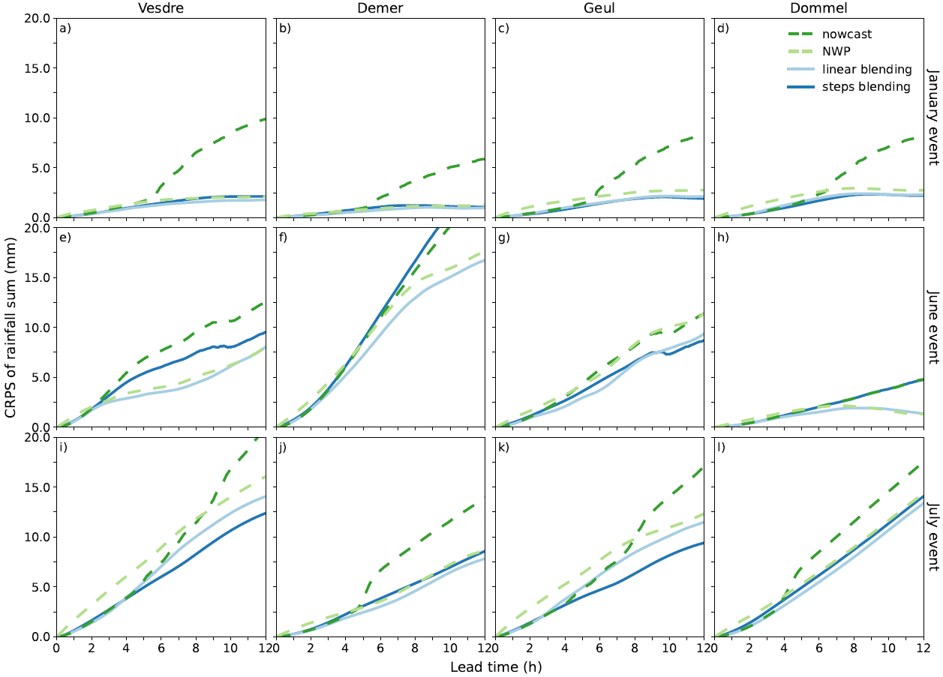
Extra slides: results on the catchment scale – cumulative sums

Slide 11
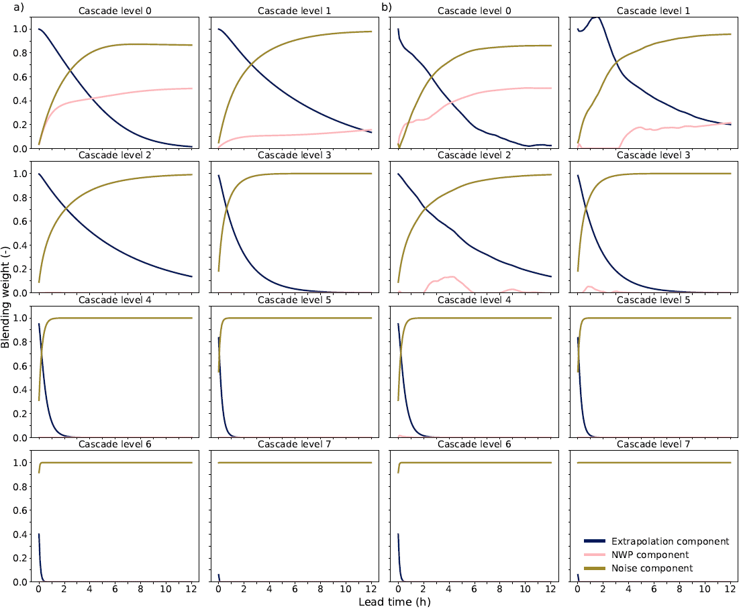
Extra slides: Blending weights
Bowler et al. (2006)
Seed et al. (2013)

Slide 12
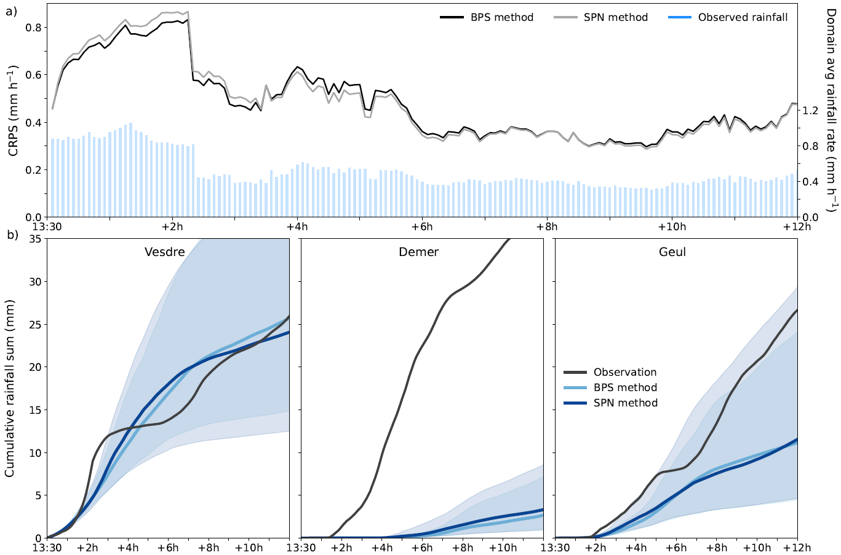
Extra slides: Effect weights method

Slide 13
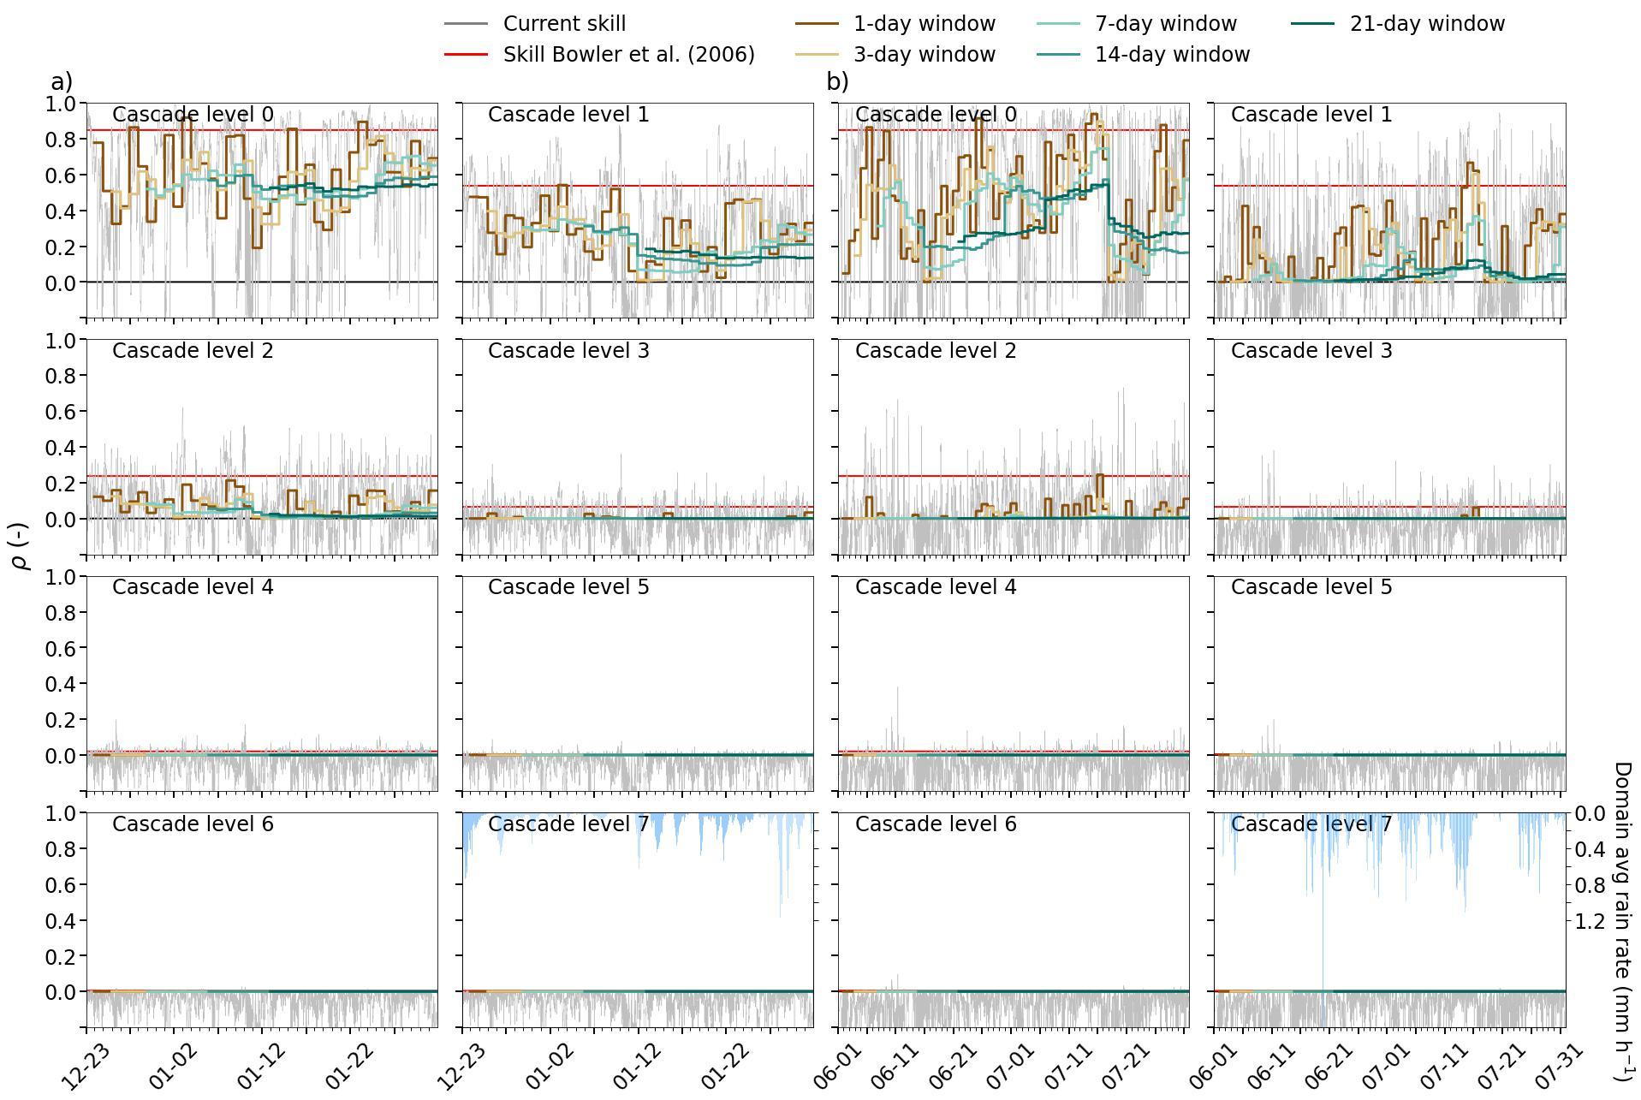
Extra slides: Different moving windows for the climatological skill

Slide 14
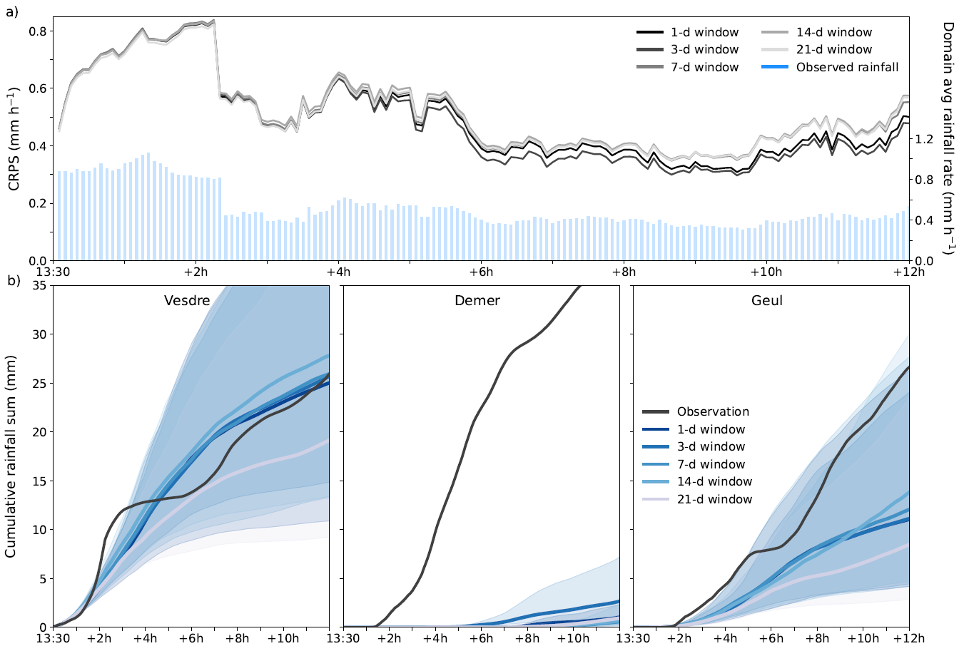
Extra slides: Effect different moving windows for the climatological skill

