Slide 1



Aeolian River Dust (PM10) in Central and Southern Taiwan Rivers: Spatial-Temporal Characterization
Student: Chun-Kuang, Chen (陳俊光)
Advisor: Christina W. Tsai, Ph.D. (蔡宛珊)
1
Notes:
Hi everyone, I’m Chun-Kuang Chen studied in National Taiwan University
My advisor is Christina Tsai.
The title of research is Aeolian River dust (PM10) in Central and Southern Taiwan Rivers: Spatial-Temporal Characterization

Slide 2
Contents
1. Introduction
Research background
Objectives of research
2. Methodology
Time frequency analysis:
Improved Complete Ensemble Empirical Mode Decomposition with Adaptive Noise (ICEEMDAN)
Correlation analysis:
Time dependent intrinsic correlation method (TDIC)
3. Results
Correlation of PM10 with hydro-meteorological factors
(Temperature, Precipitation, Relative humidity, Wind speed)
Wind Motion analysis
4. Conclusions and Ongoing works
2
Notes:
This is the contents of this research
The first part,, we will talk about research background and objectives of research
The second part, we will introduce two method used in this research
The next part will present the results of this research.
Finally, we will give some conclusions and ongoing works

Slide 3
01.
Introduction
Research background
Objectives of research
3
Notes:
The first part introduction

Slide 4

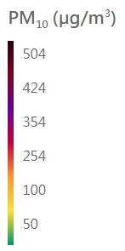
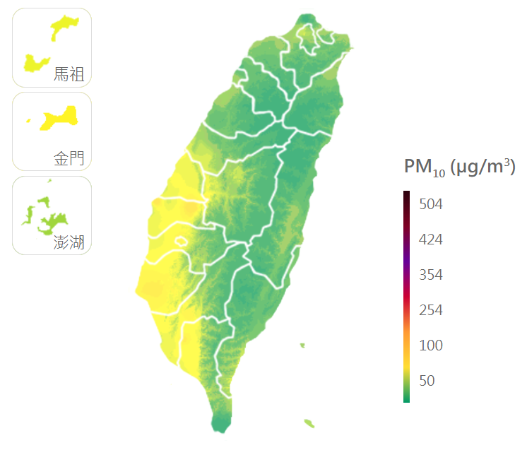

Aeolian River Dust (PM10)
Winter monsoon
Strong winds
Taiwan
Summer monsoon
On the average, nine river-dust events occurred in central and southern Taiwan per year between 1994 and 2007 (Taiwan EPA 2009).
Bare riverbeds
(https://www.epa.gov.tw/Index)
4
Introduction / Methodology / Results / Conclusions and Ongoing works
Notes:
River dust events are extreme dust events that are unique to Taiwan, specially in the central and southern Taiwan.
When the monsoon is prevailing and the weather condition is dry, strong wind can easily blow up dust from the bare river beds.

Slide 5

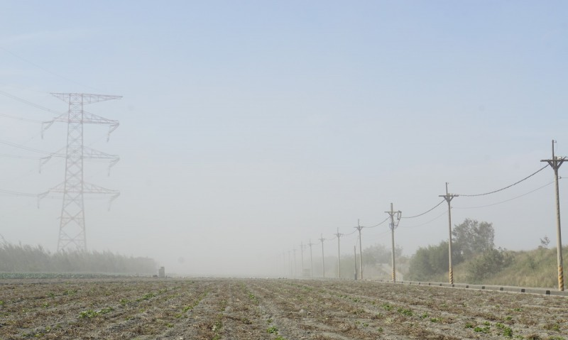


Aeolian River Dust (PM10)
Adverse health effect
Damaging the environment
Choshui river
https://www.sleepwa.com.au/respiratory-diseases/
Kaoping river
https://convenientmd.com/asthma/
5
Introduction / Methodology / Results / Conclusions and Ongoing works
Notes:
In literature, It has been demonstrated that long-term exposure to PM10, even the low-level concentrations, may induce adverse health effects.
In addition, River dust is not only a health concern for humans, but also causes damage to the environment.

Slide 6
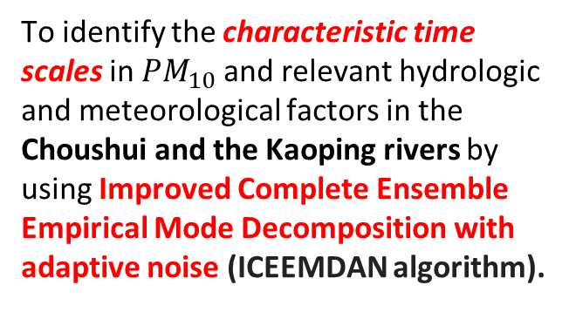
Objectives of Research
To identify the characteristic time scales in ${PM}_{10}$and relevant hydrologic and meteorological factors in the Choushui and the Kaoping rivers by using Improved Complete Ensemble Empirical Mode Decomposition with adaptive noise (ICEEMDAN algorithm).
To explore the correlation between PM₁₀ and relevant hydro-meteorological factors in the central and southern Taiwan by using the Time Dependent Intrinsic Correlation (TDIC method).
01
02
6
Introduction / Methodology / Results / Conclusions and Ongoing works
Notes:
And there are two objectives in this research.

Slide 7
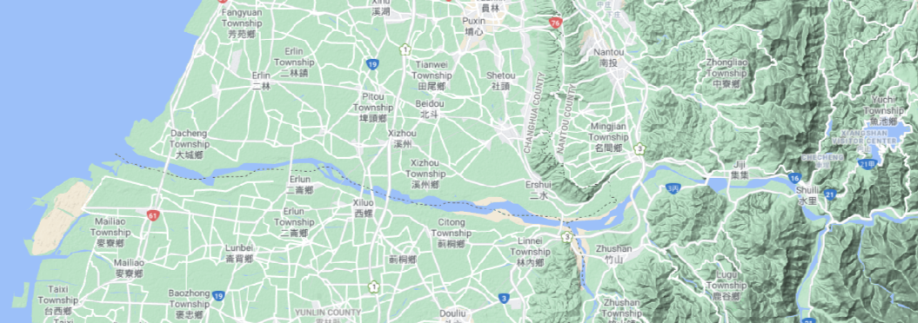
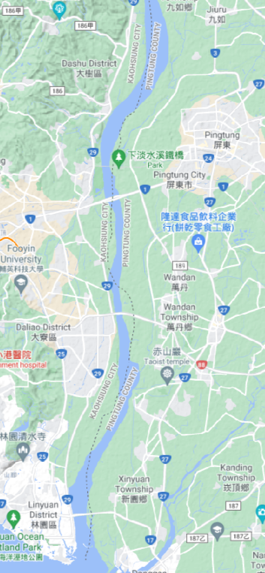
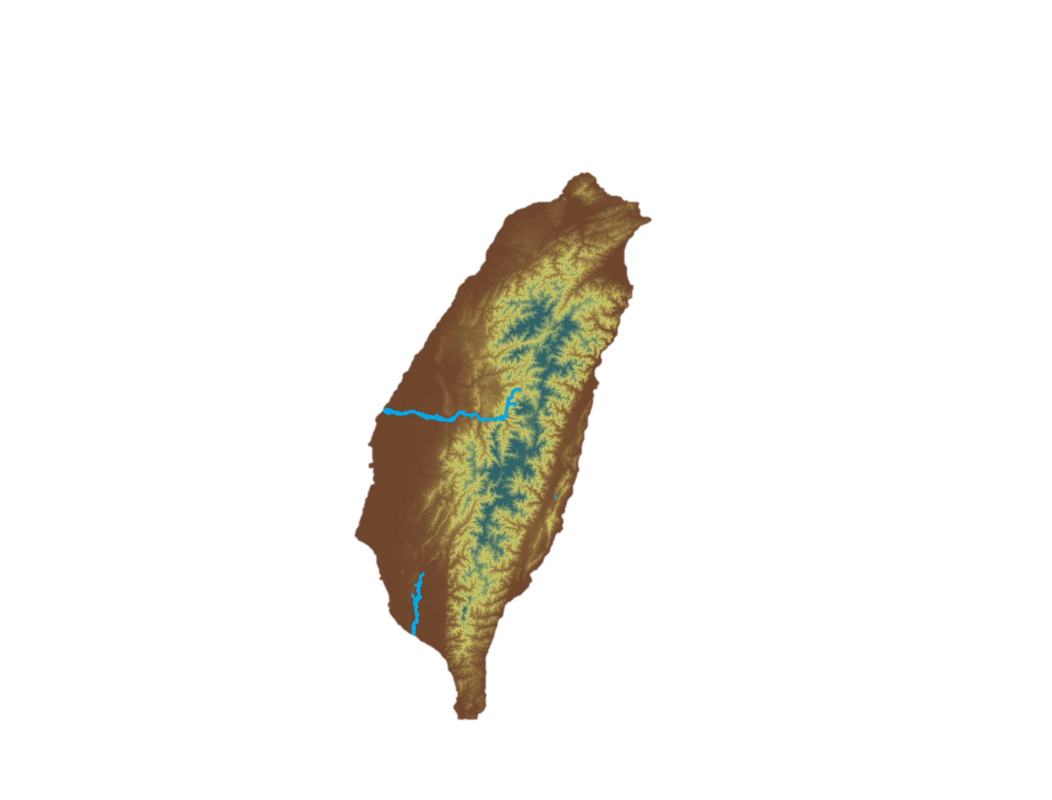
Study area
Choushui River
Kaoping River
Lunbei station
Pingtung station
Taipei
Hsinchu City
Taichung City
Monitoring Rivers
Choushui River: highest sediment yields in Taiwan
Kaoping River: largest watershed area in southern Taiwan.
Hualien country
Taiwan
Tainan City
Kaohsiung City
Taitung
(Taiwan EPA 2009)
7
Introduction / Methodology / Results / Conclusions and Ongoing works
Notes:
we chose the Choshui and Kaoping as our research river.
Choshui river has the highest sediment yields in Taiwan and Kaoping river has largest watershed area in southern Taiwan.
Therefore These two rivers are the highest potential area for river dust events.

Slide 8
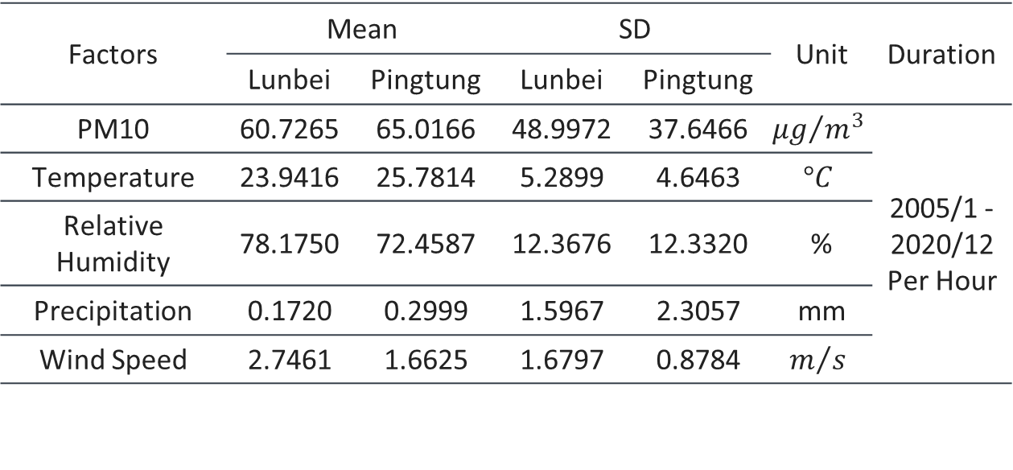
Data Acquisition and Statistics
Factors | Mean |  | SD |  | Unit | Duration
 | Lunbei | Pingtung | Lunbei | Pingtung
PM10 | 60.7265 | 65.0166 | 48.9972 | 37.6466 | $${μg}/{m^{3}}$$ | 2005/1 - 2020/12 Per Hour
Temperature | 23.9416 | 25.7814 | 5.2899 | 4.6463 | $$°C$$
Relative Humidity | 78.1750 | 72.4587 | 12.3676 | 12.3320 | %
Precipitation | 0.1720 | 0.2999 | 1.5967 | 2.3057 | mm
Wind Speed | 2.7461 | 1.6625 | 1.6797 | 0.8784 | $$m/s$$
Data Source: Taiwan Environmental Protection Administration (Taiwan EPA)
8
Introduction / Methodology / Results / Conclusions and Ongoing works
Notes:
In this research, we use PM10 and four relevant hydro-meteorological factors from 2005 to 2020 in hourly data.
These data is from Taiwan EPA.

Slide 9
02.
Methodology
Time frequency analysis (ICEEMDAN)
Time dependent intrinsic correlation method (TDIC)
10

Slide 10
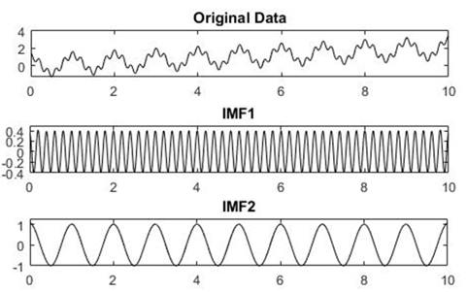
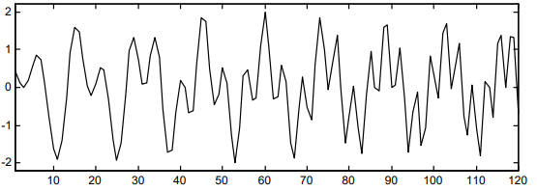
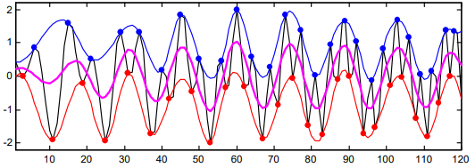
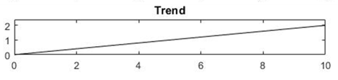
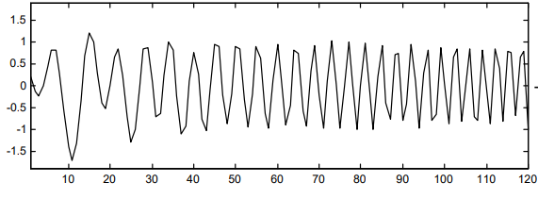
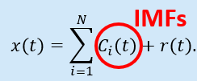
Time-Frequency Data Analysis
EMD
The Hilbert Huang Transform (HHT) proposed by Huang et al.(1998) to adaptively process nonlinear and non-stationary time series.
HHT
HSA
Empirical Mode Decomposition (EMD)
Intrinsic Mode Function (IMF)
Input signal
In the whole dataset, the number of extrema (i.e., the number of maxima and minima) and the number of zeros crossing differs at most by one.
At any point, the mean value of the envelope defined by the local maxima and the envelope defined by the local minima is near to zero.
Estimate of envelopes
。。。
。。。
Subtract the mean envelop
11
Introduction / Methodology / Results / Conclusions and Ongoing works
Notes:
Hilbert Huang transform HHT proposed by Huang et al in 1998 to adaptively extract the meaningful time scale and the trend from the nonlinear and non-stationary time series.
the first part of HHT empirical mode decomposition is a sifting process on the left hand side
it can decompose the time series into a set of meaningful components imf and the trend of data
Imf need to be satisfied two criteria on the right hand side.

Slide 11
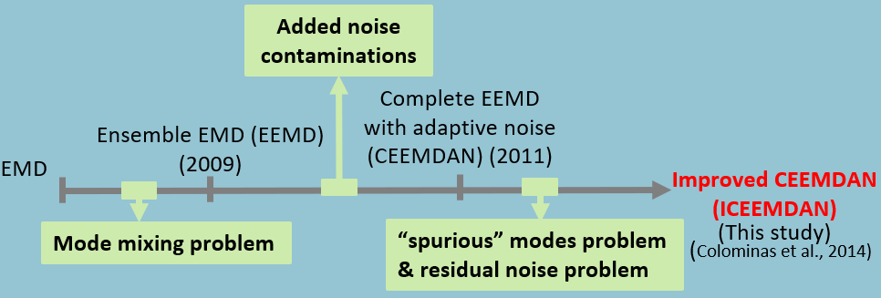
Time-Frequency Data Analysis
Improved Complete Ensemble Empirical mode decomposition
with adaptive noise (ICEEMDAN)
(Colominas et al., 2014)
Advantages of ICEEMDAN:
ICEEMDAN algorithm is an extended version of EMD.
It can process the nonlinear and nonstationary signal and adaptively control the added noise in the signal.
It overcomes the process problems existing in the earlier versions of EMD.
(1998)
11
Introduction / Methodology / Results / Conclusions and Ongoing works
Notes:
And in this research, we use the ICEEMDAN algorithm to process the time series.
ICEEMDAN algorithm is an extended version of EMD.
It can process the nonlinear and nonstationary signal and adaptively control the added noise in the signal.
It overcomes the process problems existing in the earlier versions of EMD.

Slide 12

Time Dependent Intrinsic Correlation (TDIC)
(Chen et al., 2010)
Sliding
Window
EMD
TDIC
Traditional (global) cross correlation
IMFs
Factor 1
Window Size
Factor 2
Sliding window technique
Center of Window
12
Introduction / Methodology / Results / Conclusions and Ongoing works
Notes:
TDIC is proposed by Chen et al in 2010
They combined the EMD and sliding window technique
It can chose the adaptively window size
to explore the local correlation between two IMFs.
The result of TDIC can be show like the figure on the right hand side.

Slide 13
03.
Results
Correlation of PM10 with hydro-meteorological factors (Temperature, precipitation, relative humidity, wind speed)
Wind Motion analysis
13
Notes:
The third part, results of this research

Slide 14
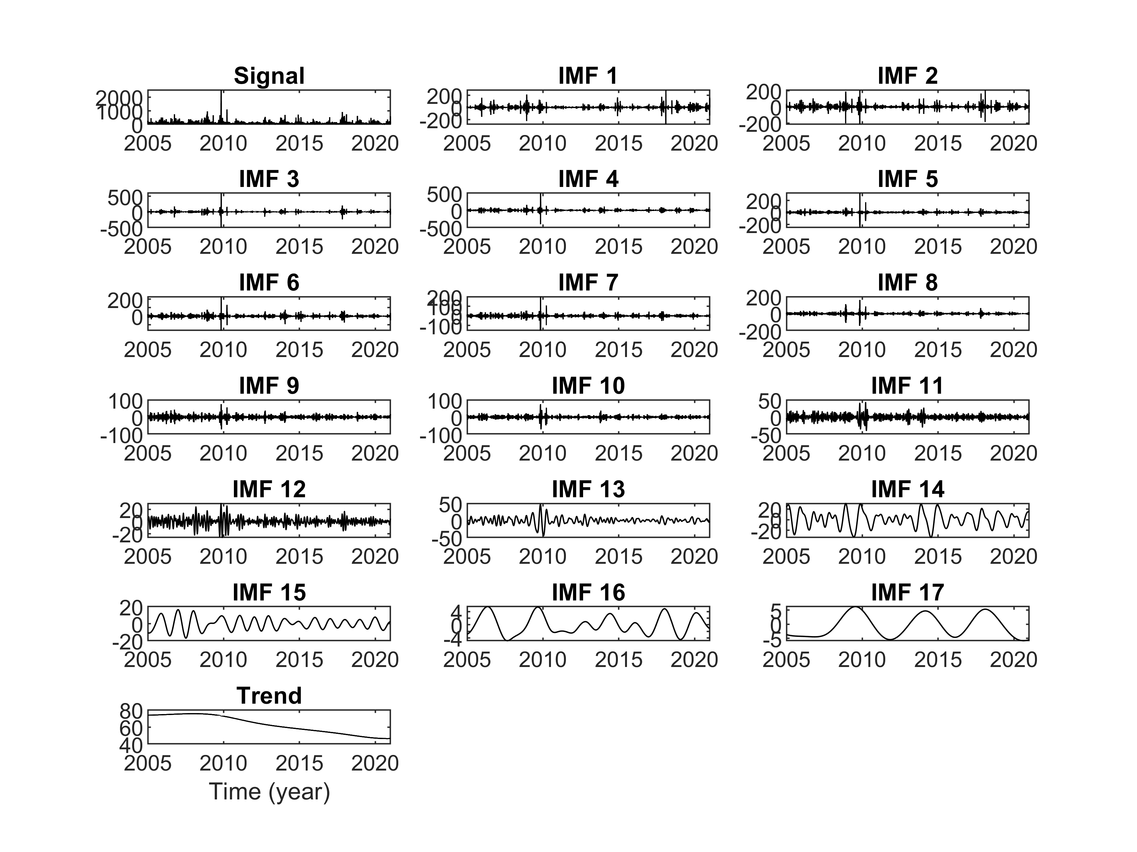
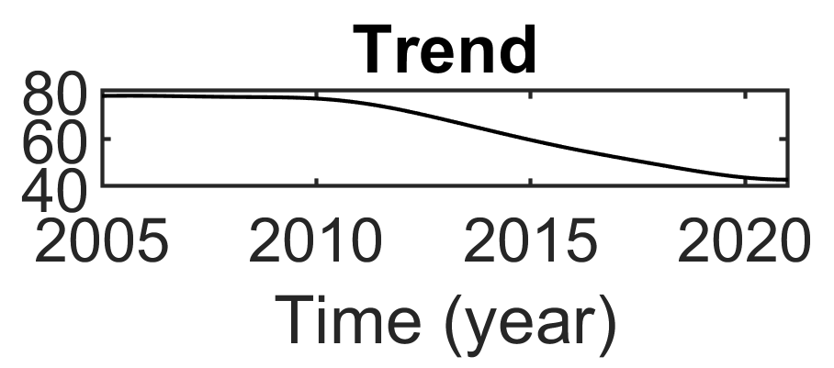
Intrinsic Mode functions
PM10 time series
Choushi River (Lunbei station) (for example)
17 meaningful time scales
Trend
(Choushui River)
(Kaoping River)
Decreasing trend
14
Introduction / Methodology / Results / Conclusions and Ongoing works
Notes:
After the decomposition of ICEEMDAN, 17 different time scales IMFs and the trend of PM10 can be extracted in Choshui river.
Moreover, In choushui and Kaoping river , either have the decreasing trend of PM10

Slide 15
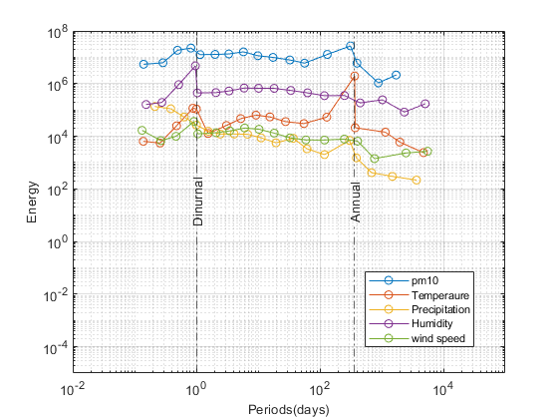
Energy distribution
Choushui River (Lunbei station) (for example)
Identification of characteristic time scales
Characteristic time scales: Annual & diurnal scales
15
Introduction / Methodology / Results / Conclusions and Ongoing works
Notes:
After we have different time scales of components,
we found the energy of five factors are concentrated at the annual and diurnal time scales.
Therefore , these two time scales may have some physical and meaningful information.
In addition, the correlation analysis will focus on these two characteristic time scales later.

Slide 16
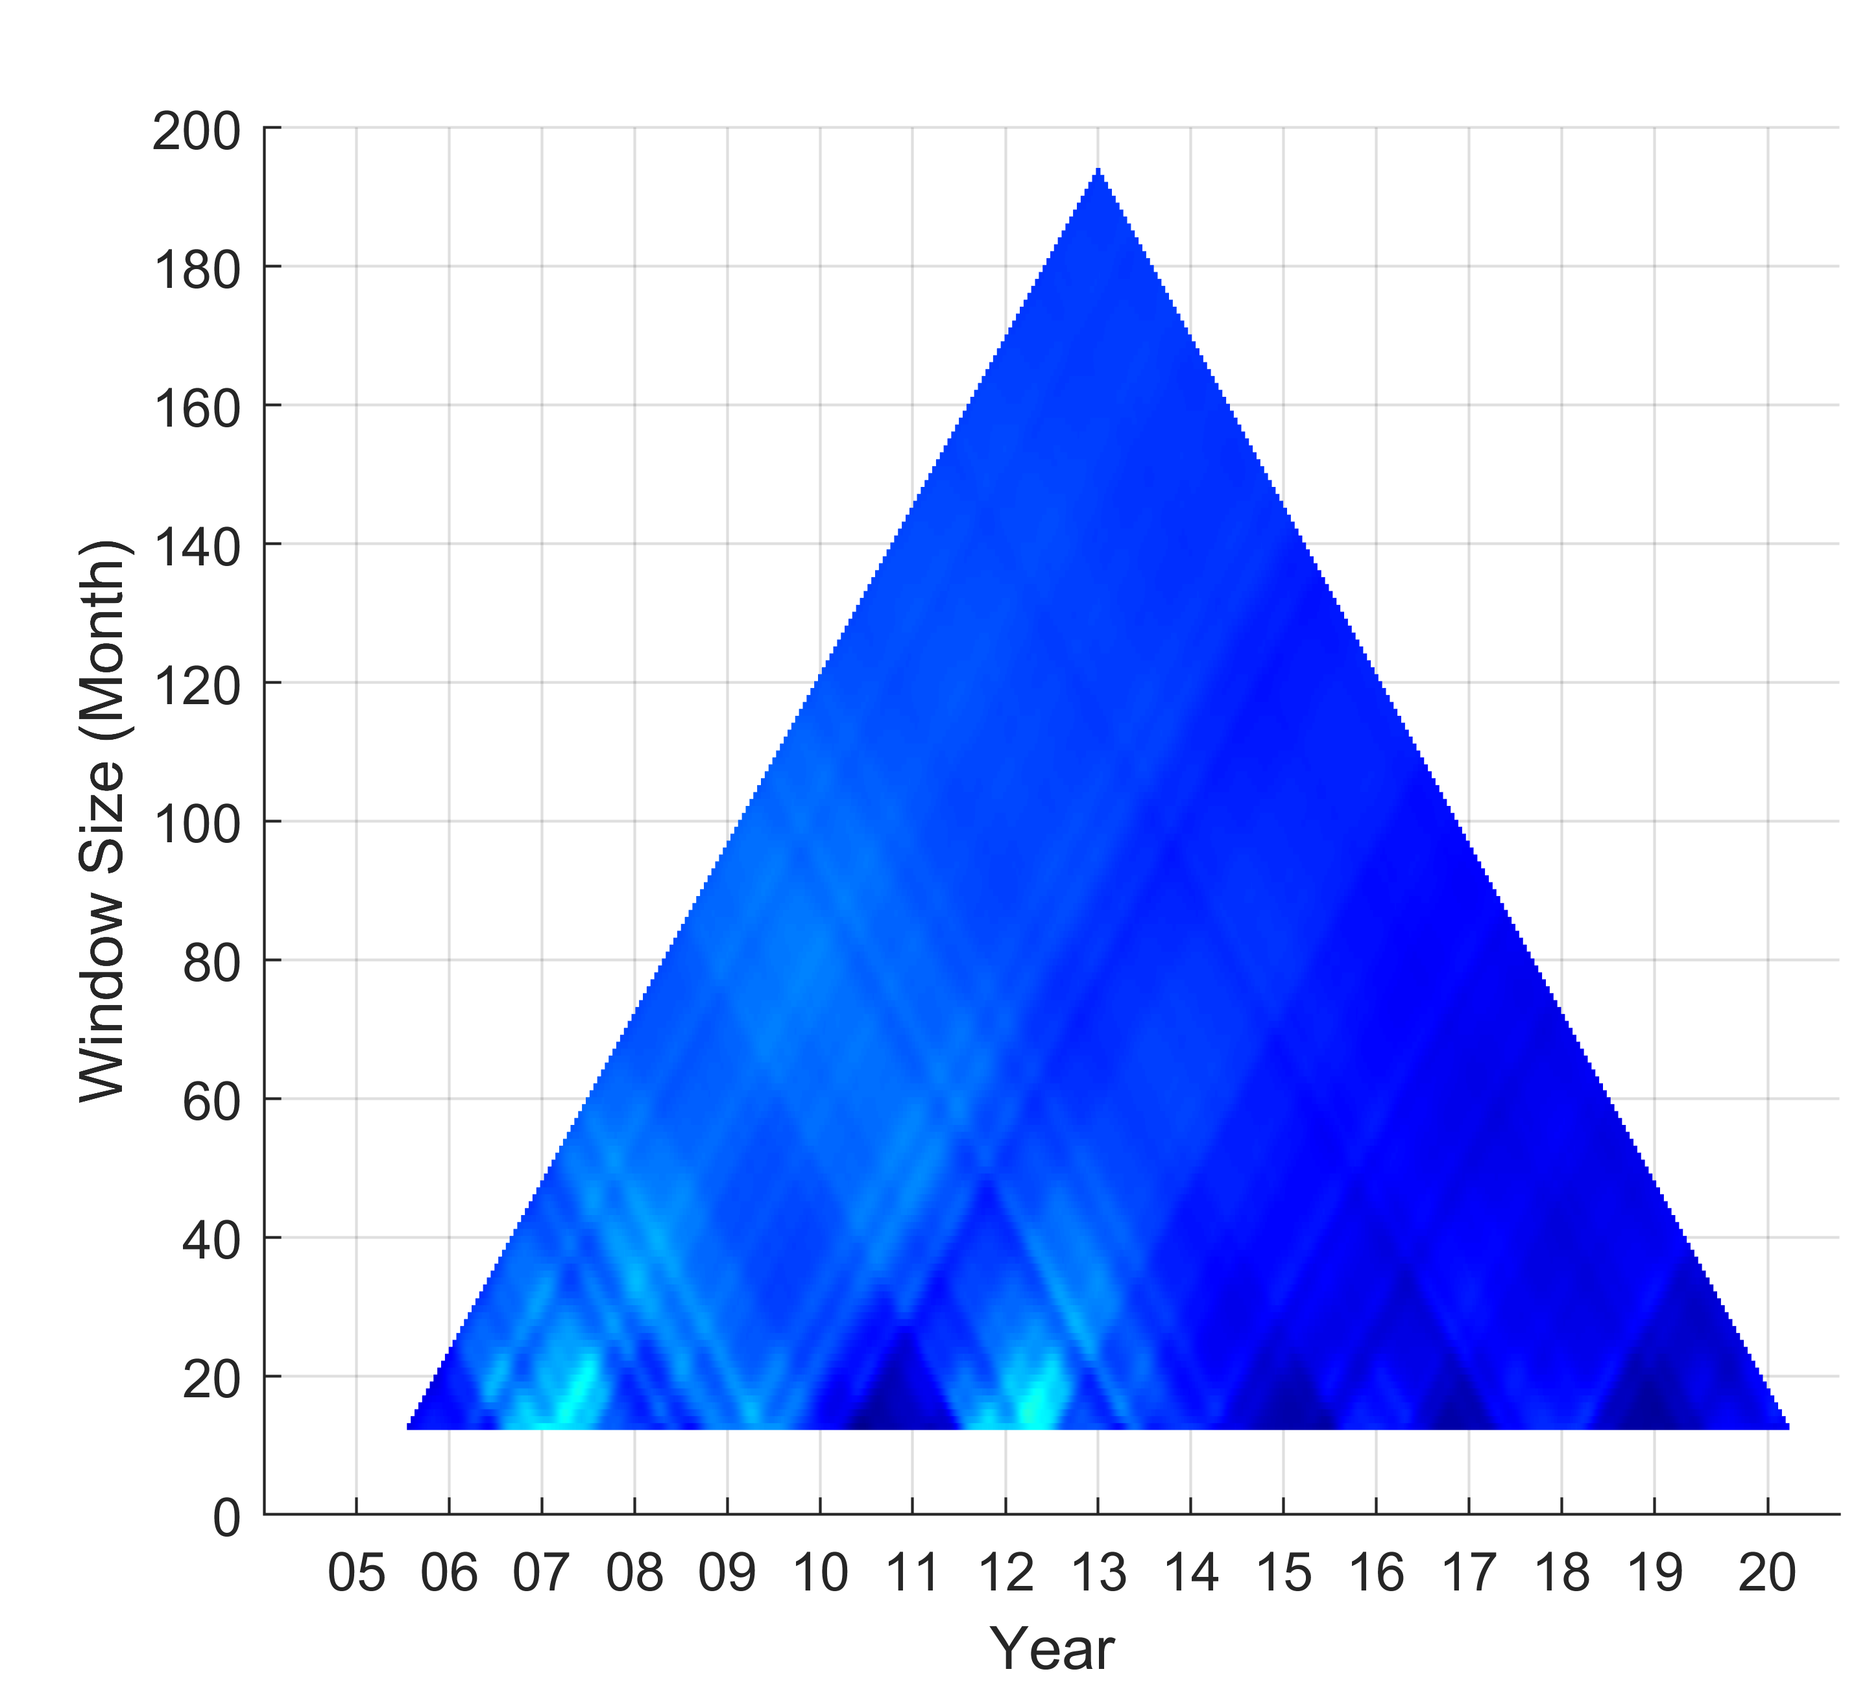
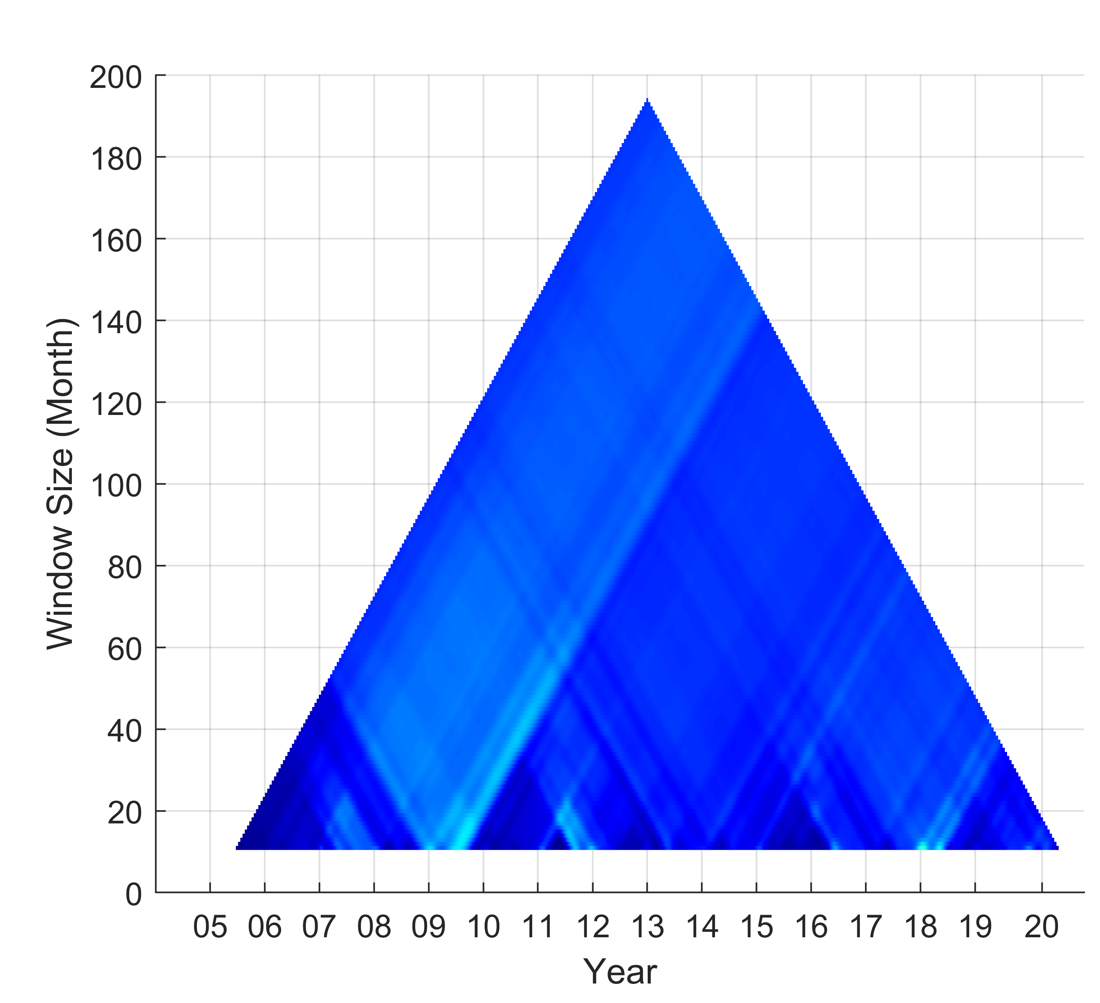
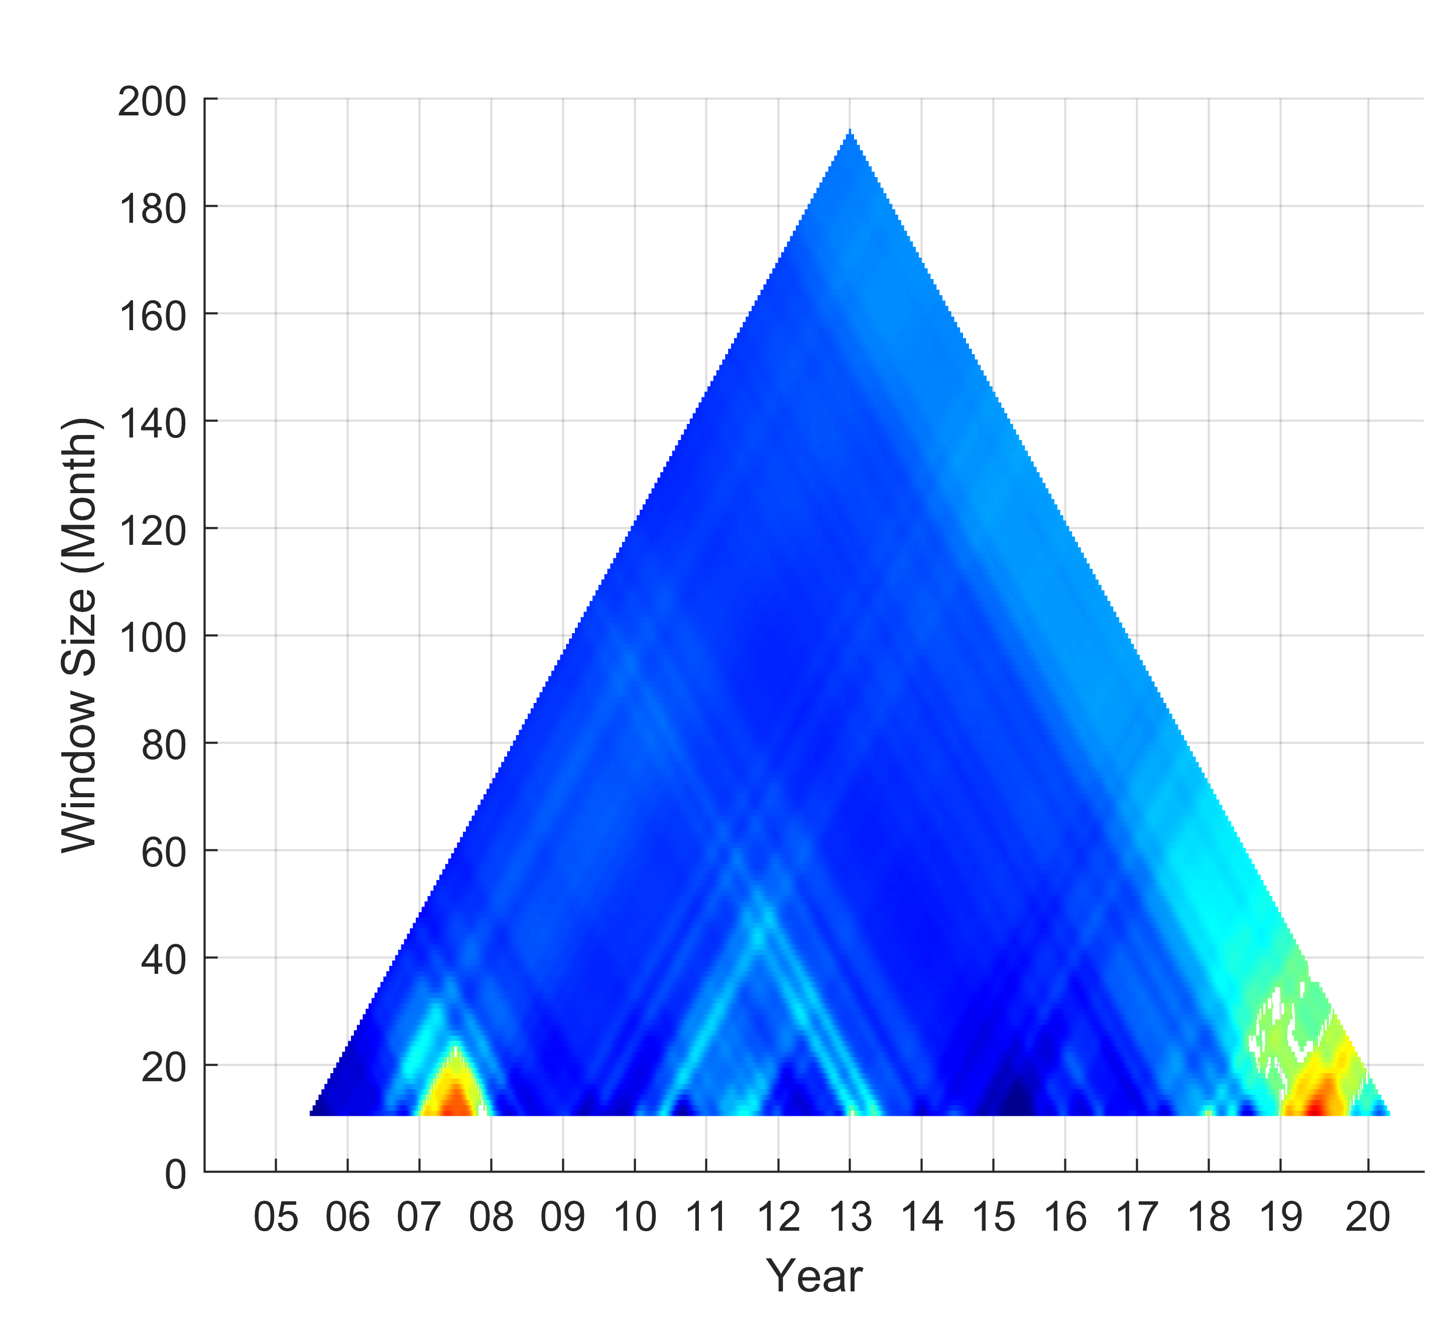
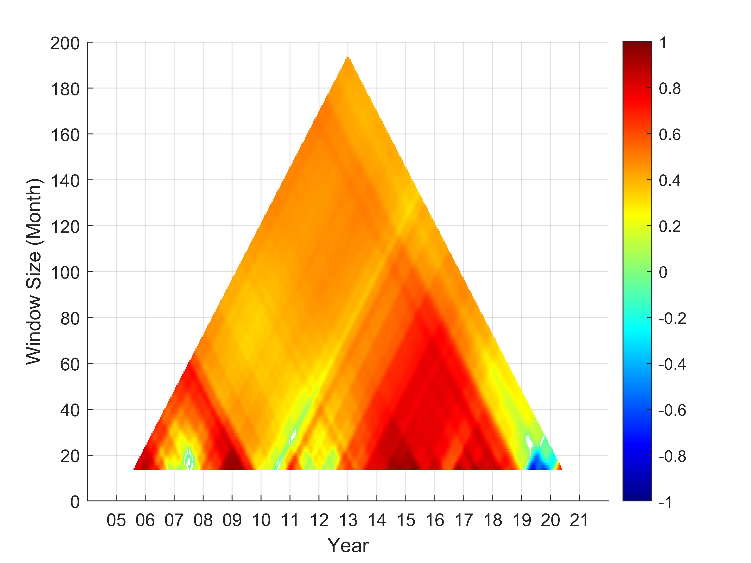
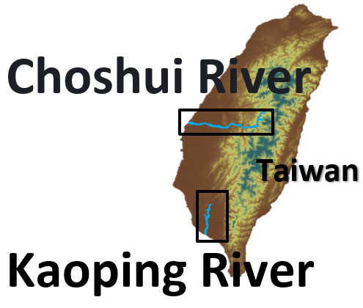
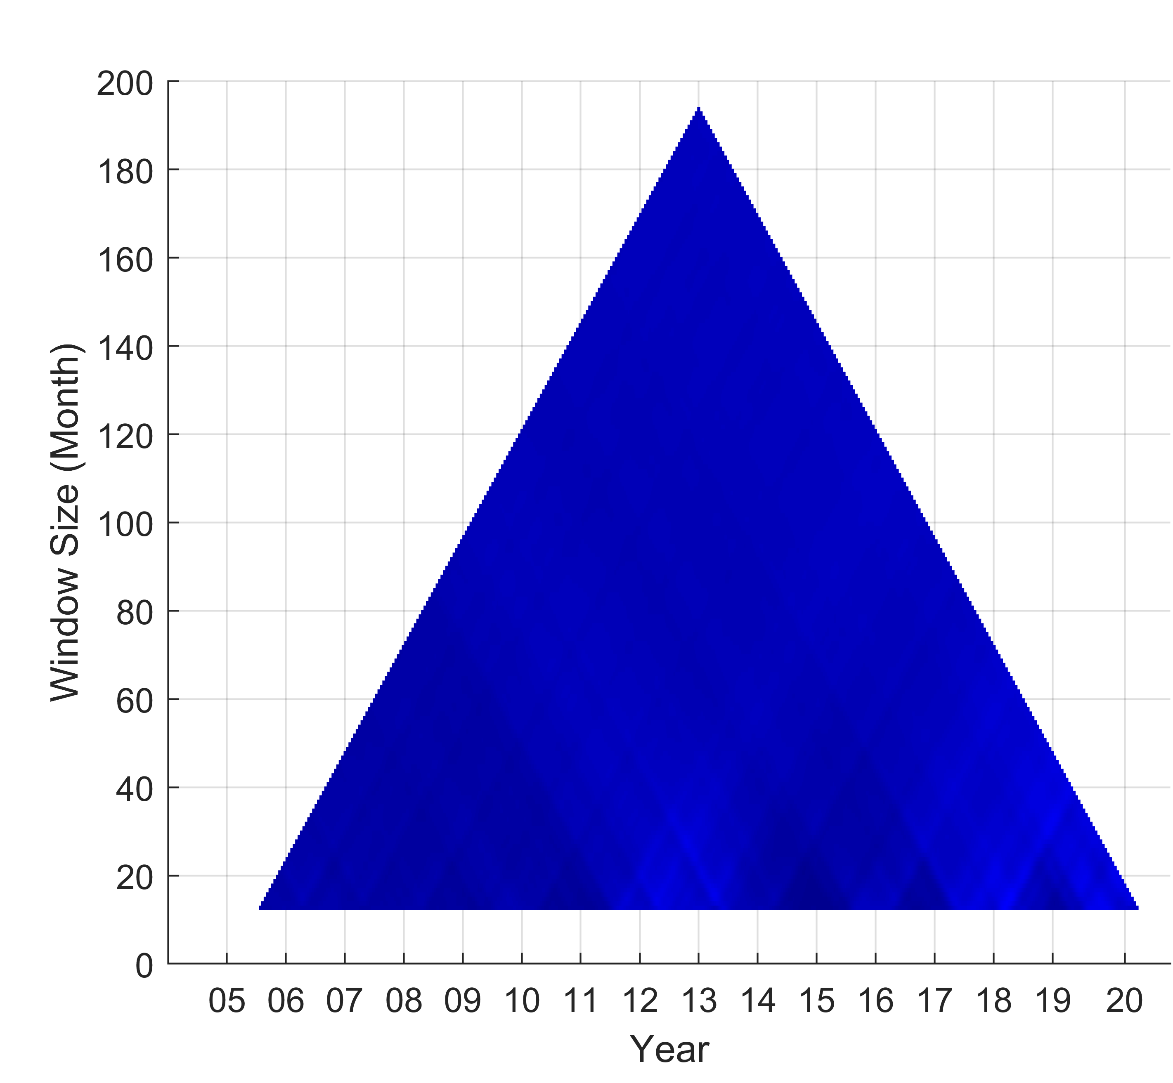
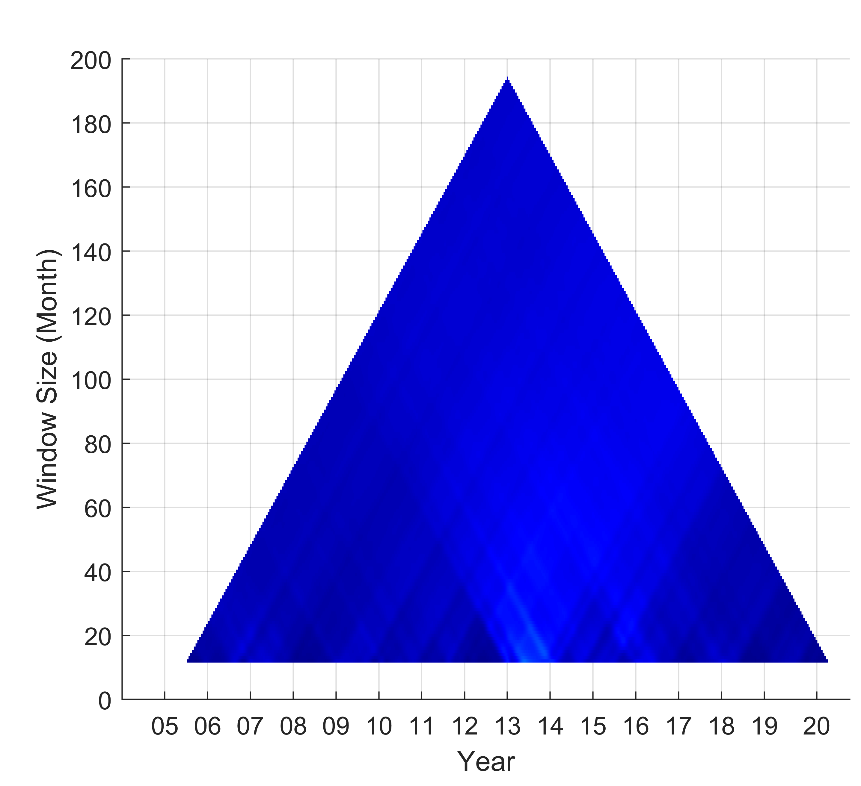
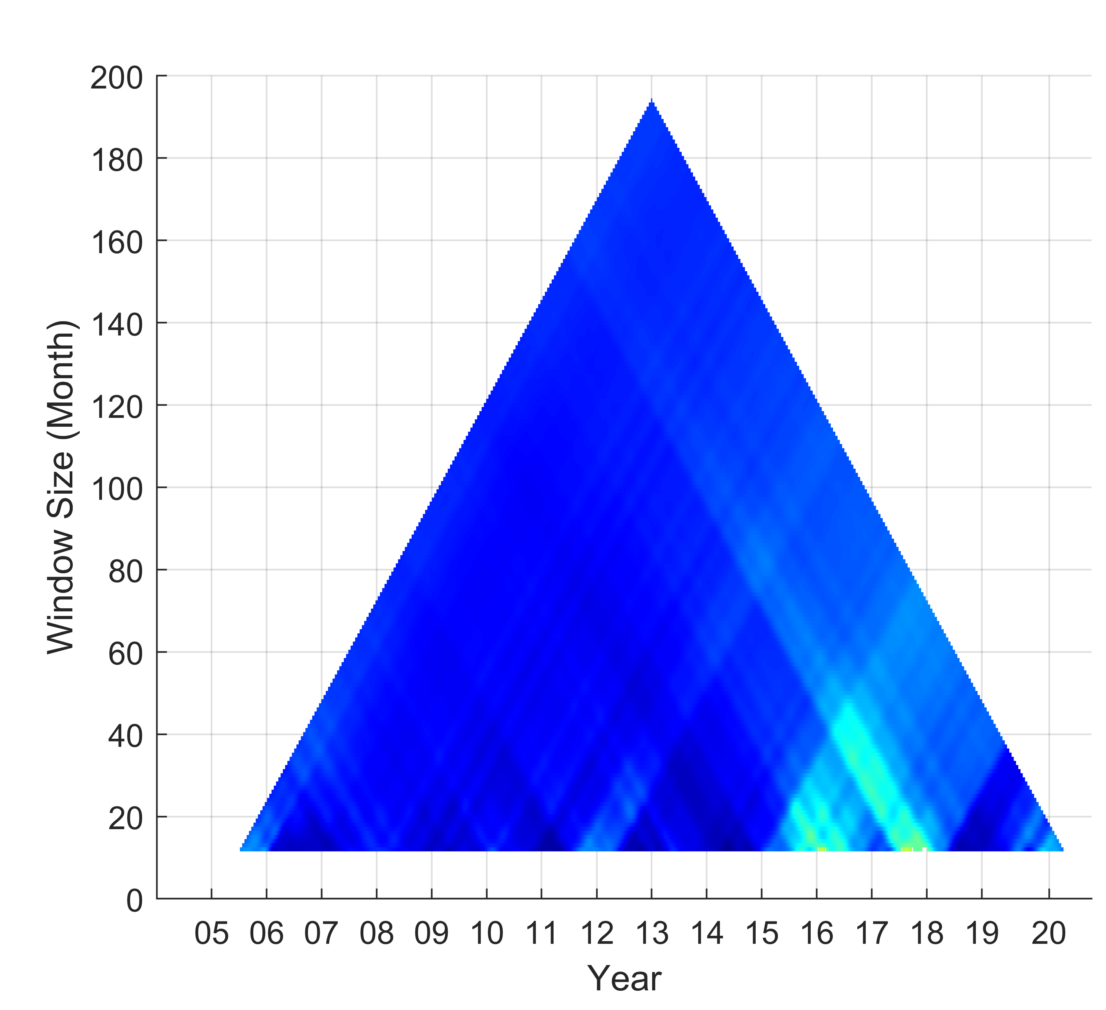
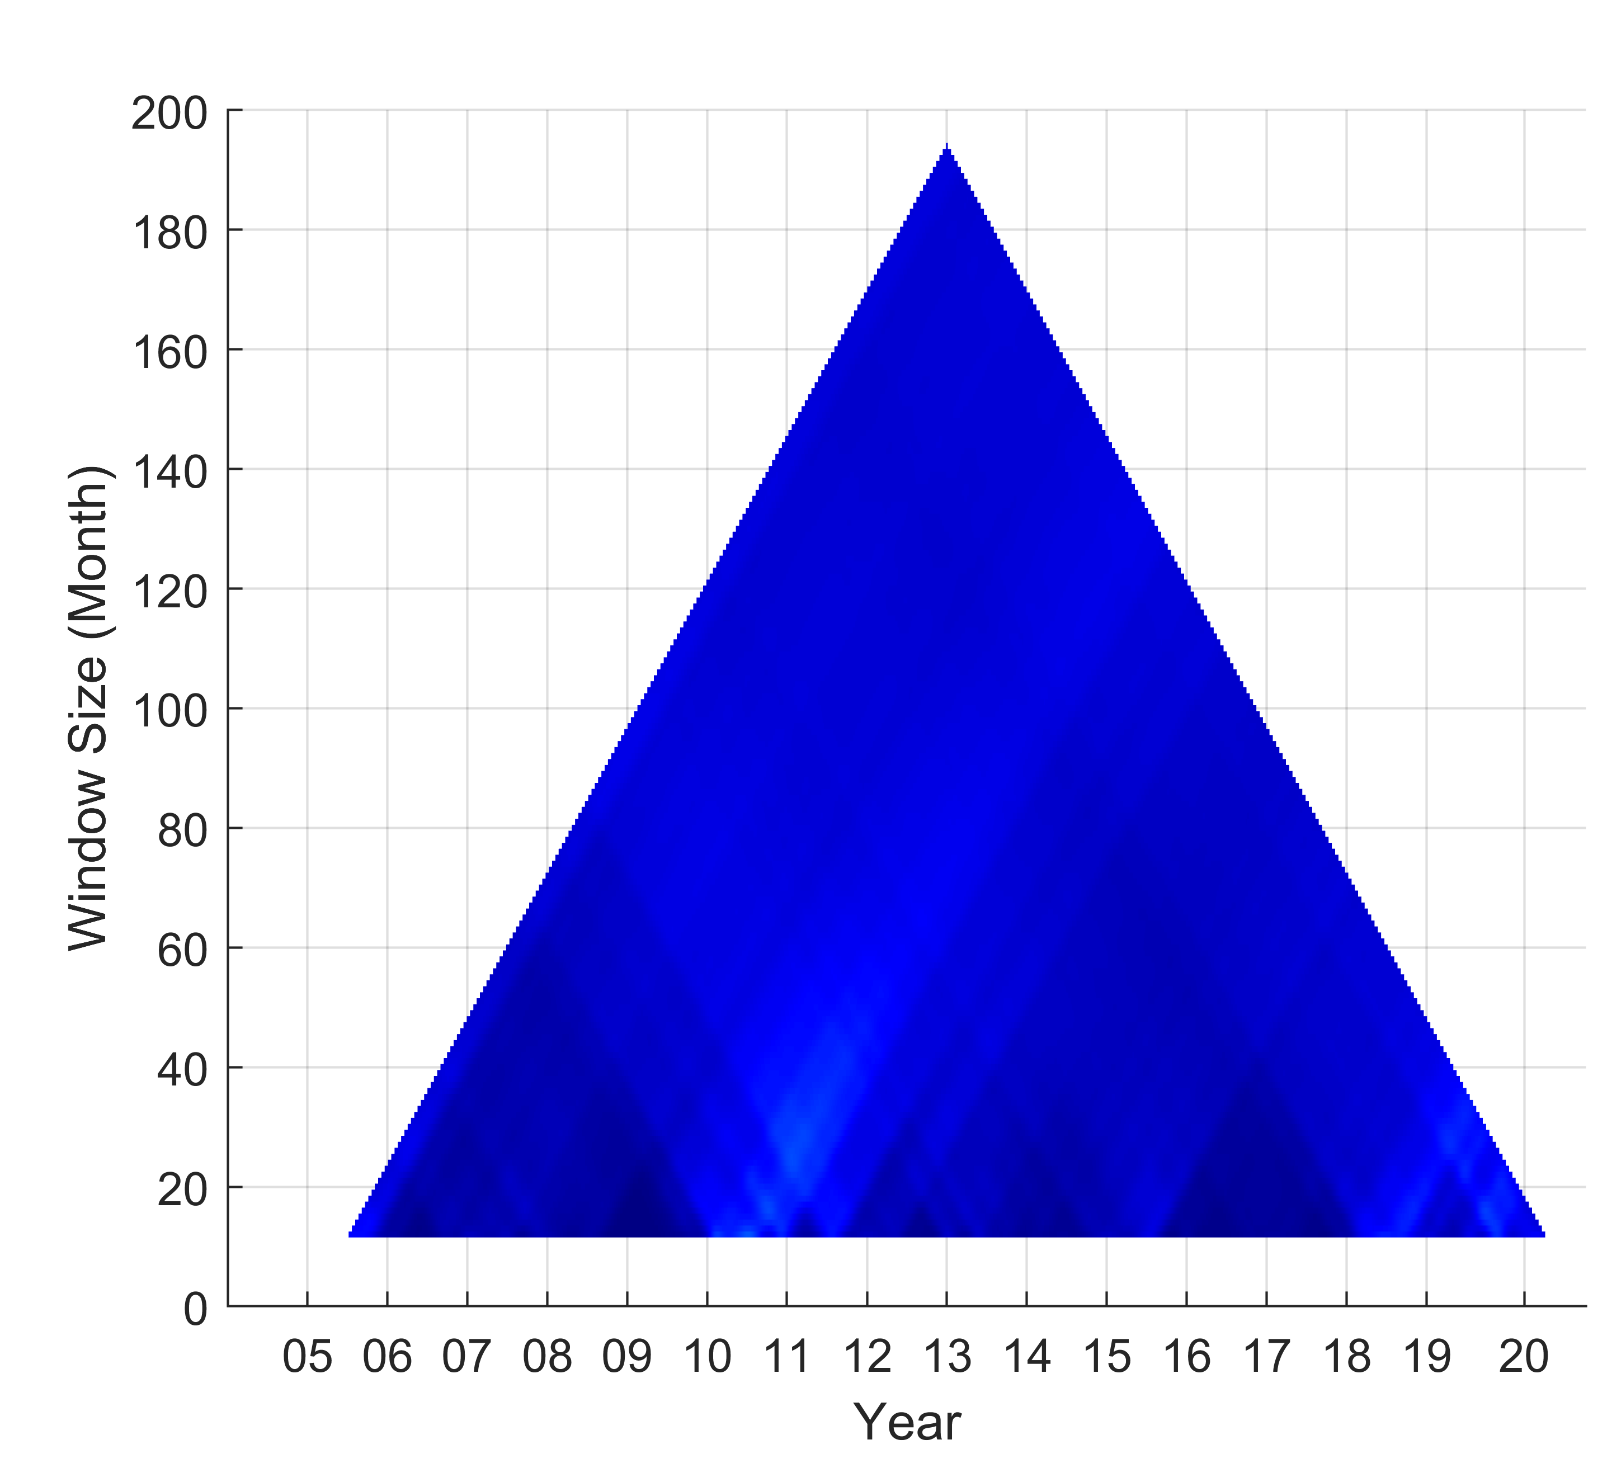
Correlation of PM10 with hydro-meteorological factors
TDICs at annual scale
Temperature
Precipitation
Humidity
Wind speed
Dispersion and dilution effect
Wet deposition
Dispersion effect
16
Introduction / Methodology / Results / Conclusions and Ongoing works
Notes:
First, TDIC results at annual time scale
Almost all the figure are shown the negative correlation Except for wind speed.
When temperature increased, PM10 concentrations may have strong dispersion and di lution effect.
And the precipitation and humidity may contribute the wet deposition of PM10
Specially, because Choshui river have sufficient river sedimentation in the downstream, the correlation tends to be positive.
However, in Kaoping river, wind speed may related to the dispersion effect.

Slide 17
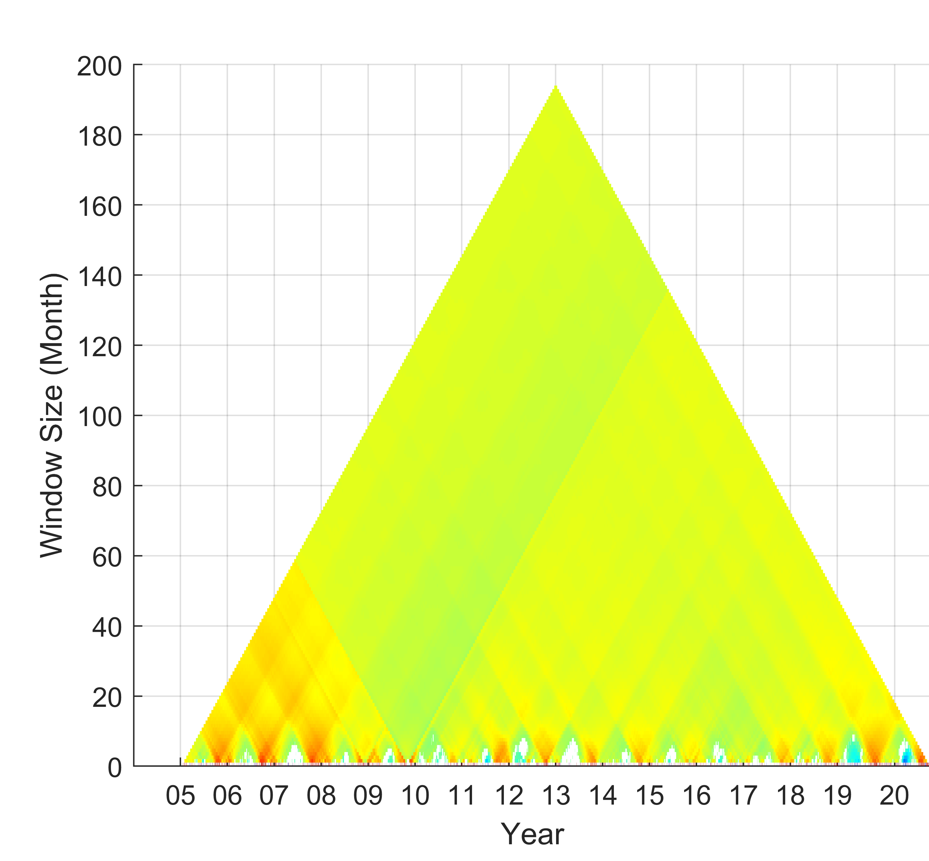
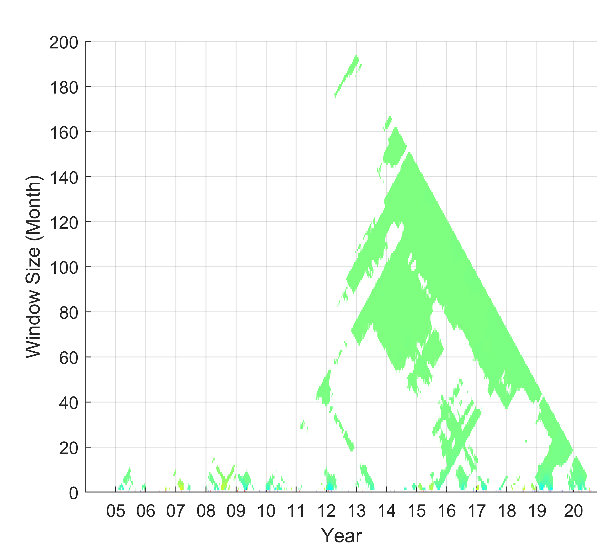
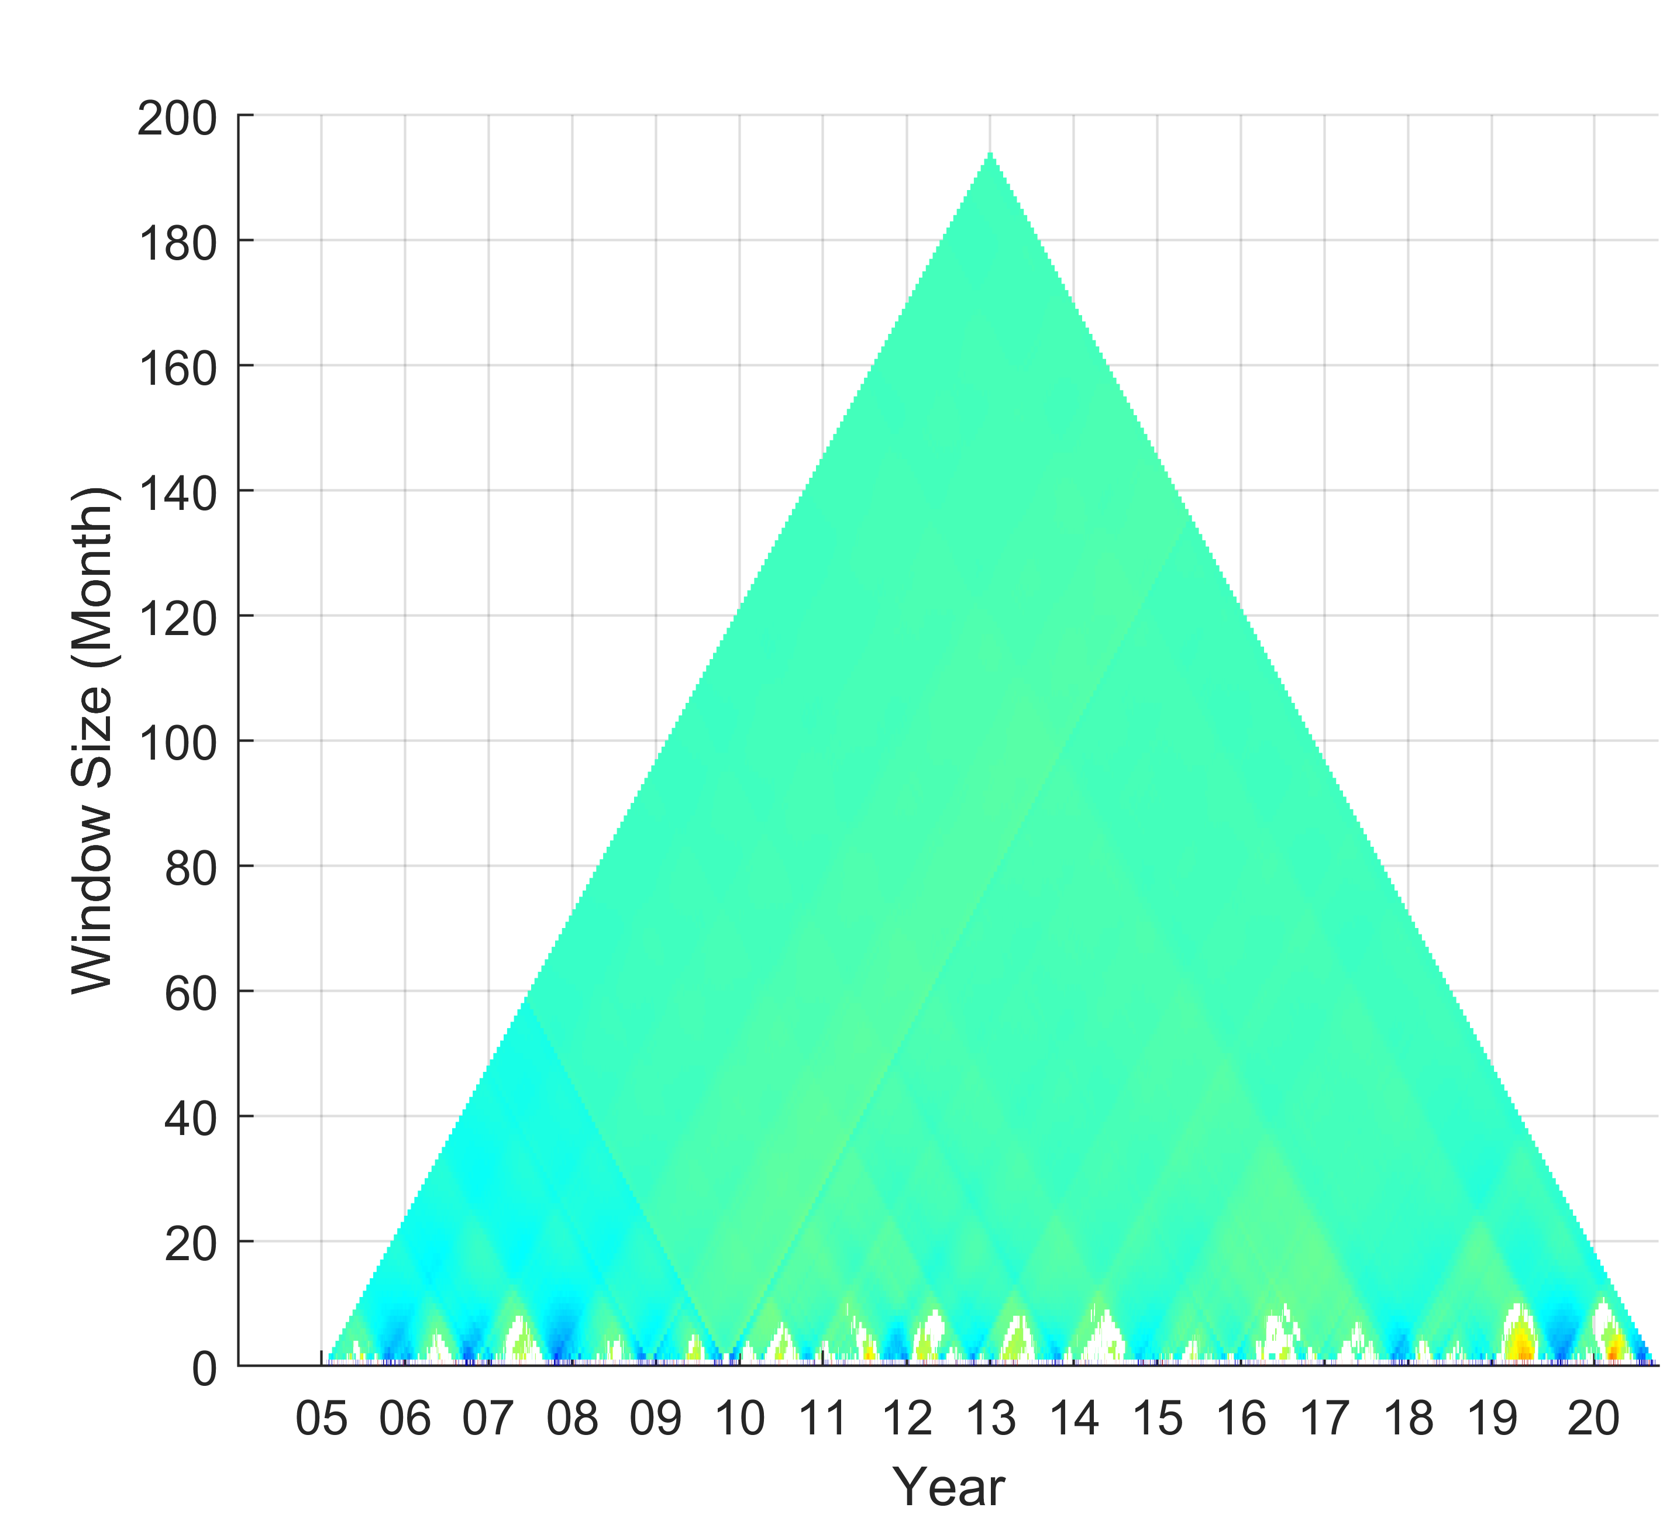
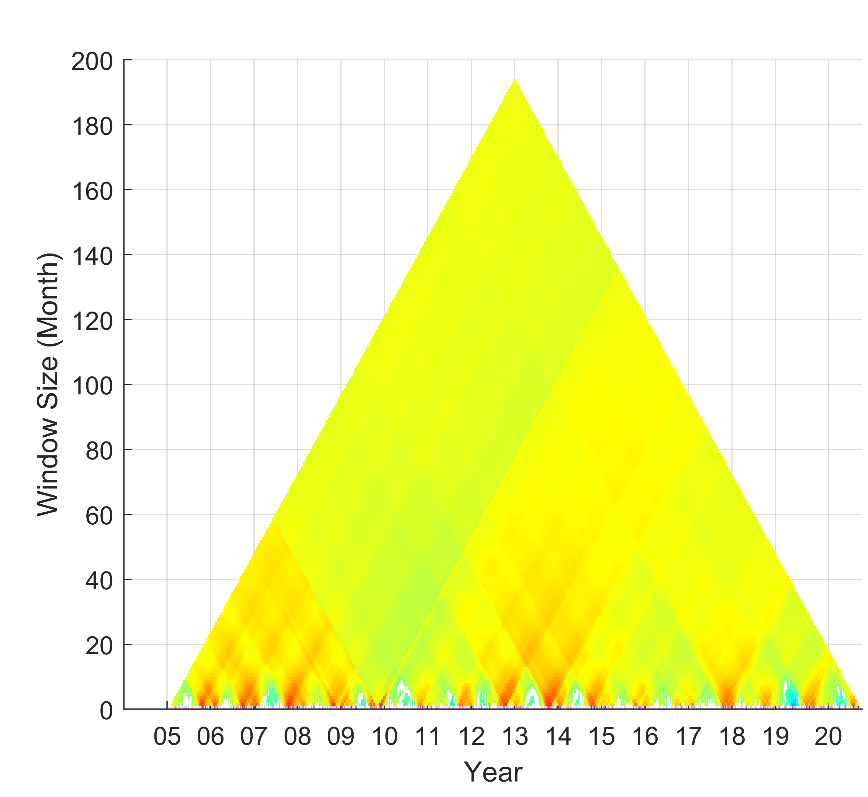
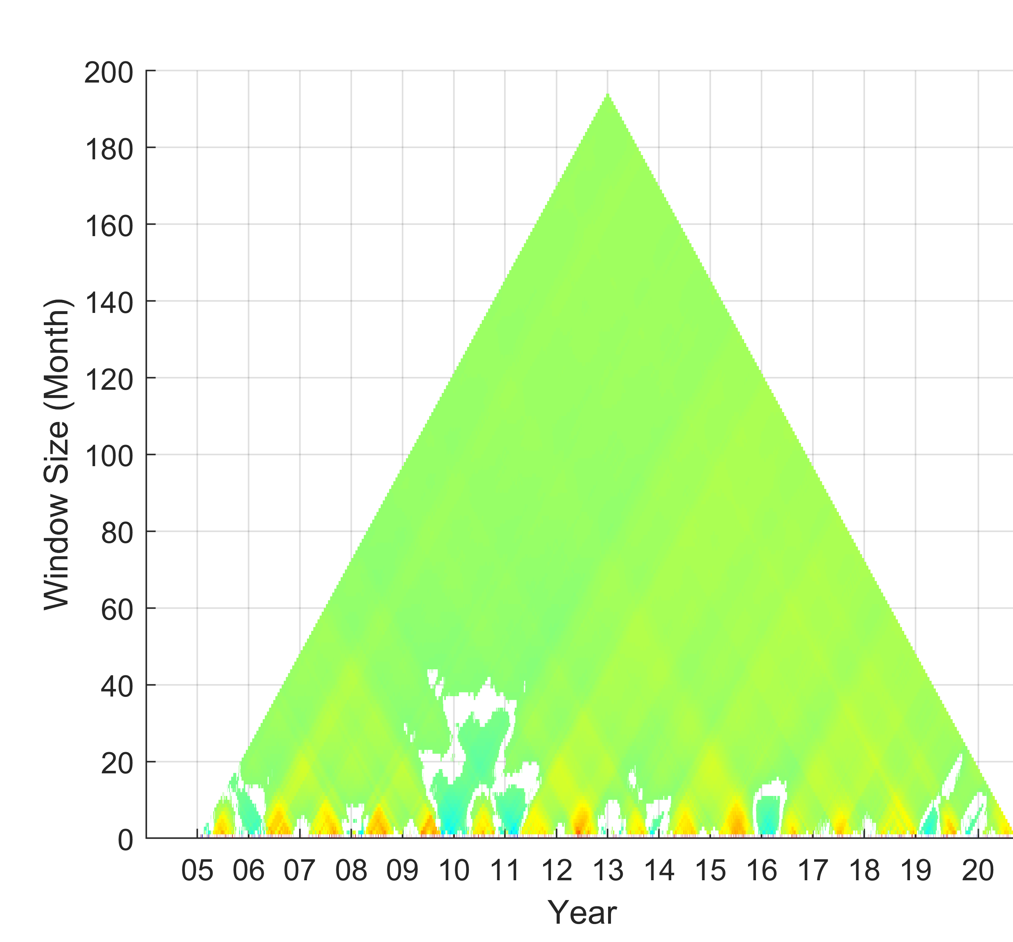
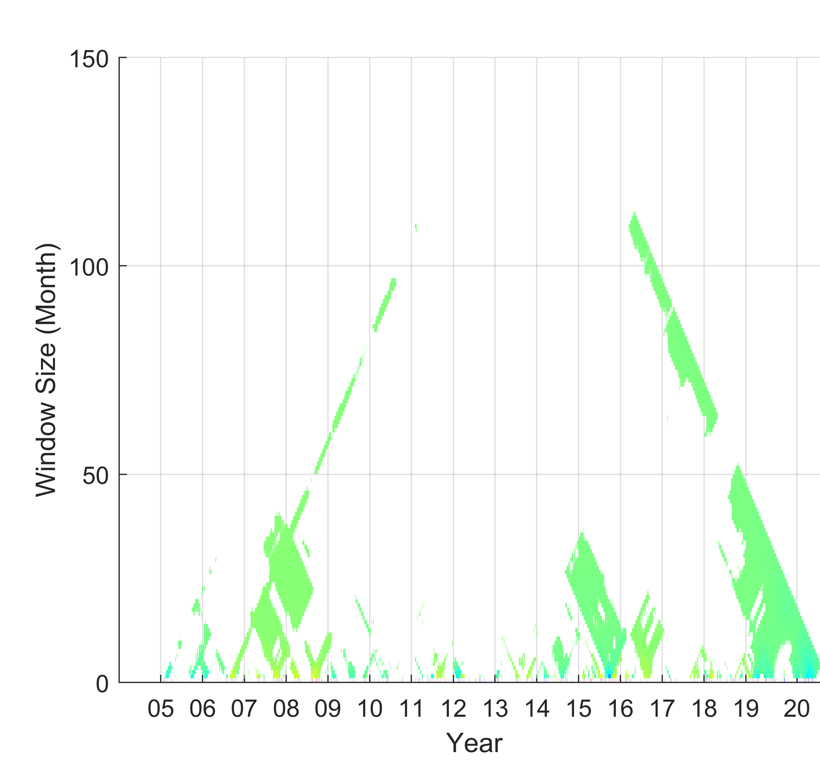
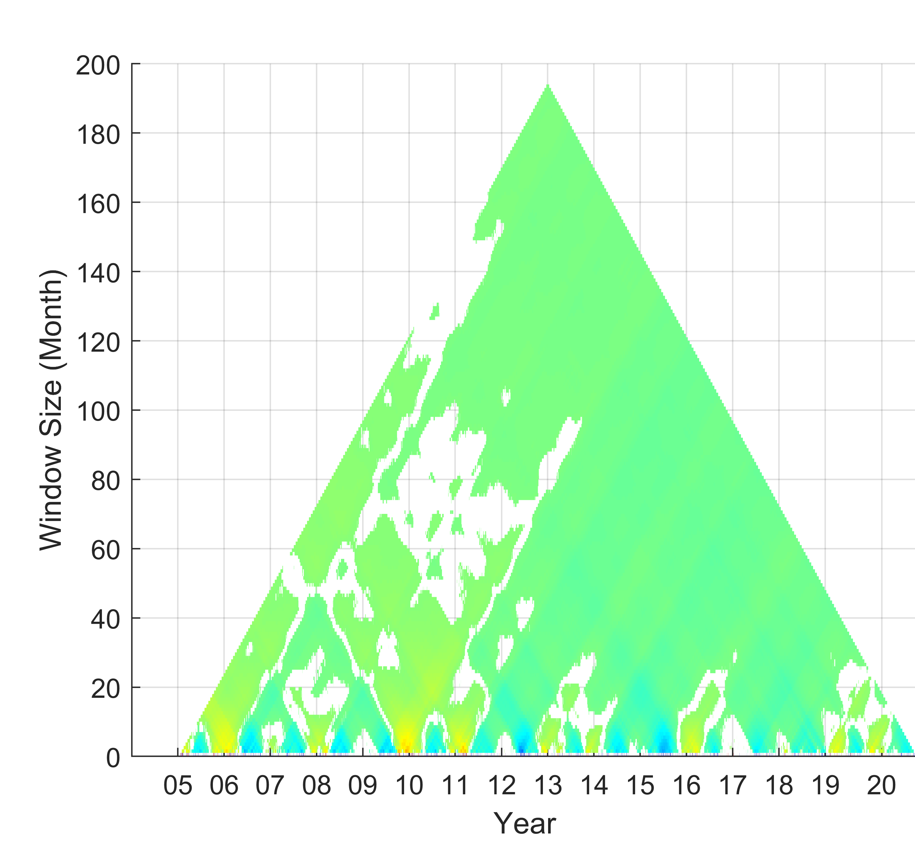
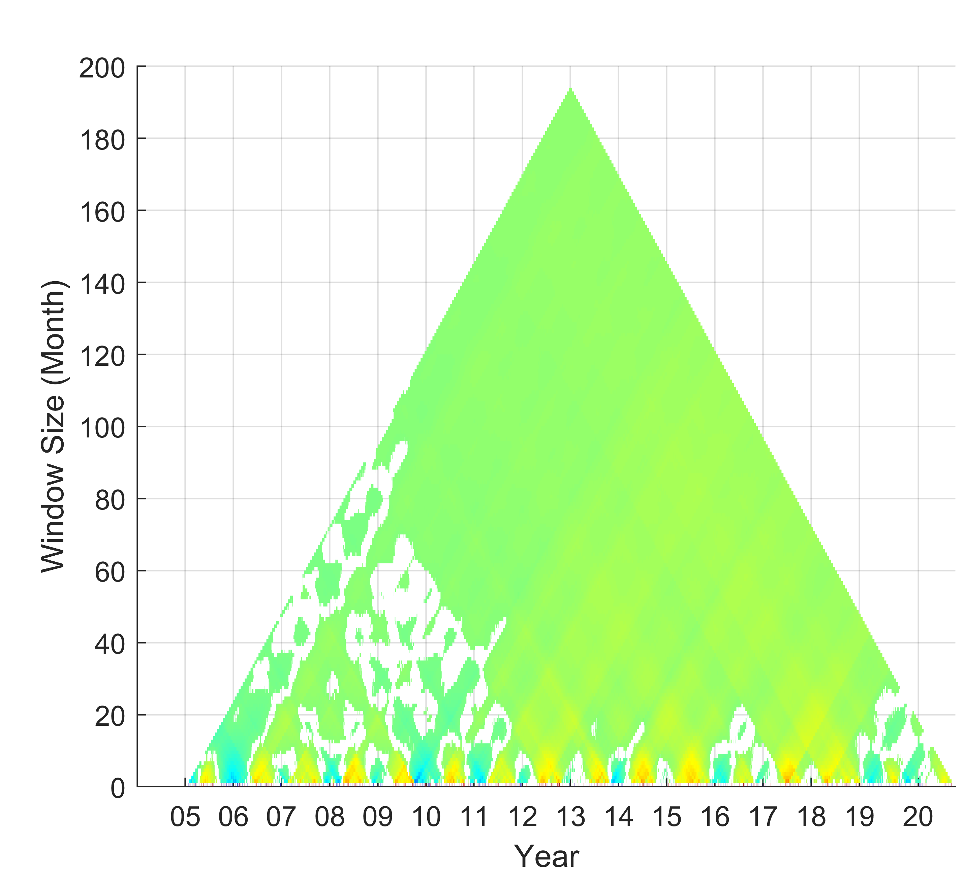
Correlation of PM10 with hydro-meteorological factors
TDIC at diurnal scale
Temperature
Precipitation
Humidity
Wind speed
Seasonal switchover
17
Introduction / Methodology / Results / Conclusions and Ongoing works
Notes:
Next, the TDIC results at diurnal scale
The seasonal switchover can be observed among PM10 and relevant hydro-meteorological factors.
The positive correlation shows in these figures that are corresponded to the season of river dust events in each rivers.
And, The precipitation and humidity are shown the weak correlation and even correlations do not pass the student t-test
because the rainfall event are usually slightly and short in Taiwan,
.

Slide 18
04.
Conclusions
and ongoing works
19

Slide 19
Conclusions and Ongoing Works
Conclusions:
A state-of-the-art algorithm, ICEEMDAN method, is introduced to process the nonlinear and nonstationary hydro-meteorological time series in this research .
After the decomposition by ICEEMDAN, the characteristic time scales of PM10 and hydro-meteorological factors can be identified and the trend of PM10 can be determined for the Choushui and the Kaoping river.
By works of TDIC, the correlation among PM10 and hydro-meteorological factors can be explored in the central and southern Taiwan rivers.
20
Introduction / Methodology / Results / Conclusions and Ongoing works
Notes:
A state of the art algorithm, ICEEMDAN method, is introduced to process the nonlinear and nonstationary time series in this research .
After the decomposition by ICEEMDAN, the characteristic time scales of PM10 and hydro-meteorological factors can be identified and the trend of PM10 can be determined in the Choshui and the Kaoping river.
By works of TDIC, the correlation among PM10 and hydro-meteorological factors can be explored in the central and southern Taiwan rivers.

Slide 20


Conclusions and Ongoing Works
Ongoing Works:
1. We are going to explore the impact of intensity and duration of droughts on the river dusts events and PM10 concentrations.
https://www.turnto23.com/news/california-drought/in-drought-ravaged-california-water-use-is-up-dramatically
DROUGHT
RESPIRATORY DISEASE
2. We are going to unravel the relationship and time lag between the clinic visits of respiratory disease and PM10 concentrations during river dust events.
https://m.theindependentbd.com/magazine/details/148863/Asthma:-Chronic-respiratory-disease
21
Introduction / Methodology / Results / Conclusions and Ongoing works
Notes:
We are going to explore the impact of intensity and duration of droughts on the river dust events and pm10 .
Next, we are going to unravel the relationship and time lag between the clinic visits of respiratory disease and PM10 concentrations during river dust events.

Slide 21
Conference presentation
Chen, C.-K. and Tsai, C. W. (2022): Spatial-Temporal Characterization of Aeolian River Dust in Central and Southern Taiwan Rivers based on Improved Complete Ensemble Empirical Mode Decomposition with Adaptive Noise, 2022 Soil Hydrology and Water Resources Management Modeling Summit, Taichung, Taiwan, 19-20 March 2022.
Journal paper
Lin, M. L., Tsai, C. W., & Chen, C. K. (2021). Daily maximum temperature forecasting in changing climate using a hybrid of Multi-dimensional Complementary Ensemble Empirical Mode Decomposition and Radial Basis Function Neural Network. Journal of Hydrology: Regional Studies, 38, 100923.
Thank you for your attention !
22

Slide 22

Comparable Table:
 | Choushui river | Kaoping river
Geographic location | Central Taiwan | Southern Taiwan
Climate | Subtropical climate | Tropical climate
Prevailing season of river dust events | Northeast monsoon (winter) | Northwest monsoon (winter) & Typhoon season (summer)
Source of river dust | Bare riverbeds in the downstream | Bare riverbeds in the downstream & river sedimentation bring by the typhoon from the upstream
Taipei
Hsinchu
Choshui River
Hualien
Tropic of Cancer
(23.5$°N$)
Taiwan
Taitung
Kaoping River

Slide 23
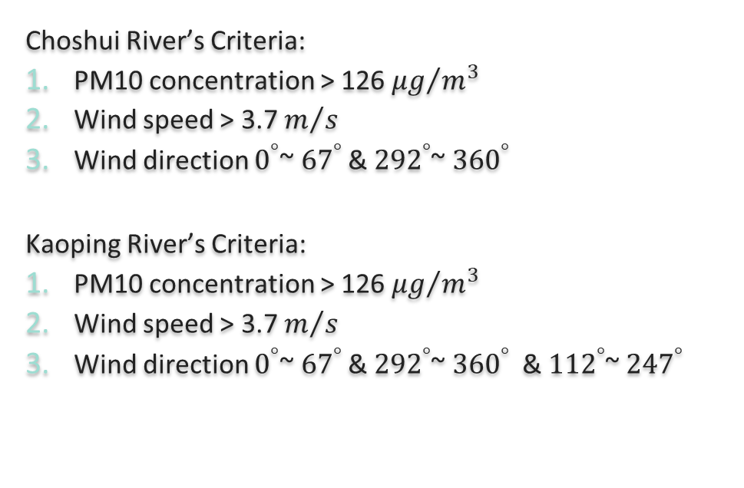
Definition of river dust events
Choshui River’s Criteria:
PM10 concentration > 126${μg}/{m^{3}}$
Wind speed > 3.7 $m/s$
Wind direction $0^{°}$~ ${67}^{°}$ & ${292}^{°}$~ ${360}^{°}$
Kaoping River’s Criteria:
PM10 concentration > 126${μg}/{m^{3}}$
Wind speed > 3.7 $m/s$
Wind direction $0^{°}$~ ${67}^{°}$ & ${292}^{°}$~ ${360}^{°}$ & ${112}^{°}$~ ${247}^{°}$
Taipei
Hsinchu
Choshui River
North Wind System
Hualien
(Taiwan EPA)
Taiwan
Taitung
Kaoping River
North Wind System
Southern Wind System
9
Introduction / Methodology / Results / Conclusions and Ongoing works
Notes:
Next is the definition of river dust events in this research.
There are some different in criteria of wind direction in two rivers.
Because river dust events may caused by northeast monsoon in either choshui and Kaoping river in winter.
However, due to geographic location, southeast monsoon only affected Kaoping river in summer during the typhoon season.

Slide 24
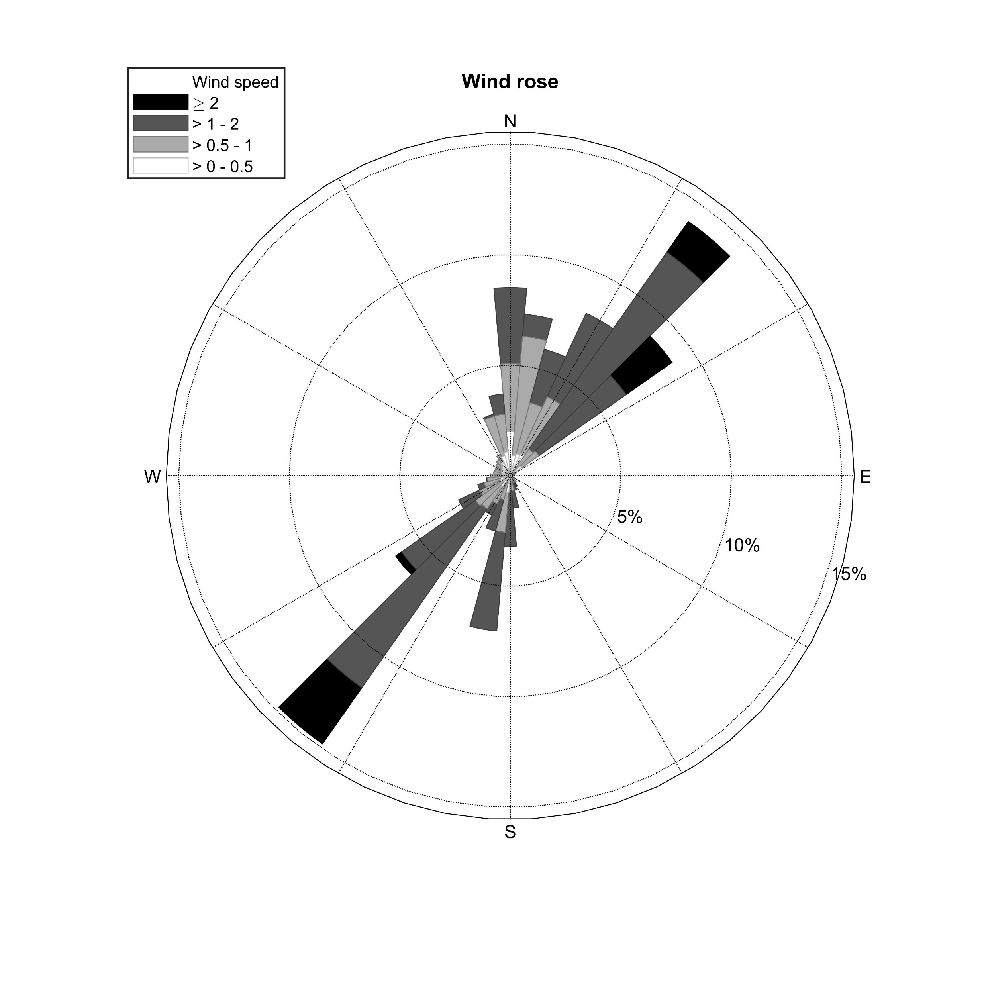
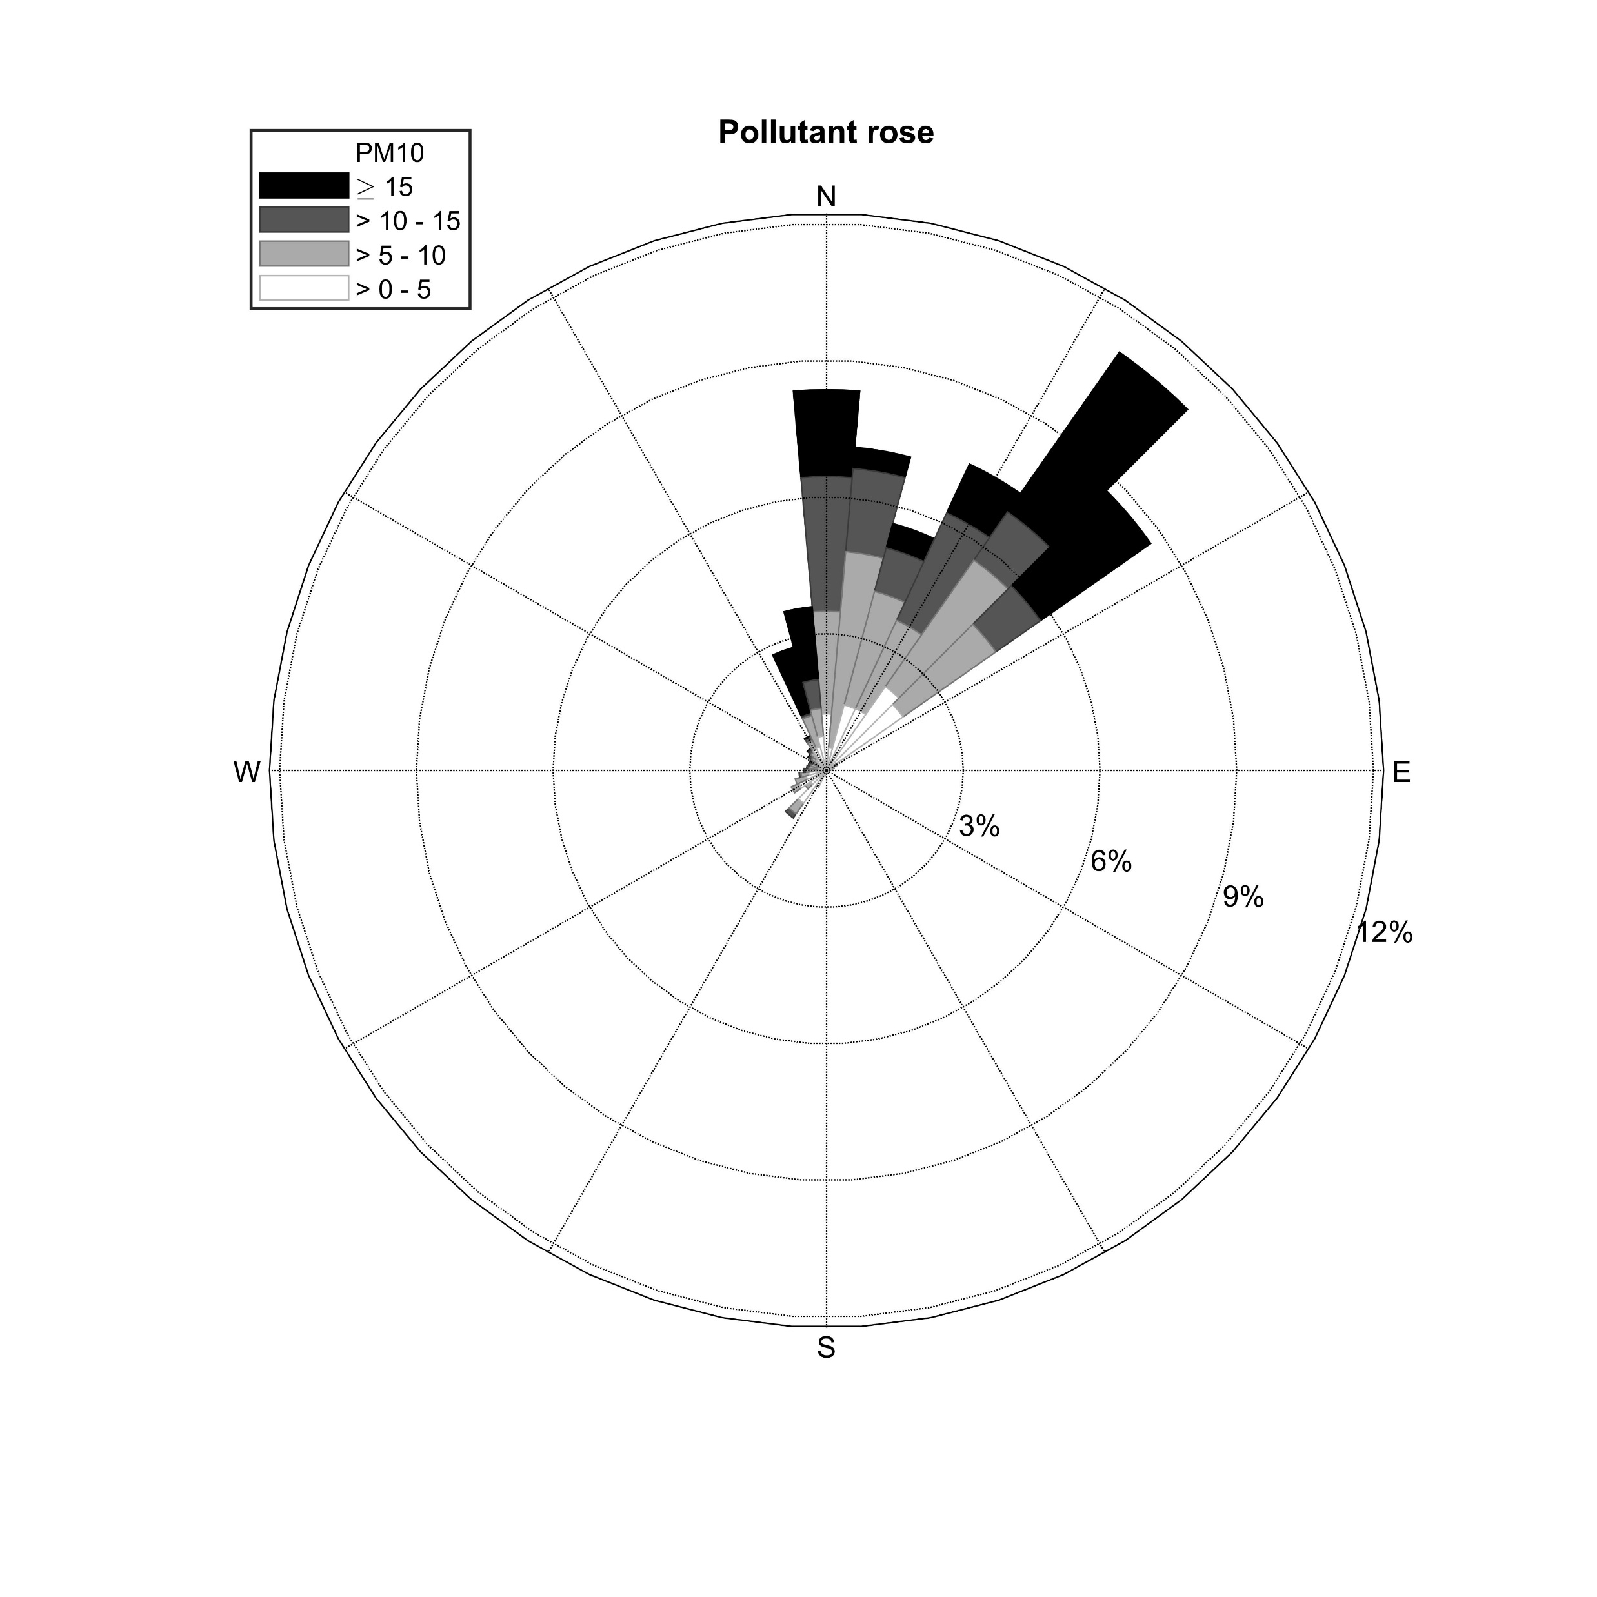
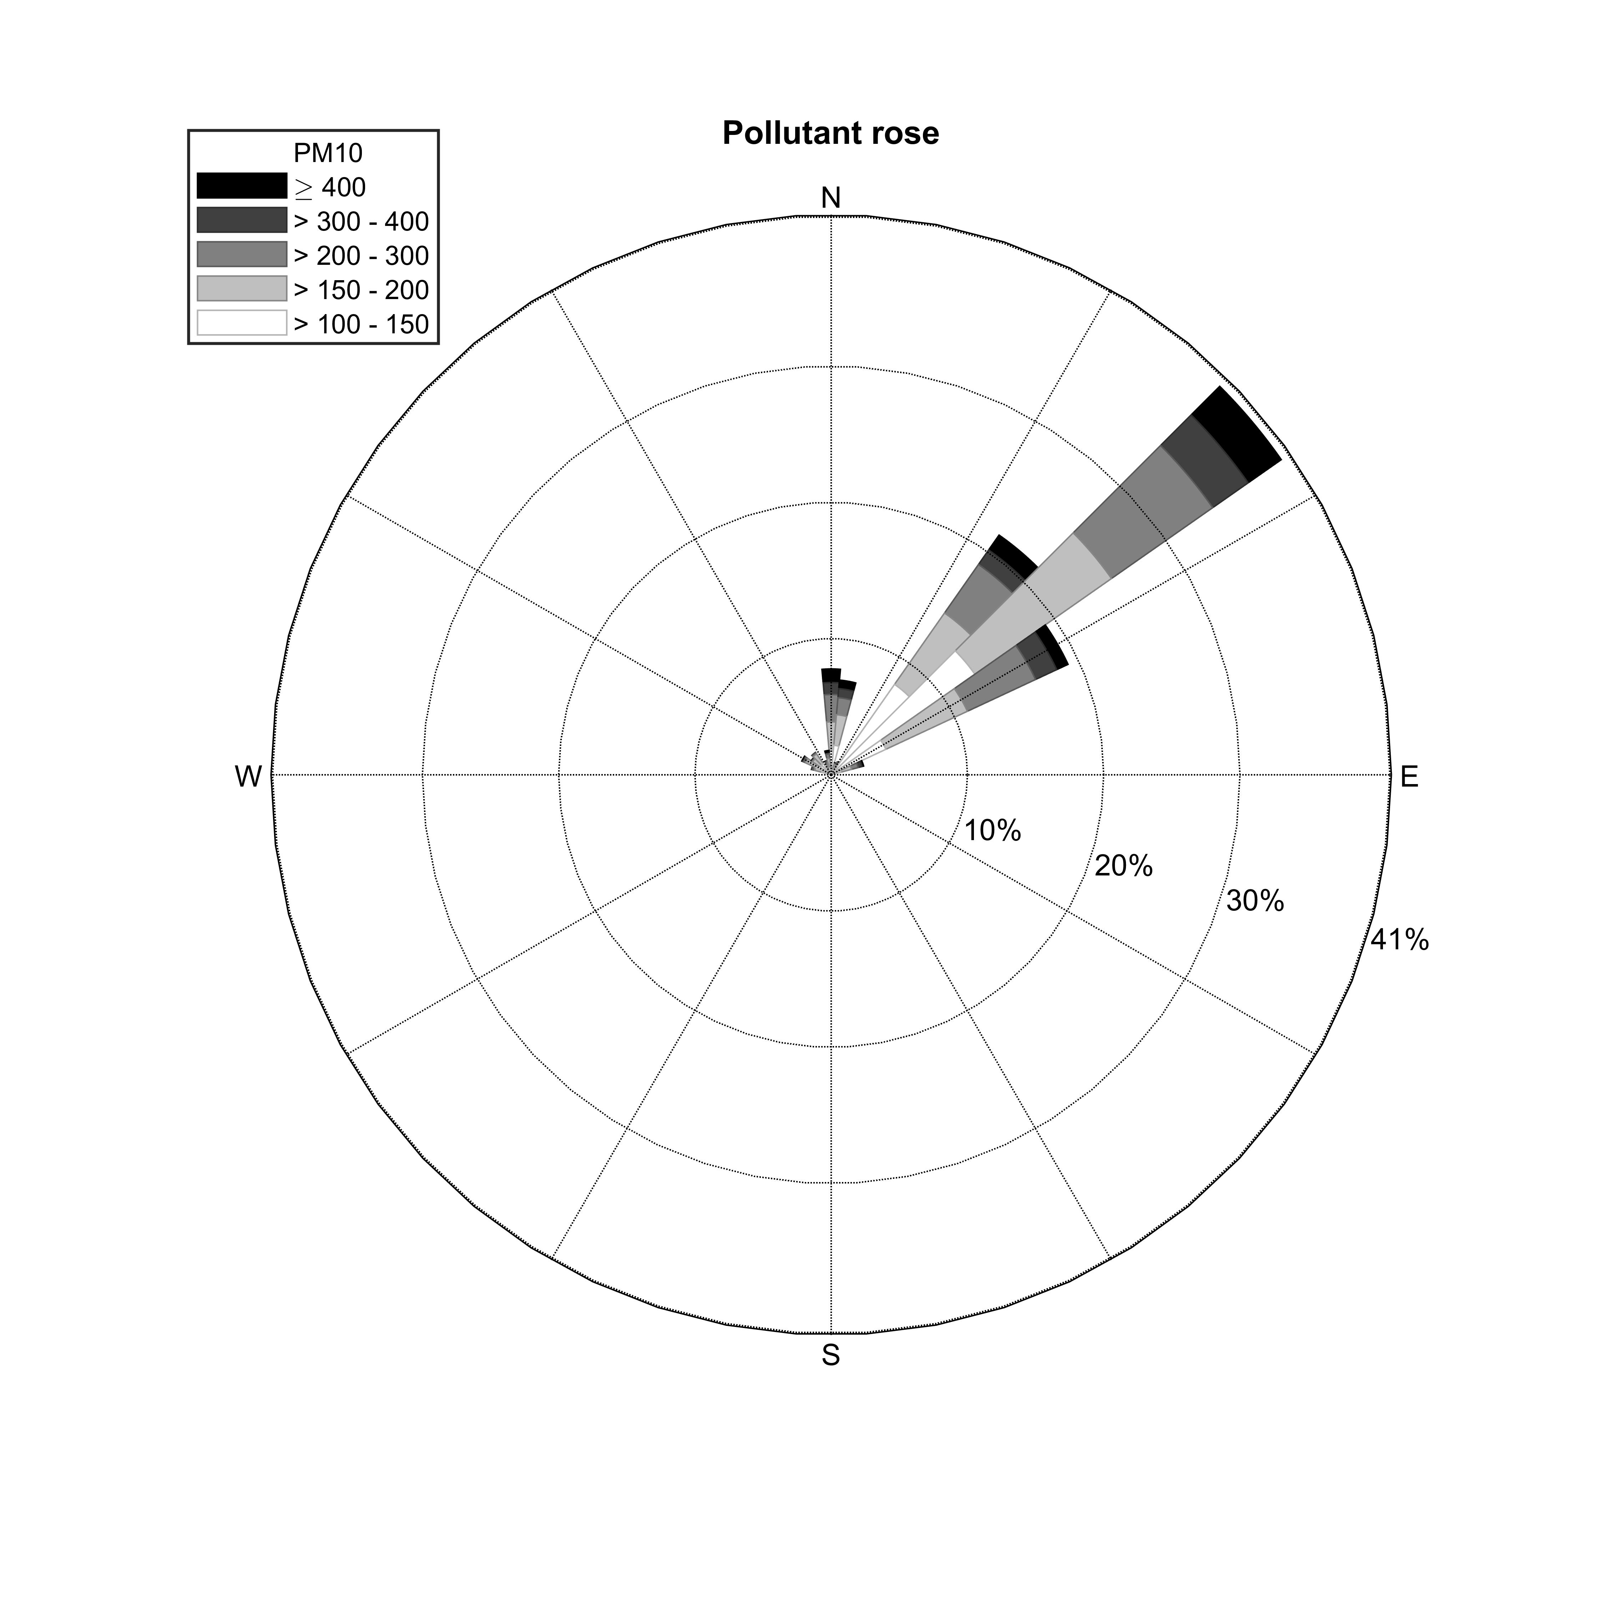


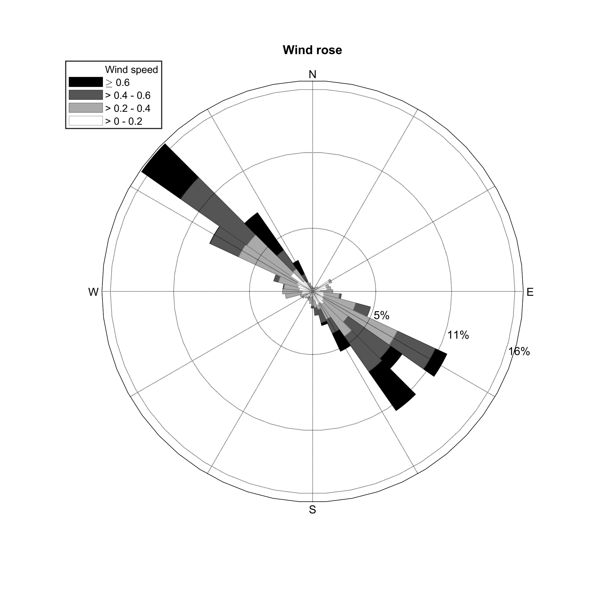
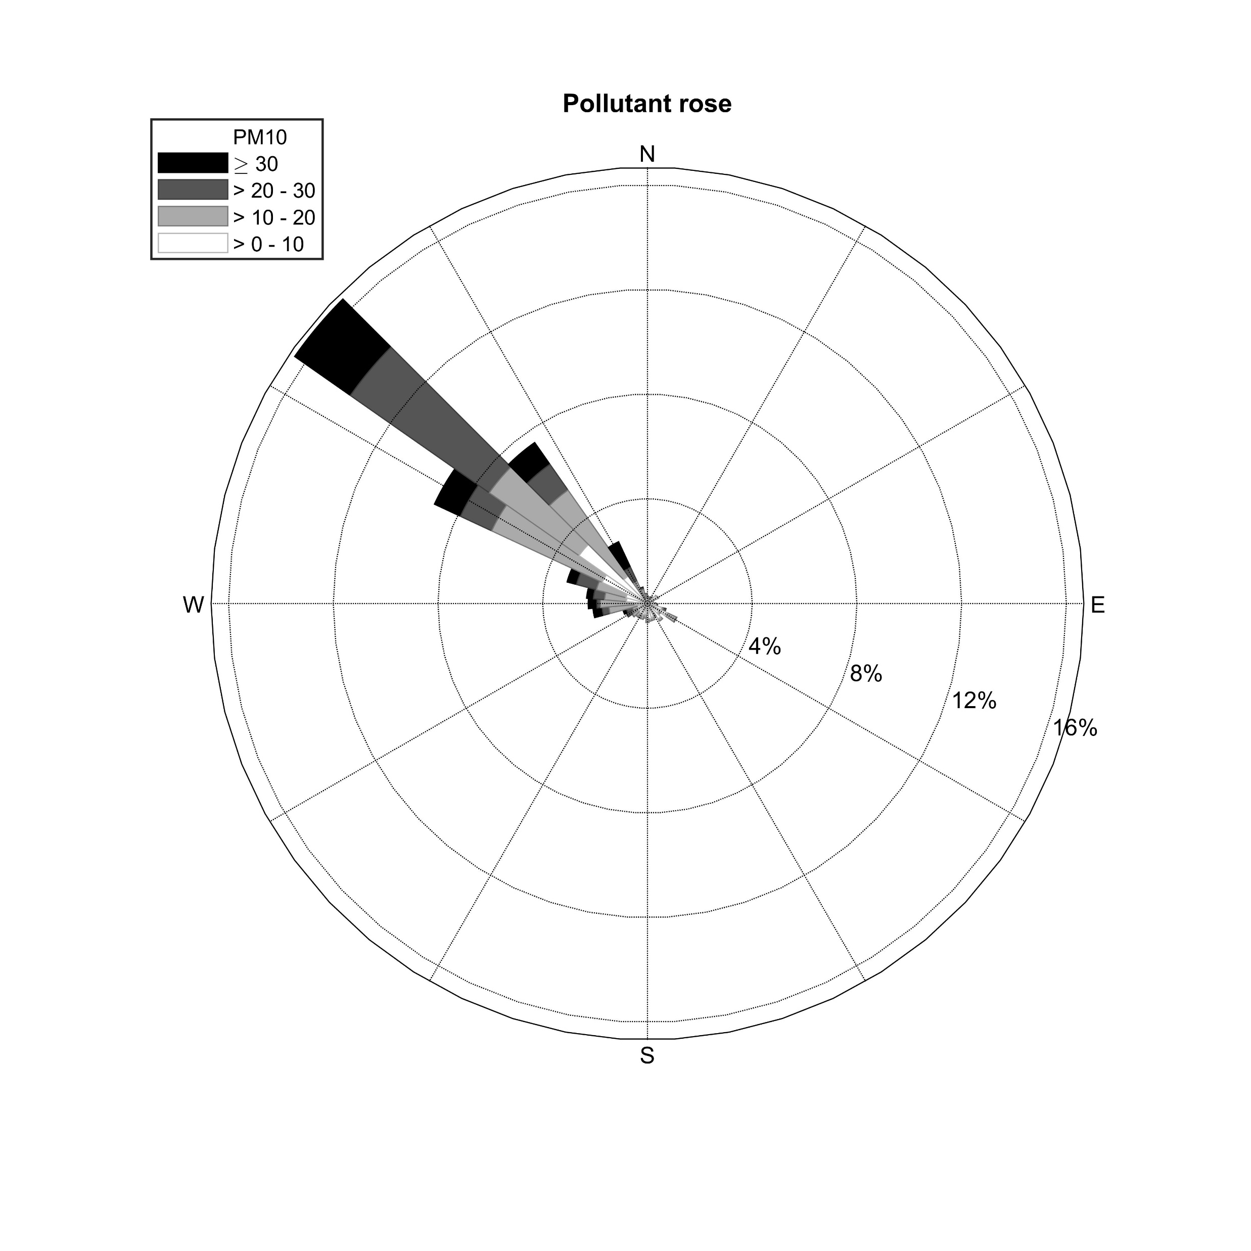
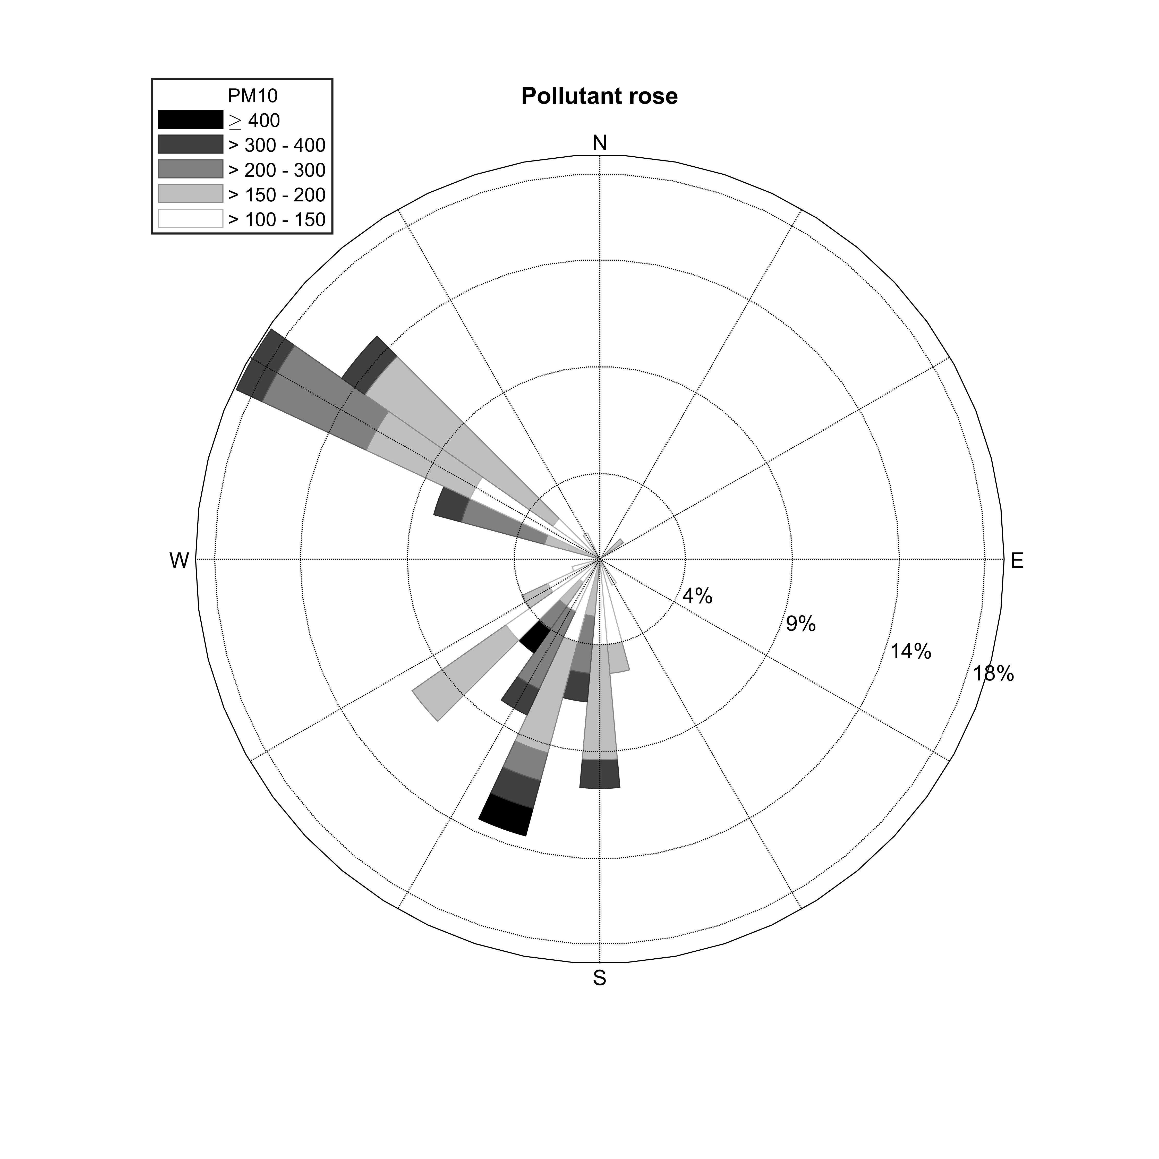
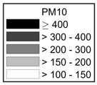
Wind Motion analysis based on ICEEMDAN
Input signal (wind speed/
wind direction/pm10)
Signal Decomposition
Signal Filtering
Signal Reconstruction
Polar to Cartesian coordinates
ICEEMDAN
Cartesian to polar coordinates
Annual scale
Wind rose
Pollutant rose
River dust events
Legend
Annual:
River dust events:
Typhoon events
18
Introduction / Methodology / Results / Conclusions and Ongoing works
Notes:
wind motion analysis based on ICEEMDAN
At annual scale, the major PM10 pollution is caused by the northeast monsoon in choshui river, and the northwest monsoon in Kaoping river.
Next, River dust events are affected by the winter monsoon in the choshui river.
And, in the Kaoping river, the river dust events caused by the northwest monsoon in winter and the typhoon events in summer.

Slide 25
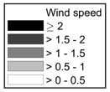
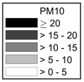
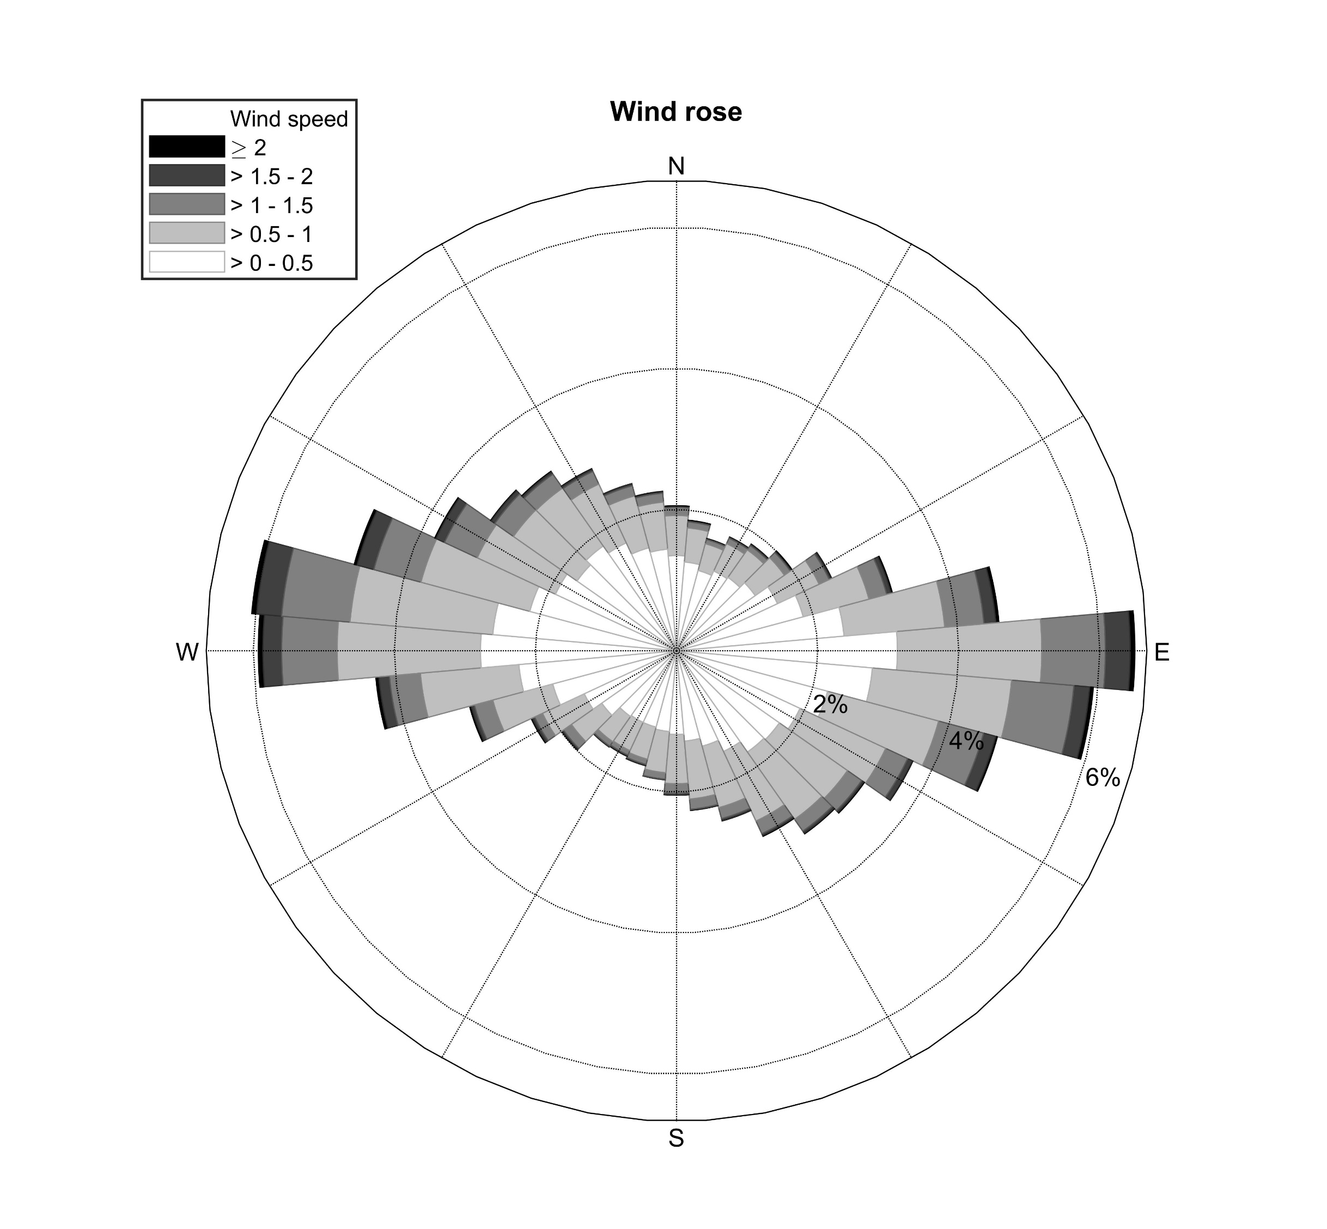
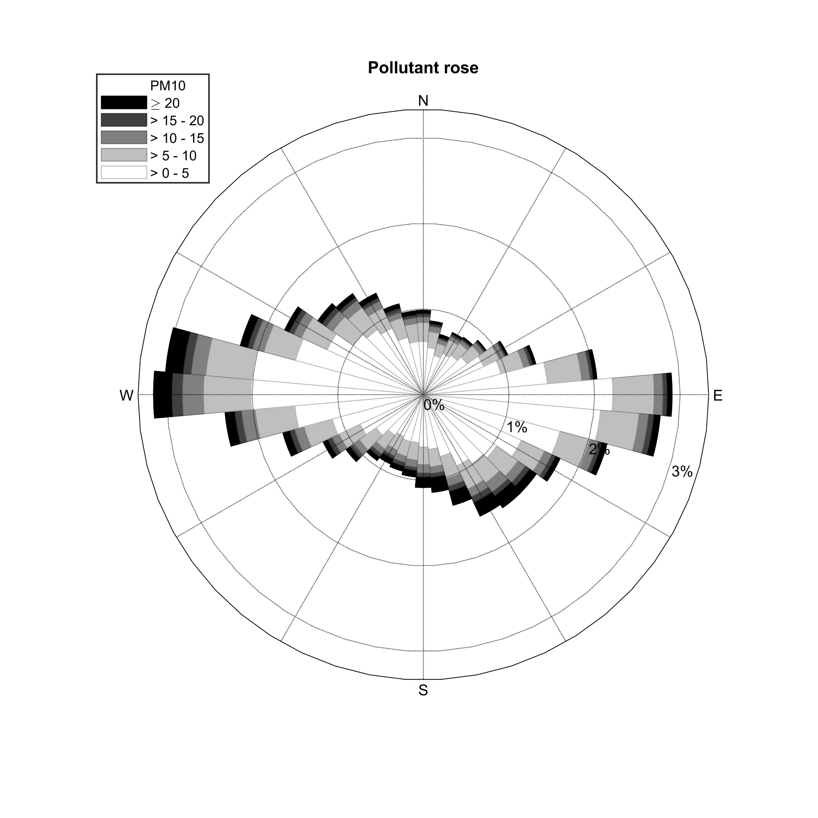
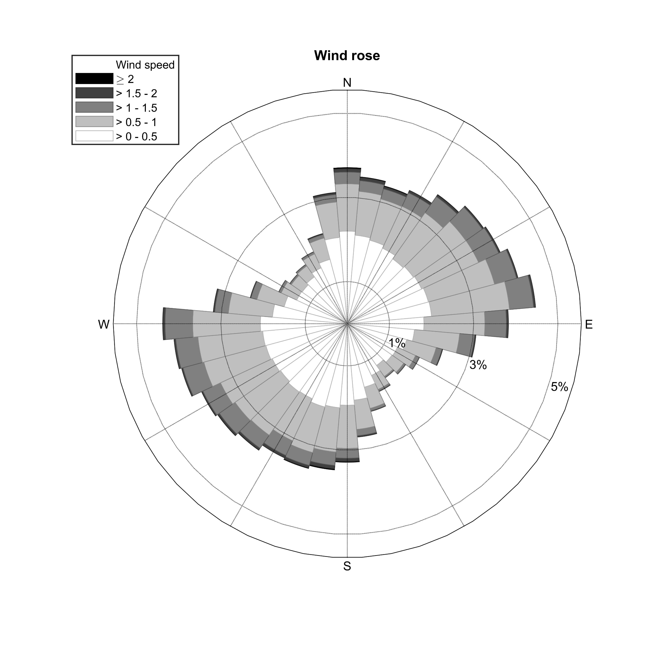
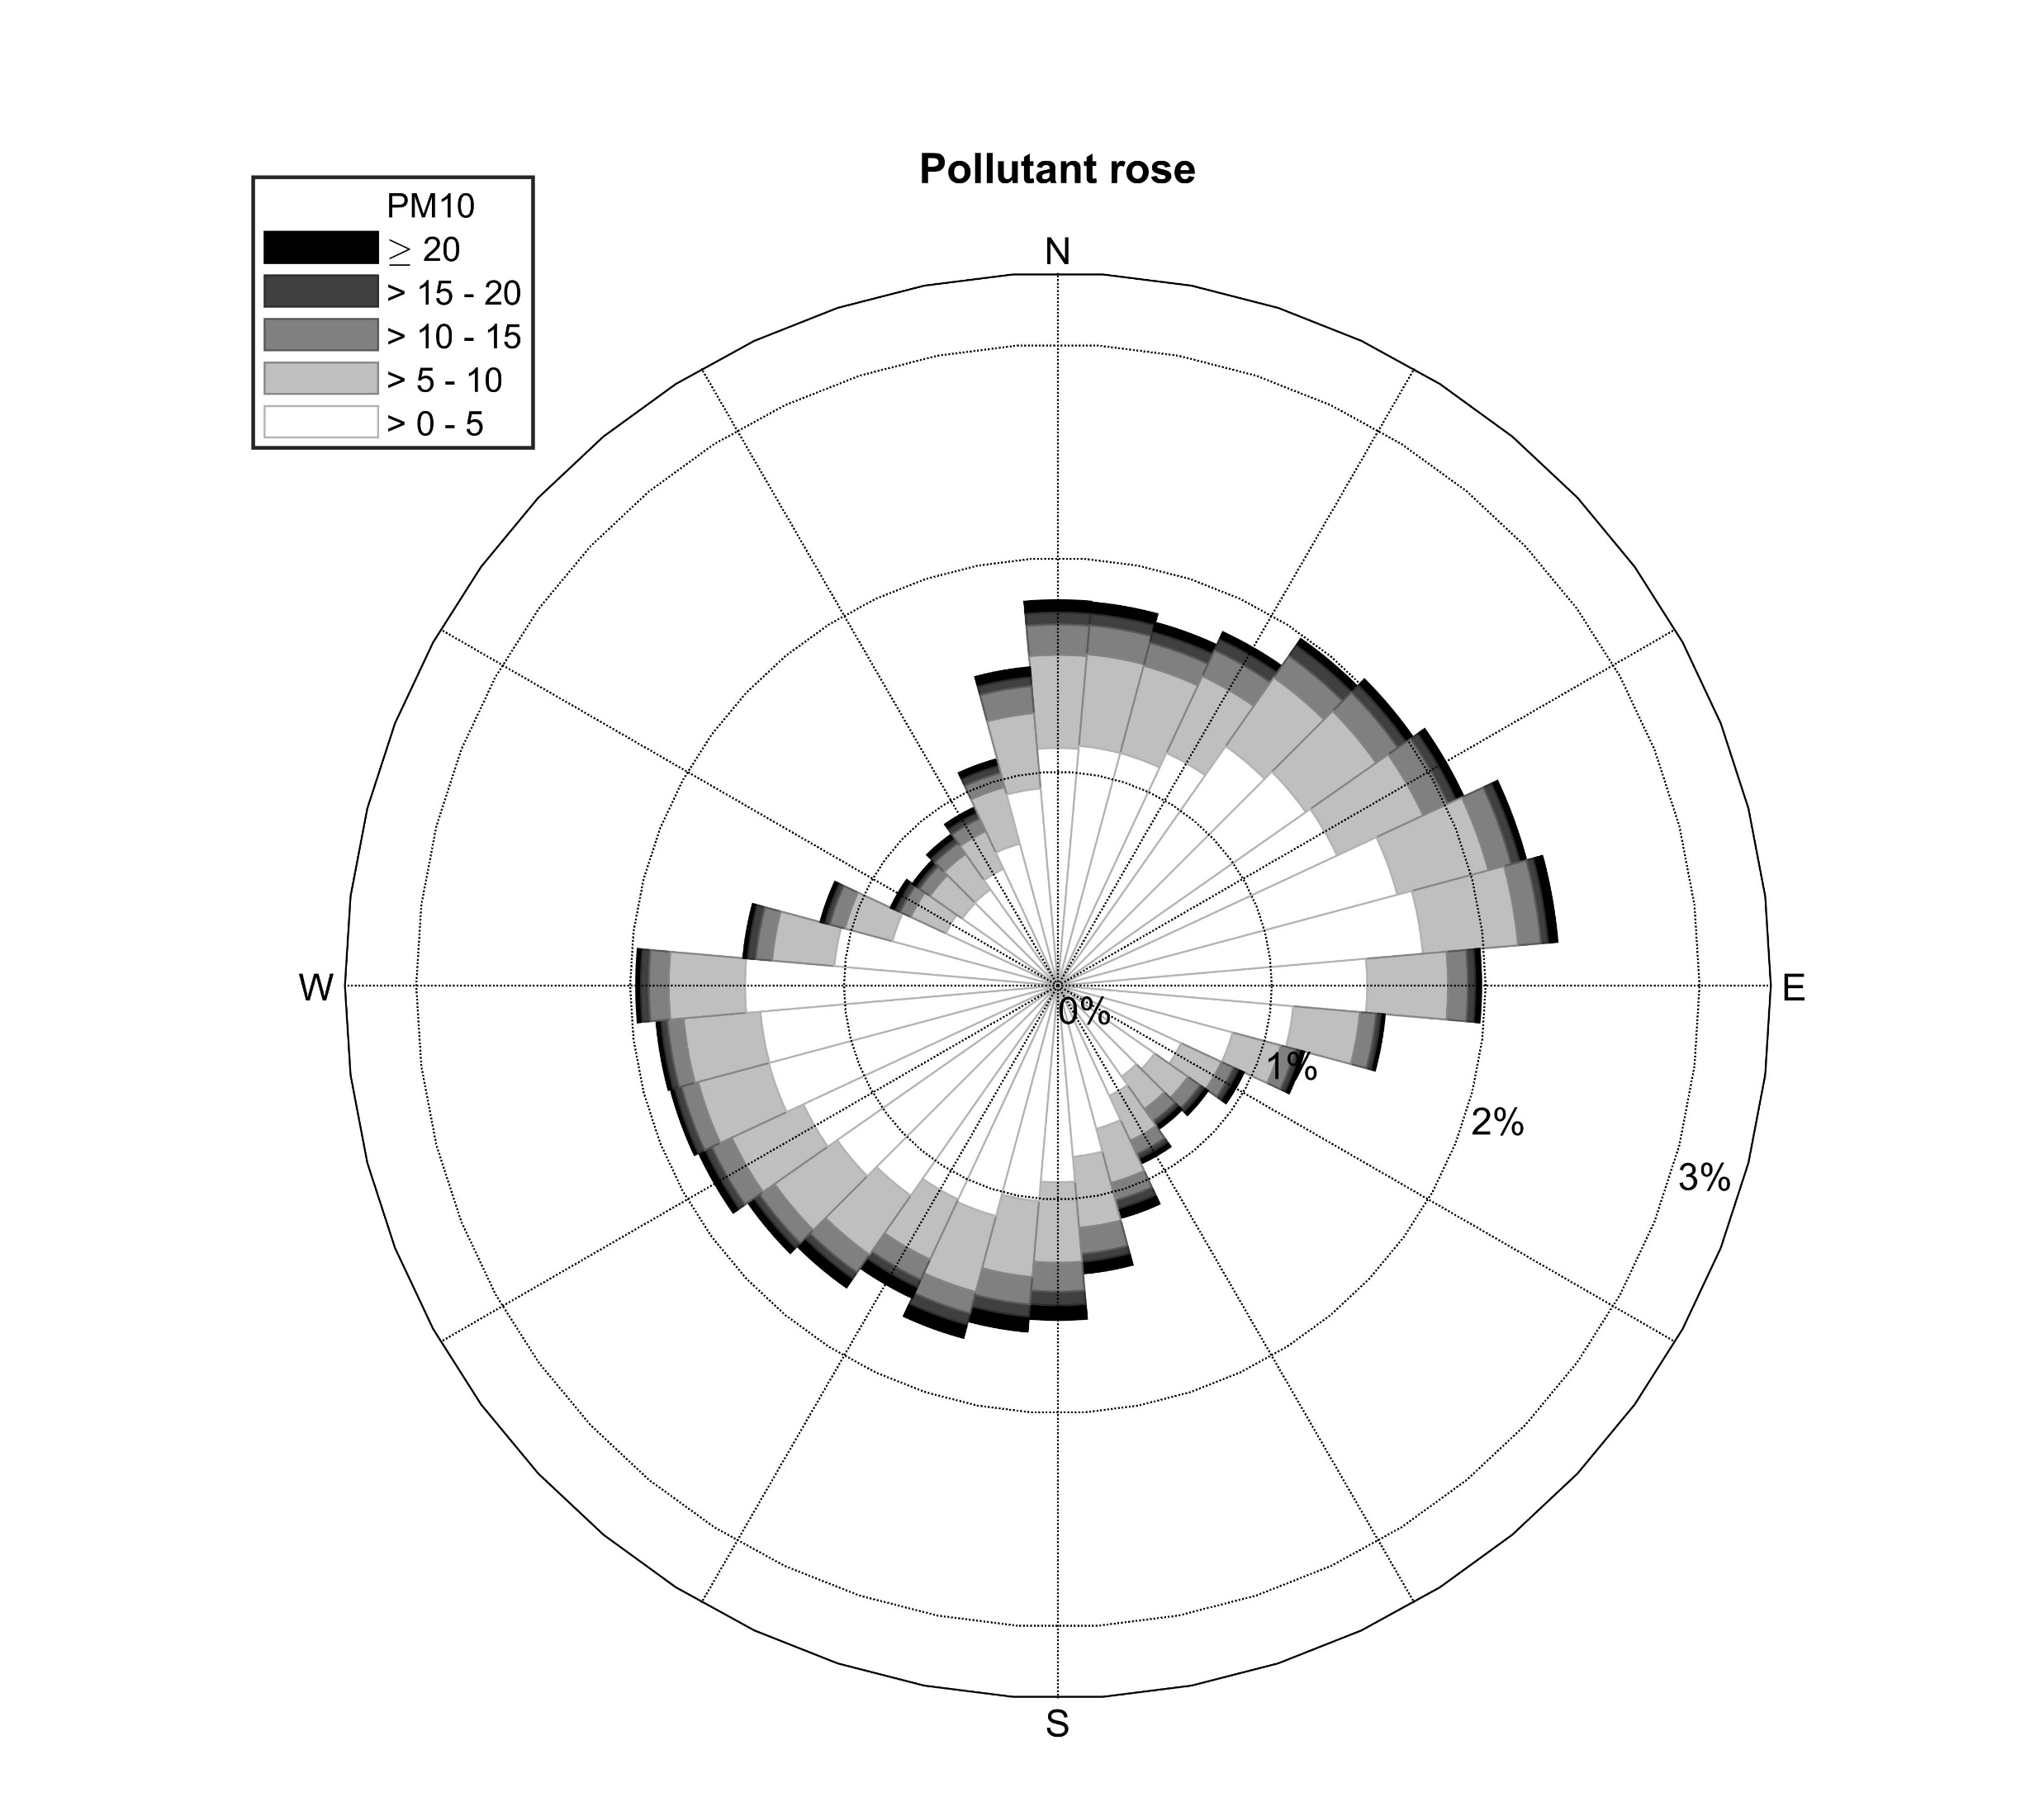
Wind Motion analysis based on ICEEMDAN
Input signal (wind speed/
wind direction/pm10)
Signal Decomposition
Signal Filtering
Signal Reconstruction
Polar to Cartesian coordinates
ICEEMDAN
Cartesian to polar coordinates
Diurnal scale
Legend
Diurnal:
Wind rose
Pollutant rose
Wind rose
Pollutant rose
18
Introduction / Methodology / Results / Conclusions and Ongoing works
Notes:
Next wind motion analysis at diurnal scale
In these two river, the wind direction is vertical to the coastline
Thus, The pollution at the diurnal scale is mainly affected by land sea breeze in choshui and Kaoping river.

