Slide 1




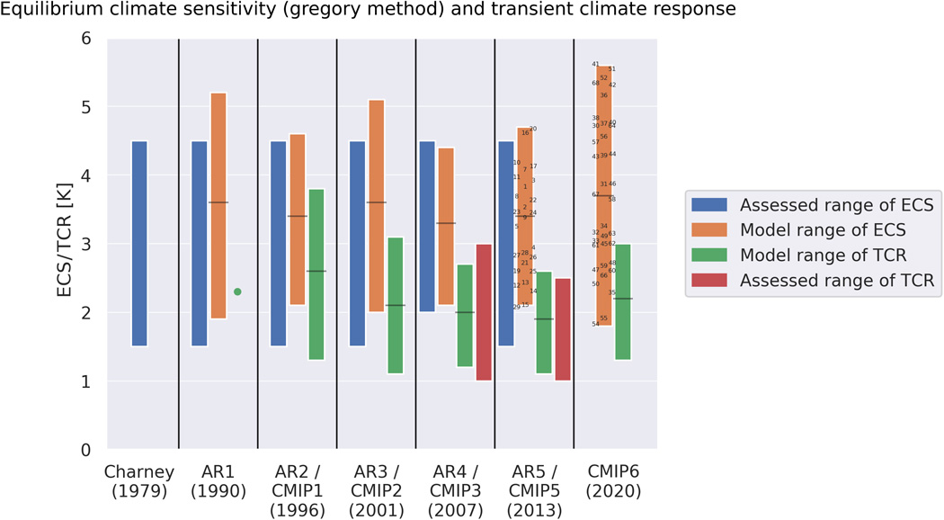


Developing an emergent constraint with network analysis and causal inference
Lucile Ricard¹, Athanasios Nenes^{1,2}, Jakob Runge³, Fabrizio Falasca⁴
(1) Laboratory of Atmospheric Processes and their Impacts (LAPI), ENAC, EPFL, Lausanne, CH-1015, Switzerland (2) Institute of Chemical Engineering Sciences, Foundation for Research & Technology-Hellas, Patras 26504, Greece
(3) German Aerospace Center, Institute of Data Science, Jena 07745, Germany (4) Courant Institute of Mathematical Sciences, New York University (NYU), New York, USA
Research objective: to constrain climate sensitivity,
the global mean temperature response to a doubled amount of CO₂
Equilibrium Climate Sensitivity (ECS) : ΔT at equilibrium after 2xCO₂
Transient Climate Response (TCR) : ΔT after 1%/year increase in CO₂ for 70 years
Larger spread and higher values in CMIP6 models
This research receives funding from the European Union’s Horizon 2020 research and innovation programme under Marie Skłodowska-Curie grant agreement No 860100 (iMIRACLI)
Meehl et al., 2020
ITS2.7/AS5.2 – Machine Learning for Climate Science
1

Slide 2

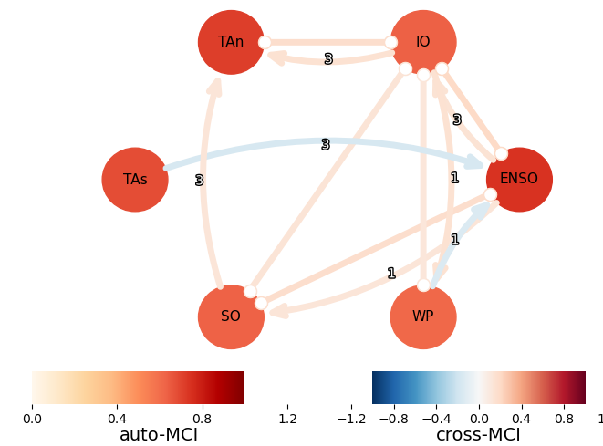
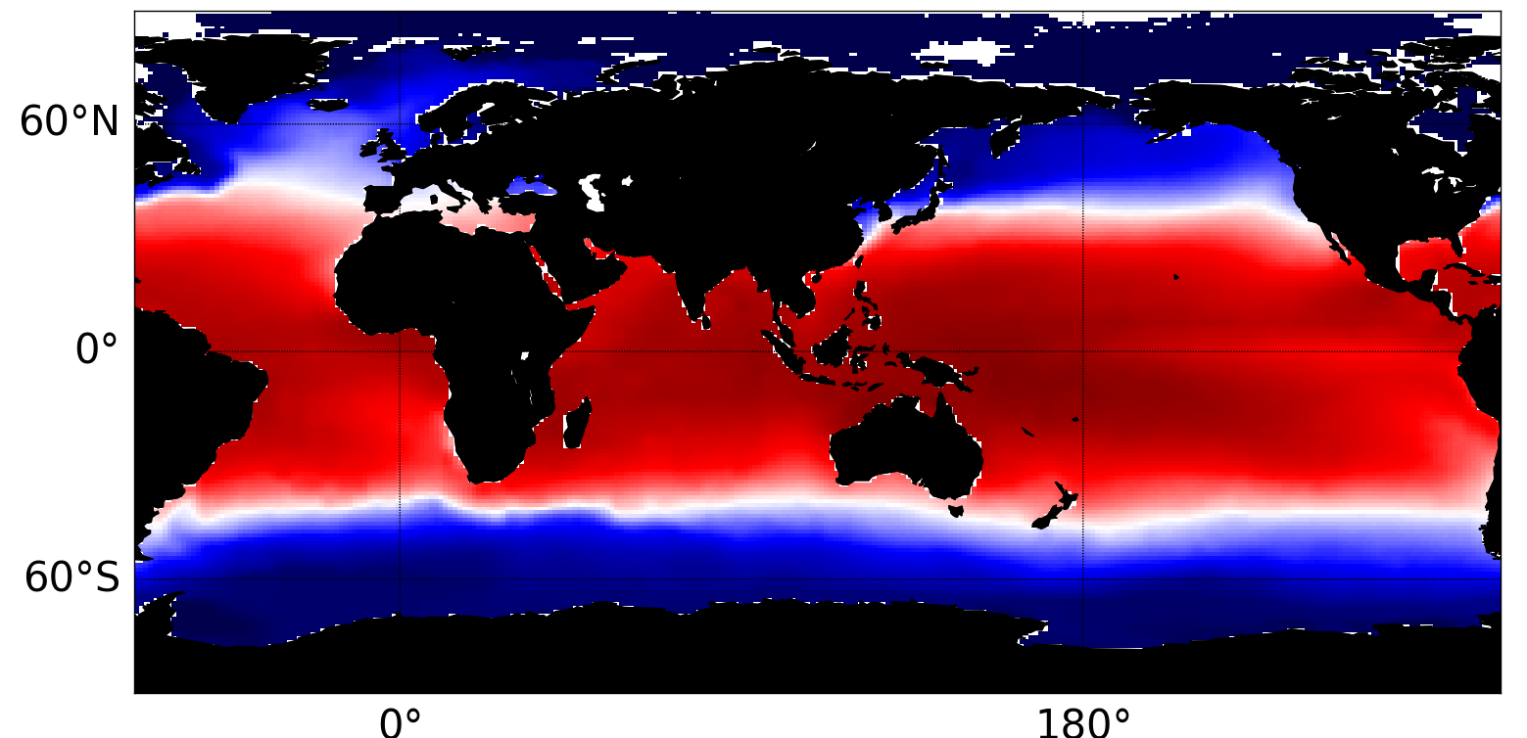
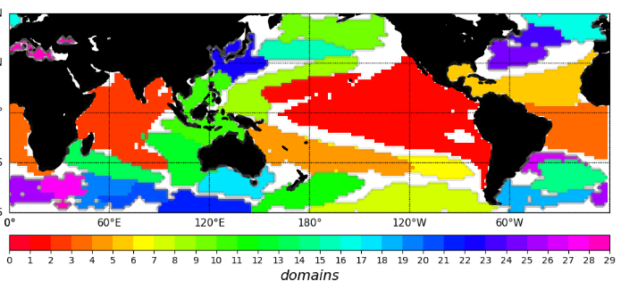
δ-MAPS and PCMCI
From large & complex spatiotemporal datasets to networks
Observations and reanalysis
HadISST
COBEv2
“ground truth”
_{21 climate models}
_{172 simulations}
Monthly Sea Surface Temperature (SST) anomalies
Historical period : 1975-2014
Tropics and subtropics : from 60°S to 60°N
_{causal graph}
_{original 3D climate field}
_{domain map}
_{Dimension reduction}
_{Causal discovery algorithm}
_{δ-MAPS}
_{PCMCI}
contain the «essence» of the field
EGU 2022
ITS2.7/AS5.2 – Machine Learning for Climate Science
2

Slide 3
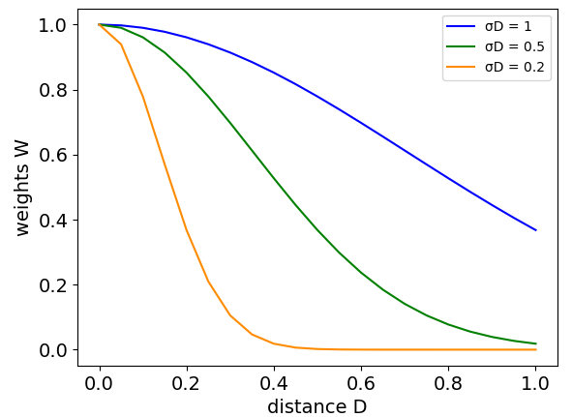
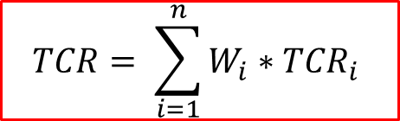
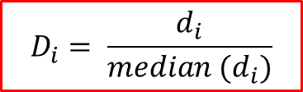
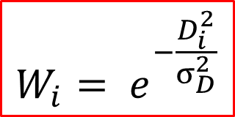
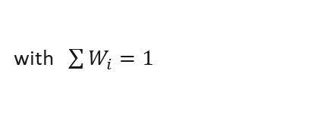

A set of metrics
Weights
Estimate
Focus on different structural aspects of the networks
With weighting scheme ClimWIP
(Knutti et al., 2017)
$$TCR= \sum_{i=1}^{n}{W_{i}∗{TCR}_{i}}$$
RMSE (kurtosis)
Scores extreme events in domains’ SST signals’ distributions
F1
Scores absence/presence causal links
$$D_{i}= \frac{d_{i}}{median (d_{i})}$$
Distance model i
to the observations
$$ECS= \sum_{i=1}^{n}{W_{i}∗{ECS}_{i}}$$
$$W_{i}= e^{−\frac{D_{i}^{2}}{σ_{D}^{2}}}$$
with $\sum{W_{i}=1}$
“Width of the Gaussian”
Assess how far are the simulations to observations
_{Performance weights}
Models far from the observations are downweighted
EGU 2022
ITS2.7/AS5.2 – Machine Learning for Climate Science
3

Slide 4
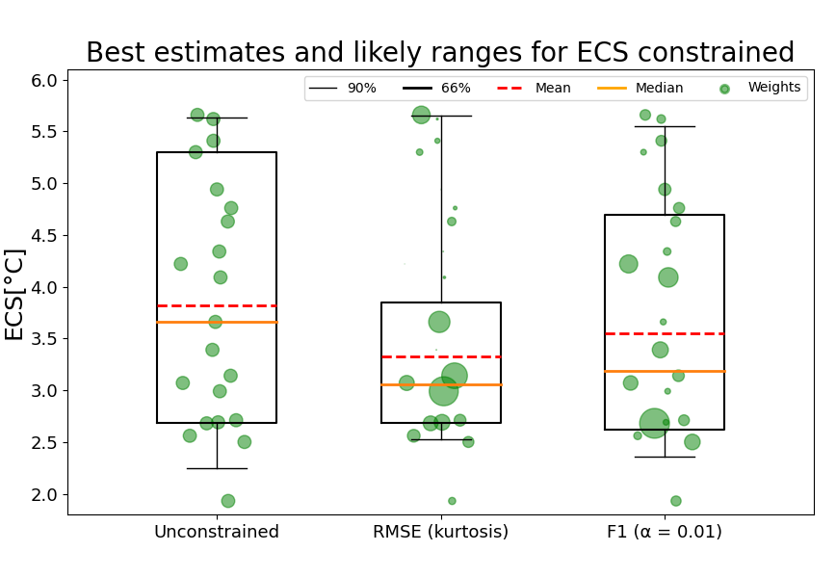
Results : best estimates and likely ranges
Current findings
 | ECS | Range 66%
unconstrained | 3.66°C | 2.68 to 5.3°C
RMSE (kurtosis) | 3.06°C | 2.69 to 3.85°C
F1 | 3.19°C | 2.62 to 4.70°C
Size of the dots are proportional to the weights
Percentiles 16% and 83%
 | TCR | Range 66%
unconstrained | 1.97°C | 1.52 to 2.66°C
RMSE (kurtosis) | 1.61°C | 1.53 to 2.04°C
F1 | 1.69°C | 1.52 to 2.41°C
Ongoing Work
Combined estimations
Get the independent weights
Assess the observational uncertainty
Equal weights ( to constrain)
EGU 2022
ITS2.7/AS5.2 – Machine Learning for Climate Science
4

