Slide 1
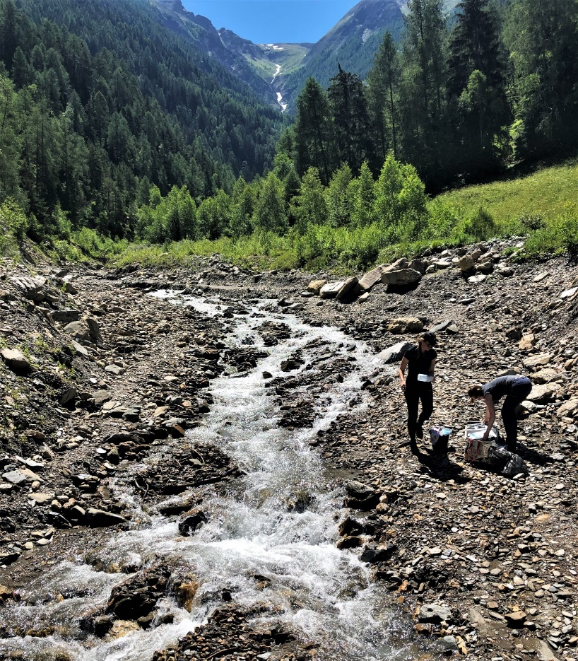






Destabilizing the
Earth’s thermostat:
Riverine alkalinity responses to
climate change
Nele Lehmann
Helmholtz-Zentrum Hereon
Alfred Wegener Institute
@Maike Ostermann
Tobias Stacke, Sebastian Lehmann, Hugues Lantuit, John Gosse, Chantal Mears, Jens Hartmann, Helmuth Thomas

Slide 2



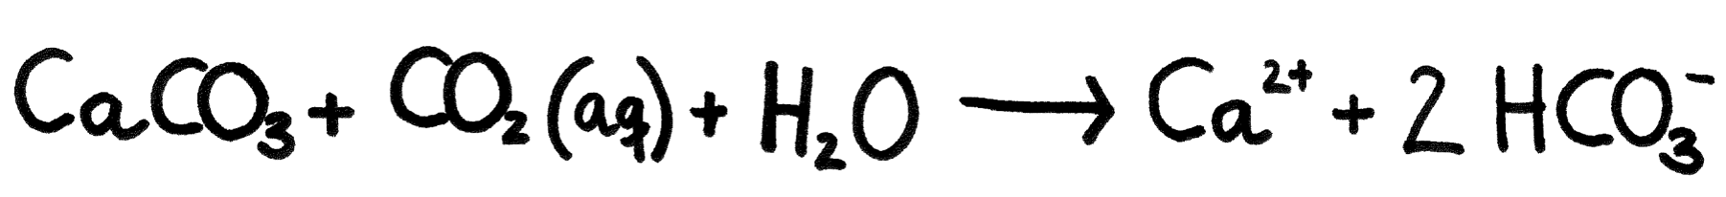

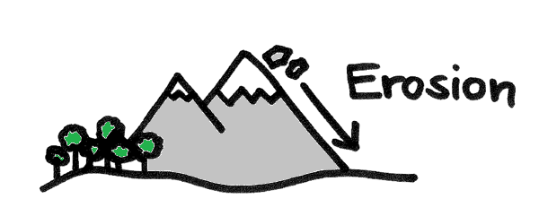
Alkalinity
?

Slide 3
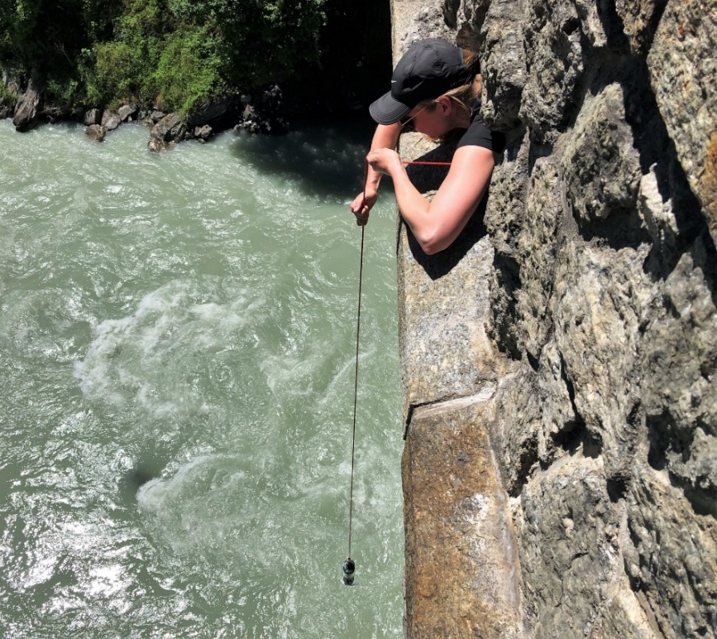
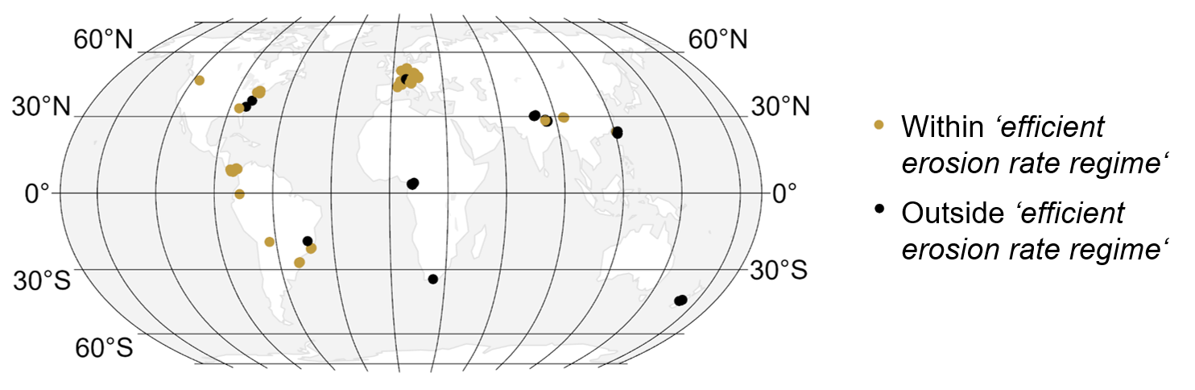
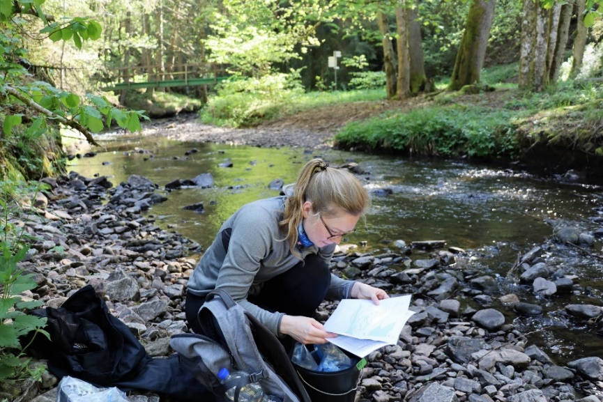
Alkalinity – Erosion rate
@Maike Ostermann
Alkalinity data: Hartmann, J., Lauerwald, R. & Moosdorf, N. A Brief Overview of the GLObal RIver 5 Chemistry Database, GLORICH. Procedia Earth and Planetary Science 10, 23–27; 10.1016/j.proeps.2014.08.005 (2014).
¹⁰Be-derived catchment-wide average erosion rate data: A. T. Codilean et al., OCTOPUS. Earth Syst. Sci. Data. 10, 2123–2139 (2018), doi:10.5194/essd-10-2123-2018.
@Heidrun Treblin

Slide 4
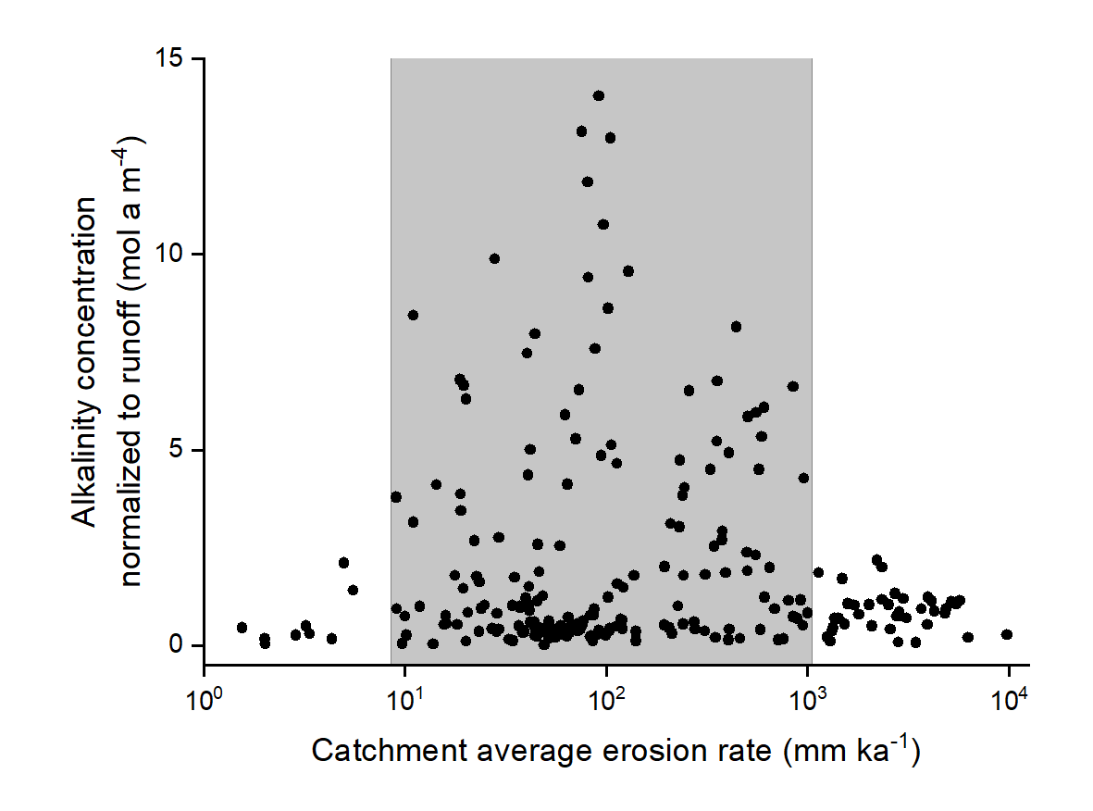
‘Efficient erosion rate regime’

Slide 5
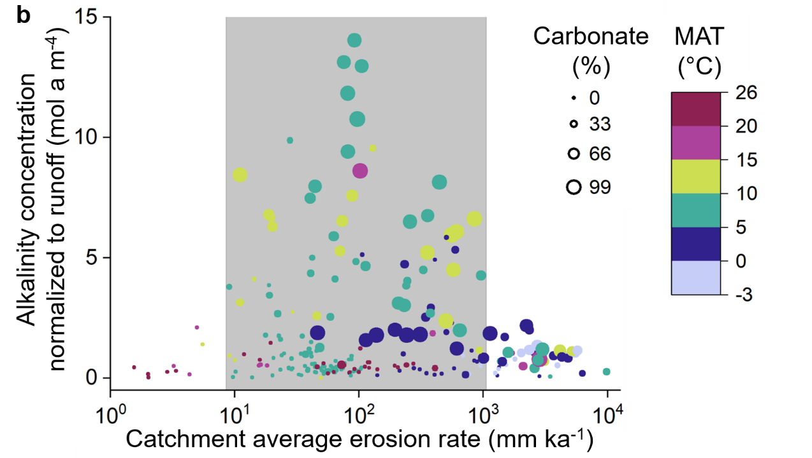
First-order controls on alkalinity

Slide 6
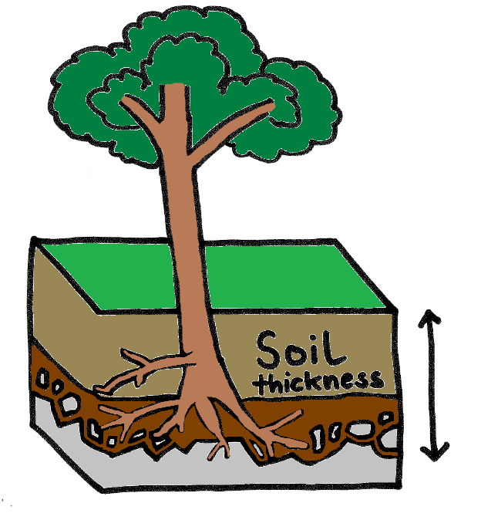
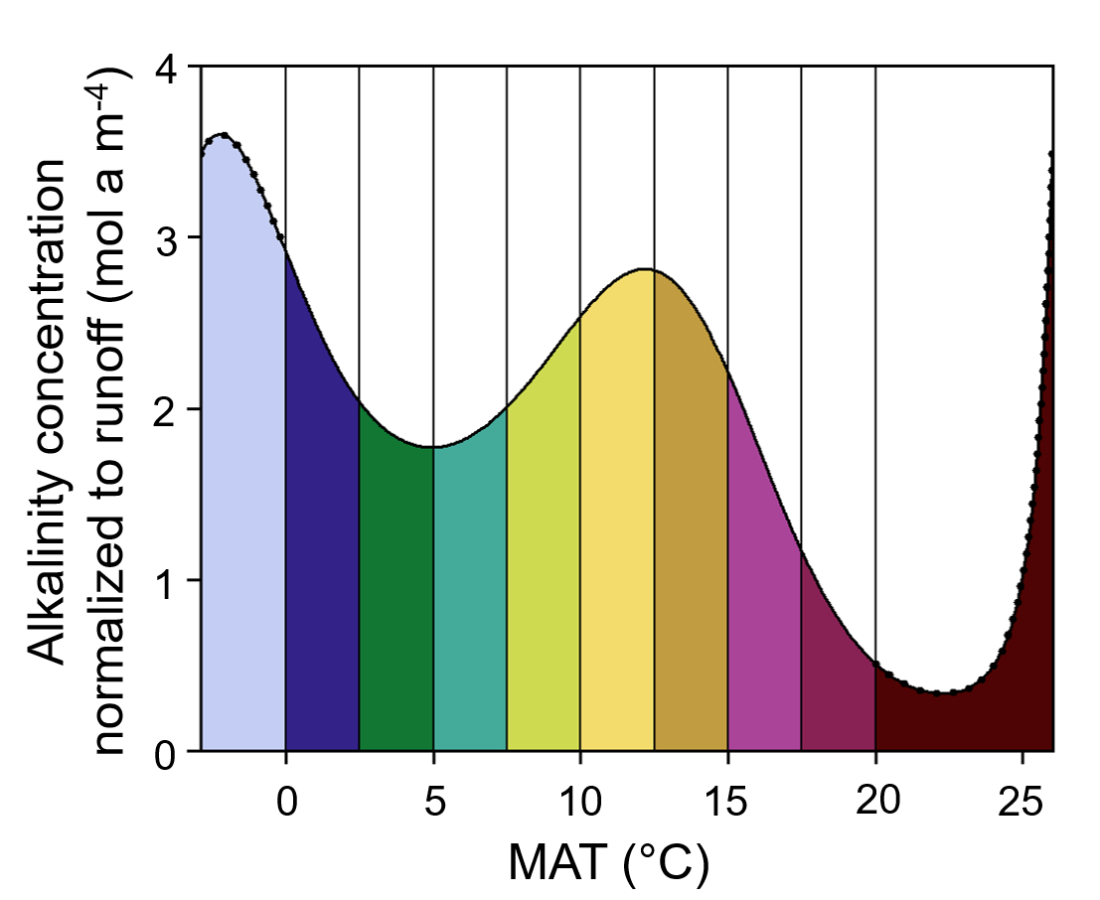
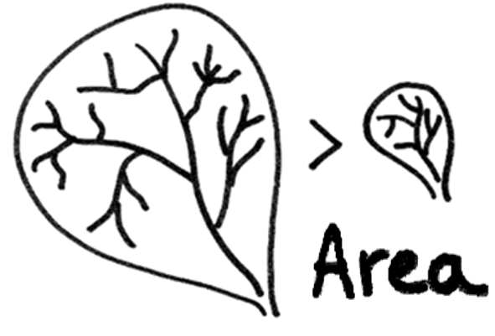

Global riverine alkalinity model (GAM → GLM)

Slide 7
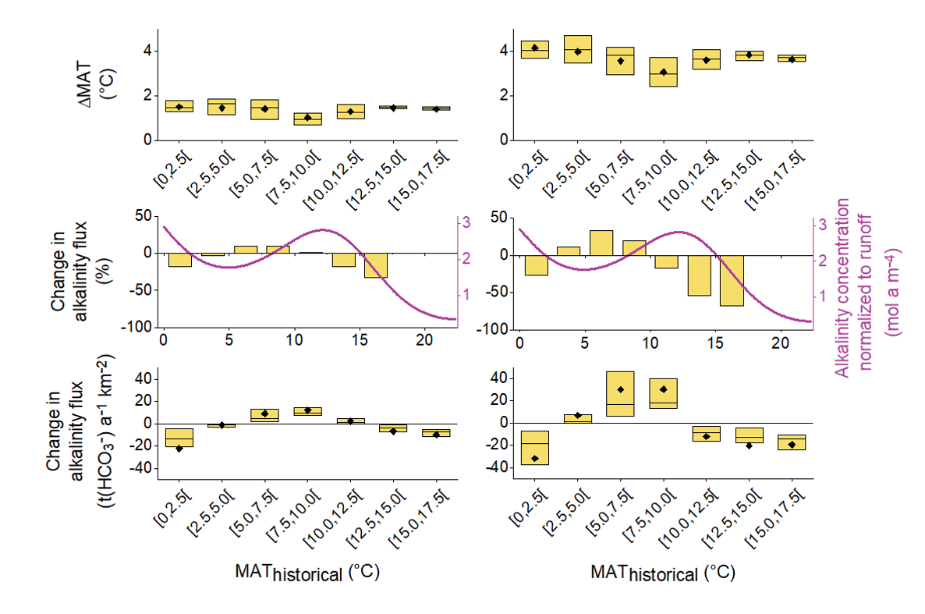
Riverine alkalinity responses to climate change
SSP1-2.6
SSP5-8.5
Temperature projections:
Lange, S. & Büchner, M. ISIMIP3b bias-adjusted atmospheric climate input data. https://doi.org/10.48364/ISIMIP.842396.1 (ISIMIP Repository, 2021).
Krasting, J. P. et al. NOAA-GFDL GFDL-ESM4 model output prepared for CMIP6 CMIP (Earth System Grid Federation, 2018).
Discharge simulations: Stacke, T. & Hagemann, S. HydroPy (v1.0). A new global hydrology model written in Python. Geosci. Model Dev. 14,
7795–7816; 10.5194/gmd-14-7795-2021 (2021).

Slide 8
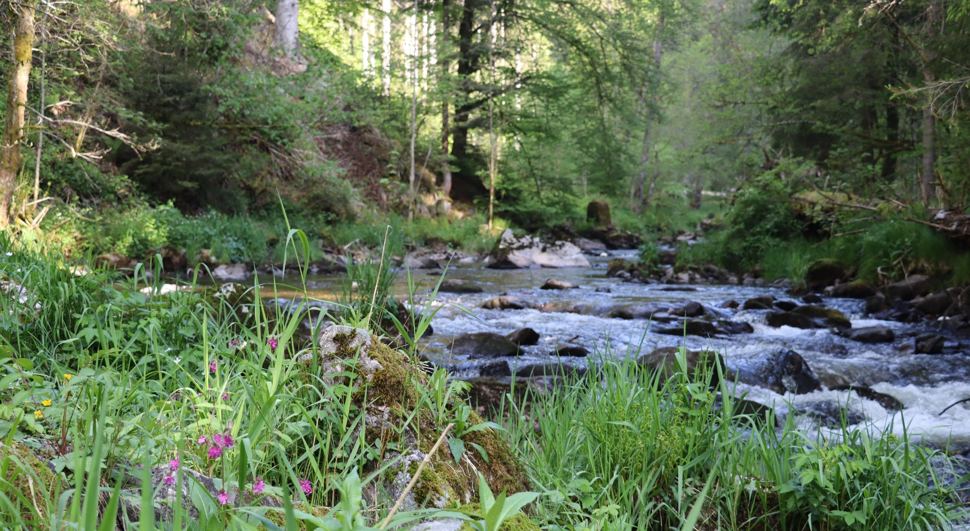

Thank you for your attention
Nele Lehmann
Helmholtz-Zentrum Hereon
Alfred Wegener Institute
nele.lehmann@hereon.de
Tobias Stacke, Sebastian Lehmann, Hugues Lantuit, John Gosse, Chantal Mears, Jens Hartmann, Helmuth Thomas
@Heidrun Treblin
N.L., T.S. and H.T. were supported by the project The Ocean’s Alkalinity: Connecting geological and metabolic processes and time-scales, which is funded by the Federal Ministry of Education and Research (BMBF) under Make our Planet Great Again – German Research Initiative, grant number 57429828, implemented by the German Academic Exchange Service (DAAD).

