Slide 1
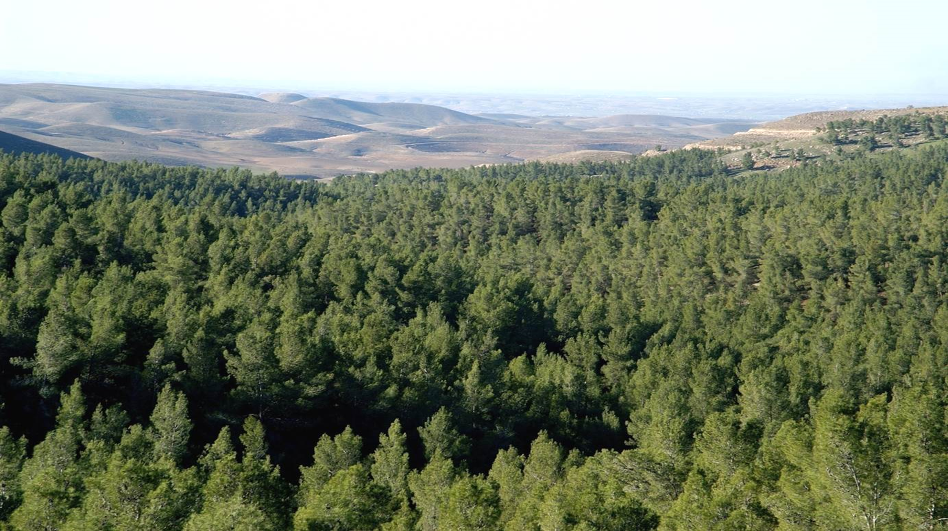
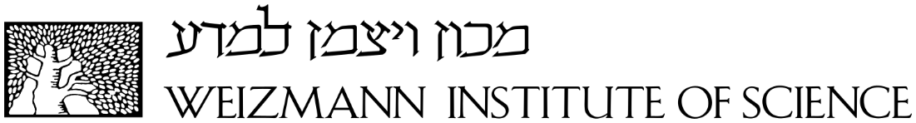
Disentangling soil, shade, and tree canopy contributions to mixed satellite vegetation indices in a sparse dry forest
Huanhuan Wang, Jonathan Muller, Fedor Tatarinov, Eyal Rotenberg, Dan Yakir
Department of Earth and Planetary Science, Weizmann Institute of Science
WIS workshop, 29. 03.2022

Slide 2
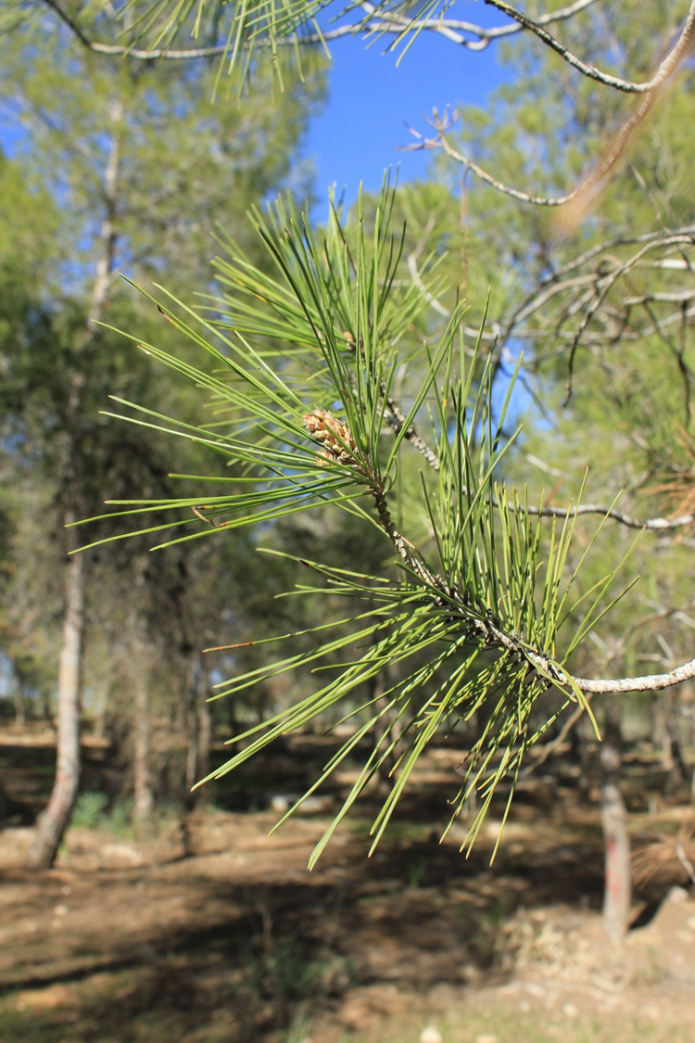
Outline
Introduction
Motivation and research questions
Methodology
- Study site
- Datasets
- Image classification
Results
- Fraction estimation
- Radiative Properties
- Canopy NDVI retrieval algorithm
Conclusions

Slide 3
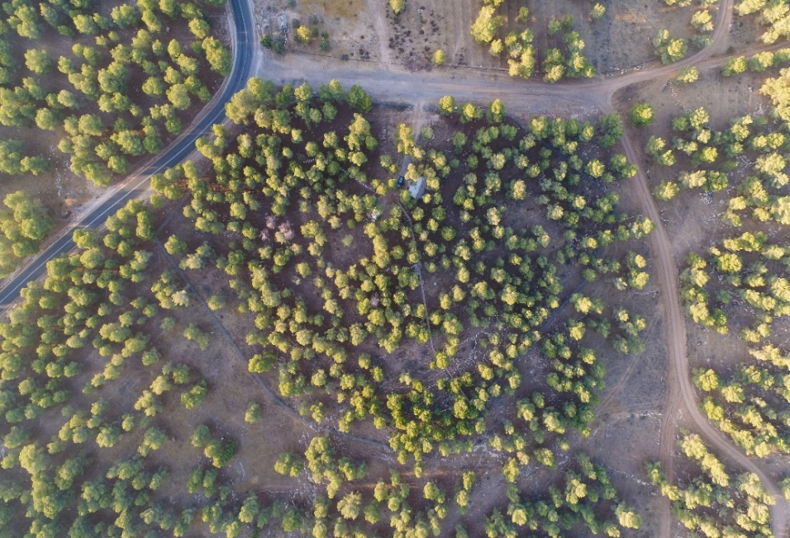
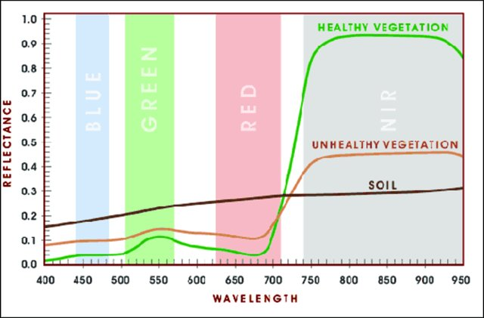
Introduction
Yatir research station by drone photography
August 2018
Mixed pixel problem in satellites
For most of the satellites, a pixel contains vegetation, soil and other elements
Soil strongly affects interpretation of satellite data, especially in sparse ecosystems
Vegetation Indices (NDVI, EVI, SAVI, etc.) were used to reduce background influences, but insufficient due to low spatial resolution
The UAV images
Very high resolution (~cm) enables precise canopy and background separation
Most work with UAV focused on extraction of the canopy information, with less results on the background elements
Most work has limited campaigns
Reflectance spectrum of vegetation and soil
Chang et al., 2013
Notes:
For most of the satellites, a pixel usually contains a mixture of difference surface elements, including vegetation, bare soil, annuals, etc. See this photo of Yatir site, taken by a drone on 08.2019, you will have a idea of our sparse forest with large exposure of soil background. Aleppo pine is the major tree species. Soil is bare in dry summer, and in winter there are patches of annuals here and there. We know that soil has a different spectrum from vegetation, with a smooth slow increase from visible to NIR, and canopy has very contrasting signals between visible and NIR band. So we can assume that the exposure of soil will greatly influence the interpretation of satellite data in these ecosystems. There are indices trying to reduce this background effect, but insufficient due to low resolution.
Recently UAV has been applied to vegetation monitoring, and enables presice canopy segmentation, but mostly focues on canopy information, also with single or limited campaigns.

Slide 4
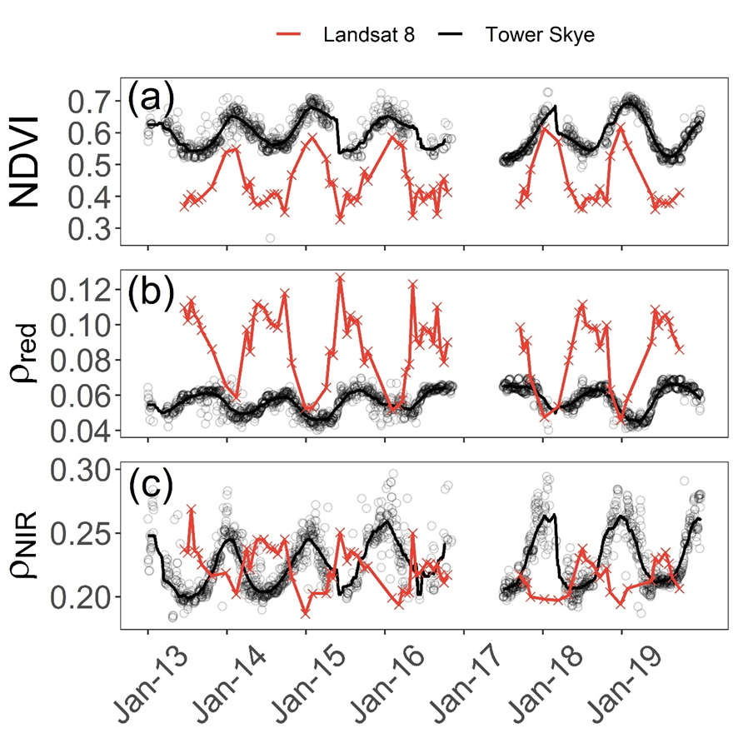
Motivation
Comparison between Landsat 8 surface data and tower Skye sensor, at tower area
Research questions
Reasons for opposite trend in ρ_{NIR} between satellite and tower?
How to use satellite vegetation indices in sparse ecosystems?
Hypotheses
Satellite and tower sensor data were determined by different fractional contributions from canopy and non-canopy elements
Notes:
This study was motivated by the comparison between Landsat 8 and tower Skye sensor at Yatir forest, in the NDVI and bands. It was shown that they agreed quite well in the patterns of NDVI, also good in red, but totally opposite in NIR.
Our research question was how come that the similar NDVI was from opposite NIR cycle? And if the satellite data is biased, how to use it properly in sparse ecosystems?
Note that here the Landsat 8 data was from surface product, so it is not due to atmospheric effect. We hypothesis it is related to the fractional contributions of surface elements in their viewing area.
For that, we need the fractions and reflectance of all the surface elements inside these area of view.

Slide 5
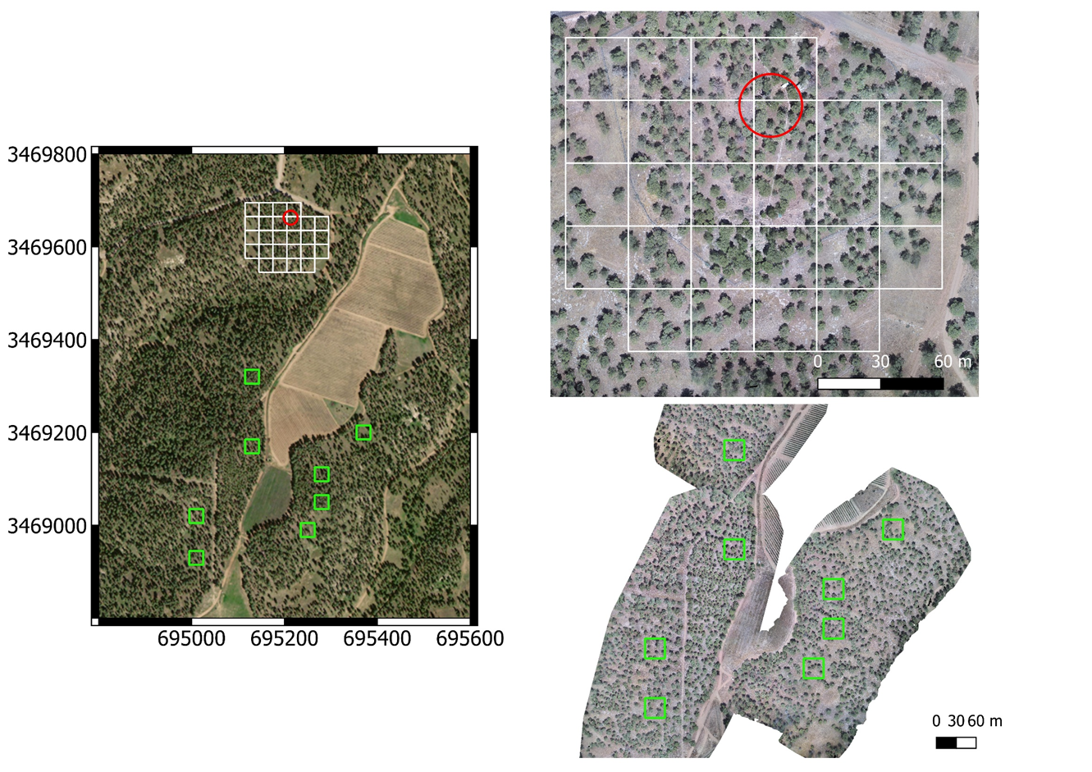
Methodology
Study site
Landsat 8 pixel (30m × 30m)
(b)
Skye footprint
(15m radius)
Northing
(a)
Yatir tower
(c)
LTER
300
200
200
100, 200, 300: density (trees/ha)
200
Easting
300
100
100
100
Notes:
This study was conducted at Yatir forest, you see here the Yatir tower station and the nearby LTER experimental plots. Each square is for one Landsat 8 pixel of 30m. The yellow polygon is the area for the comparison between Landsat and Skye, as in the motivation, as well as for analyzing the fractional contributions of the surface elements. The surrounding pixels are for validation of retrieval algorithm of canopy NDVI. At the end of the study I will show result on LTER plots. These are Landsat 8 pixels chosen at different density plots, 100, 200, and 300 trees/ha.

Slide 6
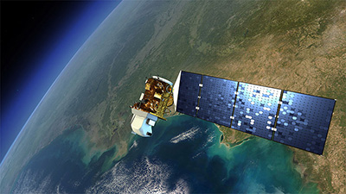
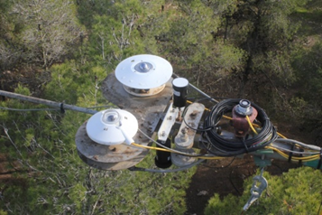
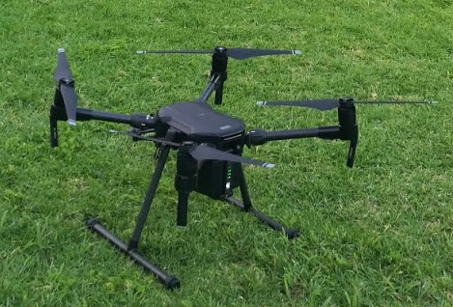
Methodology
Remote sensing datasets
Landsat 8 Operational Land Imager(OLI)
30m resolution
11 bands, from 430nm (ultra-blue) to 2290nm (Shortwave-infrared)
- February 2013 - today, every 16 days at 8:10 GMT (10:10 Israel winter time)
Red: 655±15nm, NIR: 865±15nm
Skye multi-spectrometer at the tower
ca. 15m radius footprint on ground
4 bands, 530nm (blue), 570nm (green), 660nm (red) and 860nm (Near-infrared)
May 2013 - today, every 30mins (9:45-10:15 mean values are used)
Red: 660±10nm, NIR: 860±10nm
UAV multispectral camera Sequoia+
ca. 5cm resolution at 50m flying height
4 bands, 550nm (green), 660nm (red), 735 (red edge) and 790 (Near-infrared)
March 2018 – November 2019, monthly (around noon hours)
Red: 660±40nm, NIR: 790±40nm
Notes:
We used three remote sensing datasets, as you remember, Landsat 8, tower Skye, and UAV multispectral images. UAV has about 5cm resolution at flight height of 50m, 4 bands, and flied monthly in 2018-2019. It is used for image classification for the viewing area of L8 and Skye.

Slide 7
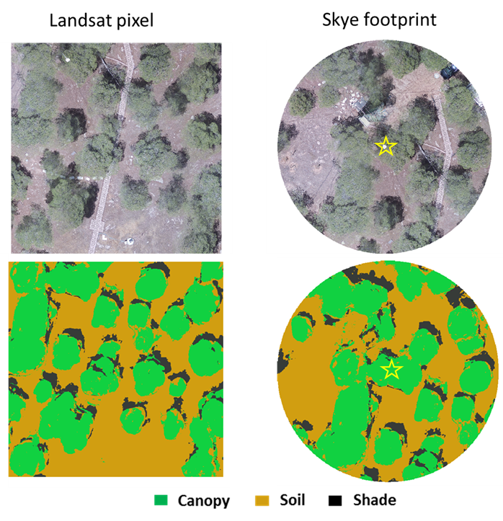
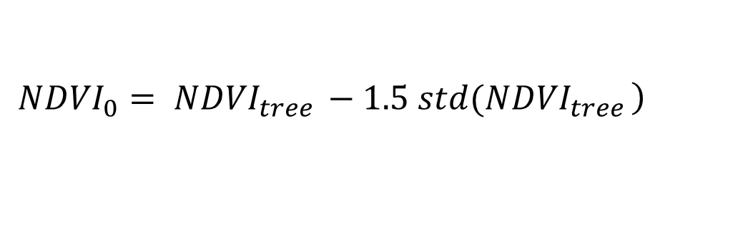

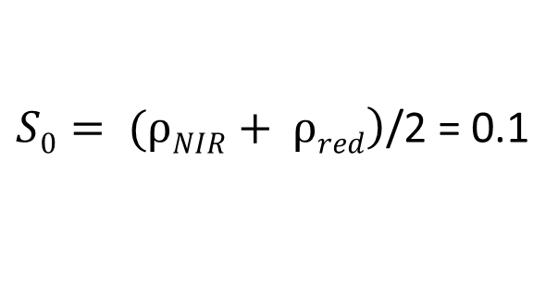
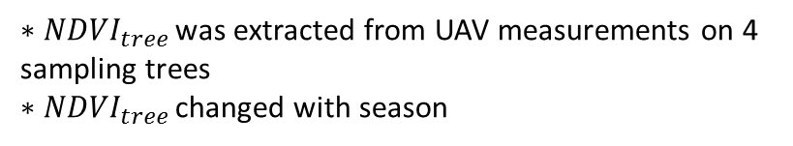
Methodology
Image classification
Example on June 25, 2019
Canopy:
$$\left.{NDVI}_{0}= {NDVI}_{tree }−1.5 std({NDVI}_{tree }\right)$$
${∗NDVI}_{tree }$was extracted from UAV measurements on 4 sampling trees
${∗NDVI}_{tree }$changed with season
Shade:
$\left.S0= (ρNIR+ ρred\right)$/2 = 0.1
(Aboutalebi, et.al., 2019)
$∗S0$stayed constant through the season
Soil: Any other pixels
Notes:
Here is our classification algorithm. We used simple thresholding for the three main components: canopy, shaded and sunlit soil. For canopy, we manually selected few sample trees, and extract the NDVI values measured by the drone, and their standard deviations. The threshold is NDVItree- 1.5sd. Not that NDVI0 changes with season, was recalculated every flight.
For shade, a constant value of 0.1 as the average of NIR and red reflectance. From Aboutalebi 2019.
Soil was simply any other pixels. After the classification procedure, the fraction and reflectance of each component can be calculated from the UAV images. Their seasonal cycles can also be obtained by processing the monthly images.

Slide 8
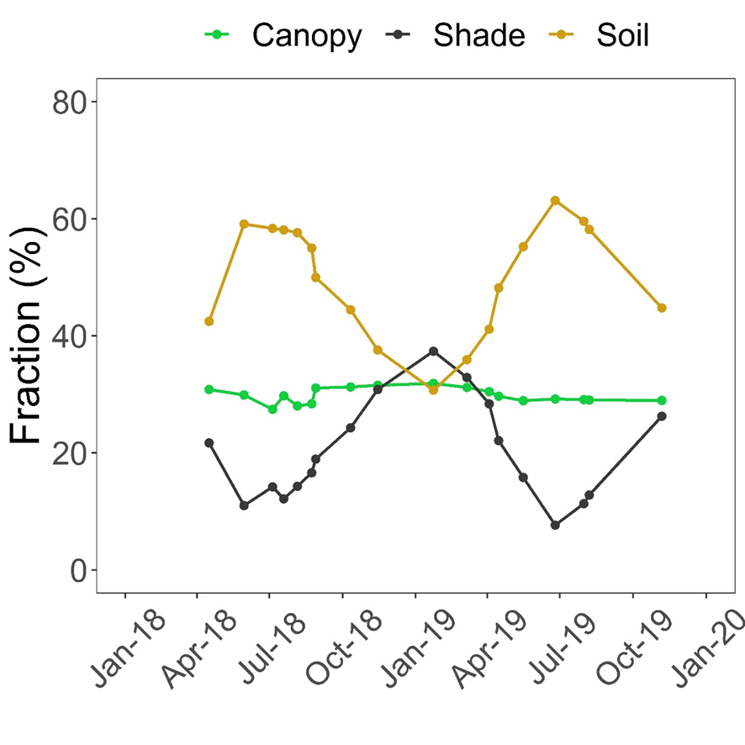
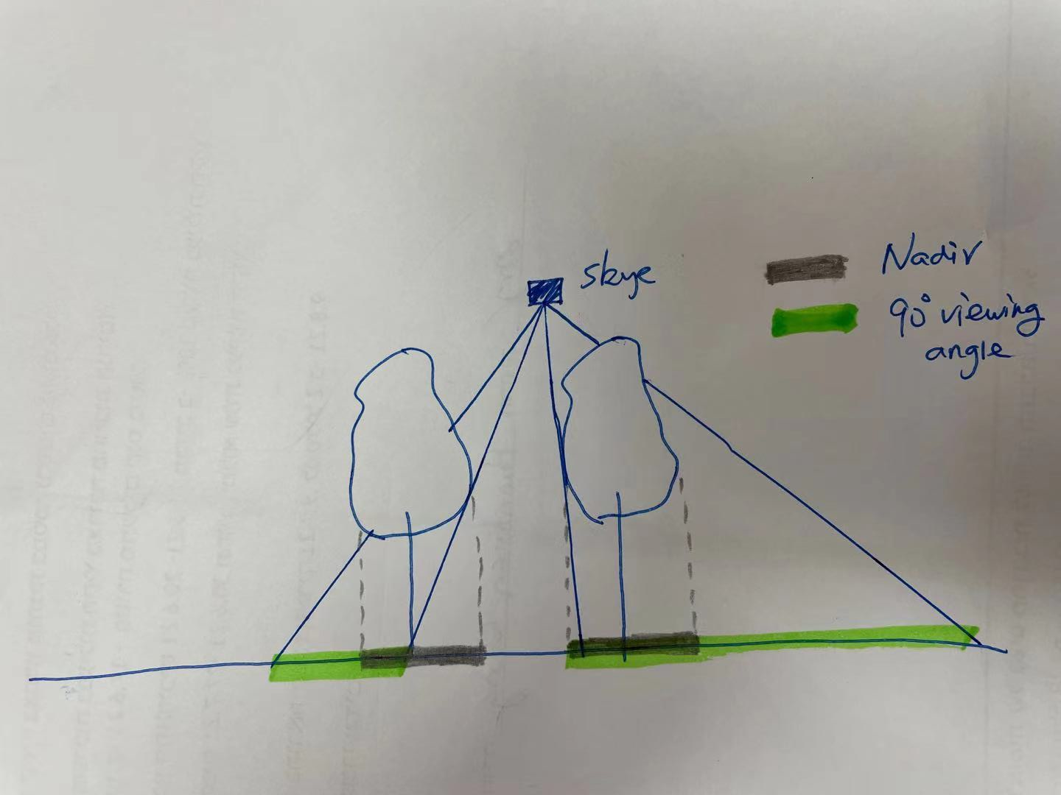
Results
Fraction estimation
Landsat 8
Skye
Landsat 8 pixels: ~30% (nadir classification)
Skye footprint: ~95% (3D simulation)
Notes:
Here we have the fraction over the tower area from Landsat 8 nadir view. The canopy fraction was about 30% in that area, and we see a large proportion of open sunlit soil in summer, up tp 60% in summer and 30% in winter. In winter shade can reach to 40% because of the low sun angle. This is from nadir view of satellite. Considering that Skye was mounted close above the canopy and it has a 90 degree angle of view, so we can imagine that it sees also large part of the side canopy, so enhancing the vegetation signals. We did a 3D simulation of artificial forest based on the classified map, the imaging trees are cylinder shape with top of 11m, and bottom 2 m. Then we counted the views that coming from any ground pixel that can eventually reach the sensor. We resulted in a canopy contribution of 95% in the signal of Skye sensor.
Now we know Landsat 8 is greatly controlled by the background properties,. but Skye mainly by canopy signal

Slide 9
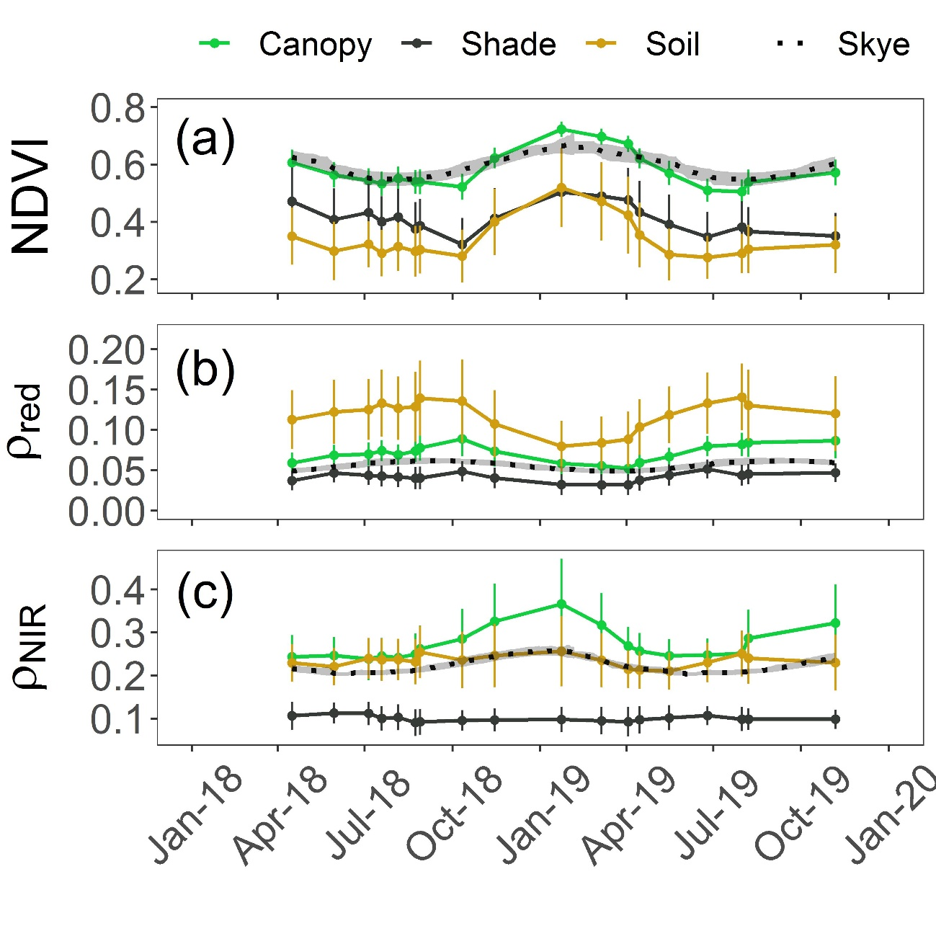
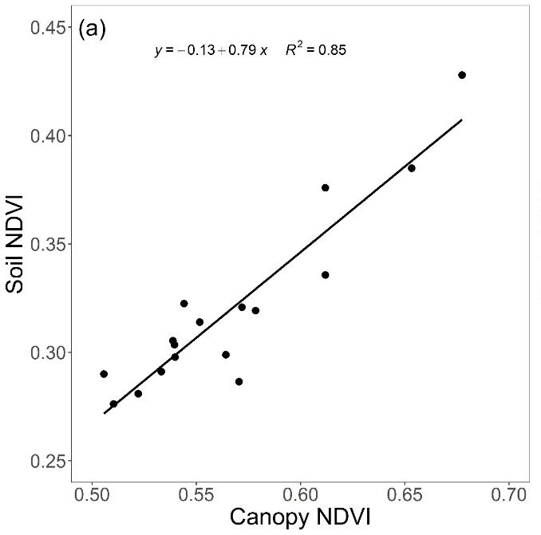
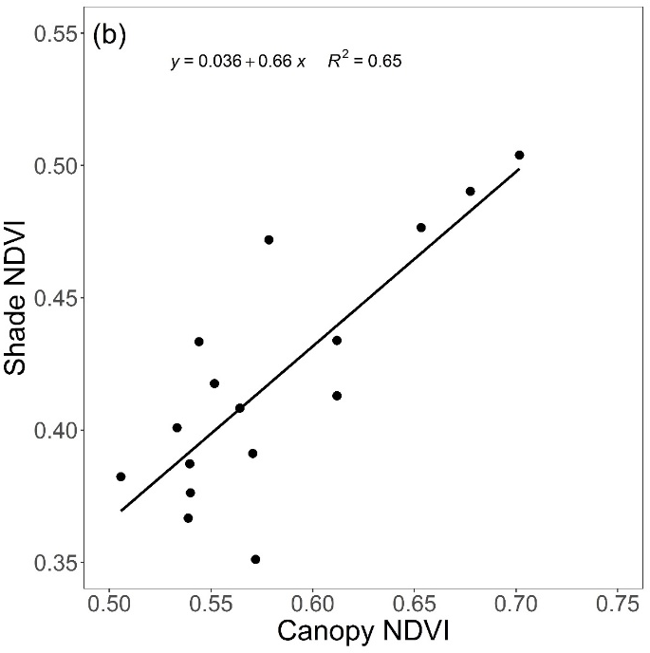
Results
Radiative properties of canopy, soil and shade
Canopy and background soil showed similar NDVI
But different in reflectance, especially in NIR
Notes:
Here are the reflectance and NDVI of the three components in the same color scales. There are three panels: top, middle, bottom. First of all, it can be seen the grey line, Skye measurements, was very close to canopy signal, consistent with 95% canopy fraction in Skye. It is shown the three component shows similar seasonal cycles in NDVI and red, which explains the same pattern between Landsat and Skye NDVI with different compositions.
The NIR is quite different. Canopy NIR went up in winter, which was a strategy to enhance light absorption in winter. Unlike red is related to pigment, NIR is more with canopy scattering properties related to structural. In our recent study published at ERL, we found there is structure changes in canopy to enhance light absorption in winter and reduce light abs. in summer to avoid overheating.
The soil reflectance changes mainly due to moisture levels. Higher moisture, lower reflectance. Here we showed high soil NIR in winter due to annuals.

Slide 10
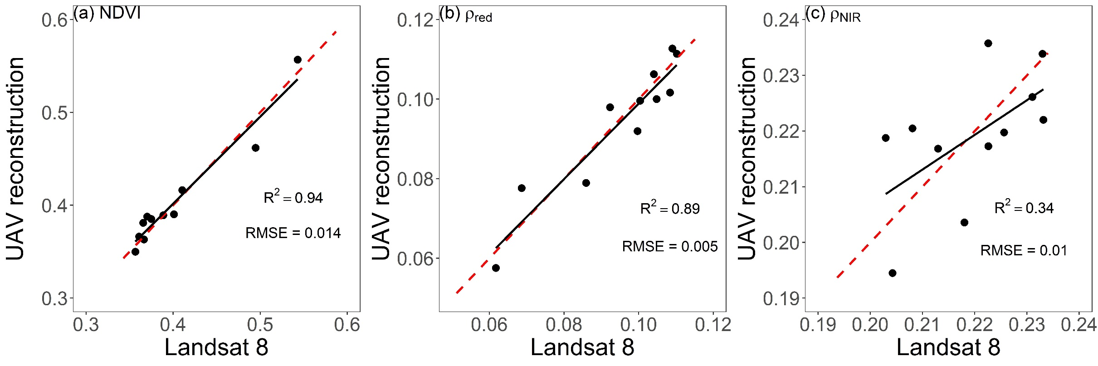
Results
Reconstruction of Landsat 8 data
Landsat 8 data could be successfully reconstructed from UAV data
Our hypothesis about the fractional contributions was confirmed
Notes:
Now after separating all the components, we want to test if we can reconstruct the satellite data based on UAV data.

Slide 11
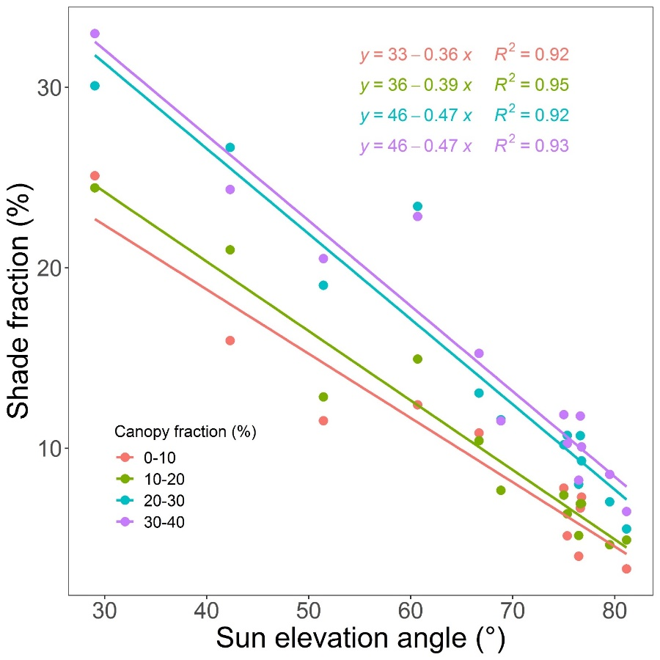
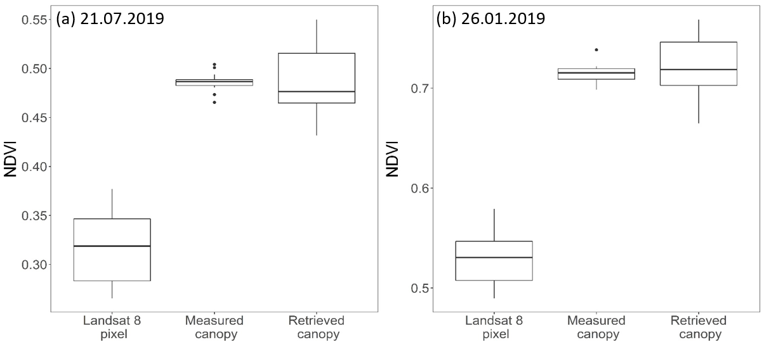
Results
Canopy NDVI retrieval algorithm
Pixel NDVI
= f(NDVI_{canopy})
= f(NDVI_{canopy})
= 1- F_{canopy} - F_{shade}
F_{canopy} : estimated from UAV multispectral images
Canopy NDVI had small variations among pixels, despite of the differences in Landsat 8 NDVI

Slide 12
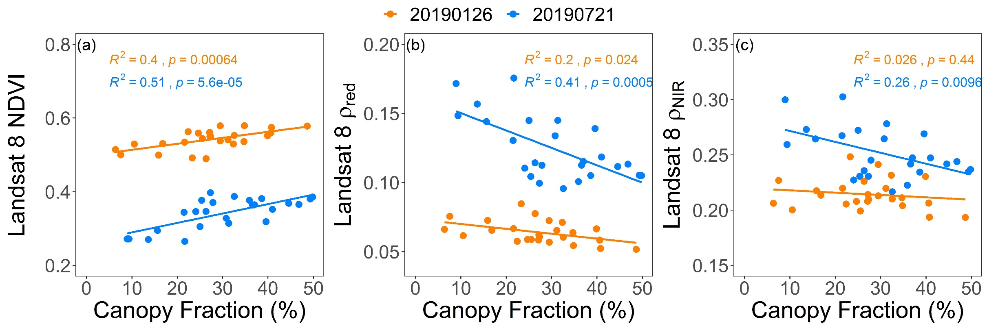
Results
Landsat 8 data and canopy cover
The differences in Landsat 8 NDVI were due to canopy fraction

Slide 13
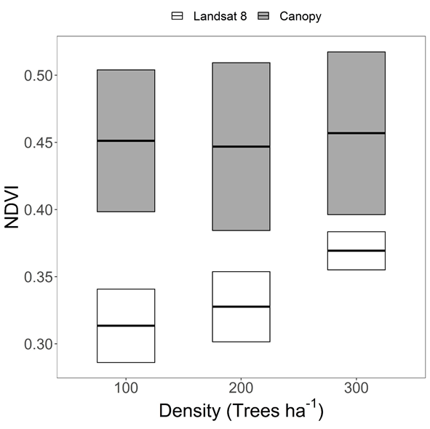
Results
Density effect at LTER experimental plots
Density effect was presented in Landsat 8 pixel NDVI
Canopy NDVI was rather homogenous regardless of density

Slide 14
Conclusions
We analyzed seasonal cycles of canopy, sunlit and shaded soil reflectance, from UAV multispectral images
The mismatch between Landsat 8 and tower Skye data at Yatir forest, was due to different fractional contribution of canopy and soil
We developed algorithm to retrieve correct canopy NDVI, and demonstrated the spatial variation in Landsat 8 NDVI was rather due to canopy fraction, associated with stand density
Accounting for non-vegetation elements in sparse ecosystems is essential for accurately interpret the satellite vegetation indices

Slide 15
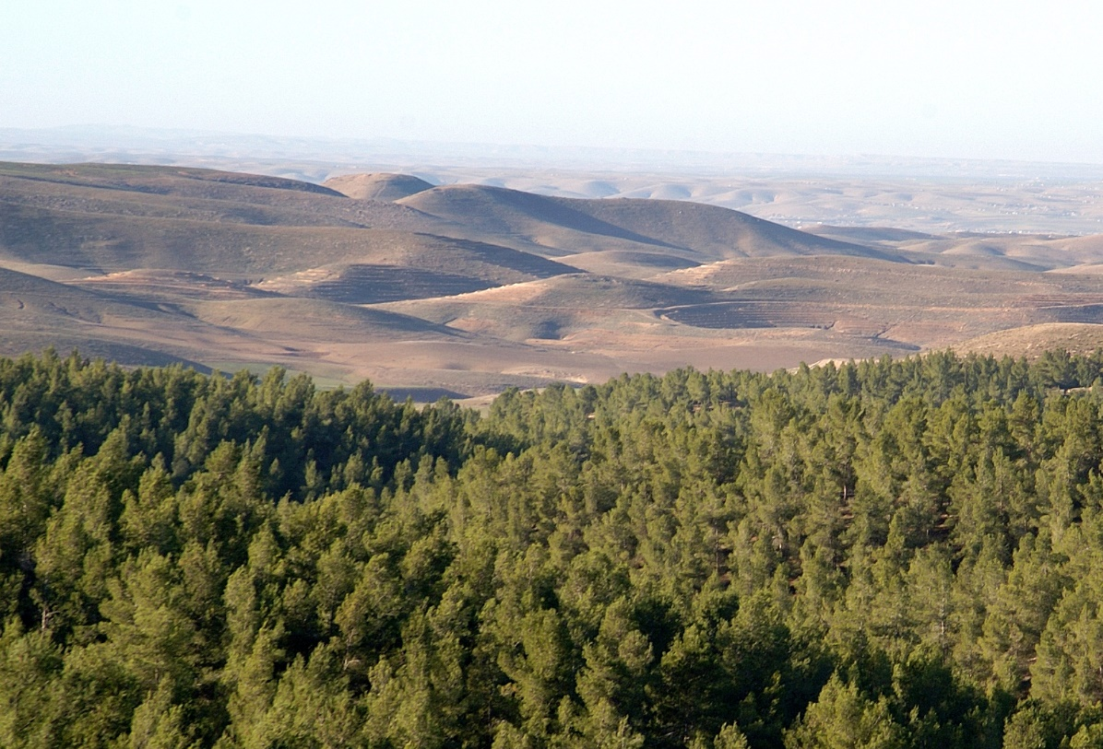
Thank you!

