Slide 1
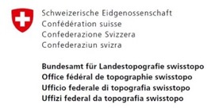



A Monte Carlo-Based Approach to Image Active 3D Fault Systems from Relocated Hypocenters
Sandro Truttmann¹, Tobias Diehl², Marco Herwegh¹
¹University of Bern, ²Swiss Seismological Service SED (ETH Zürich)
sandro.truttmann@geo.unibe.ch
25.05.2022, EGU General Assembly 2022
Notes:
I would like to introduce you a new, Monte Carlo-based approach to image active fault systems from relocated earthquake hypocenters

Slide 2
Basic Concept
Fault System
Hypocenters
Notes:
Fault system, when put under tectonic forces part of it gets reactivated seismogenically → hypocenters

Slide 3
Basic Concept
Prerequisites
Sufficient earthquakes
High relocation accuracy → relative relocations
Python toolbox
Fault System
Hypocenters
Notes:
seismogenic part can be imaged by using hypocenter locations
Prerequisites
Python toolbox to automatically image active faults from relocated hypocenter locations

Slide 4
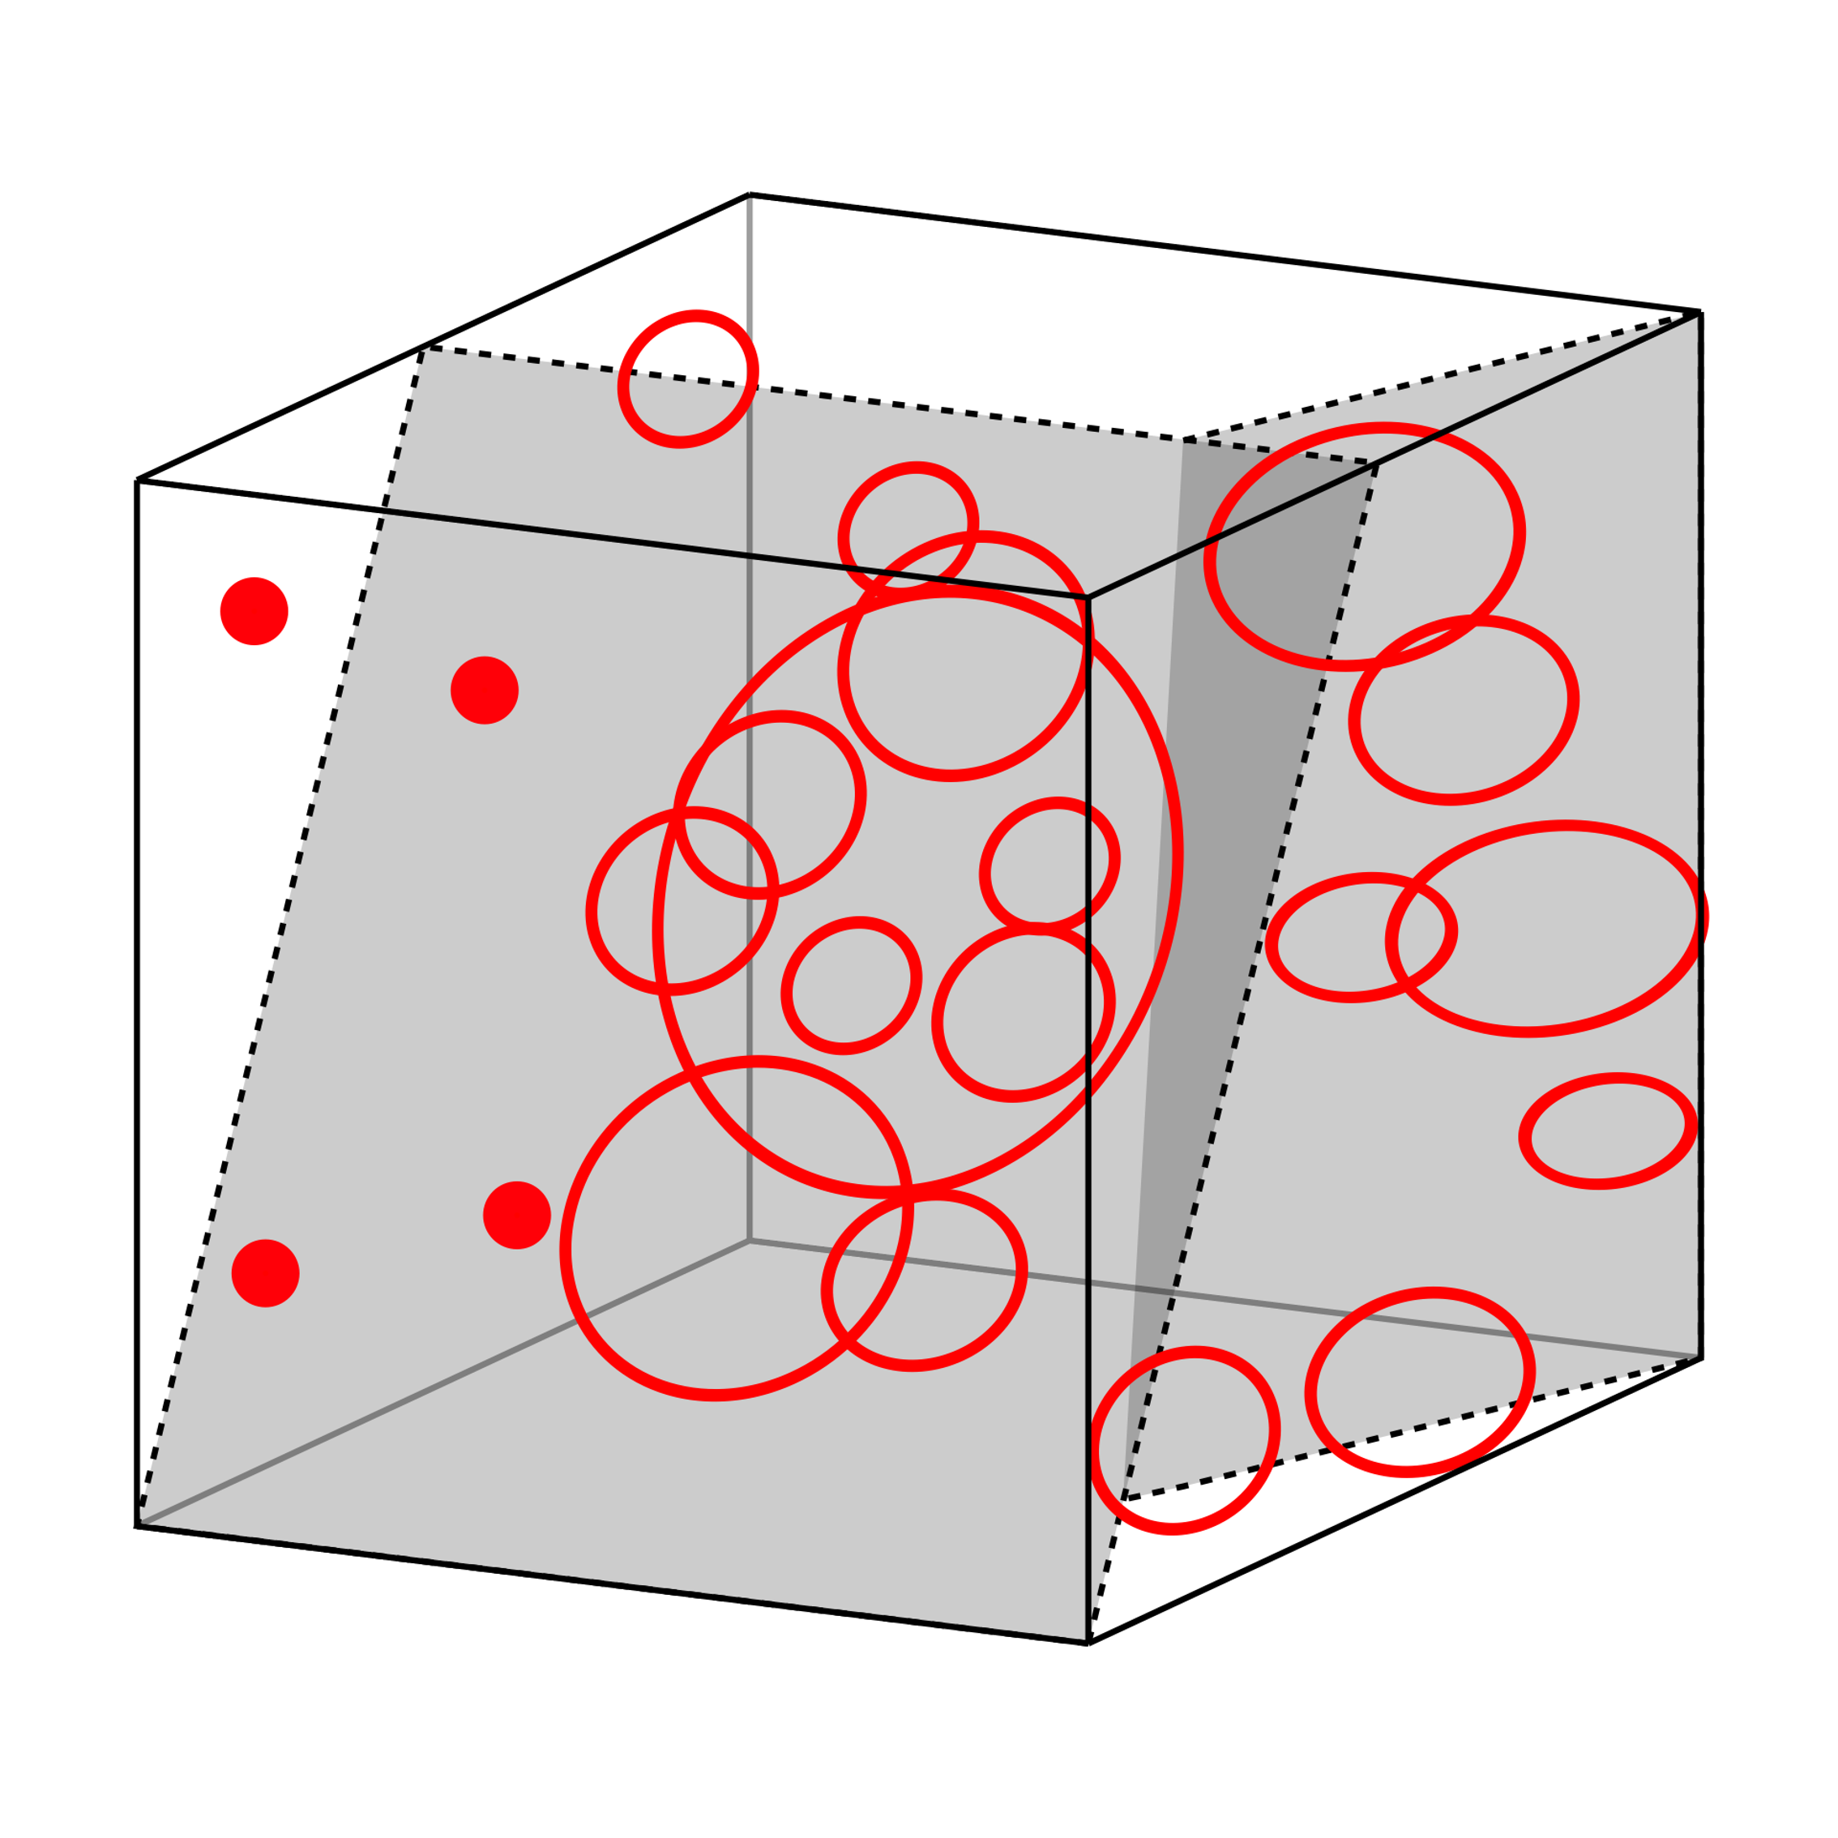
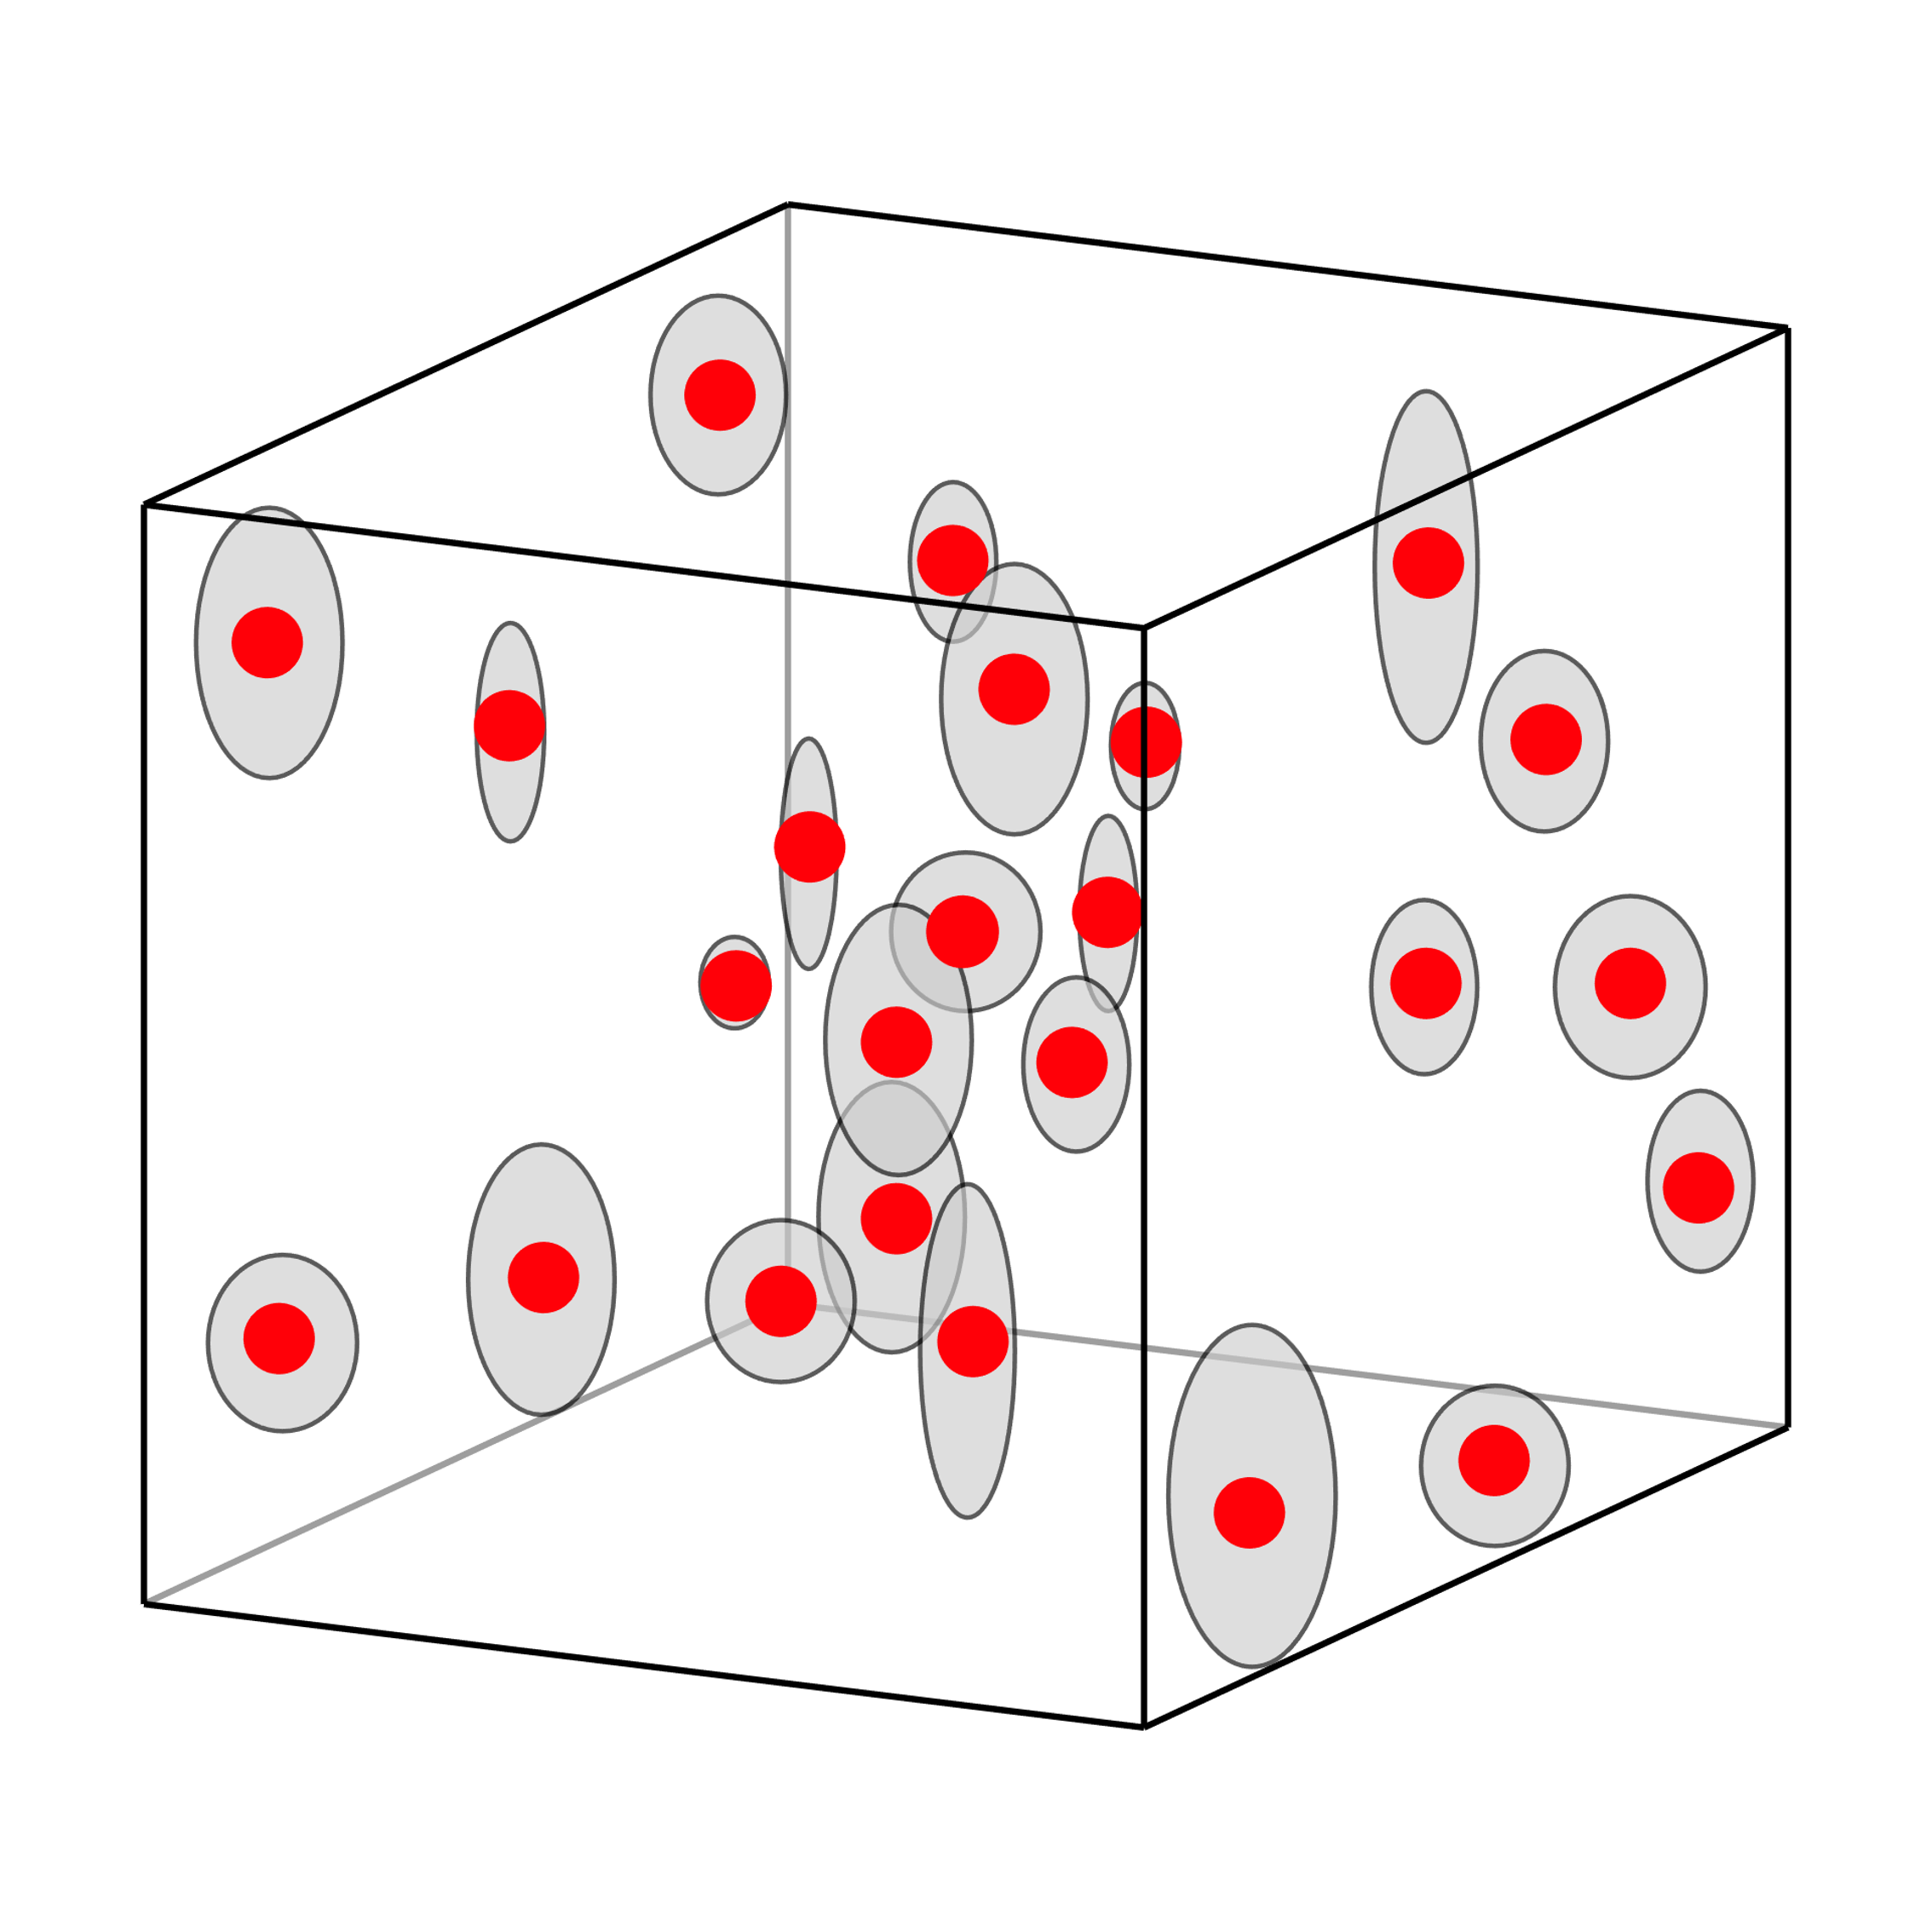
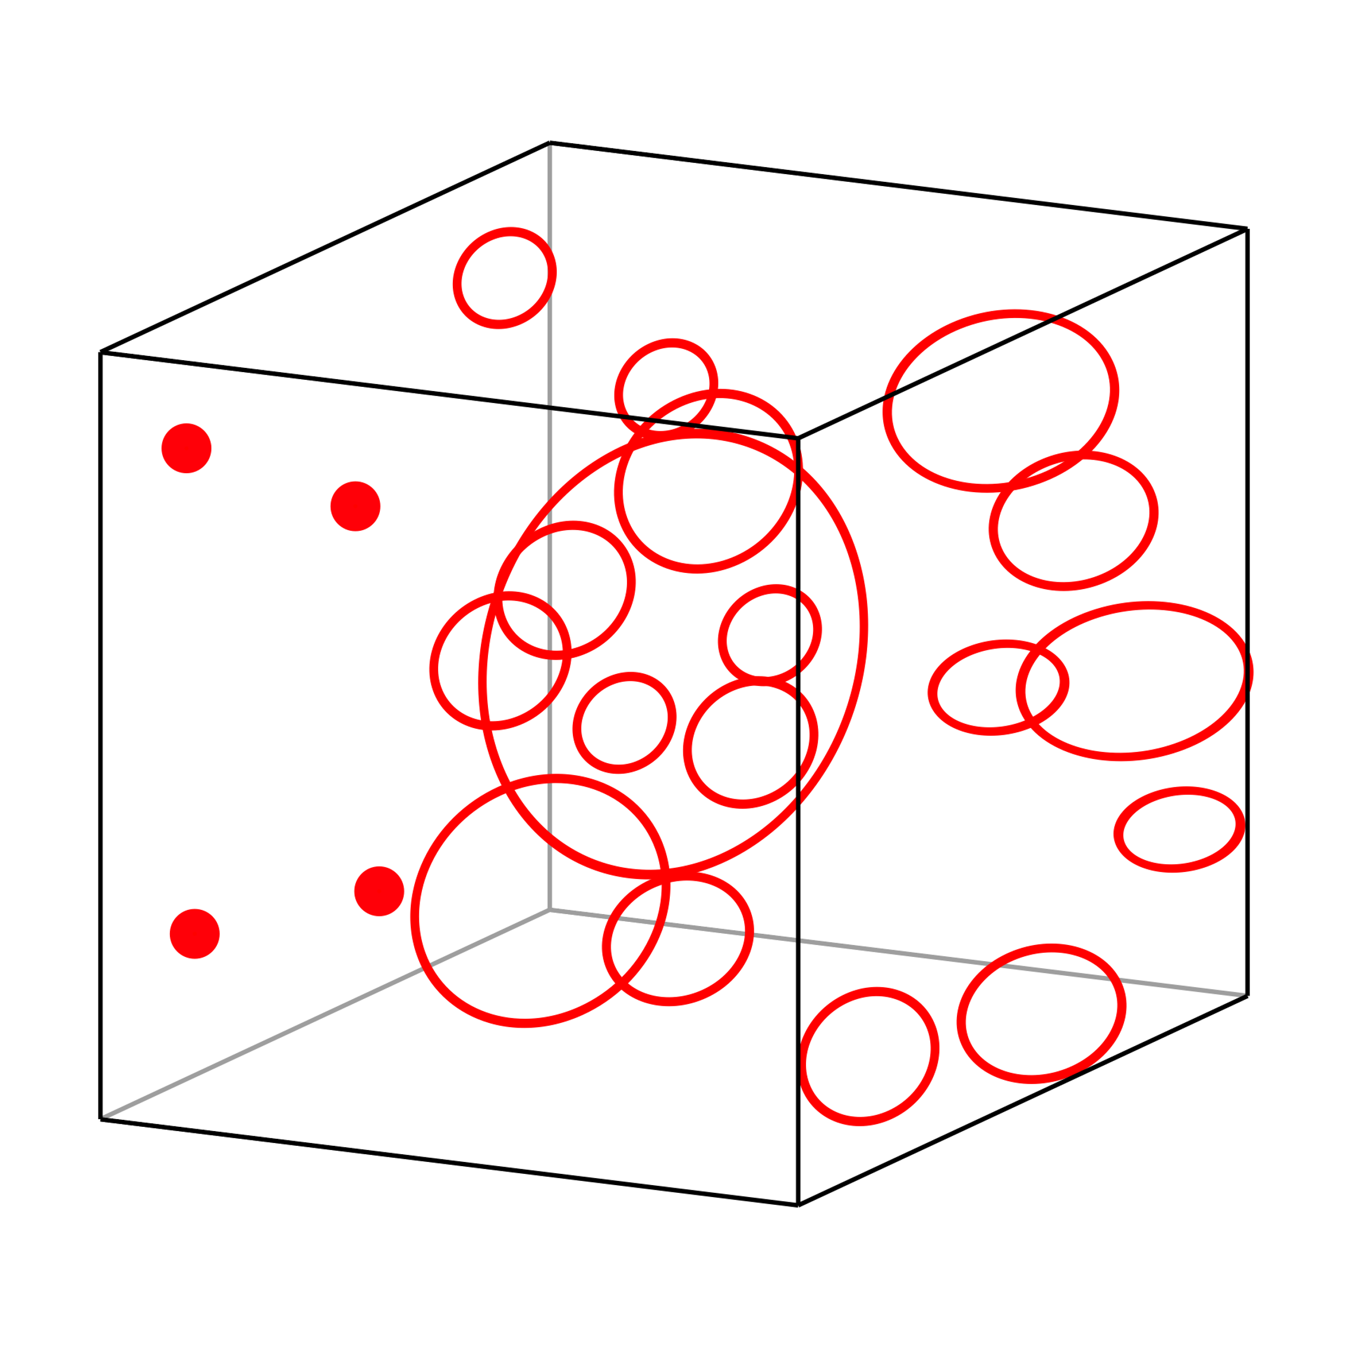
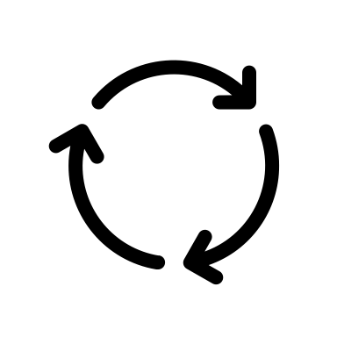
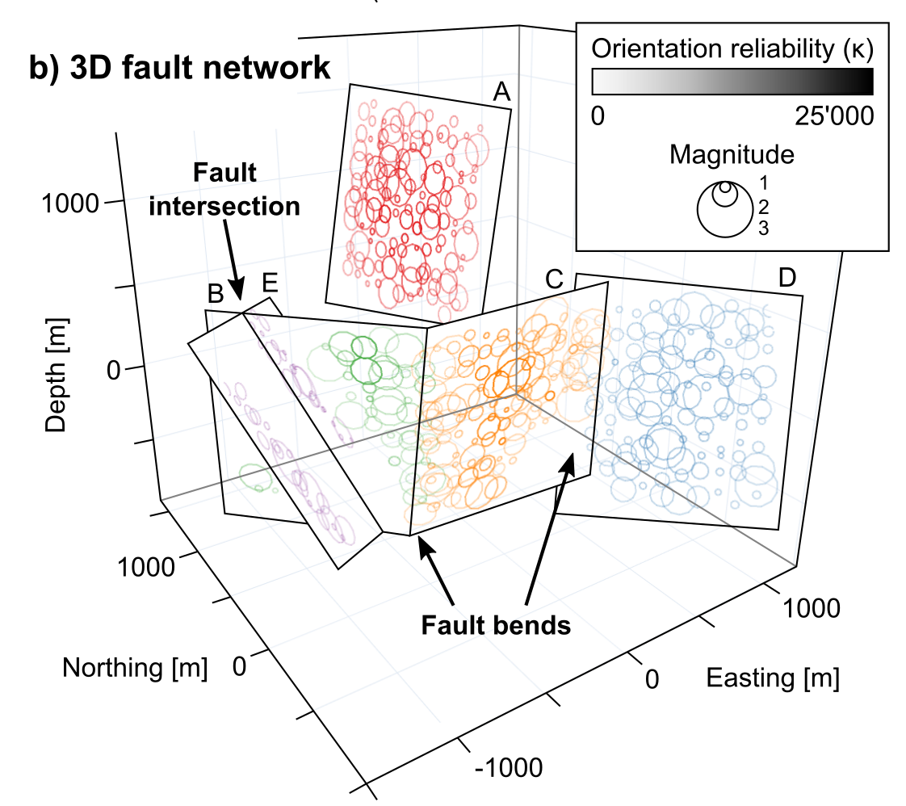
Python Toolbox
Geometries of active faults
  Nearest neighbour search
  Plane fitting (PCA)→ Fault orientation
  Mag.-Area scaling→ Fault area
  Monte Carlo simulation to account for relocation uncertainties
Validation with focal mechanisms
Stress states & kinematics
3D visualisation
MC
Truttmann et al. (in preparation)

Slide 5
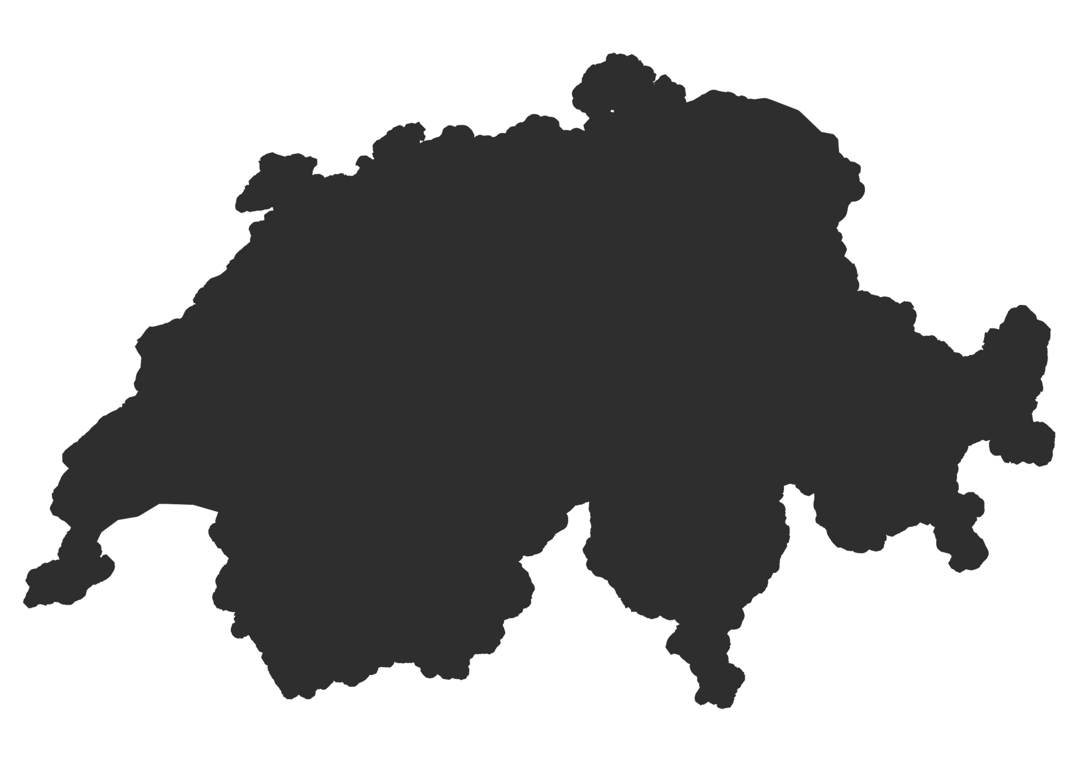
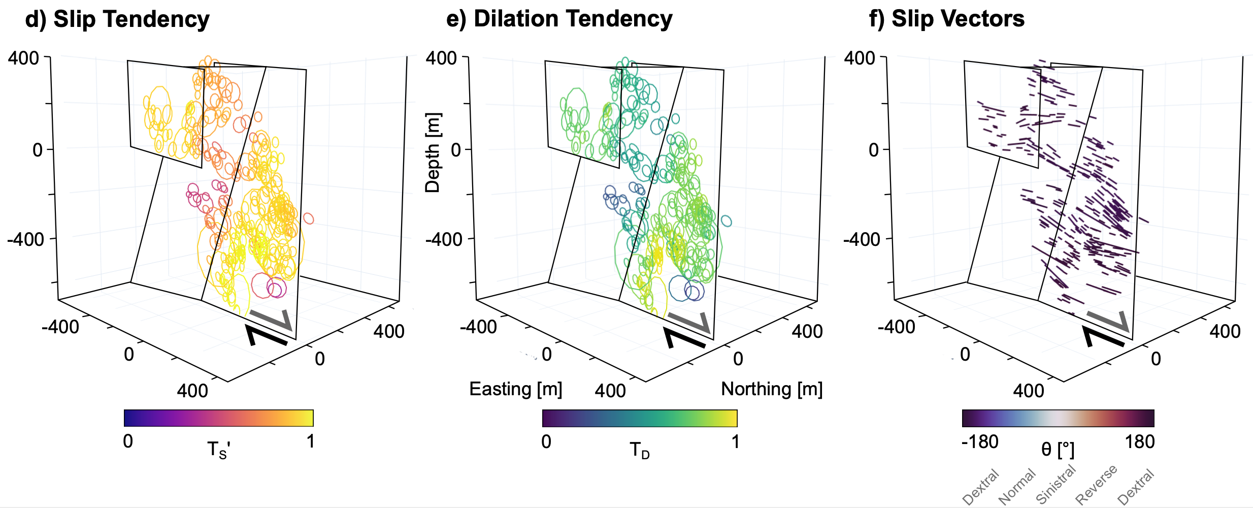
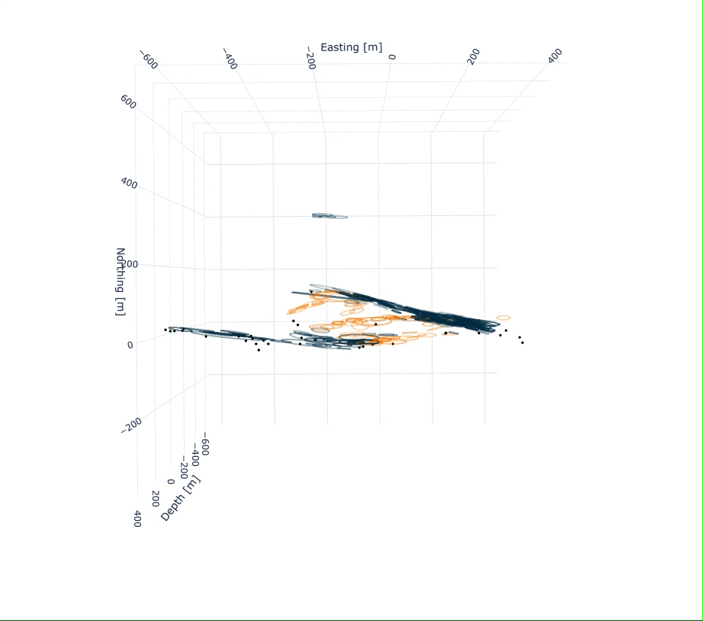
The St. Leonard Sequence
Slip tendency
2014 – 2021
n = 310
M_{L} < 3.2
Z = 6.3-7.4 km
Stepover
Kinematics
Strike-slip
faults
Truttmann et al. (in preparation)
Notes:
Application to a natural EQ sequence: St. Leonard in SW Switzerland
Image 3D geometries, reveals SS faults with interconnecting stepover
Stress states: easy slip on SS faults
Kinematics: slip vectors tell us direction of slip
Opens new possibilities in the understanding of seismogenic fault reactivation

Slide 6
Key messages
The Python toolbox allows to image the geometries, stress states and kinematics of active faults in an automated way
We successfully applied the toolbox on high-quality earthquake hypocenter datasets from the SW Swiss Alps
Future applications might include further datasets from natural earthquakes, but also from other origin (e.g. hydraulic stimulation experiments)
Interested? sandro.truttmann@geo.unibe.ch

