Slide 1




A non-destructive approach to estimate buttress volume using 3D point cloud data
Tao Han
Connor Bax, Steven Wagers, Arturo Sánchez‐Azofeifa

Slide 2
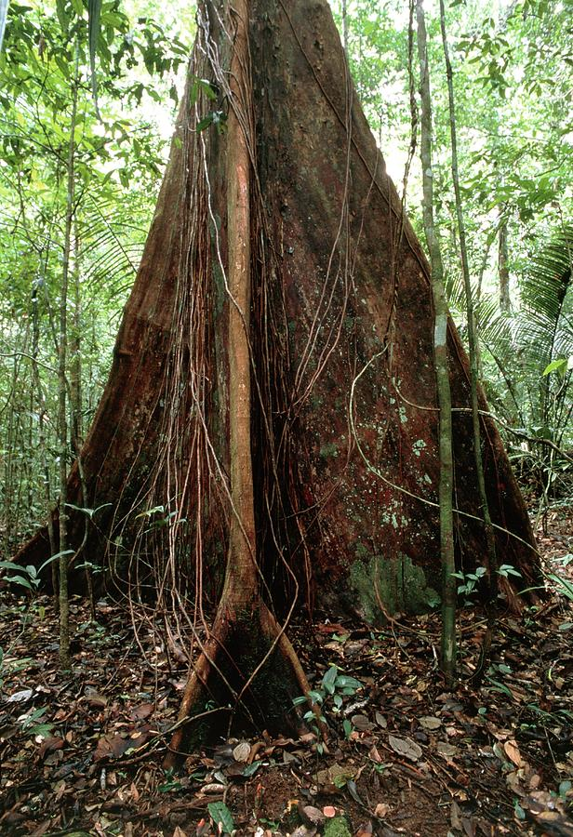
What is the buttressed trees?
Buttresses: large, wide roots on all sides of a shallowly rooted tree.
Balance the trees against unidirectional stress such as asymmetric canopy and prevailing wind.
Serve as barriers to matter flow, leading to a high accumulation of litter, soil moisture and nutrient.
Provide an important microhabitat for many life forms.
Fix a large amount of carbon due to their high wood volume.
Buttressed tree (Source: Google image)

Slide 3
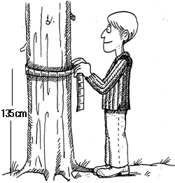
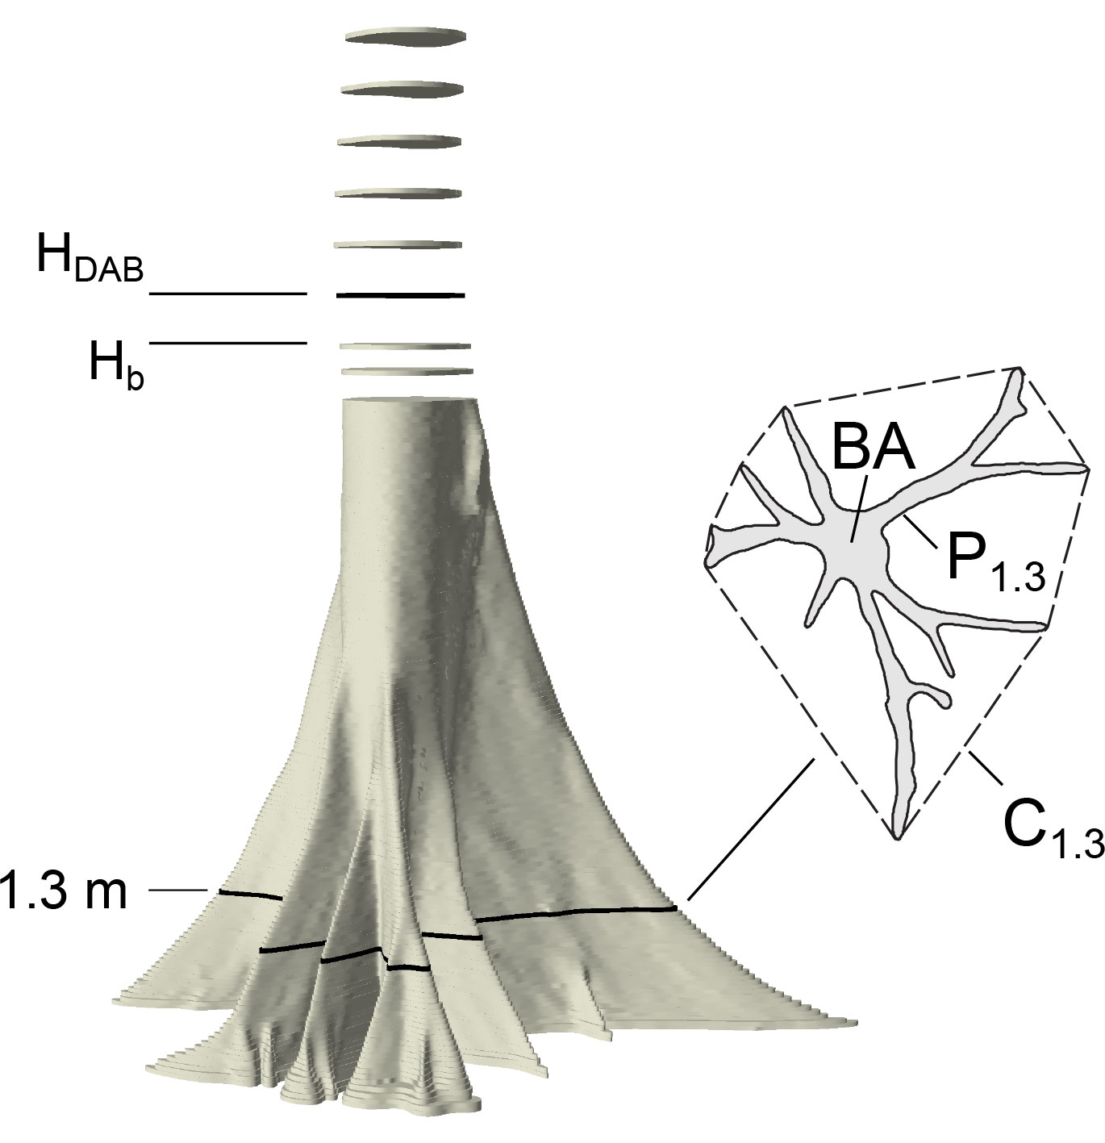
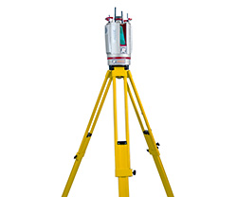
The measurement of buttressed trees
(a) Regular tree (Source: Google image)
(b) Buttressed tree (Nölke et al., 2015)
(c) Lidar collection

Slide 4
Study area and data
Table 1. General description of the three databases used in this research.
Database | Acronym | Location | Mean annual precipitation (mm) | Methods | Number
The Yangambi Reserve, Democratic Republic of Congo | YR | 0° 46′ 3″ N 24° 26′ 29″ E | 1762 | Photogrammetry | 30
 |  |  |  | Destructive | 3
Bogor Botanical Garden, Indonesia | BBG | 6° 35′ 51″ S 106° 47′ 54″ E | 4330 | Terrestrial Laser Scanning | 12
Santiago de Puriscal, Costa Rica | SP | 9° 49' 55'' N 84° 19' 60'' W | 2570 | Terrestrial Laser Scanning | 6
30 point clouds from YR database contains two species: :
13 Celtis mildbraedii (Ulmaceae, OHIA)
17 and Entandophragma cylindricum (Meliaceae, SAPELLI)
6 point clouds from SP database cover different species to indicates broader applications of our method
Allometric model development:
30 trees and 7 trees from YR and BBG database, respectively
Model validation:
3 trees and 5 trees from YR and BBG database, respectively

Slide 5
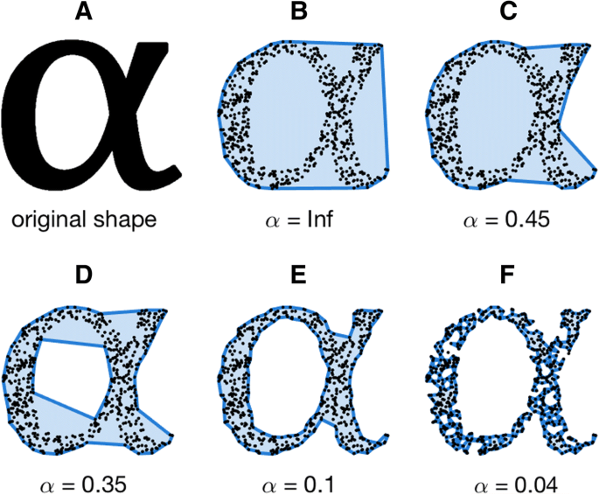
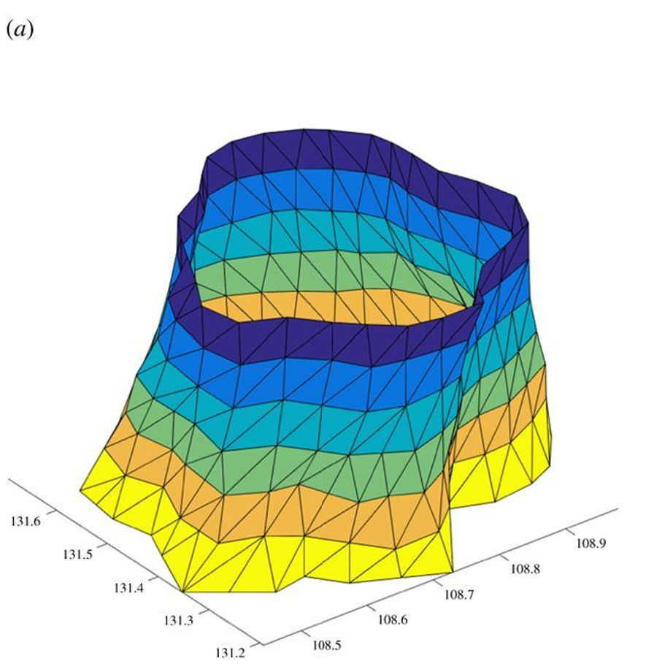
Alpha shape algorithm and slice triangulation
(a) Alpha shape algorithm (Gardiner et al., 2018)
(b) Slice triangulation (Disney et al., 2018)

Slide 6
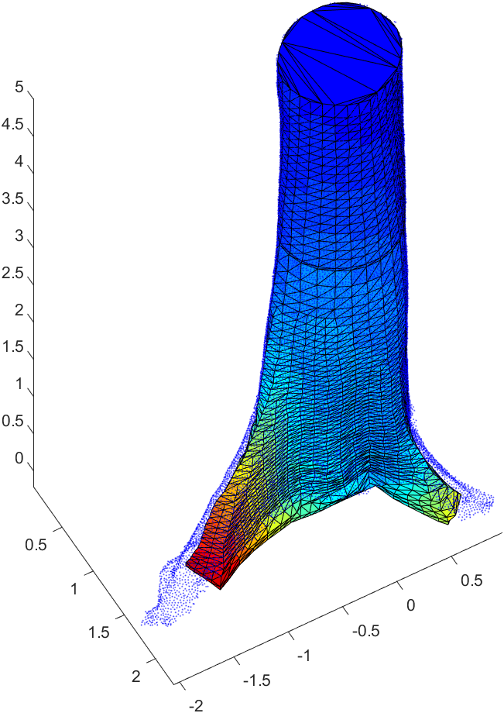
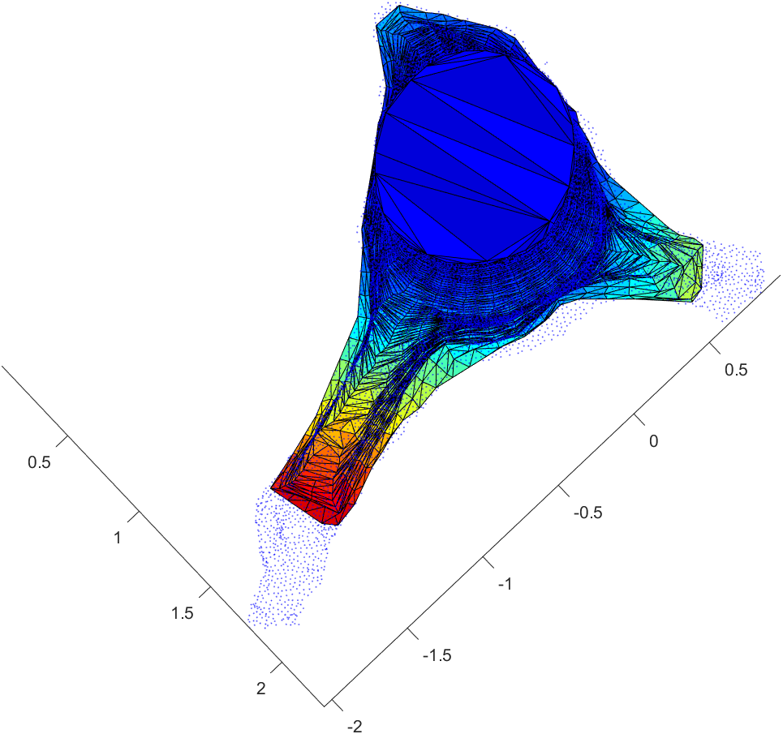
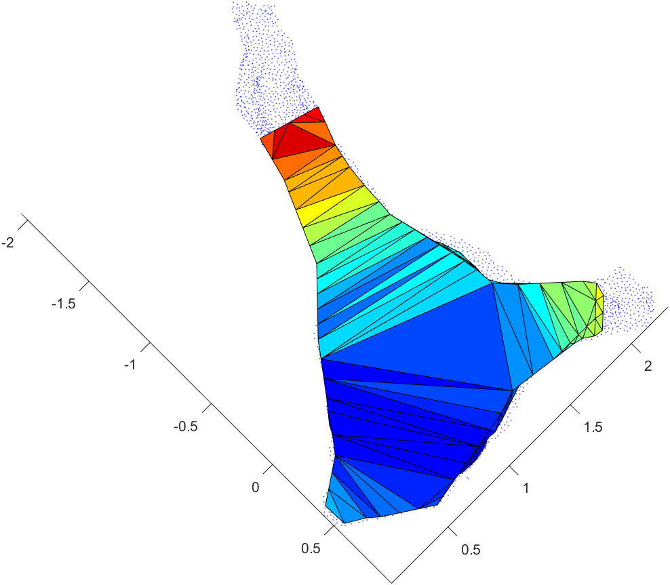
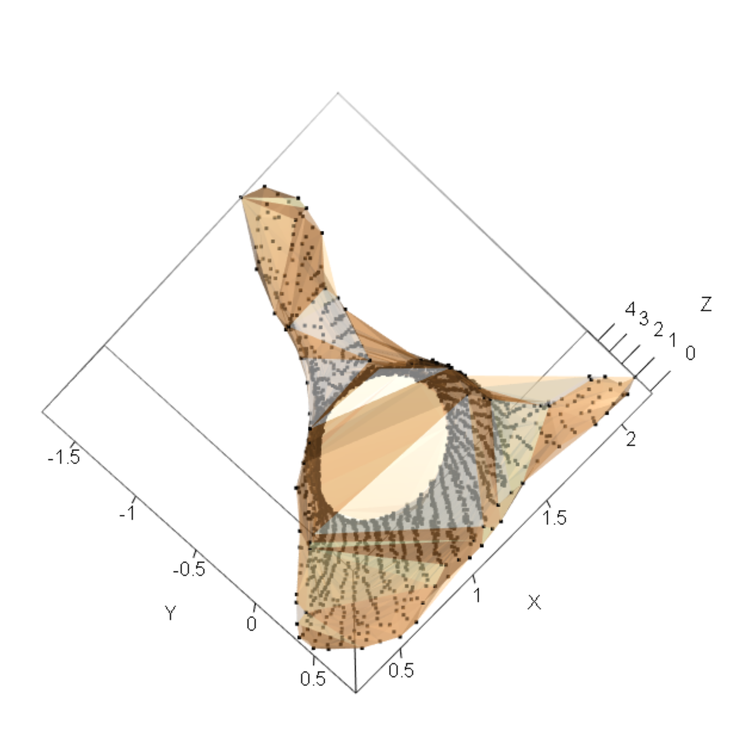
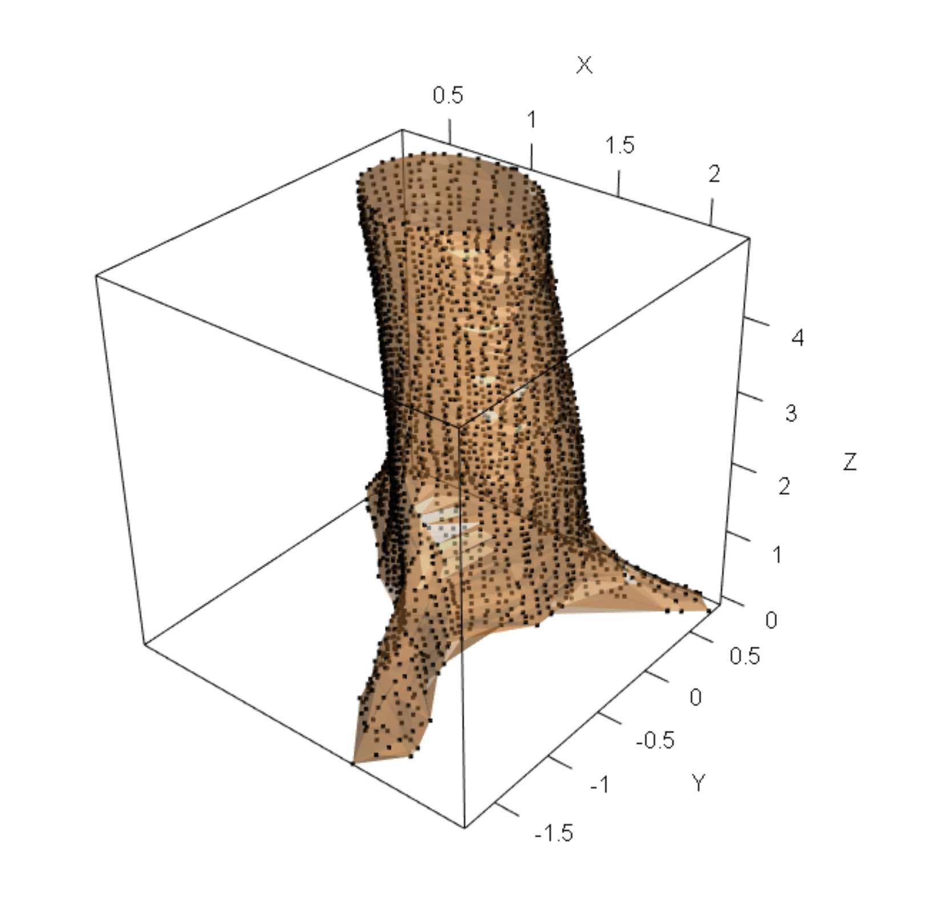
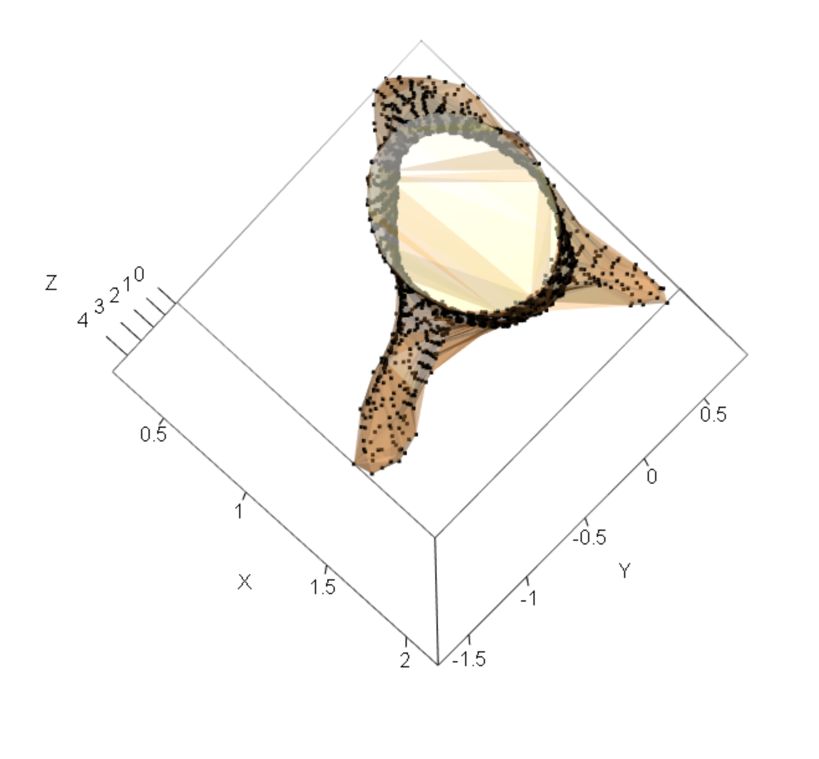
SAPELLI:
Mean volume: 10.06 m³
Slice Triangulation
RRMSE: 0.08
(a) Bottom view
(b) Side view
(c) Top view
RRMSE = RMSE/MEAN
Alpha
Shape Algorithm
RRMSE: 0.05
(d) Bottom view
(e) Side view
(f) Top view

Slide 7
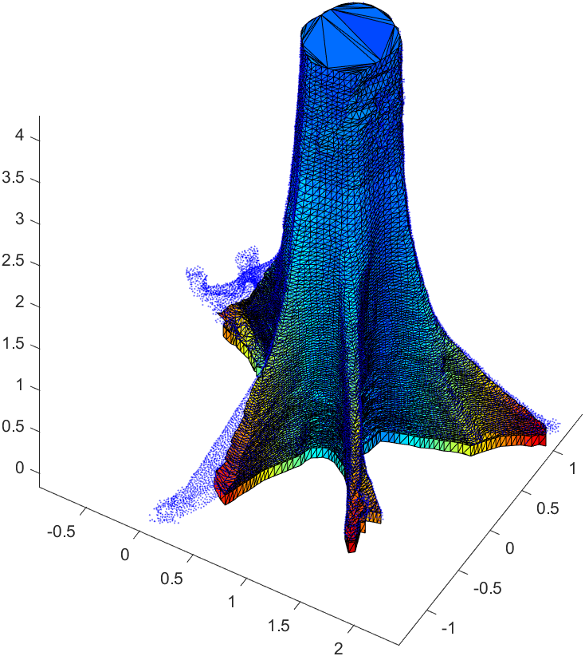
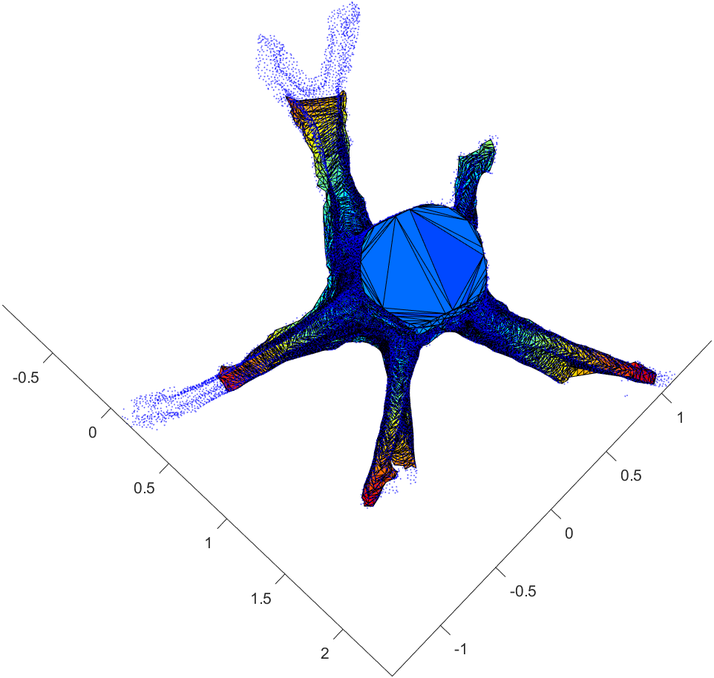
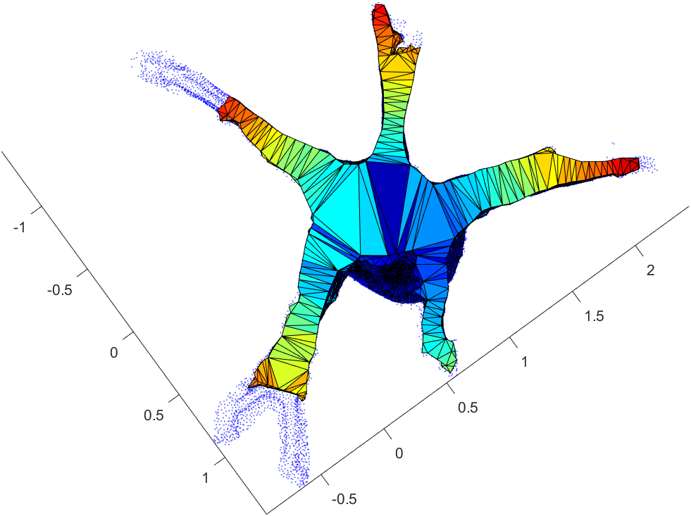
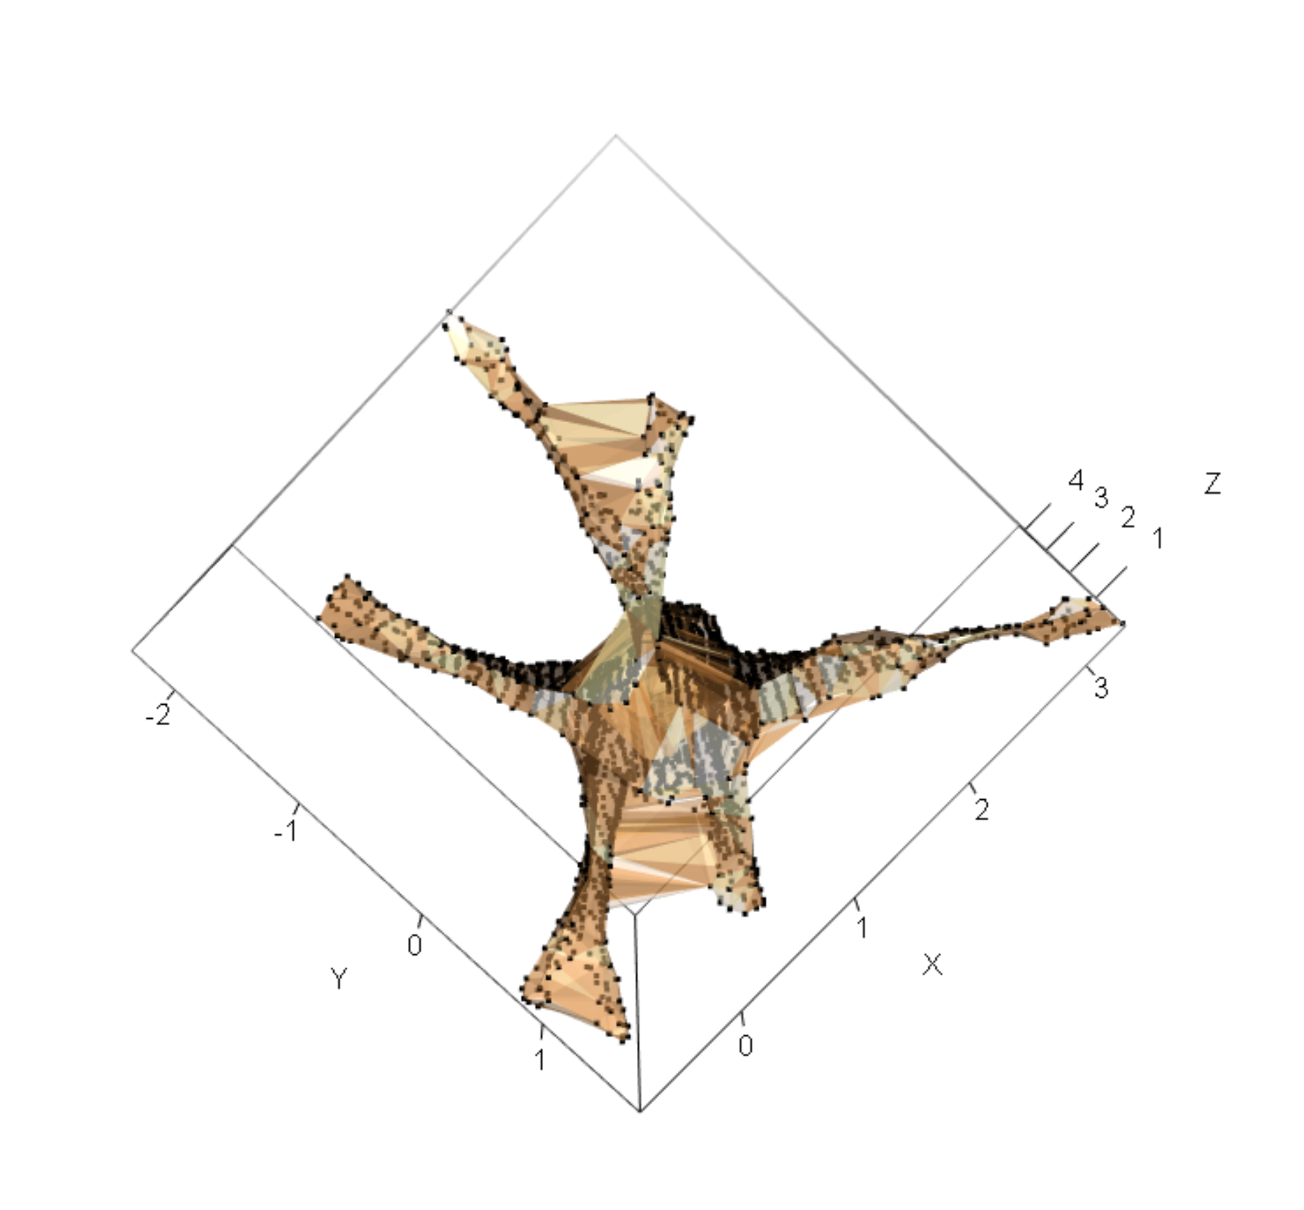
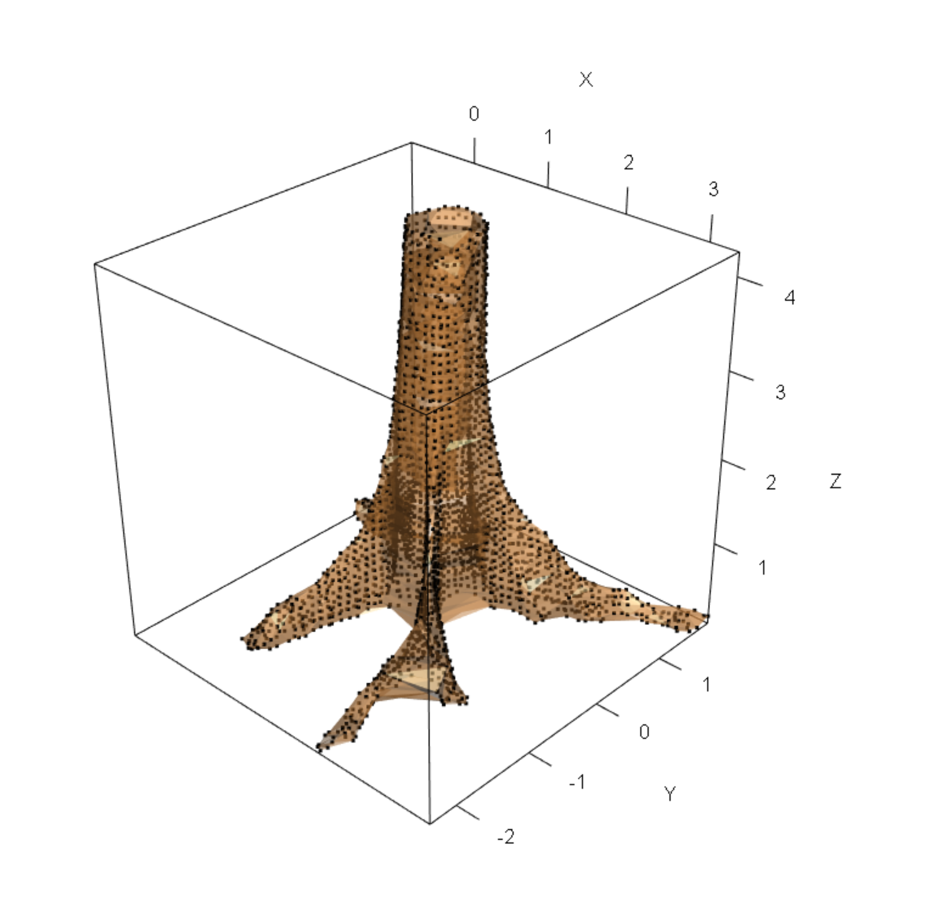
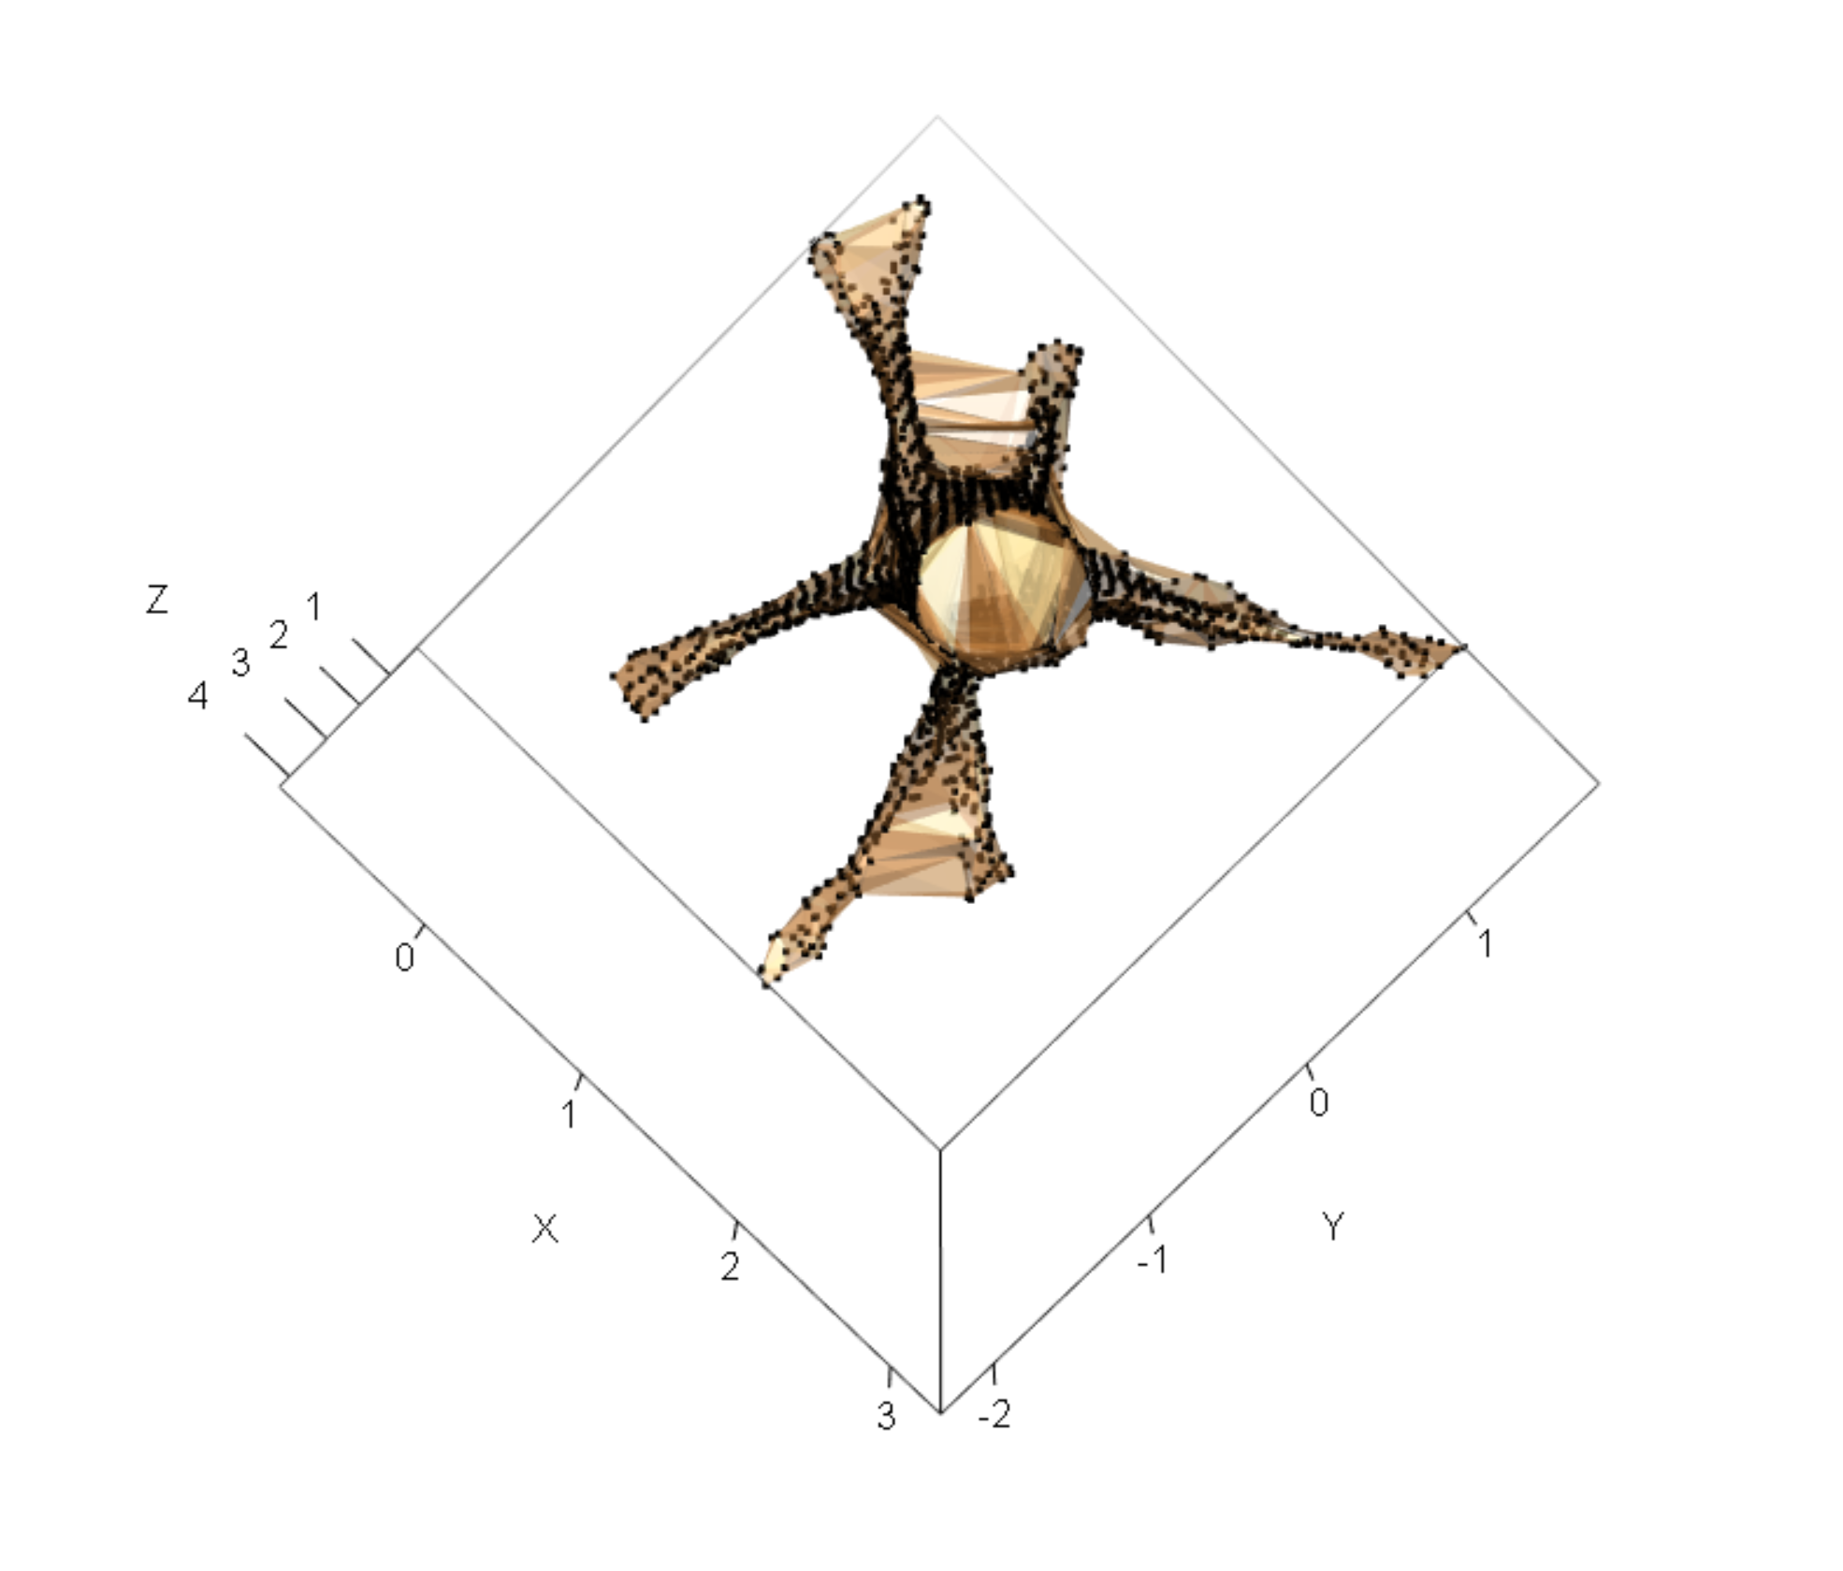
OHIA:
Mean volume: 2.12 m³
Slice Triangulation
RRMSE: 0.15
(a) Bottom view
(b) Side view
(c) Top view
Alpha
Shape Algorithm
RRMSE: 0.15
(a) Bottom view
(b) Side view
(c) Top view

Slide 8
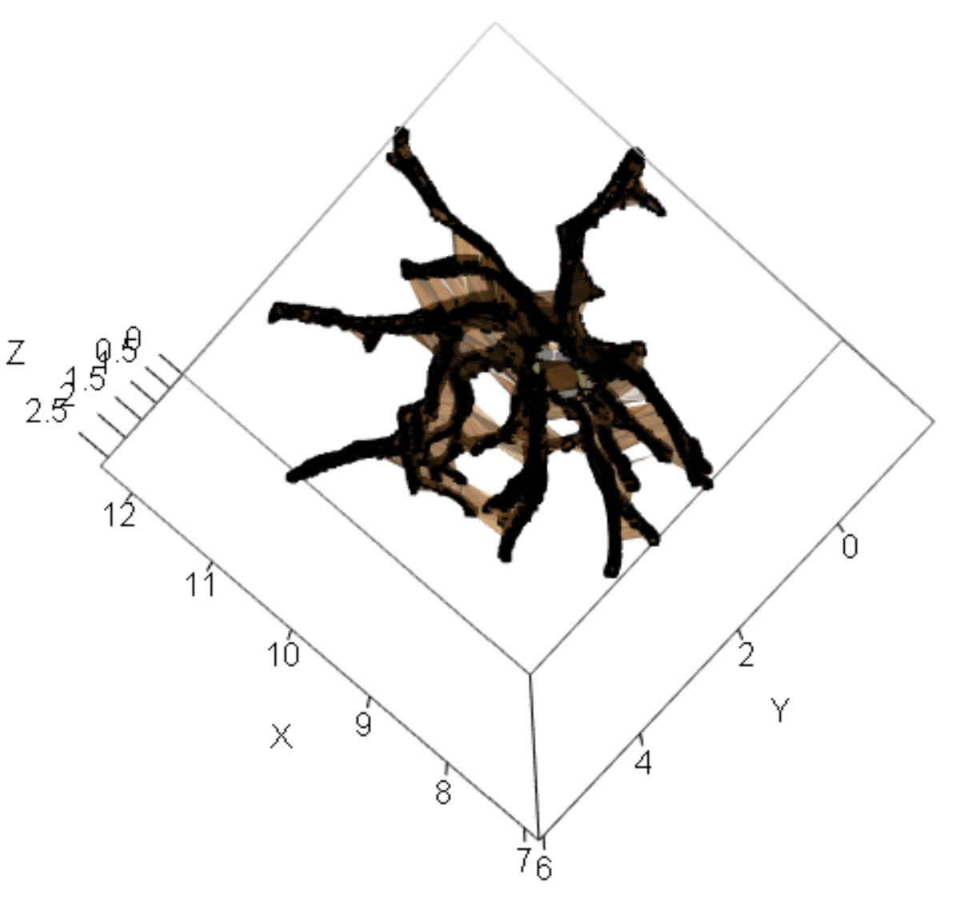
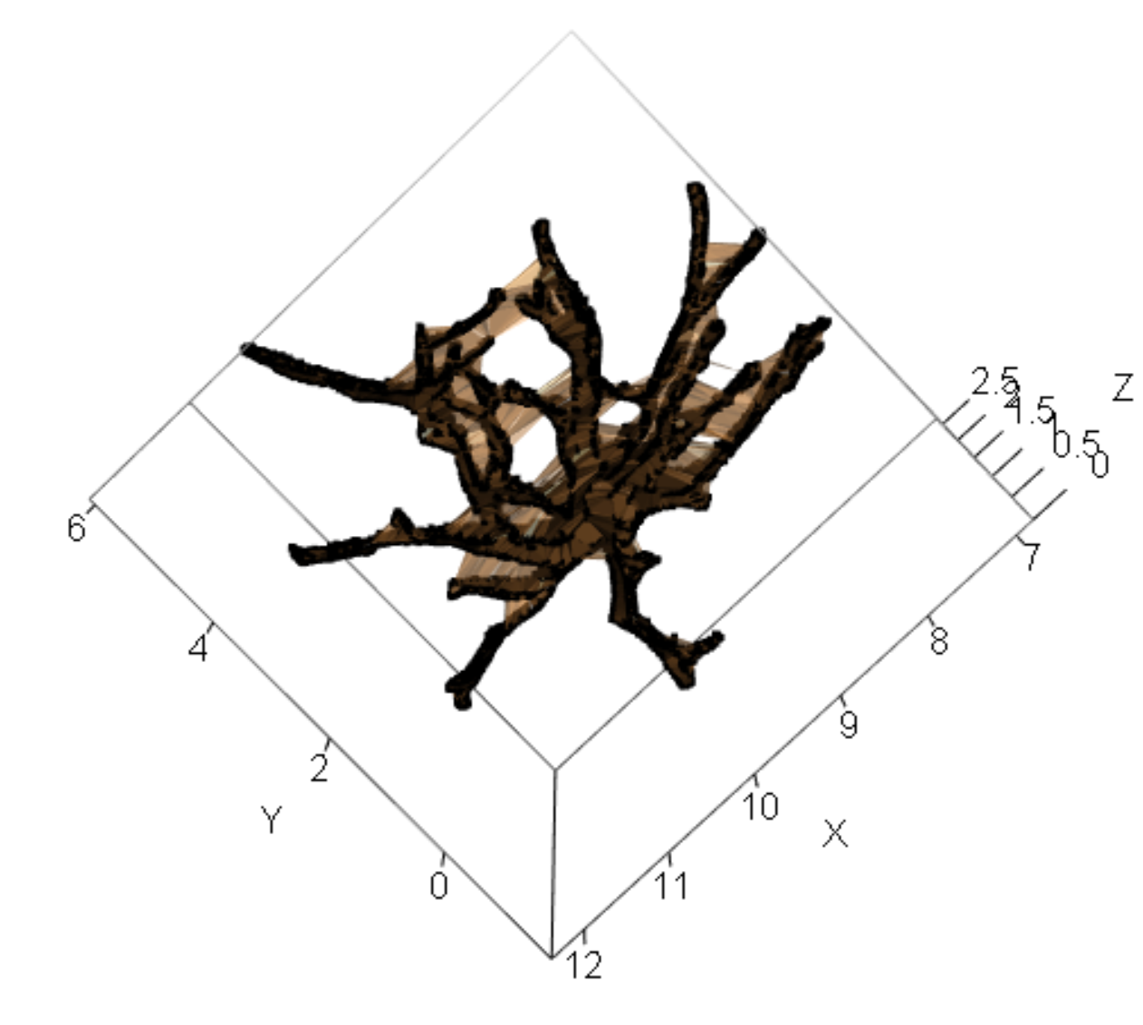
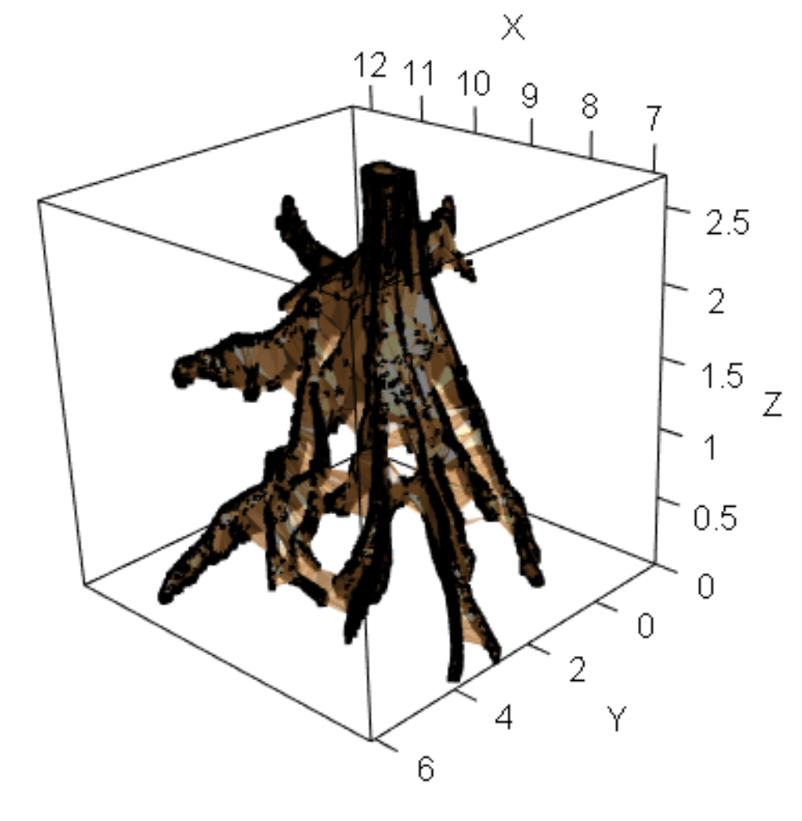
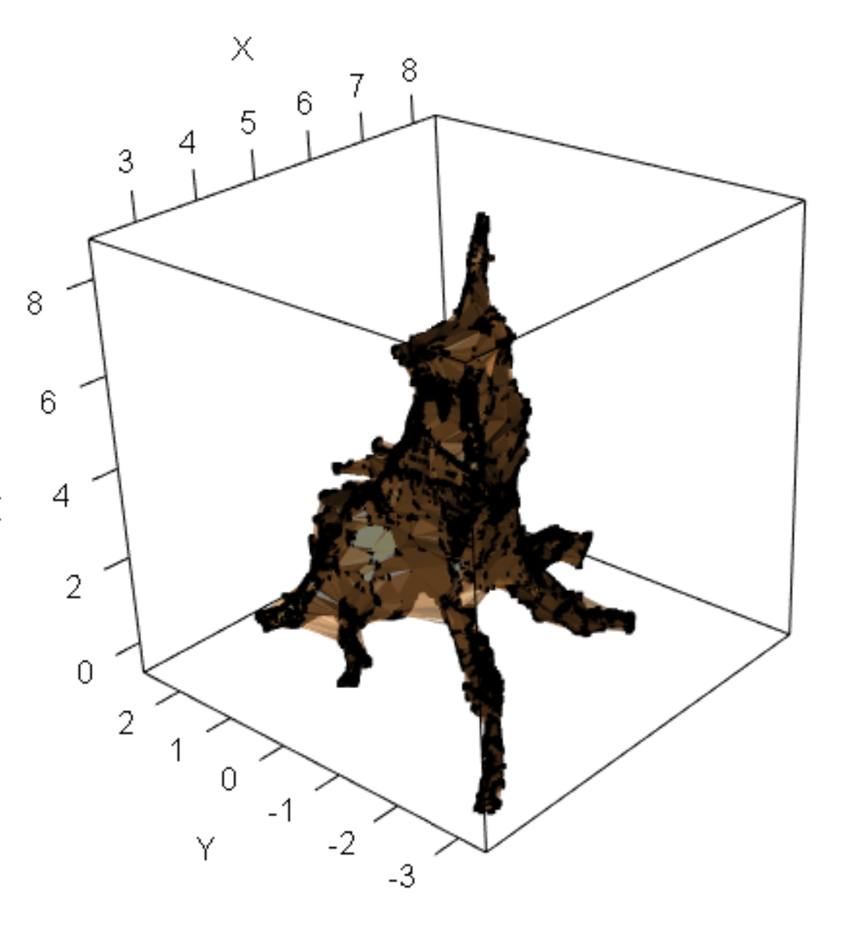
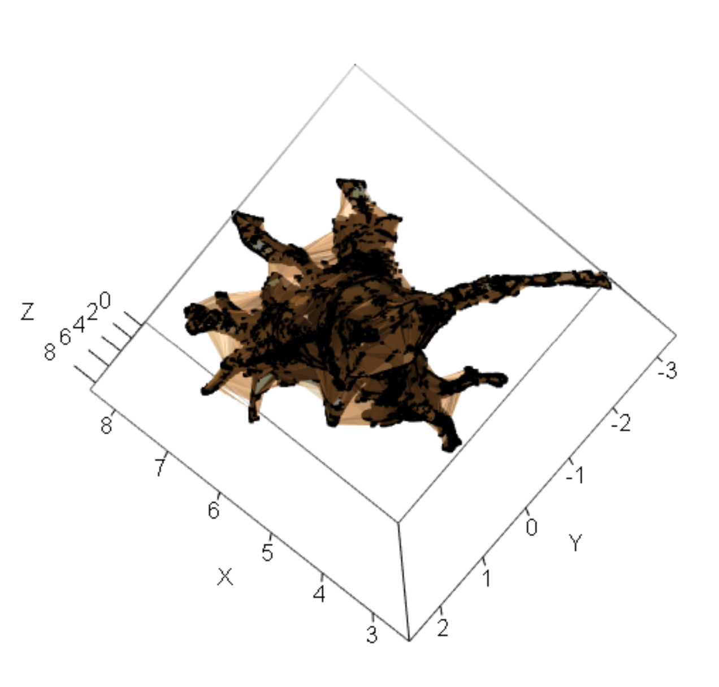
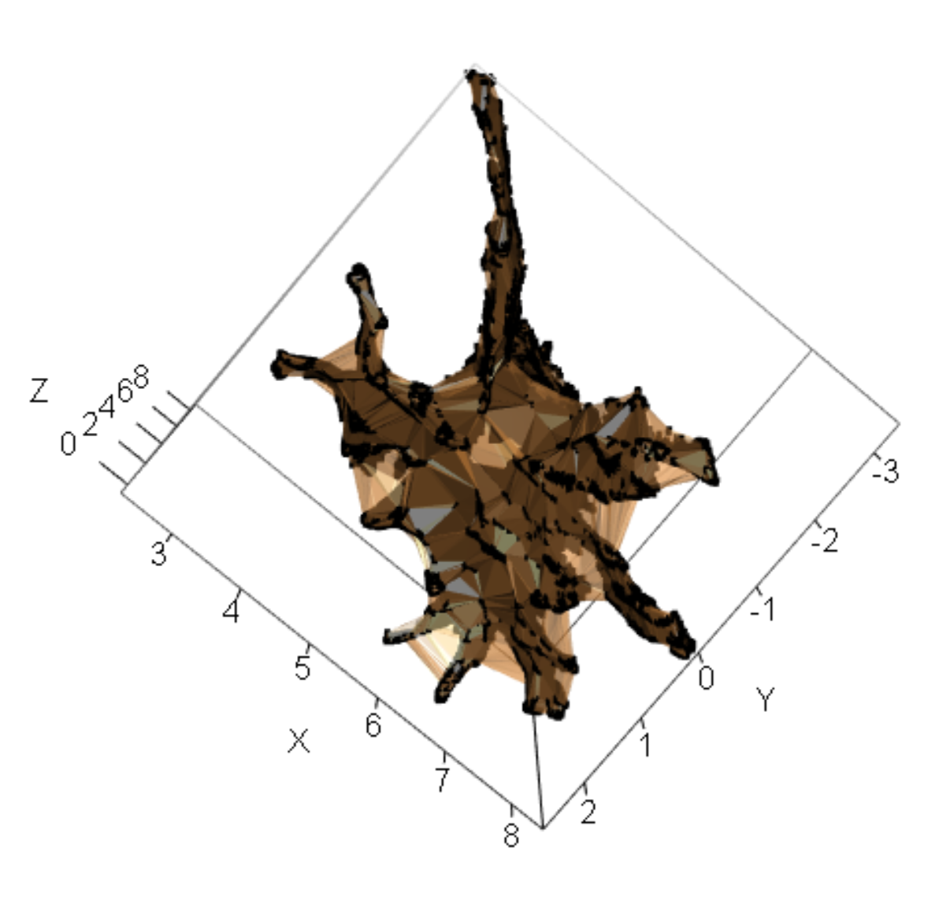
Trees presents more and shallower buttresses
Tree 1
(a) Bottom view
(b) Side view
(c) Top view
Tree 2
(a) Bottom view
(b) Side view
(c) Top view

Slide 9
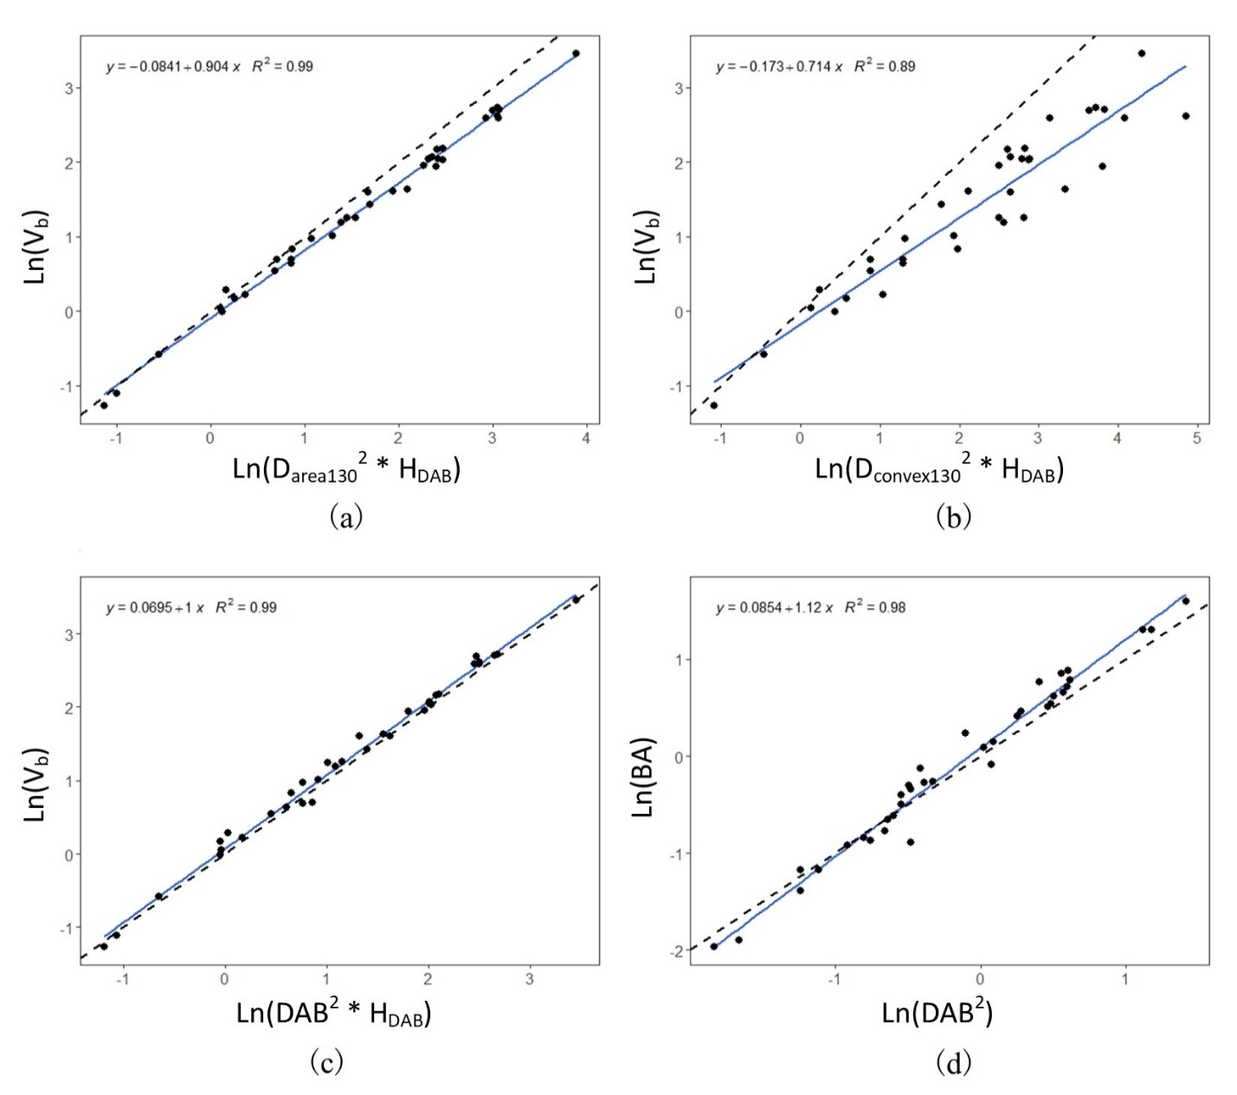
Allometric models
Table 2. Model performance on validation data.
Model | RRMSE
DAB | 0.23
Darea130 | 0.21
Dcovex130 | 0.74
DAB, diameter above the buttress;
D_{area130}, the diameter at the breast height (1.3 m) that assumes a circle disc with the same area as basal area;
D_{convex130}, the diameter that assumes a circle disc calculated from the same perimeter as the perimeter of the convex hull at the breast height.
RRMSE = RMSE/MEAN

Slide 10

Conclusions
The alpha shape algorithm and slice triangulation perform similarly on volume estimation, outperform the allometric models.
The alpha shape algorithm tends to work better than slice triangulation when the trees present more and shallower horizontal buttresses.
The proposed non-destructive method can help to correct the bias in the present and past estimates of volume and biomass of large trees, which are keystone components to understanding biomass allocation and dynamics in tropical forests.
Thank you and feel free to contact me at
than2@ualberta.ca

