Slide 1
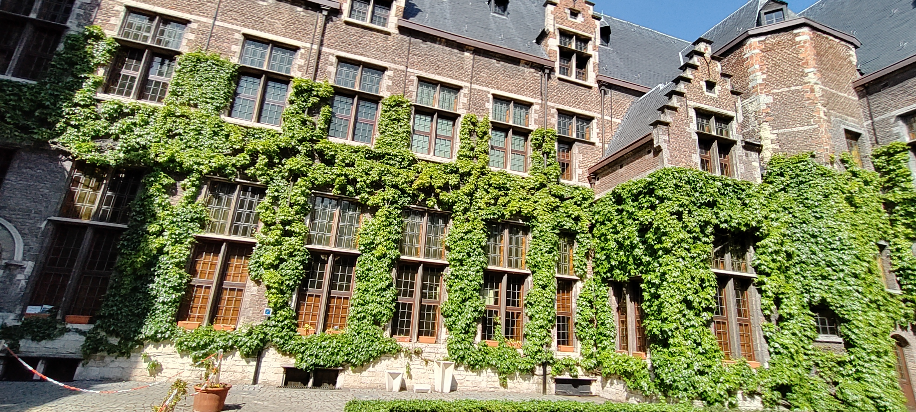
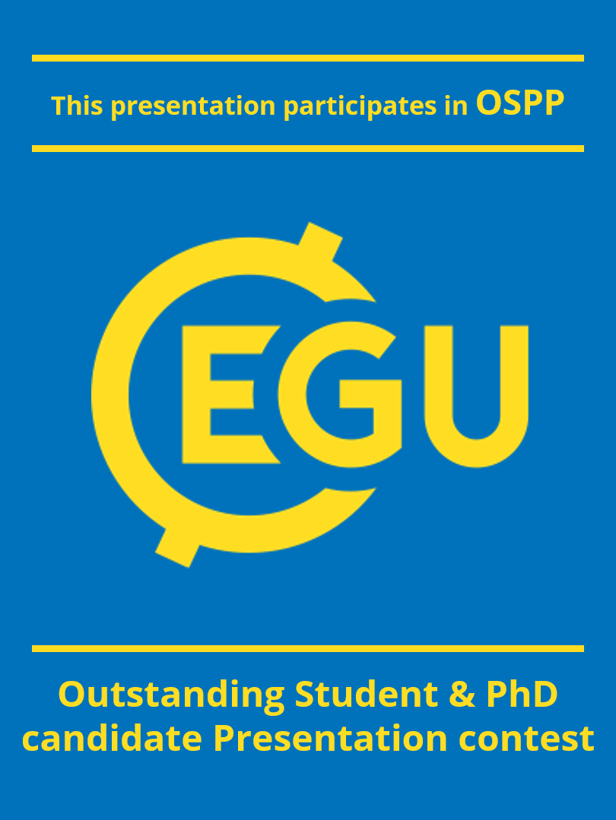



Technical compatibility of vertical greening with built heritage
EGU General Assembly 2022
University of Antwerp (Belgium)
PhD student: Marie De Groeve
Supervisors: Tim De Kock and Scott Allan Orr
Notes:
Hello everyone! Thank you very much for having me. I’m Marie and I’m a PhD student from the university of Antwerp and a colleague of a previous speaker, Eda Kale. Today I Will explain my research topic: the technical compatibility of vertical greening with built heritage.

Slide 2
INTRODUCTION
Climate stressors and the mitigation strategies in cities
Notes:
To start with, I’ll give you a short introduction and some relevant context for my research.

Slide 3
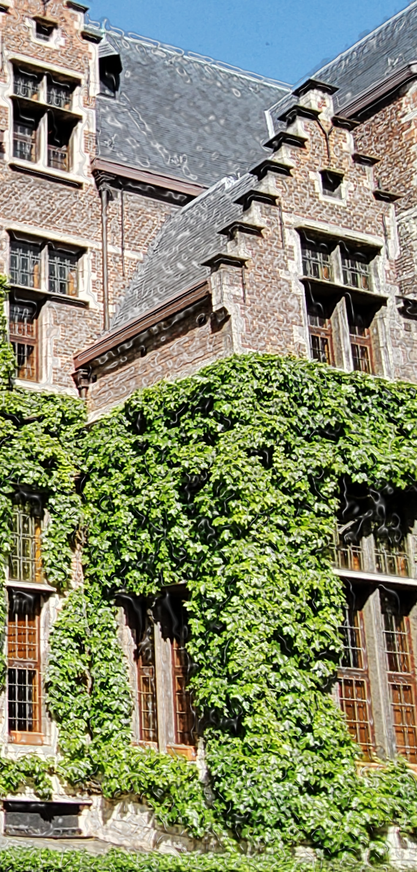
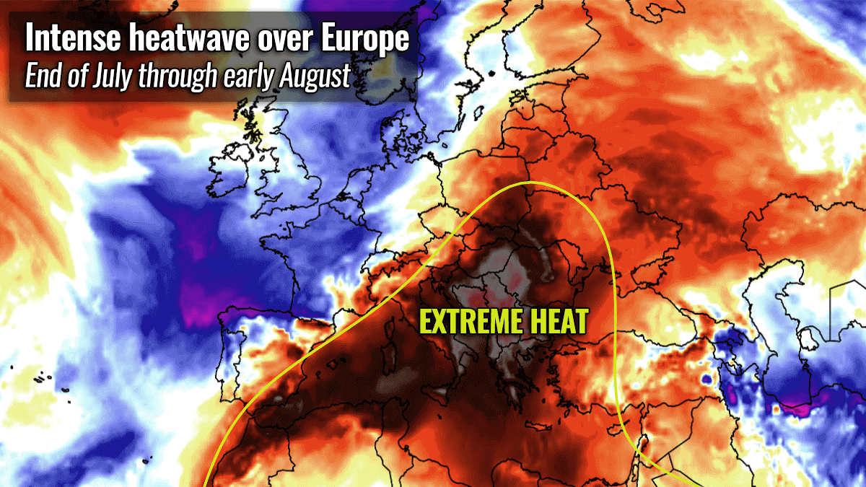
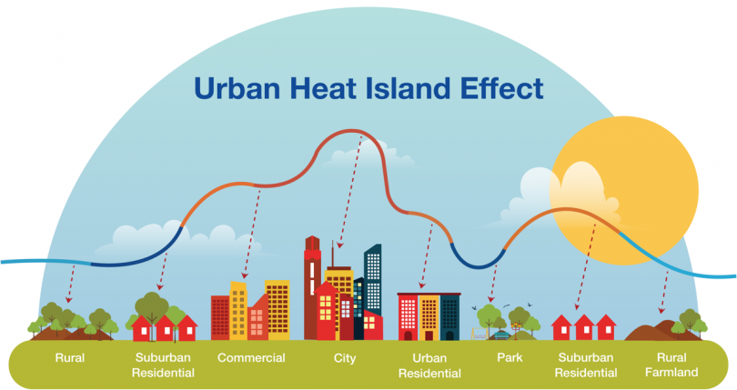

Climate stressors
Climate change
Urban heat island
More extreme weather events
Elevated global temperature
Elevated temperature and pollution levels
PhD student Marie De Groeve
marie.degroeve@uantwerpen.be
Supervisors: Tim De Kock & Scott Allan Orr
Notes:
As we all know, there is a worldwide problem, called climate change and cities experience the urban heat island effect.
Due to this events, there are elevated temperature, elevated pollution levels, more extreme weather events and so on. We are all quite aware of those drastic consequences, and that’s why cities are nowadays focussing on implementing green initiatives such as green roofs or green walls.

Slide 4
Heritage is mostly left out
Structural integrity
Impact on materials
Limited space
Strict conservation rules
1
2
3
4
PhD student Marie De Groeve
marie.degroeve@uantwerpen.be
Supervisors: Tim De Kock & Scott Allan Orr
Notes:
But, in those mitigation strategies of the cities, the historic building are mostly left out due to several reasons. I’m going to sum up 4 reasons why.
First of all, there is an uncertainty about the bearing capacity of the structure. As an example, a green roof is quite heavy and the structure of a heritage building could not always bear that load.
Next to that, we have also a big uncertainty of what the impact of green on historic building materials will be. Will they have beneficial or adverse consequences in terms of the degradation of historic building materials?
Then there is also the limited space in the core of the city, which is most of the time, is the historic city centre. If you look at this picture, you can see narrow streets, what will limit the implementation of some green initiatives.
As a last reason, sometime there are strict conservation rules like in this courtyard on the slide. The tiles are protected so they can not implement permanent green.

Slide 5
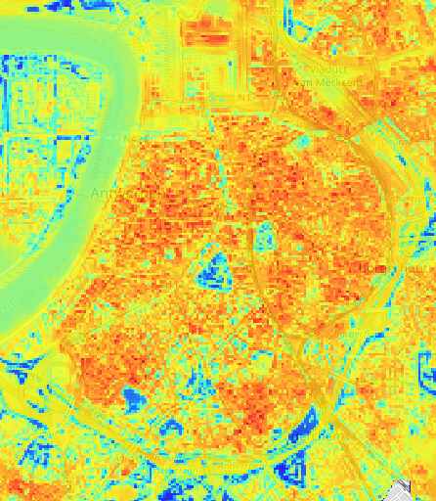
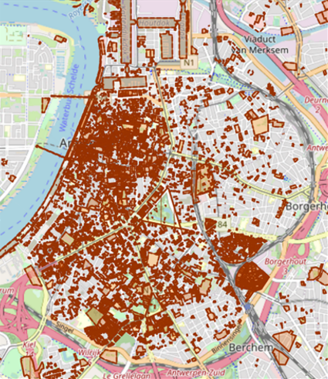
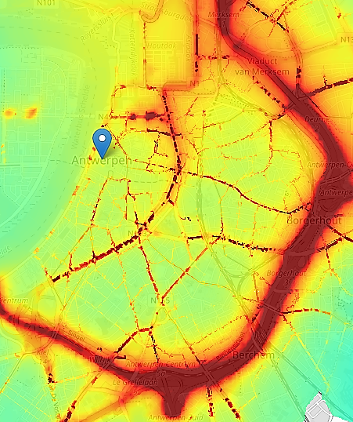


Opportunities
Opportunities
For environment
UHI mitigation
For built heritage
Benefits of green wall
Longer preservation
25
20
PhD student Marie De Groeve
marie.degroeve@uantwerpen.be
Supervisors: Tim De Kock & Scott Allan Orr
70
35
Heat map
Heritage map
PM map
Notes:
But what people don’t see, are the opportunities of implementing green on a heritage building.
First of all, as you can see on the maps, the historic buildings could be a great contribution for the mitigation strategies in cities. They is a lot of free surfaces on heritage buildings in the centre of the city, where the urban heat island is the greatest so this could give the mitigation strategies a boost.
Next to that, there are also opportunities for the built heritage itself. It can profit of the benefits of a green wall, such as improving the visitors experience/ conditions for those living and working in built heritage, possible reduction of deterioration, improving economic resilience and so on.
Also, implementing green on historic buildings is important for the preservation of it. If historic buildings will not contribute to mitigation strategies and the climate stressors will becoming worse, at a certain point, people can maybe decide to place a more sustainable building.

Slide 6
FOCUS & METHODOLOGY
The technical compatibility of built heritage and green initiatives
Notes:
With this context, I’ll take you now to my specific research topic and how I’m going to research it.

Slide 7
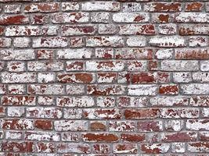
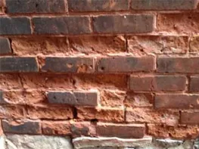
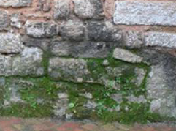
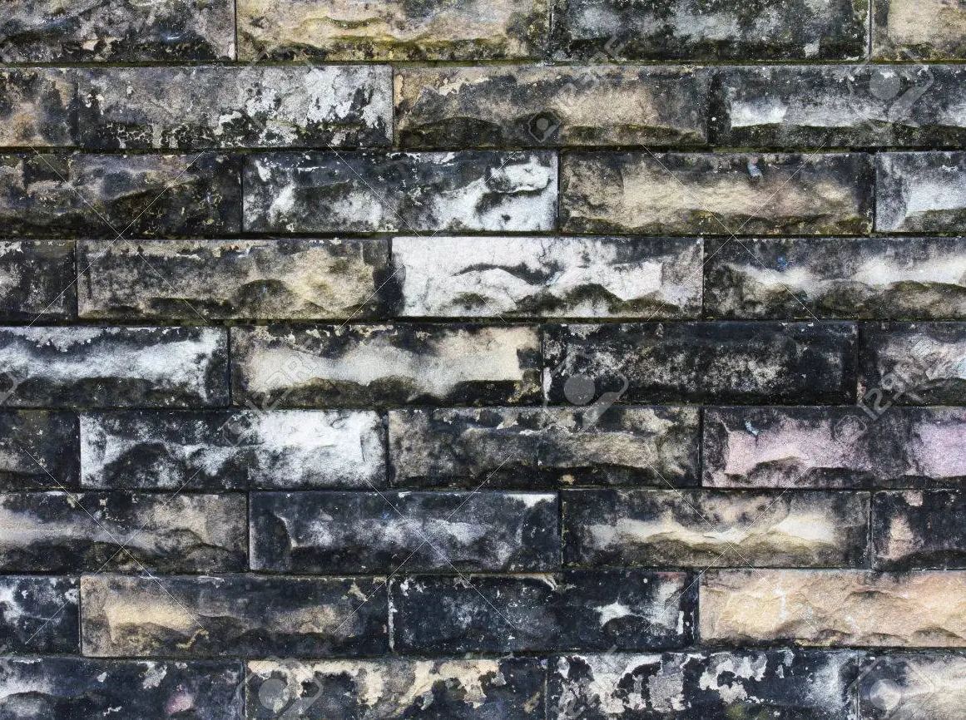
Research focus
Vertical greening
Impact on microclimate & degradation on historic building materials
Degradation types:
Green on heritage buildings
Effect on environmental parameters
Effect of changes on historic building materials
PhD student Marie De Groeve
marie.degroeve@uantwerpen.be
Supervisors: Tim De Kock & Scott Allan Orr
Salt crystallization
Frost damage
Biodeterioration
Pollutant dispersion
Notes:
My research will focus on vertical greening, which represent plants growing along the exterior wall, as you can see on the left picture of the slide. I will look how that green will have an impact on the environmental parameters and how those changes in the environmental parameters are going to have an impact on the degradation of the historic building materials. More specific, I will focus on 4 different degradation types: salt crystallization, frost damage, biodeterioration, and degradation as a consequence of pollutant dispersion, such as a gypsum crust.

Slide 8
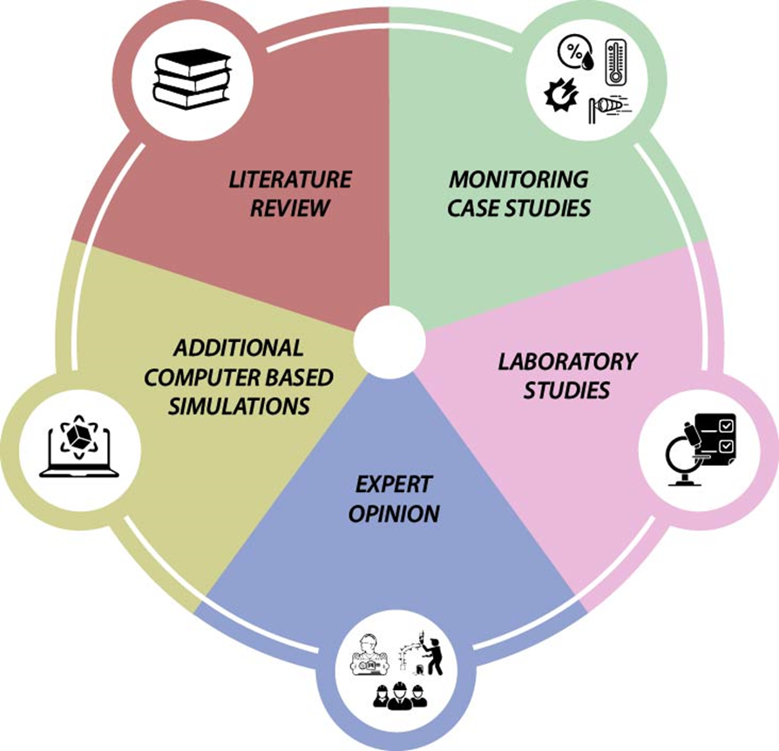
Methodology
Literature review
Search for most important parameters
PhD student Marie De Groeve
marie.degroeve@uantwerpen.be
Supervisors: Tim De Kock & Scott Allan Orr
Notes:
For performing my research, the information will be conducted in 5 different ways. First of all, I’ll start with a literature review. With this, it’s understood which environmental parameters experience an impact of implementing green in the environment. The literature review will also give a good overview what’s already established in previous research.
As an example, a mitigating effect of ivy as a green façade on frost events in a natural stone wall is shown. Due to the insulation effect of ivy, the average minimum temperature may increase and can cause a reduction till 46% in frost events.

Slide 9
Methodology
Literature review
Monitoring case studies
Search for most important parameters
Case studies in Antwerp (Belgium)
  Air & surface temperature, RH, wetness, PM, solar radiation
Laboratory studies
More controlled environment
PhD student Marie De Groeve
marie.degroeve@uantwerpen.be
Supervisors: Tim De Kock & Scott Allan Orr
Notes:
Next to that, we also have a more practical part of this research. We will monitor case studies and performing laboratory studies. Therefore, we will compare bare walls to green walls at the exterior wall facades. Some parameters will be measured on the wall surface, and others will be measured in the depth. Our case studies will focus on existing green façade in the historical city centre of Antwerp, a city in Belgium, such as this picture on the left of this slide. In laboratory studies, we will work with an imitation of a green wall on a small scale, where parameters will be tested in a more controlled environment.

Slide 10
Methodology
Literature review
Monitoring case studies
Search for most important parameters
Case studies in Antwerp (Belgium)
  Air & surface temperature, RH, wetness, PM, solar radiation
Simulations
Laboratory studies
Opportunities
  Future oriented
  Different wall compositions
  Different materials
More controlled environment
PhD student Marie De Groeve
marie.degroeve@uantwerpen.be
Supervisors: Tim De Kock & Scott Allan Orr
Notes:
Then we have the additional computer based simulations. Together with the laboratory studies, they allow us to test future-oriented, different wall compositions, different materials or whether vertical greening can attenuate the negative effect of the implementation of insulation in heritage buildings.

Slide 11
Methodology
Literature review
Monitoring case studies
Search for most important parameters
Case studies in Antwerp (Belgium)
  Air & surface temperature, RH, wetness, PM, solar radiation
Simulations
Laboratory studies
Opportunities
  Future oriented
  Different wall compositions
  Different materials
More controlled environment
Expert opinions
Enrich research in practical view
Involving important
PhD student Marie De Groeve
marie.degroeve@uantwerpen.be
Supervisors: Tim De Kock & Scott Allan Orr
Notes:
We complete this information gathering with knowledge from a professional field. Those expert could enrich our research by providing knowledge from a practical point of view. This is also the part which my colleague Eda Kale is more focusing on.
All those information brings us to the global aim of this research. We want to illustrate the real impact of green on historic building materials and we want to create a contribution of built heritage in the mitigation strategies without compromising their heritage values and with a willing contribution of practitioners.

Slide 12
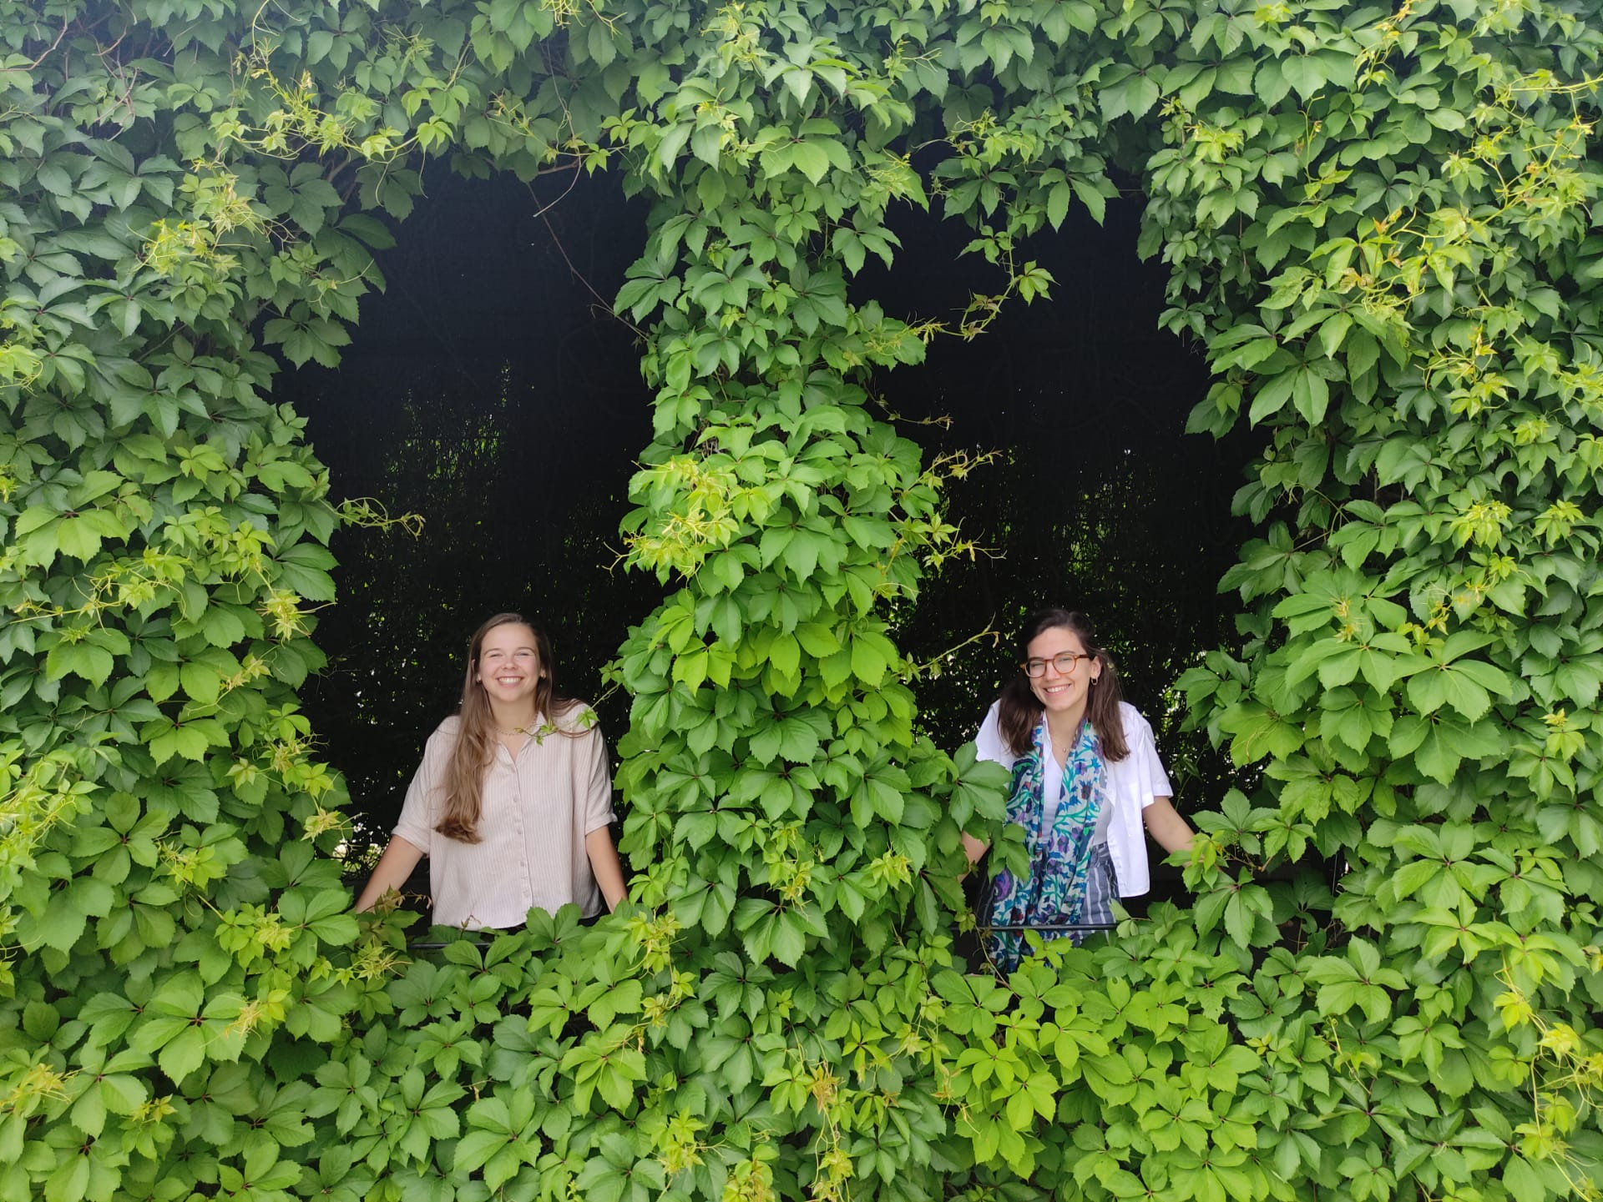
Thank you for listening!
Email: marie.degroeve@uantwerpen.be
Email: eda.kale@uantwerpen.be
Notes:
Thank you very much for your attention. If you have any questions or want to have a discussion, You can reach me after this presentation or you can contact me by email.

Slide 13
Sources
Groentool. (z.d.), Gebiedsanalyse. Geraadpleegd op 16 mei 2022, https://groentool.antwerpen.be/analysis.xhtml?zoomLevel=13&mapCenterLat=51.036064370295435&mapCenterLng=4.167938232421875&clearShapes=true
Onroerend erfgoed. (z.d.), Geoportaal, Geraadpleegd op 15 april 2022, https://geo.onroerenderfgoed.be/#zoom=10&lat=6639473.157172923&lon=462444.02742662176
Korosec M. , (2021, 27th of July), Parts of southern Europe will be baking with around 40-45°C as the most intense heatwave of summer 2021 is on the way this week, Severe Weather Europe, geraadpleegd op 16 November 2021, https://www.severe-weather.eu/europe-weather/most-intense-heatwave-summer-2021-forecast-mk/
Go Smart Bricks, (z.d.), Urban heat island – 7 things you should know, geraadpleegd op 16 mei 2022, https://gosmartbricks.com/urban-heat-island/
Energuide, (z.d.), What is a green roofs?, geraadpleegd op 15 April 2022, https://www.energuide.be/en/questions-answers/what-is-a-green-roof/670/
Stupar M., Ljaljevic G., Subakov Simic G., Jelikic A. Vukojevic J., Sabovljevic M., 2014 (8 of August), A sub-aerial biofilms investigation and new approach in biocide application in cultural heritage conservation: Holy Virgin Church (Gradac Monastery, Serbia), Indoor and Built Environment, Vol, 23 (4) 584-593, https://doi.org/10.1177%2F1420326X12466753
Steenmeijer Architecten, (z.d.), Koninklijk Atheneum, geraadpleegd op 15 April 2022, https://www.steenmeijer.be/koninklijk-atheneum-antw
Z.a., 2016, 15 February, Controlling and preventing efflorescence in Toronto, geraadpleegd op 15 April 2022, https://www.turnbullmasonry.com/controlling-and-preventing-efflorescence-in-toronto/
Stonehenge Masonry Company, (z.d.), Spalled brickword due to freeze thaw cycles, geraadpleegd op 15 april 2022, http://stonehengemasonry.ca/water-problems/img_1653/
Medicinal plants expertise, (z.d.), Important study of the bryological flora at an archaeological site, geraadpleegd op 15 april 2022, https://botanicmedicinal.com/biodeterioration-bryophytes-historical-site-chellah-moroccoarchaeological/
123RF, (z.d.), Close-old yellow brick wall weathered patina black and white, geraadpleegd op 15 april 2022, https://fr.123rf.com/photo_35047664_close-old-yellow-brick-wall-weathered-patina-black-and-white-.html
PhD student Marie De Groeve
marie.degroeve@uantwerpen.be
Supervisors: Tim De Kock & Scott Allan Orr

Slide 14


