Slide 1



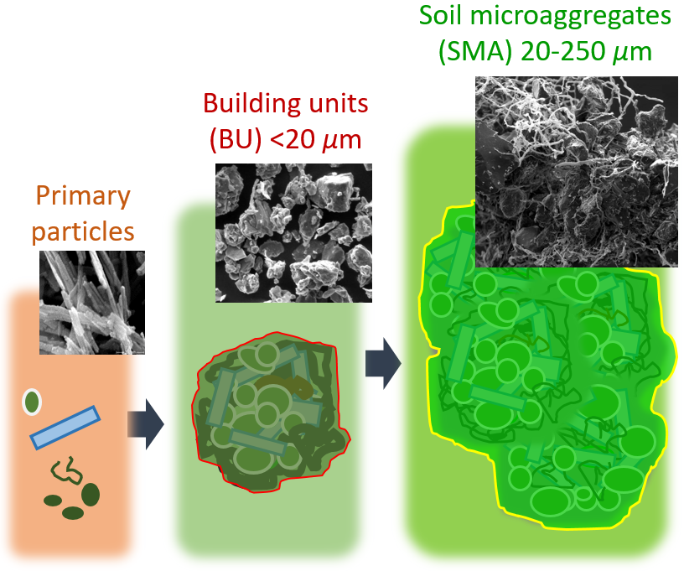
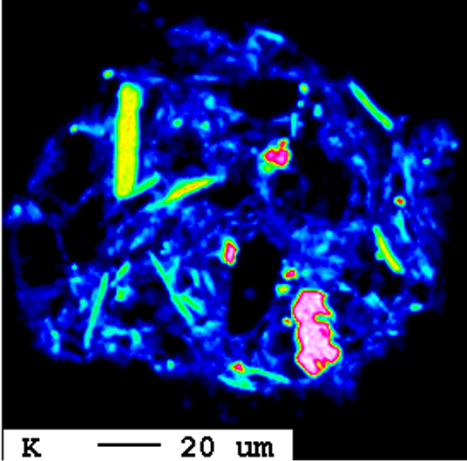
2022 EGU General Assembly, SSS8.7: Co-Evolution of structure and function in soil: Exploration, evidence, concepts and theories from particle interfaces and microaggregates to the pedon scale
Freeze-thaw cycles shape building units for soil microaggregate formation: Experiments with mineral and organic model substances
Stefan Dultz^{1,*}, Myriam Speth^{1,2}, Alexander Fechner³, Klaus Kaiser³, Robert Mikutta³, Georg Guggenberger¹
*dultz@ifbk.uni-hannover.de
¹Institute of Soil Science, Leibniz Universität Hannover ²Department of Soil Science and Soil Conservation, Justus Liebig Universität Giessen ³Soil Science and Soil Protection, Martin Luther University Halle-Wittenberg
Hierarchic structure of soil microaggregates
Observations on high shares of plate-shaped BU in SMA (Scheyern, Bavaria)
SEM-image of a cross-section
SMA intruded with a molten alloy
Electron probe micro analysis
K-mapping, polished cross-section of SMA
Our focus:
BU formation
Source:
Eva Lehndorff
Source: Robert Mikutta
Questions investigated:
● Do repeated freeze-thaw cycles induce formation of platy-shaped building units in temperate soils?
● Role of nature of soil compound, solution chemistry and the number of freeze-thaw cycles on size, shape, and stability of particles formed
Research background:
Determination on building unit formation for assessing stability and function of soil microaggregates

Slide 2
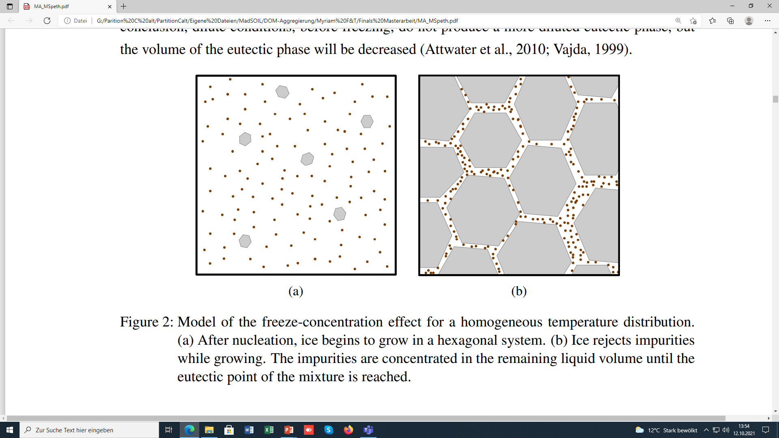
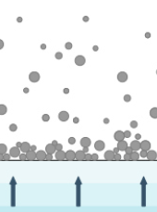
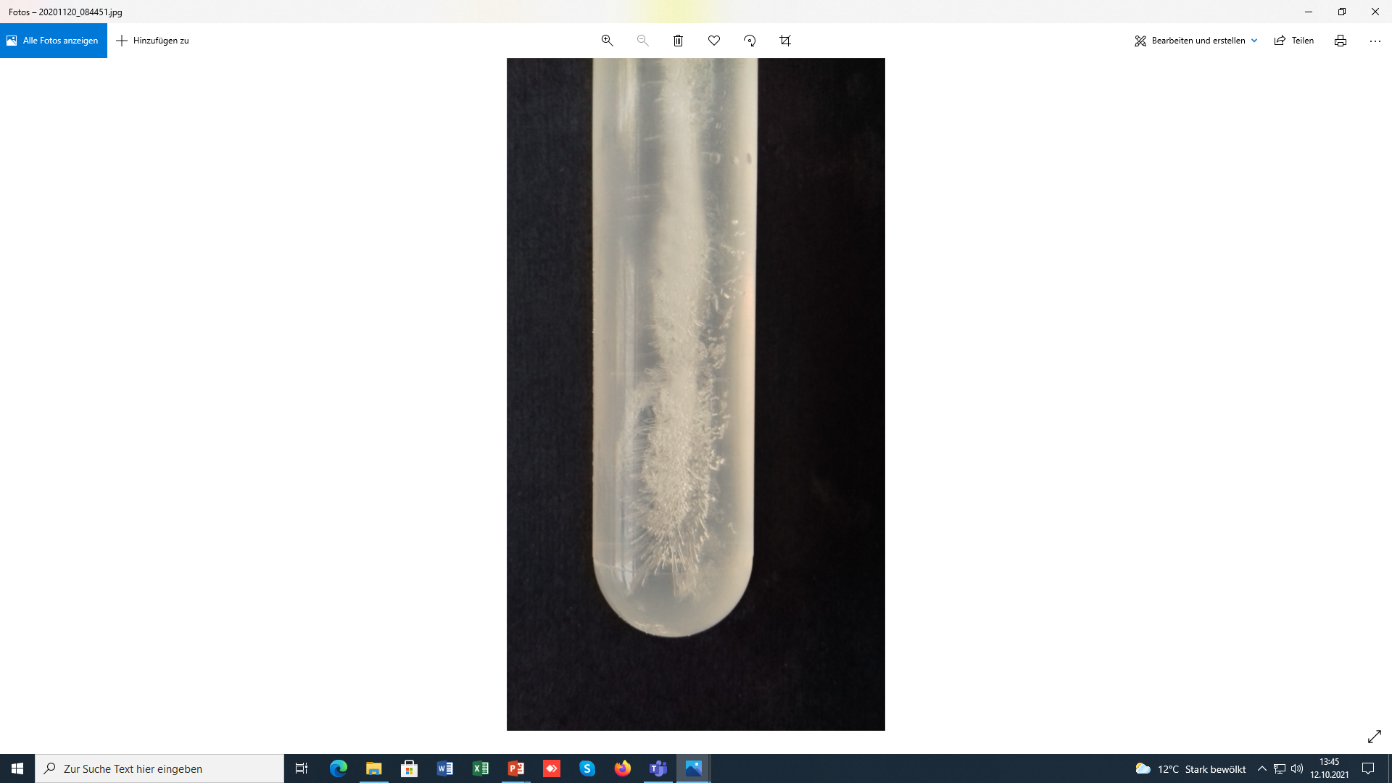
Freeze-thaw cycles shape building units for soil microaggregate formation: Experiments with mineral and organic model substances
The freeze concentration effect in suspensions
Model substances:
Illite, goethite, montmorillonite, cell mass, tannin
Methods:
● 0.005 to 10 g L⁻¹, background electrolyte
● experiments in centrifuge tubes
● freezing delayed, 0°C after 1.5 h
● up to 20 freeze & thaw cycles
´_____
1 cm
● after nucleation ice grows in hexagonal system
● ice rejects non-aqueous compounds, concentrated in the remaining liquid
● expansion of ice presses fine particles together
● plates and fibers are formed at two- and three-grain boundaries, respectively
Column formation upon freezing
Illite,
100 mg L⁻¹
____
1 cm
2

Slide 3
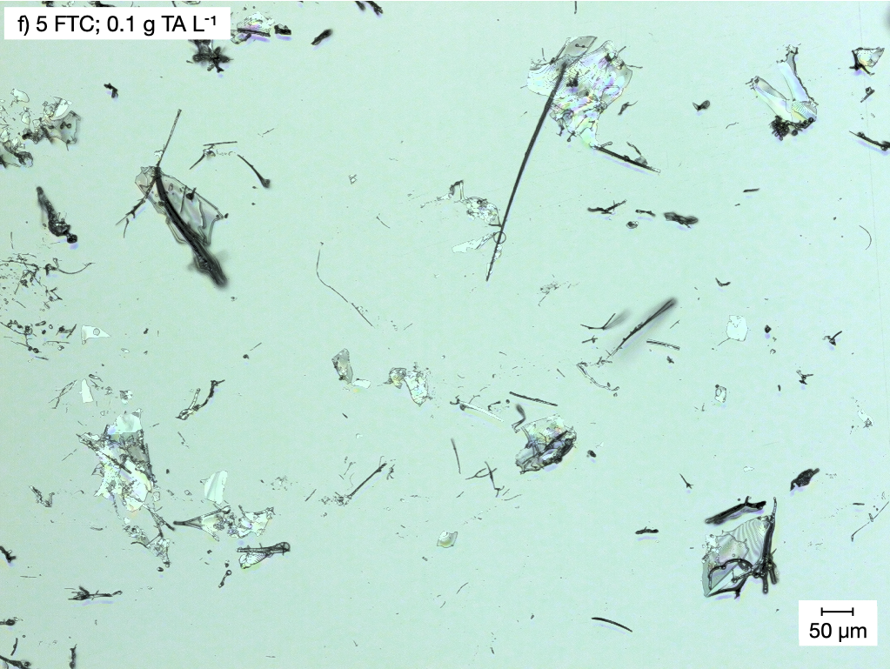
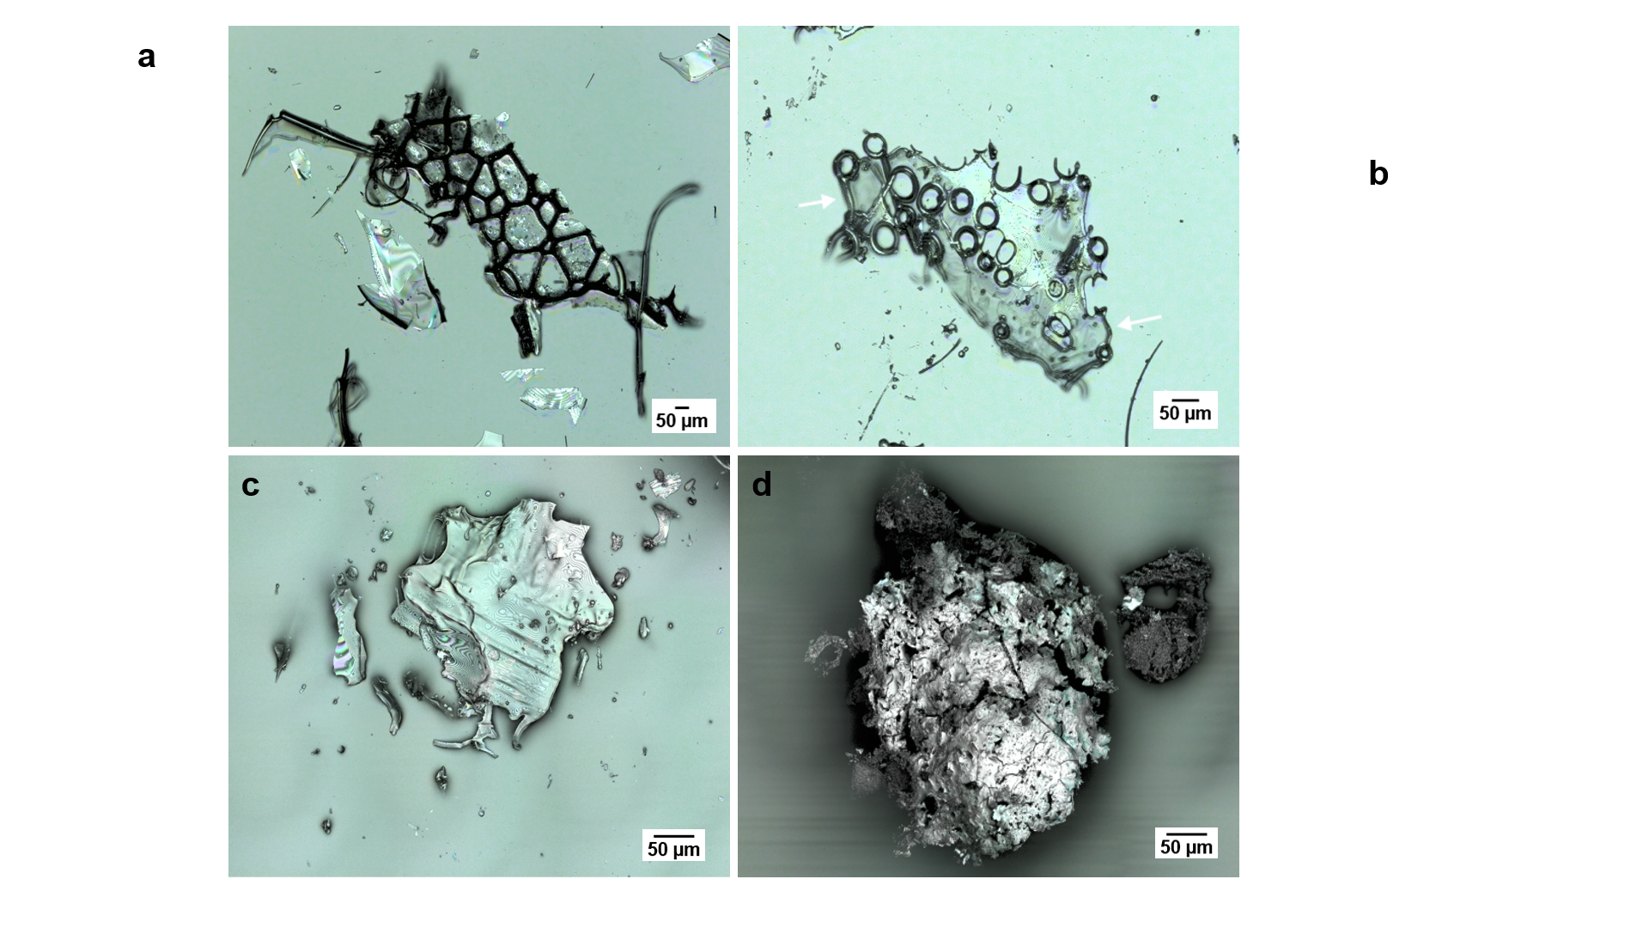
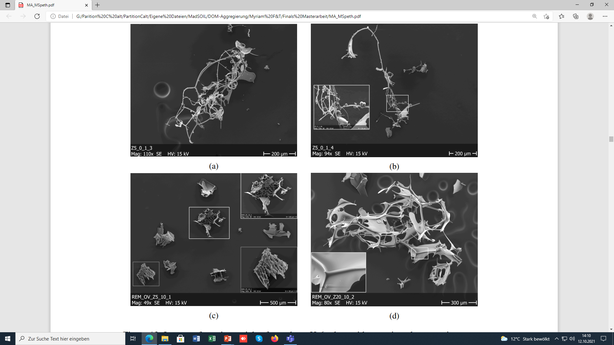
Freeze-thaw cycles shape building units for soil microaggregate formation: Experiments with mineral and organic model substances
Shape of particles formed
tannic acid
´_____
1 cm
CLSM images
discrete plates and fibers
space between fibers filled by plates
air bubbles formed by degassing
- space between fibers partly filled by plates
- 120° angle at three-grain boundary
SEM image
3

Slide 4
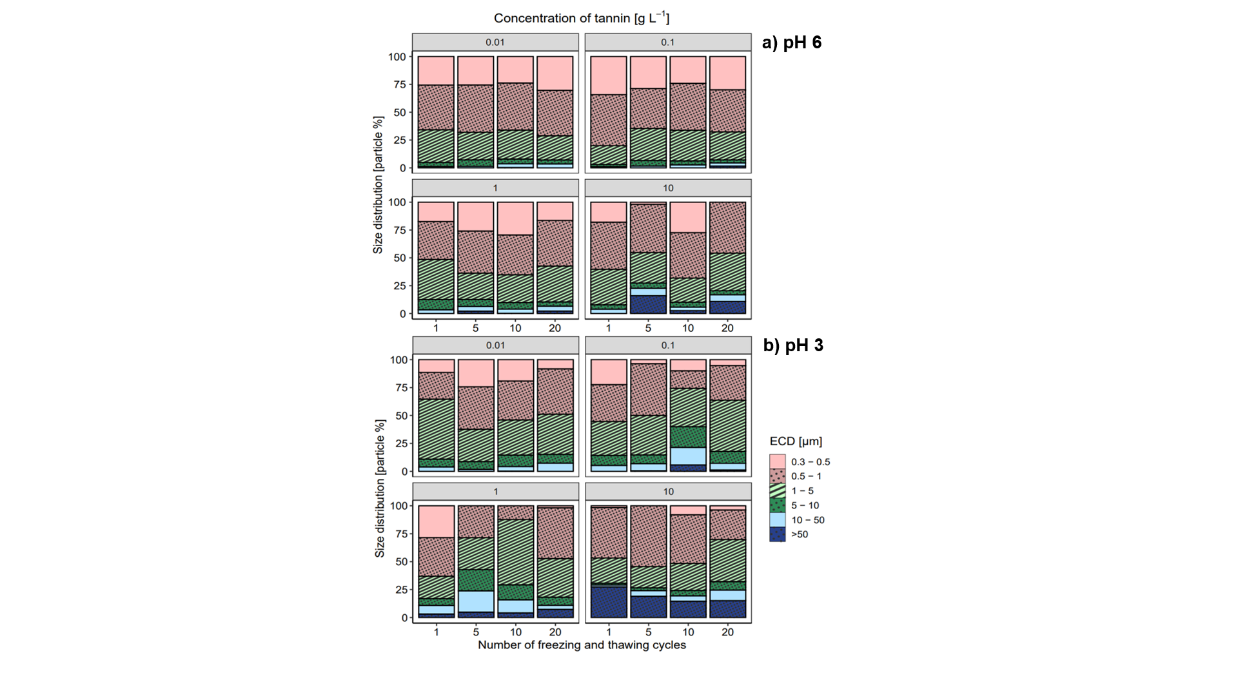
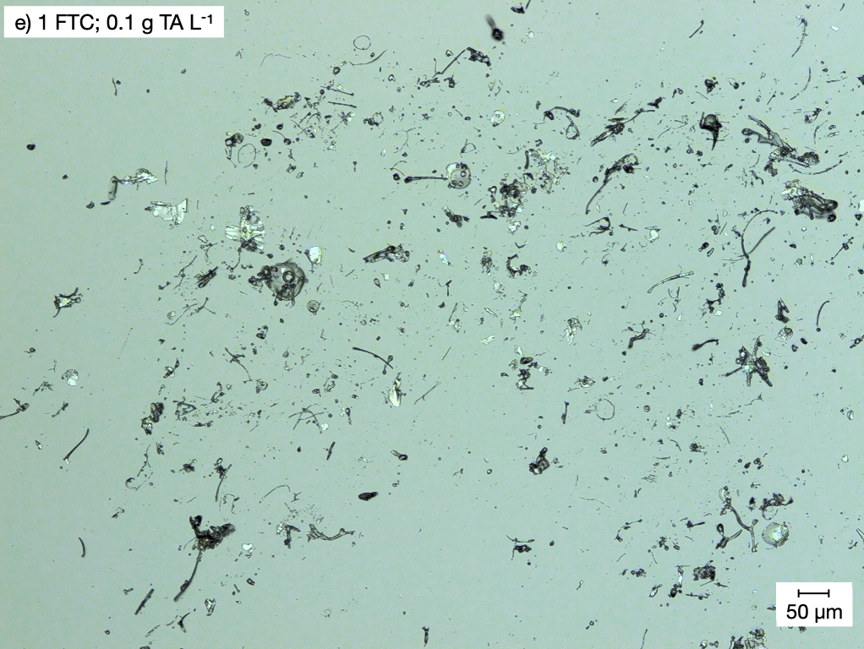
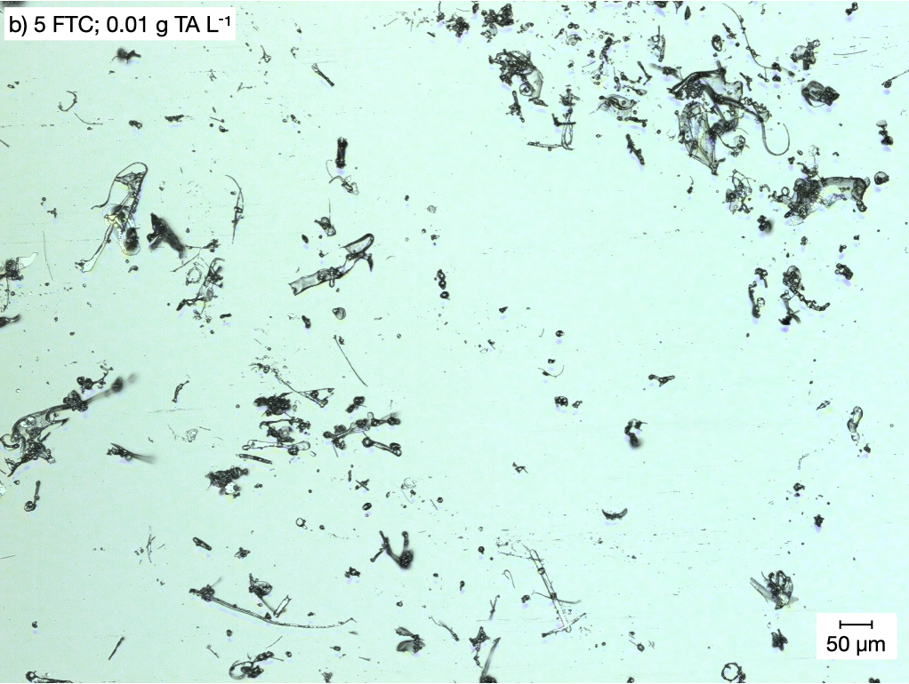
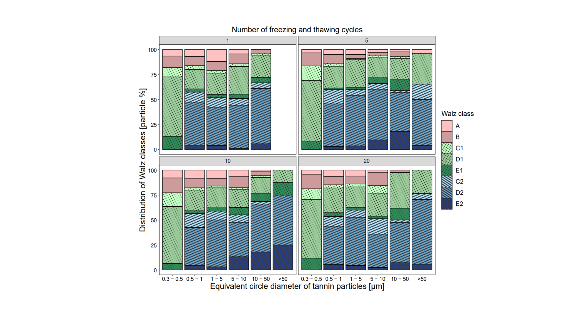
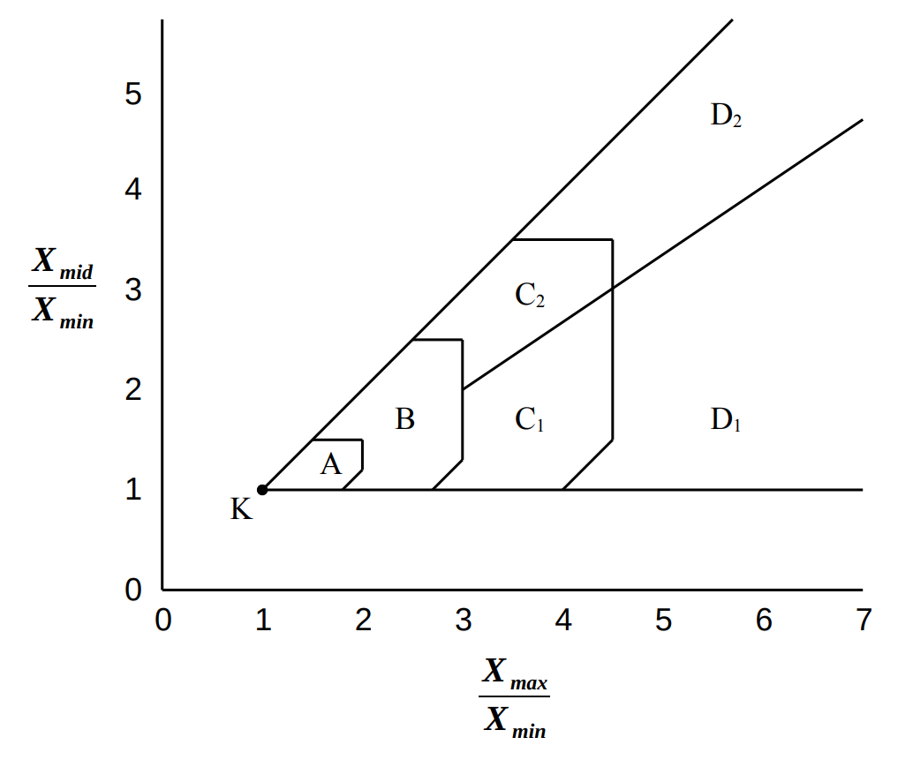
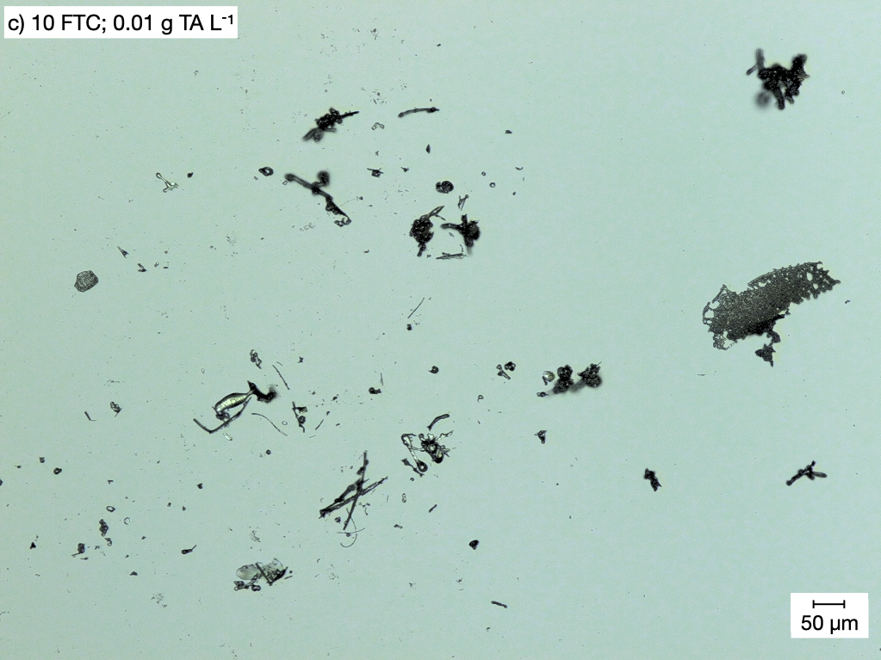
Confocal laser sanning microscopy
Sizing by equivalent circle diameter (ECD)
dry state
● larger particles at high concen-trations
● slight changes in size distribution with increasing number of freeze cycles
Distinction of nine shape classes
Walz diagram
compact
fibers
● high share of plates in at ECD > 0.5 µm
● compact particles increa-singly lost at ECD > 10 µm
plates
tannic acid particles
4

Slide 5
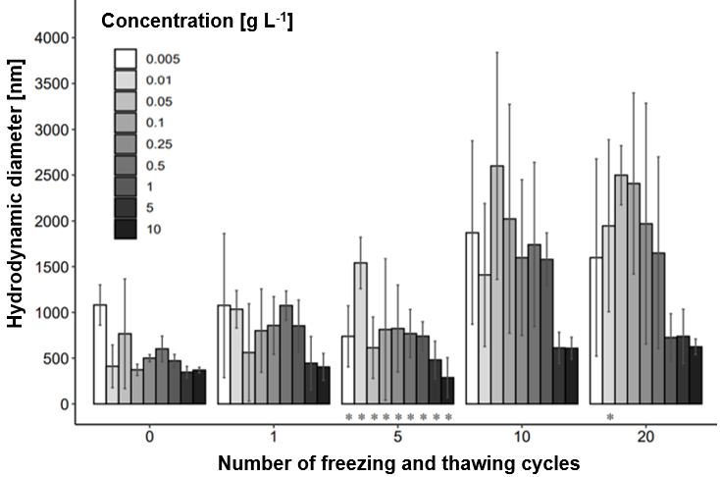
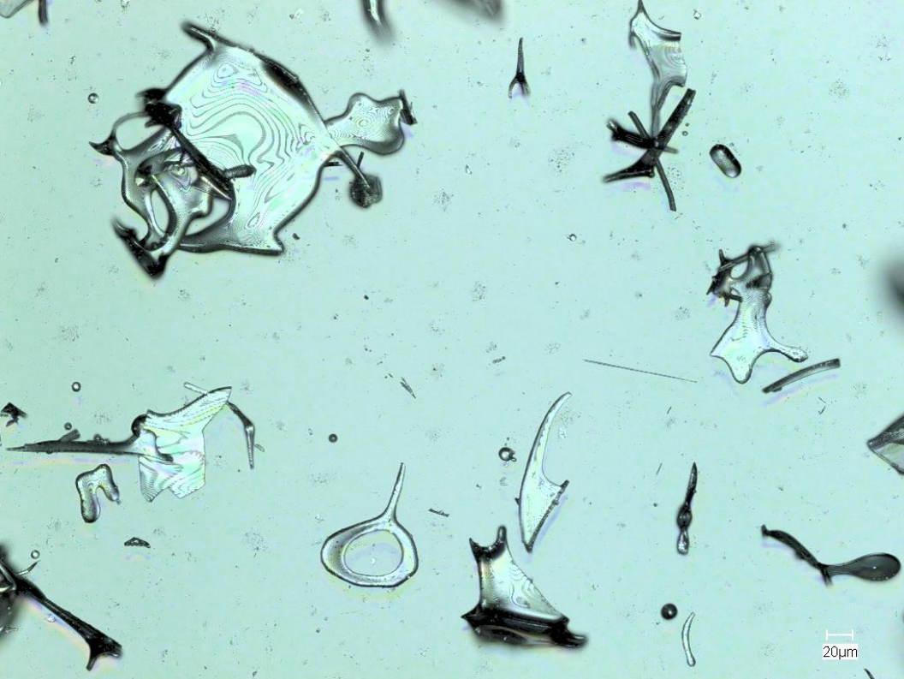
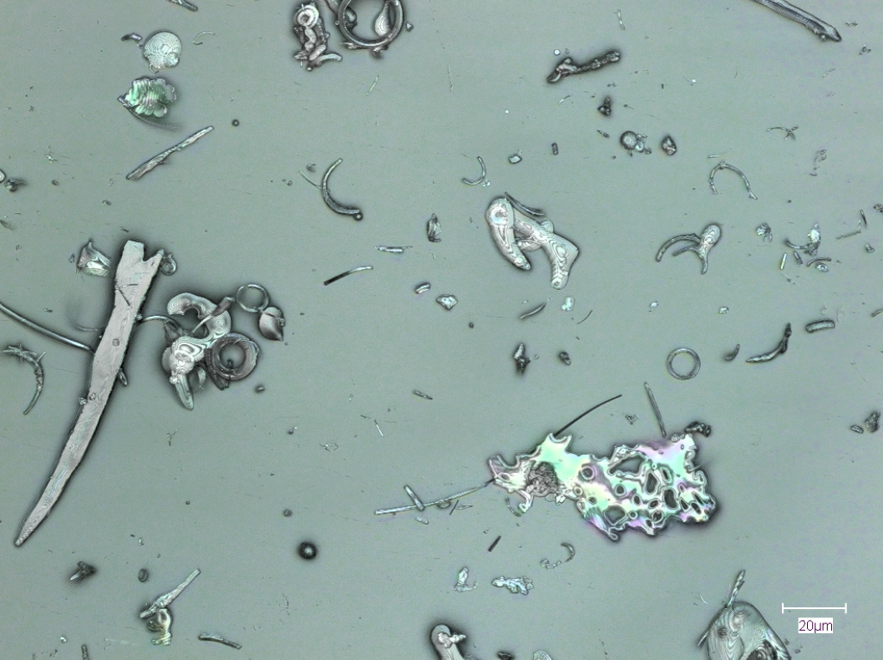
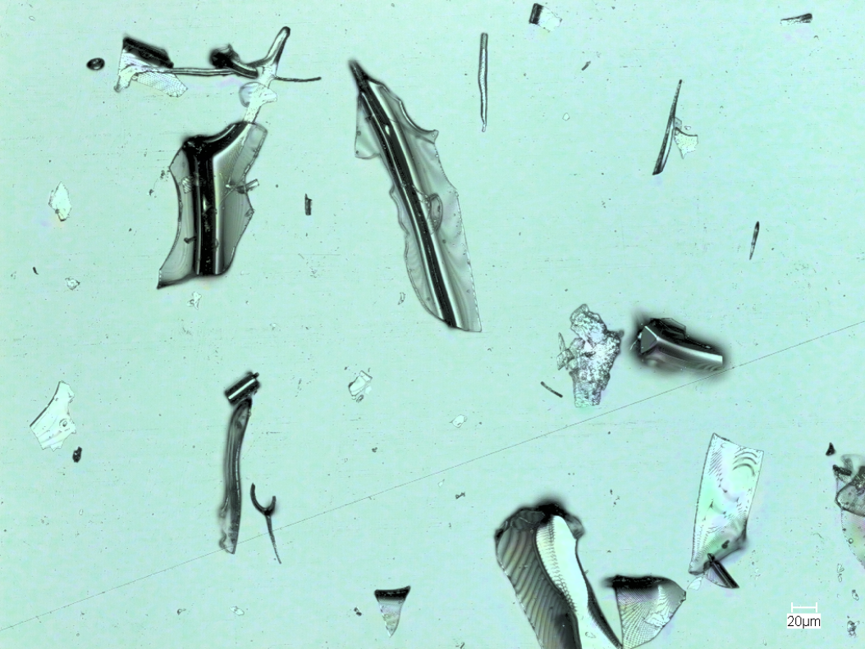
Zetasizer
- wet state -
Hydrodynamic diameter, measure for stability in suspension
● particles formed at low concentration are larger / have a higher stability
● Increase of hydrodynamic diameter with increasing number of freezing and thawing cycles
tannic acid particles
5

Slide 6
Freeze-thaw cycles shape building units for soil microaggregate formation: Experiments with mineral and organic model substances
Research question:
● Do repeated freeze-thaw cycles induce formation of platy-shaped building units in temperate soils?
● In fractions with ECD >0.5 µm platelets have high shares with 50-75 particle %
● Non-aqueous compounds tested are similarly affected by freeze and thaw cycles
´_____
1 cm
Summary
Conclusions
● Freeze and thaw cycles can significantly modify the architecture of soil microaggregates
by shaping their building units
● Possible consequences for other soil functions like C retention and availability
Acknowledgement
This study was performed within the framework of the research unit DFG RU 2179 “MAD Soil – Microaggregates: Formation and turnover of the structural building blocks of soils”

