Slide 1



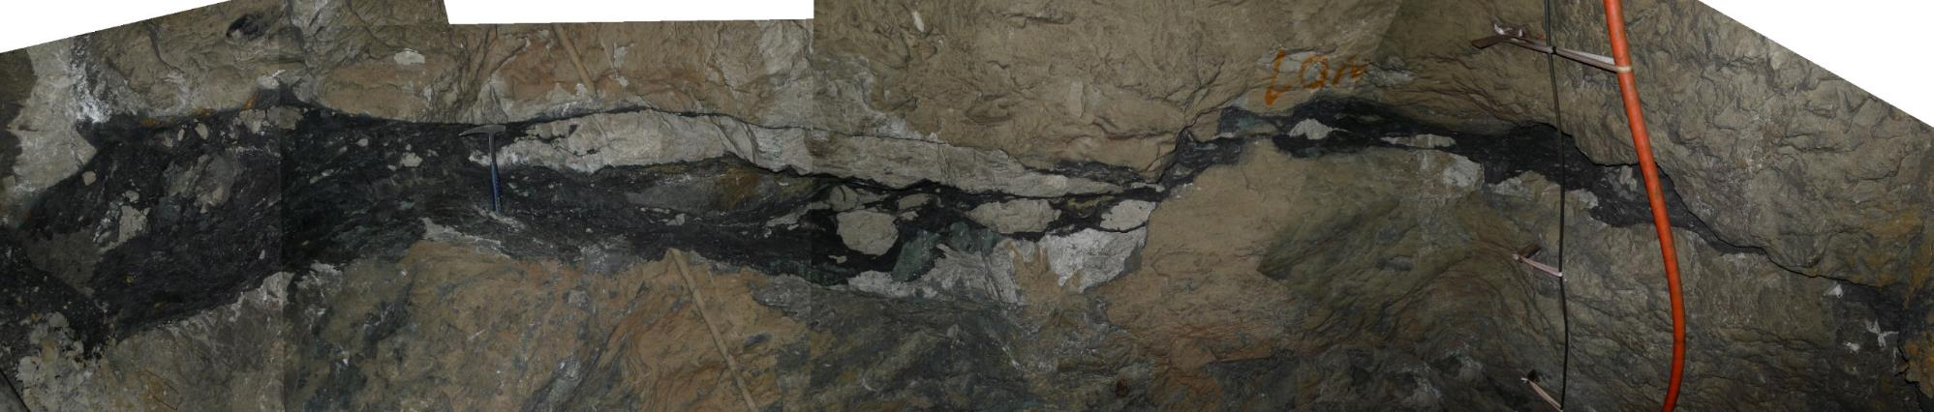
Salt welds from up close: Examples from the Eastern Alps
EGU General Asembly 2022, Vienna 23-27 May
Oscar Fernandez, Bernhard Grasemann, Hugo Ortner, Jacek Szczygiel, Thomas Leitner

Slide 2
Background
Salt has been mined in the Eastern Alps for thousands of years
The first geological maps in the area date from the early 19th century
The link between salt and geology has been debated hotly over the past 50 years, many authors support a non-diapiric origin for the salt accumulations in the Eastern Alps
Unambiguous outcrops of halokinetic-related growth strata have not been recognized so far, making this debate drag on
Salt welds provide unambiguous evidence for past halokinetics

Slide 3
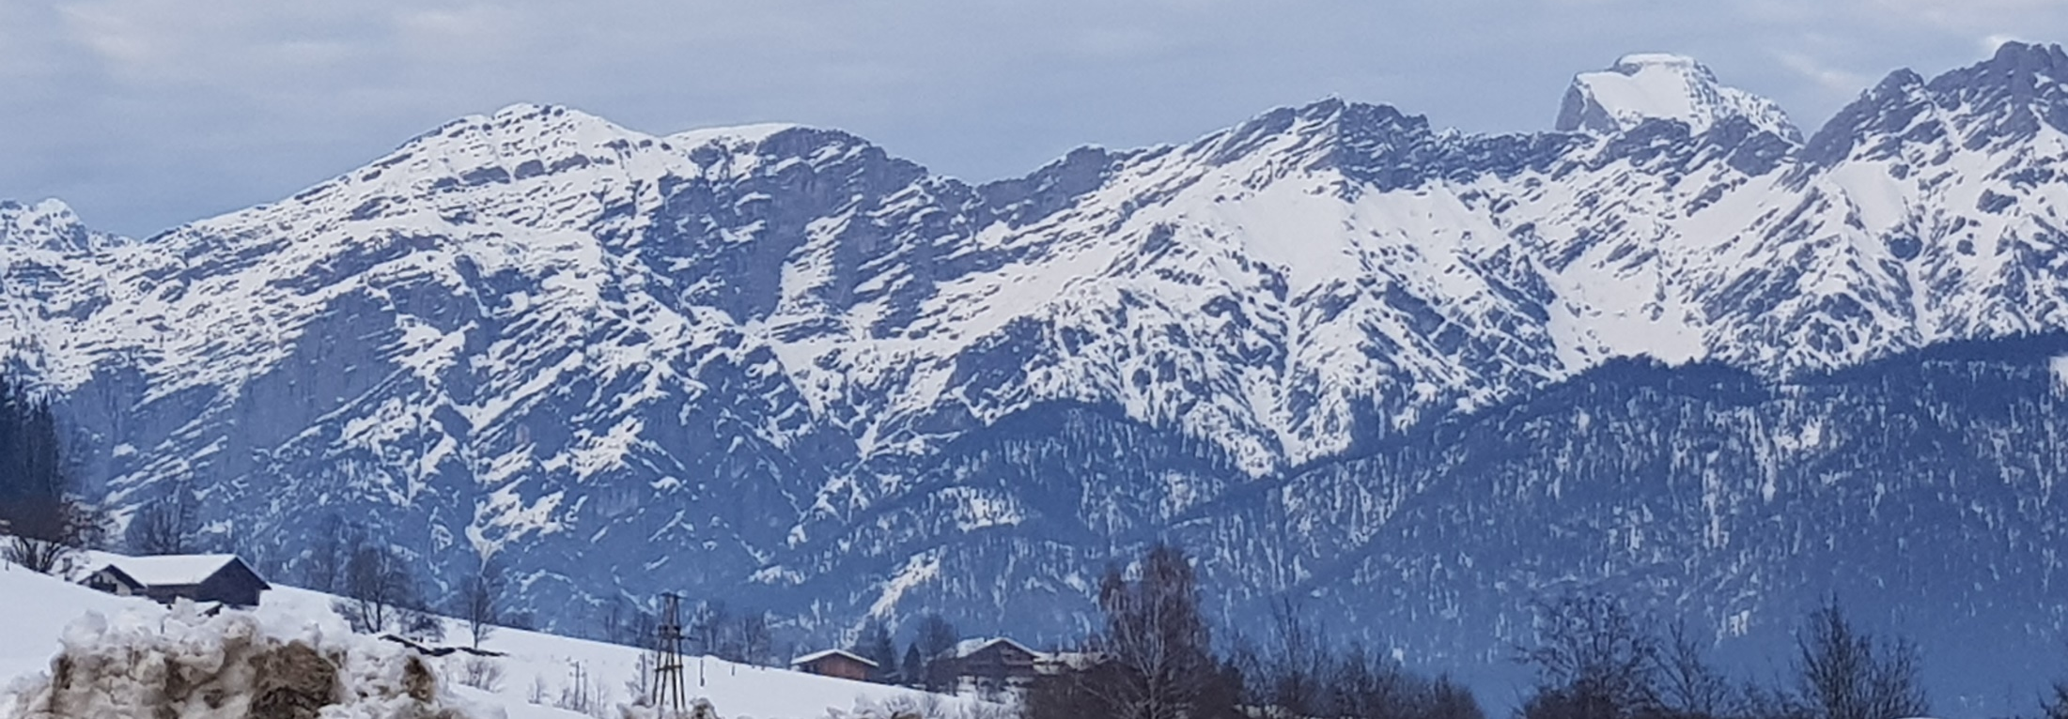

Slide 4
Background
Salt welds are features that are easy to document on geological maps or on seismic cross-sections, they are in general more difficult to observe at the millimeter to meter scale because of vegetation and weathering.

Slide 5
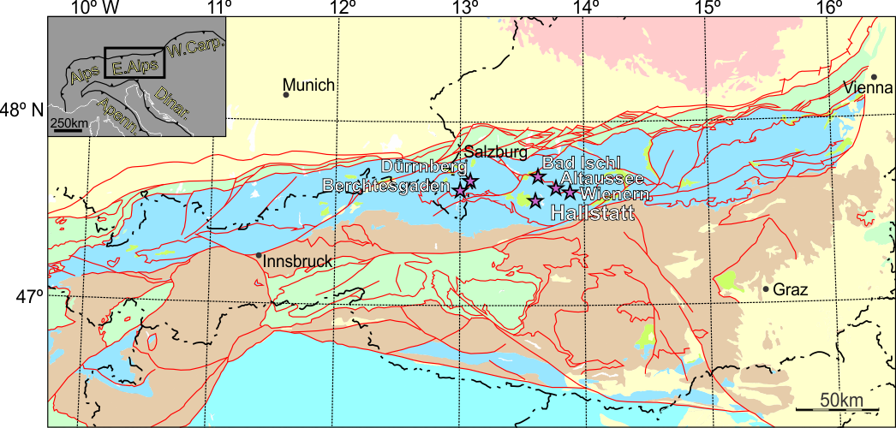
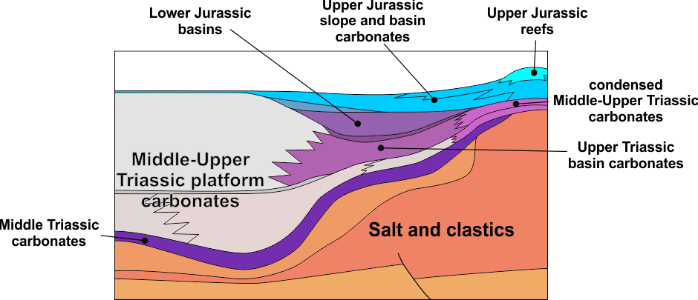
(Permian-L. Triassic)

Slide 6
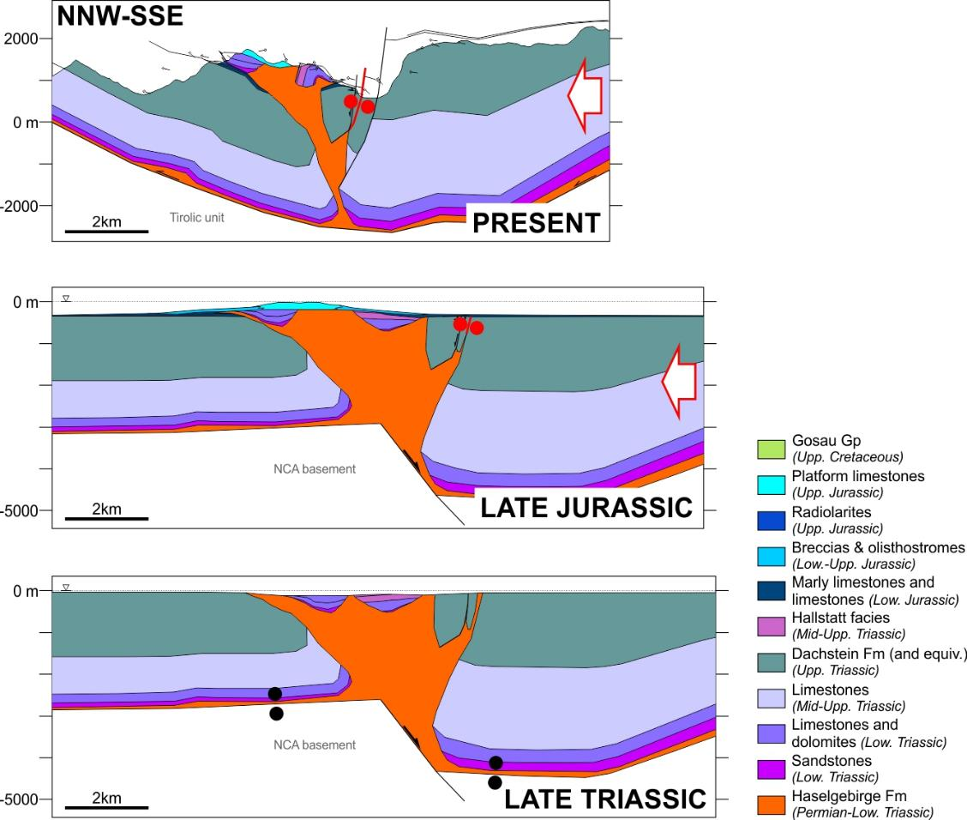

Slide 7
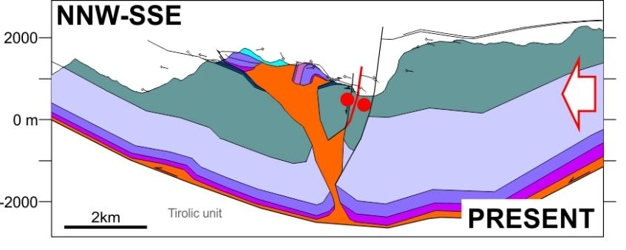
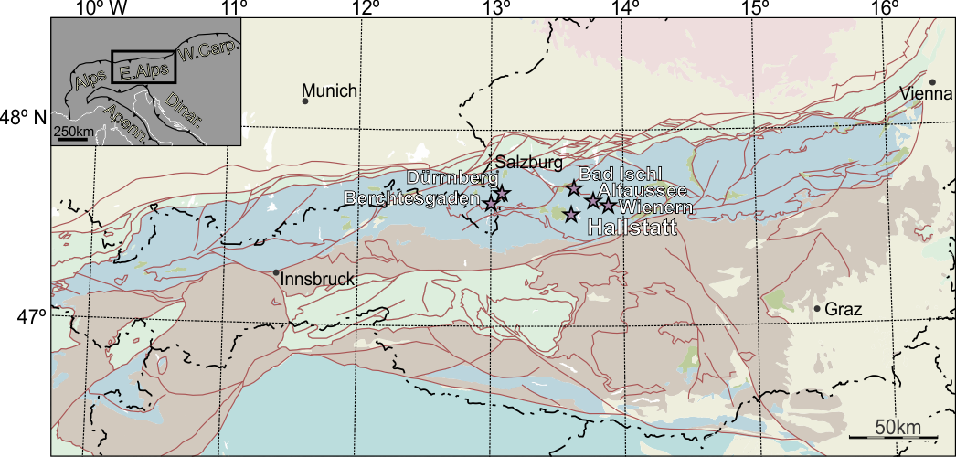
Welded salt ridge
Extension (Triassic) followed by strike-slip shearing during shortening (Jurassic-Neogene)
Weld has no evaporite material at one location (sheared)
Along-strike weld (possibly different weld structure) contains strongly sheared shales relict from the evaporite sequence and host rock fragments
Brecciated host rock

Slide 8
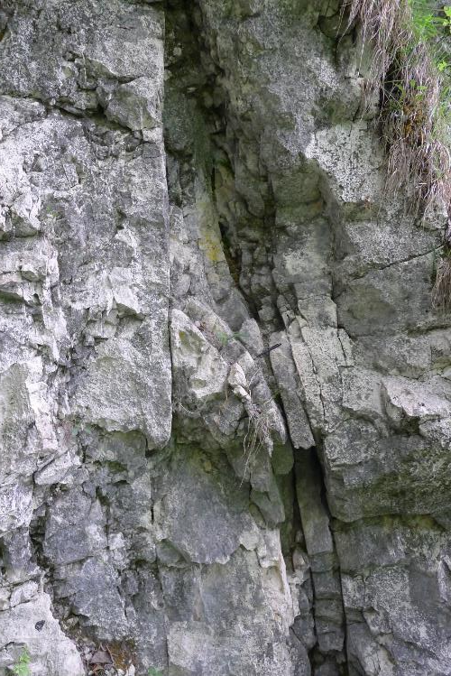
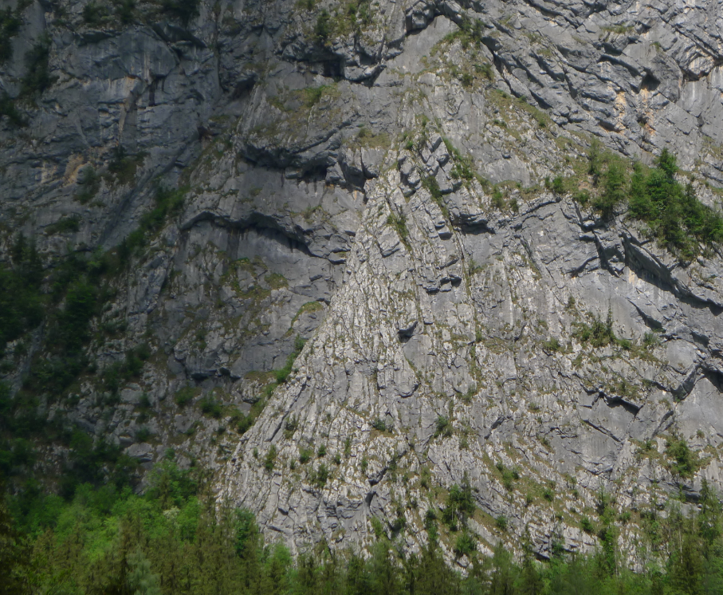
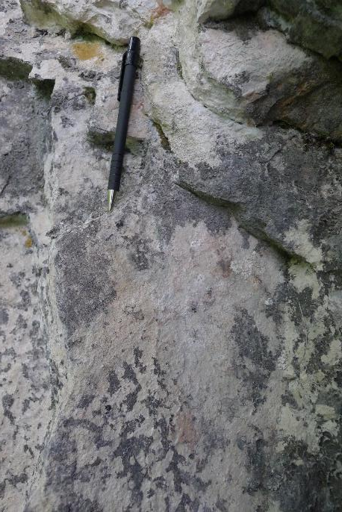
SSW-ENE
“the other side”
halokinetic hook
U. Triassic
limestone

Slide 9
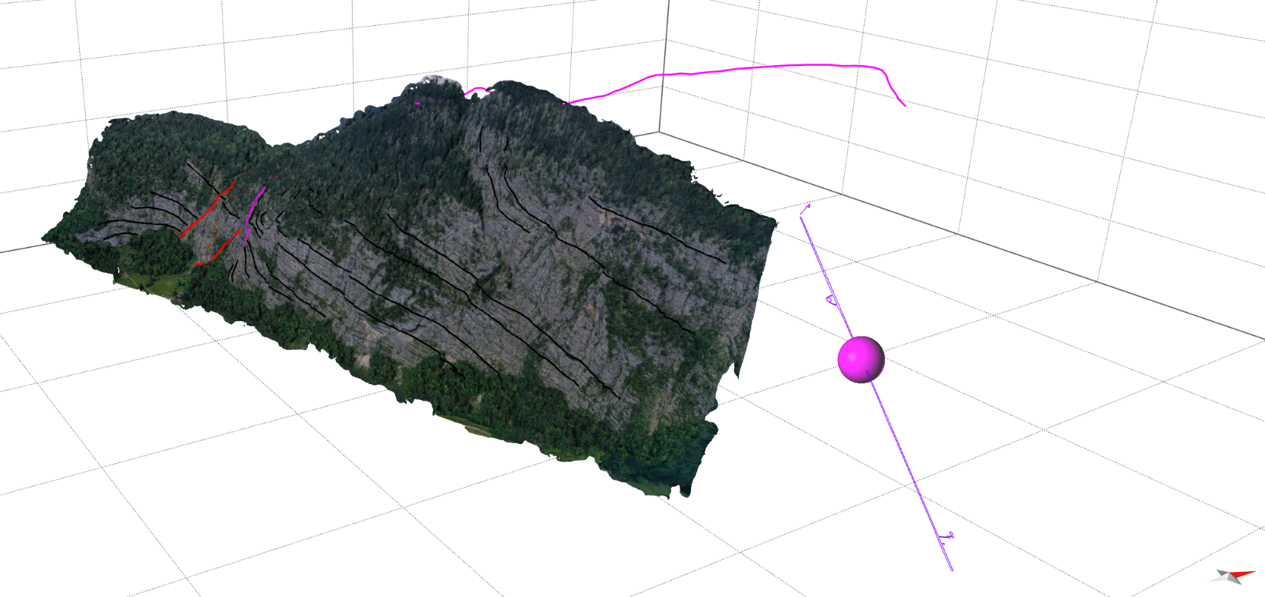

mapped weld
200m
1000m
weld in gallery
500m
Hallstatt Erbstollen (base gallery)
W
N
S
E

Slide 10
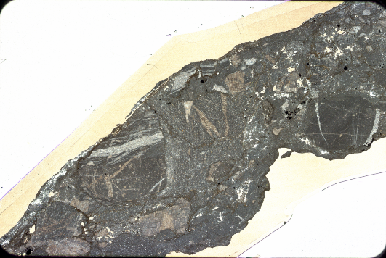
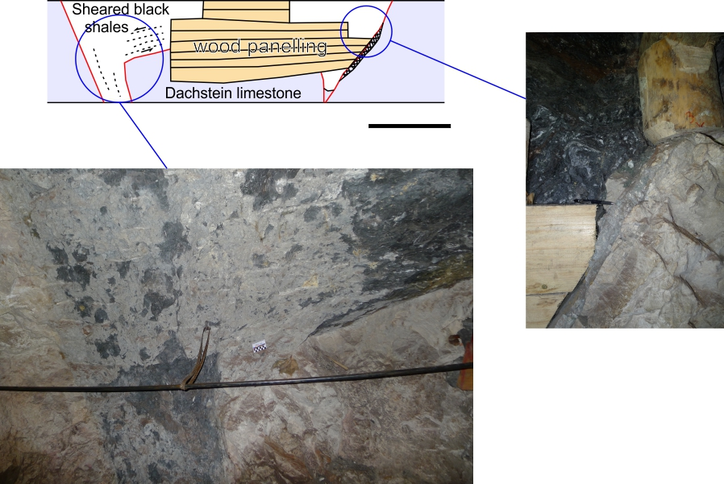
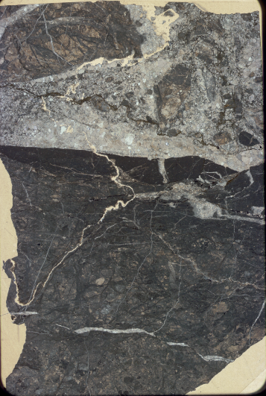
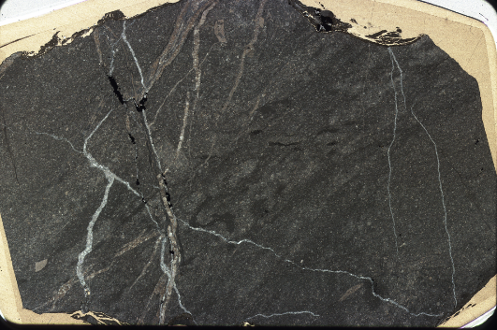
“floating” block
SSE
WNW
rock fragments
rock fragments
2m
sheared shale
breccia
sparry cc
sheared shale
(Permian)
limestone
micritic
cement
U. Triassic
limestone
U. Triassic
limestone
P/S
wallrock
(primary fabric)
wallrock

Slide 11
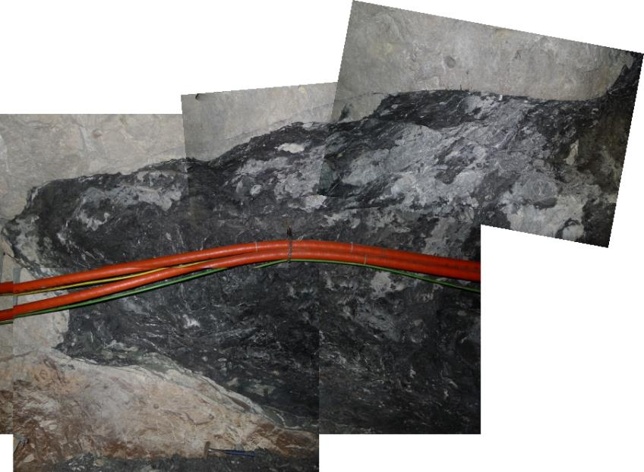
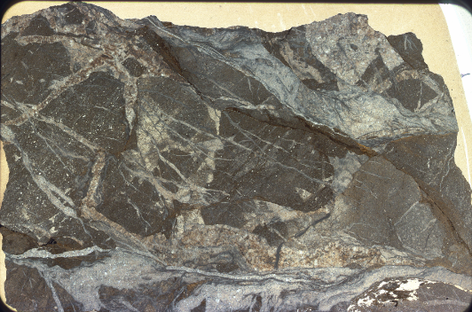
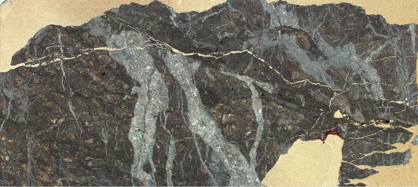
WNW
S-C
SSE
multi-generation fracs with sparry cc
rock fragments
sheared Permian shale
S-C
U. Triassic
limestone
P/S
late sparry cc in fracs

Slide 12
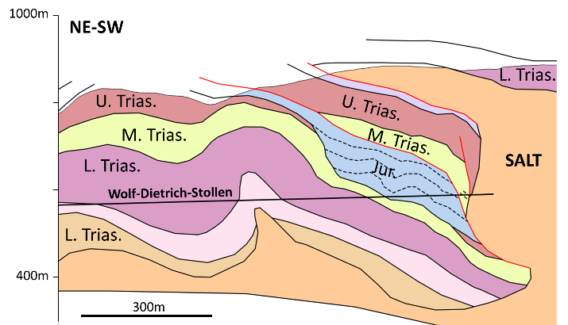
Welded extensional fault
Extension (Triassic) with area later involved in Jurassic thrusting (no reactivation of weld)
Weld contains strongly sheared relict shales from evaporite sequence and host rock fragments
Brecciated host rock

Slide 13
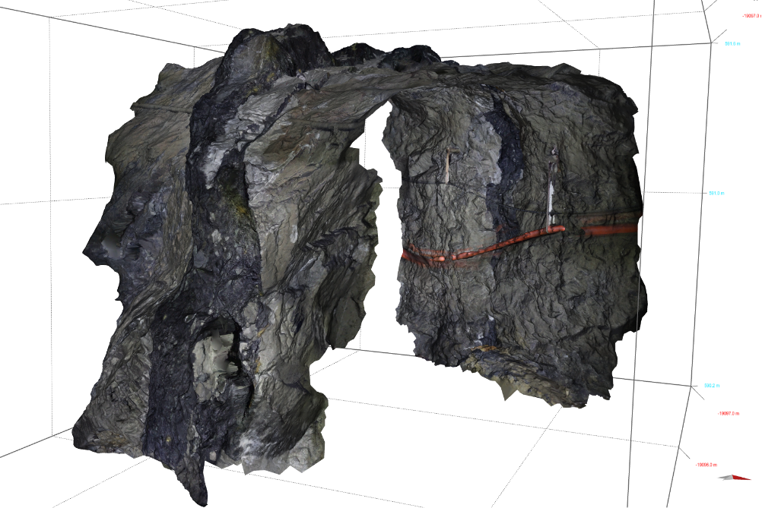
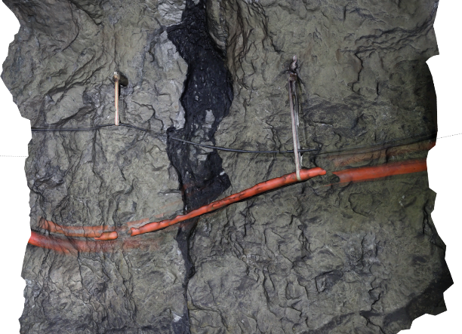
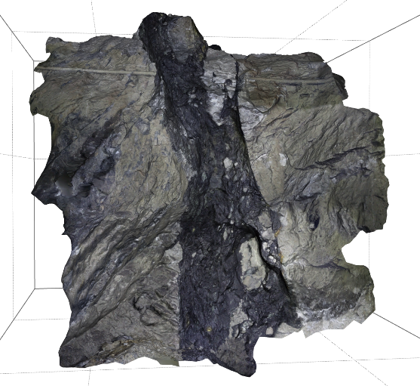
SSW
NNE
Younger
Older
Nor-Rhaet
Ladin-Carn
SSW
NNE
Younger
Nor-Rhaet
Older
Ladin-Carn
bedding
Permian

Slide 14
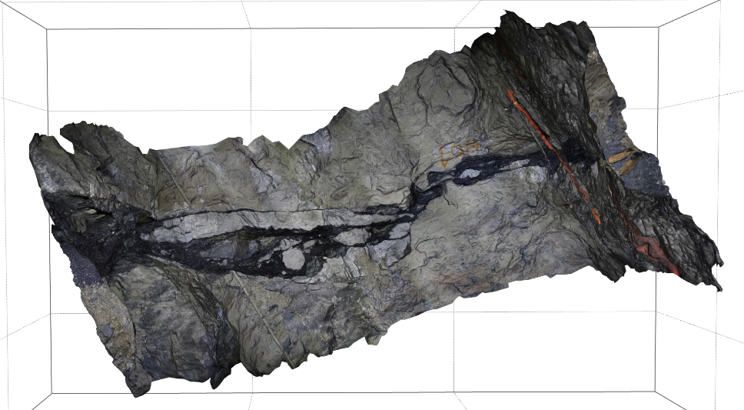
UP (away from you)
sheared Permian shale
DOWN (towards you)
footwall rock fragments
NNE
UP (away from you)
DOWN (towards you)
SSW

Slide 15
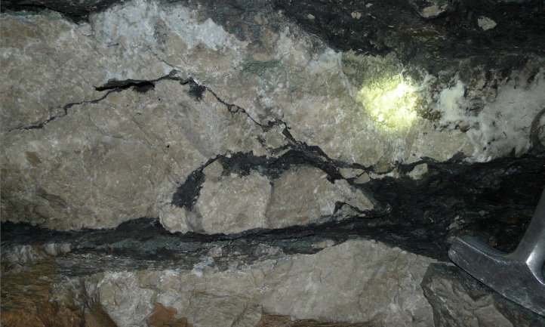
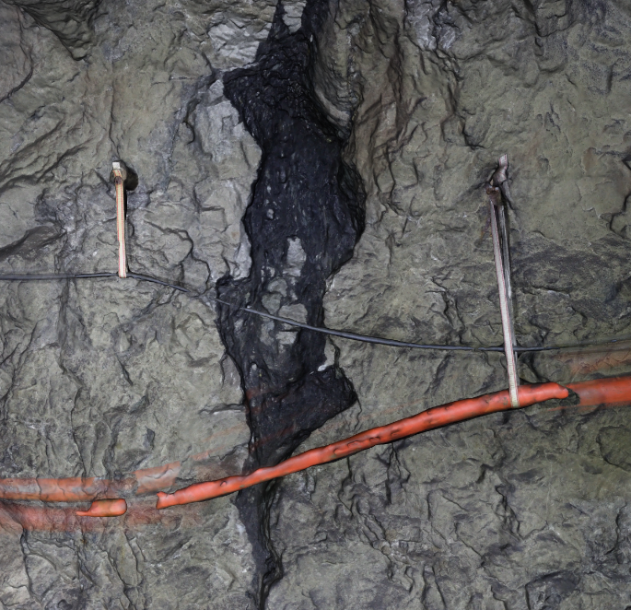
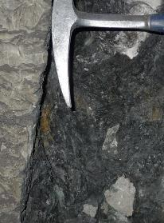
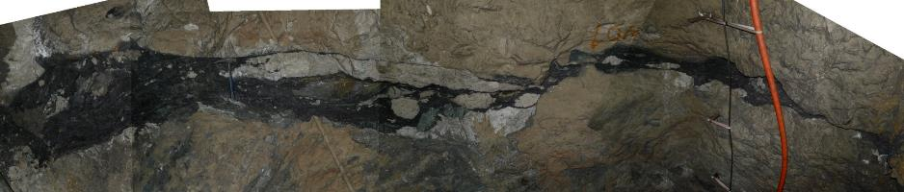
NNE
SSW
footwall blocks in weld zone
cusps?
shale injected in fractures
SSW
NNE
strongly sheared wallrock breccia
footwall
S-C
S-C
NNE
UP (away from you)
DOWN (towards you)
SSW

Slide 16
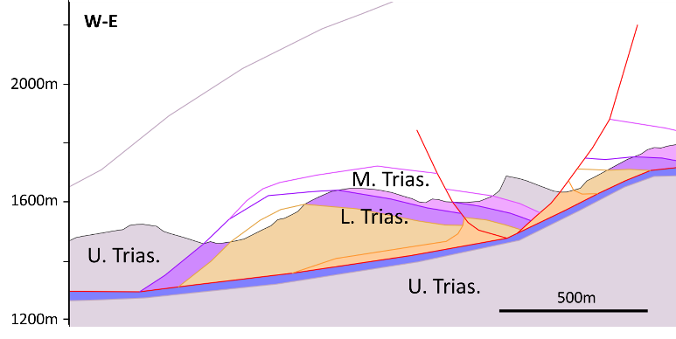
“Mystery” weld (?) feature at high angle to bedding - likely normal fault
Bedding is near-vertical
Offset on feature is strike-slip with present dip of beds but potentially original Triassic normal fault
Weld (?) contains fragments of older rock (fine-grained clastics part of evaporite sequence?) with mild deformation
Host rock brecciated to cataclastic

Slide 17
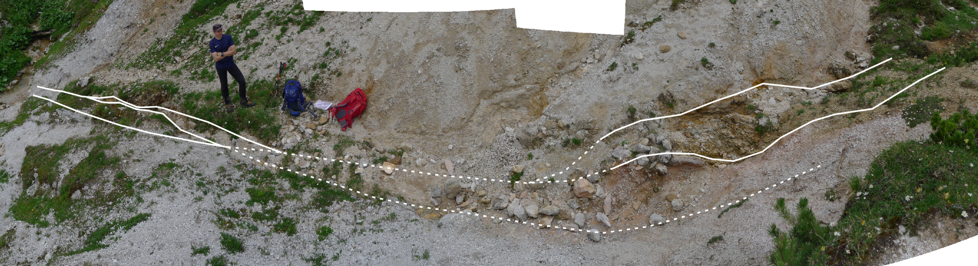

Slide 18
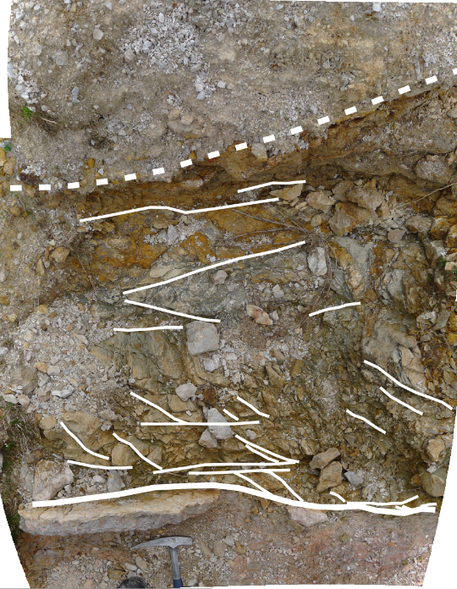
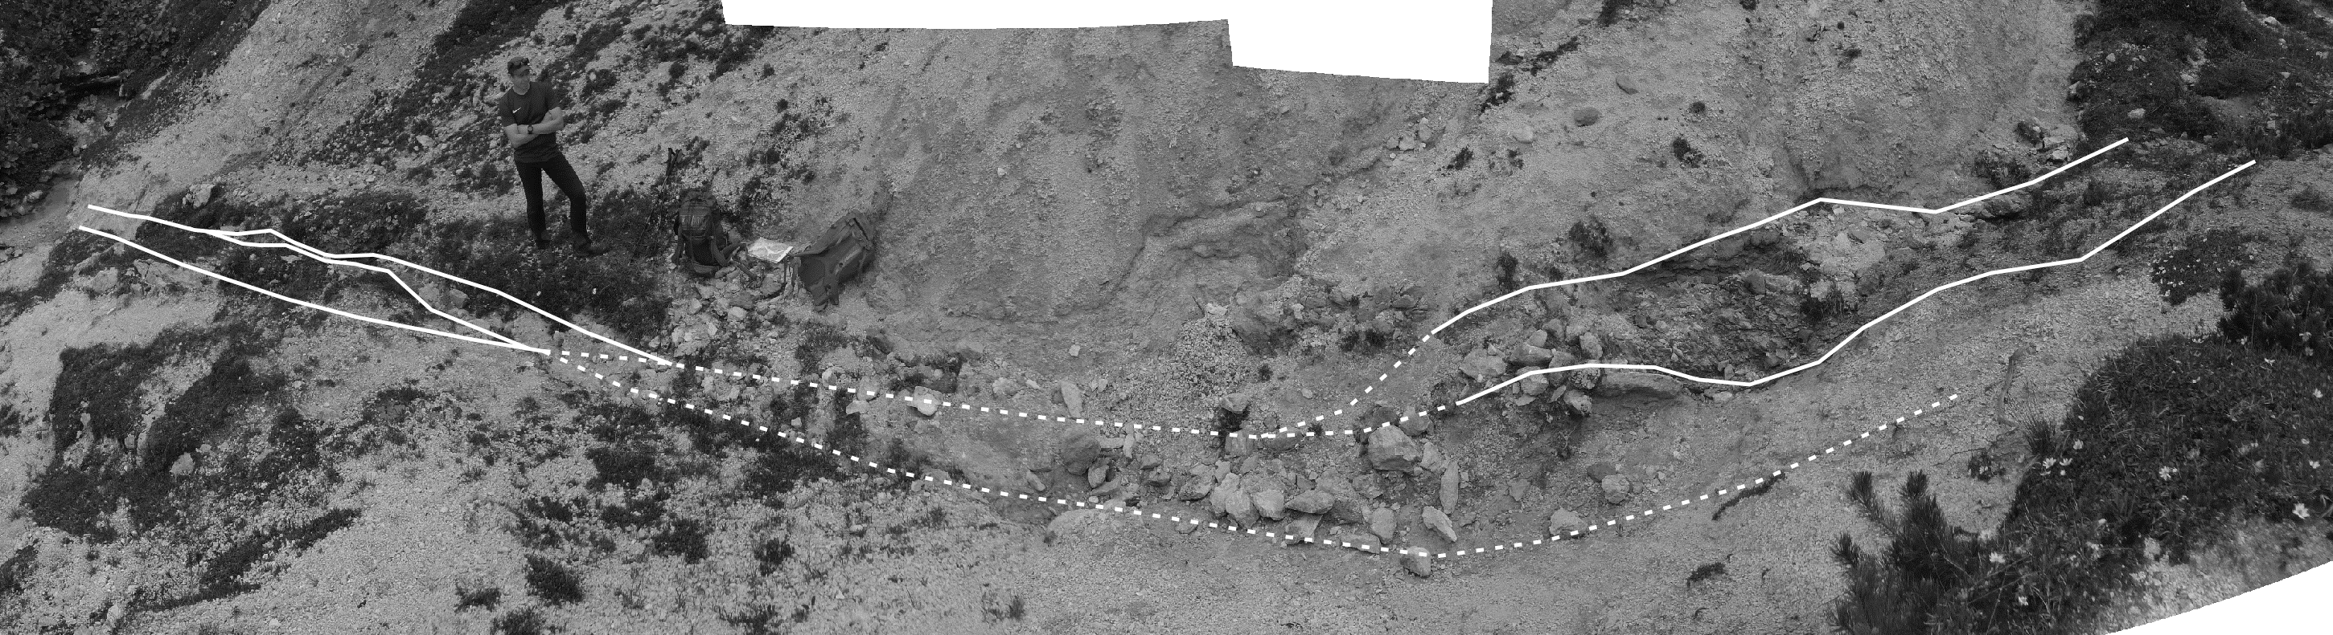

Slide 19

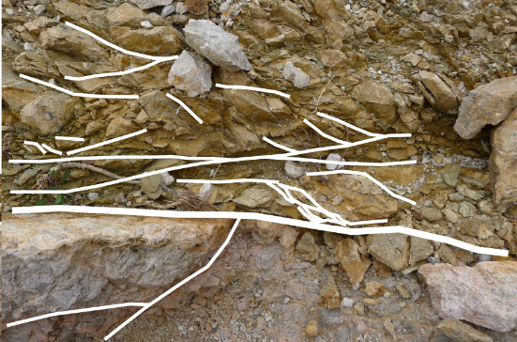
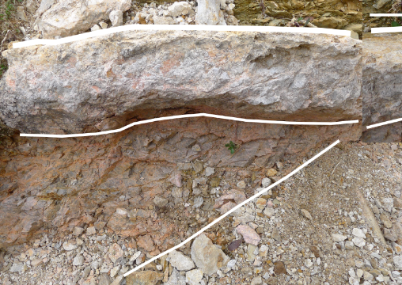
L. Trias Shale-Siltstone
S-C fabric
M. Trias (Ladinian) Lime-Dolostone

Slide 20
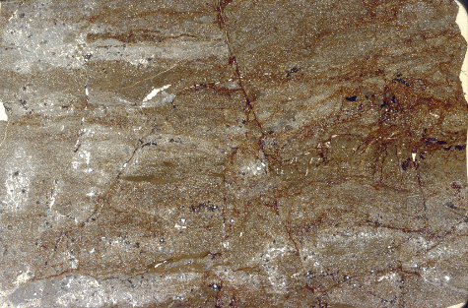
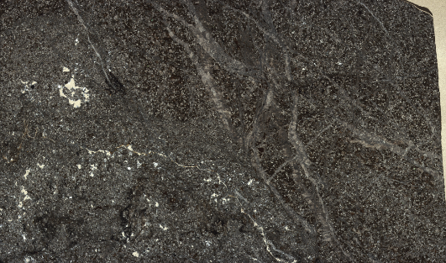
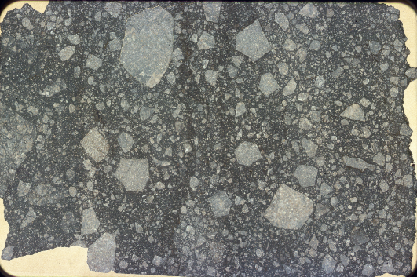
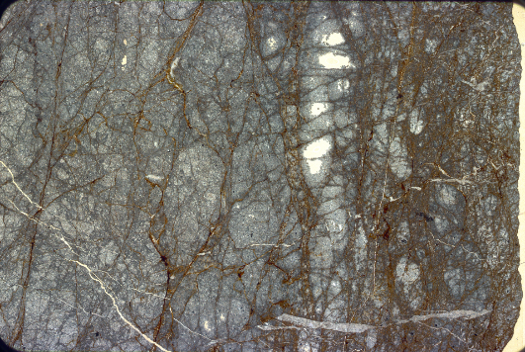
Silstone with sparry cc infilling fracs
Preserved syn-sed layering and faults
P/S surfaces + micro-crack development in dolostone
Cataclastic limestone

Slide 21
Conclusions
High fluid pressure in welds/surrounding rock is necessary to account for brecciation and cementation of breccias
Different magnitudes in host rock vs weld rock deformation are evidence of pre-salt tectonism (?)
Development of cusp-lobate geometries along welds during shearing due to strong contrast in rock strength

Slide 22
THANK YOU FOR YOUR ATTENTION!

