Slide 1


Dry air intrusions link Rossby wave breaking to large-scale dust storms in North Africa
Elody Fluck and Shira Raveh-Rubin
EGU General Assembly 23 May 2022

Slide 2

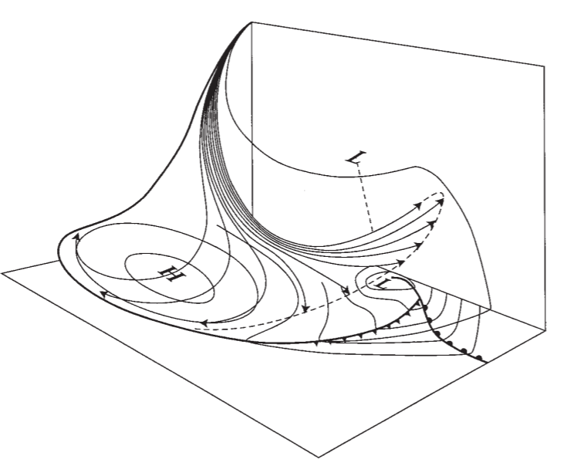
Large-scale dust storms in North Africa
Dry intrusions (DIs) are coherently descending airstreams behind cold fronts of extratropical cyclones.
When they reach the cold sector of the cyclone, they induce cold, dry and unstable windy near-surface conditions
(Raveh-Rubin and Catto 2019; Ilotoviz et al. 2021)
Danielsen 1964

Slide 3
Large-scale dust storms in North Africa
Dry intrusions (DIs) are coherently descending airstreams behind cold fronts of extratropical cyclones.
When they reach the cold sector of the cyclone, they induce cold, dry and unstable windy near-surface conditions
(Raveh-Rubin and Catto 2019; Ilotoviz et al. 2021)
Qs:
Do DIs affect surface dust distributions in NW Africa?
If so, how are DIs related to peak dust concentrations?
How often do DI-dust events occur and what is their climatological significance?
Danielsen 1964

Slide 4
Large-scale dust storms in North Africa
Dry intrusions (DIs) are coherently descending airstreams behind cold fronts of extratropical cyclones.
When they reach the cold sector of the cyclone, they induce cold, dry and unstable windy near-surface conditions
(Raveh-Rubin and Catto 2019; Ilotoviz et al. 2021)
Qs:
Do DIs affect surface dust distributions in NW Africa?
If so, how are DIs related to peak dust concentrations?
How often do DI-dust events occur and what is their climatological significance?
Data: ECMWF ERA Interim (Dee et al. 2009) and CAMS dust optical depth (Inness et al, 2019) reanalyses, AERONET
Approach: Lagrangian-based identification of dry intrusion airmass trajectories (Sprenger and Wernli 2015, Raveh-Rubin 2017) + matching algorithm between DIs and dust optical depth peaks
Danielsen 1964

Slide 5
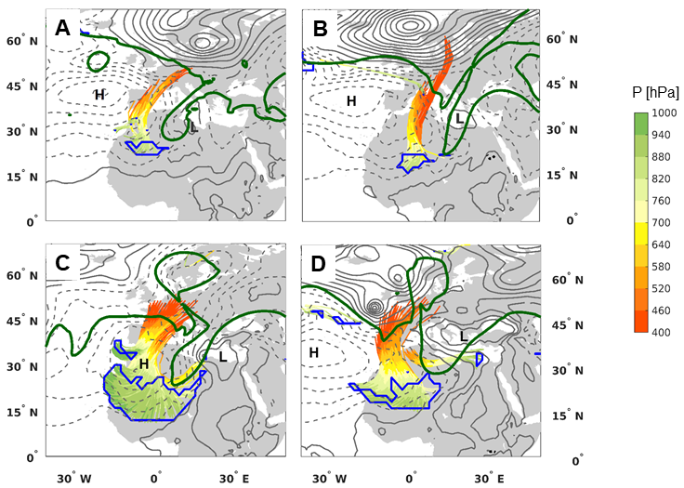
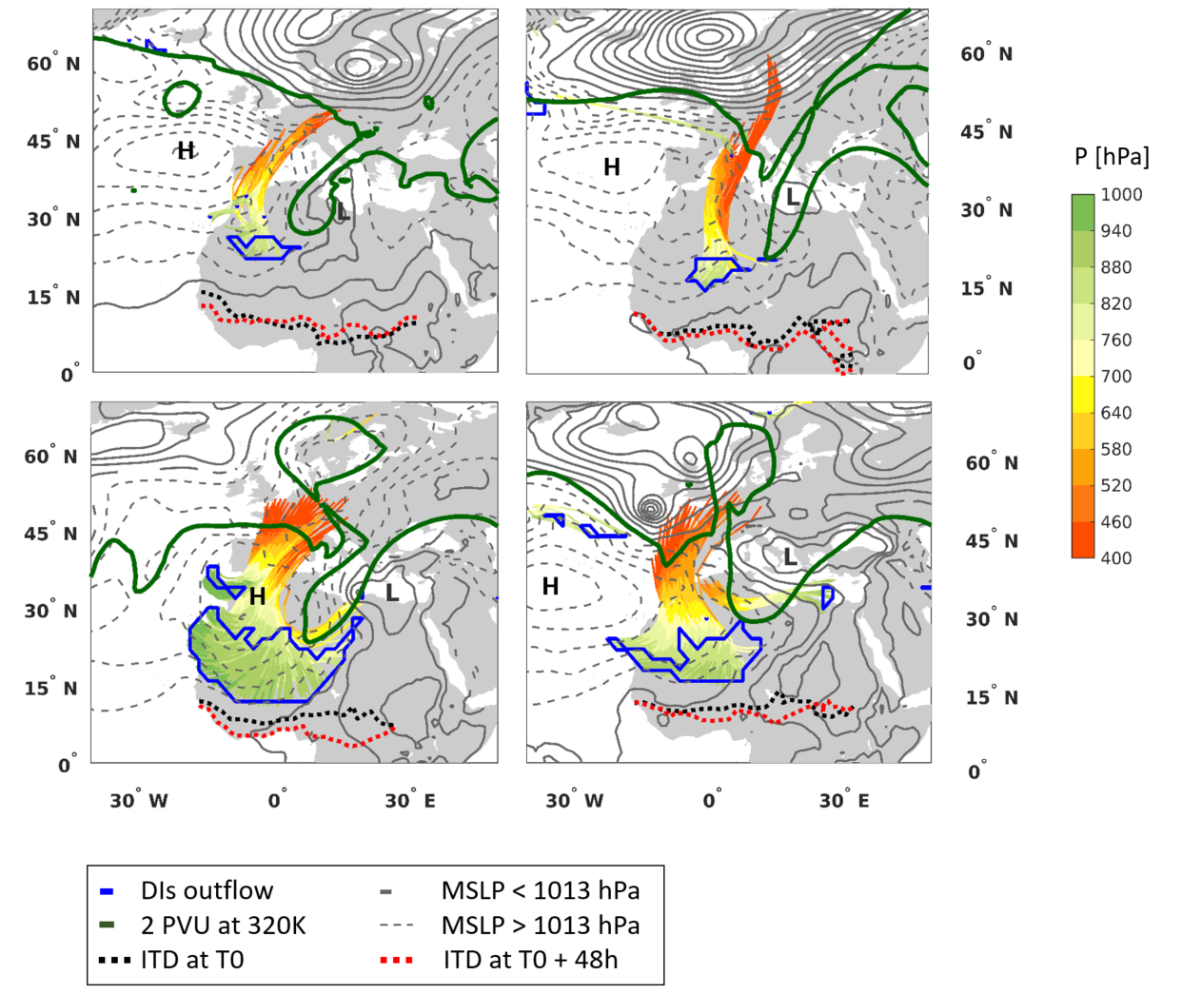
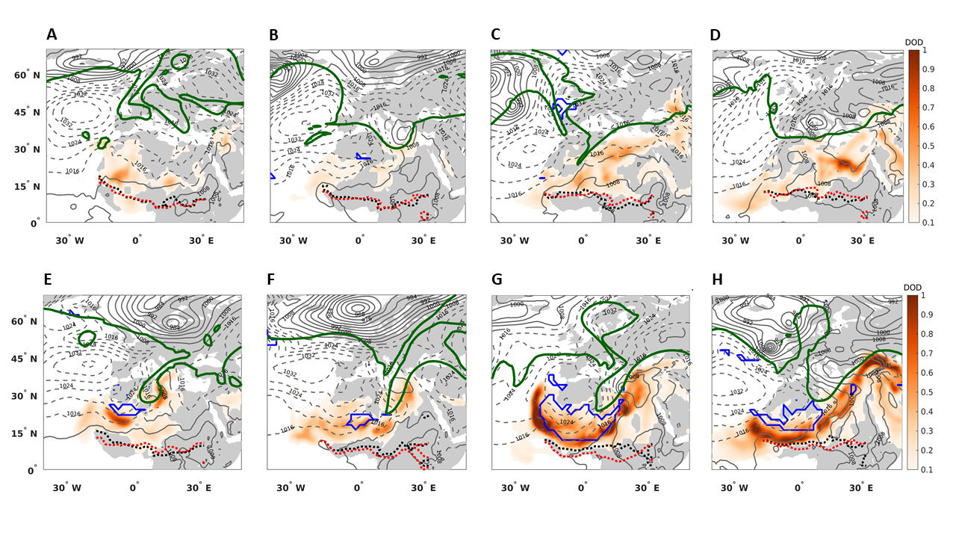
Constellation of trough - DI - dust
4 March 2004
23 March 2018
Trough guides DI air during RWB
Upper trough-DI-surface cyclone/anticyclone as in conceptual picture
DI aligned with dust (cold) front trailing from Med. cyclone
Danielsen 1964

Slide 6
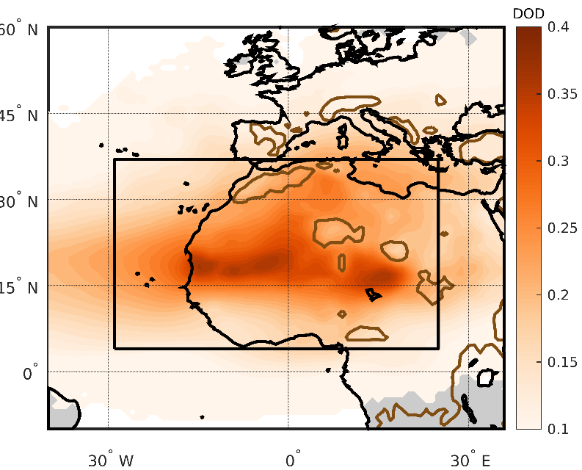
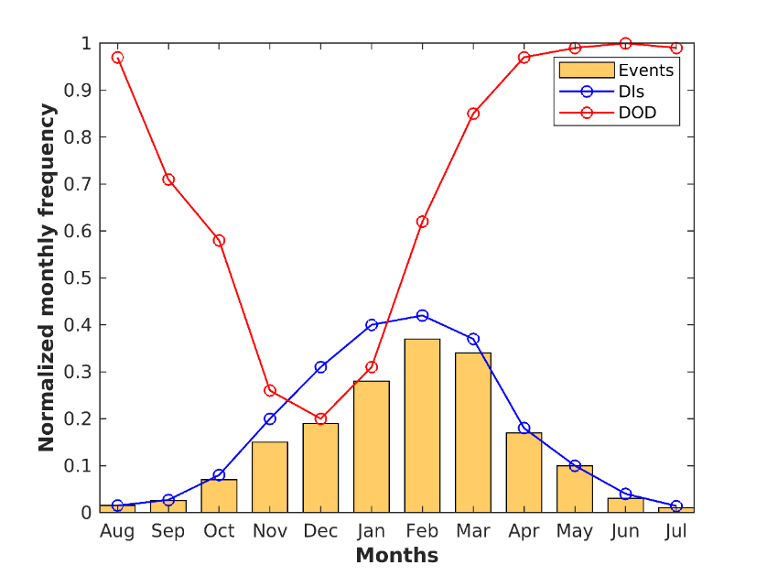
Generalization: climatology of dust + DI
Dust & DI matching algorithm
Dust optical depth (DOD) climatology
min. area 2˚x 2˚
DI
max. dist 1˚
DOD 0.1
DOD 0.3
90th
percentile
325 DI-dust events
during 2003-2018
(~20 events per year)
DI-dust events peak in
late winter - spring

Slide 7
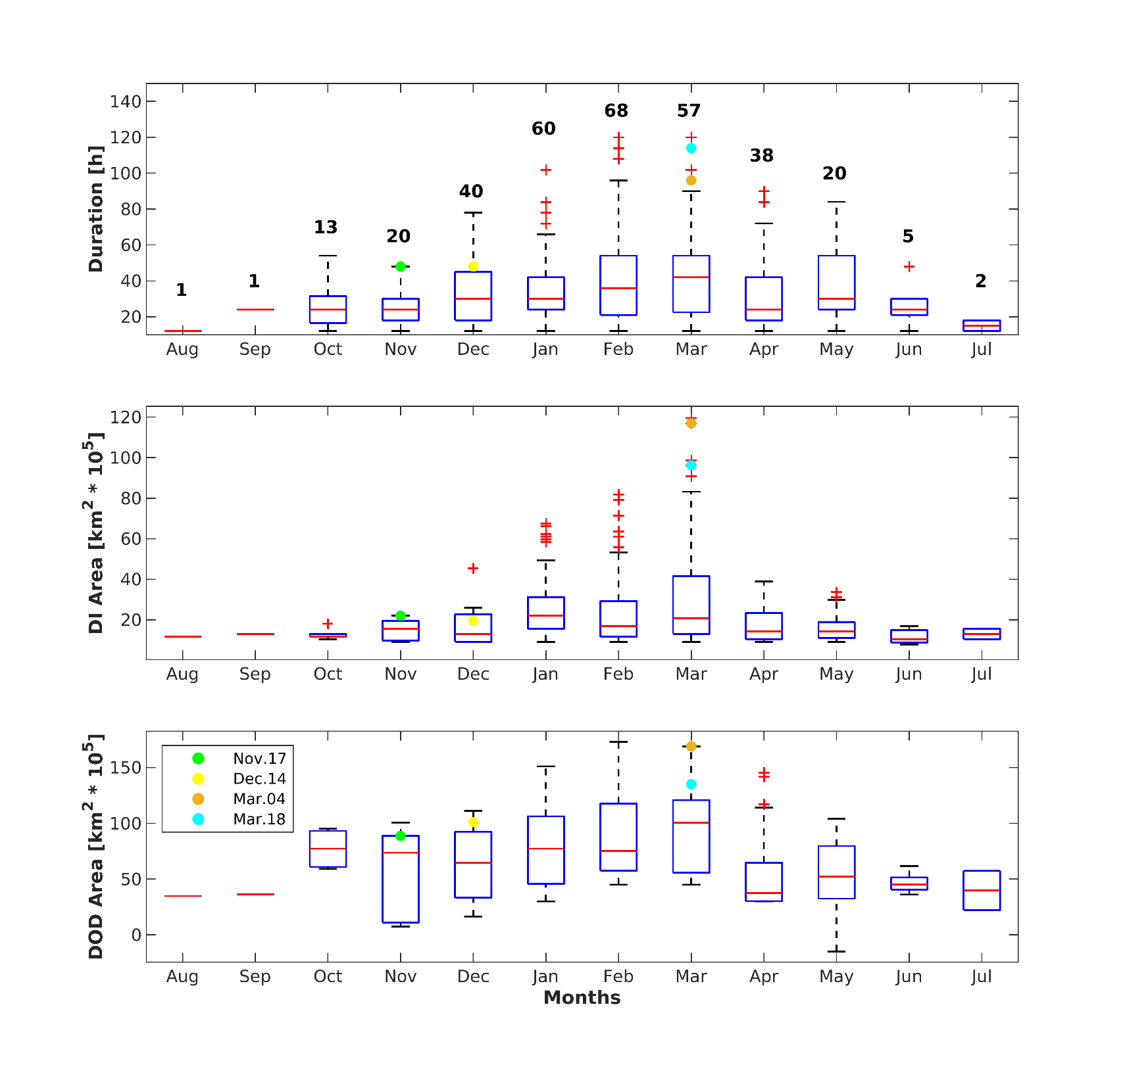
Climatological dust + DI event characteristics
Event
duration [h]
Area of DOD objects [10⁵ km²]
Longest, largest events in winter and spring
March 2004 and 2018 events are among the most extreme

Slide 8
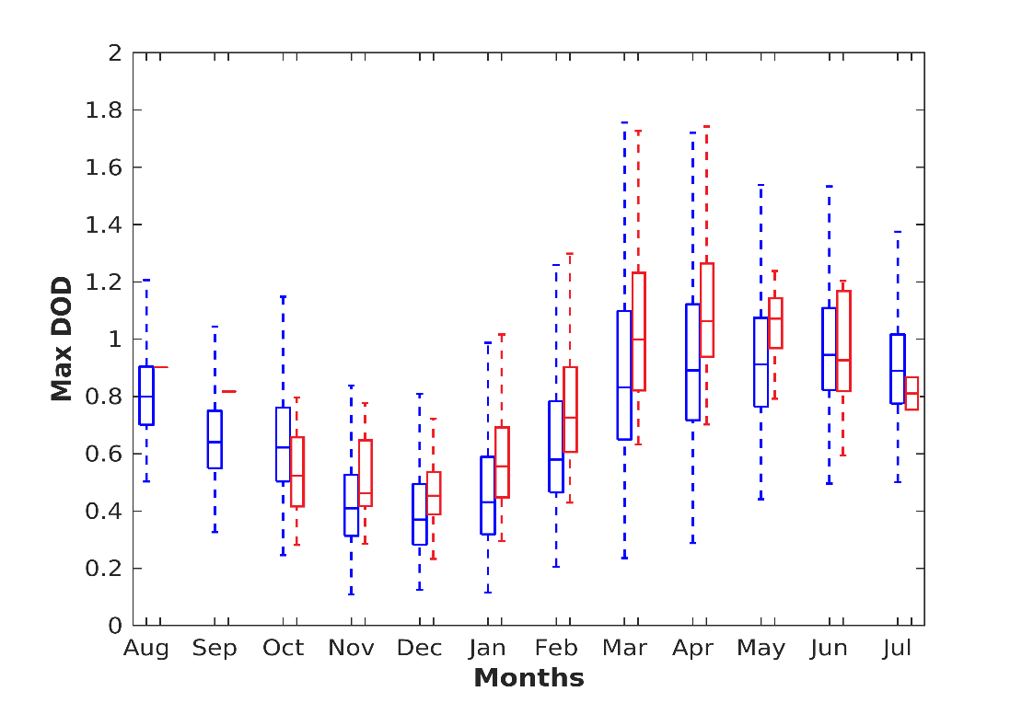
Max. intensity dust + DI events Vs. dust without DIs
Highest dust optical depth in March-April
Higher dust optical depth in the presence of DIs

Slide 9
Summary
March 2004 and 2018 events driven by RWB over the NE Atlantic, manifested as PV streamers intruding NW Africa, surface anticyclone, and (deep) Mediterranean cyclone
Connecting the upper troposphere with the near surface, DIs over West Africa reach the dust maxima
DIs induce strong dry and cold surface wind, promoting dust emission and long-range transport
Climatology of 325 dust & DI events shows peak frequency in winter-spring, when events are longer, larger, and more intense under DIs
Precursor signals 3-5 days ahead in N. Atlantic (not shown). Implications for dust transport northeastwards to Europe and Middle East

