Slide 1
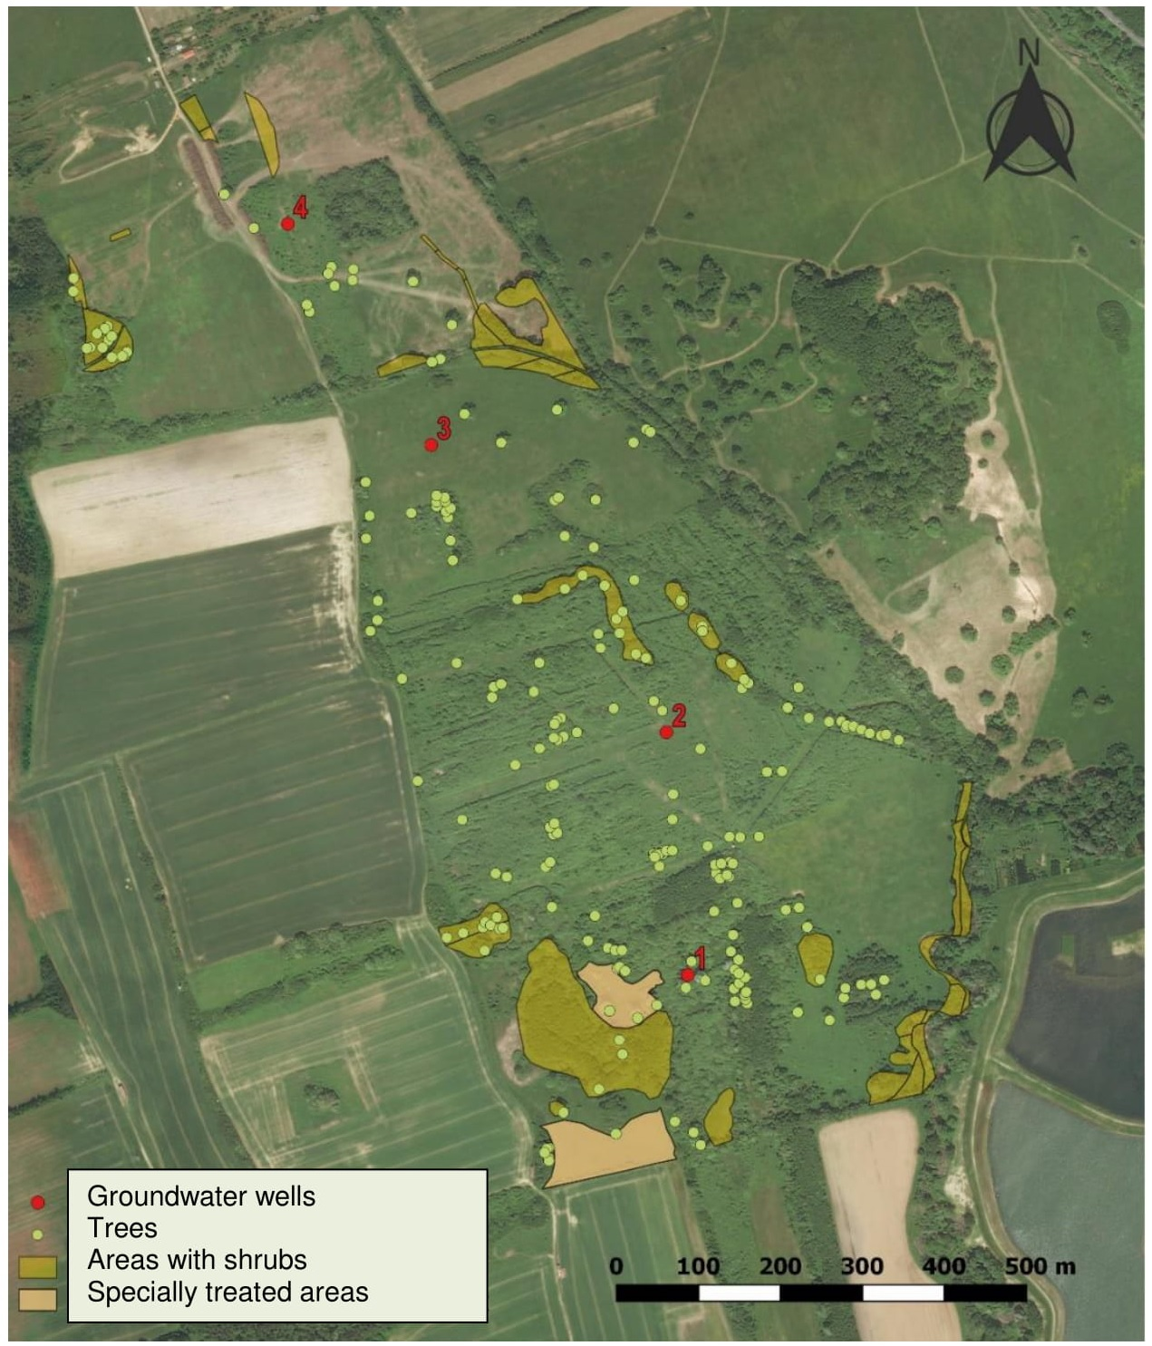
Factors influencing hydrology of a riparian woody pasture in western Hungary
Előd Szőke¹, Péter Csáki³, Péter Kutschi², Péter Kalicz¹, Zoltán Gribovszki¹
¹ University of Sopron, 9400 Sopron, Bajcsy-Zs. u. 4., Hungary ² Őrség National Park Directorate
³Self-employed
E-mail: elod0324@gmail.com
2. figure: Temperature and precipitation patterns.
1. figure: The location of the groundwater wells in the habitat reconstruction project area near Kőszeg
3. figure: Soil moisture and precipitation patterns.
Impact = Δh_before - Δh_after
∆h_after
Control
5. figure: Treatment-control space and time deviations
4. figure: Changes in groundwater levels and precipitation patterns.
7. figure: Change in groundwater level relative to the control well
6. figure: Double mass curve in groundwater
9. figure: Change in soil moisture relative to the control well
8. figure: Double mass curve in soil moisture
Research was supported by TKP2021-NKTA-43 project. Project no. TKP2021-NKTA-43 has been implemented with the support provided by the Ministry of Innovation and Technology of Hungary from the National Research, Development and Innovation Fund, financed under the TKP2021-NKTA funding scheme.”

