Slide 1
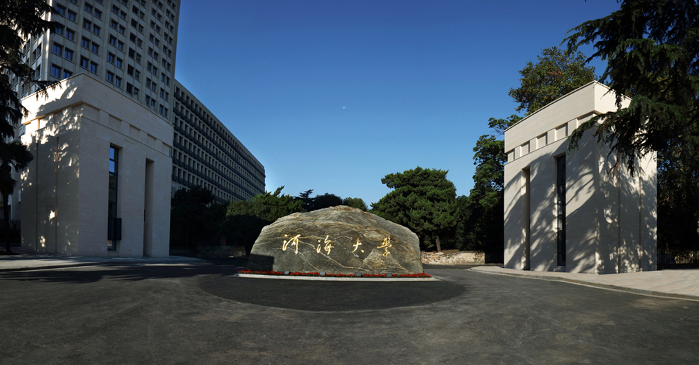

Risk analysis for reservoir flood control operation considering
two-dimensional uncertainties based on Bayesian network
Qingwen Lu
luqw@hhu.edu.cn
College of Hydrology and Water Resources, Hohai University, China
Notes:
【感谢陈宇的投稿】
字体：思源宋体Heavy

Slide 2


Research Background
Reservoir Flood Control Operation
uncertainty
initial flood regulation water level exceeds the designed flood limited water level (initial level uncertainty caused by floodwater conservation)
flood forecast
uncertainty
hydrometeorological forecast
flood forecast uncertainty caused by real time flood forecast error
Risk Analysis Based on Bayesian Network
Bayesian network (BN) can be used to deal with the uncertainties caused by the conditional correlation among different variables
Model structure: directed acyclic graph (DAG)
Model parameters: conditional probability table (CPT)
Notes:
【感谢陈宇的投稿】
字体：思源宋体Heavy

Slide 3
Risk Factors Identification
Uncertainty Quantification
Risk source 2
Normal distribution
Reservoir inflow
Risk source 1
Analytical derivation
Lateral inflow
Notes:
【感谢陈宇的投稿】
字体：思源宋体Heavy

Slide 4
Risk Analysis Model based on BN
1
Structure learning
DAG
—reservoir storage at the beginning/end of time period t
—reservoir level at the beginning/end of time period t
—average reservoir inflow in time period t
—average reservoir outflow in time period t
—average lateral inflow in time period t
—average flow at downstream
control point in time period t
BN structure for reservoir flood control operation
Notes:
【感谢陈宇的投稿】
字体：思源宋体Heavy

Slide 5
Risk Analysis Model based on BN
2
Parameter learning
Generating the training samples: Monte Carlo simulation
V_{t}, H_{t}
Generate random samples of
q_{t}, QC_{t}
Q_{t}, IU_{t}
Discretizing the variables: equal distance method
Parameter learning: maximum likelihood estimation (MLE)
CPTs
Notes:
【感谢陈宇的投稿】
字体：思源宋体Heavy

Slide 6
Risk Analysis Model based on BN
3
Probability inference
Prior probability inference
Posterior probability inference
Prediction: from cause to effect
given V₀, Q, IU, calculate the probability distributions of H and QC
evidence variables
Diagnosis: from effect to cause
given H, QC, calculate the probability distributions of V₀, Q and IU
4
Risk calculation
Reservoir
Downstream control point
Notes:
【感谢陈宇的投稿】
字体：思源宋体Heavy

Slide 7
Case Study
Xianghongdian Reservoir System
Numerical experiment setting
Case 1: Only considering the uncertainty of initial water level
Case 2: Only considering the uncertainty of flood forecast
Case 3: Simultaneously considering the uncertainties of initial water level and flood forecast
Prior probability inference
case 2 > case 3 > case 1
Notes:
【感谢陈宇的投稿】
字体：思源宋体Heavy

Slide 8
Case Study
Posterior probability inference
Predicted risk for reservoir given values of risk factors (V₀, Q_{max}, IU_{max})
Diagnosed probabilities of initial storage with different (L1,L2,L3) evidence values (H_{max}, QC_{max})
Notes:
【感谢陈宇的投稿】
字体：思源宋体Heavy

Slide 9
Conclusions
Flood control risk is mainly caused by flood forecast error, but the uncertainty of initial condition can not be neglected.
BN model can realize bi-directional inference which can be used to achieve effective risk management.
Notes:
【感谢陈宇的投稿】
字体：思源宋体Heavy

Slide 10
Thanks for your attention!
Qingwen Lu
luqw@hhu.edu.cn
College of Hydrology and Water Resources, Hohai University, China
Notes:
【感谢陈宇的投稿】
字体：思源宋体Heavy

