Slide 1


Infrastructure-damaging landslides from an extreme rainfall event: case study from Gisborne, New Zealand
Martin Brook¹, Matt Cook¹ & Murry Cave²
¹School of Environment, University of Auckland, Auckland, New Zealand
²Gisborne District Council, Gisborne, New Zealand

Slide 2
Outline
Geology & Geomorphology
November 2021 Rainfall Event
Impacts
City
Te Arai water pipeline
Wairoa-Gisborne Railway Line
Summary

Slide 3
1. Geology & Geomorphology

Slide 4
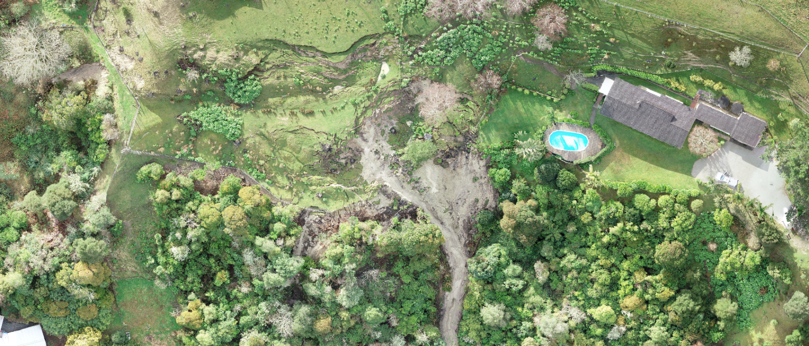
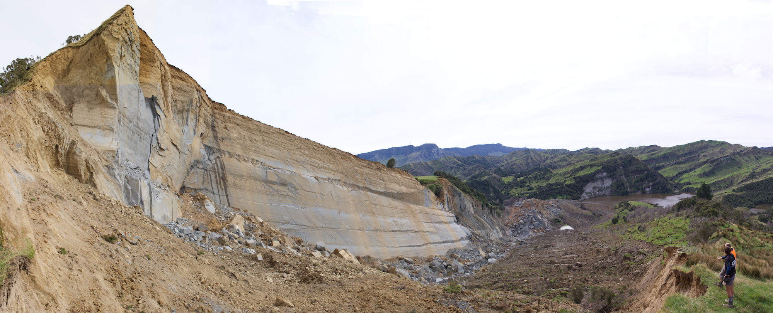
Rotational slump-earthflows
Gisborne city
Pleistocene alluvial sediments on ridgetops/slopes
Medium-high plasticity, smectite = swelling
Low volume
Typical landslides
2. Bedding plane failures
Rural areas
Miocene mudstones/sandstones
Inclined strata
Pervasive discontinuities
Large volume, complex

Slide 5
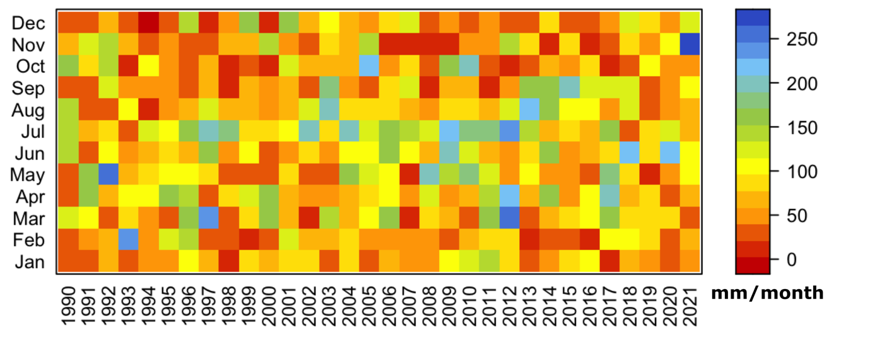
2. November 2021 Rainfall Event
1990-2021 monthly rainfall Gisborne city
Gisborne’s 1990-2020 mean annual rainfall = 995 mm
250.7 mm 3-7 November 2021 in Gisborne city
>1000 mm in some parts of the district

Slide 6
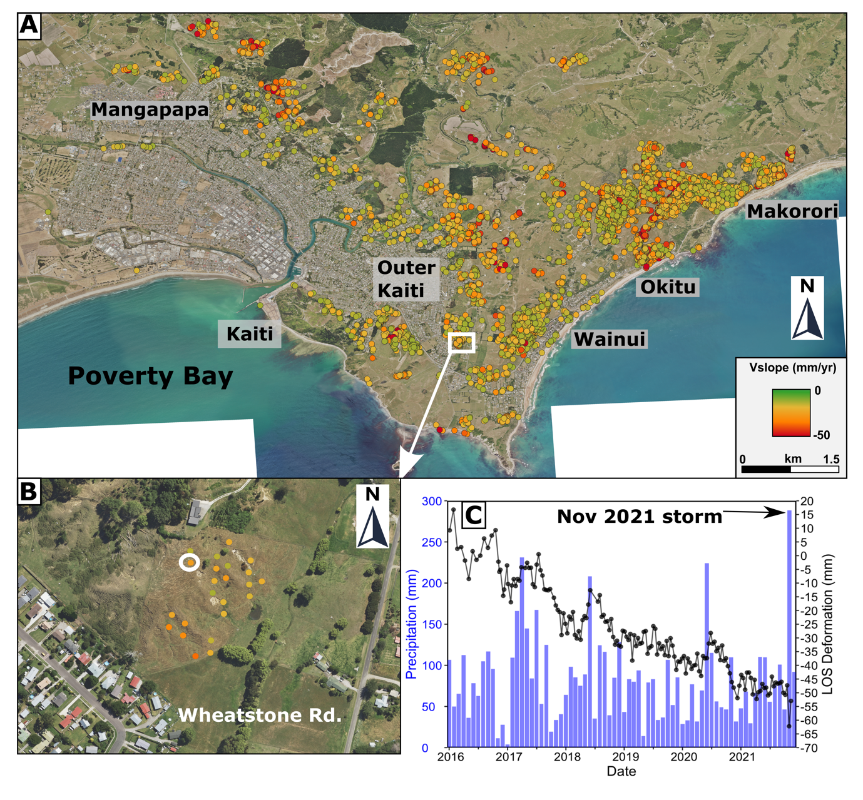
State of Emergency declared….
Sentinel-1 InSAR
Site visits
UAV surveys

Slide 7
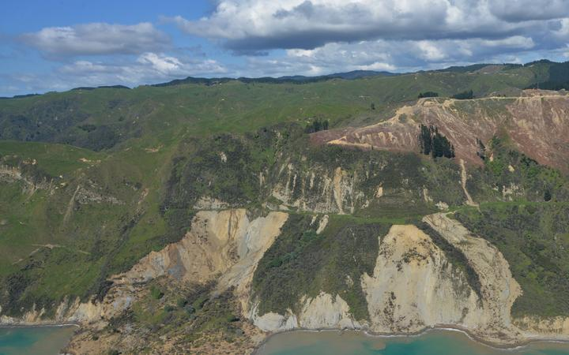
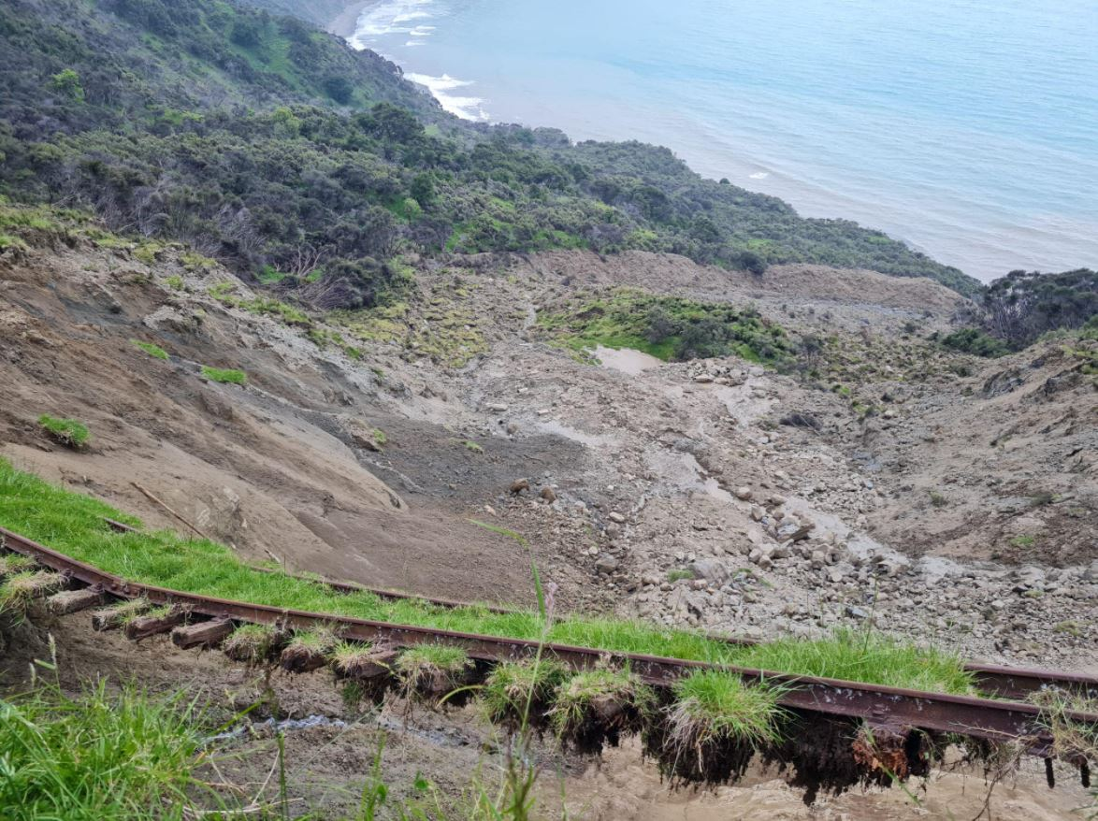
3. Impacts
3. Impacts
Whareongaonga Landslide
Gisborne-Wairoa Railway Line

Slide 8
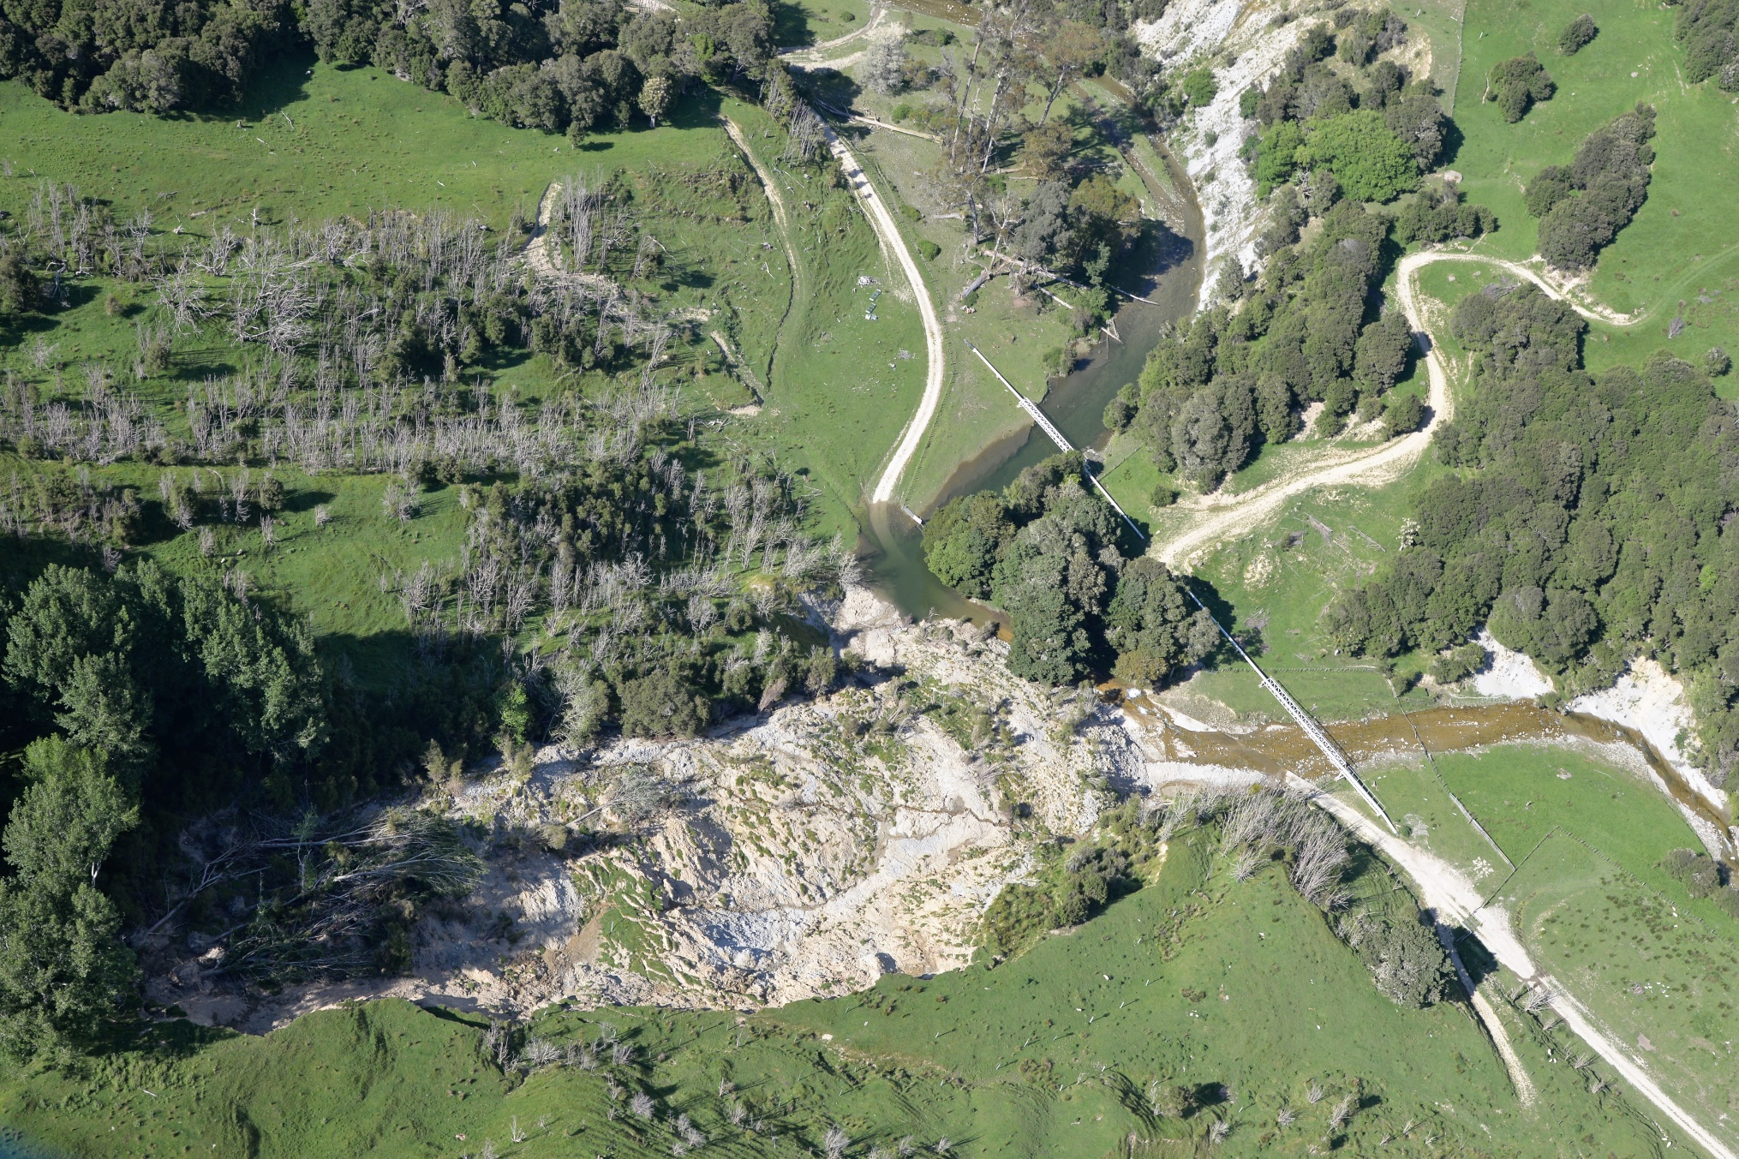
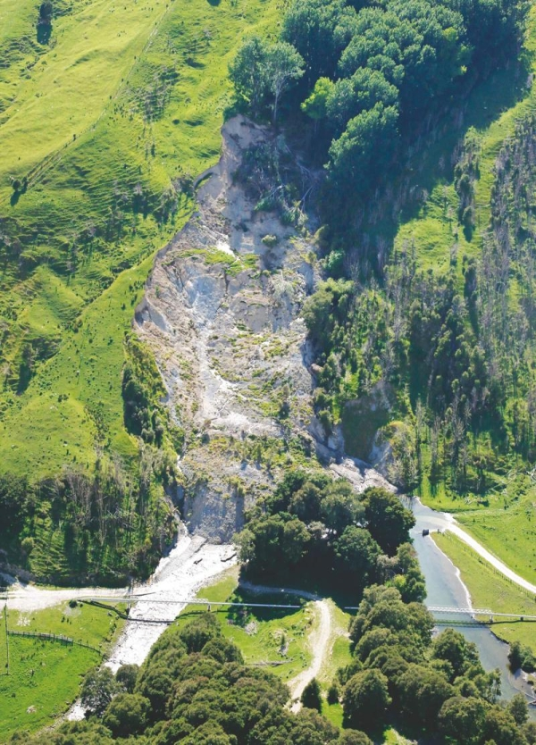
3. Impacts
Te Arai Landslide

Slide 9
Post failure drone imagery
194 Ballance St, Gisborne
194 a&b

Slide 10
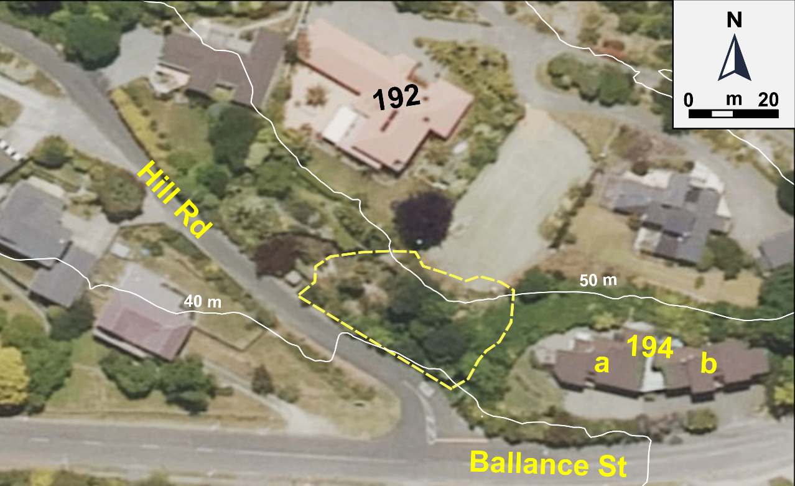
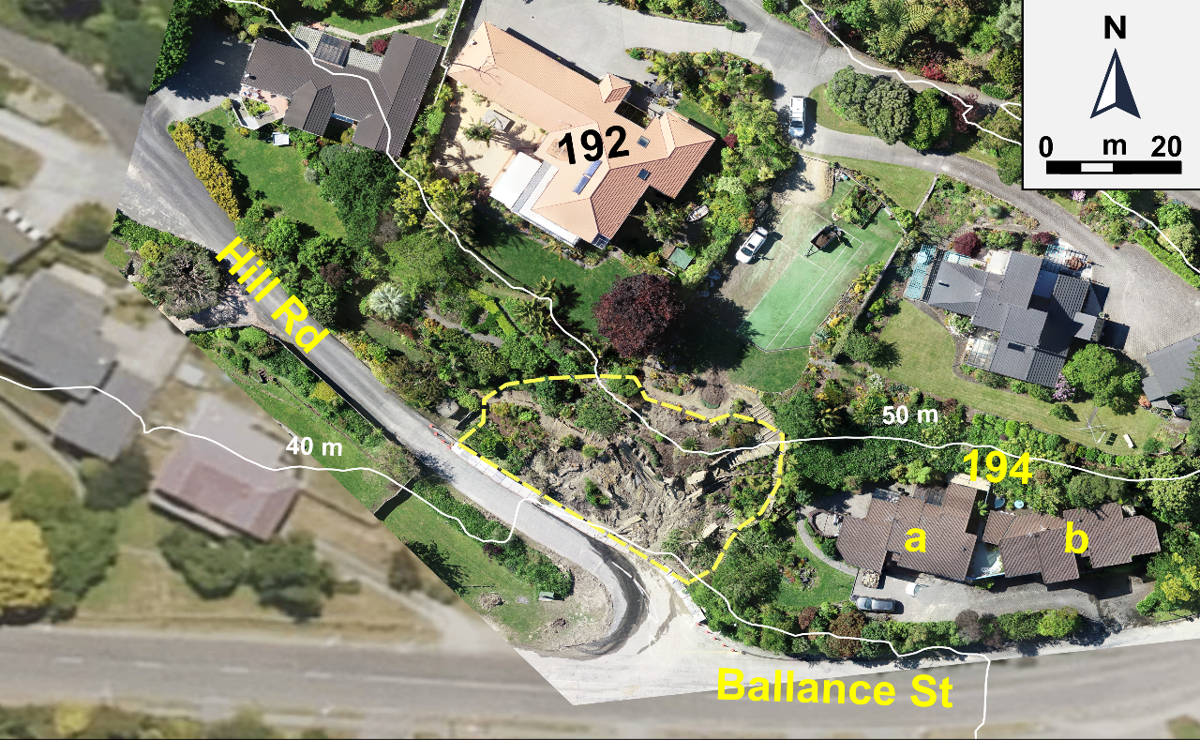
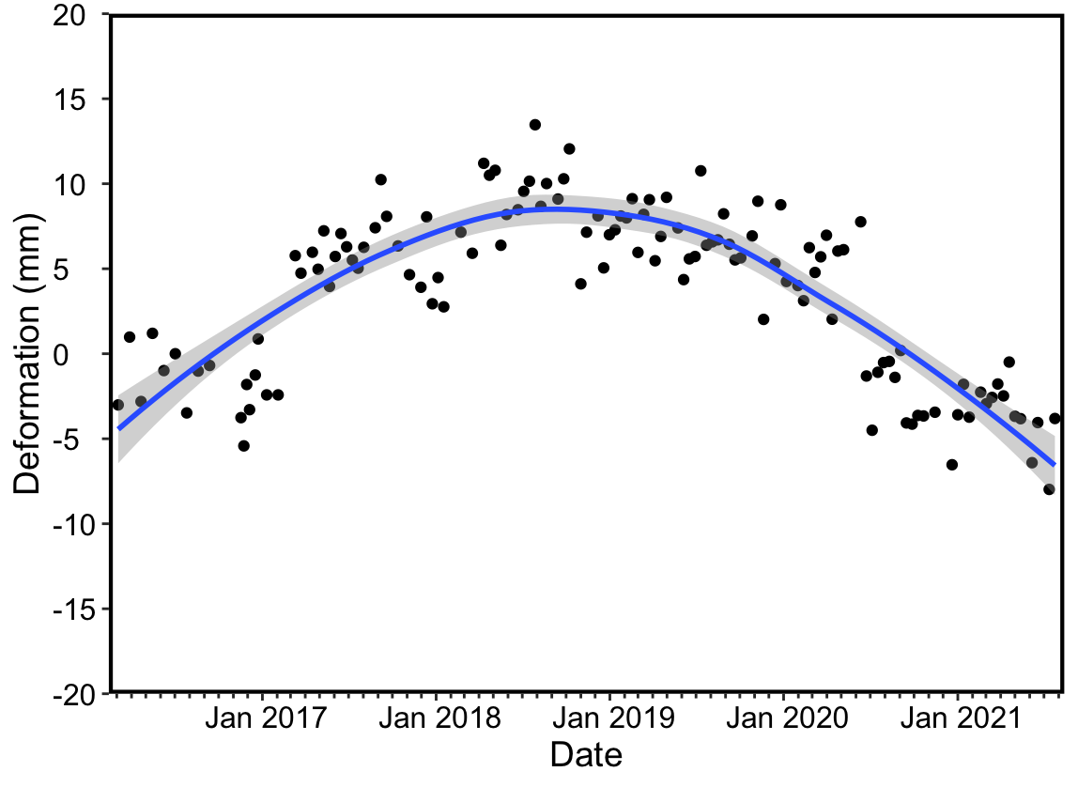
Pre failure - 2017
Pre failure - 2019
192
194
a
b
Post failure - 2021
Preliminary InSAR

Slide 11
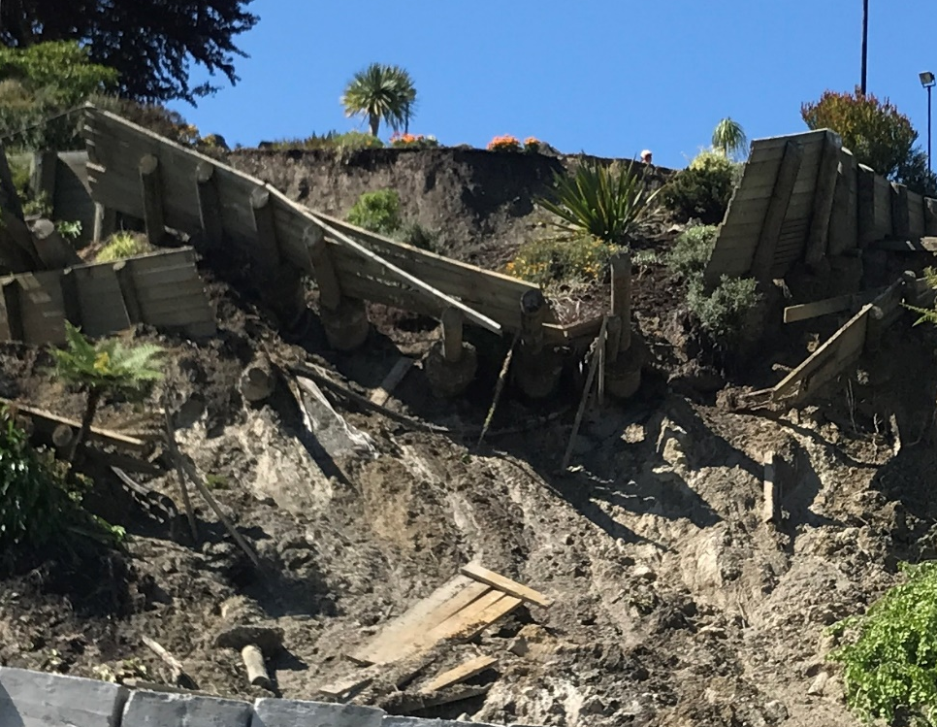
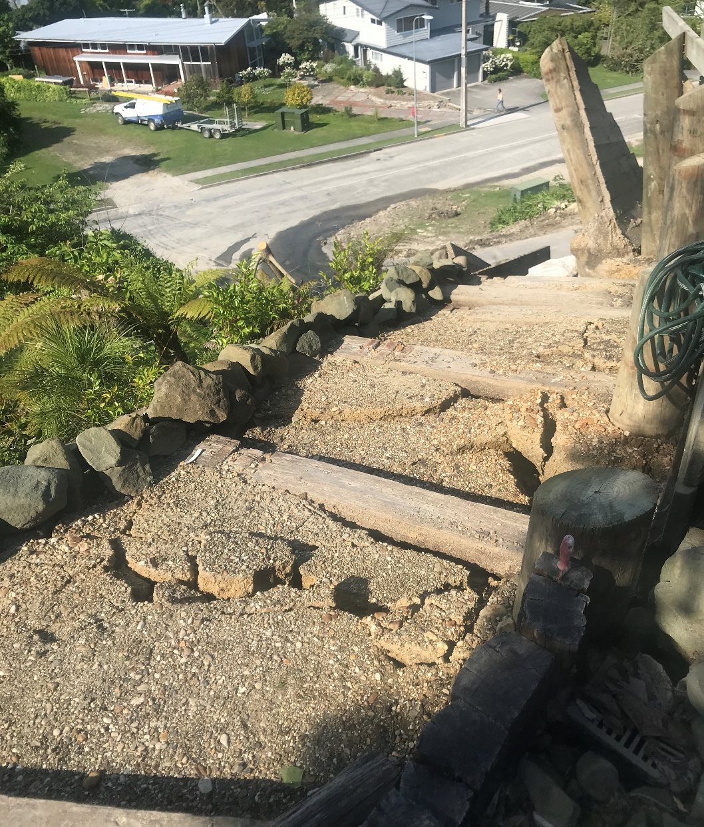
thin planks
1 m embed.
Granular
fill & geotex
PE collection
pipe
Risks: saturated ground/ponded water; reactivation; slope engineering

Slide 12
Post failure drone imagery
17
28 Gaddums Hill Road, Gisborne
28

Slide 13
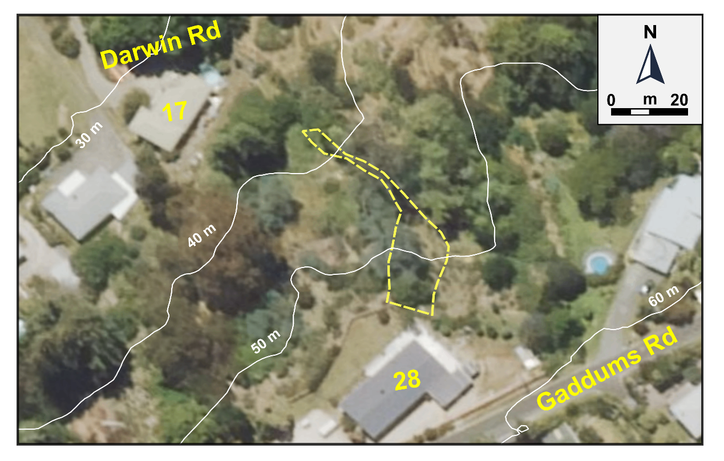
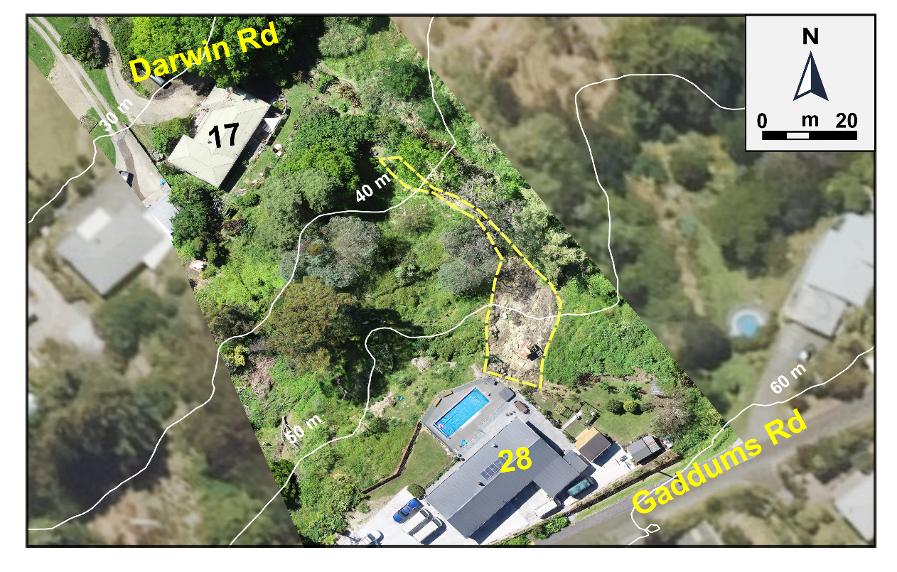
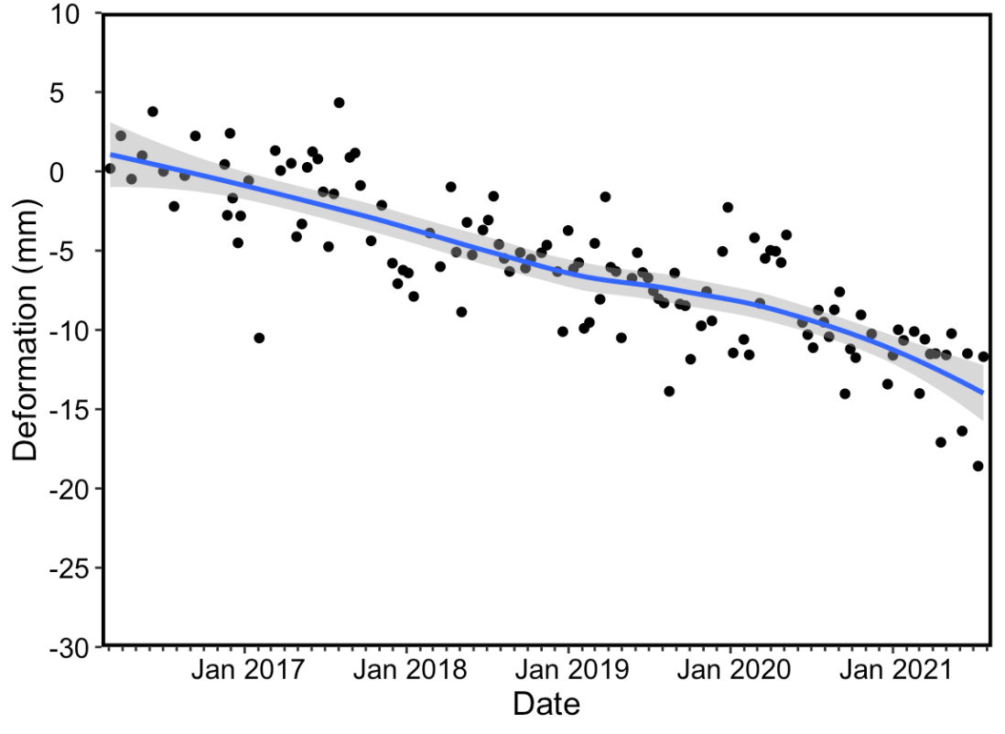
Pre failure - 2017
Pre failure - 2019
17
28
Gaddums Rd
Post failure - 2021
Preliminary InSAR

Slide 14
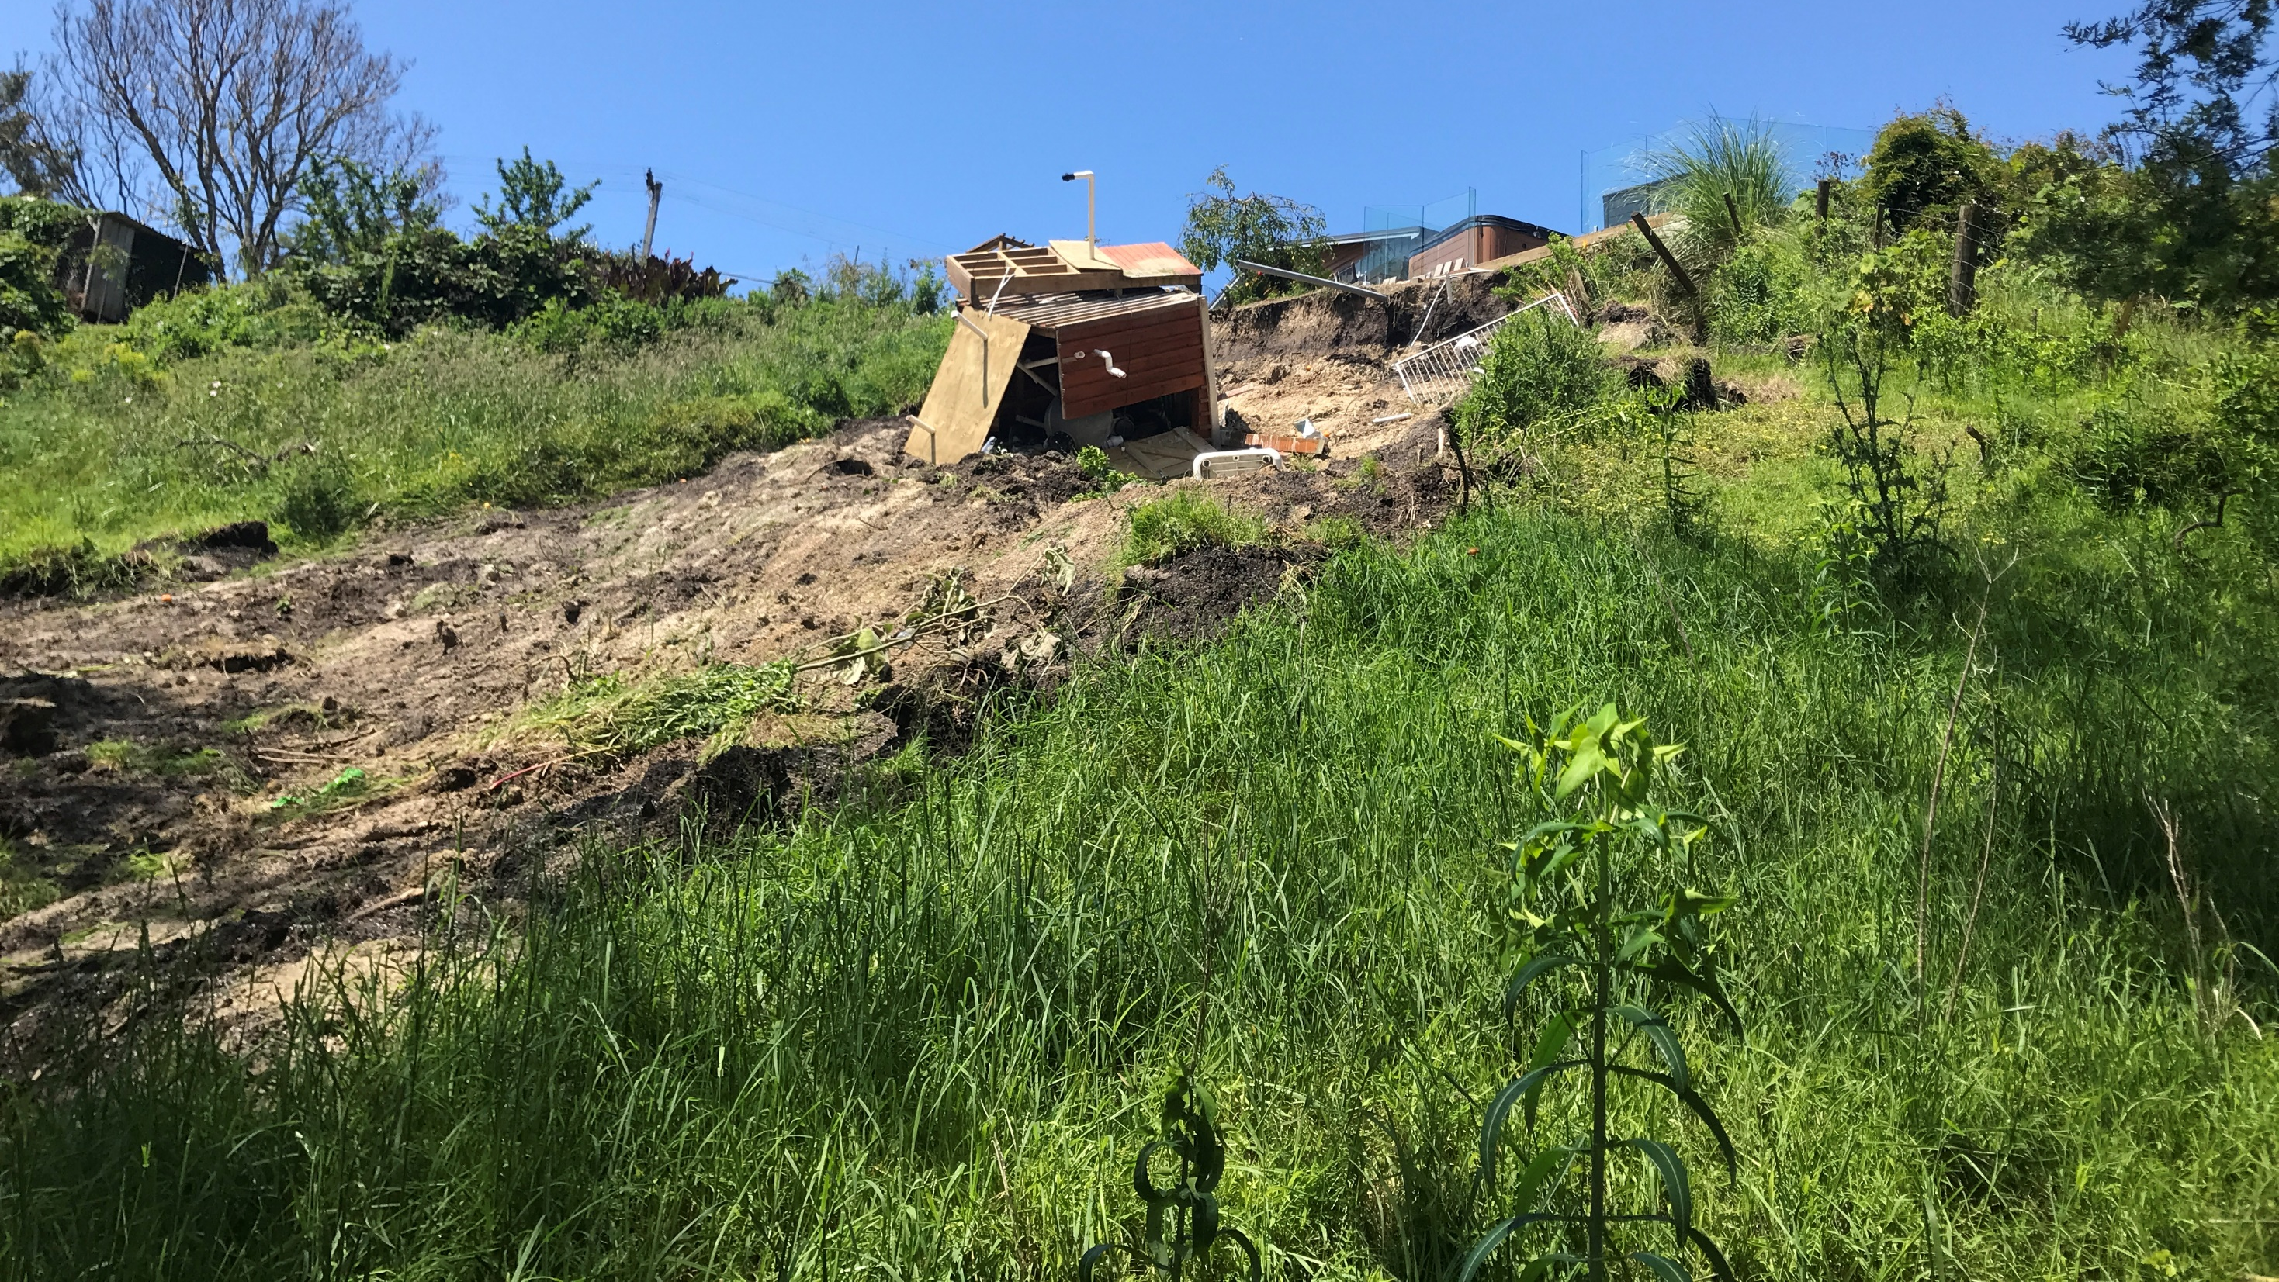
Slump-channelised earthflow
28 Gaddums Hill Rd
Displaced pool heater
(arrested)
Lateral scarp
1.5 m

Slide 15
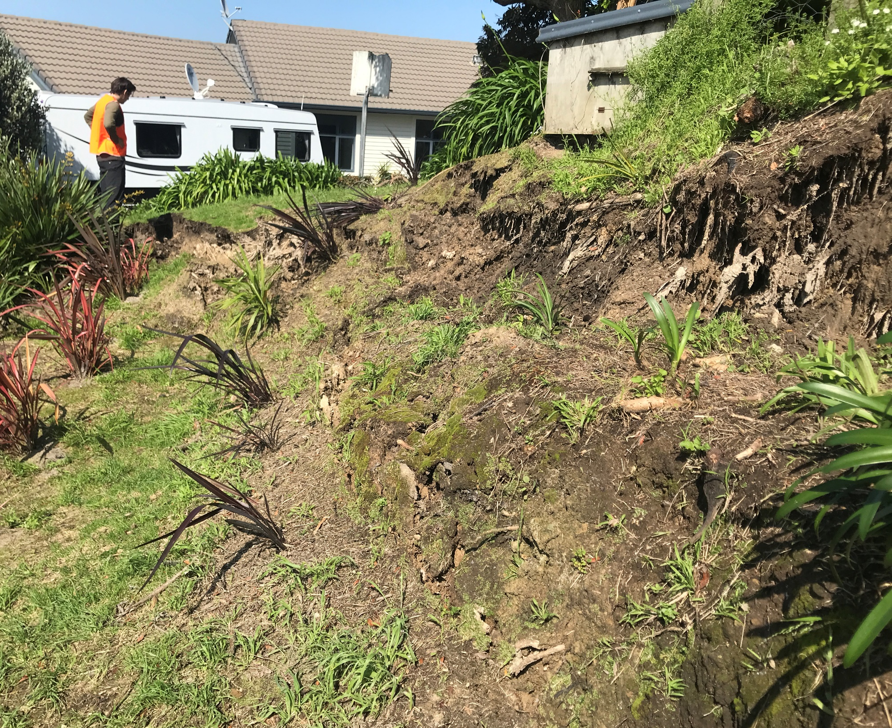
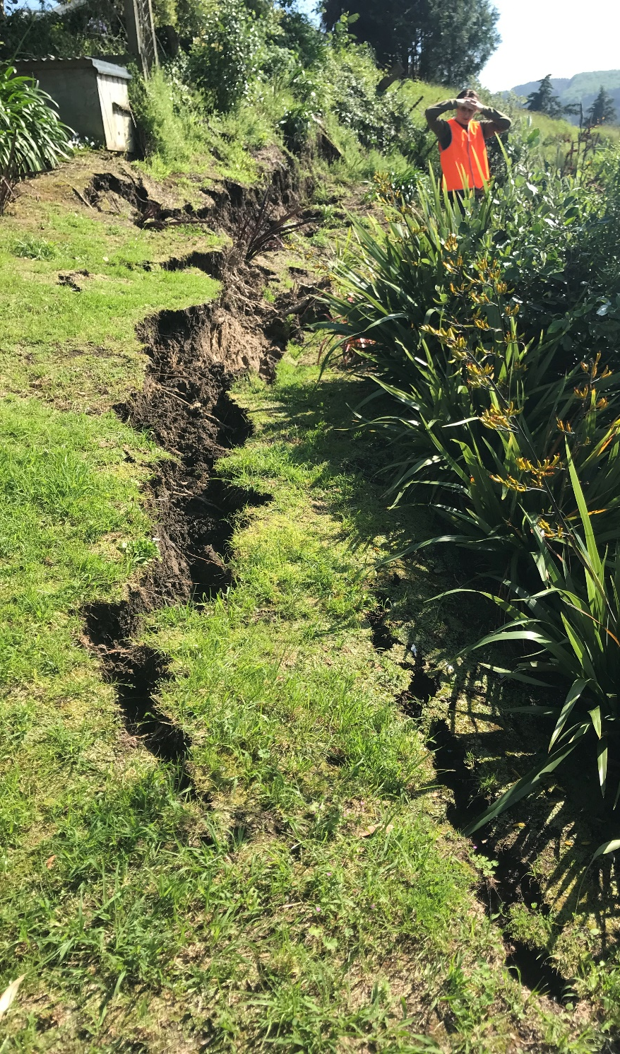
4 Belgium Terrace
4A ~15 m
Tension crack tip
bulging slope

Slide 16
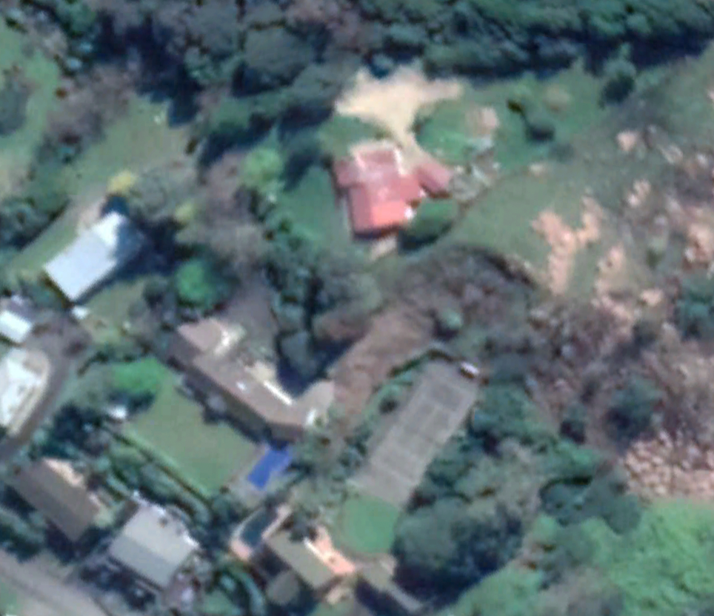
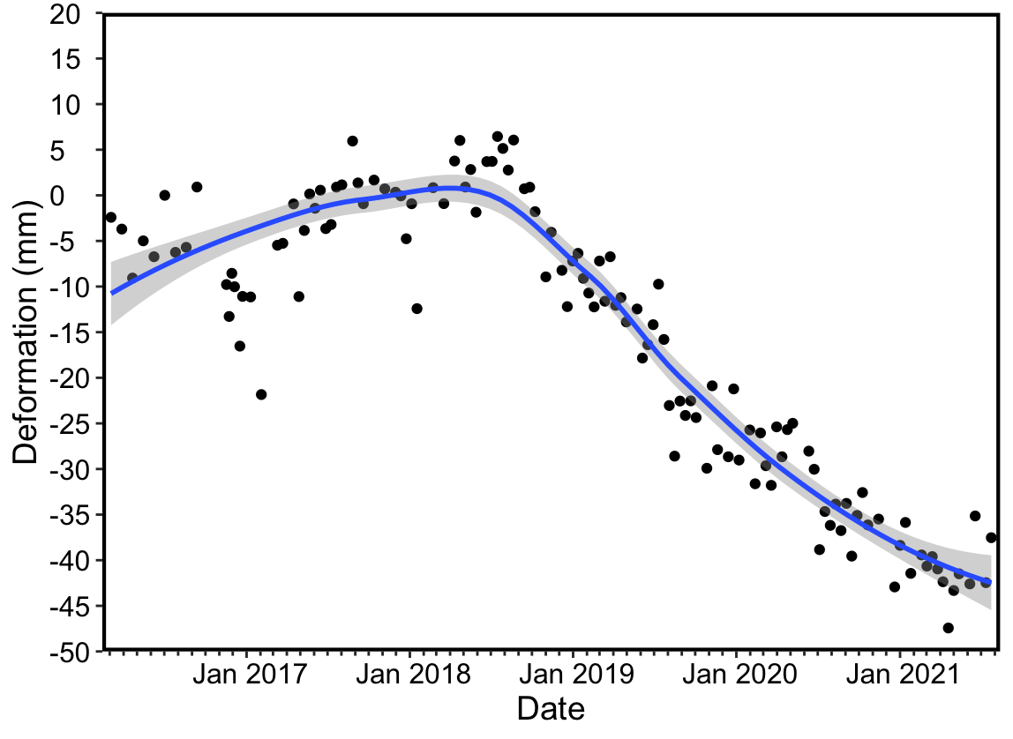
Pre failure - 2018
Pre failure - 2019
4b
Vegetation stripped
Preliminary InSAR

Slide 17

Summary
Thanks to:
Gisborne District Council
Geonet
GNS staff
EQC
“Black Swan” rain event
Soft materials
Steep slopes
Land use change
Inadequate slope retention structures
Cook M et al (2022) Preliminary investigation of emerging suburban landsliding in Gisborne, New Zealand. Quarterly Journal of Engineering Geology and Hydrogeology 55: qjegh2021-087
McGovern S et al (2021) Geomorphology and triggering mechanism of a river-damming block slide: February 2018 Mangapoike landslide, New Zealand. Landslides 18: 1087-1095

