Slide 1



Coupling regional air quality simulations of EURAD-IM with street canyon observations
– A Machine Learning Approach
05/23/2022 | Charlotte Neubacher,
Philipp Franke,
Alexander Heinlein,
Axel Klawonn,
Astrid Kiendler-Scharr,
Anne Caroline Lange
Notes:
Local traffic emissions strongly determine local air pollution especially in urban areas, however state of the art atmospheric model simulations are not able to scope the fine resolution of urban area, therefore fine resolute observations of emissions must be preprocessed in order to feed them into atmospheric models.
Welcome to my talk about Coupling regional air quality simulations with street canyon observations as a machine learning approach, I am Charlotte Neubacher a phd student in the institute for troposphere research at the Forschungszentrum Jülich.
I introduce here a hybrid model to integrated street canyon observation to existing air quality models.
Today I present a few preliminary results of the ML model we designed in a fully controllable test environment.

Slide 2
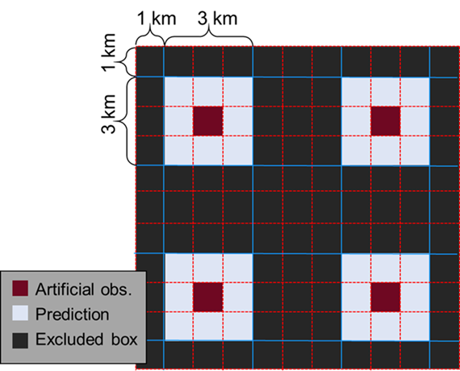

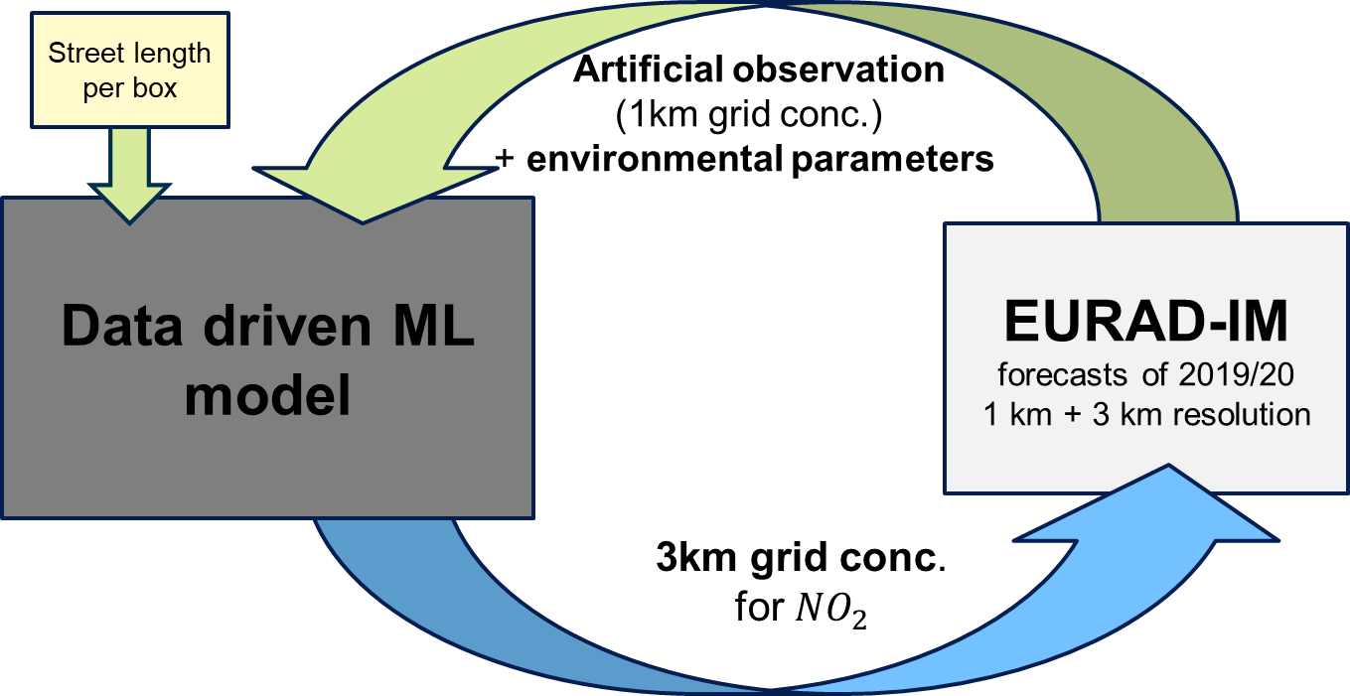
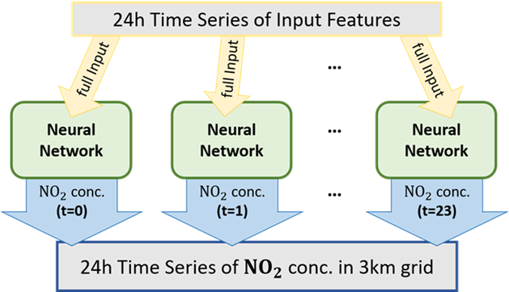
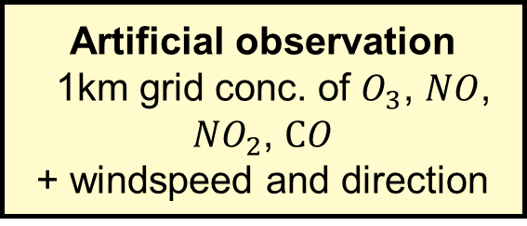
FULLY CONTROLLED Test Environment
Artificial observation
1km grid conc. of $O_{3}$, $NO$, ${NO}_{2}$, $CO$
+ windspeed and direction
©Authors. All rights reserved.
Notes:
To realize this fully controlled test environment we take two forecasts of EURAD-IM, one on a 1km resolution and a second on a 3km resolution. This set up ensures consistent data and allows for supervised learning.
We take EURAD-IM’s NO2 conc. Forecast of a 1km box as artificial observation together with additional environmental poxy data. As local traffic density proxy we include street length per box. And train a NN to predict the 3km NO2 forecast of EURAD-IM
By testing different ML Model architectures, we developed a time of the day pronouncing Model. It consists out of 24 separate and independent N, each predicting only one hour of the outcome but takes the full time series as input.
Furthermore, we selected the conc. Of ozone , No, NO2 and CO as well as windspeed and direction with a feature importance analysis as sufficient for the prediction of NO2 conc. In the 3km grid.
Currently working on finding a proper benchmark to access an accuracy check.
In the next slides I present some preliminary results of our best performing model so far.
Here you see the realization of a reduced model in a fully controlled test environmental set up.
We take here two forecasts of EURAD-IM one on a 1km resolution and a second on a 3km resolution covering the Rhine-Ruhr domain. This defines my test environmental set up which ensures that the given data set is consistent and allows for supervised learning. So, the reduced model here takes a 1km box of the forecast as artificial observation and additional environmental poxy data delivered also by EURAD-IM. In order to get the connection to local traffic emission, street length per box provided by open street view is also included as local traffic density proxy.
By testing different ML Model architectures, we developed a time of the day pronouncing Model. It consists out of 24 separate and independent N, each predicting only one hour of the outcome but takes the full time series as input. This is than trained to predict the 3km forecast of EURAD-IM.
Furthermore, we selected the conc. Of ozone , No, NO2 and CO as well as windspeed and direction with a feature importance analysis as sufficient for the prediction of NO2 conc. In the 3km grid.
Currently working on finding a proper benchmark to access an accuracy check.
In the next slides I present some preliminary results of our best performing model so far.
By analyze this reduced model we want to find a benchmark how accurate the performance could be, and we want to get insights about the importance of different features in this set up.

Slide 3

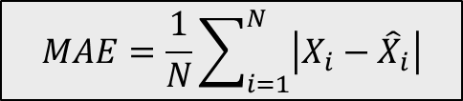
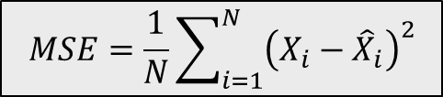
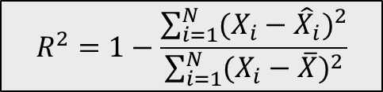
Averaged error measures
$$MSE=\frac{1}{N}\sum_{i=1}^{N}{{\left(X_{i}−{\hat{X}}_{i}\right)}^{2}}$$
$$R^{2}=1−\frac{\sum_{i=1}^{N}{{(X_{i}−{\hat{X}}_{i})}^{2}}}{\sum_{i=1}^{N}{{(X_{i}−\overline{X})}^{2}}}$$
$$MAE=\frac{1}{N}\sum_{i=1}^{N}{\left|X_{i}−{\hat{X}}_{i}\right|}$$
Notes:
Here you see different error measures. The color code charts is equal. Blue denotes the traing performance as well as orange and green performance on unseen data. As a reference red shows a baseline model which assumes that the artificial observation is equal the 3km conc.
In the upper left we see the relative error is below 0.1% for the unseen data and beats the baseline.
in the upper right the R2 score shows equally good results. It yields values around 0.9 and higher and also beats the baseline.
In the lower left the mean average error shows a deviation of around 1ppb.
Even if these results are quit nice we take now a more detail look on the individual errors.

Slide 4
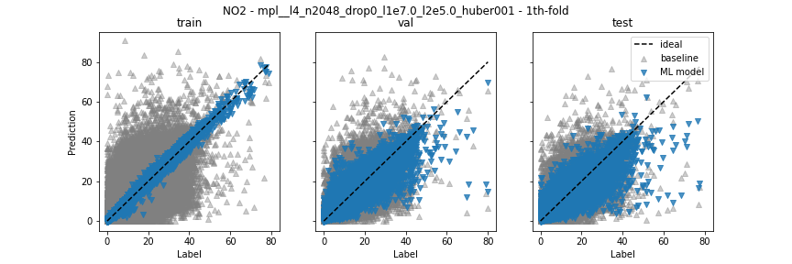

Individual model error distribution
Scatter plot - ${NO}_{2}$
Training subset
Validation subset
Test subset
Prediction [ppb]
Targeted concentration [ppb]
Targeted concentration [ppb]
Targeted concentration [ppb]
Notes:
First I want to show these scatterplots where the predicted value is plotted against the targeted conc. for both Model and baseline.
On the left in blue you see kind of the optimal behavior for the training set where as the middle and right plot show that we could prevent overprediction on the unseen data with our model. But in the lower right we see that underprediction is very present. And above a targeted concentration of 50 ppb less data is available and therefore the ethe highest errors occur there.
Secondly, we have a look….

Slide 5
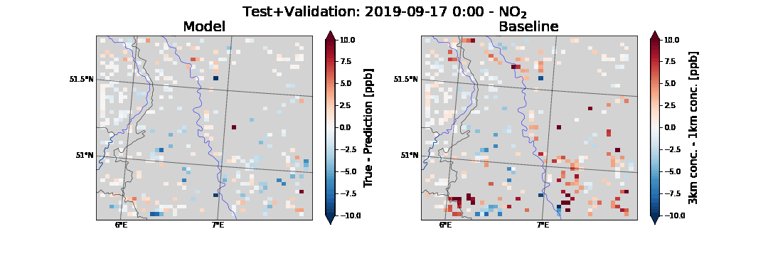
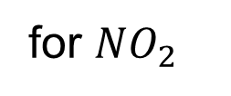
Local Distribution of Model error for 9/17/2019
Increments of 9/17/2019 at
for ${NO}_{2}$
Targeted conc. - Prediction [ppb]
Targeted conc. - 1 km conc. [ppb]
ML Model
Baseline Model
Notes:
Secondly, we have a look on the local error distribution.
You see a little animation where on the left the hourly error of the model and on the right the error of the baseline is shown.
We can observe that the model has in general lower errors but the exceptions occur manly in larger clusters and often higher errors occur there where also the baseline has higher errors.
With this I want to close and hope to answer some questions.

