Slide 1





Geophysical modelling of the deep structure of the Richat magmatic intrusion (northern Mauritania): Insights into its kinematics of emplacement
El Houssein Abdeina^{1,2,*} , Sara Bazin³, Gilles Chazot³, Hervé Bertrand⁴, Bernard Le Gall³, Nasrrddine Youbi^{2,5}, Mohamed Salem Sabar¹, Mohamed Khalil Bensalah^{2,6}, Moulay Ahmed Boumehdi^{2,6}
¹Department of Geology, Faculty of Sciences and Techniques, University of Nouakchott Al-Aasriya, BP 5026, Nouakchott, Mauritania;
²Department of Geology, Faculty of Sciences Semlalia, Cadi Ayyad University, Prince Moulay Abdellah Boulevard, P.O. Box 2390, Marrakech, Morocco;
³Laboratoire Géosciences Océan, Institut Universitaire Européen de la Mer, place Copernic, 29280 Plouzané, France;
⁴Univ Lyon, ENSL, Univ Lyon 1, CNRS, LGL-TPE, F-69007 Lyon, France;
⁵Mohammed VI Polytechnic University, Geology and Sustainable Mining Department, Hay Moulay Rachid, Ben Guerir, 43150, Morocco;
⁶Instituto Dom Luís, Universidade de Lisboa, Lisboa, Portugal.
AU: 2021-2022

Slide 2
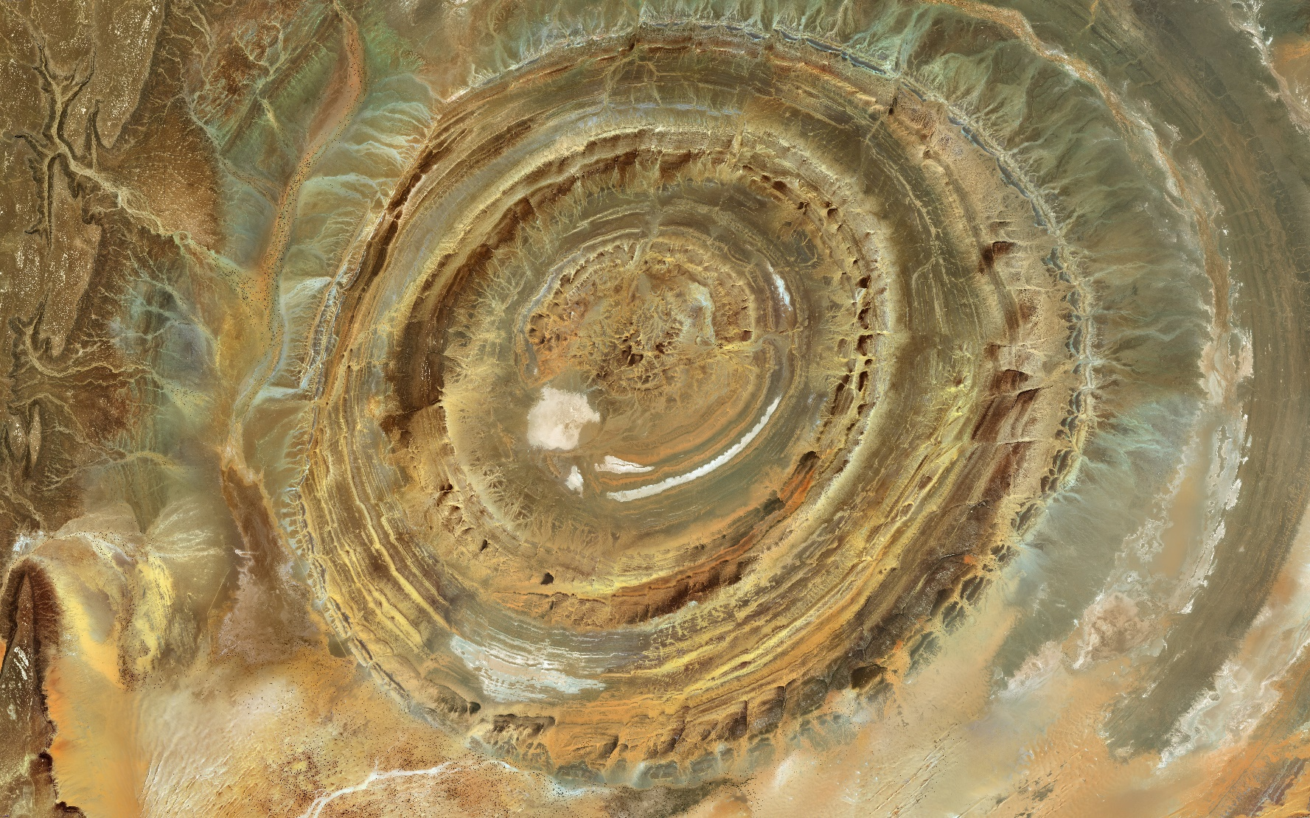
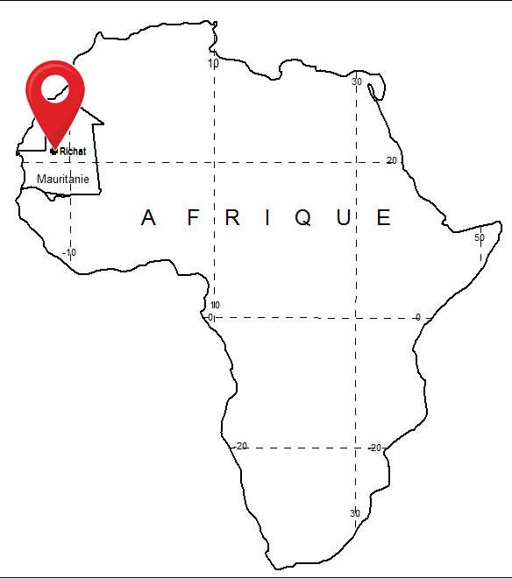
location
- Structure of the Richat «eye of Africa»
- 40 km in diameter

Slide 3
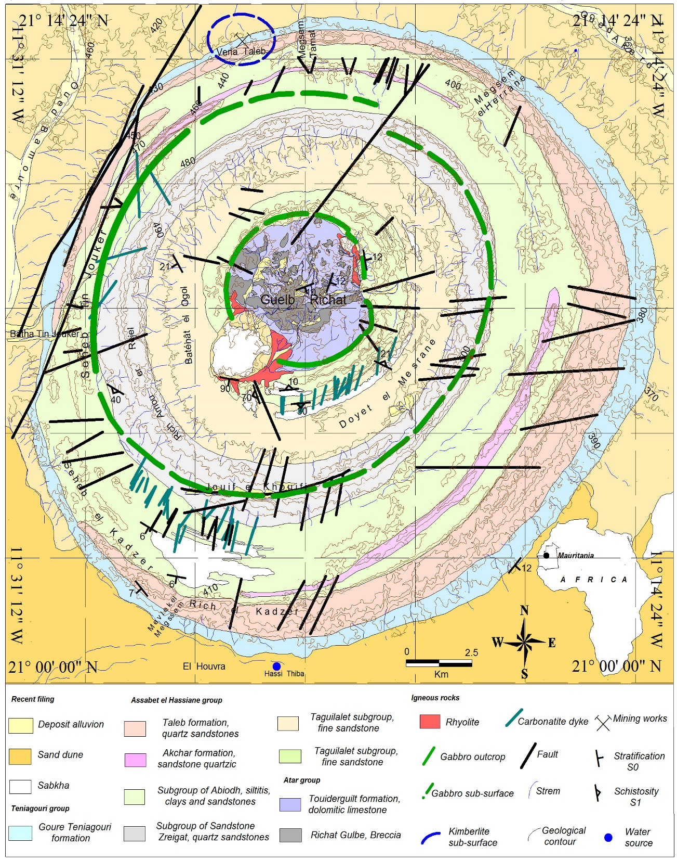
Geology setting
Located in the northwestern part of the Taoudeni basin, Adrar Mauritanian.
Marked by concentric ridges of Proterozoic-Lower Paleozoic sediments.
Geological map of the Richat structure

Slide 4

Origin
The origin of this peculiar geological structure is debated since more than 50 years
Meteorite impact model (Cailleux et al. 1964)
Deep magmatic intrusion (Dietz et al. 1969; Monod and Pomerol 1973; Matton et al. 2005; Matton and Jébrak 2014)

Slide 5
Geophysical study
Three complementary types of geophysical data allow us to image at various scales and depths of structures of the Richat magmatic complex
high-resolution airborne magnetic data
High-resolution airborne radiometric data
satellite gravity data
For a better understanding of the process of setting up the entire structure, a high resolution geophsic study has been carried out

Slide 6
High-resolution airborne magnetic
The vertical magnetic gradient map
The calculated analytical signal

Slide 7
High-resolution airborne radiometric
Potassium
Thorium
Uranium

Slide 8
Satellite gravity data
The Free Air anomaly map
The Bouguer anomaly map

Slide 9
Physical rock properties
Magnetic susceptibility
Density

Slide 10
2D-modelling of magnetic and gravity data
2D-modelling of airborne gravity and magnetic data along the XX' section.
the gabbro ring dykes are inclined with a dip of 41 to 44° towards the center of the structure.
The model also highlights the presence of an important mafic magmatic body below the structure, 1.5 to 2 km-wide and about 1.8 km-deep.

Slide 11
2D-modelling of magnetic
The 2D-model applied to the intrusive body, north of the Richat structure (section YY’) on Fig. 4b).
Our modelling images a highly magnetic body at a shallow depth (~ 50 m).
An estimated vertical extension of about 1.7 km and a thickness of ~230 m.

Slide 12
Conclusion
the Richat intrusion is characterized by the presence of two important circular magnetic signals that coincide with gabbroic ring dykes partly exposed at the surface,
its overall circular structure rests above a deep mafic (gabbroic) body,
the upwelling of magma at the surface has been facilitated by the presence of concentric faults
presence of an important mafic magmatic body below the structure
and
the central zone of the complex recorded intense hydrothermal alteration.

Slide 13
Thank you for your attention

