Slide 1
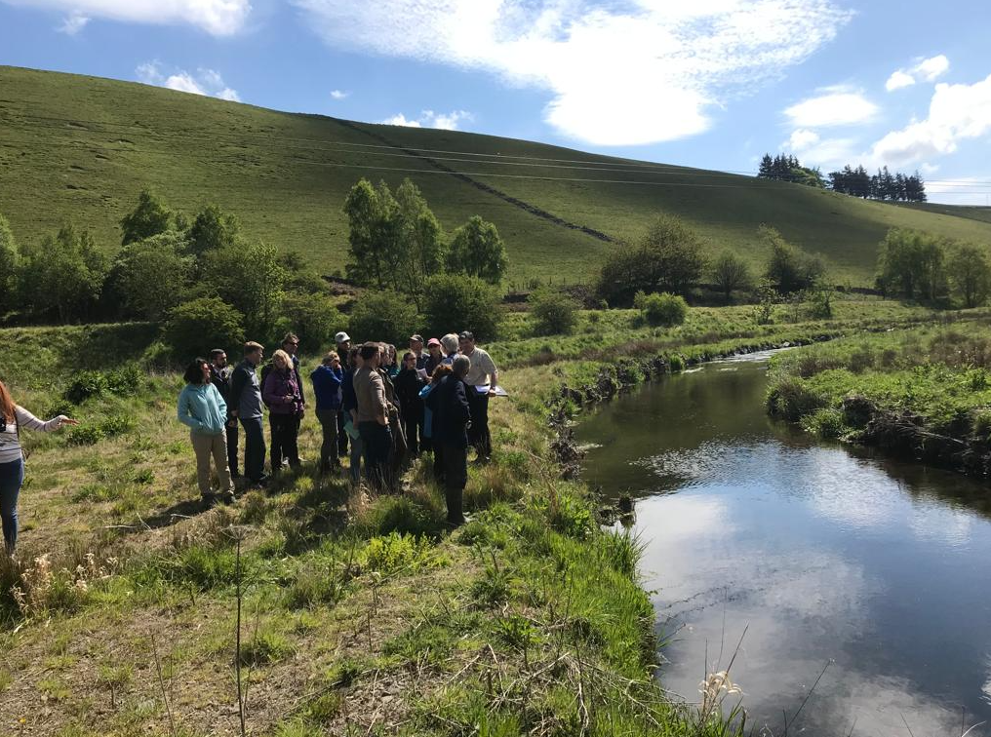

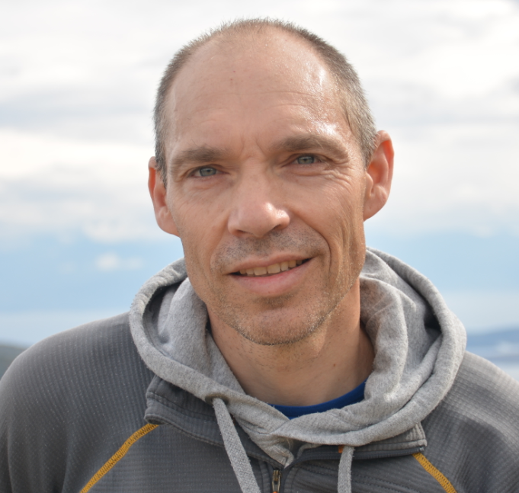
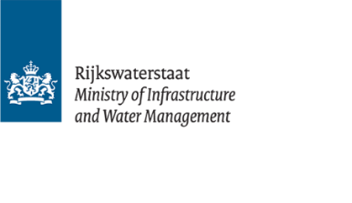


Application of the International Guidelines on Natural and Nature Based Features for Flood Risk Management and the way forward
Dr. R. (Ralph) Schielen
Rijkswaterstaat-Delft University
of Technology
EGU-2022, Vienna,
session ITS4.2/ERE1.11
(on-line presentation)
Eddleston, Scotland
Source: Beeldbank RWS, Ruimte voor de Rivier

Slide 2
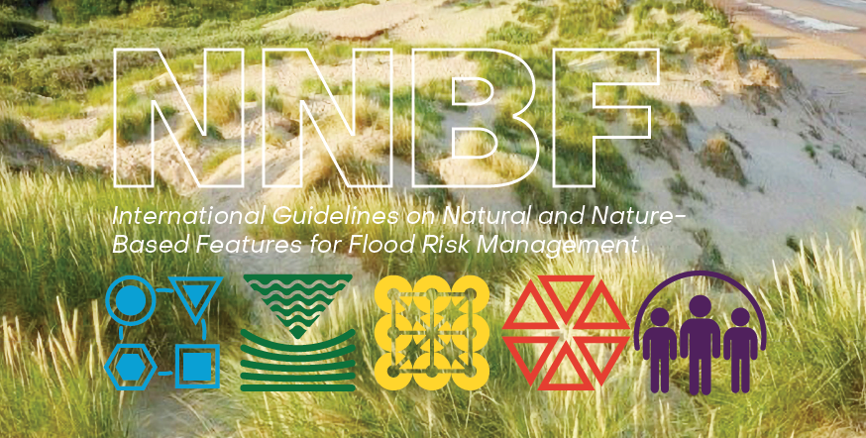
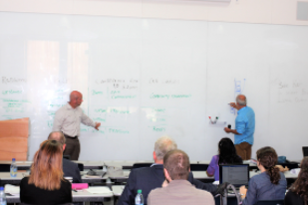
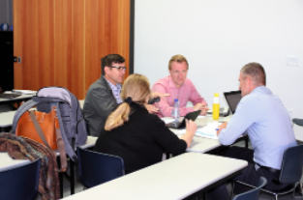
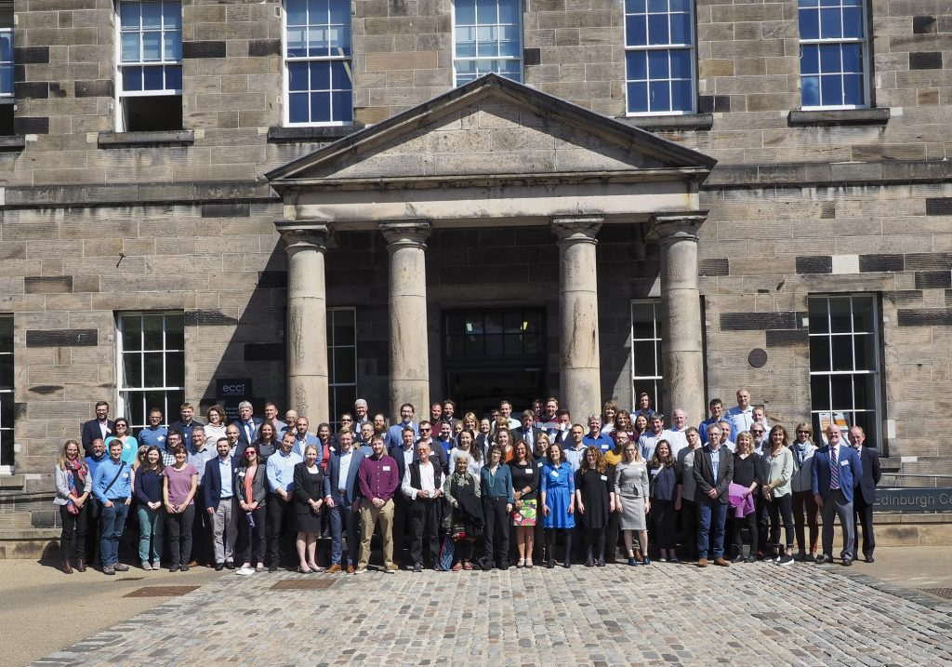


NNBF Guidelines
Publication summer 2021
>1000 pages
>170 authors and contributors
>70 organizations and 10 countries
>5.500 downloads
Source:website Engineering with Nature
https://ewn.erdc.dren.mil/?page_id=4351
Notes:
The International Guidelines on NNBF for Flood Risk Management provide practitioners with the best available information concerning the conceptualization, planning, design, engineering, construction, and maintenance of NNBF to support resilience and flood risk reduction for coastlines, bays, and estuaries, as well as river and freshwater systems.

Slide 3
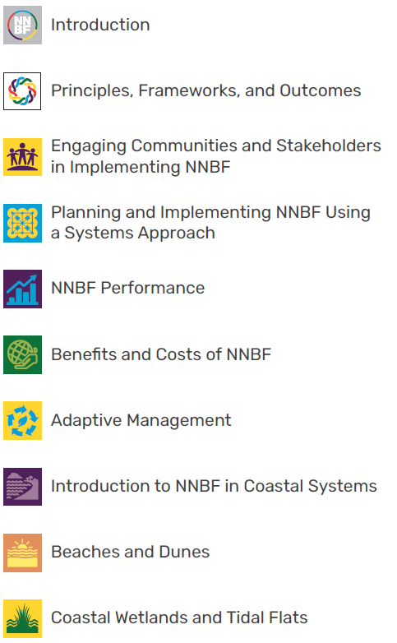
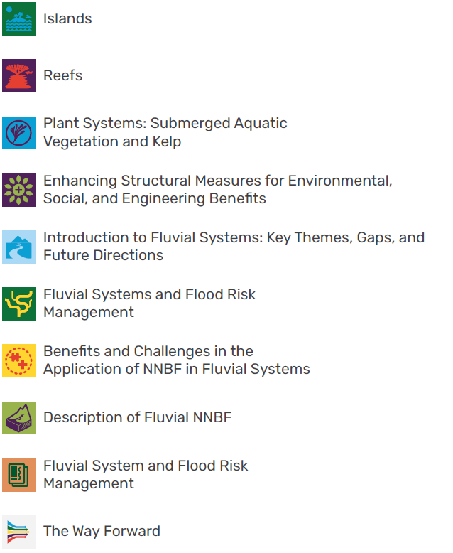
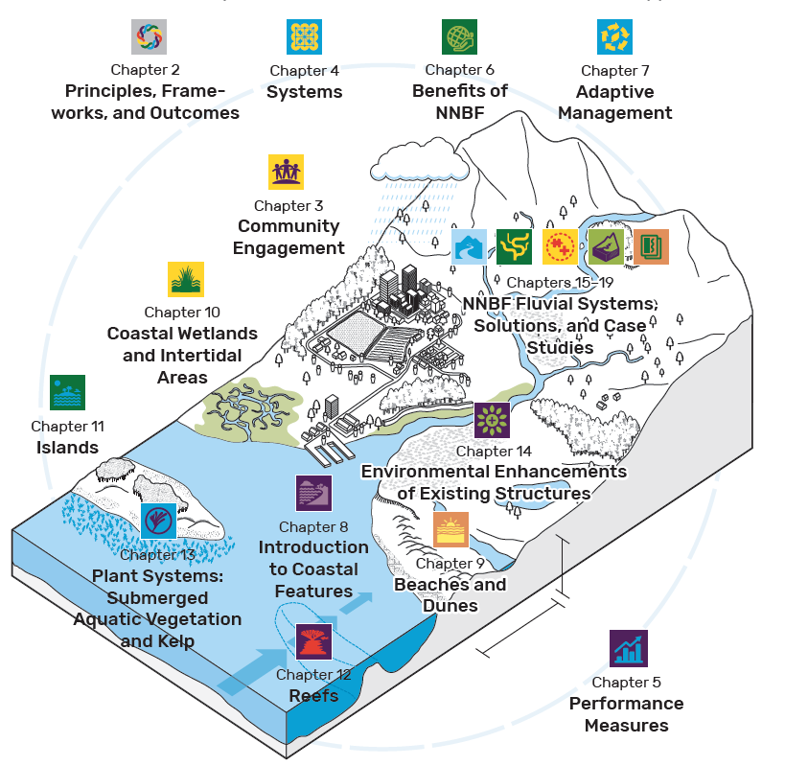
Chapters and positioning of the
chapters within a fictive
catchment
Notes:
The NNBF Guidelines include 20 chapters organized into three sections: overarching themes, coastal features, and fluvial features.
The first major section (Chapters 1 to 7) covers a set of common topics that are broadly applicable to NNBF.

Slide 4
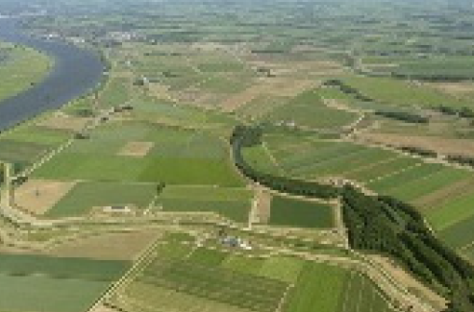
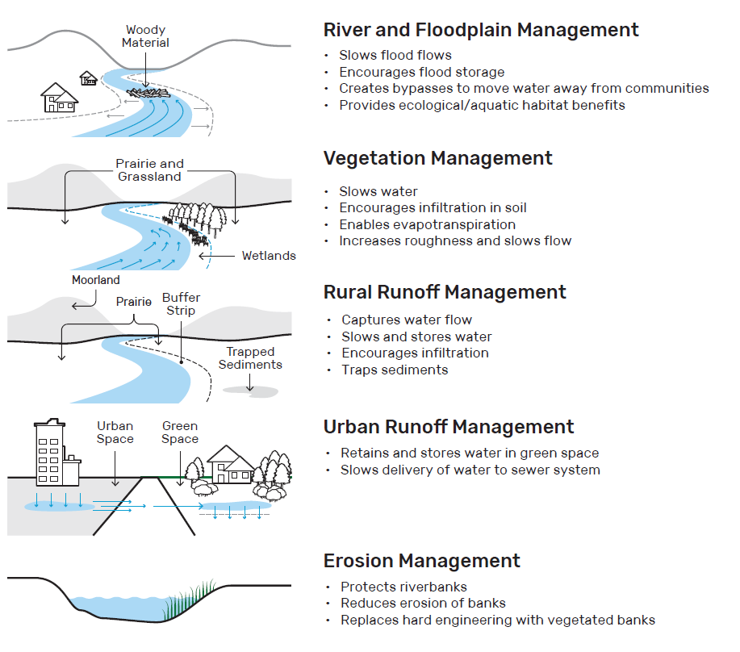
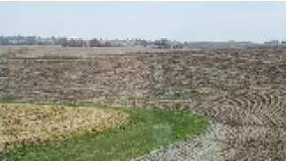
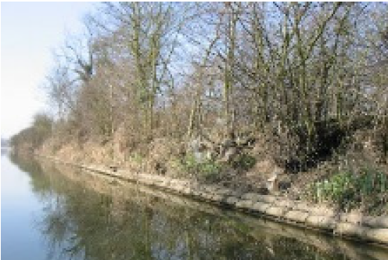
Renaturalization of polder areas
Source: Rijkswaterstaat
Agricultural contour planting
for slope erosion control
Source: USACE
Vegetated concrete blocks
Source: Environment Agency

Slide 5
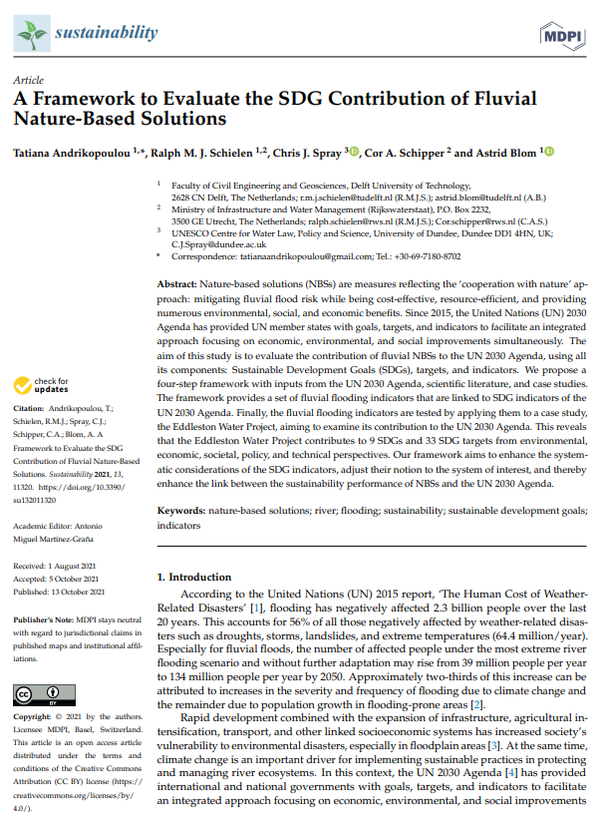
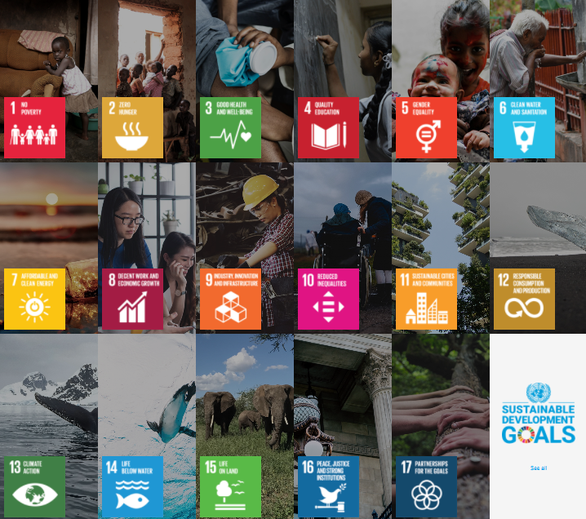
Connection to the United Nations Sustainable Development Goals
NBS leads to:
Reduction of flood risk and
-Reconnect floodplain with main channel
-Increase biodiversity
-Increase recreational possibilities
-Enhance Flora and fauna
-Appreciation of the landscape
General well-being!
We need a framework for this!

Slide 6


Next step: Upscaling and Mainstreaming NBS
Upscaling: how to make the step forward from small specific pilot projects to
projects on a larger spatial scale
Mainstreaming: how to ensure that NBS is always part of the full set of solutions for flood
risk management problems
We need to bridge the
gap between science evidence
and societal evidence

Slide 7
Thank you for your attention
Dr. R. (Ralph) Schielen
Rijkswaterstaat-Delft University
of Technology
ralph.schielen@rws.nl
Co-authors:
Chris Spray, University of Dundee, Scotland
Chris Haring, Engineer Research and Development Center, USA Army Corps of Engineers, USA
Jo Guy, Environment Agency, England
Lydia Burgess-Gamble, Environment Agency

