Slide 1



Biogels in the rhizosphere: Plant mucilage as a biofilm matrix that shapes the rhizosphere microbial habitat
Meisam Nazari, Samuel Bickel, Pascal Benard, Kyle Mason-Jones, Andrea Carminati, and Michaela Anna Dippold
Presented by
Meisam Nazari
26.05.2022
9:06

Slide 2
Introduction

Slide 3
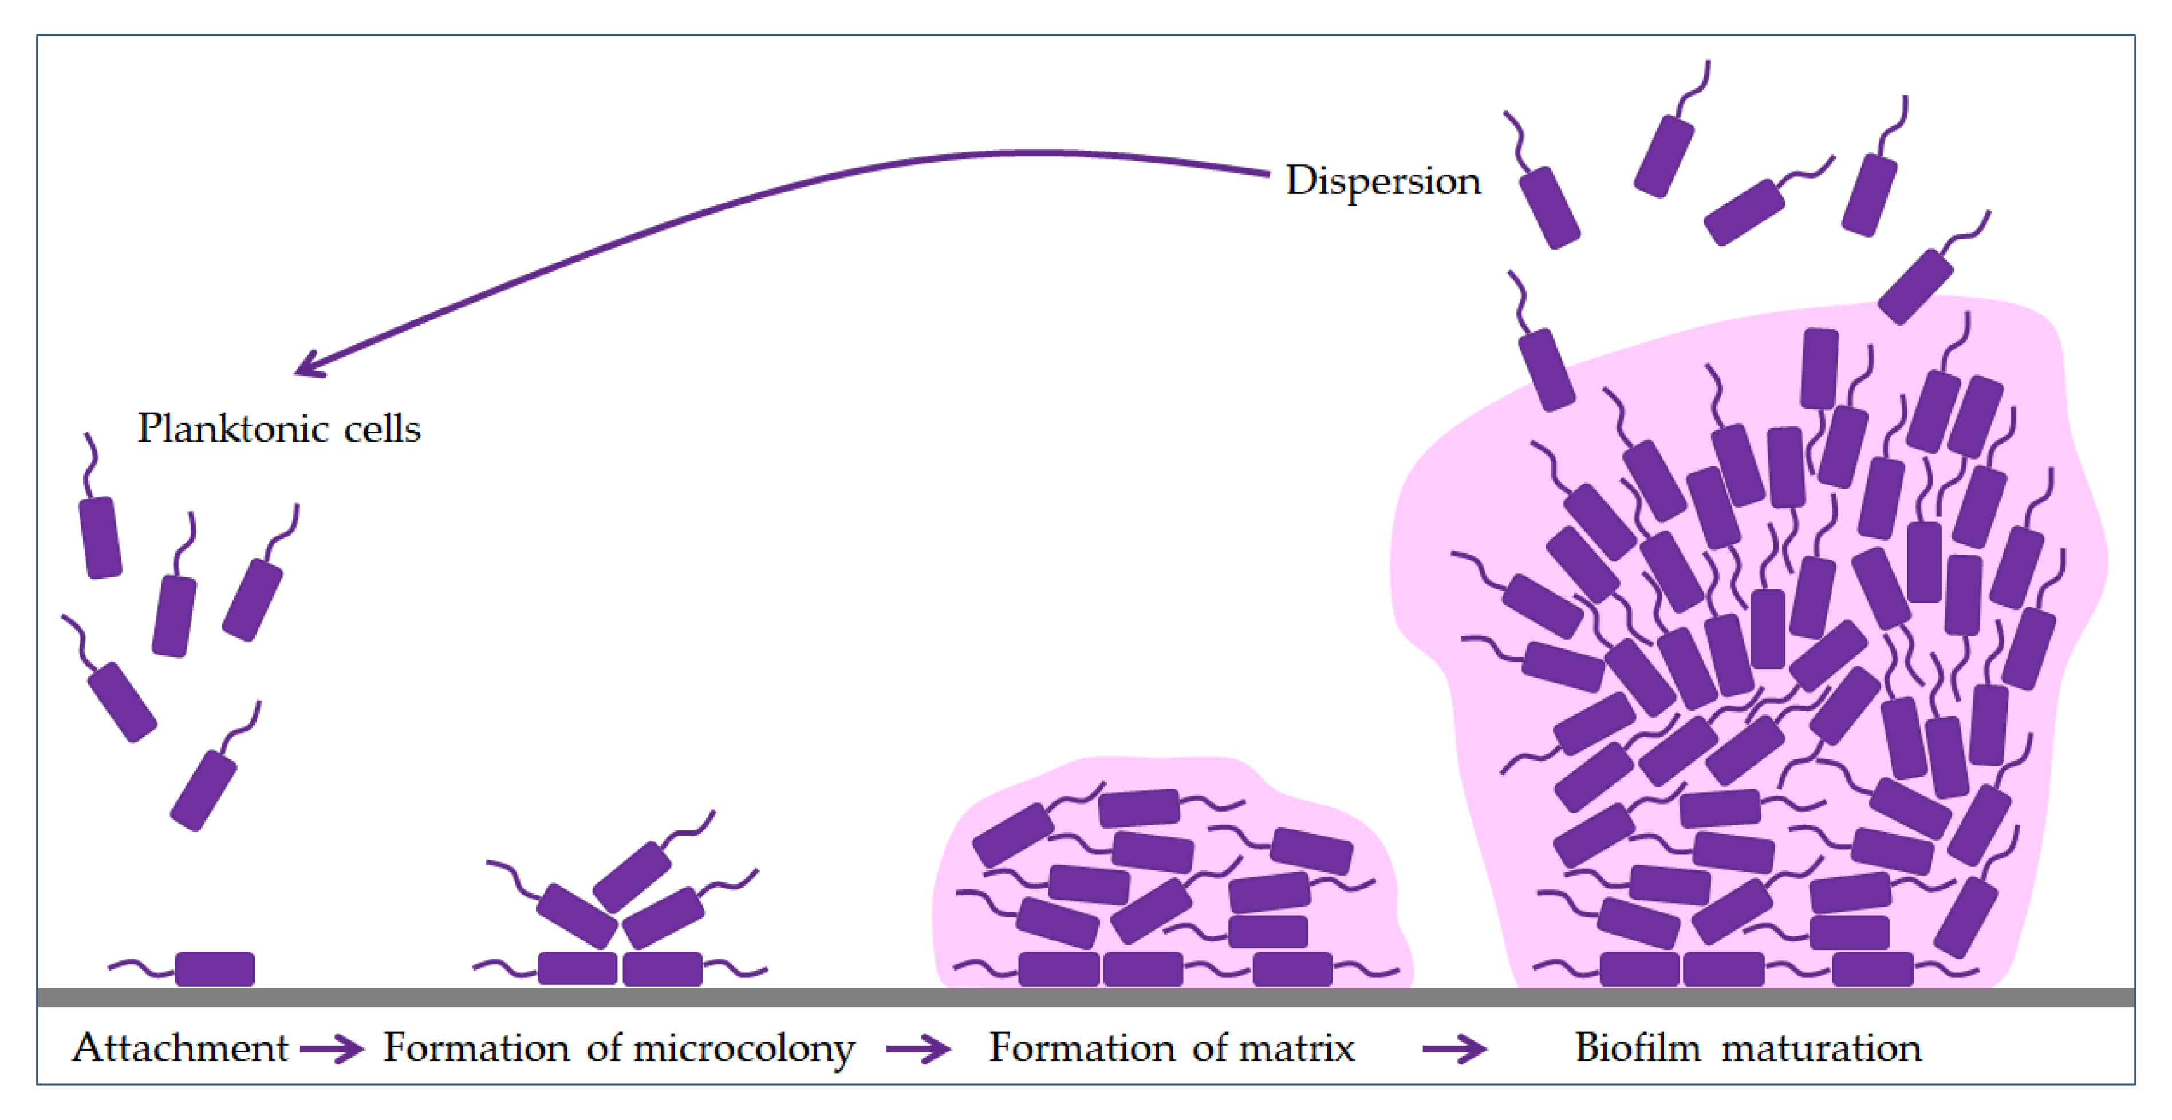
EPS
Extracellular polymeric substances (EPS) are gelatinous high-molecular-weight substances produced by microorganisms.
Talapko et al (2020)
EPS

Slide 4
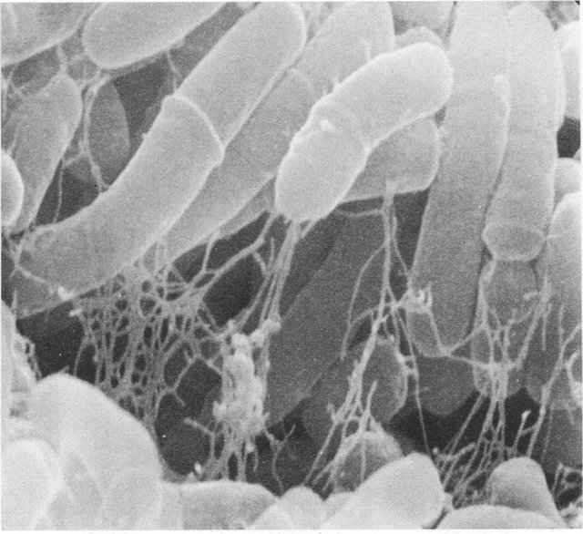
Functions of EPS
Biofilm matrix and microbial habitat
(Flemming and Wingender, 2010)
Microbial colonization of roots
(Hassani et al., 2018)
Protection of microorganisms against stresses
(Vardharajula and Skz, 2014)
Aggregating soil particles
(Costa et al., 2018)
A huge carbon source in soils
(Flemming and Wingender, 2010)
Bayston et al (2018)

Slide 5
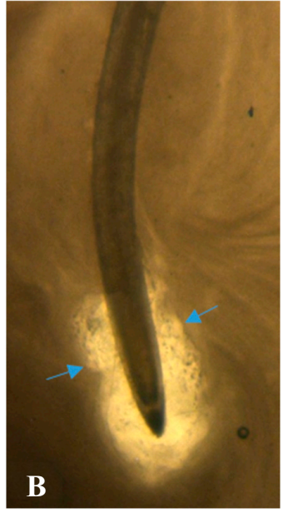
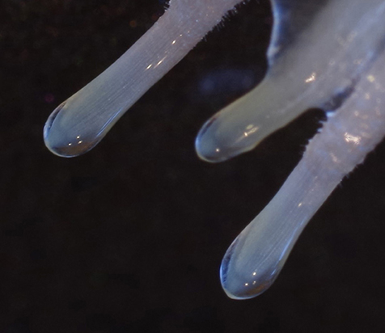
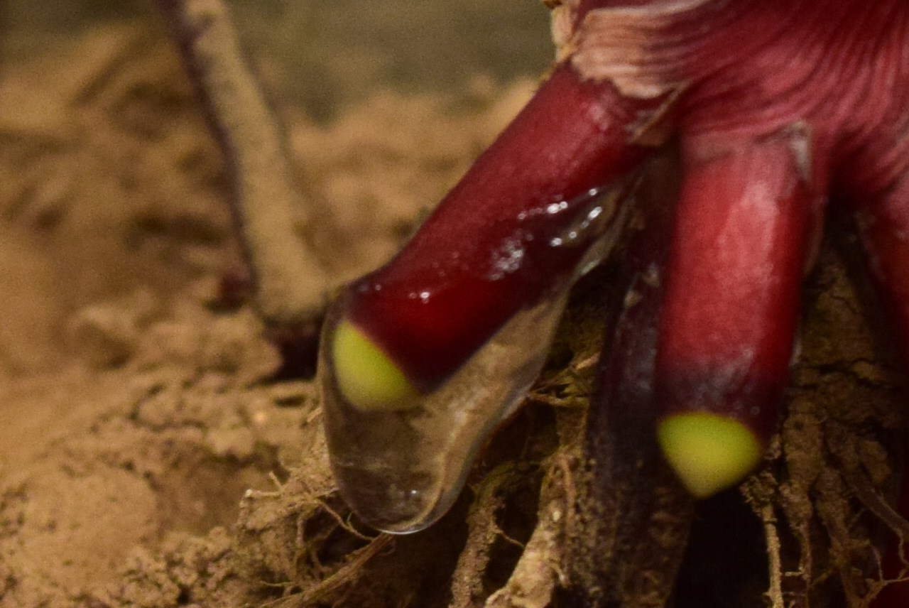
Mucilage
A gelatinous high-molecular-weight substance produced by root tips of plants
~ 15% of a plant’s photosynthetic output
Wheat root
Holz et al (2018)
Maize nodal root
Barley root
Carter et al (2019)

Slide 6
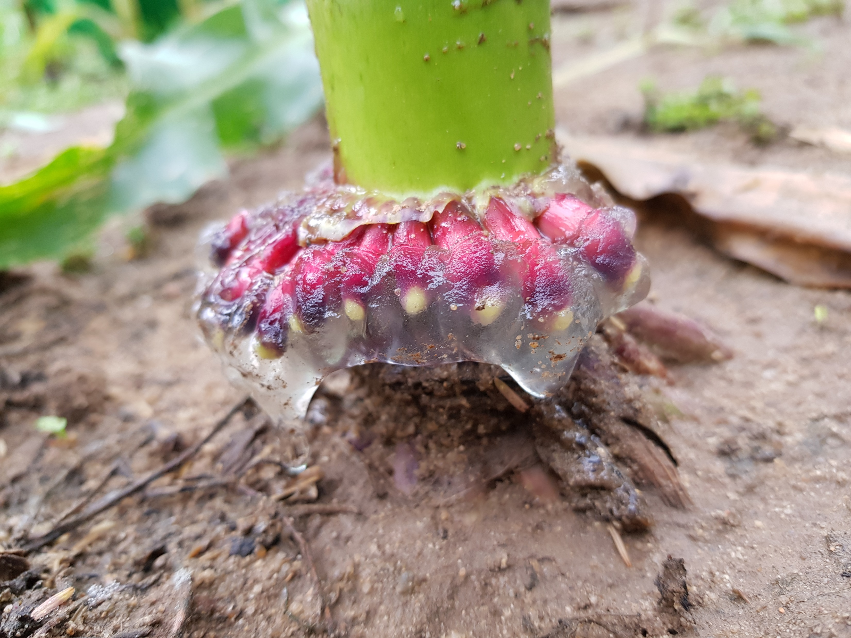
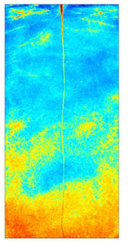

Functions of mucilage
Enhancing the rhizosphere water content
(Carminati, 2013)
Easing the penetration of growing root tips into the soil
(Iijima et al., 2003)
A substrate for microbial utilization
(Ahmed et al., 2018)
Water content

Slide 7
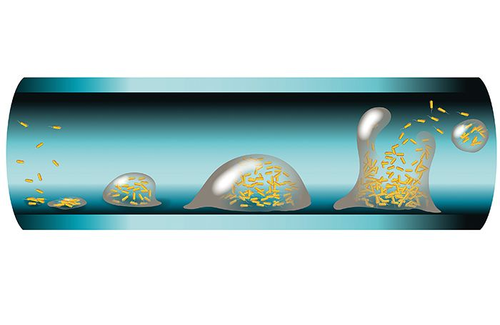
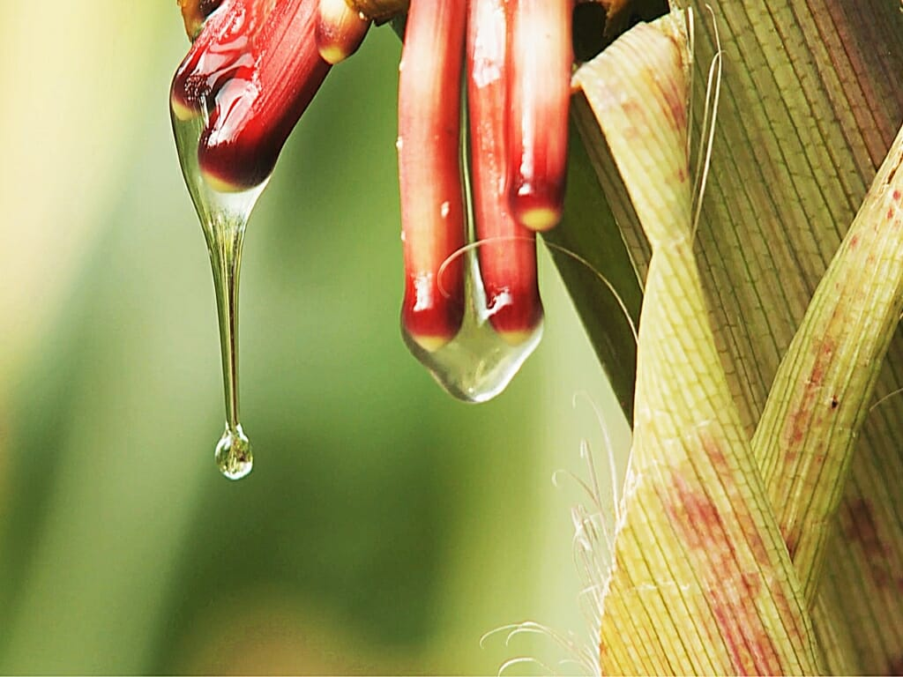

The key question of this study
Can plant mucilage function as a biofilm matrix similar to microbial EPS?

Slide 8
Methods

Slide 9
376 mucilage (root and seed) and EPS (all types of microorganisms) data points collected from 83 peer-reviewed papers (1974-2019)
Spatial and temporal model of bacterial abundance and EPS production in the mucilage matrix along a maize root segment grown within one day
Investigated variables
Physical properties
Chemical composition
Viscosity
Total protein
Neutral monosaccharides and uronic acids
Surface tension
Total polysaccharide

Slide 10
Results

Slide 11
Physical properties
----- mean
median

Slide 12
Chemical composition
----- mean
median

Slide 13
----- mean
median

Slide 14
Spatial and temporal model of the mucilage biofilm along a maize root segment grown within one day

Slide 15
Conclusions

Slide 16
Plant mucilage and microbial EPS have similar physical properties and chemical composition.
Therefore, mucilage can potentially function as a biofilm matrix like EPS.
Volume of plant-produced mucilage matrix (autotrophic) and its potential microbial abundance in the rhizosphere > those of microbial-EPS (heterotrophic).
In a mucilage-based biofilm, microorganisms can save their energy and promote their fitness.
Mucilage provides the basis for unique features of the rhizosphere microbiome.

Slide 17
Thank you so much for your attention.

