Slide 1



Integration of a Graph Network for the Definition of Neighbourhood in Landslide Detection with Machine Learning
Manuel Andreas Luck¹ and Irena Hajnsek^{1,2}
¹Institute of Environmental Engineering, ETH Zurich, 8093 Zurich, Switzerland
²Microwaves and Radar Institute, German Aerospace Center (DLR) e.V., 82234 Weßling, Germany

Slide 2
Processing Pipeline
Strong Focus on:
Automation
  Data Collection
    Google Earth Engine
    ASF API
Open Data
  Sentinel 1
  Sentinel 2
  SRTM
  Landcover
No Software Licences
  SNAP
  Python
Data Preprocessing:
Graph Creation:
Classification:
Sentinel 1
Nodes
Random Forest
Sentinel 2
Edges
Landcover
Neighbour-hood
SRTM
GEE
Python
ASF & SNAP
Python
Graph
Python

Slide 3
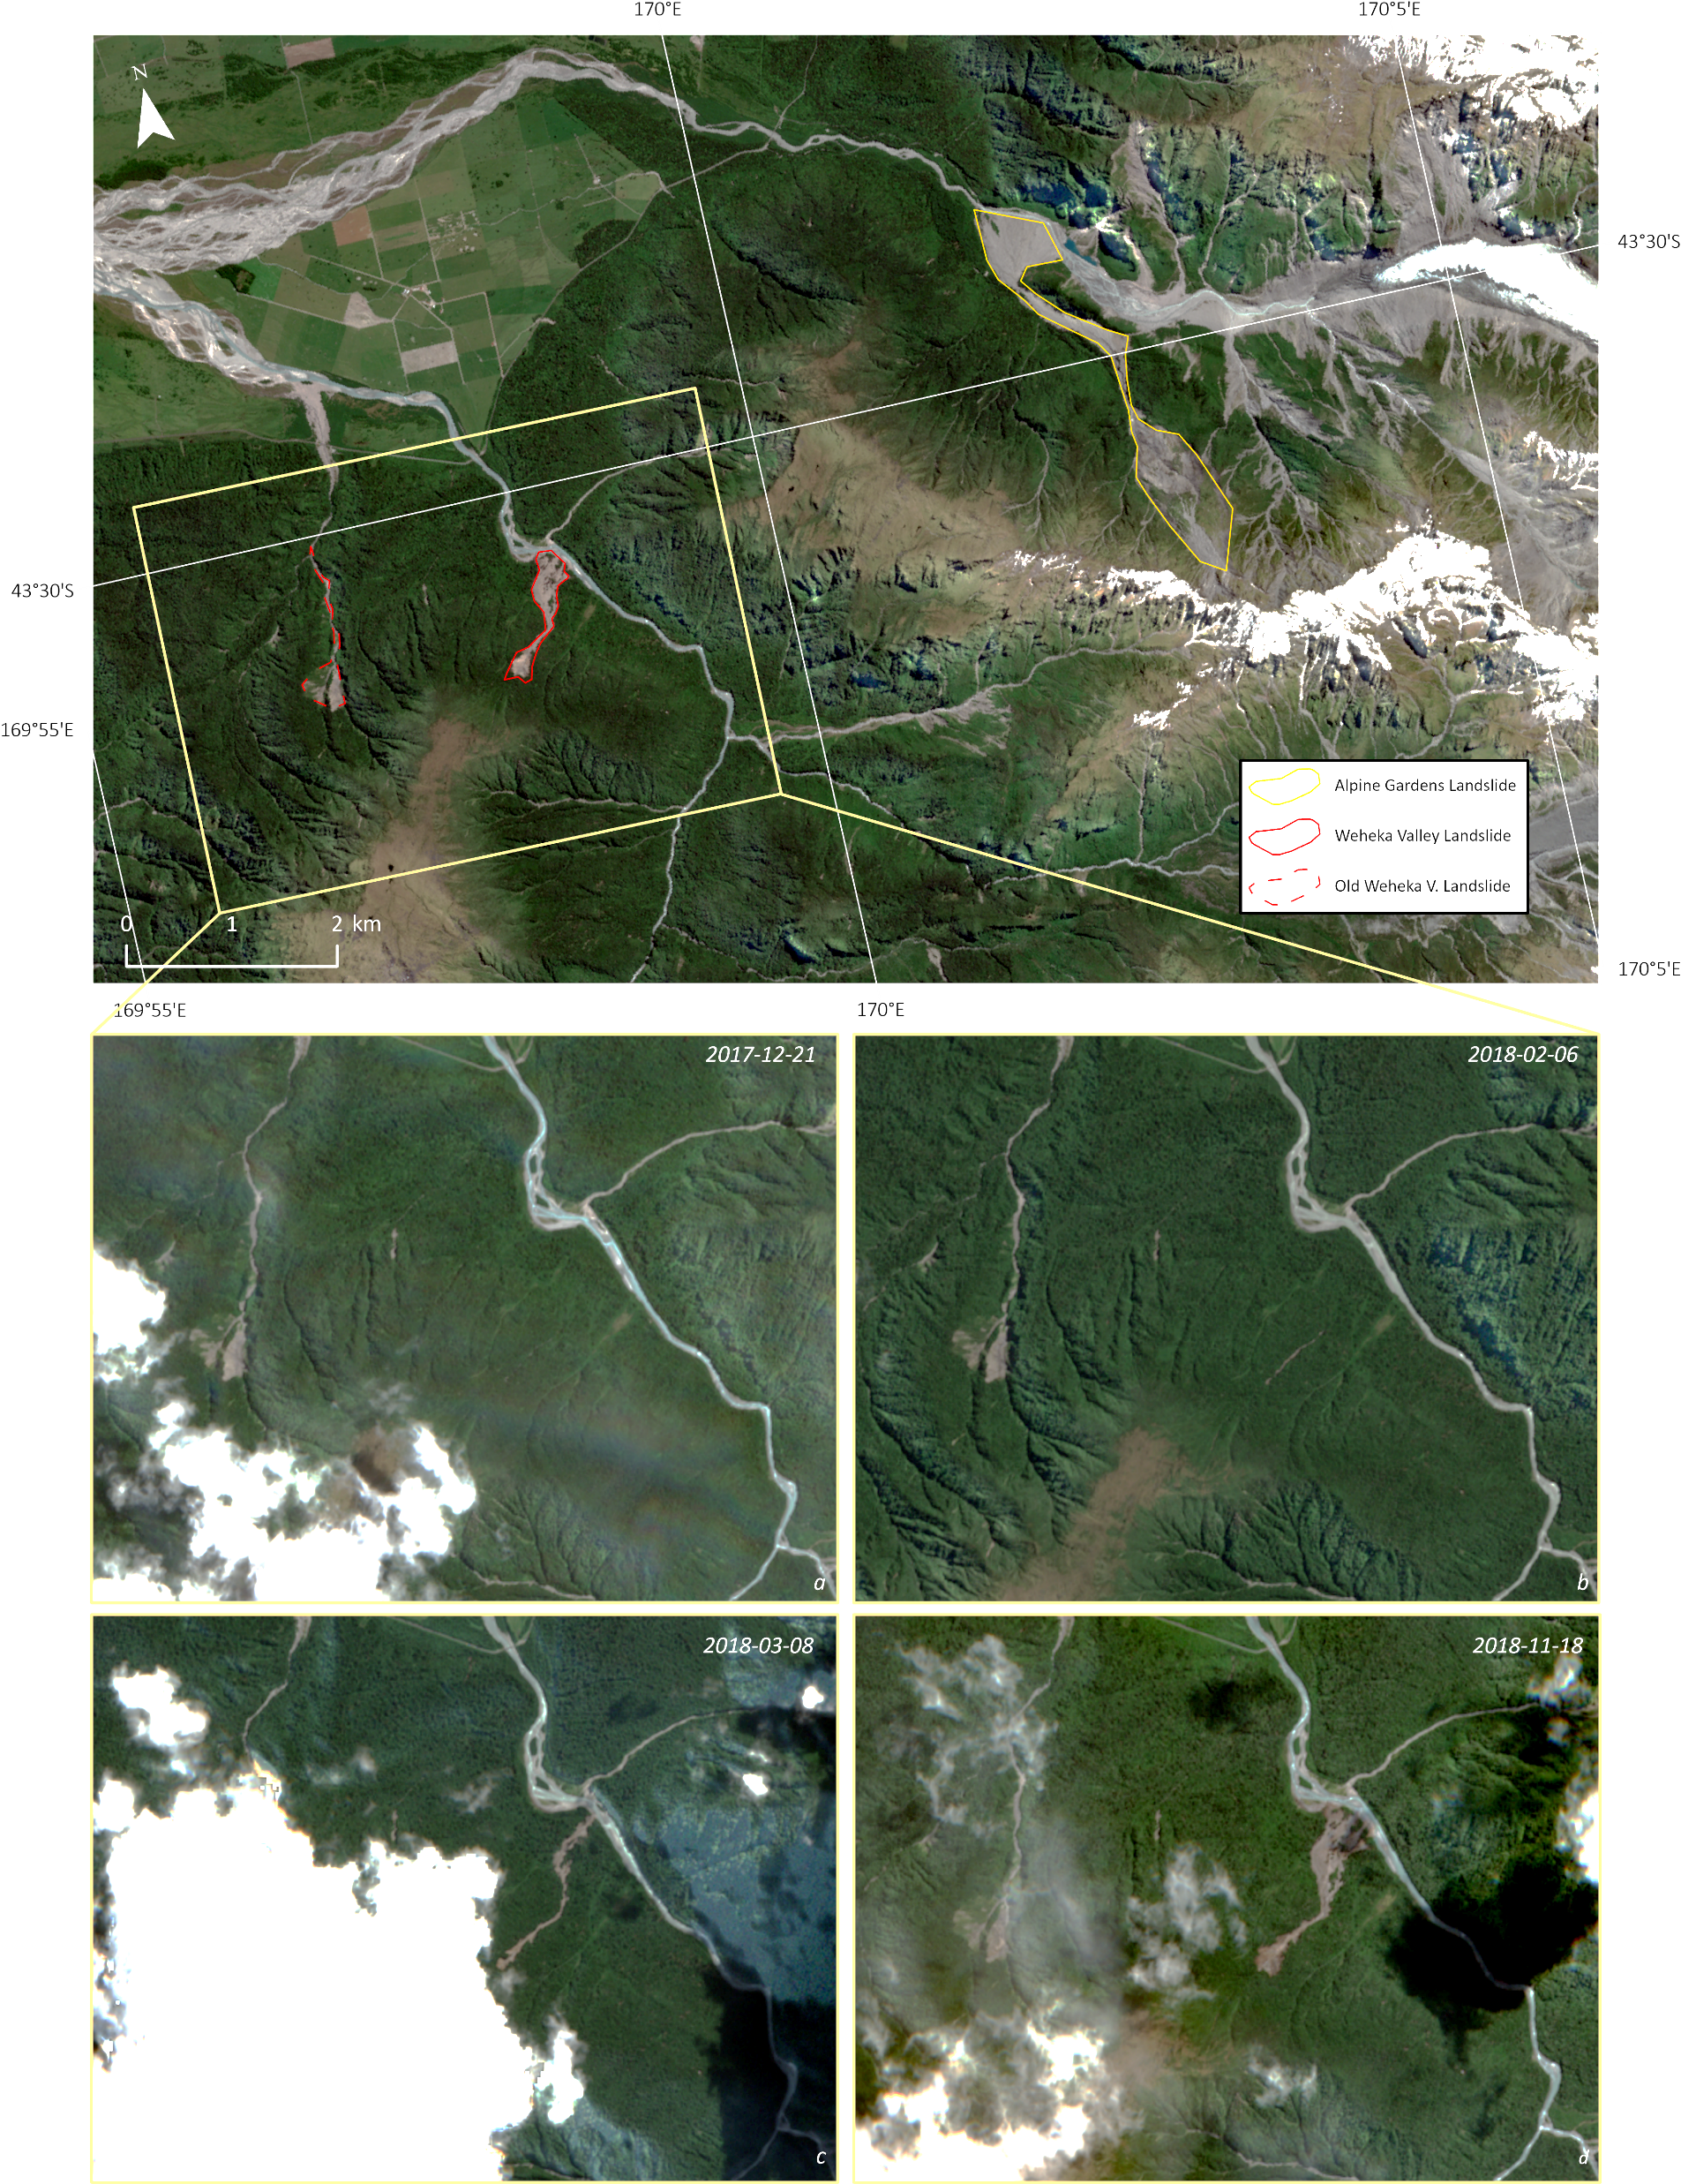
Weheka Valley
South Island of New Zealand
  43° 31’ 00.9" S
  169° 57’ 58.6" E
Survey Dates:
  2017-12-21
  2018-02-06
  2018-03-08
  2018-11-18
500 m
Contains modified Copernicus Sentinel data [2017/18]

Slide 4
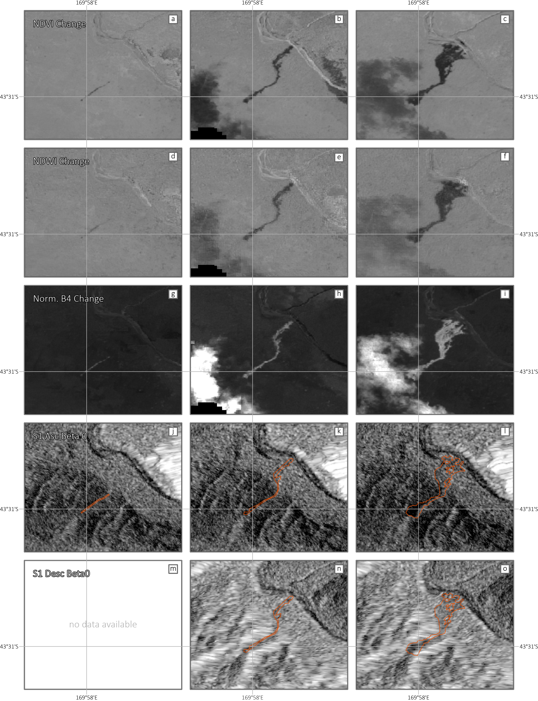
Data:
Optical:
  Sentinel 2
    Level 1C
    Bands:
      2,3,4,8
    Indices:
      NDVI
      NDWI
Contains modified Copernicus Sentinel data [2017/18]

Slide 5
Data:
SAR:
  Sentinel 1
    VV-Polarisation
    Beta Nought
    Shadow & Layover
Further Data:
  Digital Elevation Model
    SRTM
  Landcover
    ESA WorldCover
    Copernicus
    Landcover
Contains modified Copernicus Sentinel data [2017/18]

Slide 6
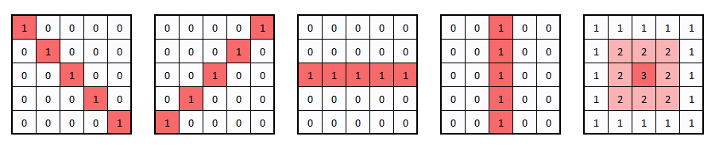
Neighbourhood Operations:
Describe Surroundings
  Moving Window
    Mean
    Std
    Highpass
    Lowpass
    …

Slide 7
Neighbourhood Operations:
  Landslide does not
  follow one specific
  geometric shape
  Shape is based on
  topography

Slide 8
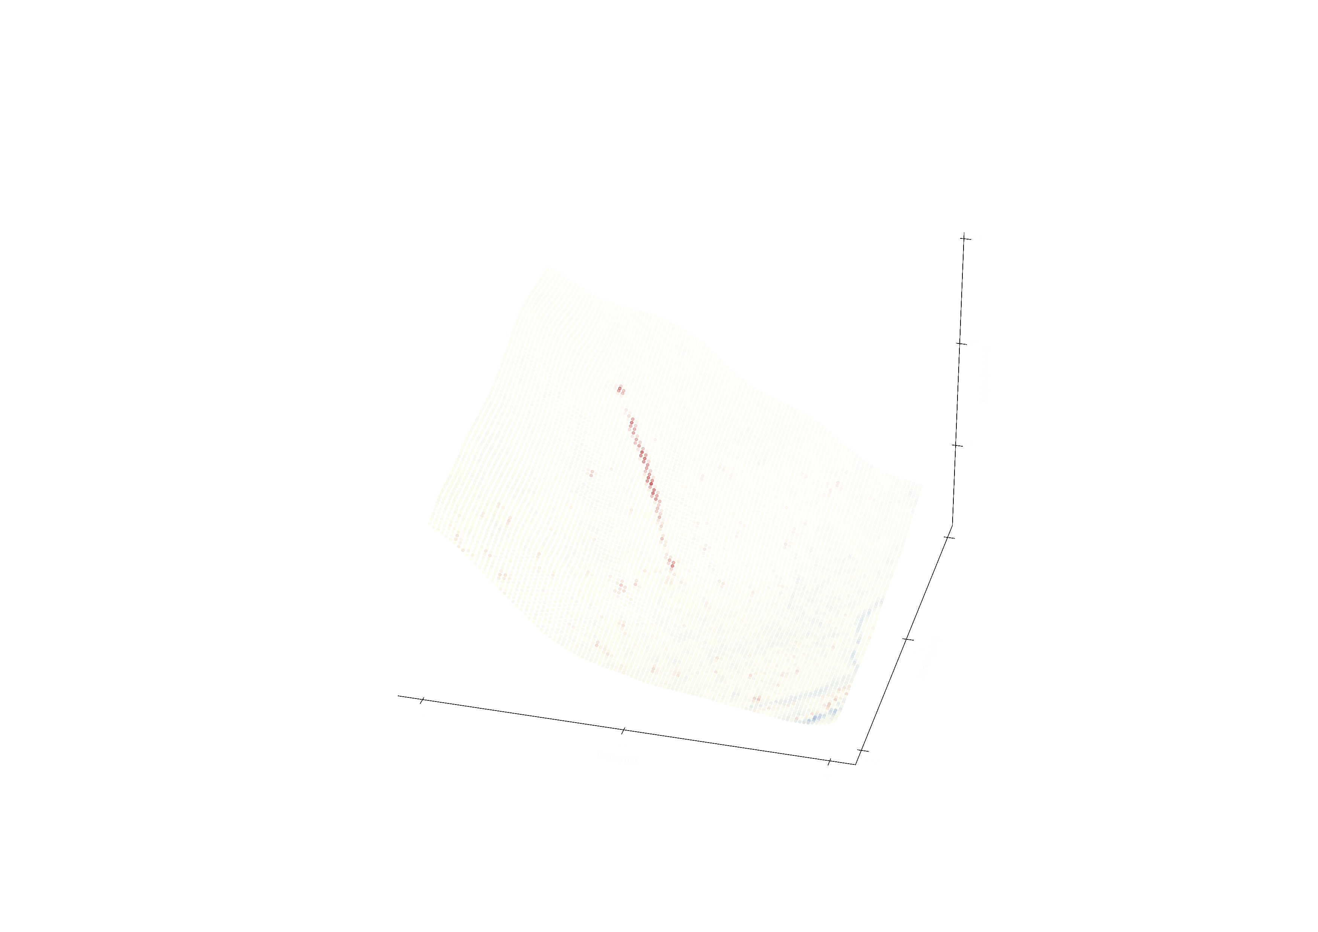
How can we integrate the topography?

Slide 9
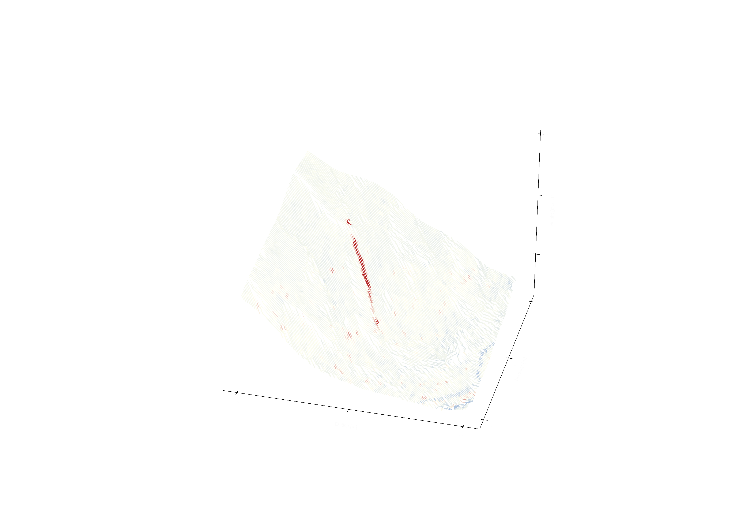
Graph Network
  Nodes
    Based on image
    coordinates
  Edges
    Based on steepest
    slope in 3x3
    neighbourhood

Slide 10

Standard Neighbourhood Smoothing
7x7 window mean

Slide 11
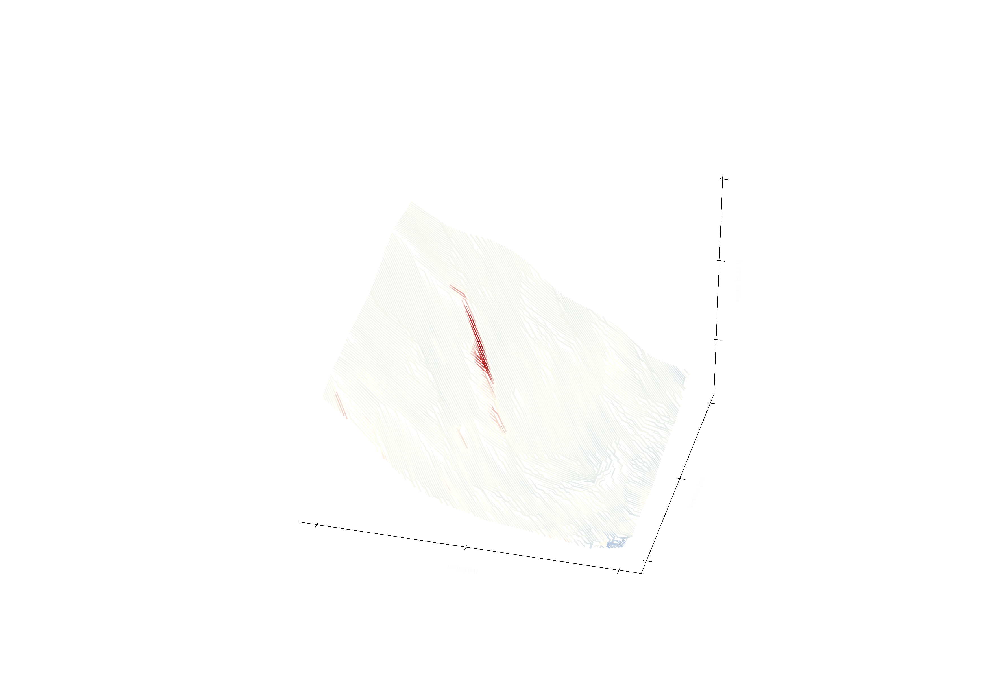
Graph Neighbourhood Smoothing
3 nodes downslope mean

Slide 12

Graph Neighbourhood Smoothing
3 nodes upslope mean

Slide 13

Graph Neighbourhood Smoothing
Combined up- & downslope mean

Slide 14
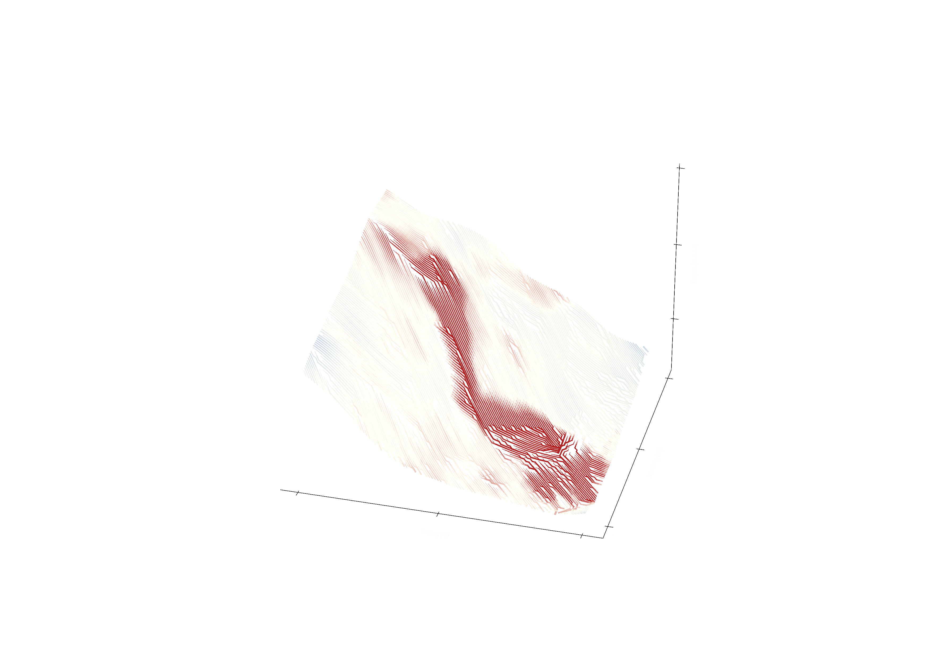

What scale?
Graph network enhances small scales
Similar results for large scales
Graph Neighbourhood
Standard Neighbourhood

Slide 15
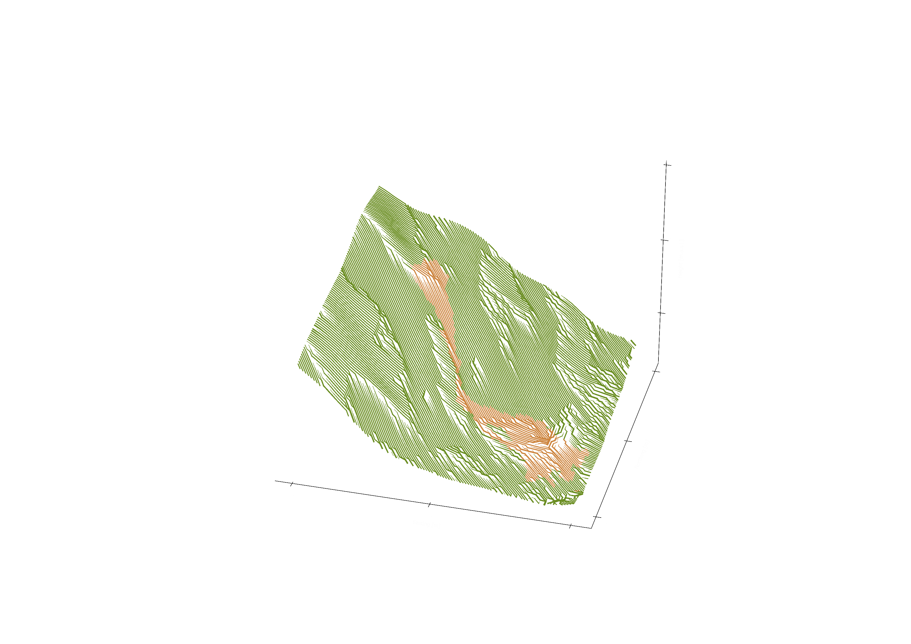
What next?
Training of the Random Forest Classifier
Look at different landcover classes
  Integrate other data products
Investigate different edge conditions

Slide 16
Questions?
luck@ifu.baug.ethz.ch
www.linkedin.com/in/manuel-luck-remote-sensing

