Slide 1
Long-term analysis of the environmental impact of mining in the Upper Silesia Coal Basin area based on historical and the latest remote sensing data
Maria Przyłucka, Zbigniew Perski, Zbigniew Kowalski
Polish Geological Institute – National Research Institute
email: maria.przylucka@pgi.gov.pl

Slide 2
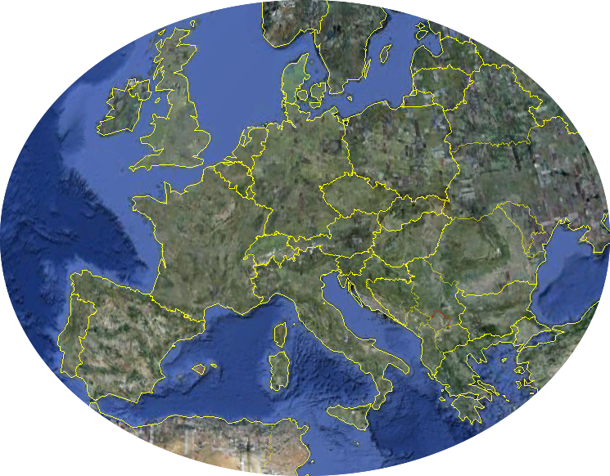
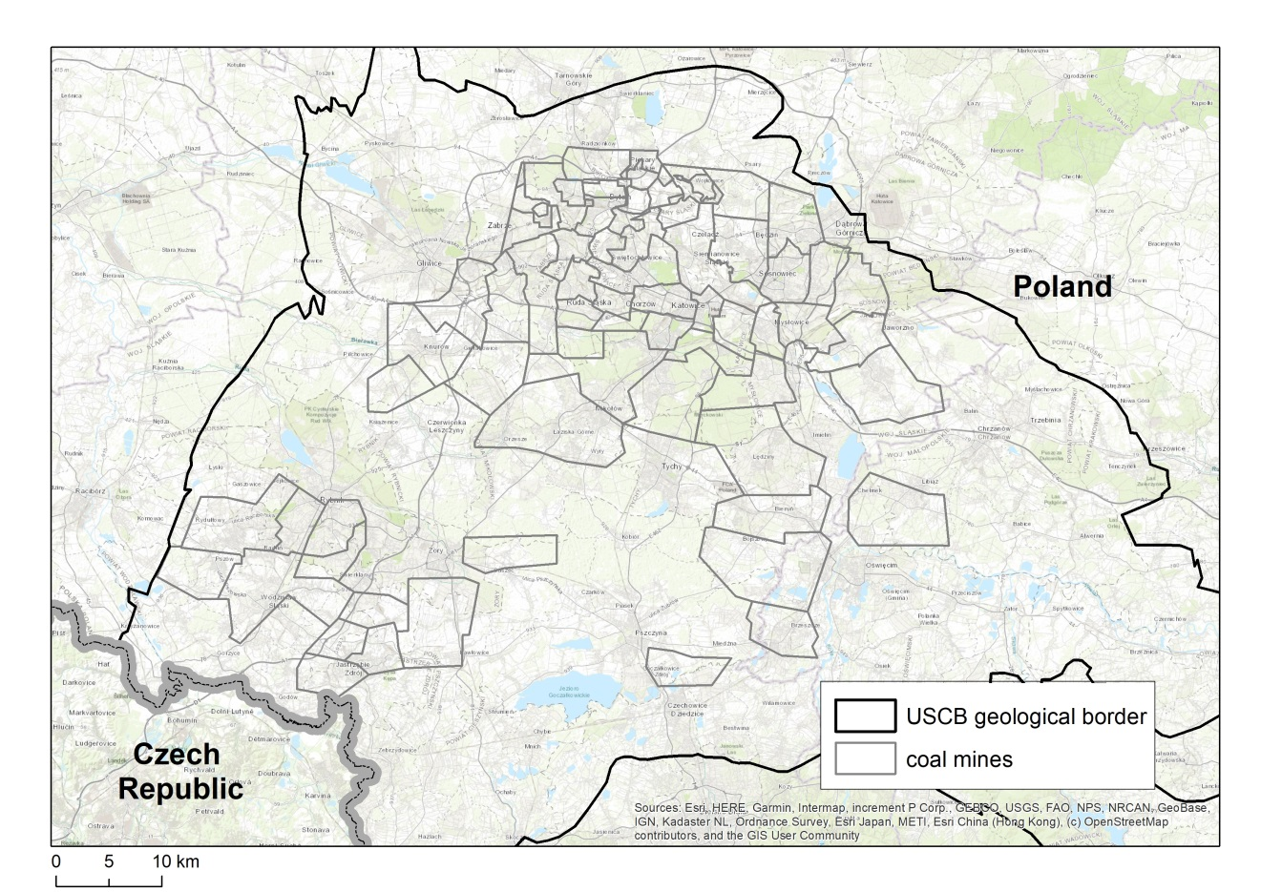
Upper Silesian Coal Basin
Upper Silesian Coal Basin
Location: southern Poland, Ostrava-Karvina in the Czech Republic.
Total area: 7,250 km².
Major hard coal basin in Poland, and also one of the largest in Europe.
Mining activities within Carboniferous hard coal deposits
Active for over 200 years.
The big metropolitan area of 37 towns
Population: ~3 million inhabitants.
In the study area, hazardous ground deformations are caused primarily by the extensive longwall mining operations.
Average depth of extraction: 705 m
Annual extraction (2020): 42 mln t

Slide 3
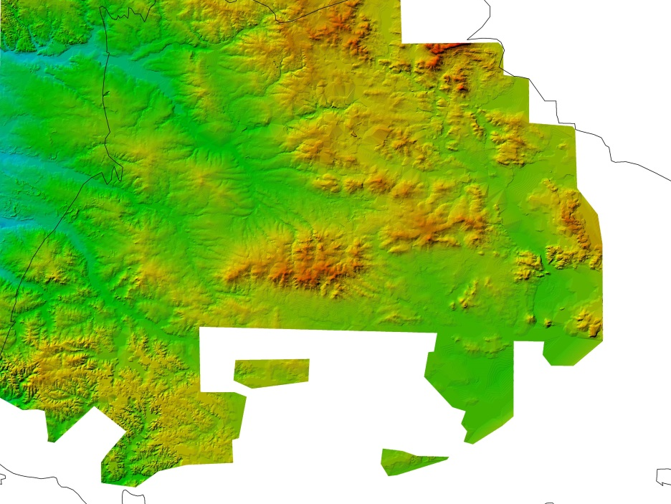
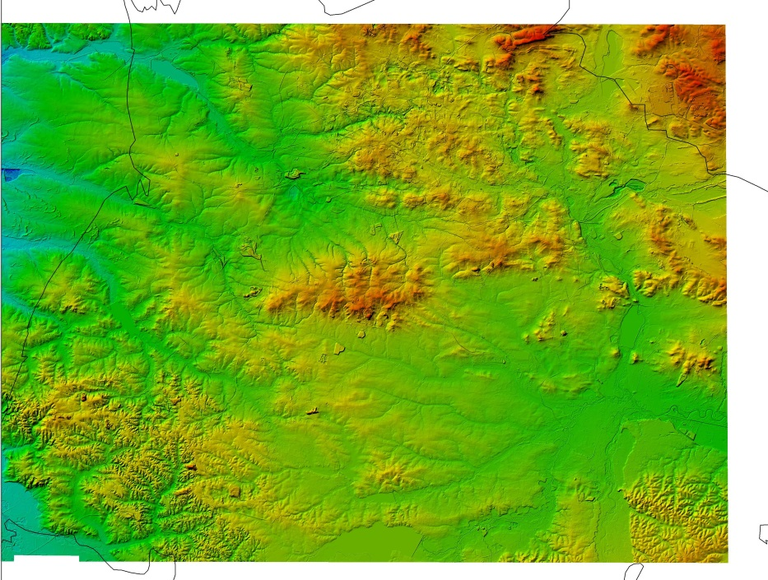
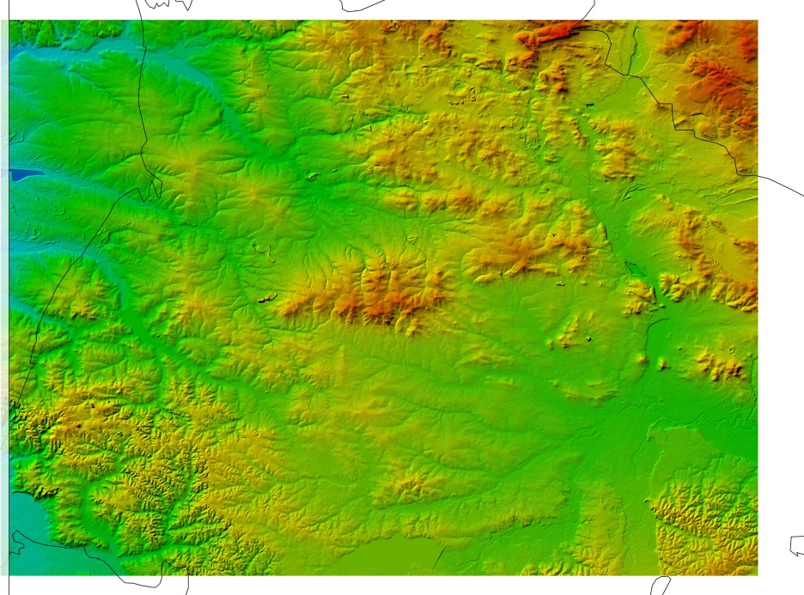
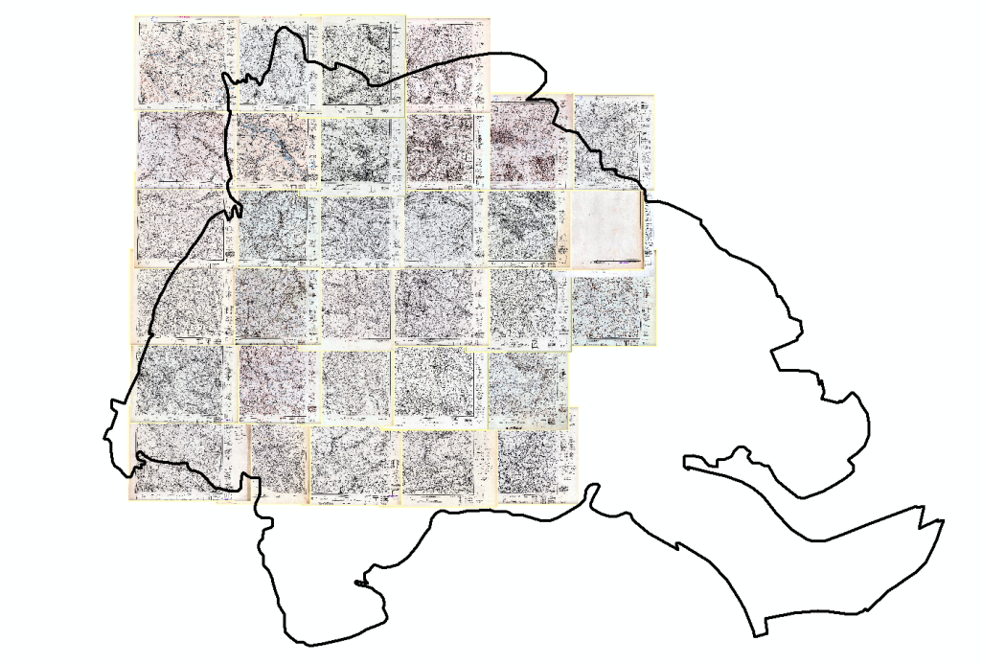
Differential elevation models (DTM->DEM)
MSTBLTR
1940
LIDAR
2013
Numerical terrain model DTED, derived from the vectorization of diapositives of topographic maps from the 90s of the twentieth century
Meßtischblatt - German topographic map at the scale 1 : 25000 prepared before Second World War (manual vectorization)
LIDAR digital terrain model from 2013
DTED
1990

Slide 4
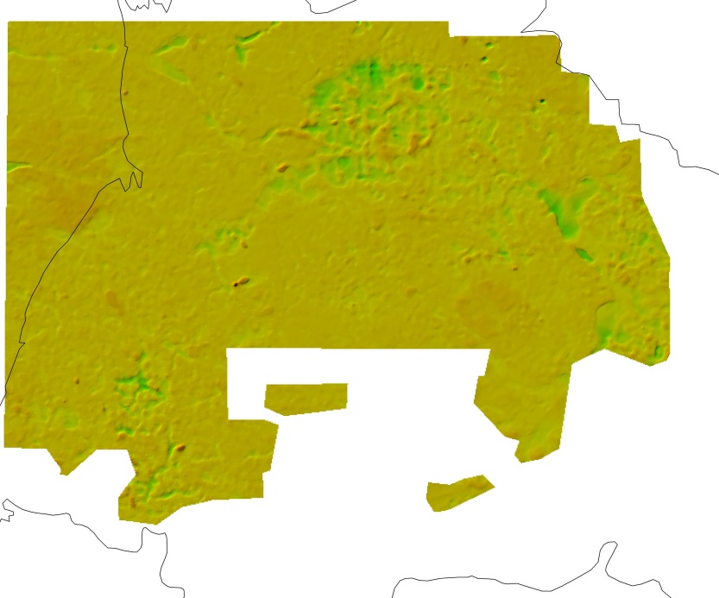
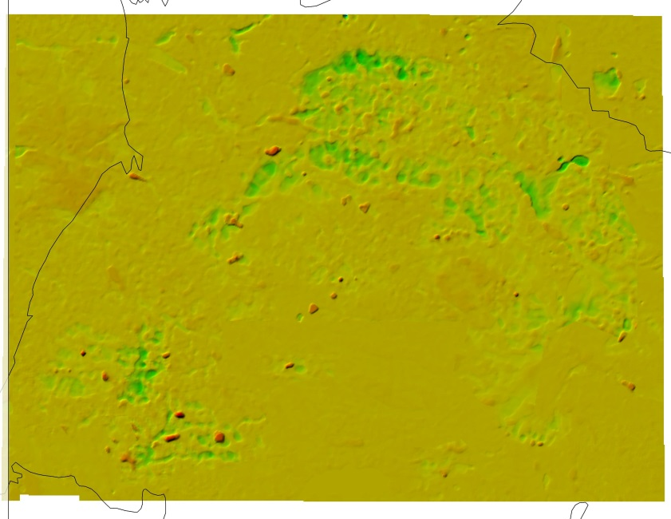
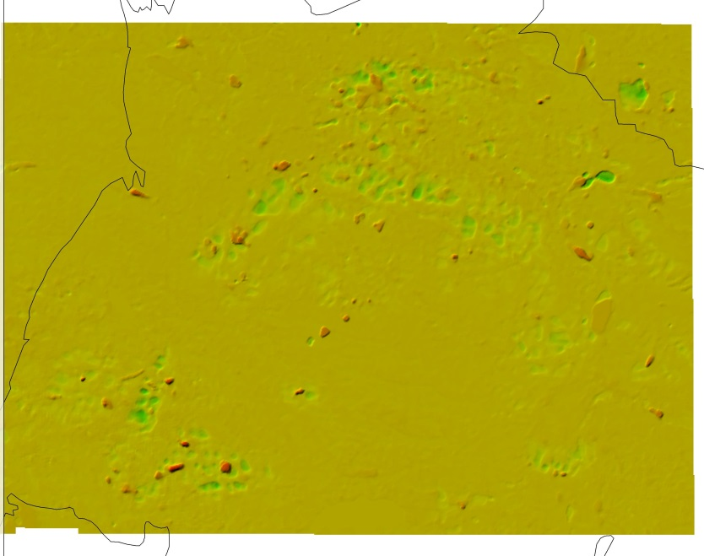
Differential elevation models (DTM->DEM)
DTED – MSTBLTR
1990 - 1940
LIDAR – MSTBLTR
2013 - 1940
LIDAR - DTED
2013 - 1990

Slide 5
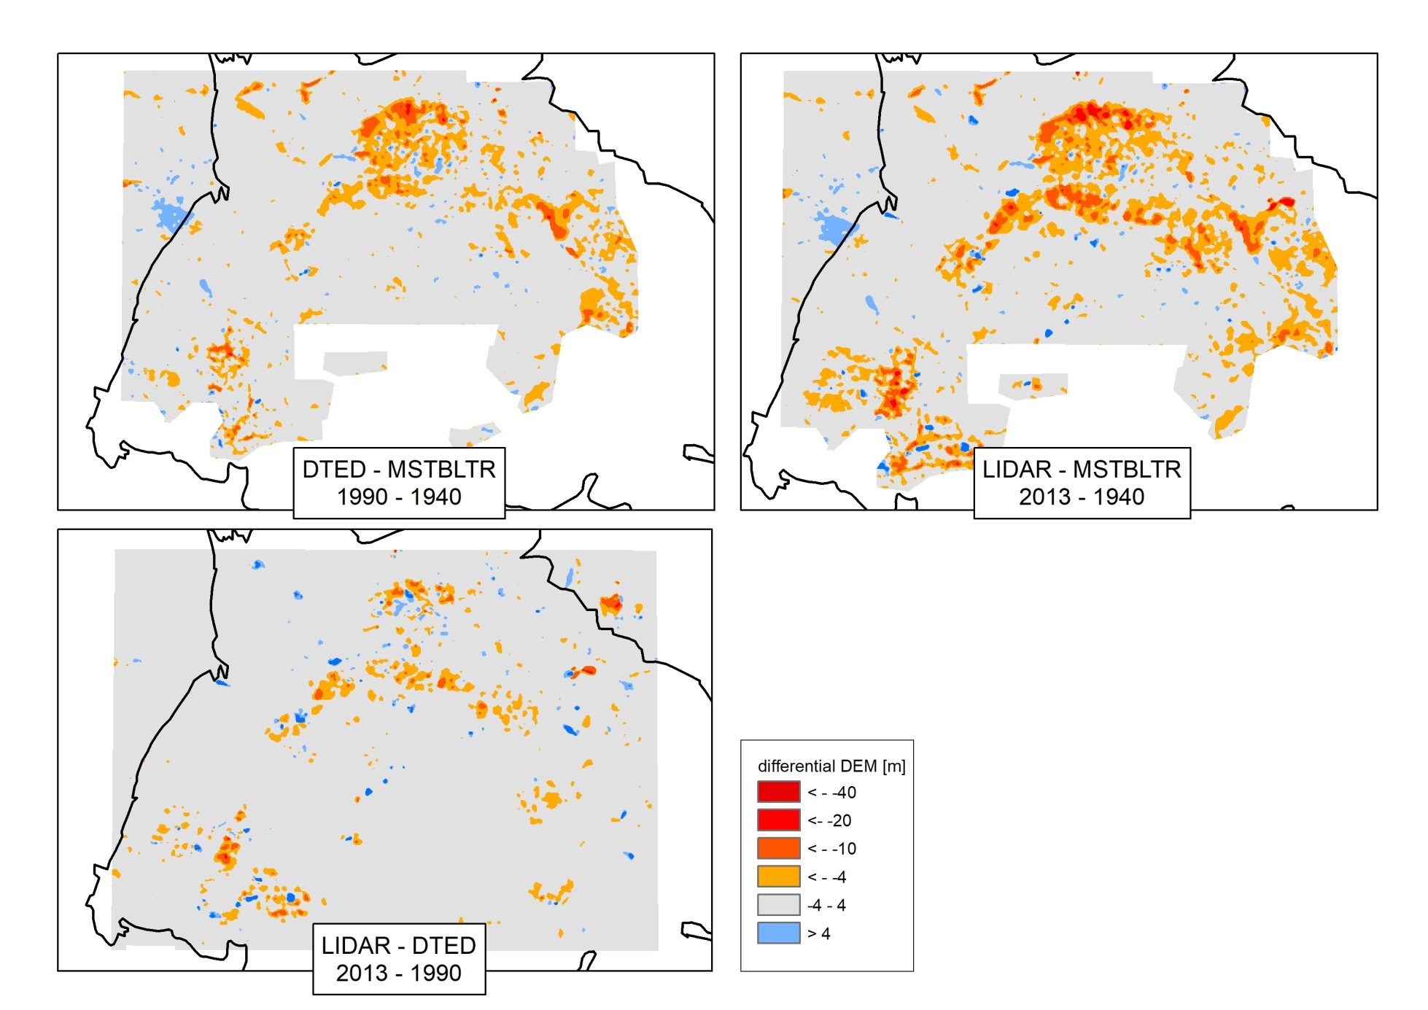
Differential elevation models (DTM->DEM)
For three time intervals, the area under the influence of the subsidence was estimated:
1940-1990: 370 km²
1990-2013: 260 km²
1940-2013: 450 km²

Slide 6
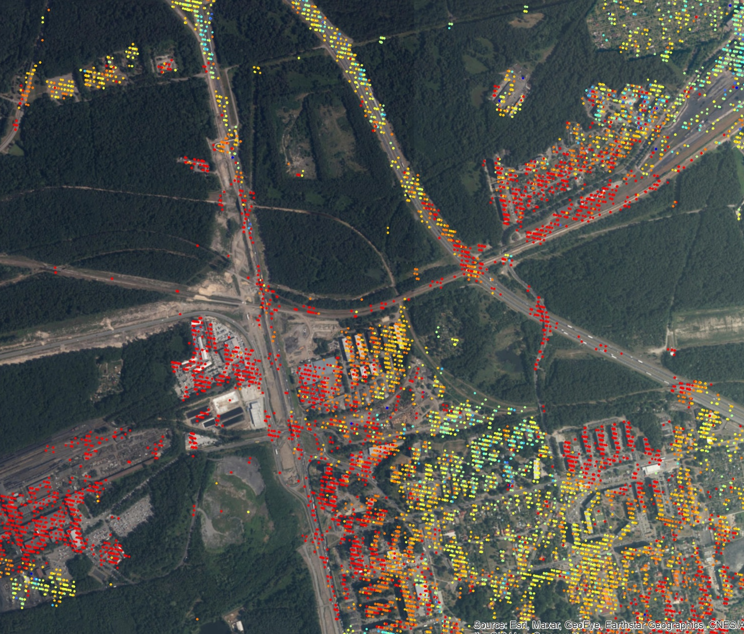
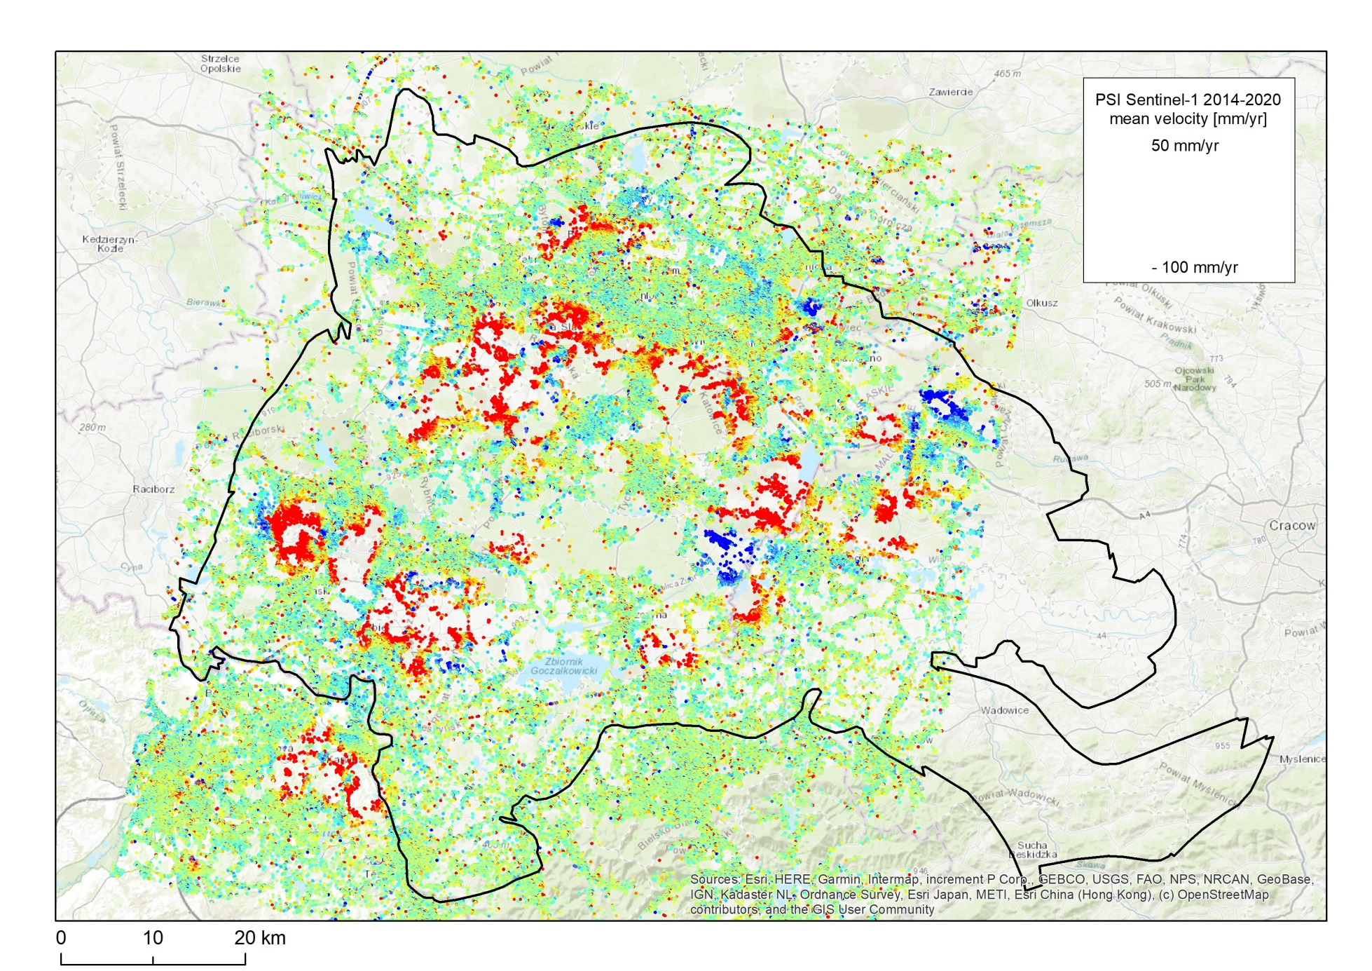
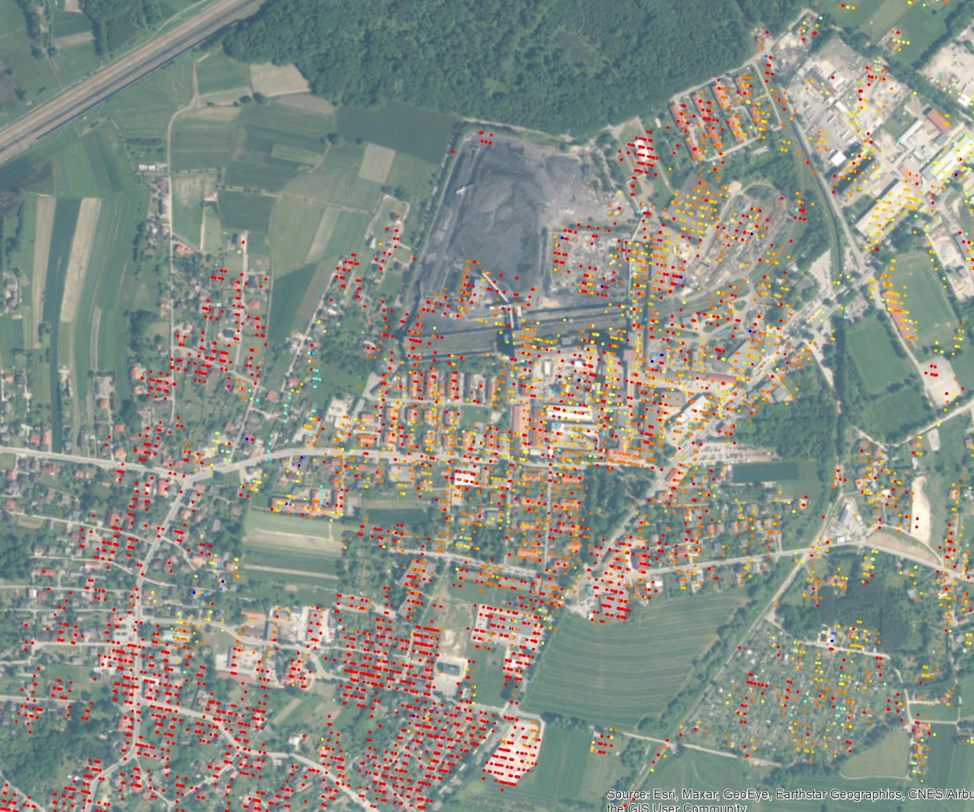
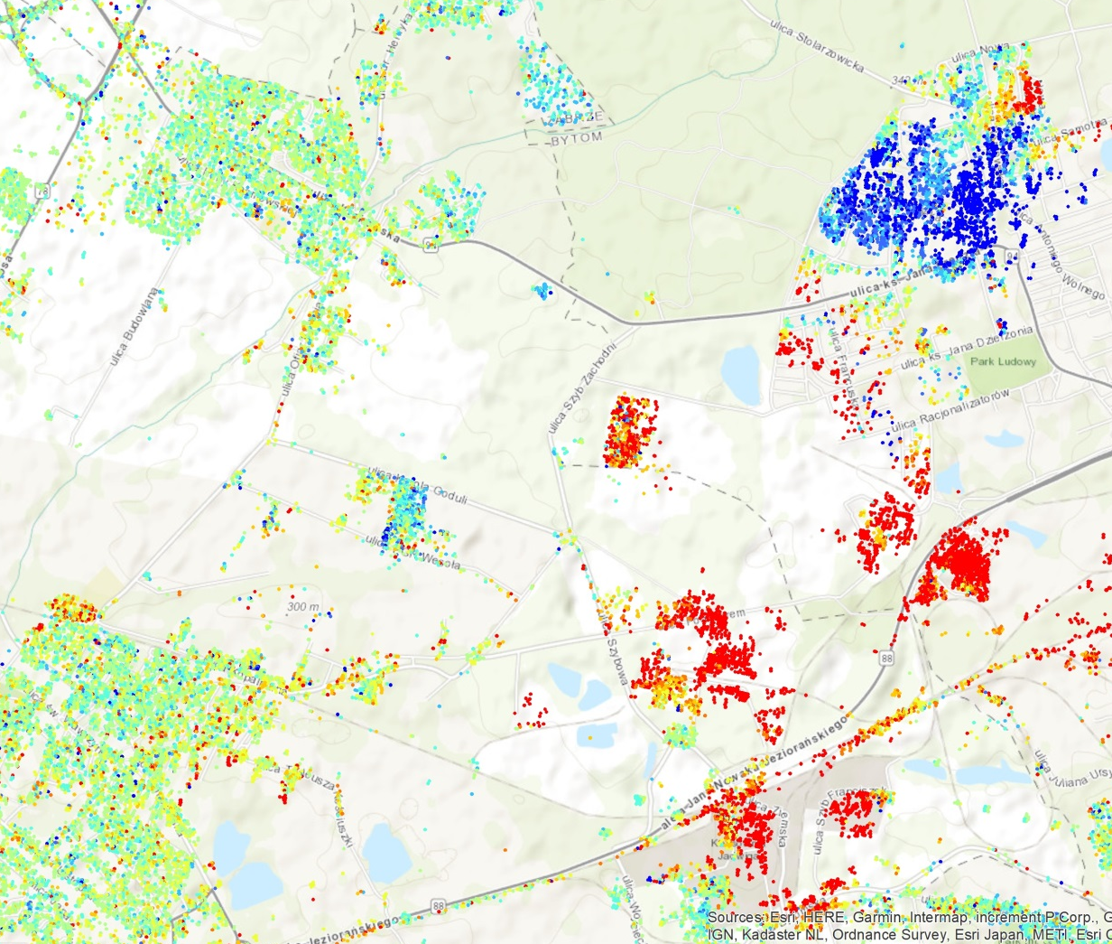
PSI Sentinel-1 2014-2020
period of 6 years (26.10.2014 -26.06.2020),
total of 260 scenes,
124 descending
8,139,901 PS points over 6,620 km2,
average density 1230 PS /sq km.

Slide 7
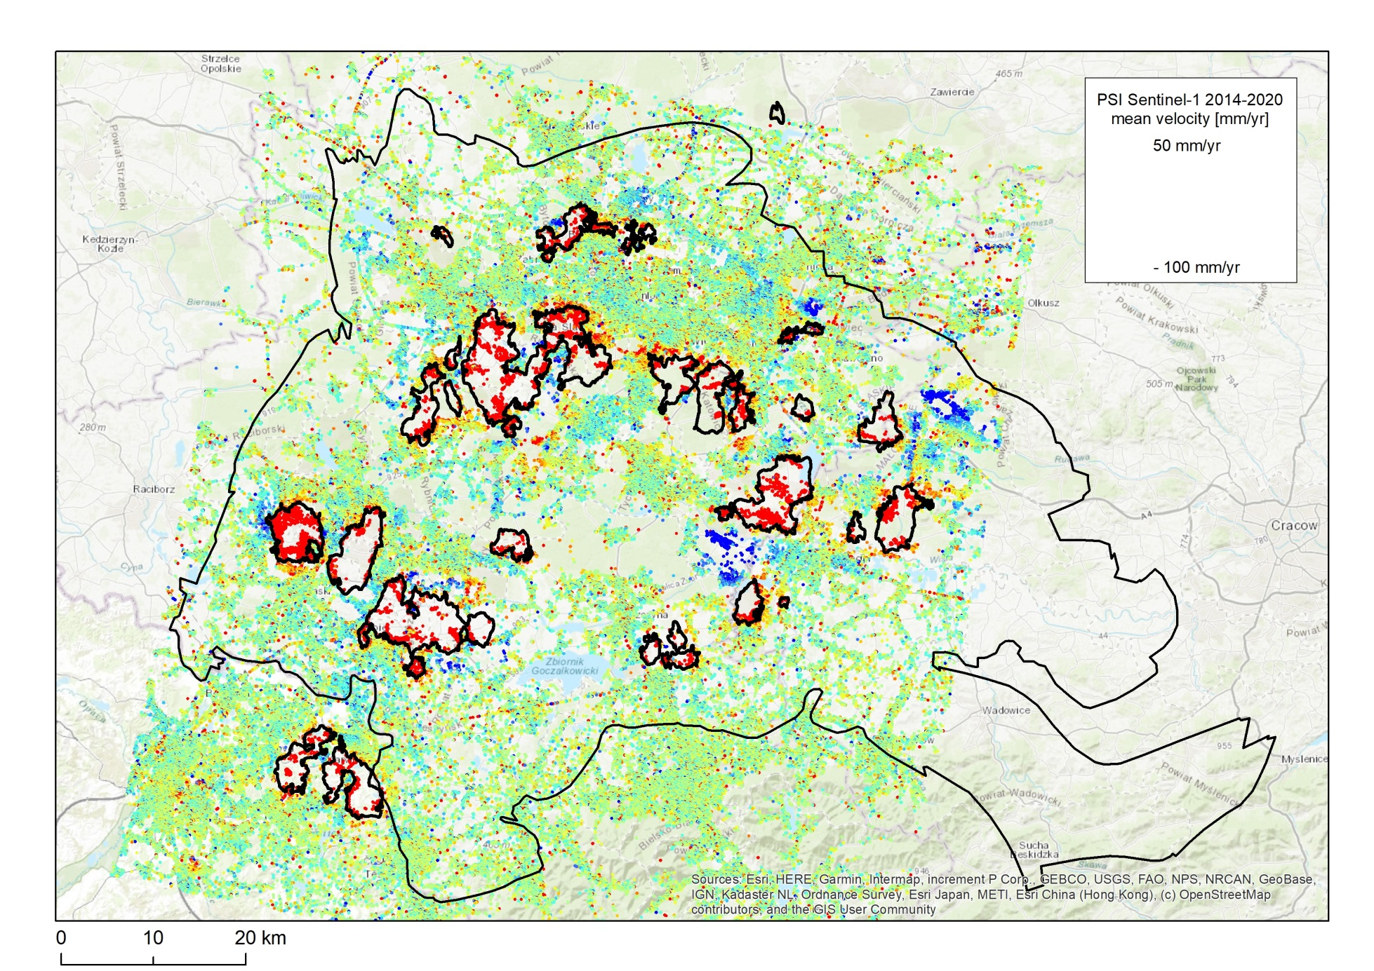
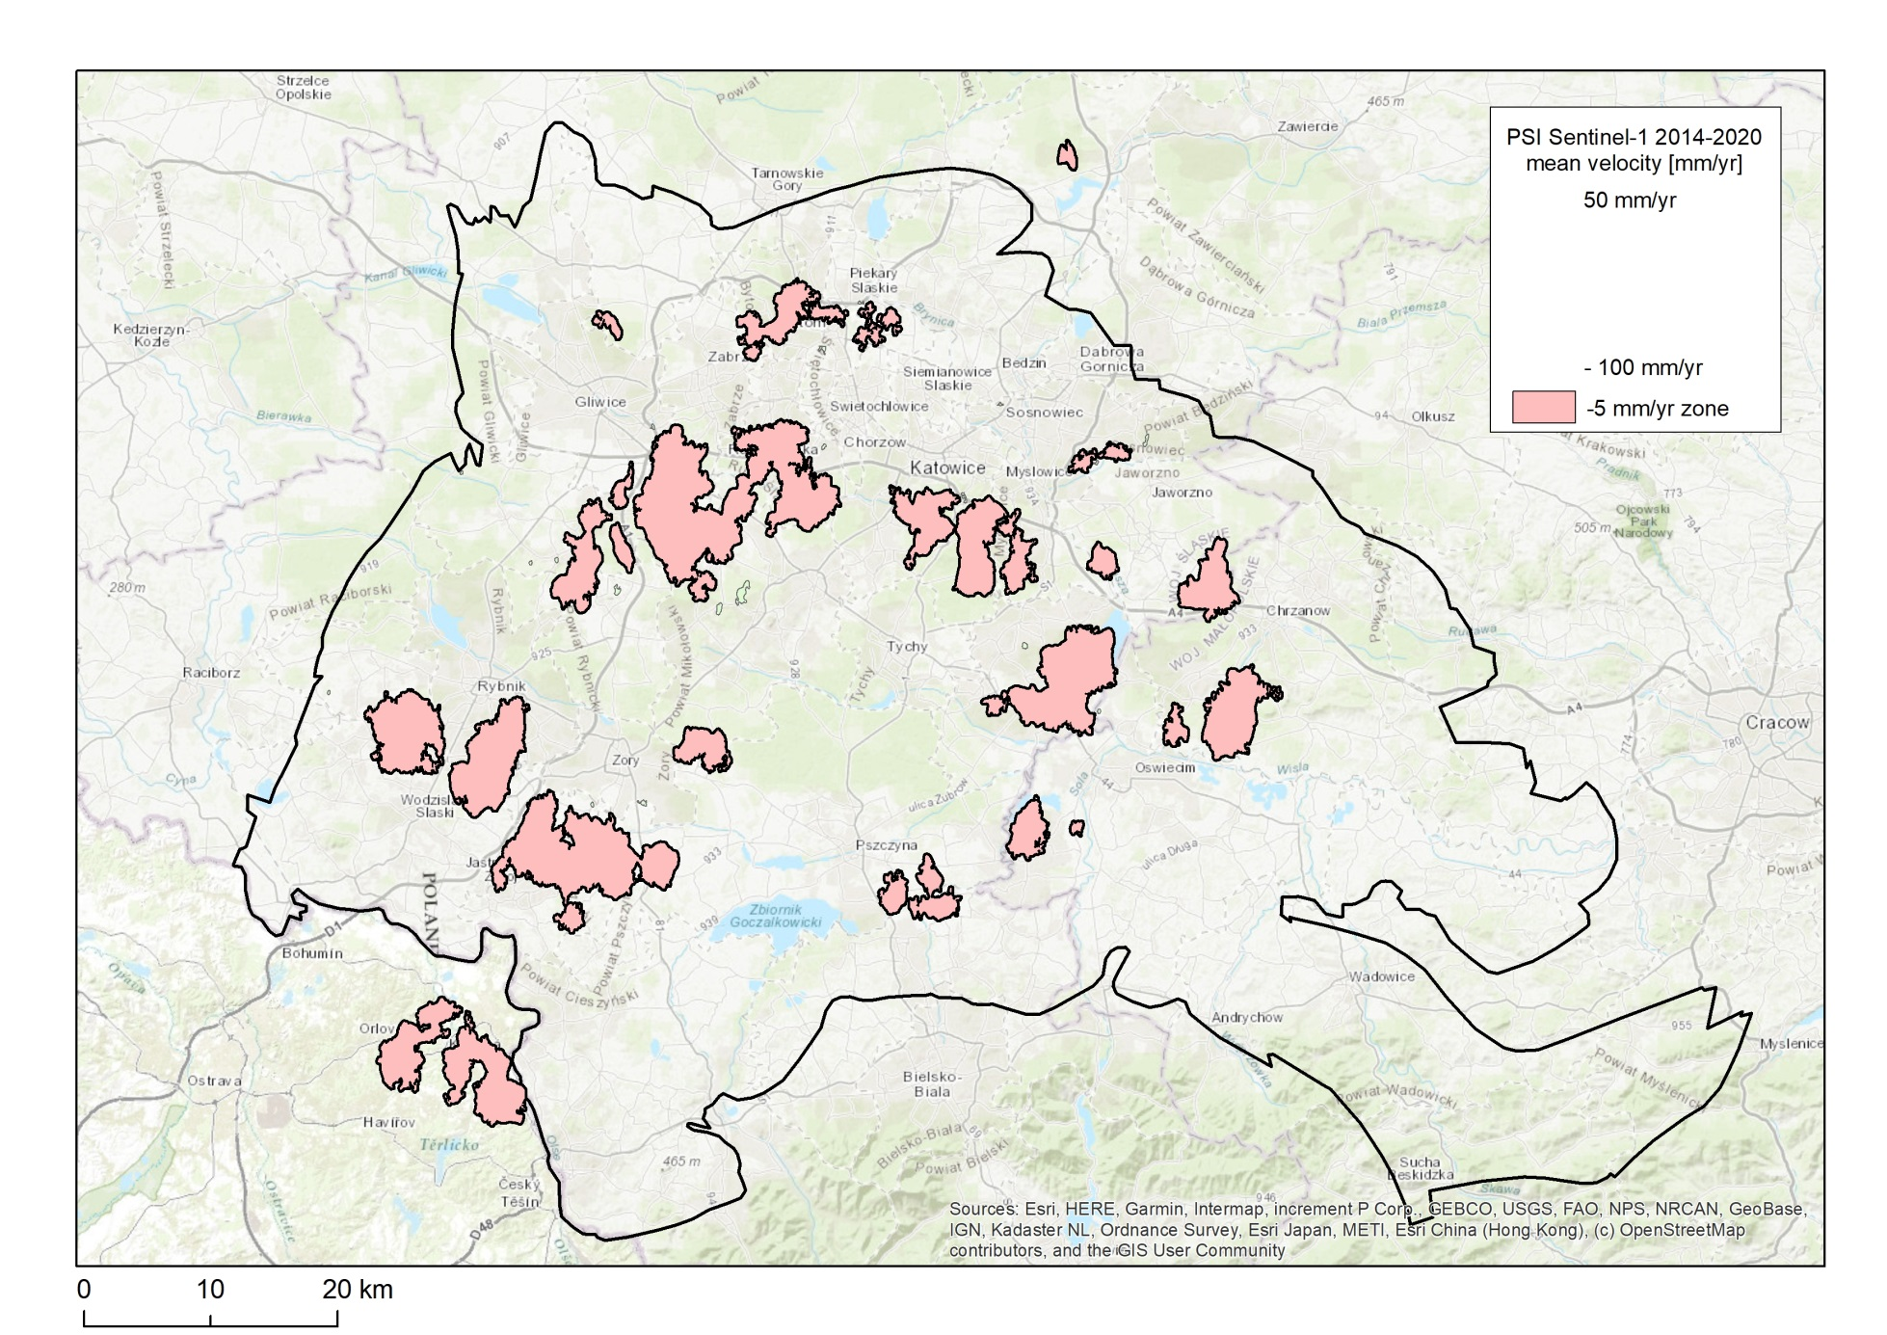
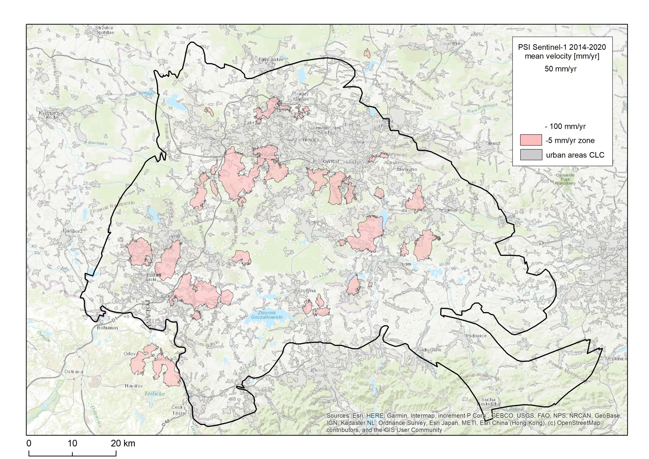
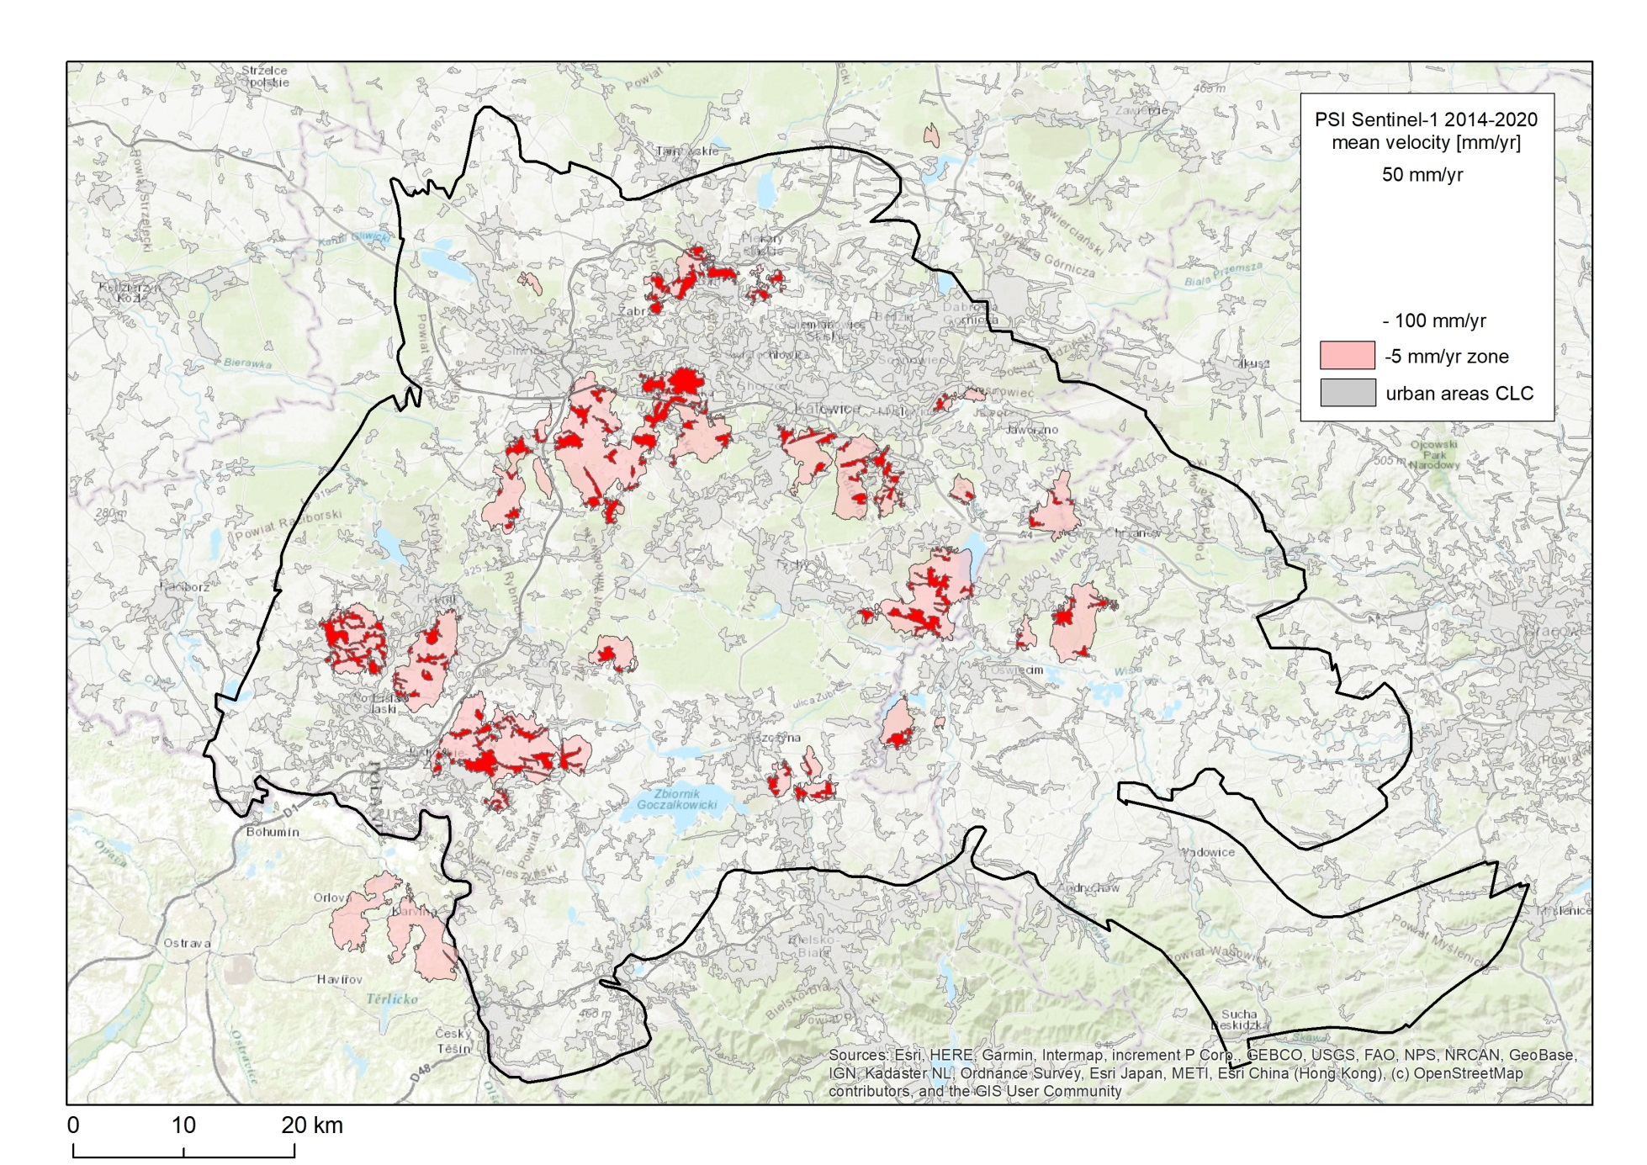
PSI Sentinel-1 2014-2020
Over 111 sq km of urban areas is under direct influence of underground mining.

Slide 8
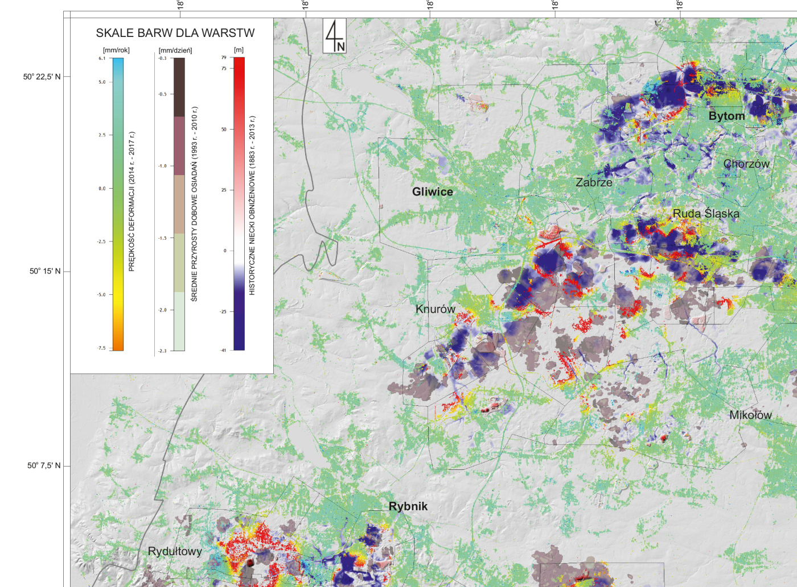
Historical and contemporary terrain deformations

Slide 9
Summary
Data from different sources were used to analyze the long-term influence of mining in the area of interest.
The analysis covered the period from the mid-twentieth century to 2020.
As a result, zones of mining-induced subsidence where the terrain surface was systematically changed in individual years were identified.
The large spatial extend of the data allowed for identification of over 600 sq km influenced by undergound coal exploitation.

Slide 10
Thank you!
maria.przylucka@pgi.gov.pl

