Slide 1
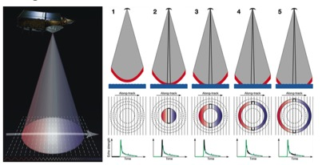
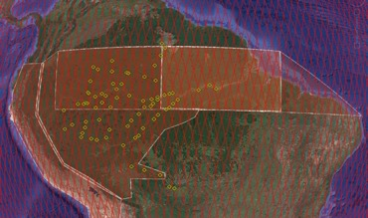
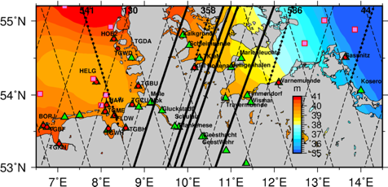
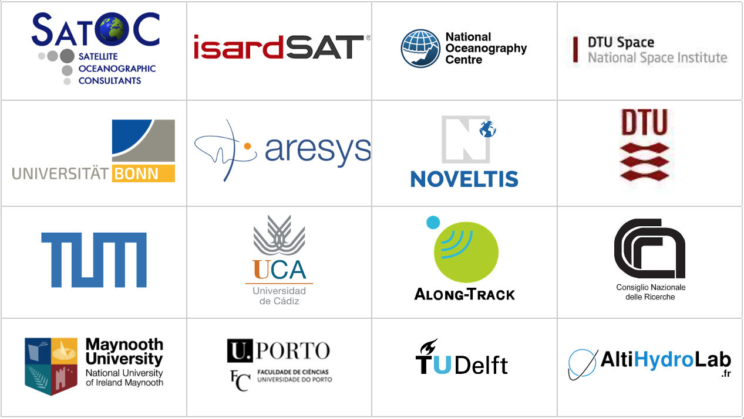
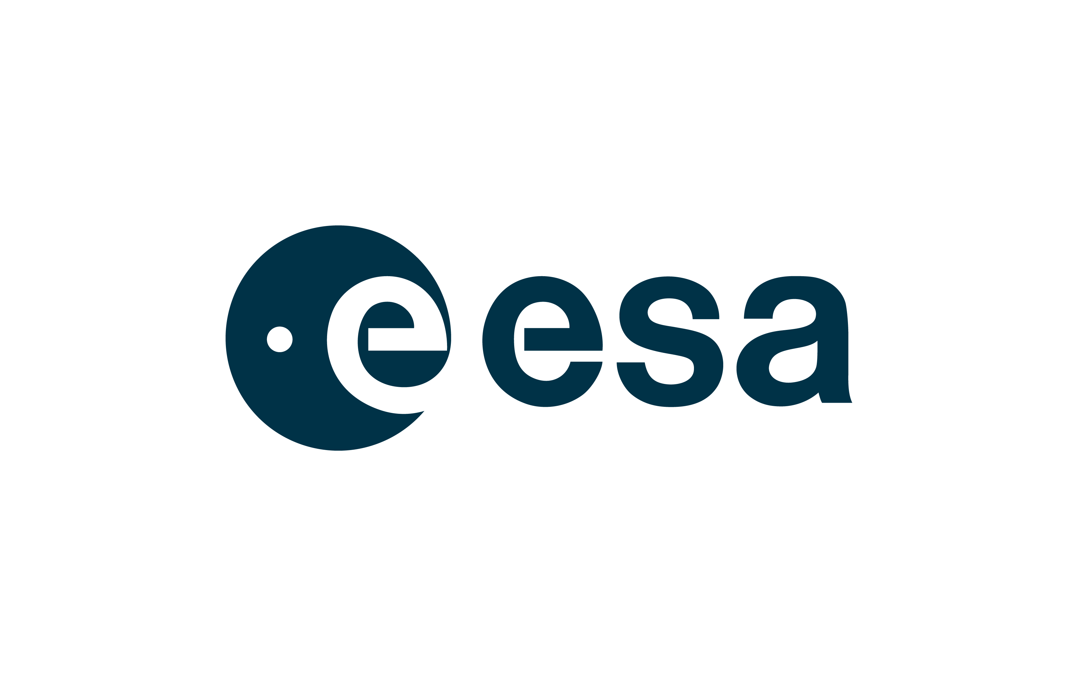
Improving SAR Altimeter processing over inland waters - the ESA HYDROCOASTAL project .
D. Cotton, Albert Garcia-Mondejar, Stephanie Urien, Ester Vendrell, Christine Gommenginger, Ole Andersen, Karina Nielsen, Heidi Ranndal, Luciana Fenoglio-Marc, Michele Scagliola, Mathilde Cancet, Marcello Passaro, Denise Dettmerring, Pierre Fabry, Nicholas Bercher, Angelica Tarpanelli, Stefano Vignudelli, Francesco de Biasio, Peter Bauer-Gottwein, Joana Fernandes, Cornelis Slobbe, Marc Naeije, Jesus Gomez-Enri, Peter Thorne, Elena Zakharova, Andy Shaw, Marco Restano, Jérôme Benveniste,
d.cotton@satoc.eu
Notes:
Hello, I’m David Cotton, from Satellite Oceanographic Consultants in the UK. This presentation is about the European Space Agency funded HYDROCOASTAL Project, the title is “Improving SAR altimeter processing over the coastal zone and inland waters – The ESA HYDROCOASTAL project.
In this presentation I give a very brief overview, please see the full presentation for a more detailed description
HYDROCOASTAL is funded by the European Space Agency, under the Science for Society Programme.
The aim is to to maximise exploitation of SAR and SARin altimeter measurements in the coastal zone and inland waters, by evaluating and implementing new innovative approaches to process SAR and SARin data from CryoSat-2, and SAR altimeter data from Sentinel-3A and Sentinel-3B.
There are 15 partners in the project: Listed at the bottom of this slide
First some background to the scientific motivation behind the project.
The junction between the coastal zone and inland waters provides a challenge to researchers as it represents a boundary between different science domains (hydrology and oceanography), and different satellite measurement regimes.
It is also a region of high variability in small spatial and temporal scales, pushing to the limit the ability of satellite data in terms of sampling and providing accurate measurements. HYDROCOASTAL aims to enhance our understanding of interactions between the inland water and coastal zone, and the small scale processes that govern these interactions. Also the project aims to improve our capability to characterize the variation at different time scales of inland water storage, exchanges with the ocean and the impact on regional sea-level changes.

Slide 2
HYDROCOASTAL Overview
Scientific Review and Requirements Consolidation
Review the current state of the art in SAR and SARin altimeter data processing as applied to the coastal zone and to inland waters.
Implementation and Validation (July 2020 – May 2022)
Implement new SAR, SARin altimeter processing algorithms
Evaluate performance of the candidate algorithms
Selected algorithms used to generate “global” data set
Global L2 inland water and coastal zone data set
Time Series (L3) and River Discharge (L4) for medium to large rivers
Experimental data set for small rivers and tributaries
Impact Assessment (June – December 2022)
The impact of global products assessed through a series of case studies
Outreach and Road Map (April 2023)
Notes:
HYDROCOASTAL started in February 2020, and is now planned to be completed in April 2023. There are four main phases:
In the first phase we carried out a review of the the current state of the art in SAR and SARin altimeter data processing as applied to the coastal zone and to inland waters.
From this we produced a requirements baseline, and a state of the art review of SAR altimeter processing.
We are currently close to the end of the second phase, due to finish in the next few months. In this phase we have been
Implementing new SAR, SARin altimeter processing algorithms to generate 2-year test data set
Evaluating the performance of these candidate algorithms
Then, based on the results of this evaluation, the best performing algorithms will be implemented to generate “global” coastal zone and inland water data sets.
In Phase 3, Impact Assessment we will assess the impact of these new products through a series of case studies
And in the final phase: Outreach and Road Map, we will review the project and provide recommendations for further R&D and implementation in current and future SAR altimeter missions.

Slide 3
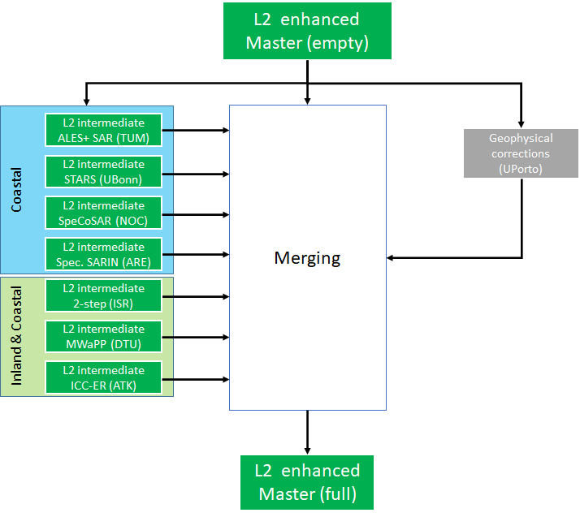
Candidate L2 algorithms
Six candidate L2 processing algorithms have been implemented. Their performance is being evaluated, and algorithms will be selected to generate global coastal zone and inland water products in the second year of the project.
Two Step Analytical Processor – coastal and inland: isardSAT
Specialised SARin – coastal: Aresys
MWaPP – Multiple Waveform Persistent Peak – inland: DTU Space
ICC-ER (Isolate, Cleanse, Classify - Empirical Retracker – inland: ATK
Statistical Re-tracker STARS type – coastal: U Bonn
ALES+ for SAR - coastal: TU Munich
HYDROCOASTAL L2 product merging. The L2 enhanced Master will include output from all L2 processors. (credit: isardSAT)
Notes:
Six candidate “re-tracking” algorithms have been implemented and their performance is now being evaluated. Based on this evaluation, algorithms will be selected to generate final output global scale coastal zone and inland water products.
The candidate algorithms for inland waters are:
Two Step Analytical Processor – coastal and inland: isardSAT
MWaPP – Multiple Waveform Persistent Peak – inland: DTU Space
ICC-ER (Isolate, Cleanse, Classify - Empirical Retracker – inland: ATK
The outputs are soon to be combined in a single “L2 Enhanced Master Product”, which will be ready shortly and will be made publicly available.

Slide 4
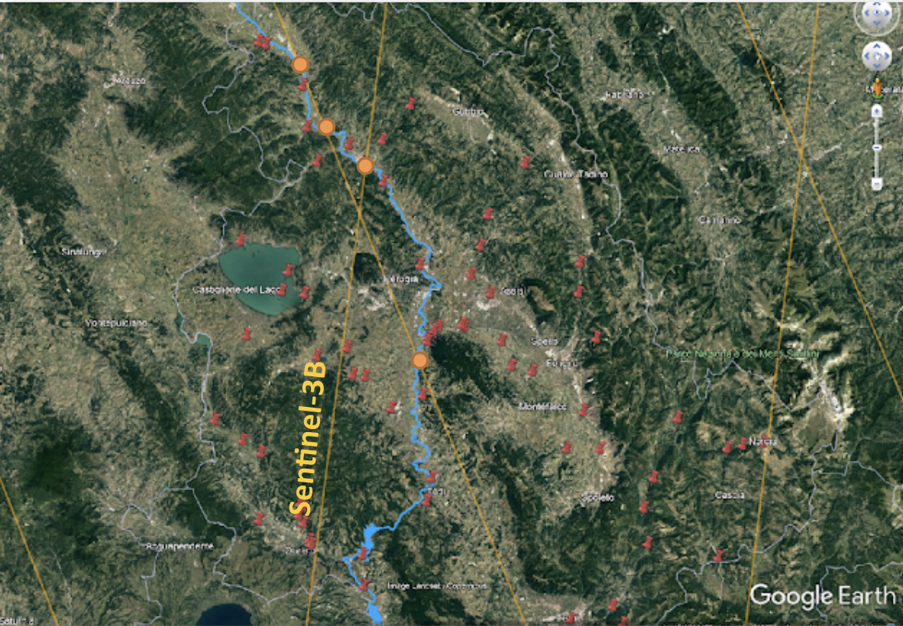
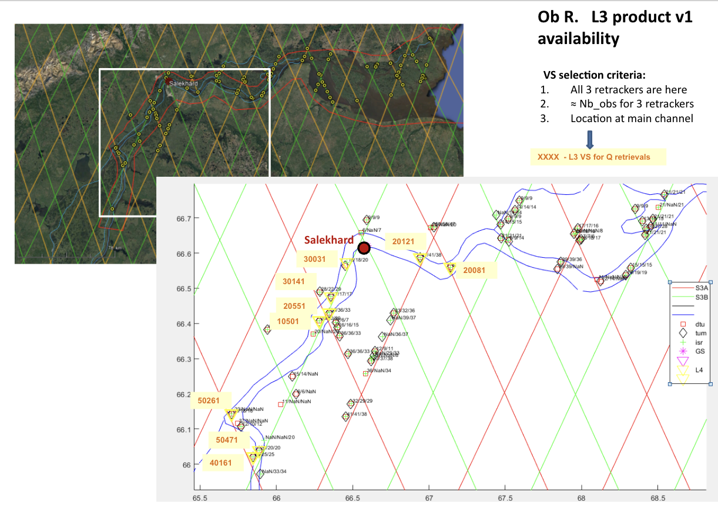
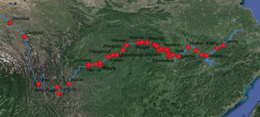
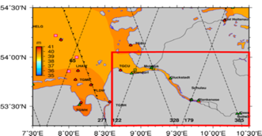
First Test Data Set Evaluation
The performance of the different processors will be evaluated through detailed studies. From this evaluation algorithms will be selected to generate a global output product.
Inland Waters
Rhine and Elbe (U Bonn)
Water Level Time Series (DGFI/TUM)
Amur, Yangste and Zambezi (DTU)
Nonacho and Reindeer Lakes (DTU)
Amazon Basin (AHL)
Ob River (NUIM)
Po and Mississippi (CNR-IRPI)
Notes:
The products from the difference processing schemes are being evaluated in specific detailed studies:
Here we list the validation studies over inland waters, which include
Rhine and Elbe (U Bonn)
Water Level Time Series (DGFI/TUM)
Amur, Yangste and Zambezi (DTU)
Nonacho and Reindeer Lakes (DTU)
Amazon Basin (AHL)
Ob River (NUIM)
Po and Mississippi (CNR-IRPI)
The figures on the right illustrate some of the validation sites.

Slide 5
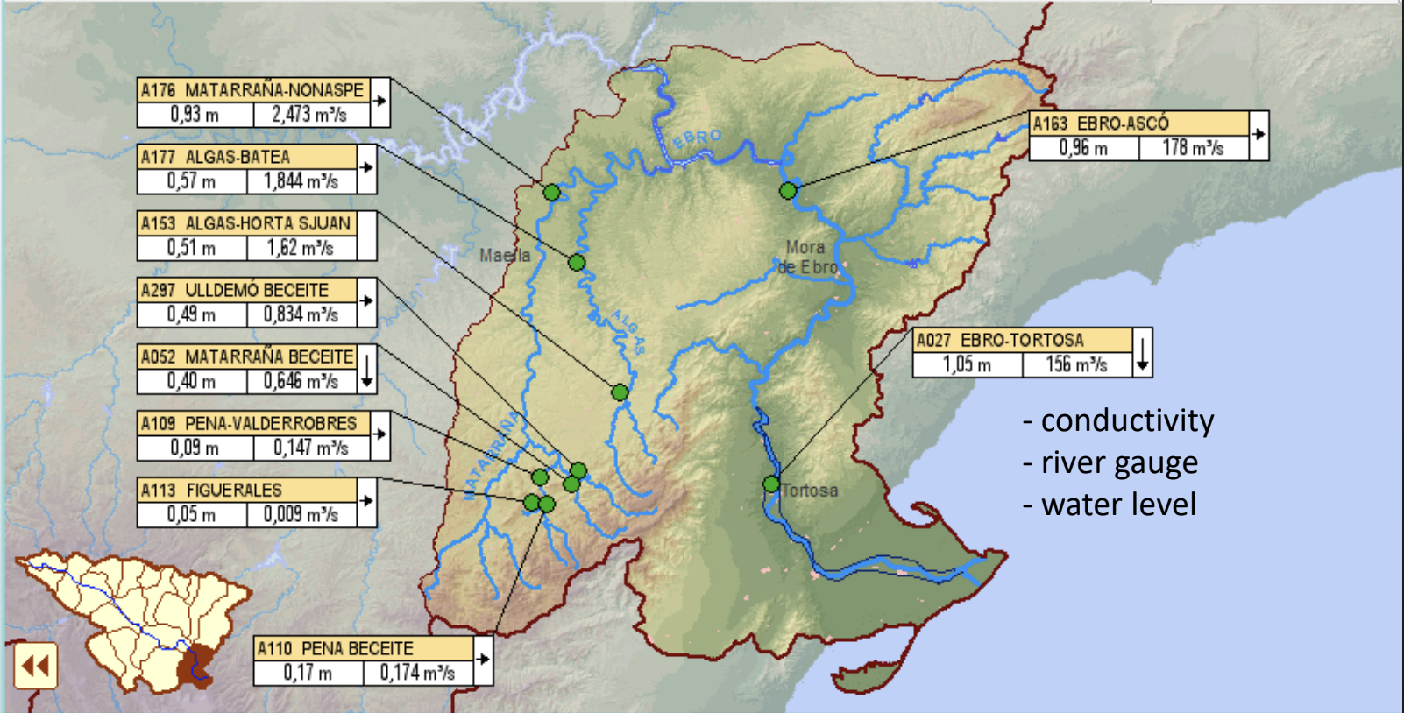
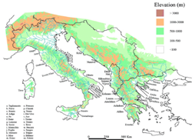
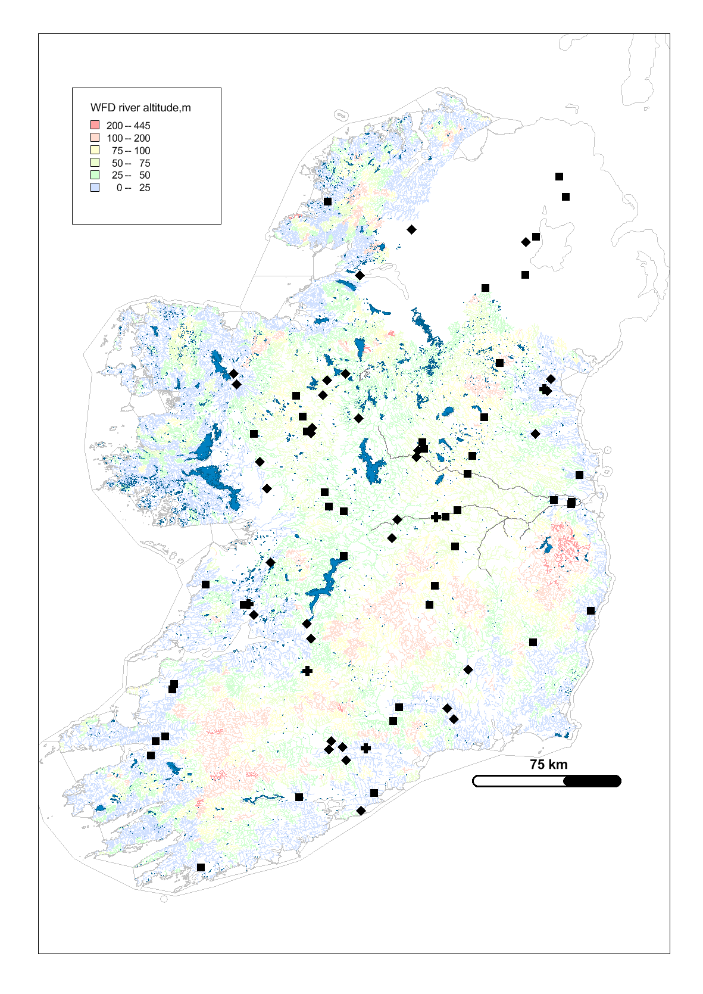
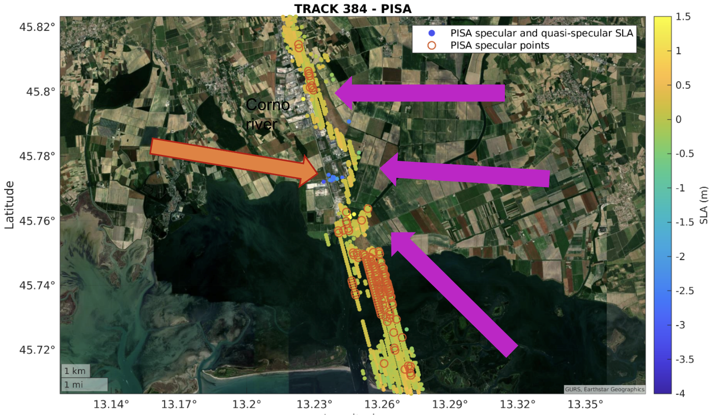
Impact Assessment
In the final year of the project a series of impact assessment studies will be carried out, to test and demonstrate the potential impact and benefits of the global dataset.
Processing Case Studies
Fully Focused SAR (Aresys, isardSAT)
Attitude Errors (Aresys)
Along and Across track slope (Aresys)
Open Loop Tracking Study (NOVELTIS)
Phase Unwrapping / Across Track Slope (DTU Space)
Coastal / Inland
Severn Estuary (NOC)
Baltic, German Bight, Elbe Estuary (U Bonn)
Venice Lagoon (CNR)
Thailand Coast (TU Delft)
Ebro River and Delta (isardSAT)
Wadden Sea (TU Delft)
Inland
Operational Hydrological Forecasting (DTU Env)
Lake Size, riverbank configuration (NUIM)
Discharge Validation (CNR)
Global Water Level Climatology (AHL, ATK)
Groups from outside the project team are welcome to engage with the project and carry out their own case studies. Please contact us with your suggestions!
Notes:
In the final year of the project, members of the team will be carrying out a number of impact assessment case studies, to test and demonstrate the potential impact and benefits of the global dataset.
They are listed on this slide
The inland water impact assessment studies cover a range of aspects, from basin scale water level climatologies (AHL), to catchment modelling (DTU), to more localised studies for the Ebro, Po and Rhine
As noted at the bottom of the slide, groups from outside the project team are welcome to engage with the project and carry out their own case studies, so please contact us with your suggestions.

