Slide 1
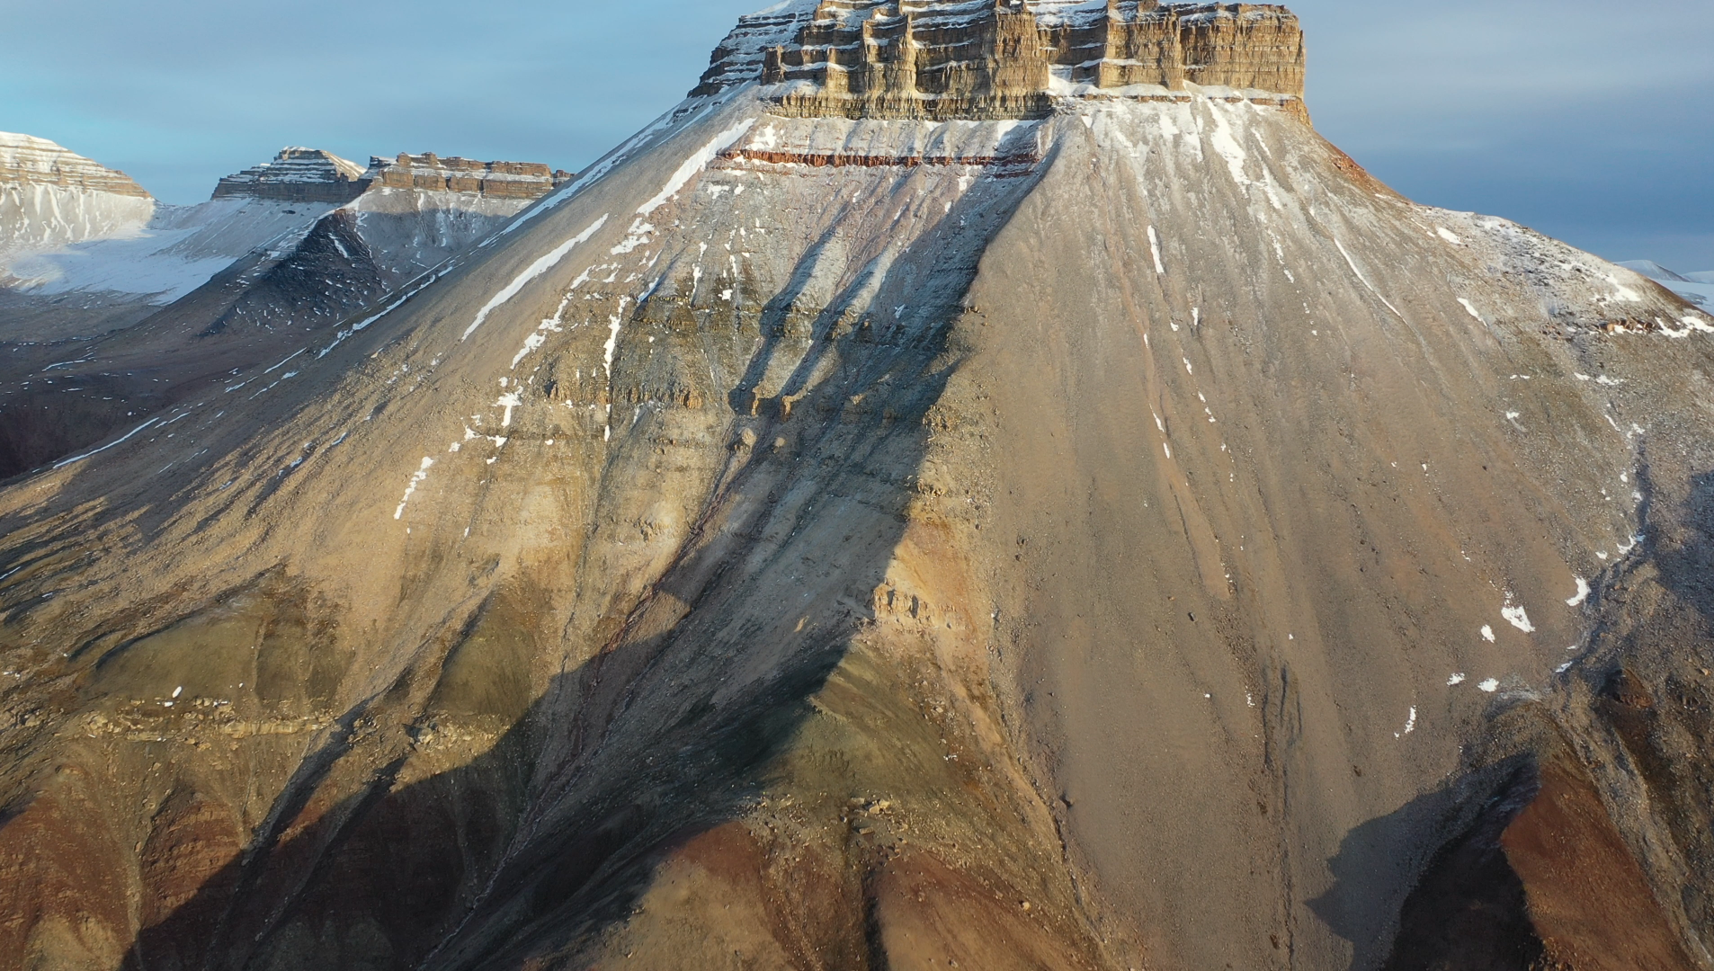


Deep-time paleoclimate archive in High Arctic, Svalbard, Norway
Aleksandra Smyrak-Sikora,
The University Centre in Svalbard
REFERENCES

Slide 2
Deep-time paleoclimate archive in High Arctic, Svalbard, Norway
Aleksandra Smyrak-Sikora¹
Lars Eivind Augland ²,
Peter Betlem^{1,2},
Sten-Andreas Grundvåg³,
William Helland-Hansen⁴,
Mads E. Jelby⁵,
Maria A. Jensen¹,
Malte M. Jochmann^{1,6},
Erik P. Johanessen⁷,
Morgan T. Jones^{2,8},
Maayke Koevoets-Westerduin²,
Gareth S. Lord ¹,
Atle Mørk ⁹,
Snorre Olaussen¹,
Sverre Planke^{2,8,10},
Kim Senger ¹,
Lars Stemmerik ¹¹,
Madeleine Vickers²,
Kasia K. Śliwińska¹¹,
Valentin Zuchuat¹²
¹ Department of Arctic Geology, The University Centre in Svalbard, aleksandras@unis.no; peterbe@unis.no; MariaJ@unis.no; maltej@unis.no; garethlo@unis.no; snorreo@unis.no
kim.senger@unis.no;
² Department of Geosciences, The University of Oslo, l.e.augland@geo.uio.no; m.t.jones@geo.uio.no; m.l.vickers@geo.uio.no, maaykekoevoets@gmail.com
³ Department of Geosciences, University of Tromsø - The Arctic University of Norway; sten-andreas.grundvag@uit.no
⁴ Department of Earth Science, University of Bergen, P. Box 7803, N-5020 Bergen, Norway, William.Helland-Hansen@uib.no
⁵ Department of Geosciences and Natural Resource Management, University of Copenhagen, Øster Voldgade 10, DK-1350 Copenhagen K, Denmark; madsj@ign.ku.dk
⁶ Store Norske Spitsbergen Kulkompani AS, malte.jochmann@snsk.no
⁷ EP Skolithos, Sisikveien 36, 4022 Stavanger, Norway; erik.p.johannessen@gmail.com
⁸ Centre for Earth Evolution and Dynamics (CEED), University of Oslo, Pb. 1028 Blindern, 0315 Oslo, Norway.
⁹Department of Geoscience and Petroleum, Norges teknisk-naturvitenskapelige universitet - NTNU, Trondheim; atle.arctic@gmail.com
¹⁰ Volcanic Basin Petroleum Research (VBPR), Oslo; planke@vbpr.no
¹¹ Geological Survey of Denmark and Greenland, Øster Voldgade 10, 1350 København K, Denmark; ls@geus.dk; kksl@geus.dk
¹² Faculty of Georesources and Materials Engineering, RWTH Aachen University, Wüllnerstrasse 2, 52062 Aachen, Germany, valentin.zuchuat@emr.rwth-aachen.de

Slide 3
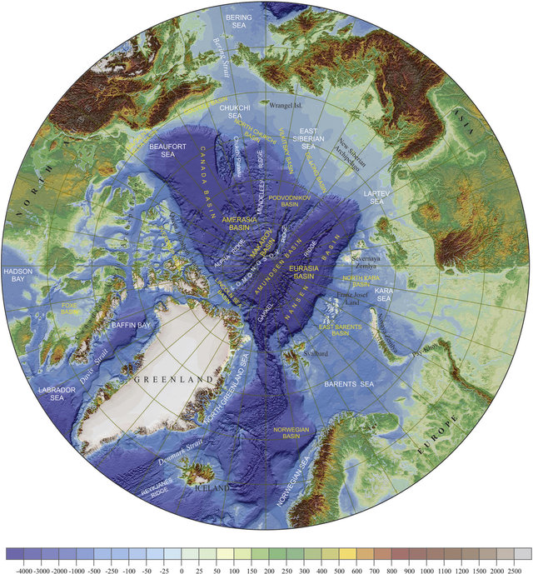
Svalbard-Norwegian archipelago in the High Arctic
Topography and bathymetry map of the Arctic region at 1:5 M scale in
a polar stereographic projection based on ETOPO1 Global Relief Model
(NOAA National Geophysical Data Center, 2011), from Petrov et al., 2016

Slide 4
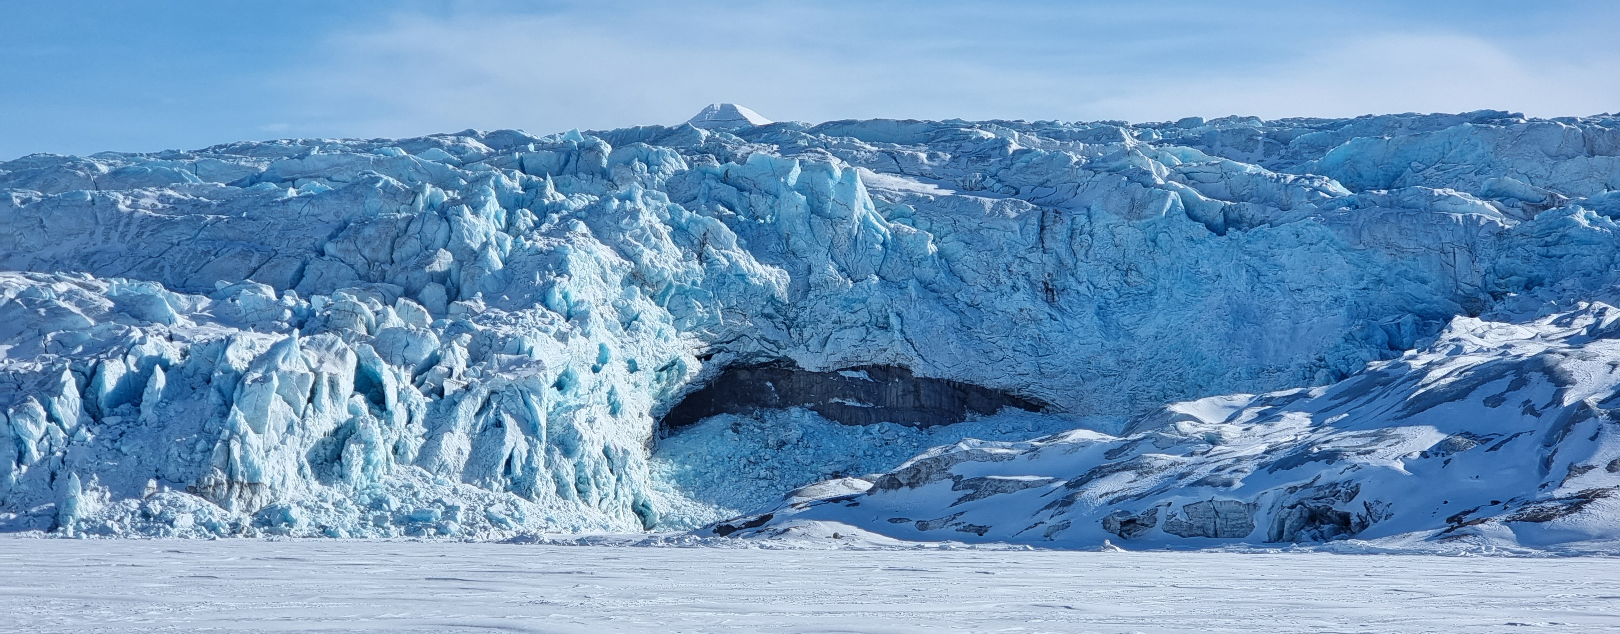
Svalbard-Norwegian archipelago in the High Arctic
< 60% of Svalbard is covered by glaciers

Slide 5
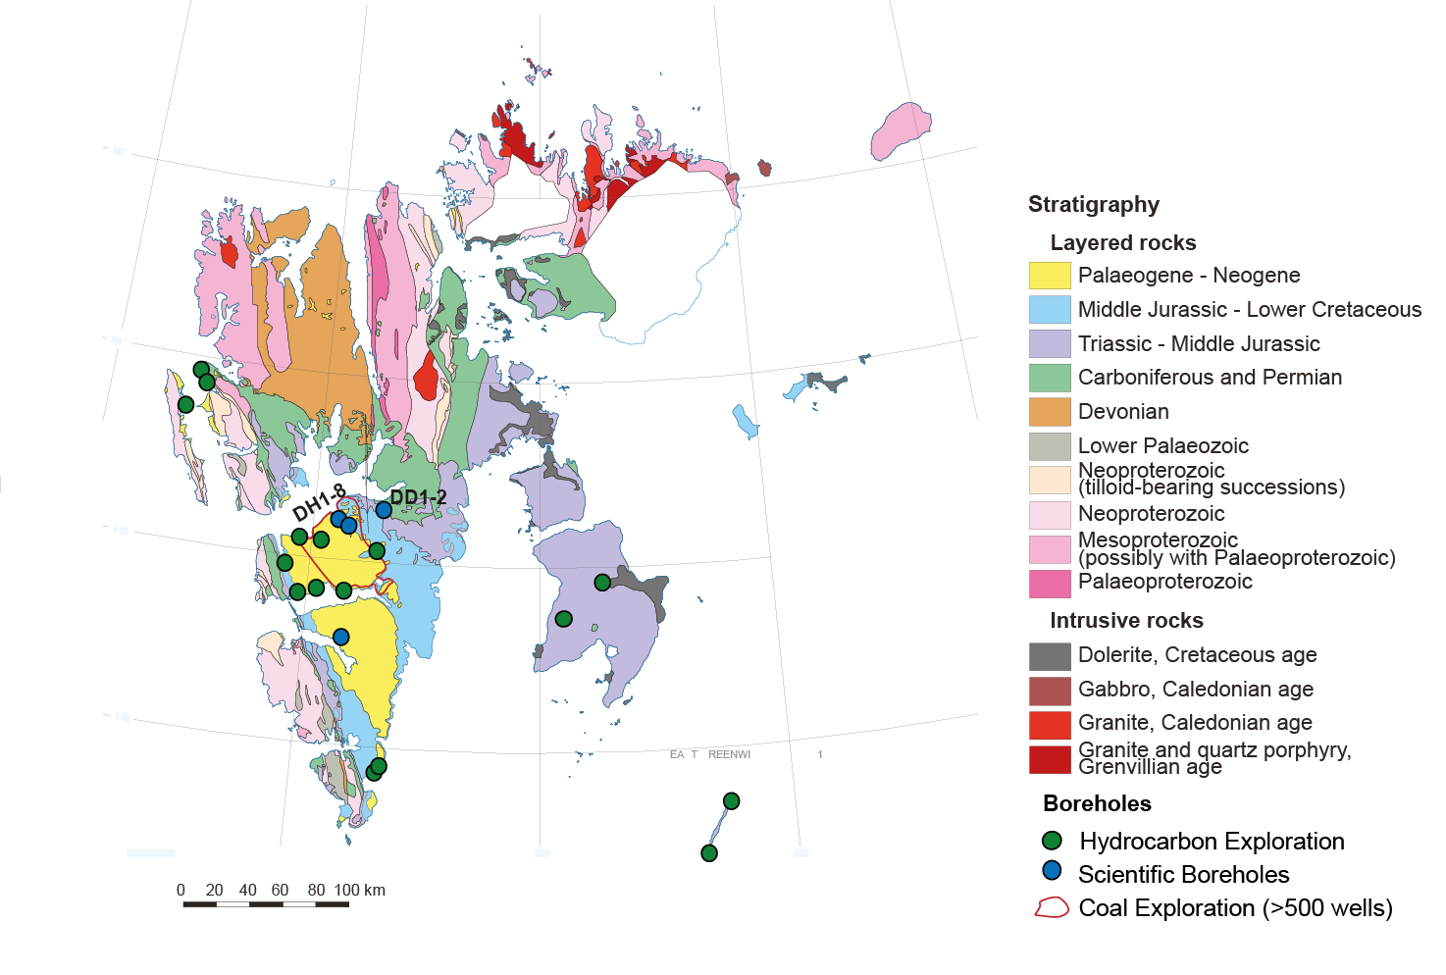

Geological map of Svalbard
Outcrop and borehole data
Modified from Dallmann at al. 2015

Slide 6
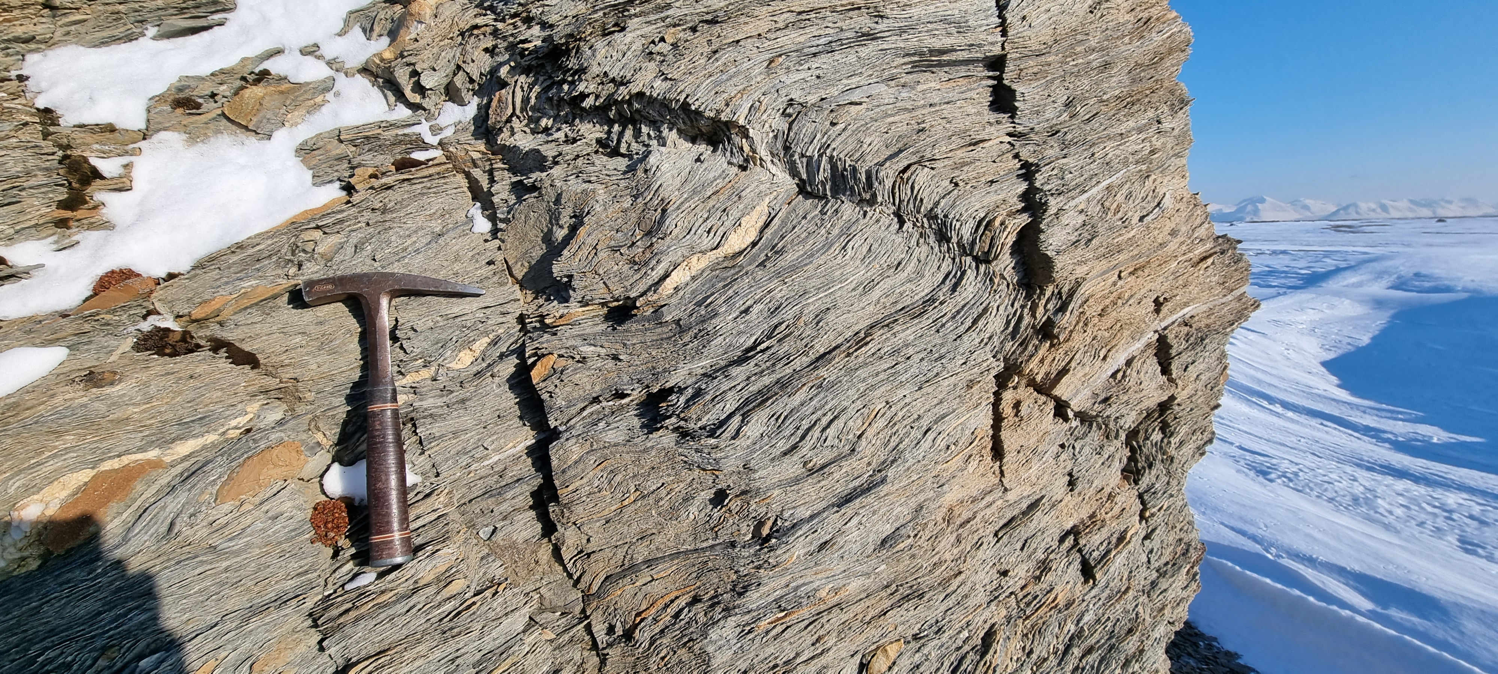
Selected deep-time paleoclimate events preserved in Svalbard
The Late Proterozoic Snowball/Slush Earth glacial conditions
The Great Ordovician Biodiversification Event

Slide 7
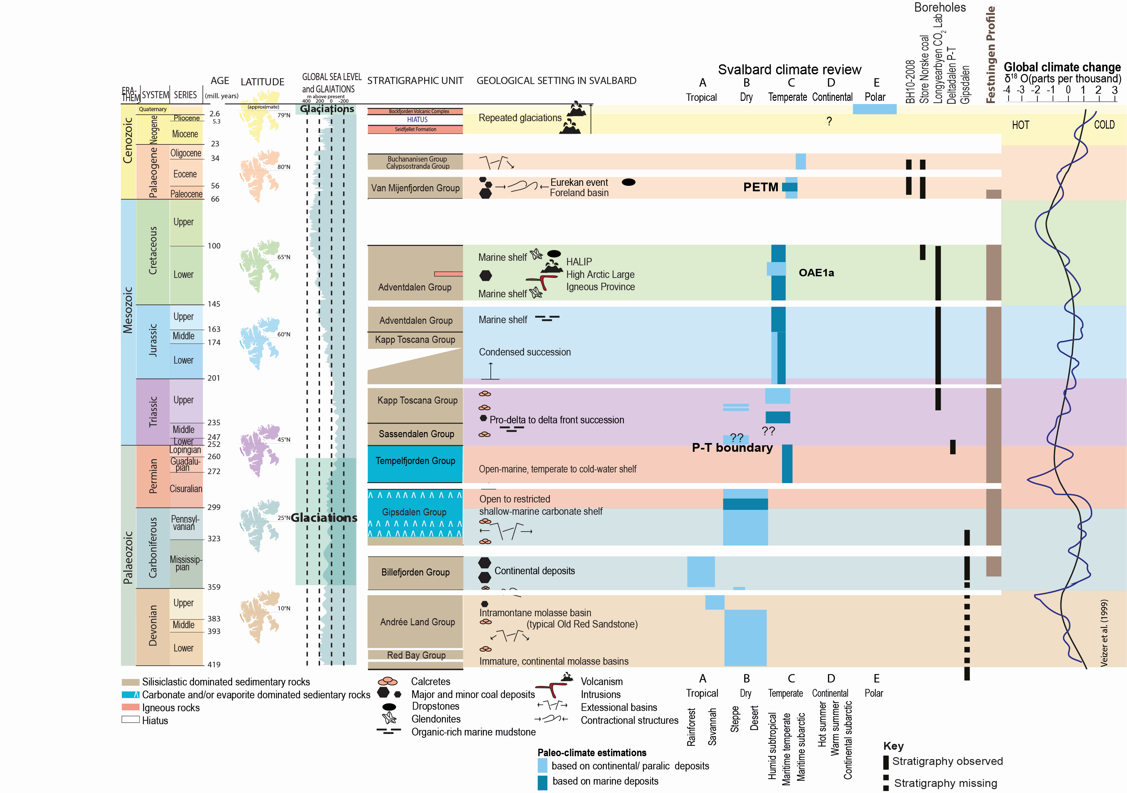
Deep-time paleoclimate archive in High Arctic, Svalbard, Norway
Paleoclimate of Svalbard
Notes:
The Late Proterozoic Snowball Earth glacial conditions
The Late Paleozoic tropical to sub-tropical climates and eustatic sea-level fluctuations caused by the Gondwana glaciations
The End Permian Mass Extinction (EPME)
Mesozoic climate fluctuations, including The Aptian (Early Cretaceous) oceanic anoxic event (OAE1a)
Paleogene warming including the Paleocene-Eocene Thermal maximum (PETM)
Quaternary to Holocene glaciations.

Slide 8
Deep-time paleoclimate archive in High Arctic, Svalbard, Norway
Paleoclimate of Svalbard
Notes:
The Late Proterozoic Snowball Earth glacial conditions
The Late Paleozoic tropical to sub-tropical climates and eustatic sea-level fluctuations caused by the Gondwana glaciations
The End Permian Mass Extinction (EPME)
Mesozoic climate fluctuations, including The Aptian (Early Cretaceous) oceanic anoxic event (OAE1a)
Paleogene warming including the Paleocene-Eocene Thermal maximum (PETM)
Quaternary to Holocene glaciations.

Slide 9
Deep-time paleoclimate archive in High Arctic, Svalbard, Norway
Paleoclimate of Svalbard
Notes:
The Late Proterozoic Snowball Earth glacial conditions
The Late Paleozoic tropical to sub-tropical climates and eustatic sea-level fluctuations caused by the Gondwana glaciations
The End Permian Mass Extinction (EPME)
Mesozoic climate fluctuations, including The Aptian (Early Cretaceous) oceanic anoxic event (OAE1a)
Paleogene warming including the Paleocene-Eocene Thermal maximum (PETM)
Quaternary to Holocene glaciations.

Slide 10
Paleoclimate of Svalbard
Paleocene-Eocene Thermal maximum (PETM)
Paleocene climate fluctuations preserved in coal
The Aptian Oceanic Anoxic Event (OAE1a)
Valanginian Weissert Event
The Volgian Isotopic Carbon Excursion (VOICE)
End Permian Mass Extinction (EPME)
and Dienerian crisis
The Late Paleozoic
tropical to sub-tropical
climate fluctuations
Deep-time paleoclimate classification
from Zhang et al. 2016
Notes:
The Late Proterozoic Snowball Earth glacial conditions
The Late Paleozoic tropical to sub-tropical climates and eustatic sea-level fluctuations caused by the Gondwana glaciations
The End Permian Mass Extinction (EPME)
Mesozoic climate fluctuations, including The Aptian (Early Cretaceous) oceanic anoxic event (OAE1a)
Paleogene warming including the Paleocene-Eocene Thermal maximum (PETM)
Quaternary to Holocene glaciations.

Slide 11
Deep-time paleoclimate archive in High Arctic, Svalbard, Norway
Paleoclimate of Svalbard
Notes:
The Late Proterozoic Snowball Earth glacial conditions
The Late Paleozoic tropical to sub-tropical climates and eustatic sea-level fluctuations caused by the Gondwana glaciations
The End Permian Mass Extinction (EPME)
Mesozoic climate fluctuations, including The Aptian (Early Cretaceous) oceanic anoxic event (OAE1a)
Paleogene warming including the Paleocene-Eocene Thermal maximum (PETM)
Quaternary to Holocene glaciations.

Slide 12
Digital outcrops: Festningen
7 km-long nearly continuous stratigraphic section
of Lower Carboniferous to Cenozoic strata,
spanning nearly 300 million years
Senger et al., 2022

Slide 13
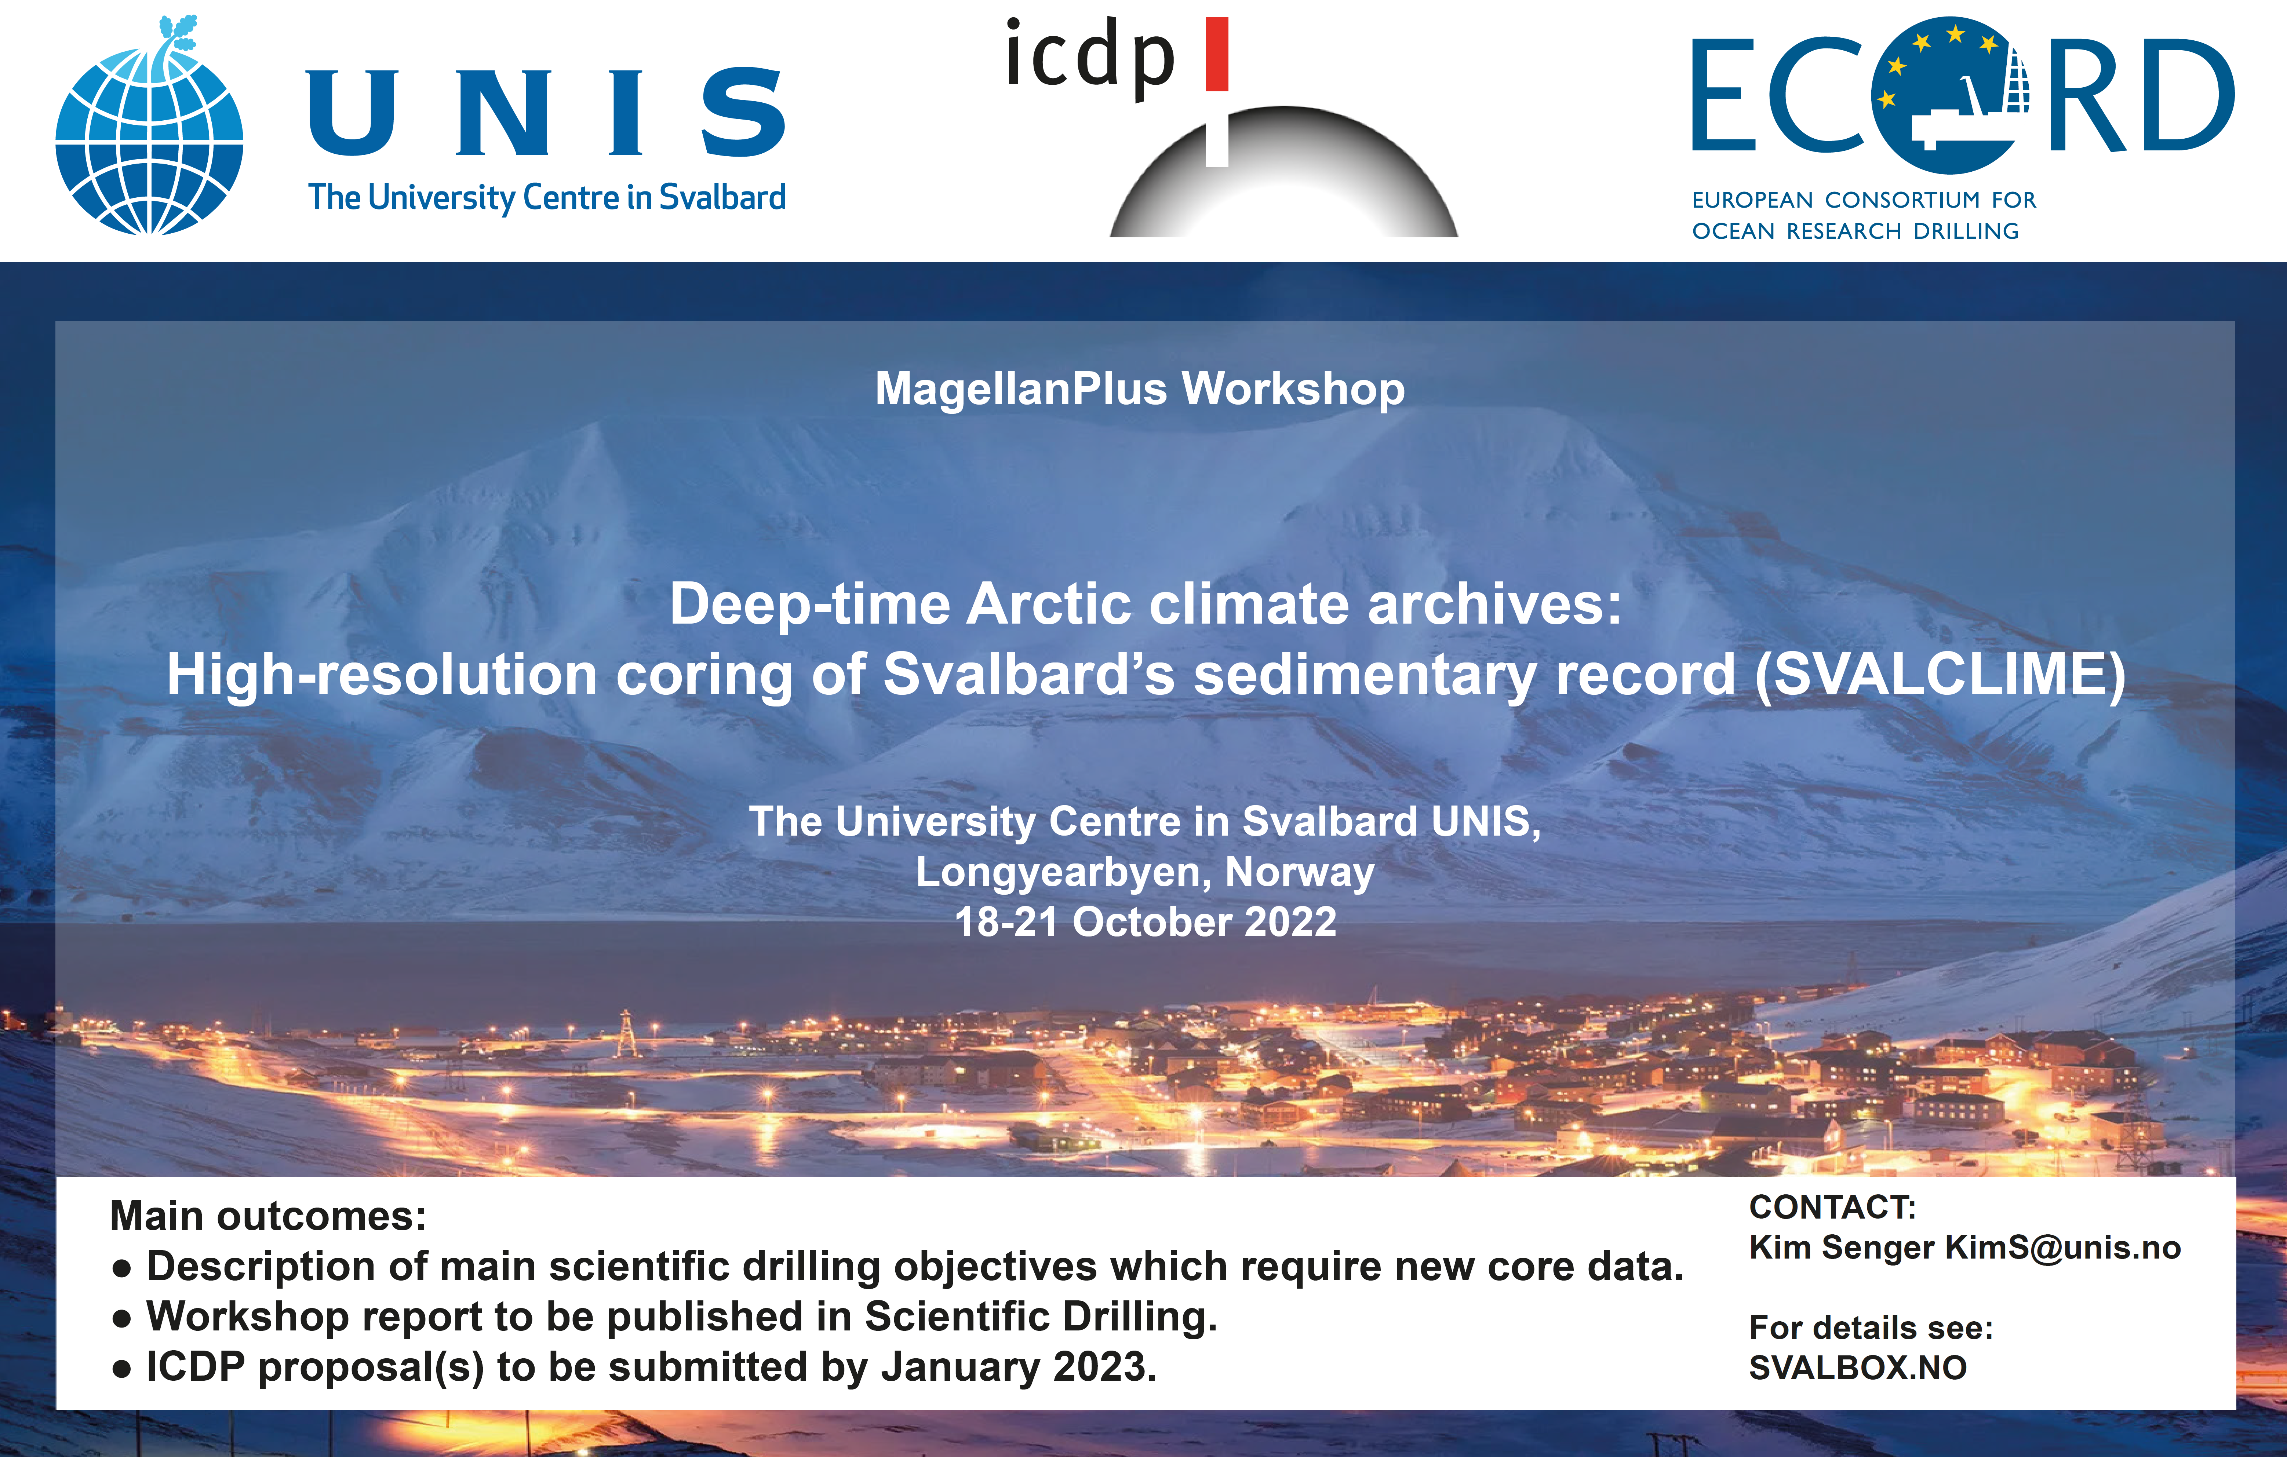

Slide 14
REFERENCES
Sea level curve, glaciations and major geological events modified from Dalmann 2015,
Dallmann, W.: Geoscience Atlas of Svalbard, Norsk Polarinstitutt Rapportserie, p. 148-292, 2015.
Worsley, D.: The post-Caledonian development of Svalbard and the western Barents Sea, Polar Research, 27, 298-317, 10.1111/j.1751-8369.2008.00085.x, 2008.
Global temperatures curve from Veizer et al. (1999; updated online in 2004)
Veizer, J., Ala, D., Azmy, K., Bruckschen, P., Buhl, D., Bruhn, F., Carden, G.A.F., Diener, A., Ebneth, S., Godderis, Y., Jasper, T., Korte, C., Pawellek, F., Podlaha, O.G. & Strauss, H. (1999). 87Sr/86Sr, δ13C and δ18O evolution of Phanerozoic seawater. Chemical geology, 161(1-3), 59-88.
Drilling in Svalbard:
Braathen, A., Bælum, K., Christiansen, H. H., Dahl, T., Eiken, O., Elvebakk, H., Hansen, F., Hanssen, T. H., Jochmann, M., Johansen, T. A., Johnsen, H., Larsen, L., Lie, T., Mertes, J., Mørk, A., Mørk, M. B., Nemec, W. J., Olaussen, S., Oye, V., Rød, K., Titlestad, G. O., Tveranger, J., and Vagle, K.: Longyearbyen CO2 lab of Svalbard, Norway – first assessment of the sedimentary succession for CO2 storage, Norwegian Journal of Geology, 92, 353–376, 2012.
Olaussen, S., Senger, K., Braathen, A., Grundvåg, S. A., and Mørk, A.: You learn as long as you drill; research synthesis from the Longyearbyen CO2 Laboratory, Svalbard, Norway, Norwegian Journal of Geology, 99, 157-187, https://dx.doi.org/10.17850/njg008, 2019.
Senger, K., Tveranger, J., Braathen, A., Olaussen, S., Ogata, K., and Larsen, L.: CO2 storage resource estimates in unconventional reservoirs: insights from a pilot-sized storage site in Svalbard, Arctic Norway, Environmental Earth Sciences, 73, 3987–4009, http://dx.doi.org/10.1007/s12665-014-3684-9, 2015.
Senger, K., Brugmans, P., Grundvåg, S.-A., Jochmann, M., Nøttvedt, A., Olaussen, S., Skotte, A., and Smyrak-Sikora, A.: Petroleum exploration and research drilling onshore Svalbard: a historical perspective, Norwegian Journal of Geology, 2019.
REFERENCES

Slide 15
UPPER PALEOZOIC
Ahlborn, M., and Stemmerik, L.: Depositional evolution of the Upper Carboniferous-Lower Permian Wordiekammen carbonate platform, Nordfjorden High, central Spitsbergen, Arctic Norway, NORWEGIAN JOURNAL OF GEOLOGY, 95, 91-126, 2015.
Berry, C. M., and Marshall, J. E.: Lycopsid forests in the early Late Devonian paleoequatorial zone of Svalbard, Geology, 43, 1043-1046, 2015.
Blomeier et al. (2009) – Late Carboniferous carbonates and Gondwana eustatic cycles
Blomeier, D., Scheibner, C., and Forke, H.: Facies arrangement and cyclostratigraphic architecture of a shallow-marine, warm-water carbonate platform: the Late Carboniferous Ny Friesland Platform in eastern Spitsbergen (Pyefjellet Beds, Wordiekammen Formation, Gipsdalen Group), Facies, 55, 291-324, 2009.
Blomeier et al. (2011) - Permian change from warm/arid to cool climate
Blomeier, D., Dustira, A., Forke, H., and Scheibner, C.: Environmental change in the Early Permian of NE Svalbard: from a warm-water carbonate platform (Gipshuken Formation) to a temperate, mixed siliciclastic-carbonate ramp (Kapp Starostin Formation), Facies, 57, 493-523, 2011.
Blomeier, D., Dustira, A. M., Forke, H., and Scheibner, C.: Facies analysis and depositional environments of a storm-dominated, temperate to cold, mixed siliceous-carbonate ramp: the Permian Kapp Starostin Formation in NE Svalbard, Norwegian Journal of Geology/Norsk Geologisk Forening, 93, 2013.
Bond et al. (2015) - Mid Permian mass extinction
Bond, D. P., Wignall, P. B., Joachimski, M. M., Sun, Y., Savov, I., Grasby, S. E., Beauchamp, B., and Blomeier, D. P.: An abrupt extinction in the Middle Permian (Capitanian) of the Boreal Realm (Spitsbergen) and its link to anoxia and acidification, GSA Bulletin, 127, 1411-1421, 2015.
Hanken and Nielsen (2013) - L.Carb.-E.Perm carbonate build-ups and climate variations
Hanken, N.-M., and Nielsen, J. K.: Upper Carboniferous–Lower Permian Palaeoaplysina build-ups on Svalbard: the influence of climate, salinity and sea-level, Geological Society, London, Special Publications, 376, 269-305, 2013.
Hüneke et al. (2001) - L.Carb.-E.Perm carbonates and climate variations
Hüneke, H., Joachimski, M., Buggisch, W., and Lützner, H.: Marine carbonate facies in response to climate and nutrient level: the Upper Carboniferous and Permian of Central Spitsbergen (Svalbard), Facies, 45, 93-135, 2001.
Olaussen, S., Stemmerik, L., Sorento Drøhse , T., Johannessen, E. P. & Smyrak-Sikora, A. Carboniferous Permian climate changes as recorded in Svalbard. Conference abstract, NGF
Smyrak-Sikora, A., Johannessen, E. P., Olaussen, S., Sandal, G., and Braathen, A. Sedimentary architecture during Carboniferous rift initiation–the arid Billefjorden Trough, Svalbard, Journal of the Geological Society, 176, 225-252, 2019.
Smyrak‐Sikora, A., Nicolaisen, J. B., Braathen, A., Johannessen, E. P., Olaussen, S., & Stemmerik, L. Impact of growth faults on mixed siliciclastic‐carbonate‐evaporite deposits during rift climax and reorganisation‐Billefjorden Trough, Svalbard, Norway. Basin Research 2021.
Sorento, T., Olaussen, S., and Stemmerik, L.: Controls on deposition of shallow marine carbonates and evaporites–lower Permian Gipshuken Formation, central Spitsbergen, Arctic Norway, Sedimentology, 67, 207-238, 2020.

Slide 16
MESOZOIC
Grundvåg, S., Jelby, M. E., Sliwinska, K. K., Nøhr-Hansen, H., Aadland, T., Sandvik, S. E., Tennvassås, I., Engen, T., and Olaussen, S.: Sedimentology and palynology of the Lower Cretaceous succession of central Spitsbergen: integration of subsurface and outcrop data, Norwegian Journal of Geology, 2019.
Hurum et al. (2016) - Barremian dinosaurs and climate
Hurum, J. H., Druckenmiller, P. S., Hammer, Ø., Nakrem, H. A., and Olaussen, S.: The theropod that wasn't: an ornithopod tracksite from the Helvetiafjellet Formation (Lower Cretaceous) of Boltodden, Svalbard, Geological Society, London, Special Publications, 434, 189-206, 2016.
Jelby et al. (2020) - Jr-Cr boundary and isotope signals
Jelby, M. E., Śliwińska, K. K., Koevoets, M. J., Alsen, P., Vickers, M. L., Olaussen, S., and Stemmerik, L.: Arctic reappraisal of global carbon-cycle dynamics across the Jurassic–Cretaceous boundary and Valanginian Weissert Event, Palaeogeography, Palaeoclimatology, Palaeoecology, 555, 109847, 2020.
Lord, G. S., Johansen, S. K., Støen, S. J., and Mørk, A.: Facies development of the Upper Triassic succession on Barentsøya, Wilhelmøya and NE Spitsbergen, Svalbard, Norwegian Journal of Geology/Norsk Geologisk Forening, 97, 2017
Midtkandal et al. (2016) - Aptian global anoxia
Midtkandal, I., Svensen, H. H., Planke, S., Corfu, F., Polteau, S., Torsvik, T. H., Faleide, J. I., Grundvåg, S.-A., Selnes, H., and Kürschner, W.: The Aptian (Early Cretaceous) oceanic anoxic event (OAE1a) in Svalbard, Barents Sea, and the absolute age of the Barremian-Aptian boundary, Palaeogeography, Palaeoclimatology, Palaeoecology, 463, 126-135, 2016.
Klausen et al. (2020) - Late Triassic delta and dinosaurs
Klausen, T. G., Nyberg, B., and Helland-Hansen, W.: The largest delta plain in Earth’s history, Geology, 47, 470-474, 2019.
Klausen, T. G., Paterson, N. W., and Benton, M. J.: Geological control on dinosaurs’ rise to dominance: Late Triassic ecosystem stress by relative sea level change, Terra Nova, 32, 434-441, 2020.
Koevoets et al. (2016) - Jurassic isotope excursions
Koevoets, M., Hammer, Ø., and Little, C. T.: Palaeoecology and palaeoenvironments of the Middle Jurassic to lowermost Cretaceous Agardhfjellet Formation (Bathonian-Ryazanian), Spitsbergen, Svalbard, Norwegian Journal of Geology, 99, 2019.
Koevoets, M. J., Abay, T. B., Hammer, Ø., and Olaussen, S.: High-resolution organic carbon–isotope stratigraphy of the Middle Jurassic–Lower Cretaceous Agardhfjellet Formation of central Spitsbergen, Svalbard, Palaeogeography, Palaeoclimatology, Palaeoecology, 449, 266-274, 10.1016/j.palaeo.2016.02.029, 2016.
Paterson and Mangerud (2020) Mid-Late Triassic palynology and climate
Paterson, N. W., and Mangerud, G.: A revised palynozonation for the Middle–Upper Triassic (Anisian–Rhaetian) Series of the Norwegian Arctic, Geological Magazine, 157, 1568-1592, 2020.
Pott (2012) - Late Triassic paleo-flora
Pott, C.: The Upper Triassic flora of Svalbard, Acta Palaeontologica Polonica, 59, 709-740, 2012.
Rismyhr, B., Bjærke, T., Olaussen, S., Mulrooney, M. J., and Senger, K.: Facies, palynostratigraphy and sequence stratigraphy of the Wilhelmøya Subgroup (Upper Triassic–Middle Jurassic) in western central Spitsbergen, Svalbard, Norsk Geologisk Tidsskrift, 99, 35-64, 2018.
Rodríguez-Tovar, F.J., Dorador, J., Zuchuat, V., and Planke, S. (submitted). Response of microbenthic trace maker community to the End-Permian Mass Extinction in central Spitsbergen, Svalbard. Submitted to Palaeogeography, Palaeoclimatology, Palaeoecology
Wignall et al. (2016) - Early Triassic anoxia
Wignall, P. B., Bond, D. P., Sun, Y., Grasby, S. E., Beauchamp, B., Joachimski, M. M., and Blomeier, D. P.: Ultra-shallow-marine anoxia in an Early Triassic shallow-marine clastic ramp (Spitsbergen) and the suppression of benthic radiation, Geological Magazine, 153, 316-331, 2016.
Vickers et al. (2016) - Early Cretaceous climate
Vickers, M. L., Price, G. D., Jerrett, R. M., and Watkinson, M.: Stratigraphic and geochemical expression of Barremian–Aptian global climate change in Arctic Svalbard, Geosphere, 12, 1594-1605, 2016.
Zuchuat et al. (2020) - PT boundary
Zuchuat, V., Sleveland, A., Twitchett, R., Svensen, H., Turner, H., Augland, L., Jones, M., Hammer, Ø., Hauksson, B., and Haflidason, H.: A new high-resolution stratigraphic and palaeoenvironmental record spanning the End-Permian Mass Extinction and its aftermath in central Spitsbergen, Svalbard, Palaeogeography, Palaeoclimatology, Palaeoecology, 109732, 2020.

Slide 17
PALEOGENE
Dypvik et al. (2011) - PETM
Dypvik, H., Riber, L., Burca, F., Rüther, D., Jargvoll, D., Nagy, J., and Jochmann, M.: The Paleocene–Eocene thermal maximum (PETM) in Svalbard—clay mineral and geochemical signals, Palaeogeography, Palaeoclimatology, Palaeoecology, 302, 156-169, 2011.
Greenwood et al. (2010) - Eocene Arctic rainforest
Greenwood, D. R., Basinger, J. F., and Smith, R. Y.: How wet was the Arctic Eocene rain forest? Estimates of precipitation from Paleogene Arctic macrofloras, Geology, 38, 15-18, 2010.
Harding et al. (2011) – PETM
Harding, I. C., Charles, A. J., Marshall, J. E., Pälike, H., Roberts, A. P., Wilson, P. A., Jarvis, E., Thorne, R., Morris, E., and Moremon, R.: Sea-level and salinity fluctuations during the Paleocene–Eocene thermal maximum in Arctic Spitsbergen, Earth and Planetary Science Letters, 303, 97-107, 2011.
Eocene deposition
Helland‐Hansen, W., and Grundvåg, S. A.: The Svalbard Eocene‐Oligocene (?) Central Basin succession: Sedimentation patterns and controls, Basin Research, 33, 729-753, 2021.
Jochmann, M. M; Firkanten Formation
Jochmann, M. M., Augland, L. E., Lenz, O., Bieg, G., Haugen, T., Grundvåg, S. A., Midtkandal, I., Dolezych M. & Hjálmarsdóttir, H. R. (2020). Sylfjellet: a new outcrop of the Paleogene Van Mijenfjorden Group in Svalbard. arktos, 6(1), 17-38.
Marshall (2013), Firnaknten Formation coal.
Marshall, C (2013). Palaeogeographic and Economic Development of the Coal Bearing Todalen Member, Spitsbergen PhD Thesis, University of Nottingham-
Spielhagen and Tripati (2009) - Paleocene climate fluctuations
Spielhagen, R. F., and Tripati, A.: Evidence from Svalbard for near-freezing temperatures and climate oscillations in the Arctic during the Paleocene and Eocene, Palaeogeography, Palaeoclimatology, Palaeoecology, 278, 48-56, 2009.
Uhl et al. (2007) - Fossil leaves in the Eocene of Spitsbergen
Uhl, D., Traiser, C., Griesser, U., and Denk, T.: Fossil leaves as palaeoclimate proxies in the Palaeogene of Spitsbergen (Svalbard), ACTA PALAEOBOTANICA-KRAKOW-, 47, 89, 2007.

