Slide 1
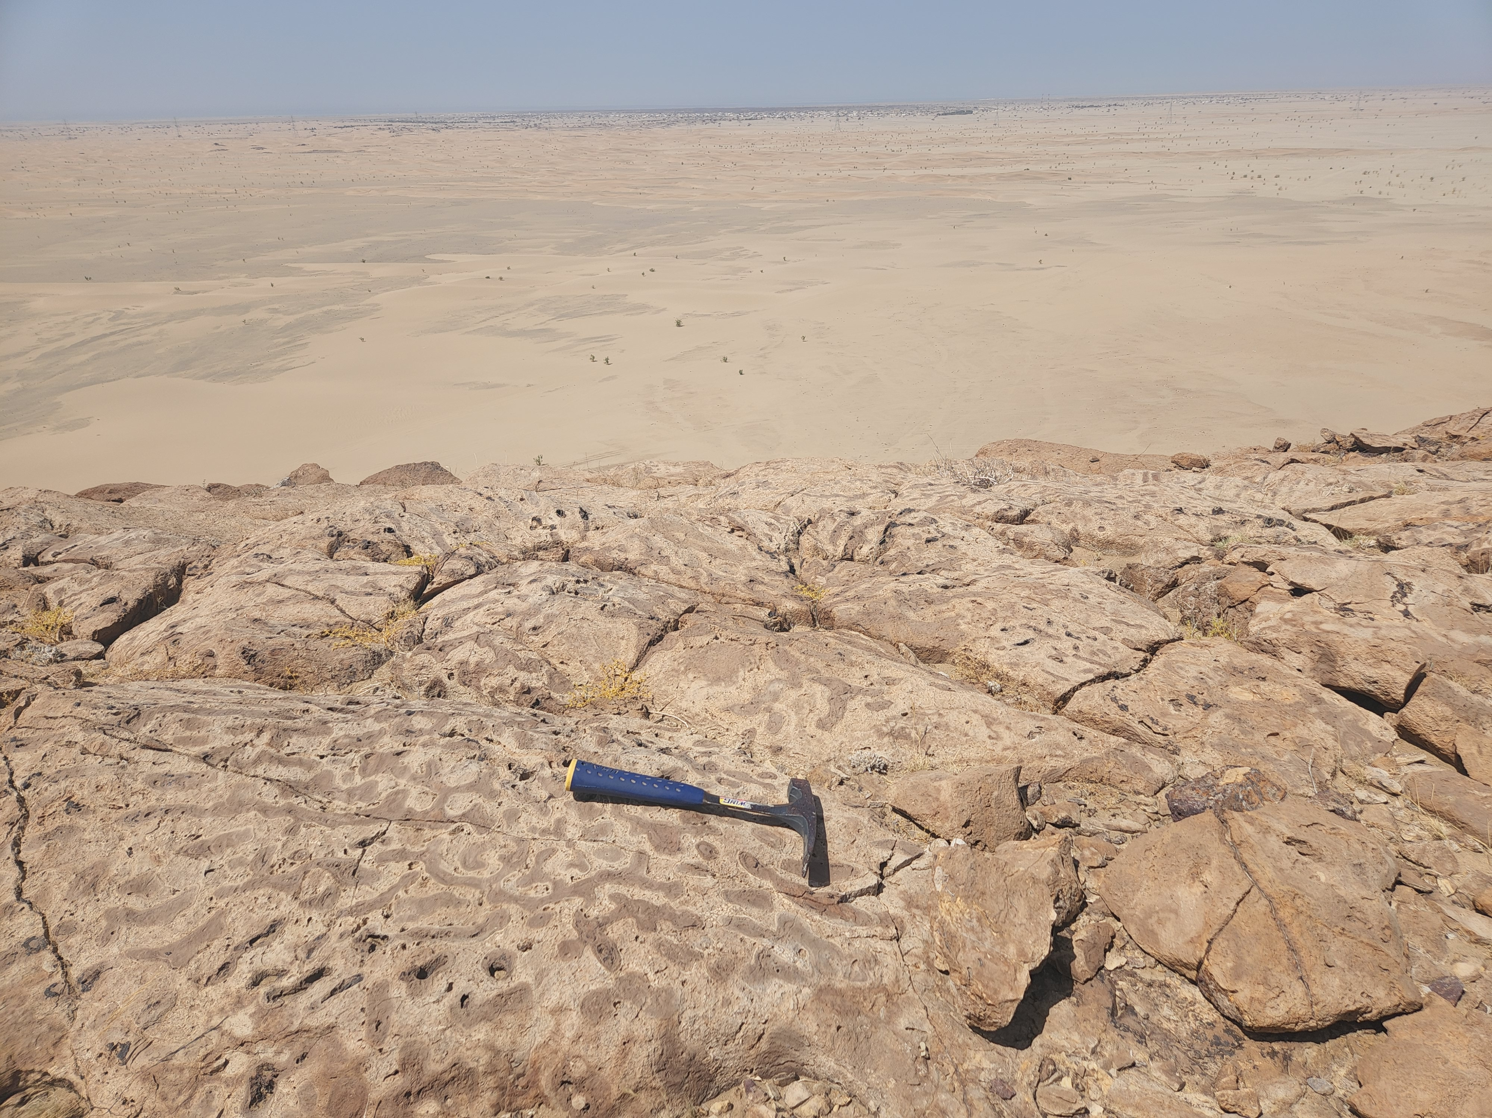



Tectonic control on the reef evolution in the Red Sea rift basin
Tihana Pensa
Abdulkader Afifi, Antoine Delaunay, Guillaume Baby
EGU General Assembly
23 May 2022, Vienna, Austria

Slide 2
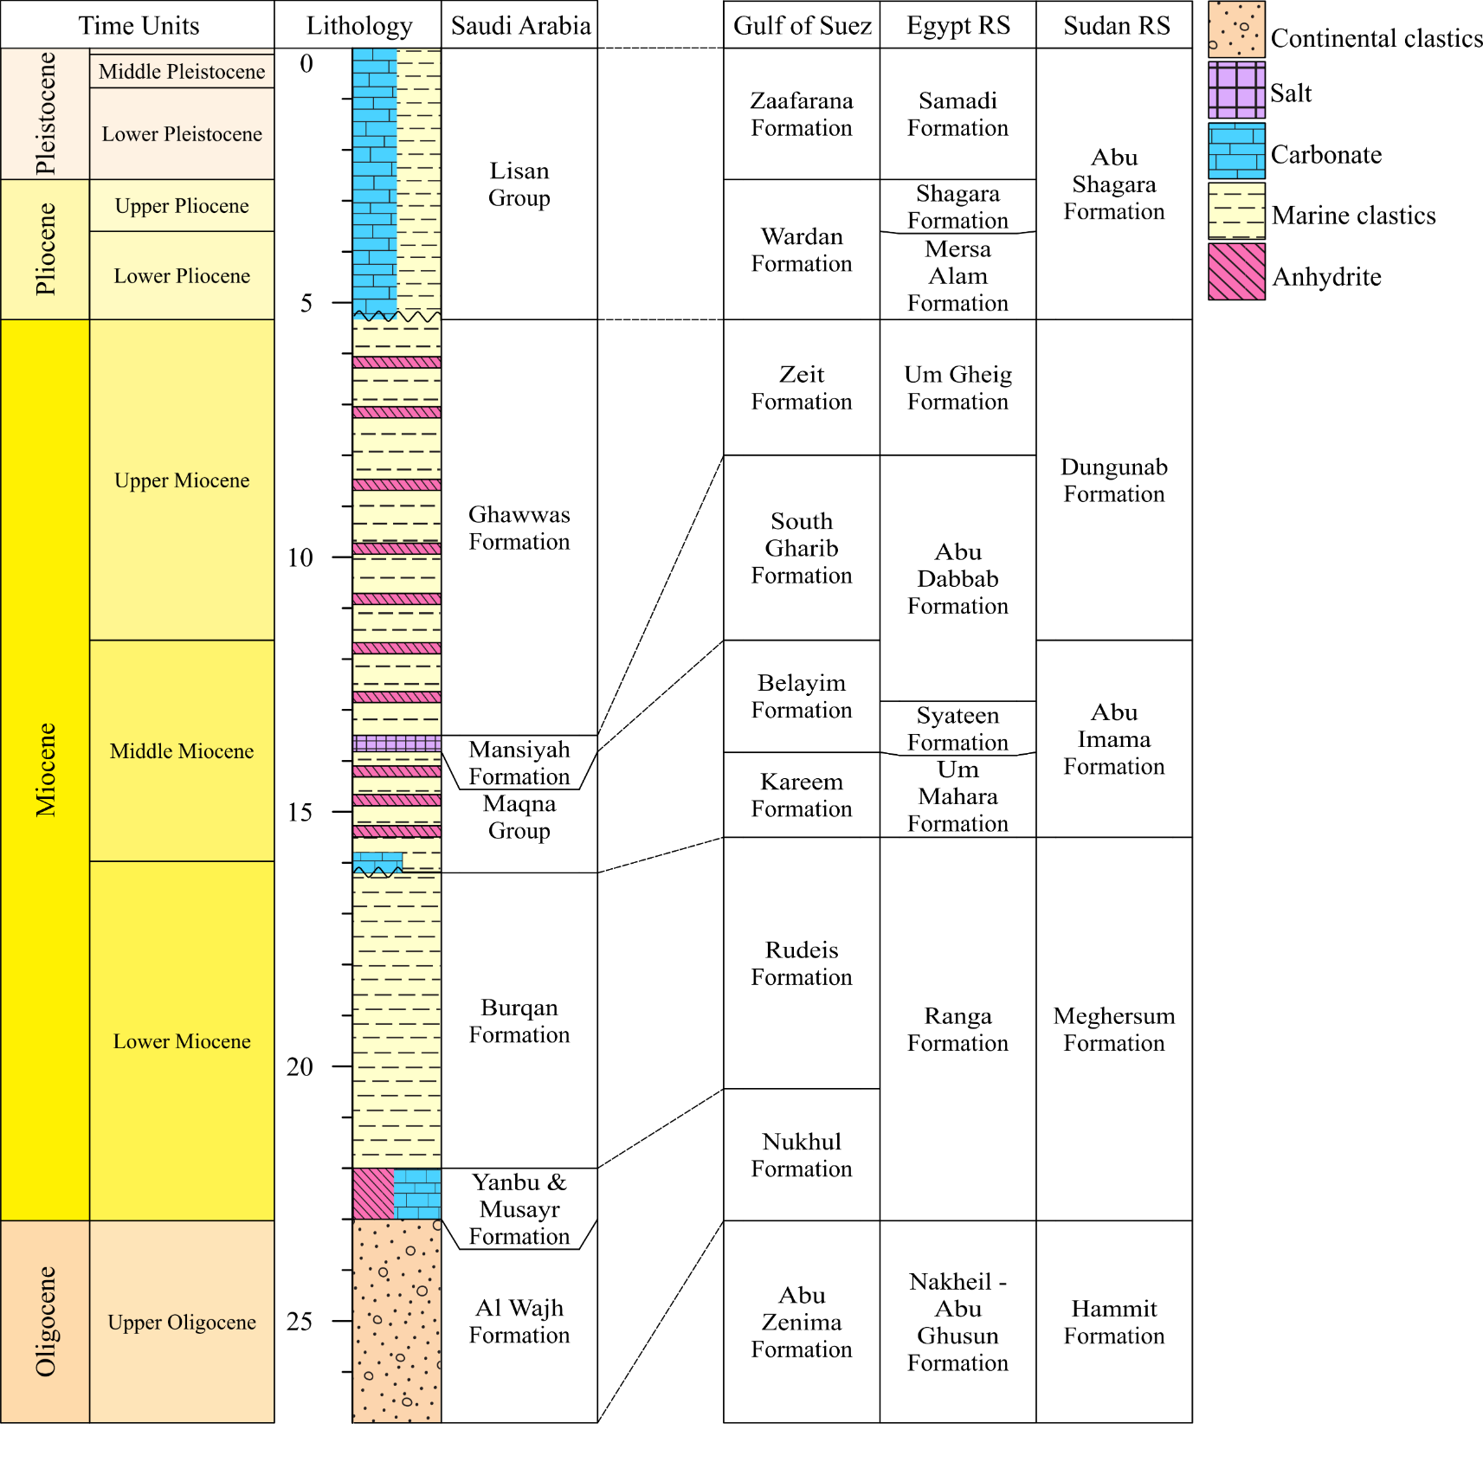

Slide 3
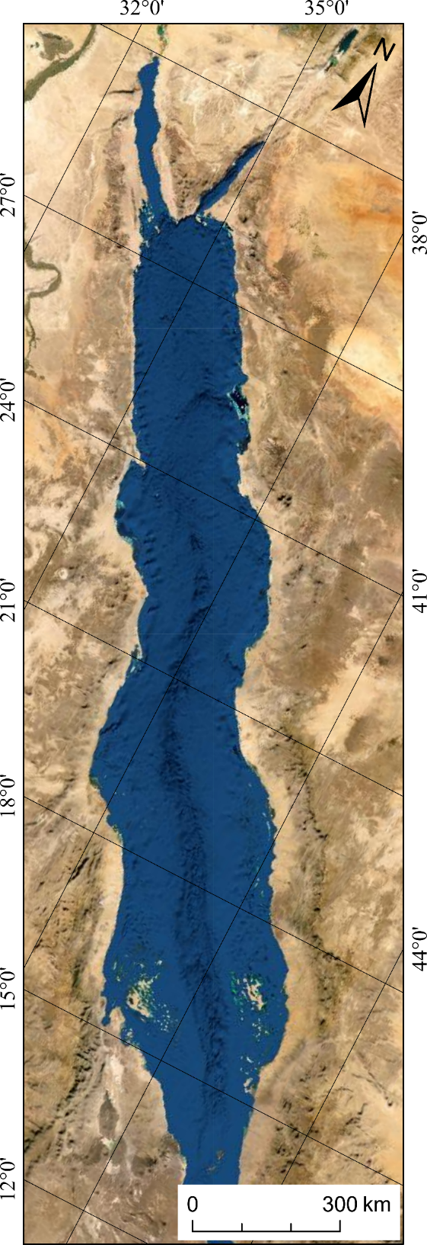
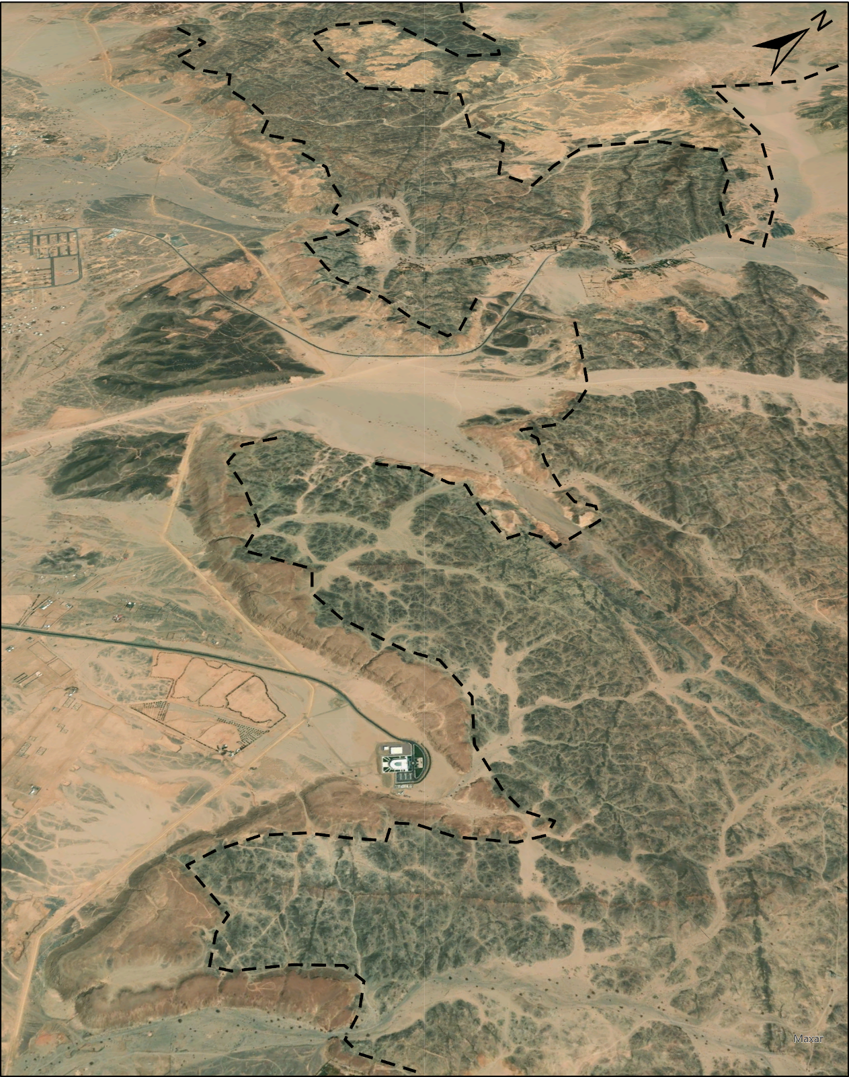
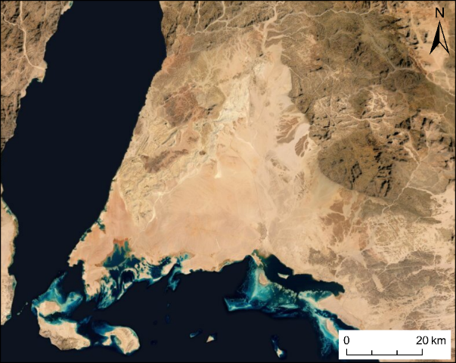
Back reef
Basement
Forereef

Slide 4
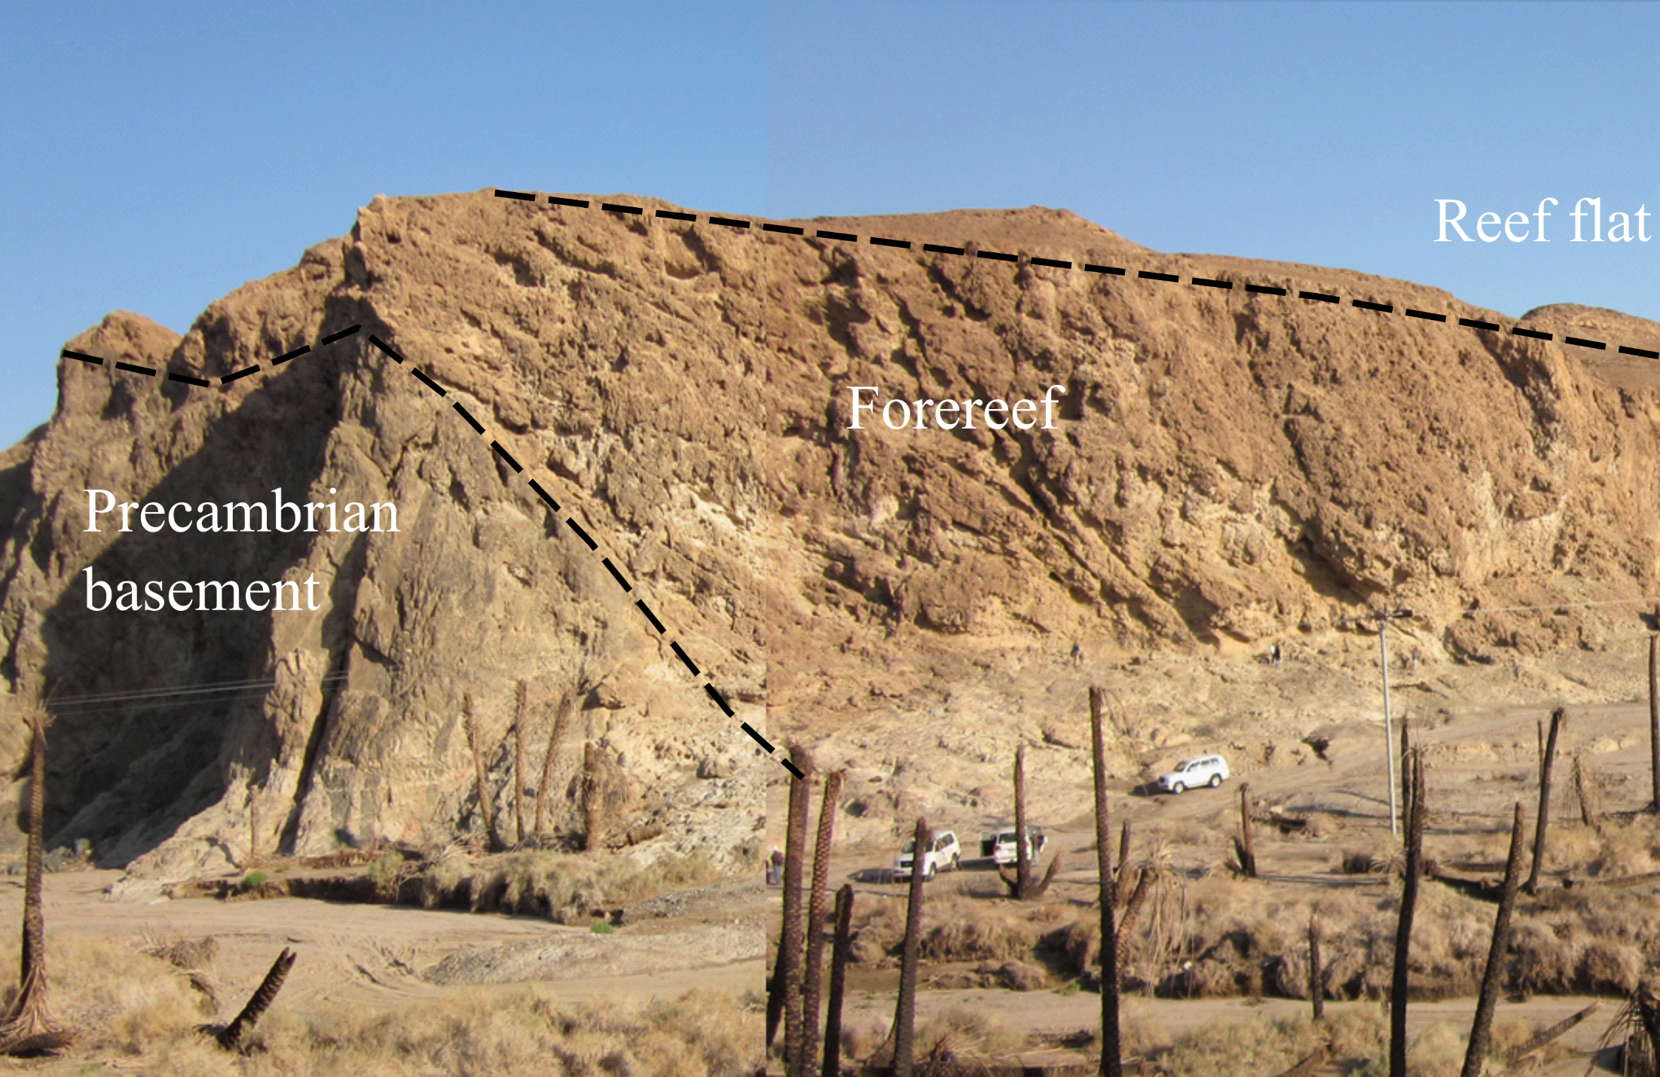

Slide 5
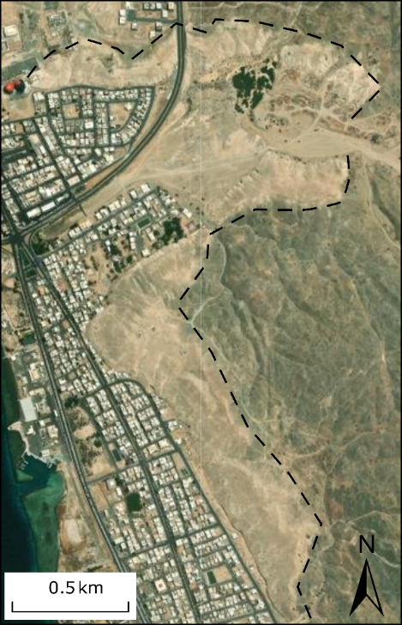
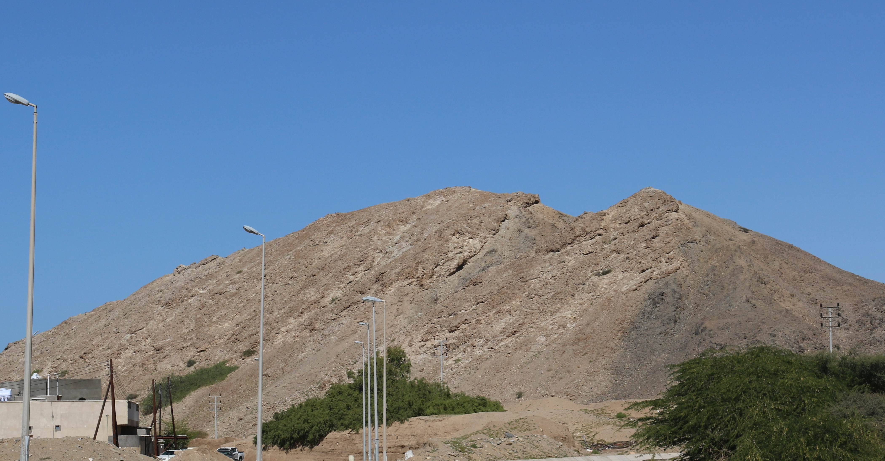
Basement
Fore-reef

Slide 6
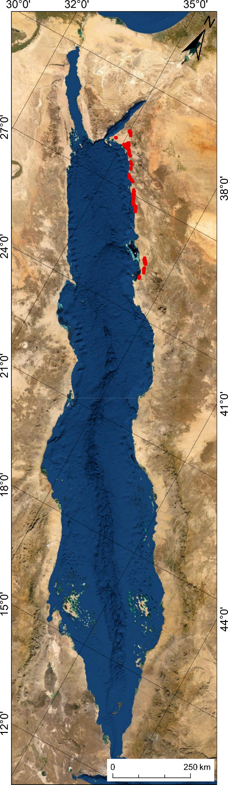

Slide 7
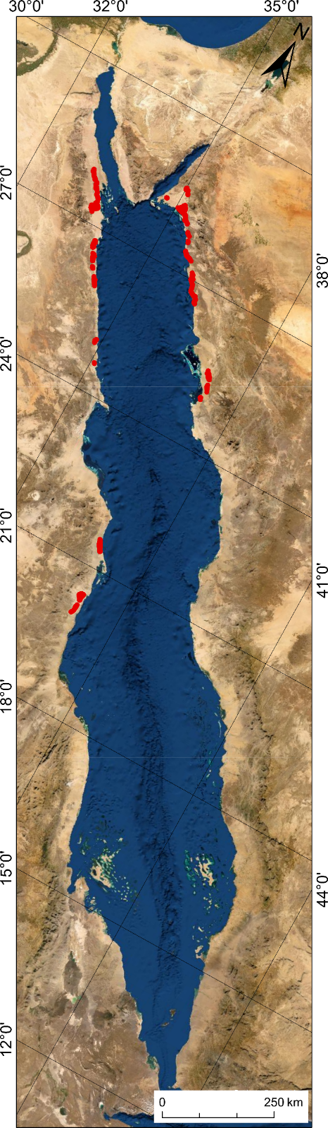

Slide 8
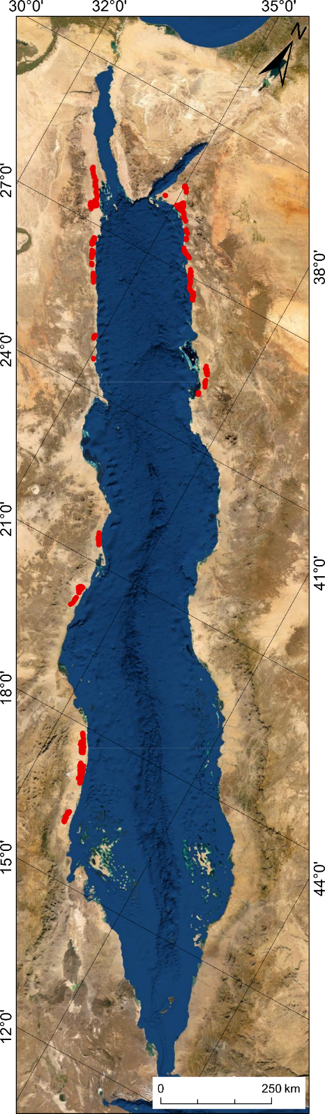

Slide 9
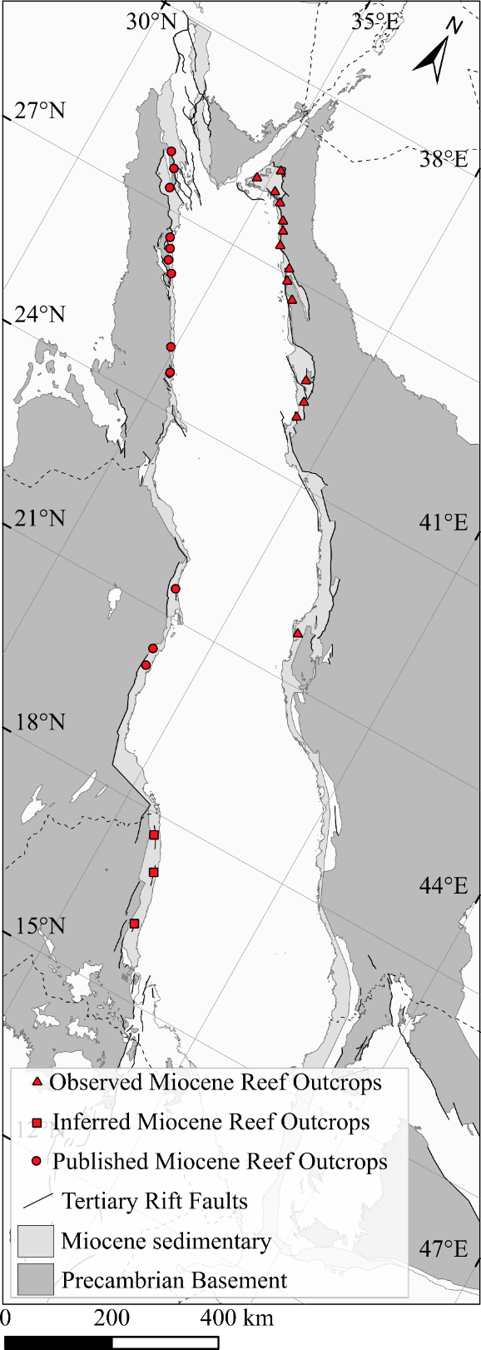

Slide 10
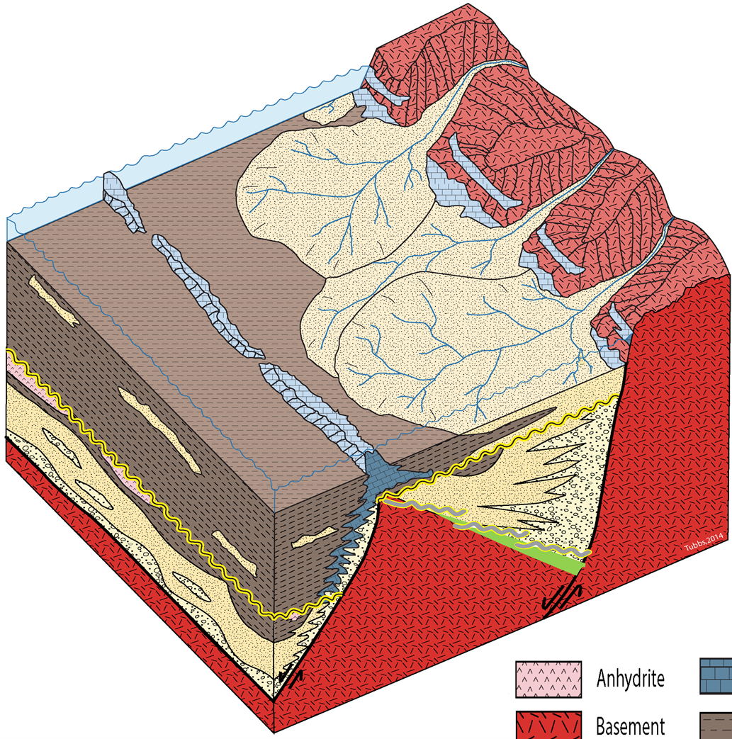
Reef
Syn-rift
Tubbs, 2014
Precambrian basement
Fore-reef
Pre-rift

