Slide 1




Advancing seismic processing of the Skaftá jökulhlaup in 2015, Iceland
Thoralf Dietrich, Eva P.S. Eibl, Fabian Lindner, Sebastian Heimann,
With thanks to: Finnur Pálsson, Eyjólfur Magnusson, Daniel Binder
Thoralf.Dietrich@uni-potsdam.de
<number>
EGU, 25.05.2022
Glacial/Environmental seismology
<number>

Slide 2
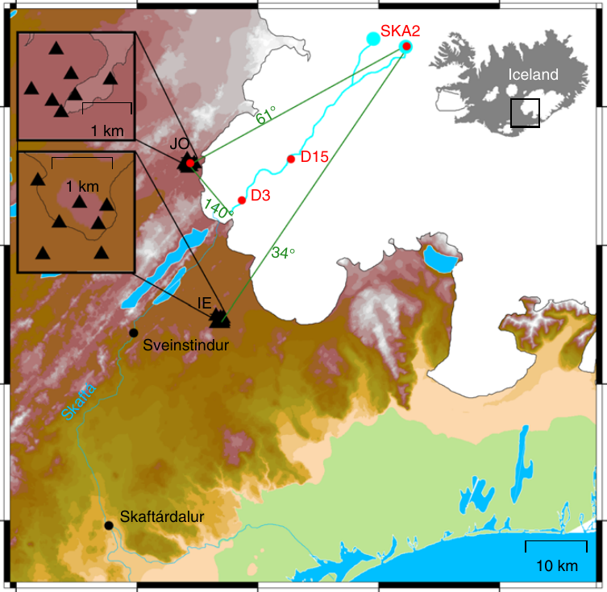
Tracking floods subglacially with seismic arrays
JO: Saw flood
Skaftá cauldrons in W-Vatnajökull (S-Iceland) drain every 1-5 years
2 Arrays (IE and JO) collected data during a flood from Sep. 30 – Oct. 2 2015
With fk-analysis, only JO array observed the flood
Eastern Lake
Terminus
IE: blind
Fig. 1, modified. from Eibl et al, 2020 (Nat. Comm.)
EGU, 25.05.2022
Glacial/Environmental seismology
Thoralf.Dietrich@uni-potsdam.de
<number>

Slide 3
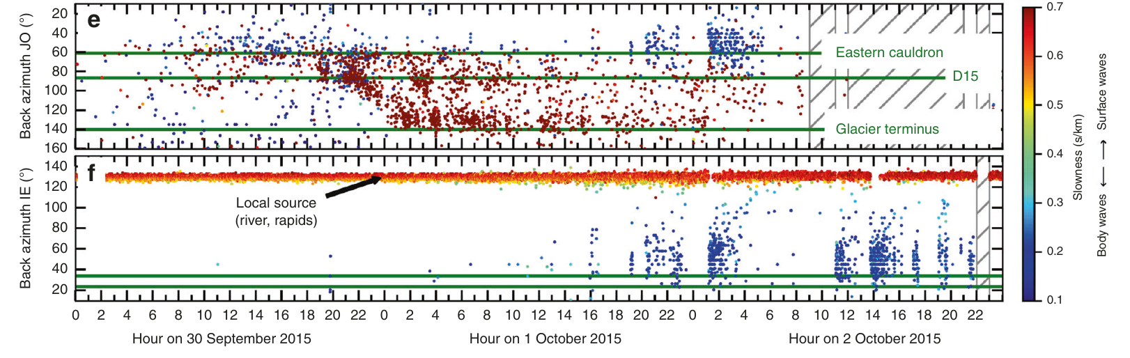
Tracking the flood: fk-analysis
JO
IE
Flood starts
Flood reaches terminus
Fig. 2, modified. from Eibl et al, 2020 (Nat. Comm.)
EGU, 25.05.2022
Glacial/Environmental seismology
Thoralf.Dietrich@uni-potsdam.de
<number>

Slide 4
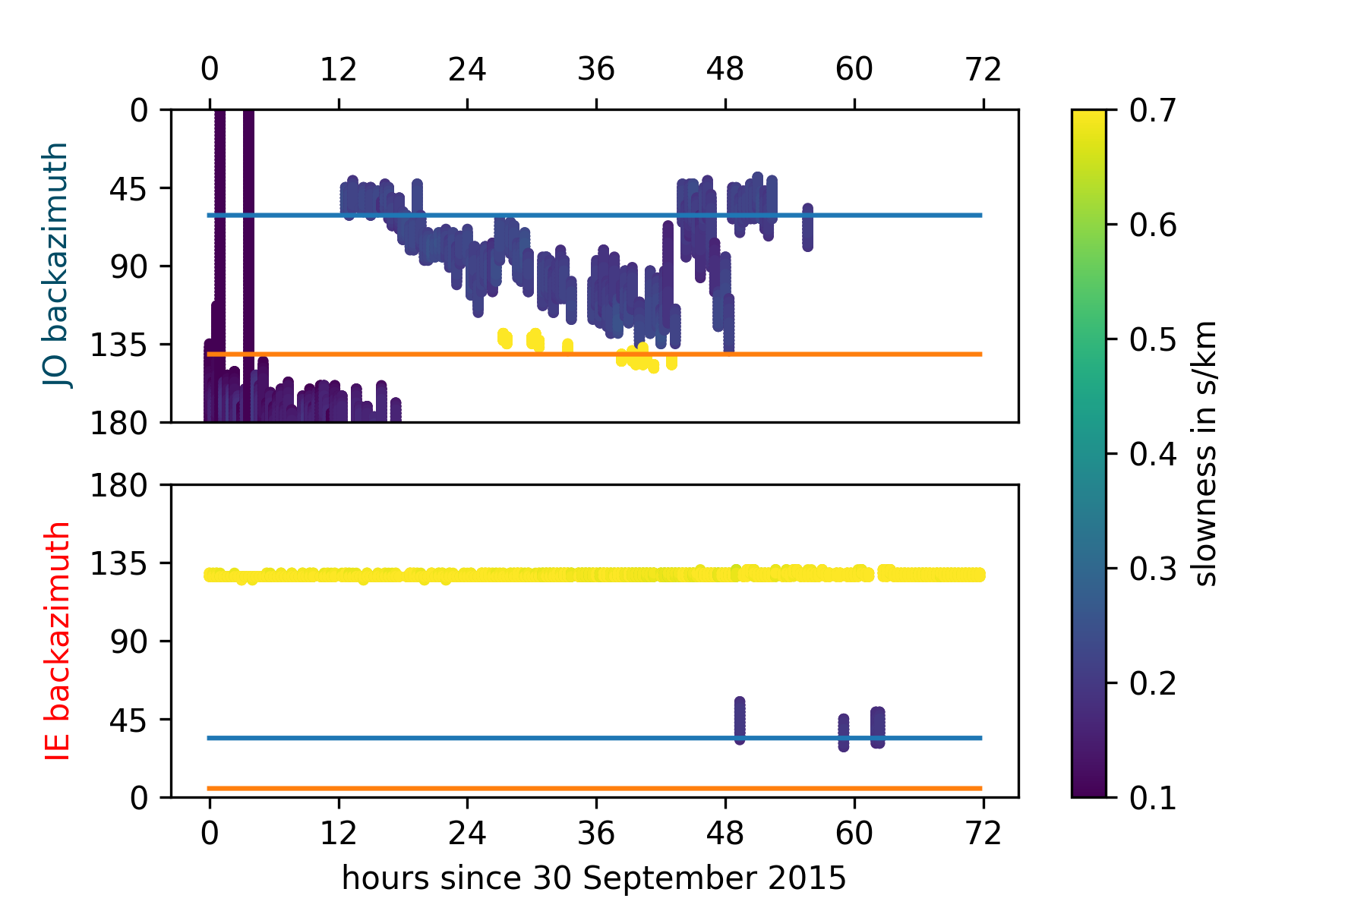
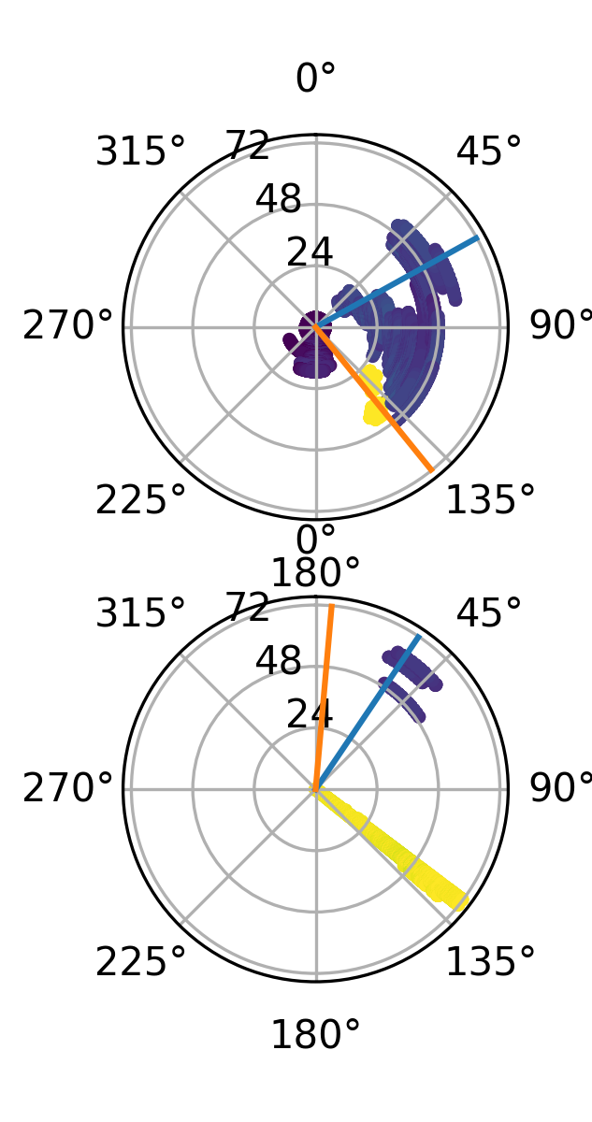
Tracking the flood: match-field processing (MFP)
Eastern Lake
Eastern Lake
Terminus
Terminus
EasternLake
Eastern Lake
Terminus
Processed with code by Fabian Lindner and Sebastian Heimann,
Method: Corciulo et al, 2012 (Geophysics)
(Code: https://github.com/fablindner/glseis/blob/master/array_analysis.py and pyrocko.org/)
EGU, 25.05.2022
Glacial/Environmental seismology
Thoralf.Dietrich@uni-potsdam.de
<number>

Slide 5
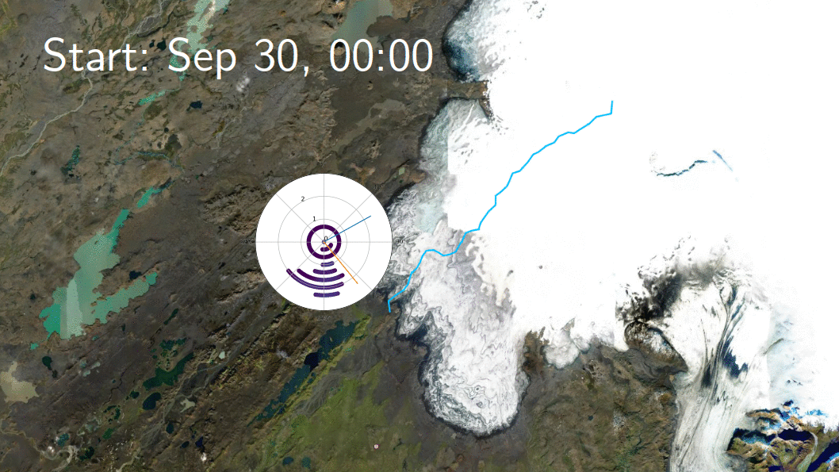
3h time bins since Sep 30 2015, 00:00
JO
Floodpath provided by Magnússon et al., Jökull, 2004
EGU, 25.05.2022
Glacial/Environmental seismology
Thoralf.Dietrich@uni-potsdam.de
<number>

Slide 6
MFP results are very similar, but more detailed than fk-analysis
Frequency band choice influences (apparent) backazimuth
Discuss with me: Parameter choices, other processing options, source processes
EGU, 25.05.2022
Glacial/Environmental seismology
Thoralf.Dietrich@uni-potsdam.de
<number>

Slide 8
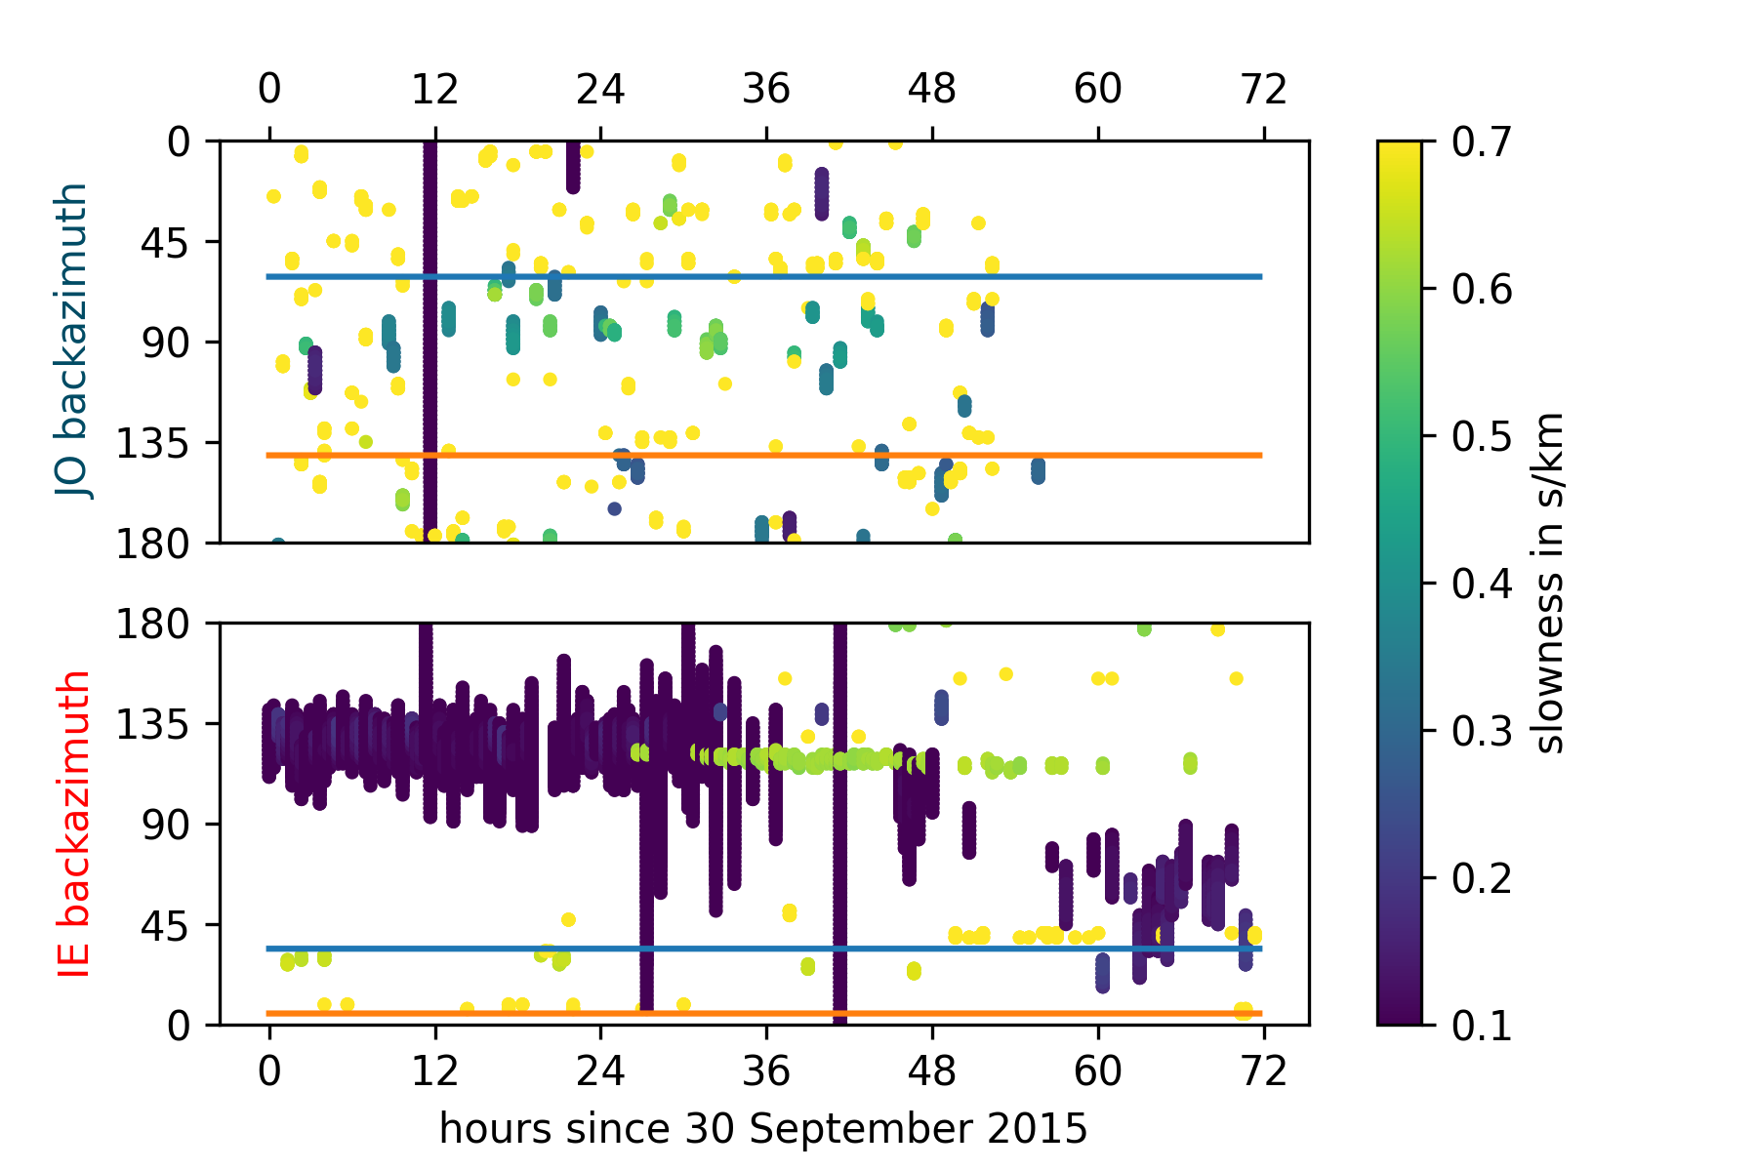
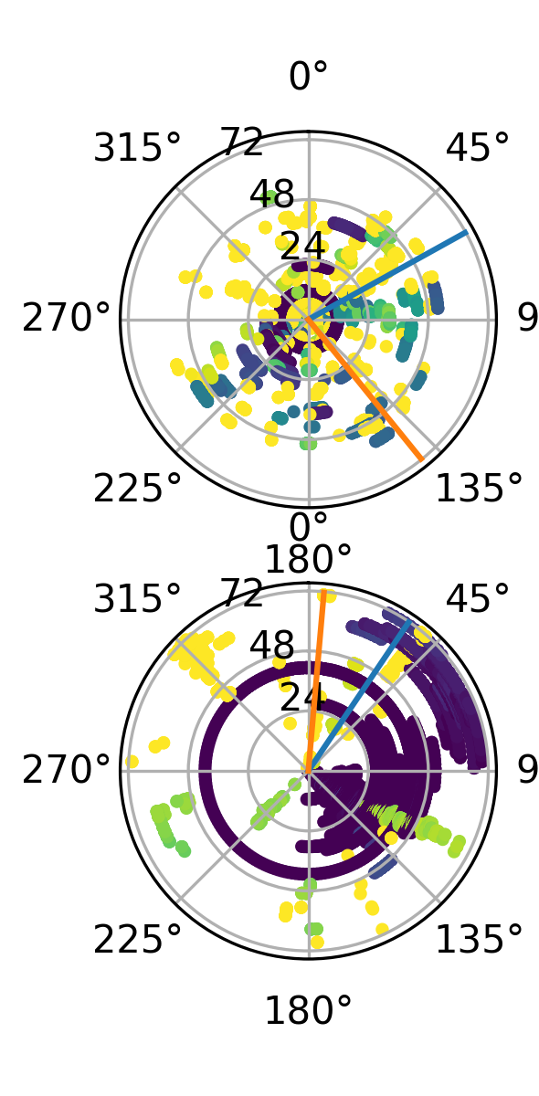
MFP, without strongest component
Eastern Lake
Eastern Lake
Terminus
Terminus
Eastern Lake
Eastern Lake
Terminus
Processed with code by Fabian Lindner and Sebastian Heimann,
Method: Corciulo et al, 2012 (Geophysics)
(Code: https://github.com/fablindner/glseis/blob/master/array_analysis.py and pyrocko.org/)
EGU, 25.05.2022
Glacial/Environmental seismology
Thoralf.Dietrich@uni-potsdam.de
<number>

