Slide 1
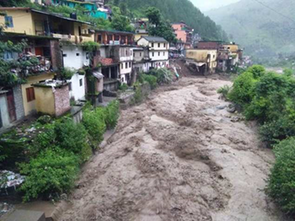

Postprocessing of precipitation forecasts over India with
Quantile Mapping and Ensemble Model Output Statistics
Martin Widmann, Michael Angus, Andrew Orr, Gregor Leckebusch
Datasets
Forecast:
NEPS (NCMRWF): 12 km, 23 ensemble members,
May - October 2018, 2019, day 1 forecast
Observations:
IMD gridded daily rain gauge data, 0.25 deg
IMERG, Integrated Multi-satellitE Retrievals for
GPM with rain gauge adjustments, 0.1 deg
Bihar Sept. 2019
Uttarakhand June 2013
Kerala August 2018
Objectives
Implement two frequently used postprocessing methods for operational forecasts
Evaluate using multiple performance measures with a focus on heavy precipitation
EGU22, HS4.3, 26.5.2022

Slide 2
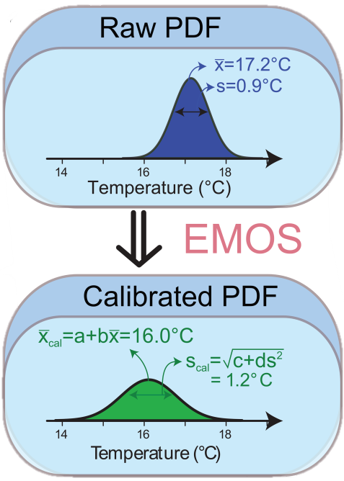
Postprocessing methods
Quantile Mapping (QM)
Ensemble Member Output Statistics (EMOS)
CDF of all daily
values at a
given location
PDF of ensemble members on a given day at a given location
Schefzik et al. 2017
Yields correct distribution by construction except from fitting and sampling effects
Uncontrolled effect on ensemble spread depending on whether variance is reduced or increased
Optimises ensemble spread
Uncontrolled effect on distribution of all values

Slide 3
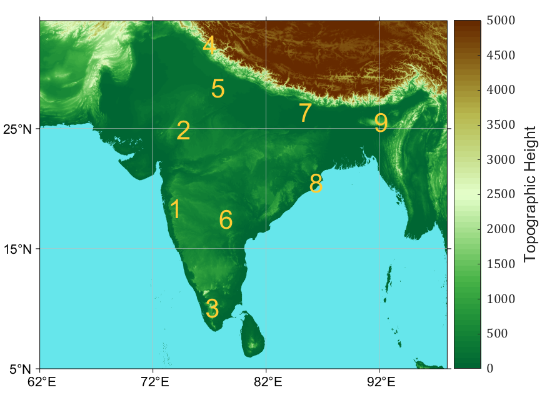
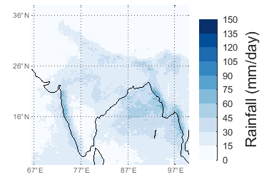
Validation setup
Postprocessing performed on each 0.25°x.0.25° grid cell in the IMD observed dataset
Validation at 9 test locations representing a range of climates across India
1. Mumbai, 18.3°N, 73.3°E
2. Rajasthan 25.0°N, 74.0°E
3. Kerala 10.0°N, 76.6°E
Shimla 32.4°N, 76.4°E
Delhi 28.4°N, 77.1°E
Hyderabad 17.5°N, 77.8°E
Patna 26.4°N, 84.8°E
Bhubaneswar 20.5°N, 85.7°E
Meghalaya 25.6°N, 91.5°E.
90th percentile of daily rainfall at each IMD grid cell

Slide 4
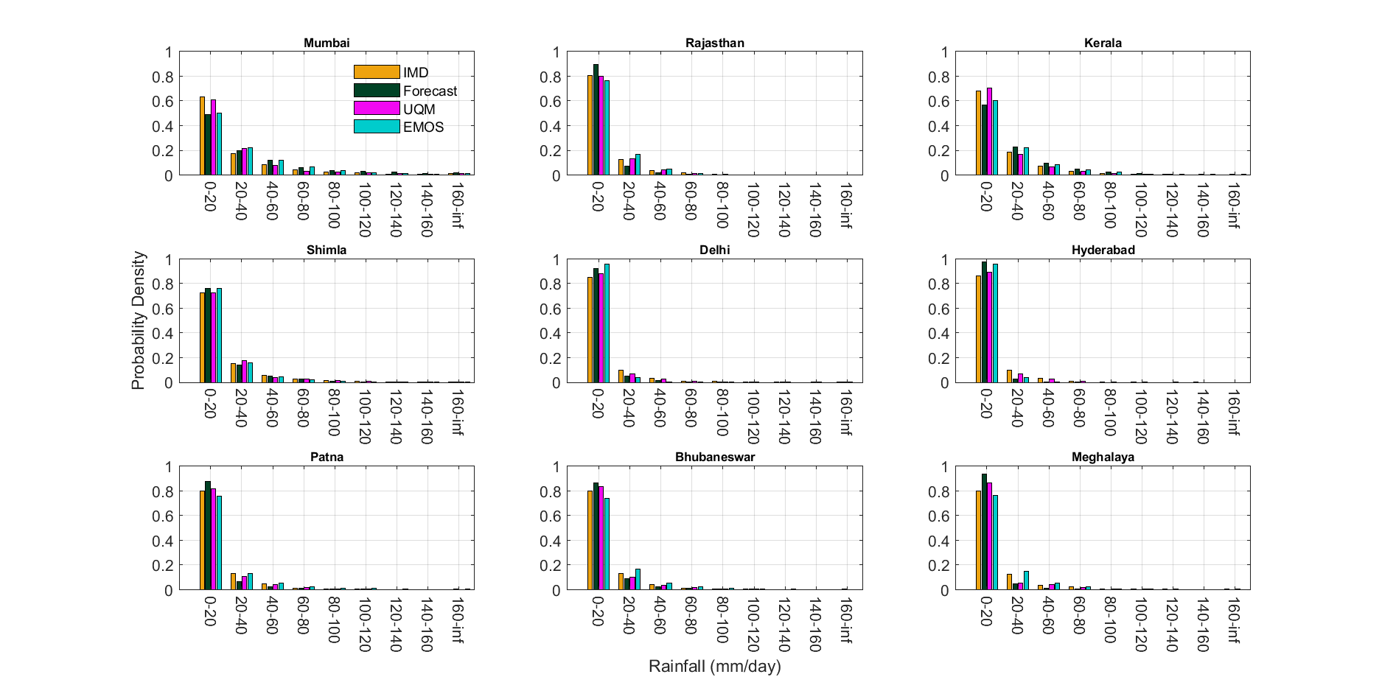
Marginal Distributions
QM closer to observations (IMD) than EMOS in most cases
QM not perfect because parametric fitting (2 x Gamma) is used
EMOS sometimes close to raw forecast and sometimes not

Slide 5
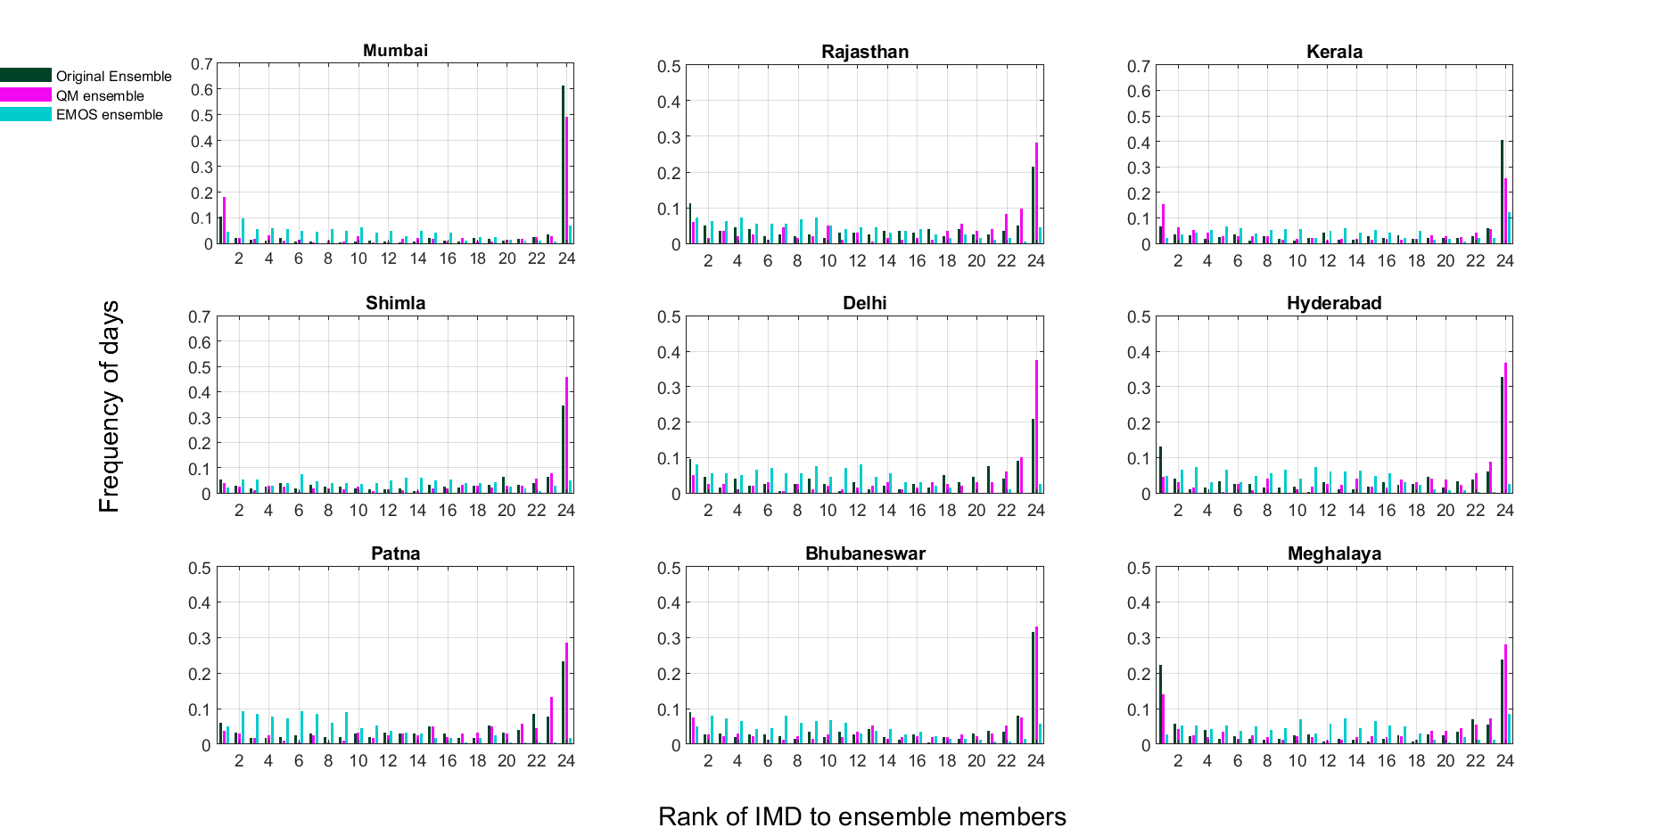
Ensemble Spread: Rank Histograms
Raw forecast is underdispersive in most locations
QM is still underdispersive, in some locations even more than raw forecast
EMOS has correct spread
For each test location, the rank of the observations with respect to the 23 ensemble members of the raw and postprocessed forecast is shown as a frequency histogram. Only wet days (more than 0 mm/day) are included in the relative frequencies). A rank of 1 (24) indicates the observed rainfall was wetter (drier) than all ensemble members.

Slide 6
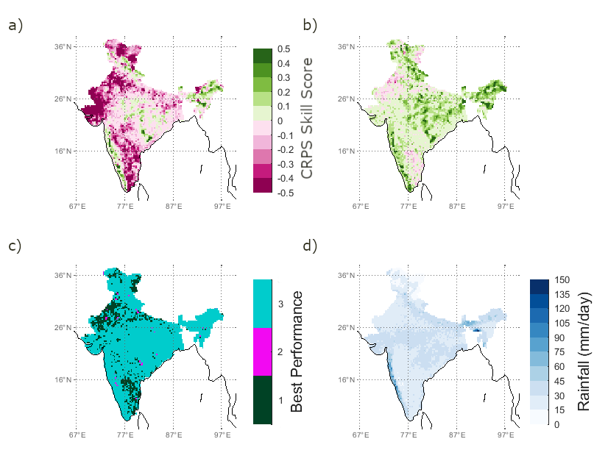
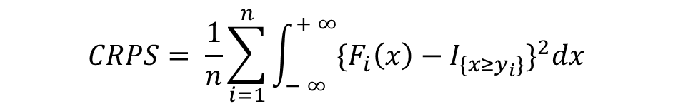
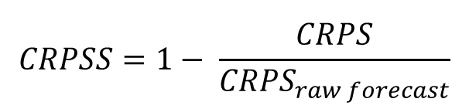
Performance across all values: Continuous Ranked Probability Score
Continuous Ranked Probability Score (CRPS):
Continuous Ranked Probability Skill Score (CRPSS):
QM
EMOS
$$CRPS= \frac{1}{n}\sum_{i=1}^{n}{\int_{− ∞}^{+ ∞}{{\{F_{i}\left(x\right)−I_{\{x≥y_{i}\}}\}}^{2}dx}}$$
90th percentile
EMOS
QM
RAW
$$CRPSS=1− \frac{CRPS}{{CRPS}_{raw forecast}}$$
EMOS performs best

Slide 7
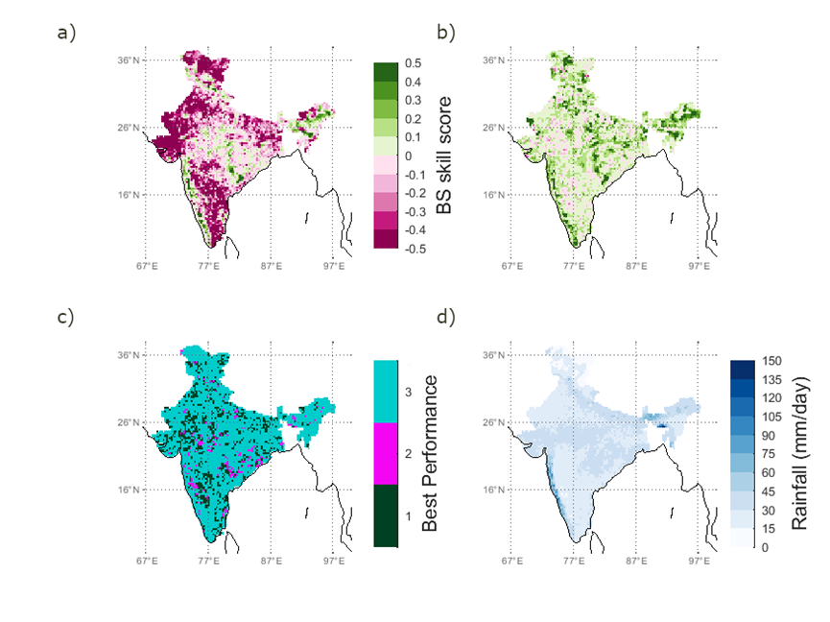
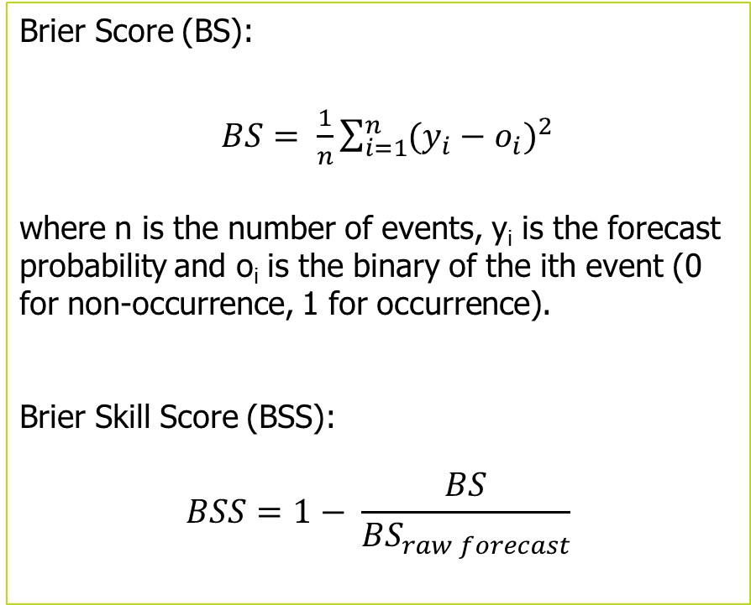
Performance for heavy rainfall (90th percentile): Brier Skill Score
Brier Score (BS):
$BS= \frac{1}{n}\sum_{i=1}^{n}{{(y_{i}−o_{i})}^{2}}$
where n is the number of events, y_{i} is the forecast probability and o_{i} is the binary of the ith event (0 for non-occurrence, 1 for occurrence).
Brier Skill Score (BSS):
$$BSS=1− \frac{BS}{{BS}_{raw forecast}}$$
QM
EMOS
90th percentile
EMOS
QM
RAW
.
EMOS performs best, skill score is above zero almost everywhere
QM is consistently outperformed by EMOS, and by the forecast in most locations

Slide 8
Summary and Conclusions
QM is moderately better than the raw forecast and EMOS for distributions of all daily rainfall values
(as expected per construction)
EMOS corrects under/overdispersion very well
For user-relevant skill scores (CRPSS, BSS) EMOS is clearly better than the raw forecast and QM
Receiver Operating Characteristics (ROC) Skill Scores (not shown) are inconclusive
Results also hold for IMERG 0.1 deg observations (not shown)
Outlook: Implement EMOS operationally using the UK Met Office IMPROVER post-processing system
Thank you! If you have questions please email m.widmann@bham.ac.uk

Slide 9
References
Baran, S., & Nemoda, D. (2016). Censored and shifted gamma distribution based EMOS model for probabilistic quantitative precipitation forecasting. Environmetrics, 27(5), 280-292.
Gneiting, T., Raftery, A. E., Westveld III, A. H., & Goldman, T. (2005). Calibrated probabilistic forecasting using ensemble model output statistics and minimum CRPS estimation. Monthly Weather Review, 133(5), 1098-1118.
Javanshiri Z, Fathi M, Mohammadi SA. (2021) Comparison of the BMA and EMOS statistical methods for probabilistic quantitative precipitation forecasting. Meteorol Appl. 28:e1974. https://doi.org/10.1002/met.1974
Maraun, D., & Widmann, M. (2018). Statistical downscaling and bias correction for climate research. Cambridge University Press.
Pastén-Zapata, E., Jones, J. M., Moggridge, H., & Widmann, M. (2020). Evaluation of the performance of Euro-CORDEX Regional Climate Models for assessing hydrological climate change impacts in Great Britain: A comparison of different spatial resolutions and quantile mapping bias correction methods. Journal of Hydrology, 584, 124653.
Schefzik, R. (2017). Ensemble calibration with preserved correlations: unifying and comparing ensemble copula coupling and member‐by‐member postprocessing. Quarterly Journal of the Royal Meteorological Society, 143(703), 999-1008.
Wilks, D.S. (2006) Comparison of ensemble MOS methods in the Lorenz 96 setting. Meteorological Applications, 13, 243–256.
Wilks, D.S. (2011) Statistical Methods in the Atmospheric Sciences, 3rd edition. New York: Academic Press

