Slide 1
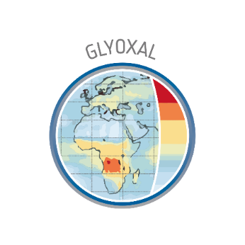

Investigation of the glyoxal tropospheric column variability observed from space during wildfire events
Christophe Lerot, Nicolas Theys, Isabelle De Smedt, Michel Van Roozendael, Jenny Stavrakou, Jean-François Müller
Royal Belgian Institute for Space Aeronomy (BIRA-IASB)
EGU General Assembly 2022, 23-27 May
Christophe.Lerot@aeronomie.be - https://glyretro.aeronomie.be/

Slide 2
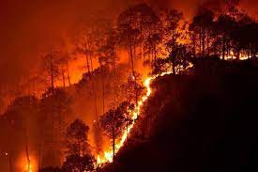
Context
Wildfires emit large amounts of pollutants and aerosols.
Climate change leads to more frequent and more intense wild fires → huge impact on ecosystems and air quality.
TROPOMI/S5p provides crucial information on key trace gases and aerosols produced by fire events. Observed spatial patterns are directly related to the respective production mechanisms and lifetimes.

Slide 3
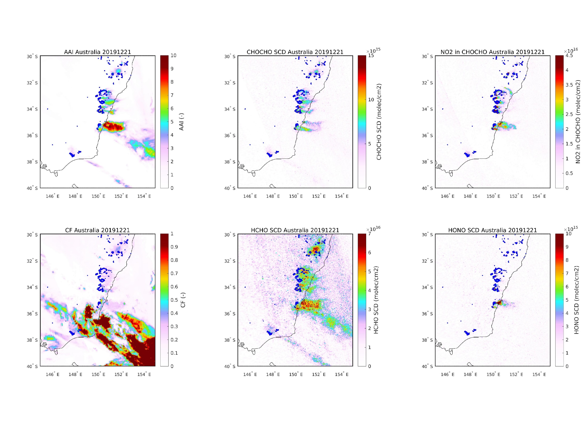
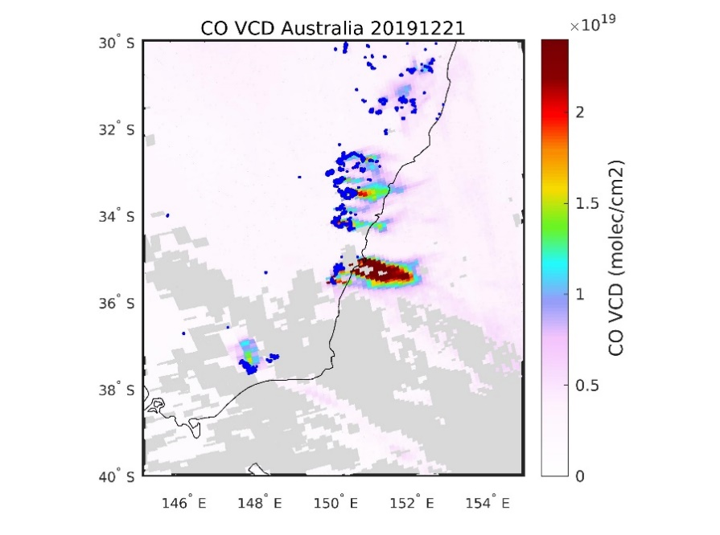
Spatial distribution of probed trace gases
HONO
NO2
CHOCHO
Primary emissions: PE
Secondary emissions: SE
PE: +++
Lifetime: --
PE: ++
Lifetime: -
PE: ++, SE: +
Lifetime: -
HCHO
CO
AAI
PE: +, SE: ++
Lifetime: -
PE: ++, SE: +
Lifetime: +
PE: ++, SE: +
Lifetime: +

Slide 4
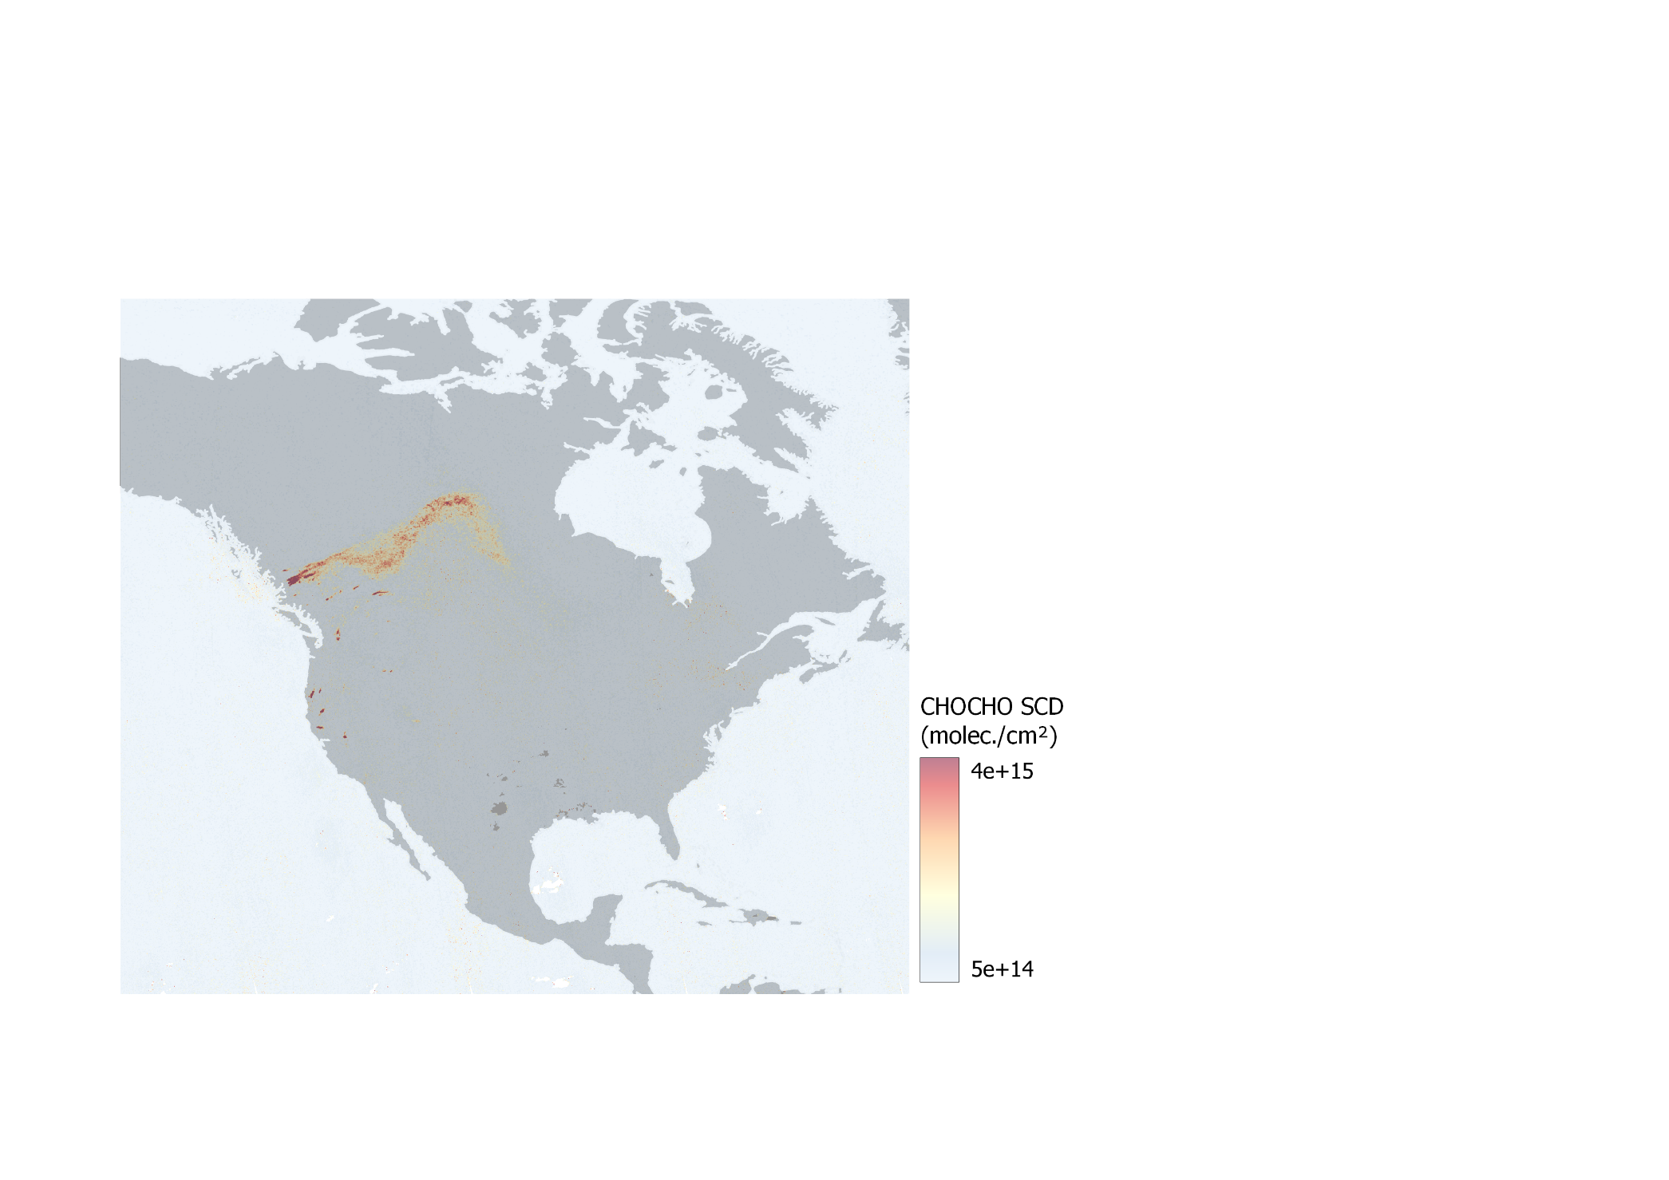
Spatial distribution of glyoxal and formaldehyde
Canadian wildfires – CHOCHO SCDs (10/08/2018)
Heterogeneous uptake of glyoxal can contribute to the formation of secondary organic aerosol and brown carbon.
Enhanced CHOCHO and HCHO signals are sometimes observed at long distances from fire sources (Alvarado et al., ACP, 2020).

Slide 5
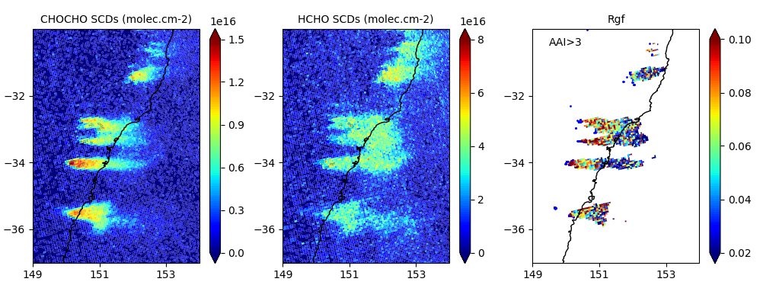

Spatial distribution of glyoxal and formaldehyde
Direct emissions from fires larger for CHOCHO than for HCHO
Clear CHOCHO hot spots near the fire sources.
The CHOCHO/HCHO ratio (Rgf) typically has maximum values near the fires and decreases downwind.
Australian wildfires – 05/12/2019
CHOCHO
HCHO
Rgf
Note: Differences of sensitivity between Visible and UV spectral ranges are accounted for by computing Rgf as:
$$R_{gf}=\frac{{SCD}_{CHOCHO}}{{SCD}_{HCHO}}×\frac{{SCD}_{NO2}(UV)}{{SCD}_{NO2}(Visible)}$$

Slide 6
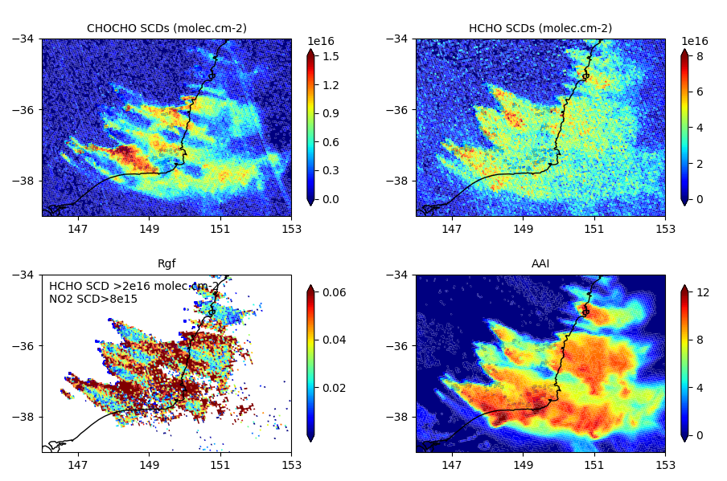
Glyoxal depletion in fire plumes
2019/2020 bushfires in Australia 04/01/2020
During the extreme 2019/2020 Australian bushfires, local minima in glyoxal (Rgf) distributions have been occasionally identified near fire sources!
CHOCHO is the only species to show such a behavior.
CHOCHO
HCHO
Rgf
AAI

Slide 7
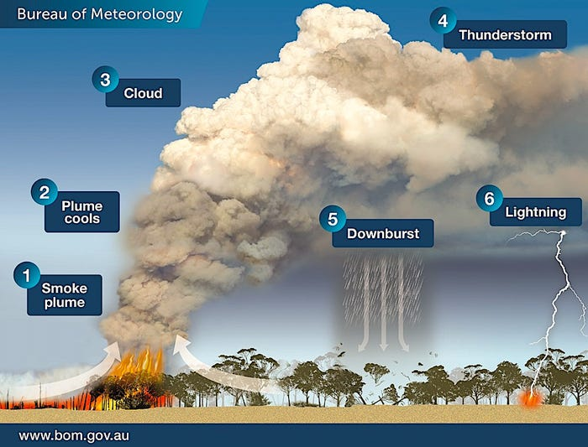
PyroCb events
Record-breaking number of pyrocumulonimbus (PCb) formed during the 2019/2020 Australian “Black summer”.
Such clouds form above intense heat source such as fires. Because of the strong involved convective processes, humid air condenses at high altitudes on the large amounts of injected particles.
Occurring more and more frequently, they become a significant source of particles in the UTLS.
© Bureau of Meteorology, Victoria

Slide 8
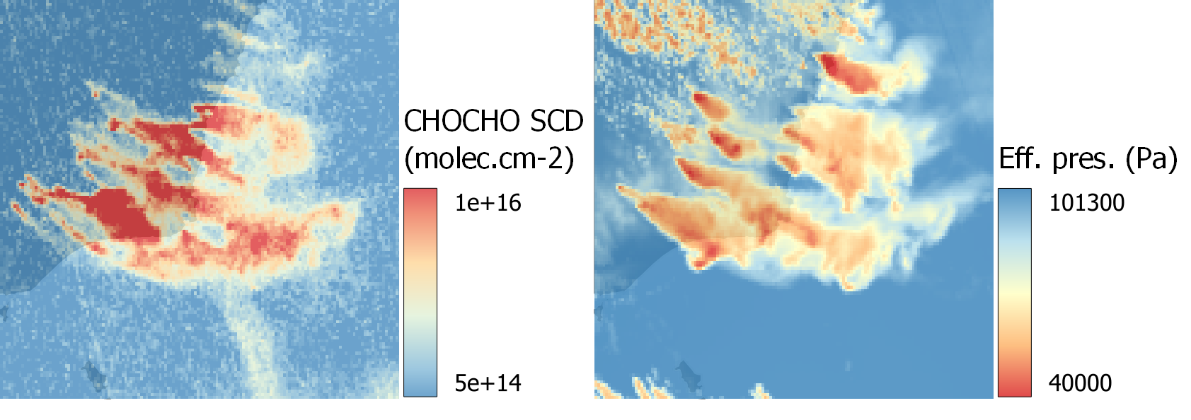
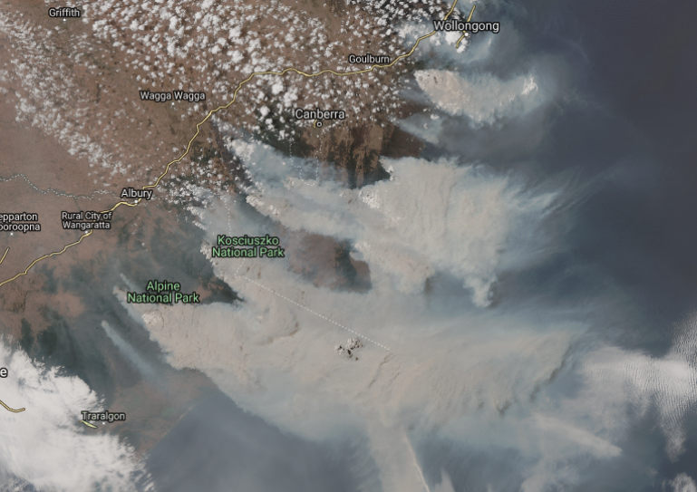
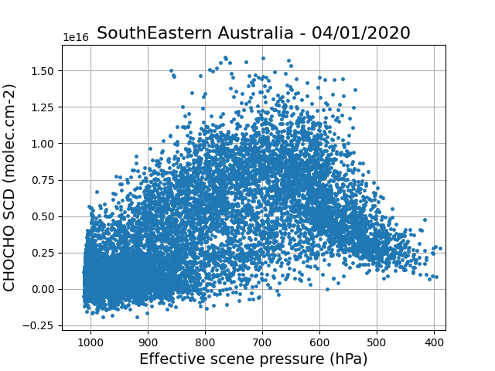
PyroCb events
2019/2020 bushfires in Australia 04/01/2020
Glyoxal depletion correlates with presence of higher PCb (low FRESCO effective scene pressures).
Glyoxal is highly soluble (H_{CHOCHO}=3e5-5e7 M/atm; H_{HCHO}=2e2-1e4 M/atm; R. Sander, ACP, 2015)
→ aqueous processing?
© https://pyrocb.ssec.wisc.edu/

Slide 9
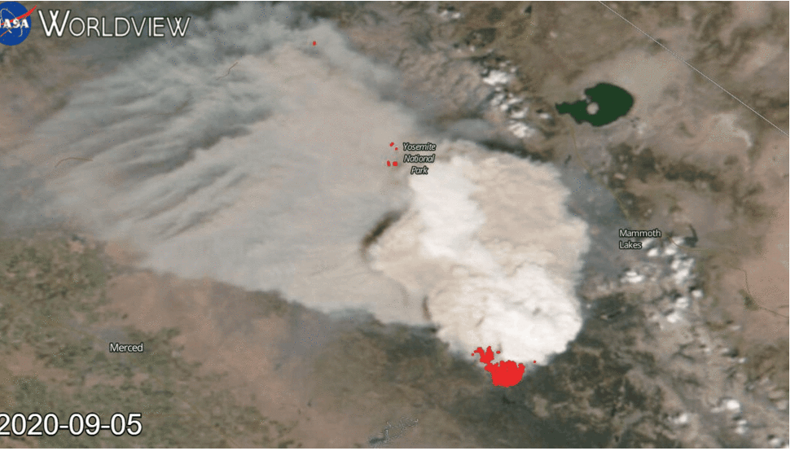
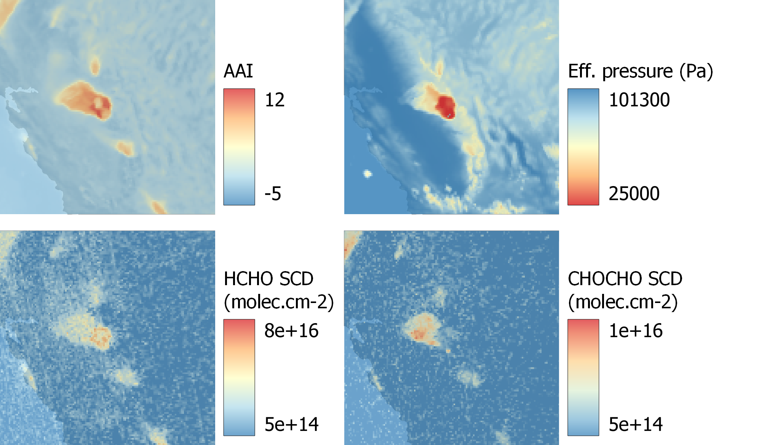
PyroCb events
Creek Fire – California
05/09/2020
Credits: NASA Worldview
© https://pyrocb.ssec.wisc.edu/
Other examples in the updated material.

Slide 10
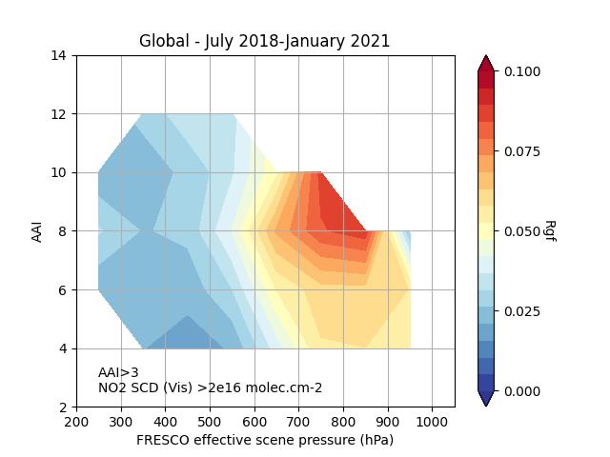
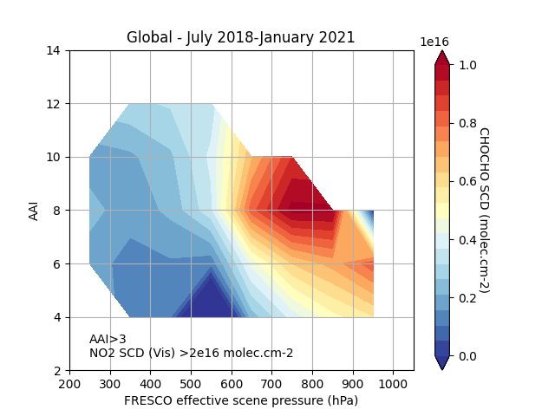
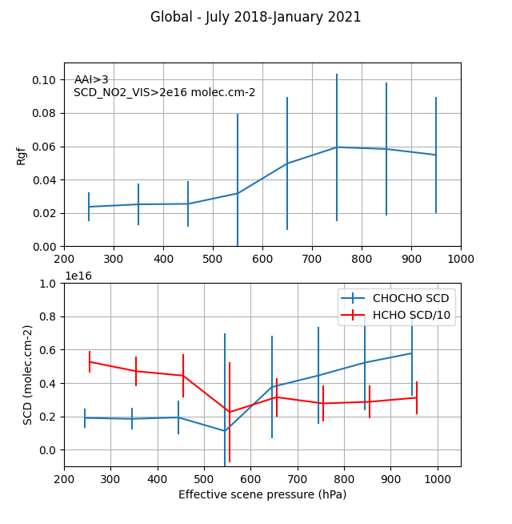
Global Analysis
July 2018 – December 2021; global scale.
Filters applied to keep TROPOMI data only near fire sources (glyoxal signal expected to be high).
CHOCHO SCD decreases when effective scene altitude is high, as opposed to HCHO. Rgf follows the same pattern.
Rgf
AAI
CHOCHO SCDs (molec.cm-2)
Scene Pressure (hPa)
AAI
Rgf
Scene Pressure (hPa)
Scene Pressure (hPa)

Slide 11
Summary
Wildfire events become more frequent and more intense because of climate change. Such events have a significant impact on air quality.
Highest glyoxal columns are expected near the fire sources. Sudden reductions are however observed in case of Pyrocumulonimbus occurrences.
We attribute this removal to aqueous processing on droplets formed at high altitude, i.e. the gaseous glyoxal is absorbed by cloud water, where it can be either chemically processed or eliminated from the atmosphere through precipitation.
Although difficult to quantify, the phenomenon is believed to be marginal for the glyoxal budget. It might however become more important as PCb occur more and more frequently.
Many PyroCb events are missed by TROPOMI. In the future, TEMPO will help tracking PCb formation.
© https://pyrocb.ssec.wisc.edu/

Slide 12
Extra slides:
Other examples of CHOCHO depletion
© https://pyrocb.ssec.wisc.edu/

Slide 13
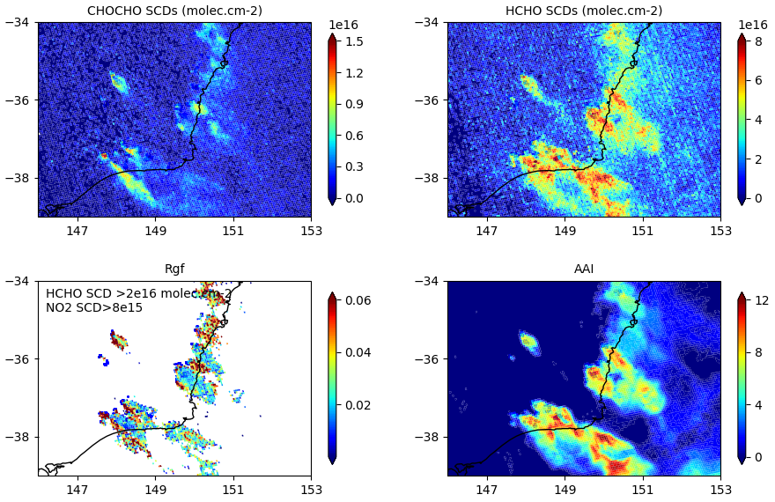
Glyoxal depletion in fire plumes
2019/2020 bushfires in Australia 30/12/2019
During the extreme 2019/2020 Australian bushfires, local minima in glyoxal (Rgf) distributions have been occasionally identified near fires!
Only CHOCHO shows such a behavior.

Slide 14
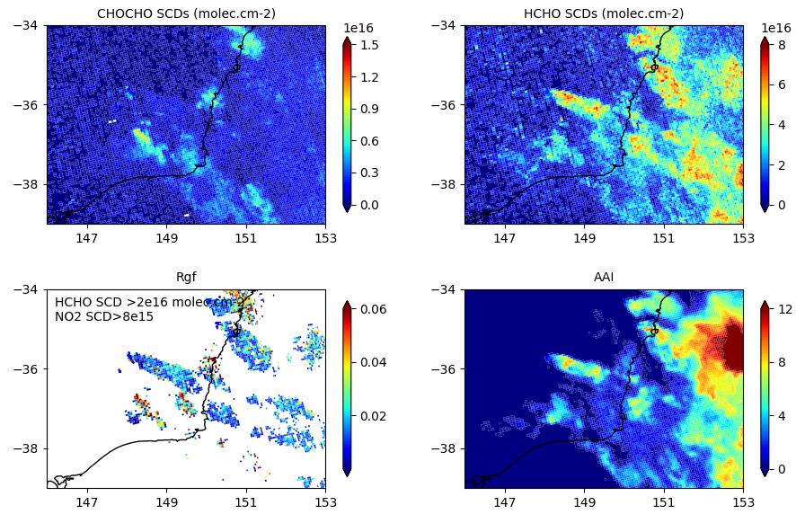
Glyoxal depletion in fire plumes
2019/2020 bushfires in Australia 31/12/2019
During the extreme 2019/2020 Australian bushfires, local minima in glyoxal (Rgf) distributions have been occasionally identified near fires!
Only CHOCHO shows such a behavior.

Slide 15
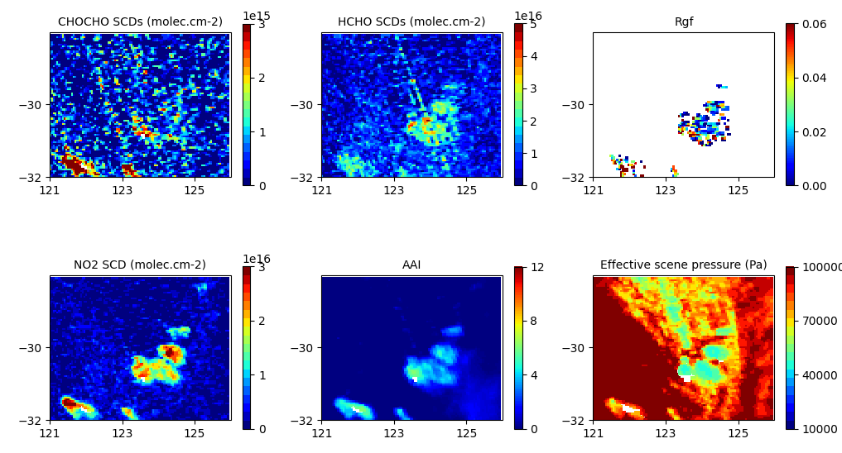
PyroCb events
Australia
22/02/2019

Slide 16
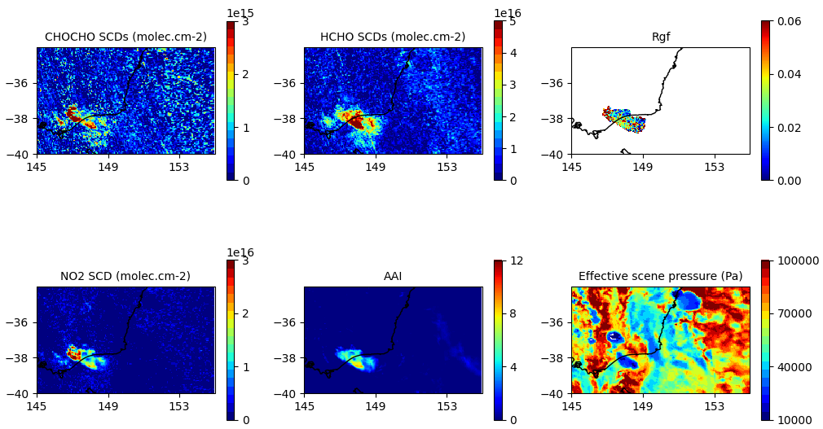
PyroCb events
Australia
05/03/2019

Slide 17
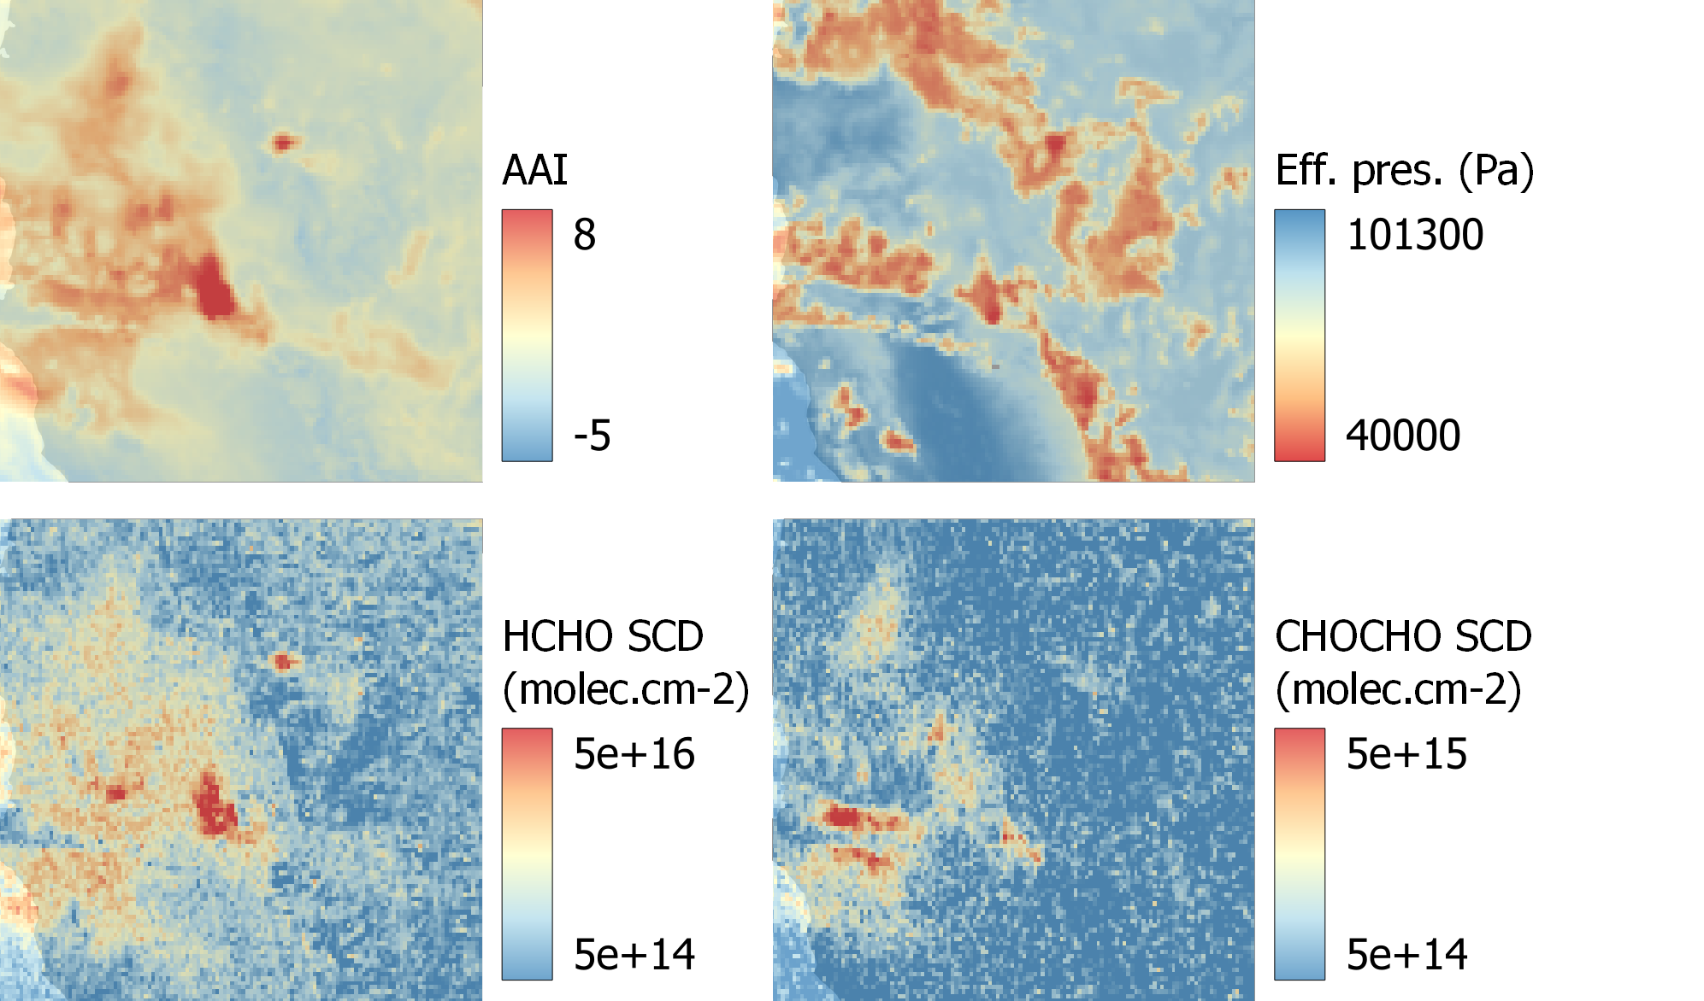
PyroCb events
Bootleg Fire – California
13/08/2021

Slide 18
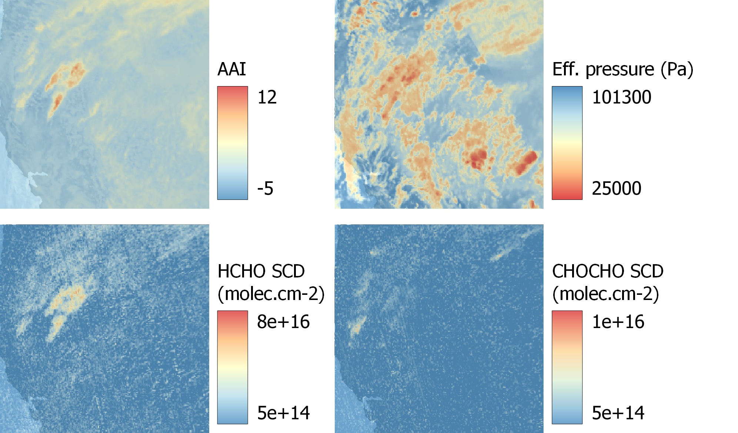
PyroCb events
Creek Fire – California
09/09/2021

Slide 19
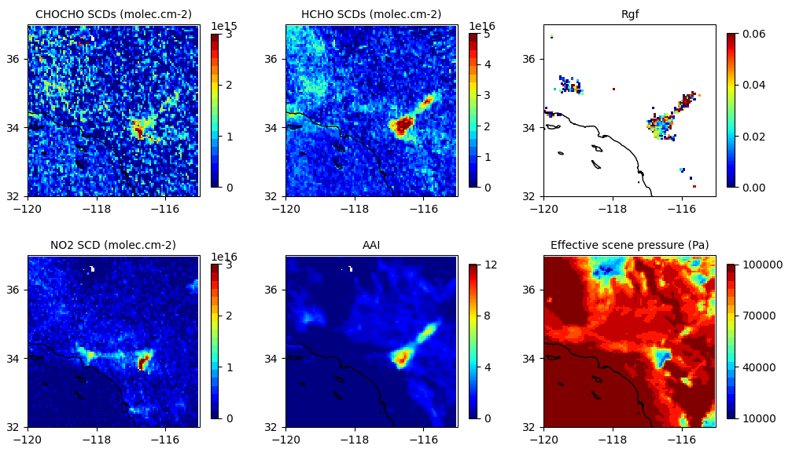
PyroCb events
Cranston Fire – California
26/07/2018

Slide 20
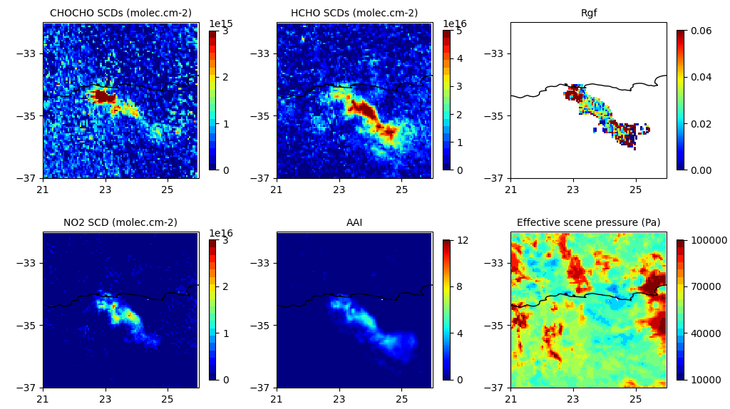
PyroCb events
South Africa
29/10/2018

