Slide 1

Improved Monitoring of Subglacial Lake Activity in Greenland
Rasmus Bahbah Nielsen^{1,*}, Louise Sandberg Sørensen^{1,*}, Sebastian B. Simonsen¹, Natalia Havelund Andersen¹, Jade Bowling^{2,3}, Noel Gourmelen^{4,5}, Alex Horton⁵, Amber Leeson², Jenny Maddalena², Malcolm McMillan², Nanna B. Karlsson⁶, Anne M. Solgaard⁶, and Birgit Wessel⁵ ¹Geodesy and Earth Observation, DTU Space, Technical University of Denmark,Kgs. Lyngby, DENMARK ²Centre for Polar Observation & Modelling, Centre for Excellence in Environmental Data Science, Lancaster University, Lancaster, UNITED KINGDOM ³Lancaster Environment Centre, Lancaster University, Lancaster, UNITED KINGDOM ⁴School of GeoSciences, University of Edinburgh, Edinburgh, UNITED KINGDOM ⁵EarthWave Ltd., Edinburgh, UNITED KINGDOM ⁶Geological Survey of Denmark and Greenland, Copenhagen, DENMARK 7German Aerospace Center (DLR), German Remote Data Center (DFD), Wessling, GERMANY *These authors contributed equally to this work.

Slide 2
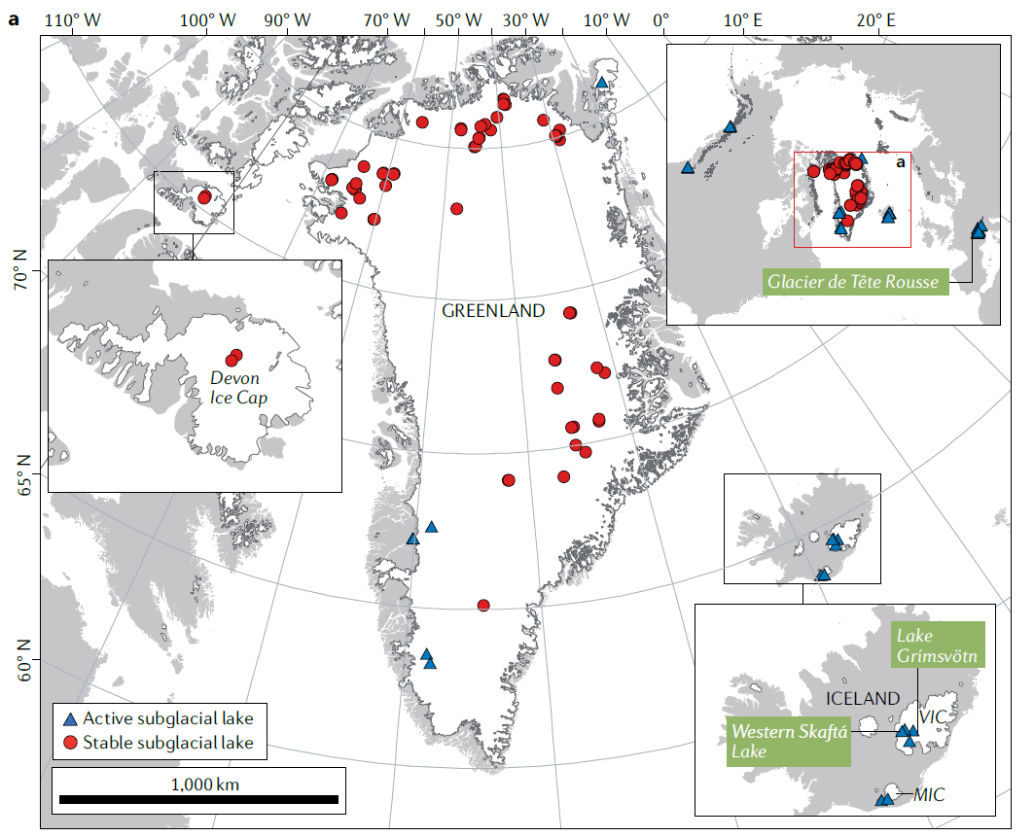
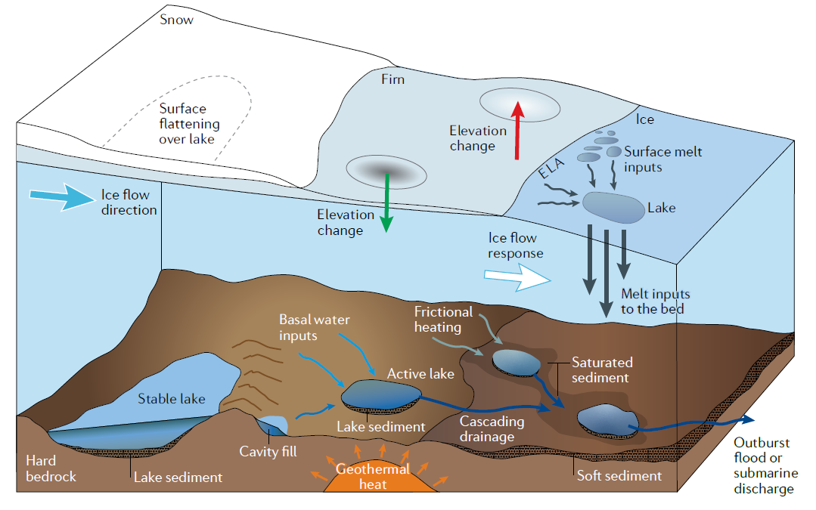
What is a Subglacial Lake in Greenland?
Lakes under the GrIS
The active lakes drains and increase the discharge at the bedrock
A drainage event creates an observable collapse basin
Active lakes in Greenland create small collapse basins,
and are difficult to monitor
Livingstone et al. 2022
Livingstone et al. 2022

Slide 3
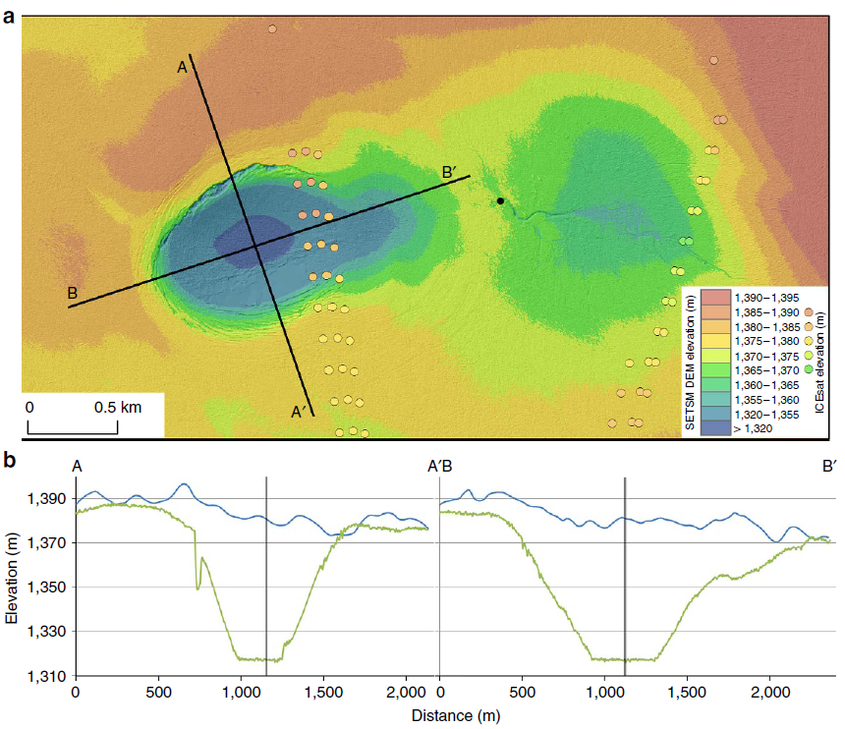
Why CryoSat-2 Swath and TanDEM-X Improves Monitoring of Subglacial Lake Activity
Palmer et al. 2015
Former subglacial lake studies in Greenland have mostly relied on the ArcticDEM
The ArcticDEM has a spatial resolution of 2m
Only 5 ArcticDEM scenes between 2011 and 2017, after the drainage event in Palmer study

Slide 4
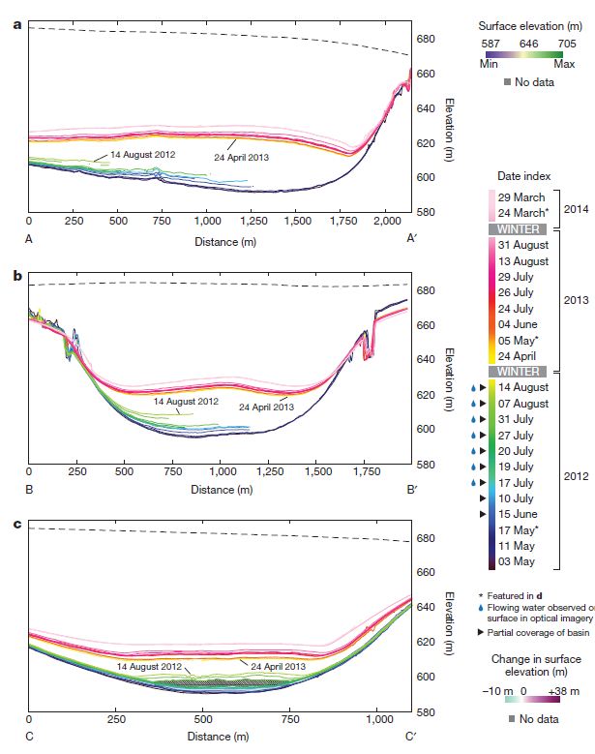
Why CryoSat-2 Swath and TanDEM-X Improves Monitoring of Subglacial Lake Activity
Willis et al. 2015
We don’t have a data source that can periodically monitor subglacial activity
In Greenland
Former subglacial lake studies in Greenland have mostly relied on the ArcticDEM
The ArcticDEM has a spatial resolution of 2m
44 ArcticDEM scenes between 2012 and 2017 (mostly during summer), the drainage event was in 2011, in Willis study

Slide 5
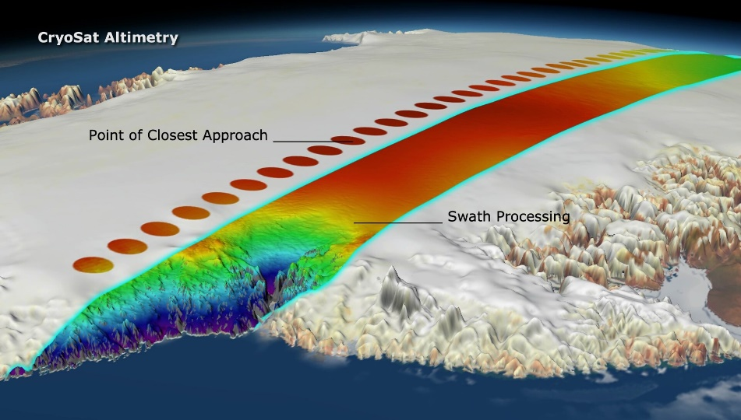
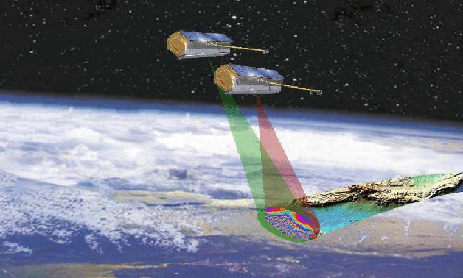
Why CryoSat-2 Swath and TanDEM-X Improves Monitoring of Subglacial Lake Activity
ESA/Planetary Visions
Zink et al. 2015
Using the CryoSat-2 interferometric mode, we can enhance the resolution
The processor is finely tuned to monitor small scale structures, e.g. collapse basins
High resolution radar interferometry DEM provided by the German Aerospace Centre (DLR)
Further improves the temporal resolution of subglacial activity

Slide 6
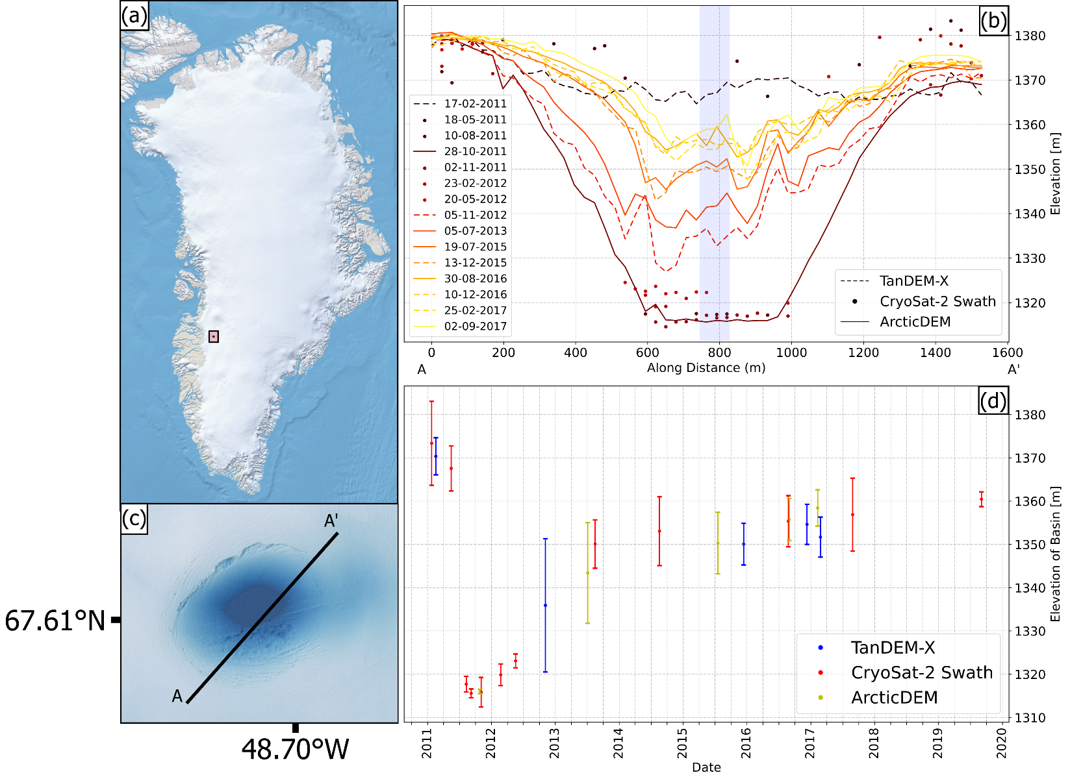

Why CryoSat-2 Swath and TanDEM-X Improves Monitoring of Subglacial Lake Activity
Elevation data confirms the drainage happened in the period May-August 2011
The lake recharge happens in the melt season, arguing for surface melt filling the lake
Due to the ice sheet dynamics the collapse basin drift away from the lake, thus stagnating the uplift after 2014
12 CryoSat-2 Swath tracks and 5 TanDEM-X scenes with 5 ArcticDEM scenes
Area of ~1.6 ${km}^{2}$
Same lake described in Palmer et al. 2015

Slide 7
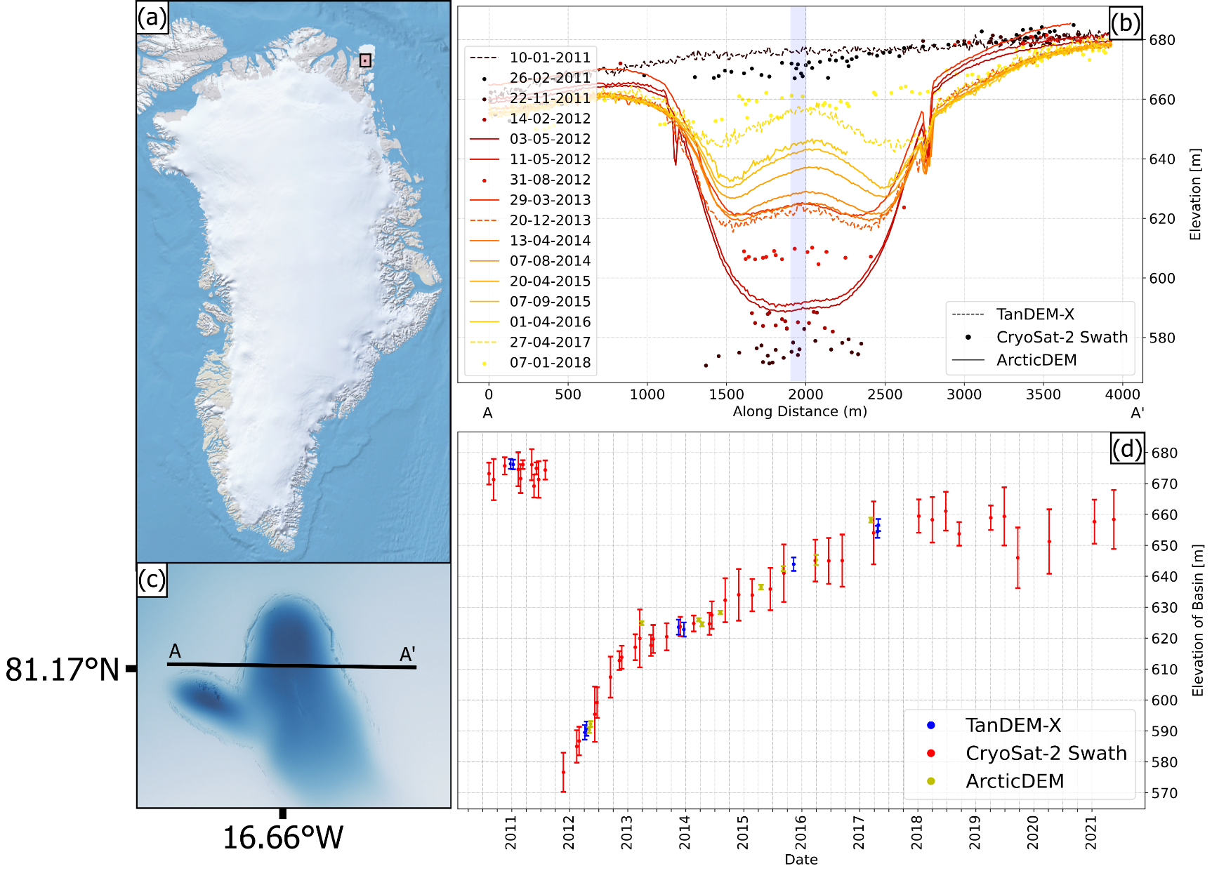

Why CryoSat-2 Swath and TanDEM-X Improves Monitoring of Subglacial Lake Activity
Elevation data confirms the drainage happened in the period May-August 2011
The collapse basin was 20 meters deeper than previous studies (100 m)
The recharge deaccelerated after the first melt season in 2012
The lake drained again in 2019
CryoSat-2 Swath proves to substantial improve active subglacial lake monitoring
46 CryoSat-2 Swath tracks and 9 TanDEM-X scenes with 44 ArcticDEM scenes
Area of ~44 ${km}^{2}$
Same lake described in Willis et al. 2015

Slide 8
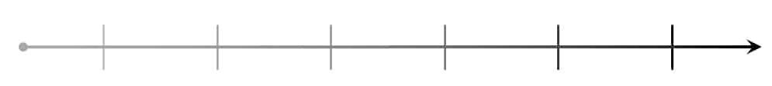
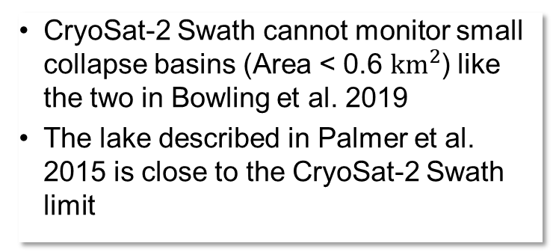
Challenges and Future
CryoSat-2 Swath cannot monitor small collapse basins (Area < 0.6 ${km}^{2}$) like the two in Bowling et al. 2019
The lake described in Palmer et al. 2015 is close to the CryoSat-2 Swath limit
Try to monitor smaller lakes by improving the CryoSat-2 Swath processor
Try to detect new collapse basins with CryoSat-2 Swath
Extend the timeseries for identified subglacial lakes with the still operational CryoSat-2

Slide 9
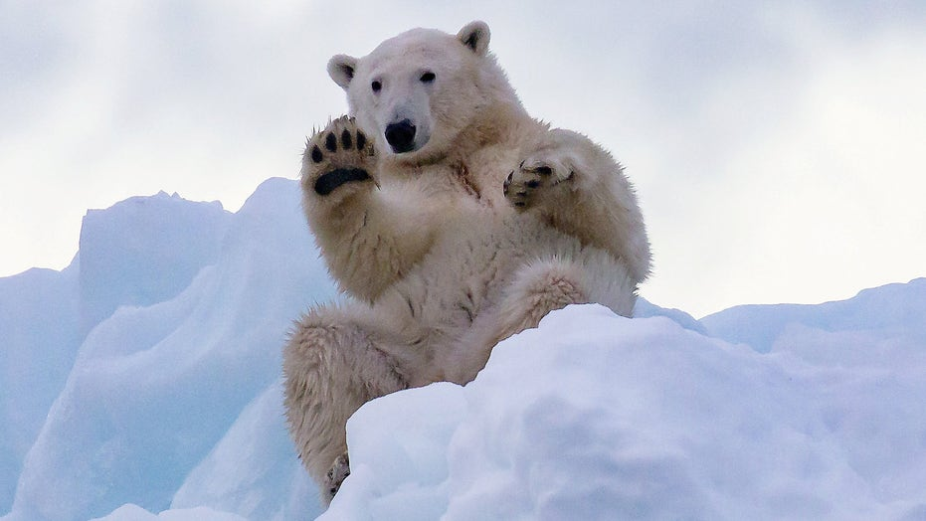
Thank You For Listening
References:
Livingstone, S.J., Li, Y., Rutishauser, A. et al. Subglacial lakes and their changing role in a warming climate. Nat Rev Earth Environ 3, 106–124 (2022). https://doi.org/10.1038/s43017-021-00246-9
Palmer, S. et al. Subglacial lake drainage detected beneath the Greenland ice sheet. Nat. Commun. 6:8408 doi: 10.1038/ncomms9408 (2015).
Gourmelen, N., Escorihuela, M., Shepherd, A., Foresta, L., Muir, A., Garcia-Mondejar, A., Roca, M., Baker, S., & Drinkwater, M. R. (2018). CryoSat-2 swath interferometric altimetry for mapping ice elevation and elevation change. Advances in Space Research, 62(6), 1226-1242. https://doi.org/10.1016/j.asr.2017.11.014
Willis, M., Herried, B., Bevis, M. et al. Recharge of a subglacial lake by surface meltwater in northeast Greenland. Nature 518, 223–227 (2015). https://doi.org/10.1038/nature14116
ESA/ Planetary Visions, https://earth.esa.int/eogateway/news/cryosats-swath-processing-technique
Manfred Zink and Gerhard Krieger and Hauke Fiedler and Irena Hajnsek and Alberto Moreira and Marian Werner, The TanDEM-X Mission (2015)
Bowling, J.S., Livingstone, S.J., Sole, A.J. et al. Distribution and dynamics of Greenland subglacial lakes. Nat Commun 10, 2810 (2019). https://doi.org/10.1038/s41467-019-10821-w

