Slide 1



New approach for flood risk estimation
by integrating remote sensing and in-situ data
Rodolfo Roseto, Domenico Capolongo, Pierfrancesco Dellino
Department of Earth and Geoenvironmental Sciences,
University of Bari, Italy
Session HS1.2.2 – 'Advances in river monitoring and modelling for a climate emergency: data-scarce environments, real-time approaches, inter-comparison of innovative and classical frameworks, uncertainties, harmonisation of methods and good practices'
May 26th, 2022

Slide 2
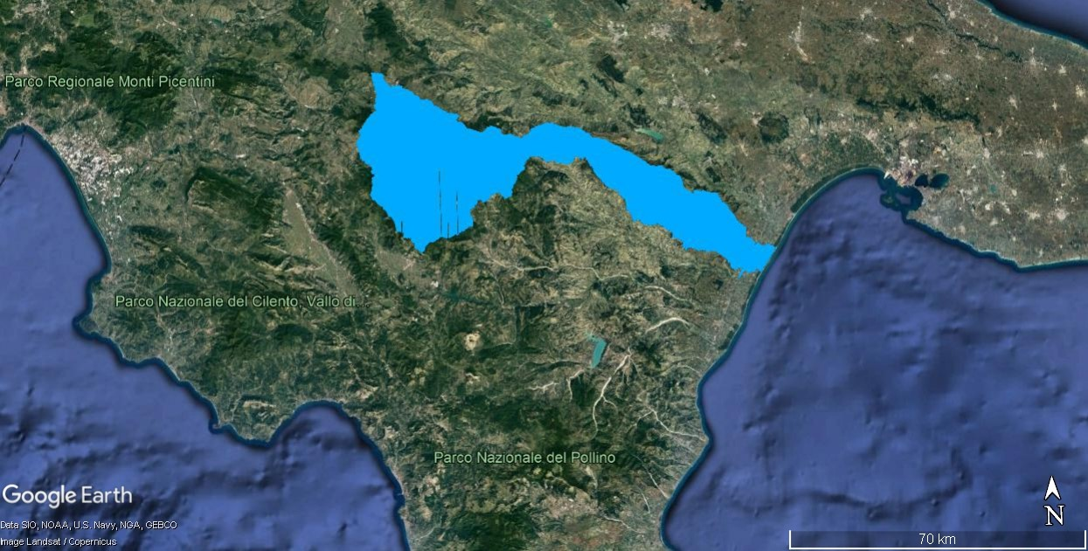
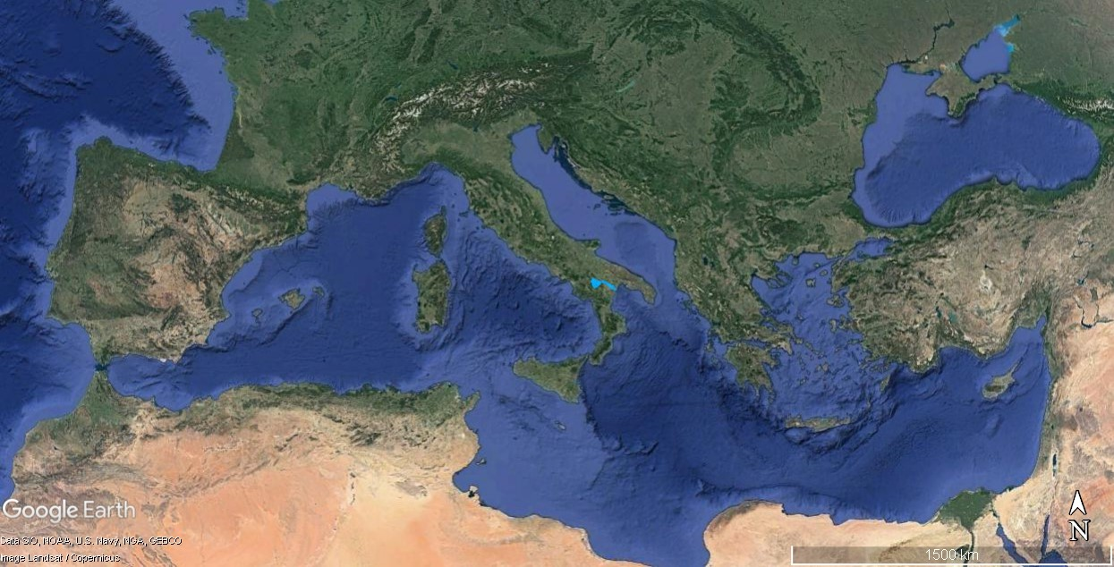
Study area: Basento river (Basilicata, Southern Italy)
DTMs
Cross Sections
Rainfall time series
Land
Cover
Photo
Sieving
Hydraulic parameters
IDF curves
Filled capacity discharge
Rainfall intensity
Flood probability

Slide 3
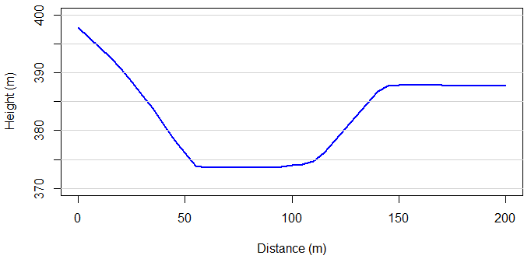
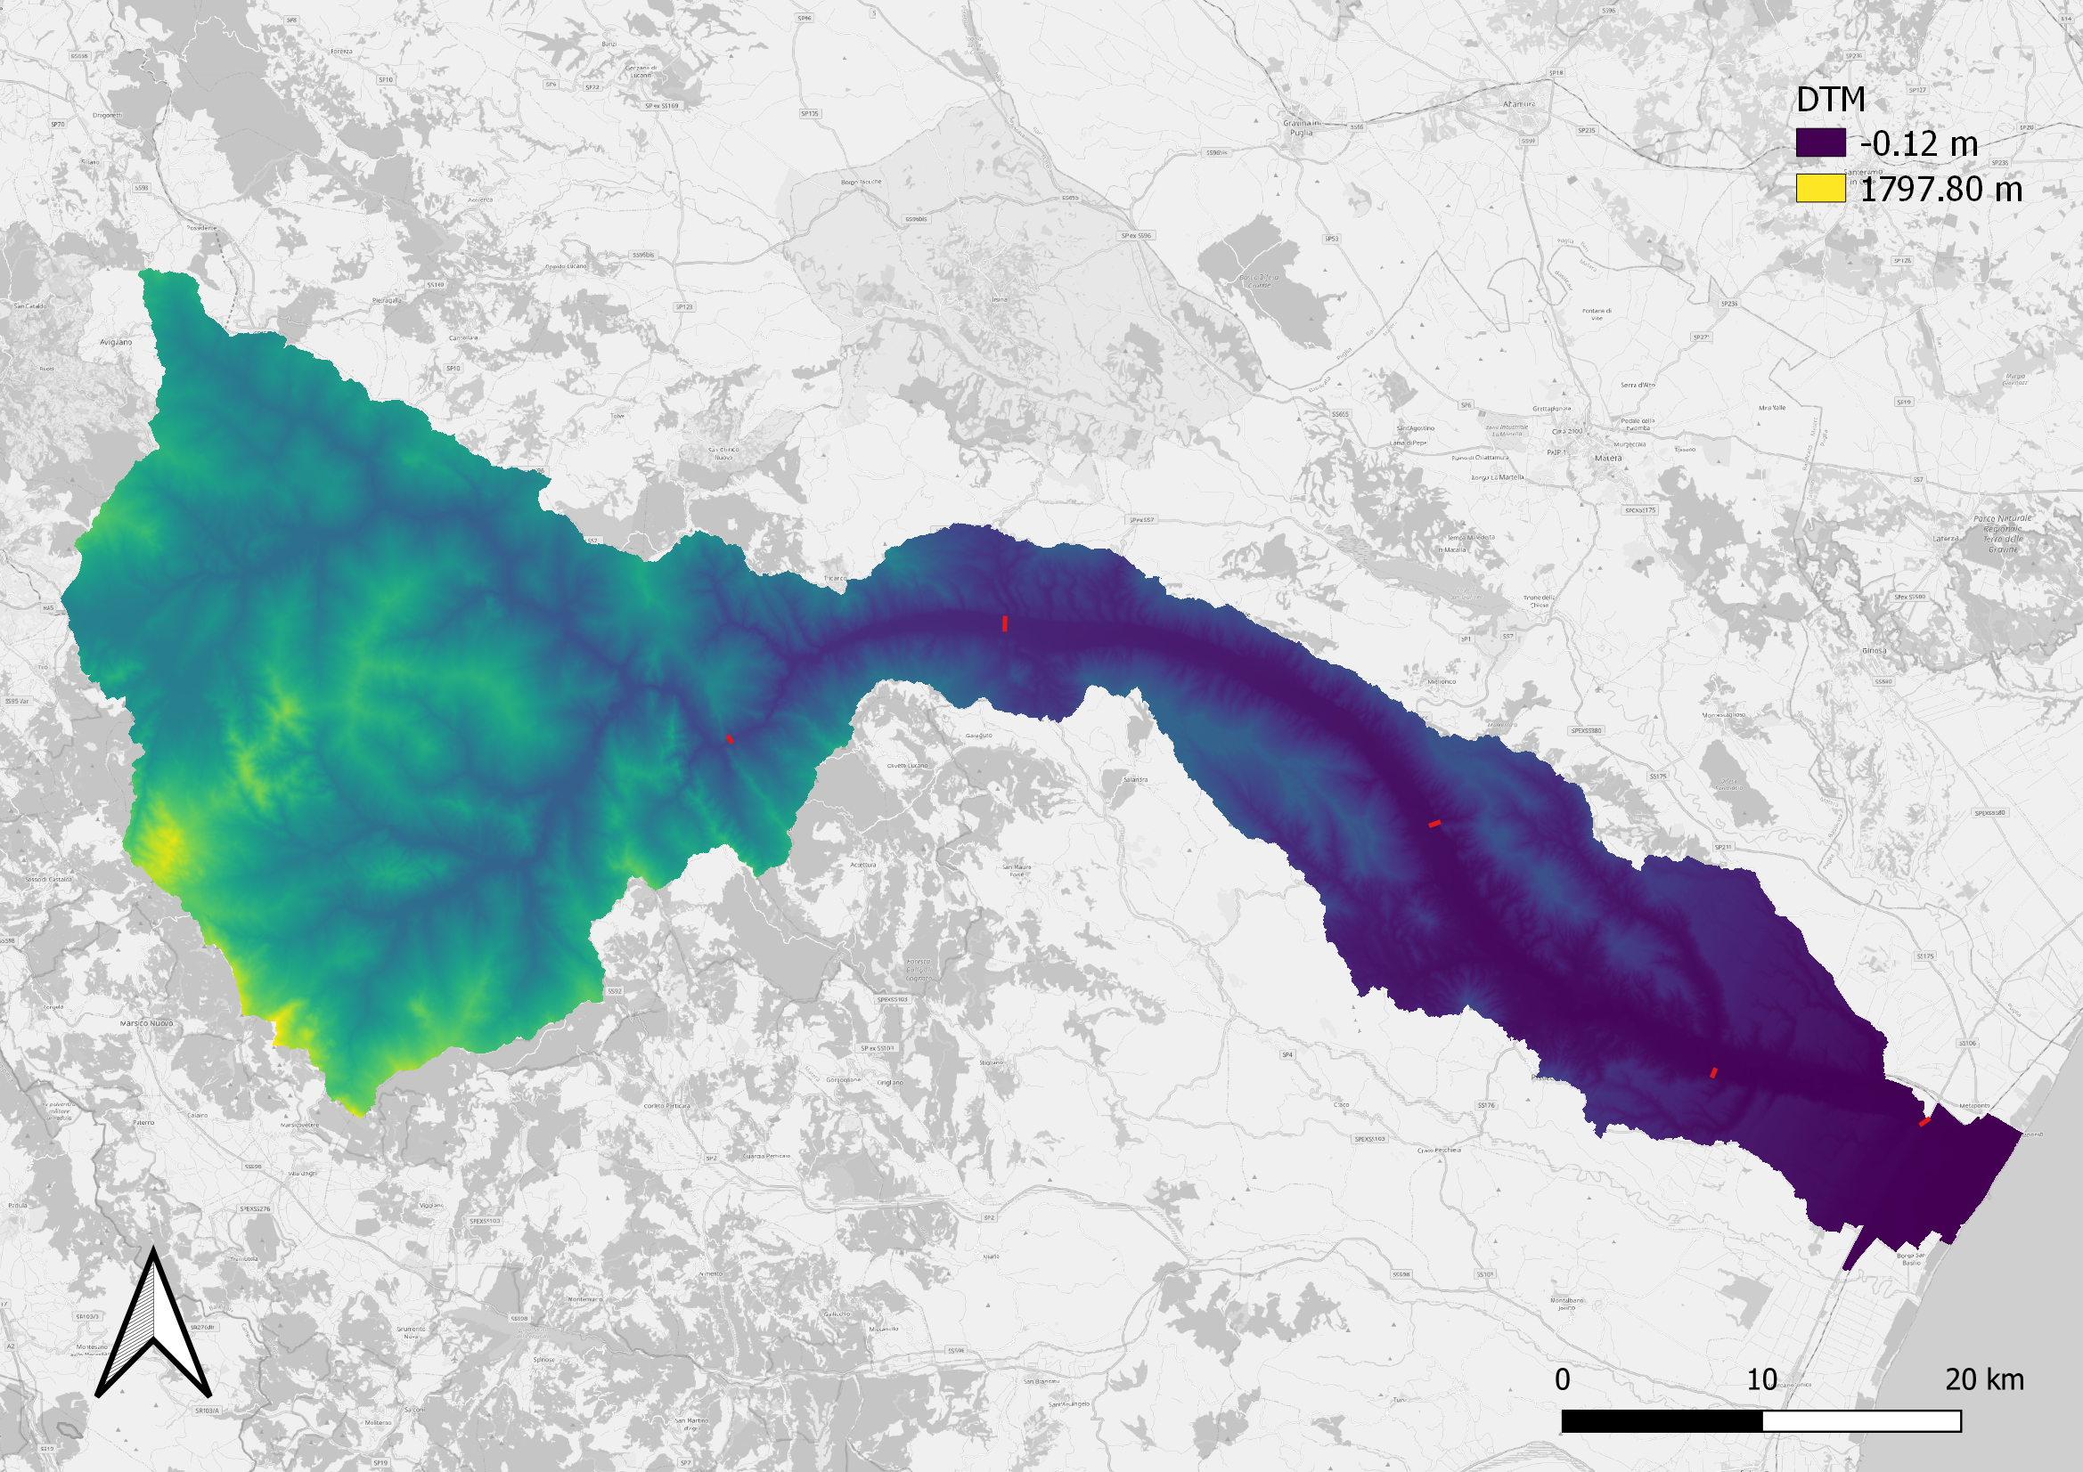
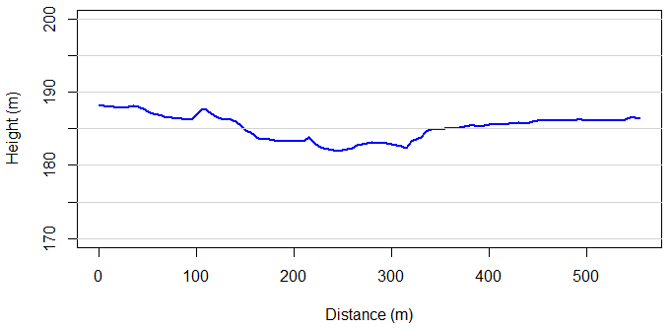
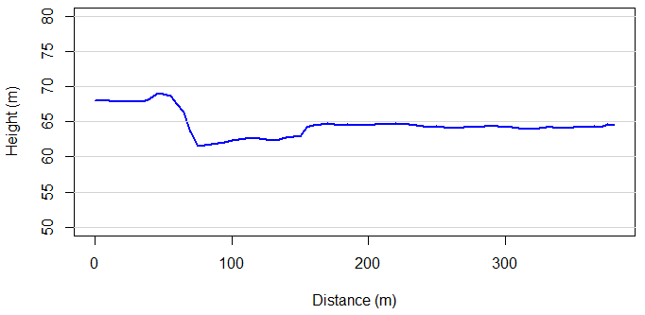
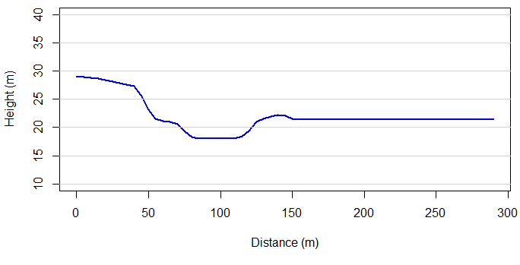
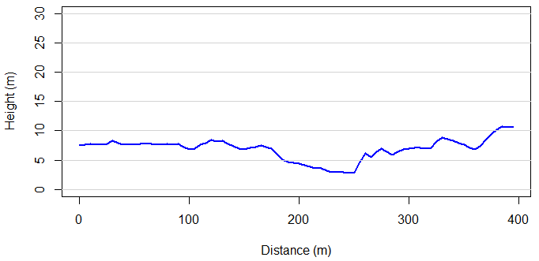
From DTM to cross-sections
2
1
3
4
5

Slide 4
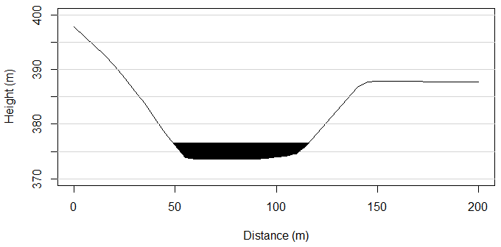
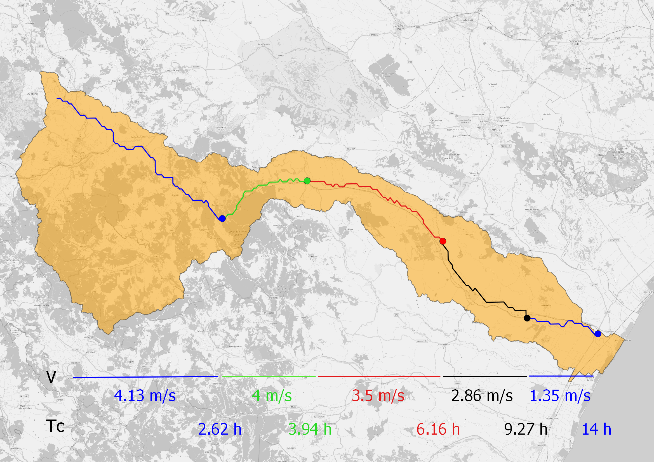
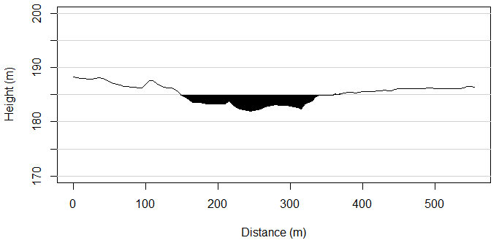
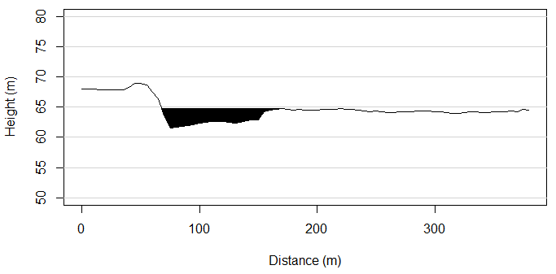
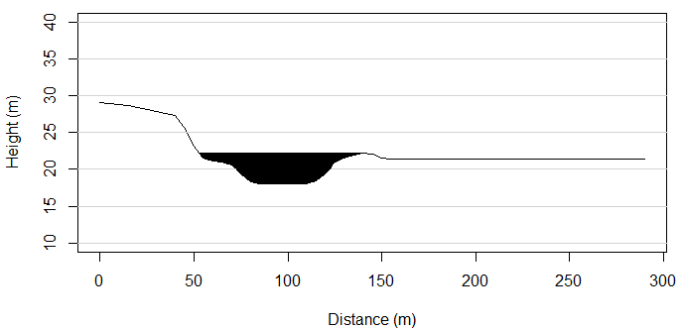
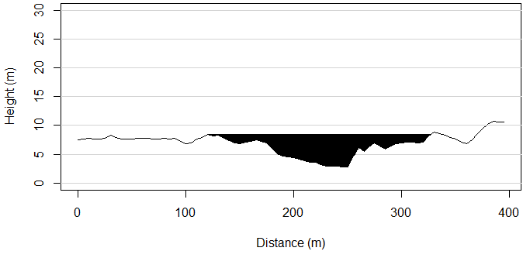
From cross-sections to velocity and time of concentration

Slide 5
Hydraulic parameters for each cross-sections

Slide 6
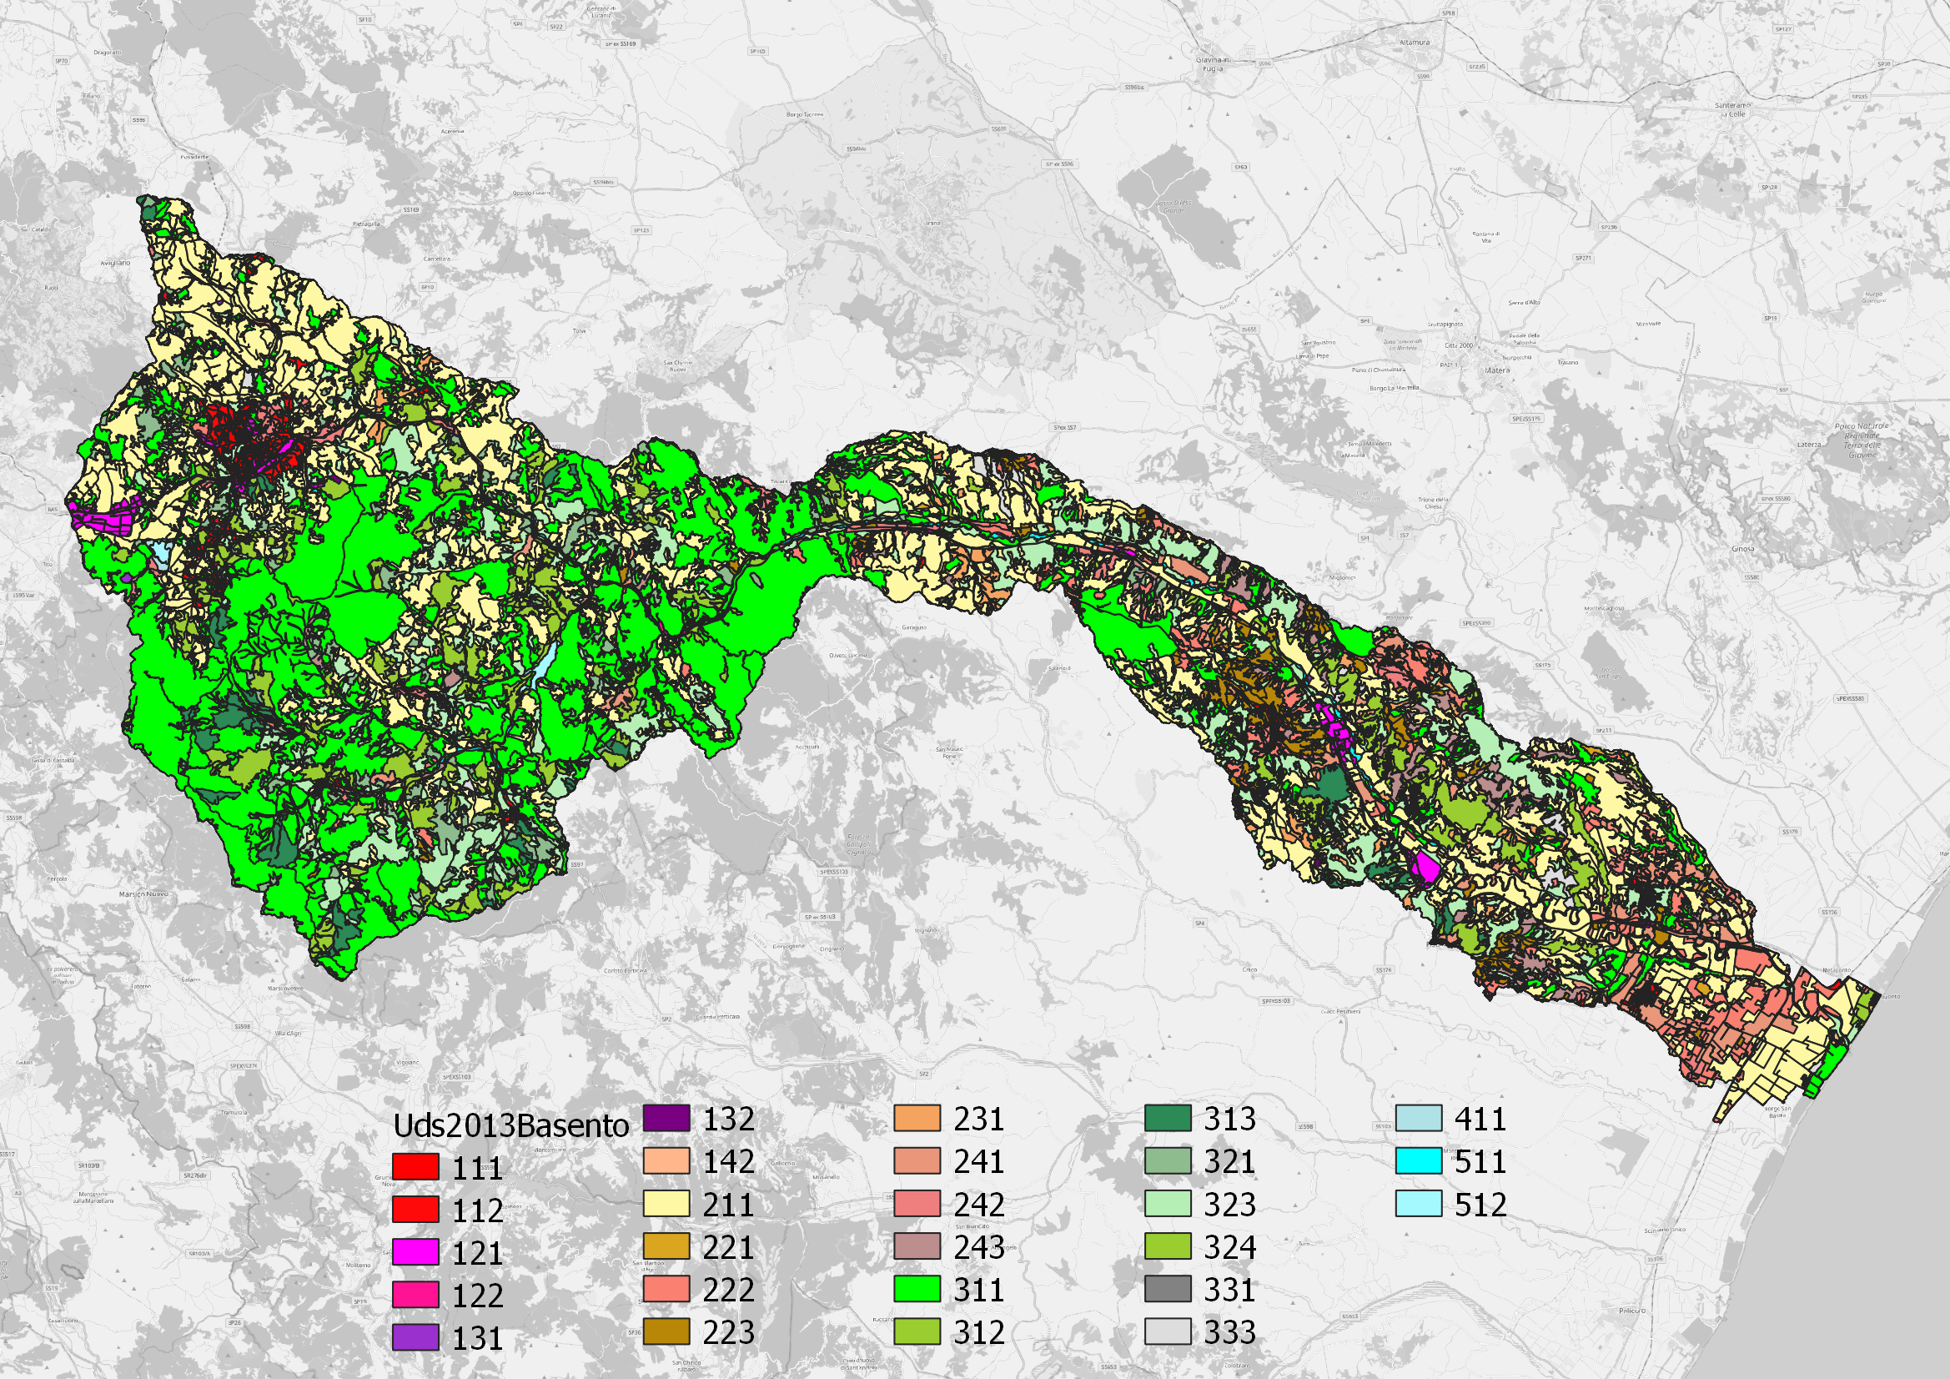
From land cover to runoff coefficient

Slide 7
From land cover to runoff coefficient
C = 0.29
C = 0.29
C = 0.30
C = 0.31
C = 0.32

Slide 8
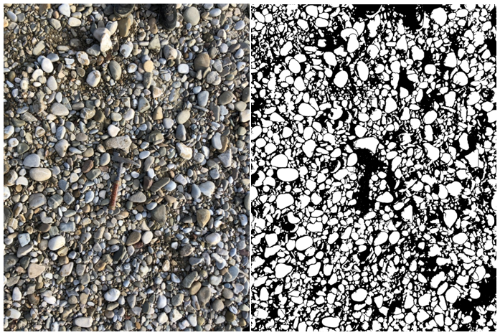

Photo sieving to calculate roughness coefficient
$$K_{s}=GSD 84 percentile$$

Slide 9

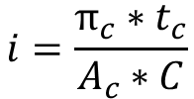
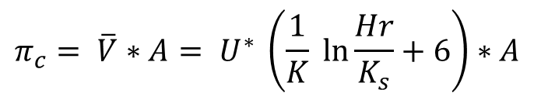
Filled capacity discharge
Peak discharge
Upstream catchment area
$$π_{c}= \overline{V}∗A= U^{∗} \left(\frac{1}{K} \ln{\frac{Hr}{K_{s}}+6}\right)∗A$$
$$Q=\frac{i}{tc}∗A_{c} ∗C$$
Runoff coefficient
$$i=\frac{π_{c}∗t_{c}}{A_{c}∗C}$$

Slide 10
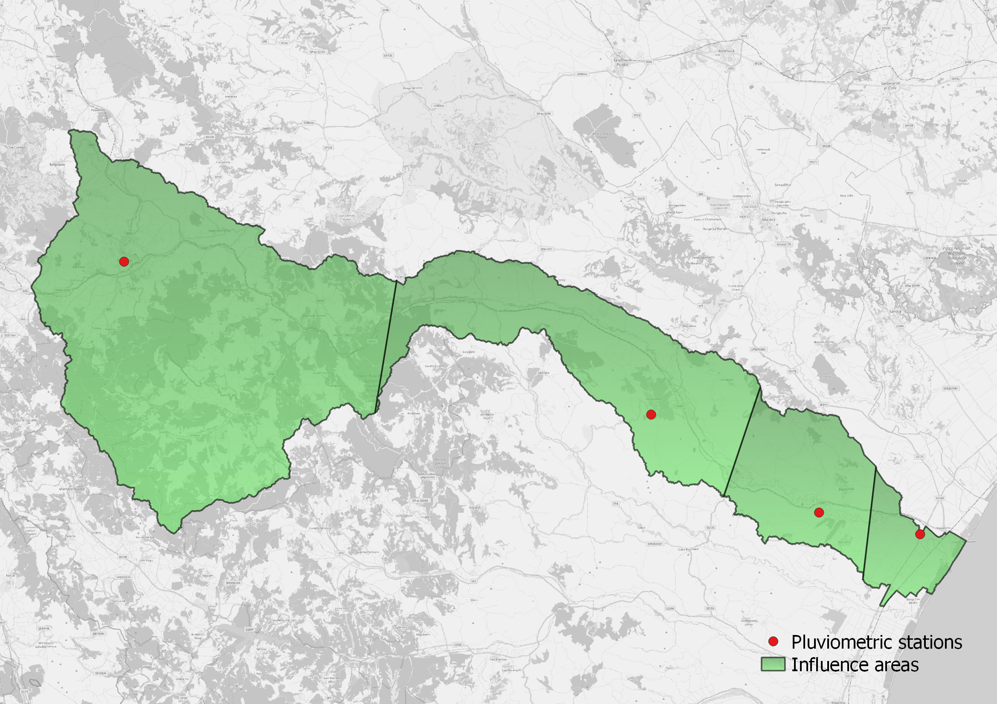
Pluviometric stations and influence areas
Influence areas:
Potenza: 912.38 km²
Ferrandina: 387.52 km²
Torre Accio: 185.27 km²
Basento freatimetro: 74.41 km²
Potenza
Ferrandina
Torre Accio
Basento Freatimetro

Slide 11
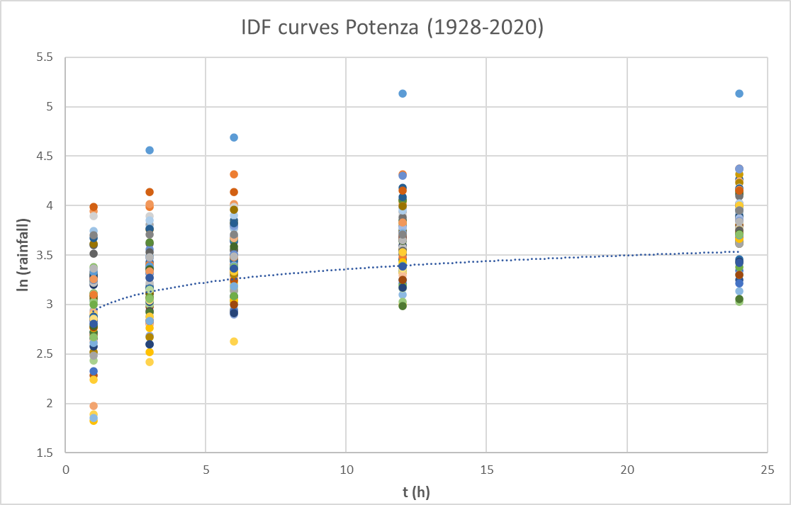
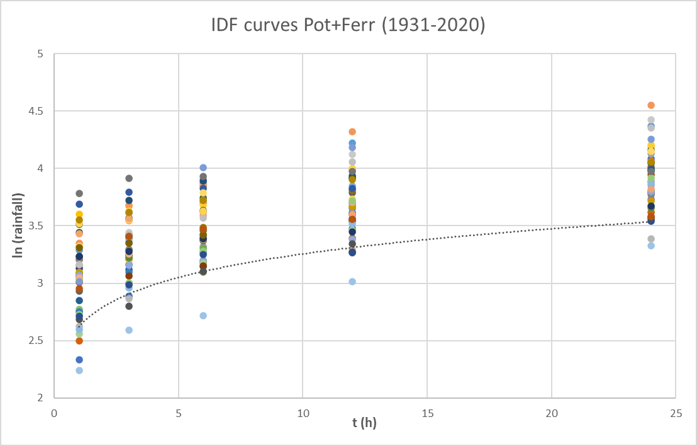
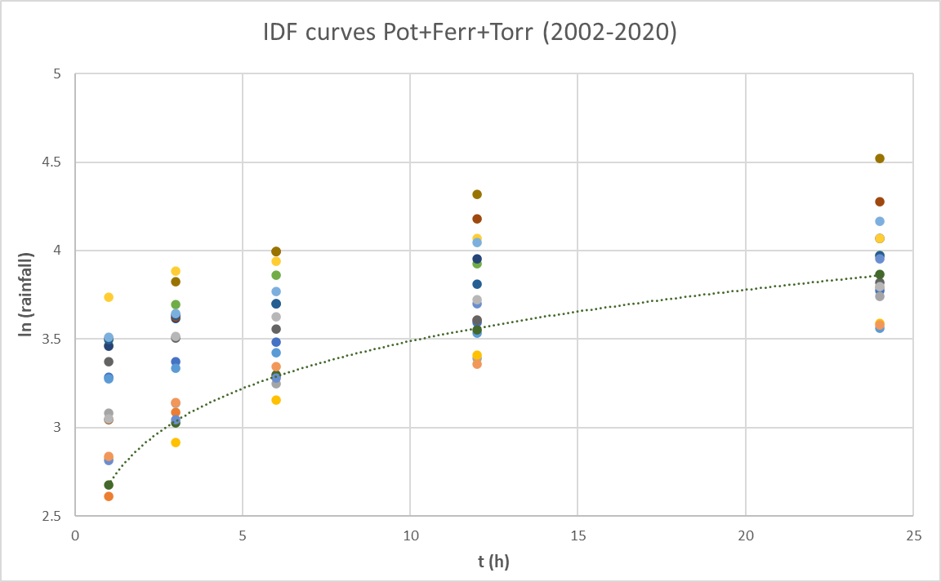
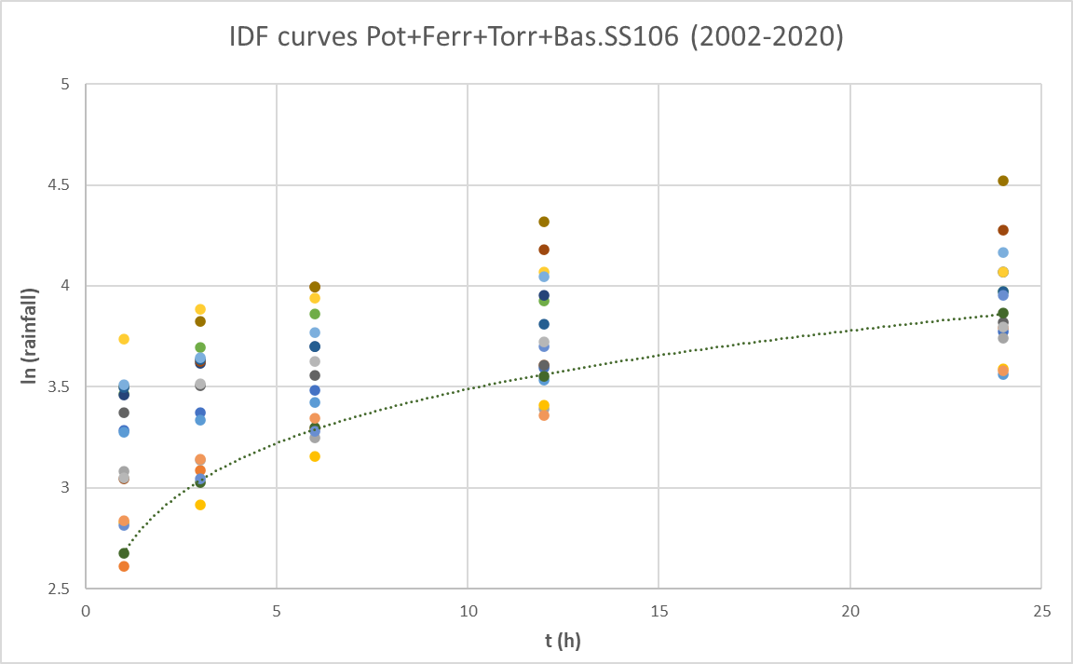
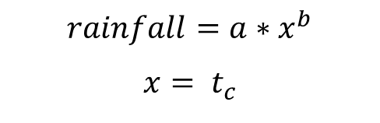
IDF-curves to rainfall distribution during the time of concentration
$$rainfall=a∗x^{b}$$
$$x= t_{c}$$

Slide 12
Flood probability for each cross section

Slide 13
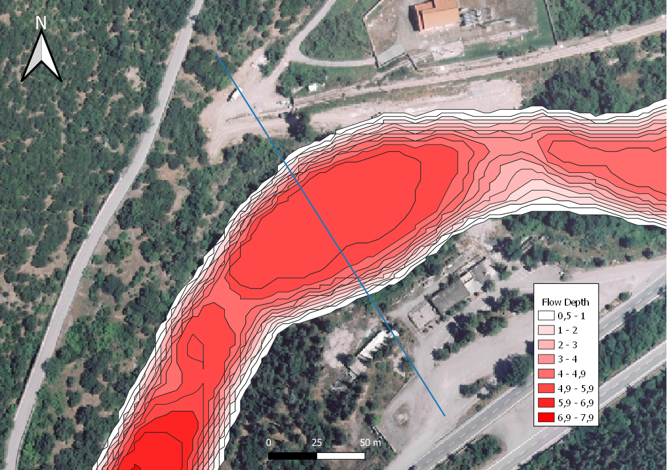
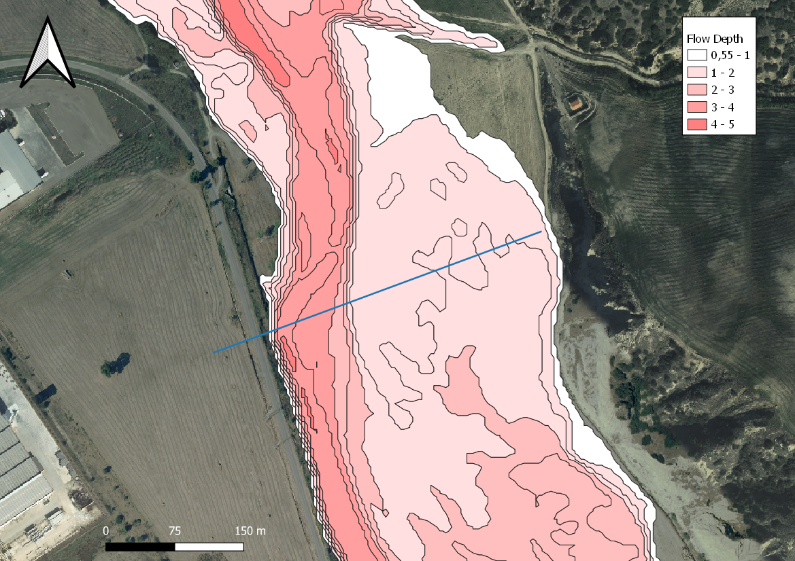
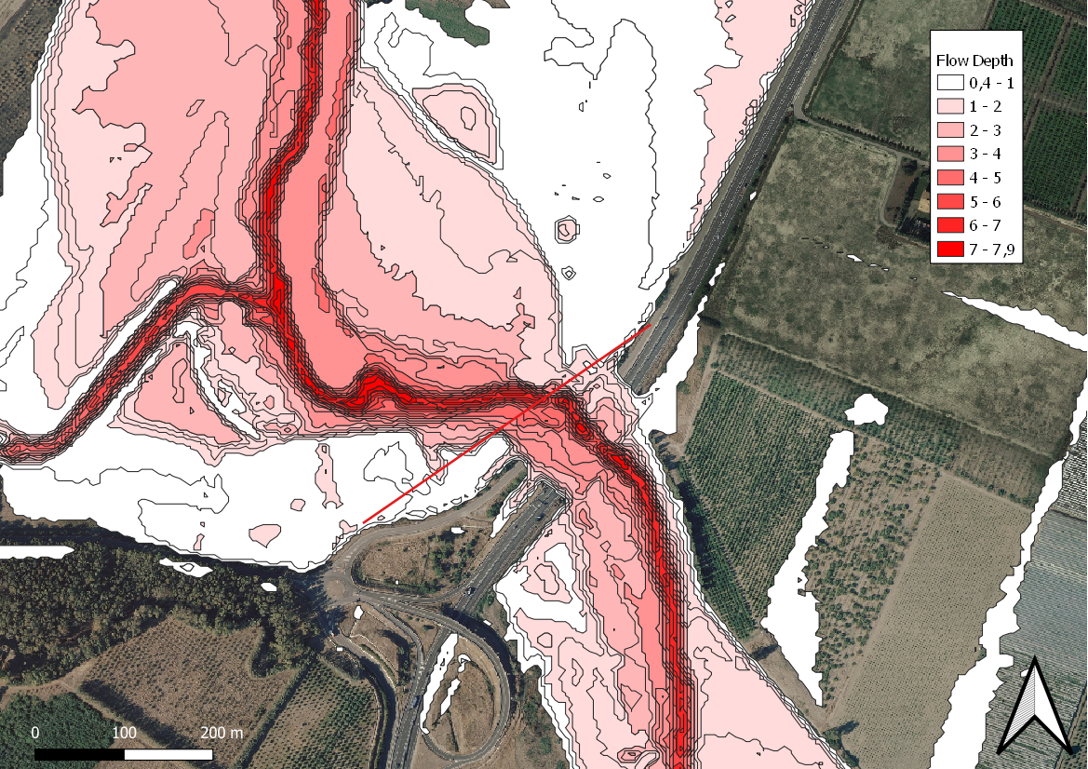
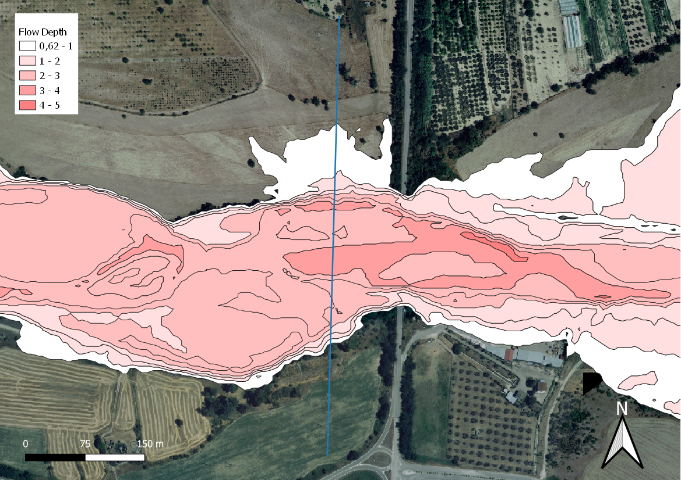
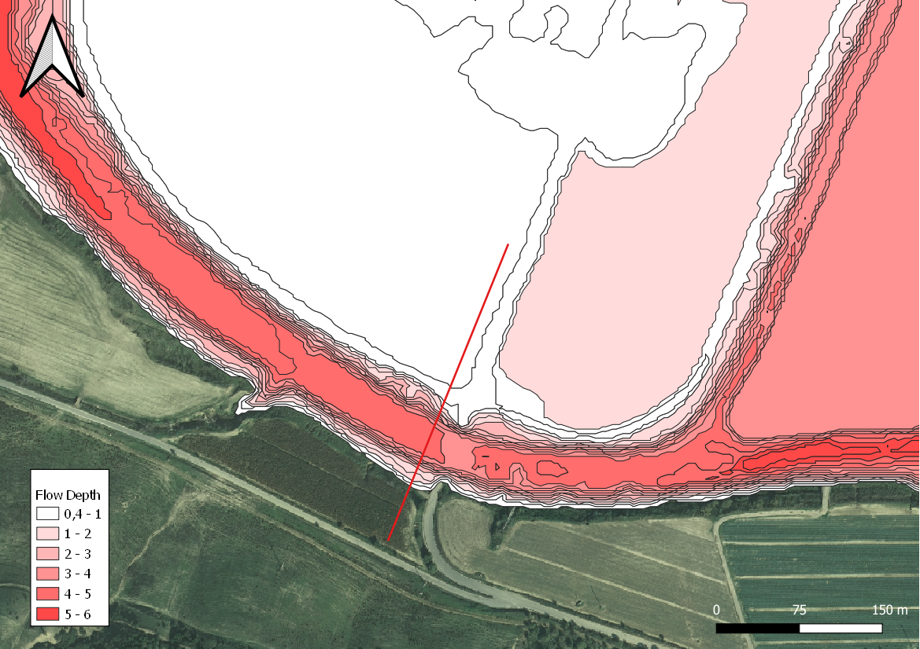
FLO-2D model results comparison (Flow depth)

Slide 14
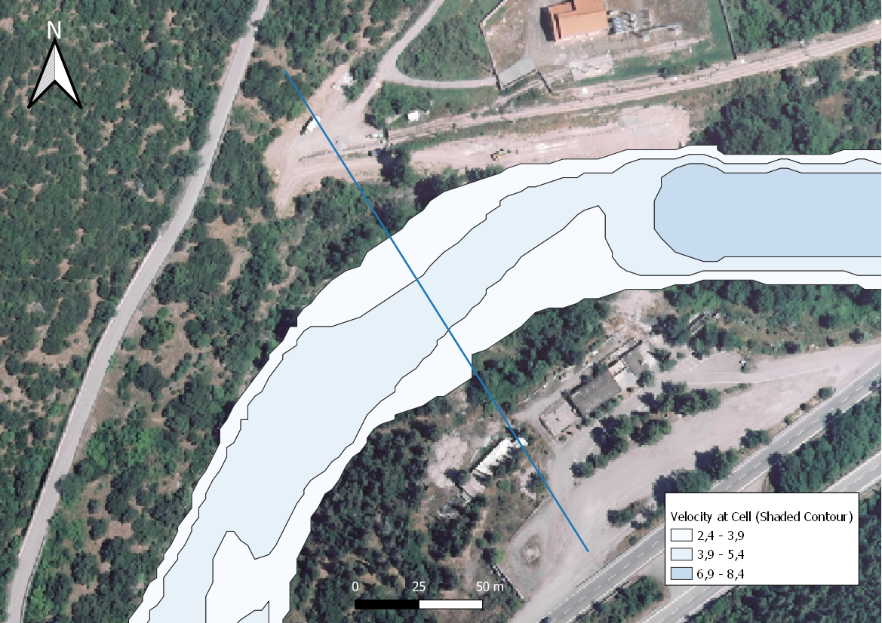
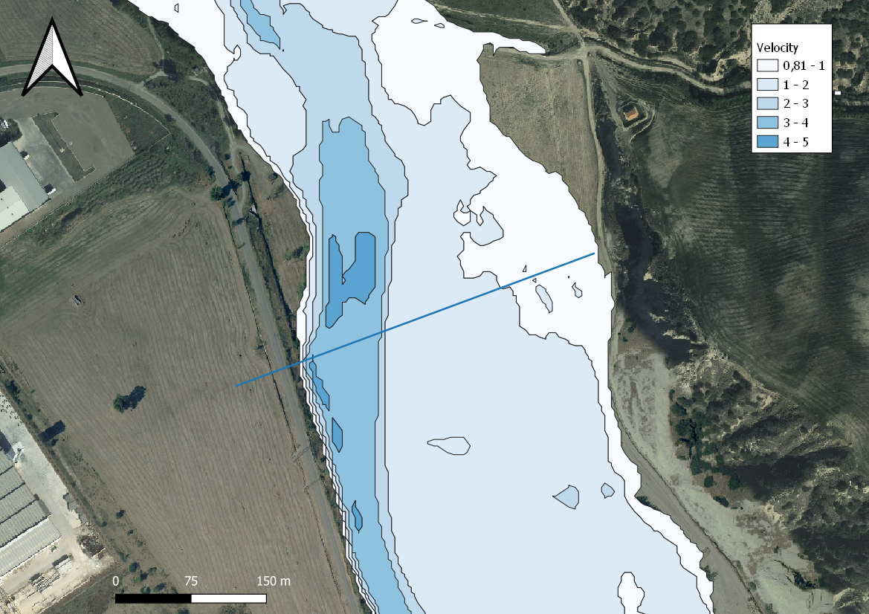
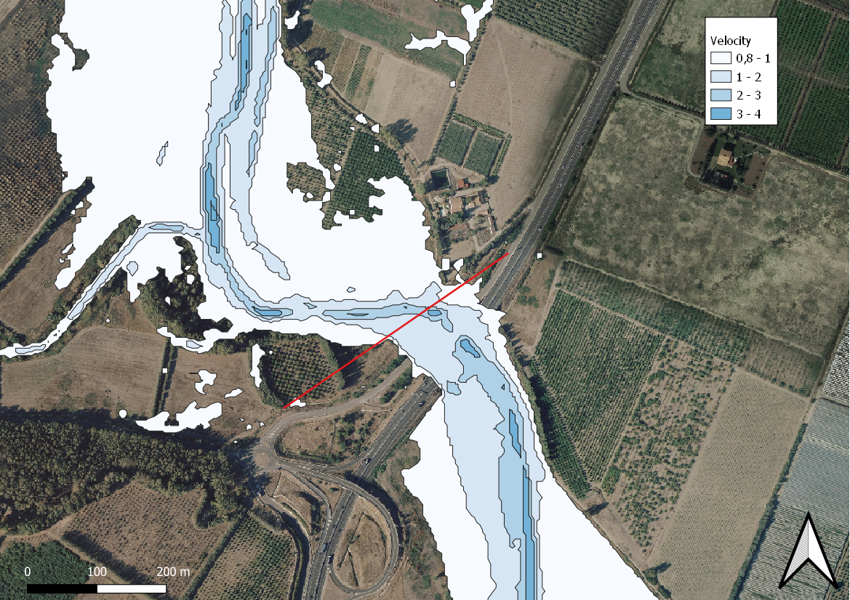
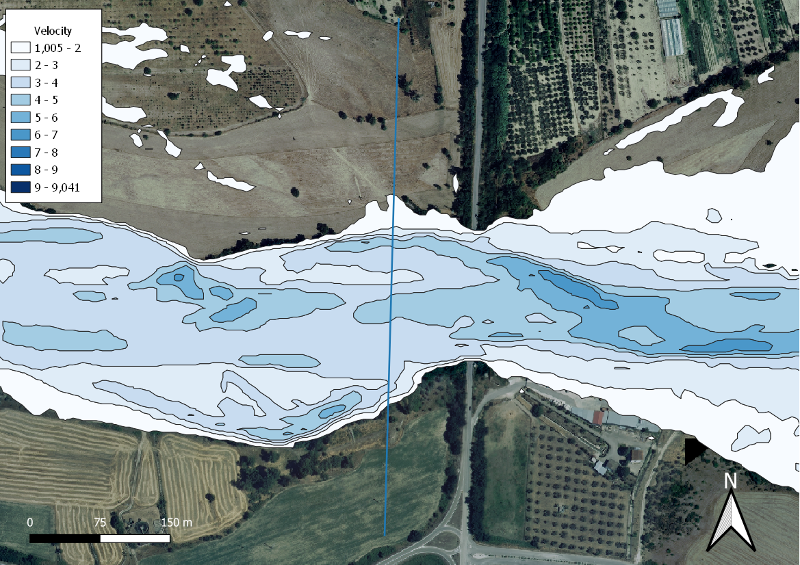
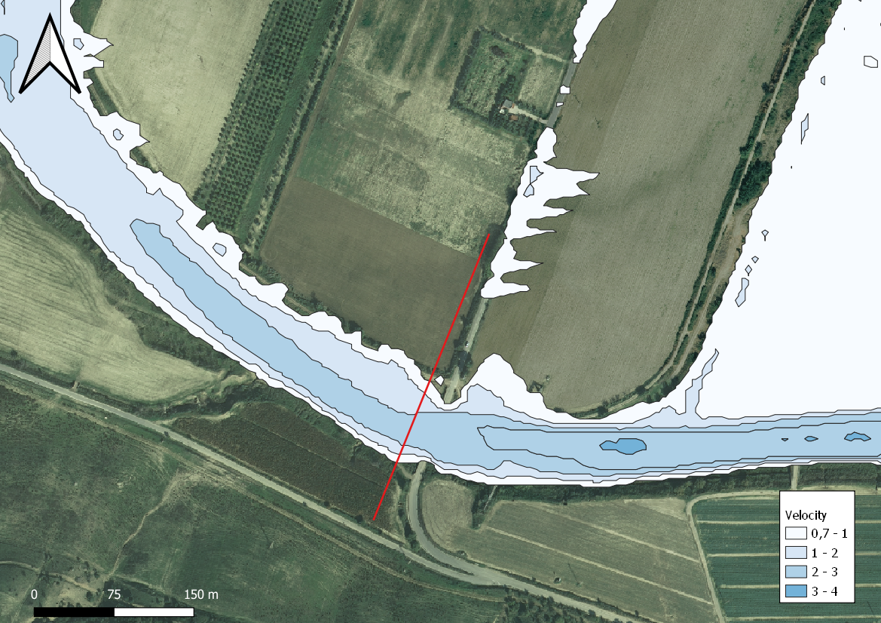
FLO-2D model results comparison (Velocity)

Slide 15
Conclusions
DTM > Cross sections
Hydraulic parameters
Photo sieving > Roughness Coefficient
Land cover > runoff coefficient
Rainfall time series > IDF curves Rainfall intensity
Flood probability
- The match between simulation and modelling encourage the application of our model to other river catchment areas

Slide 16
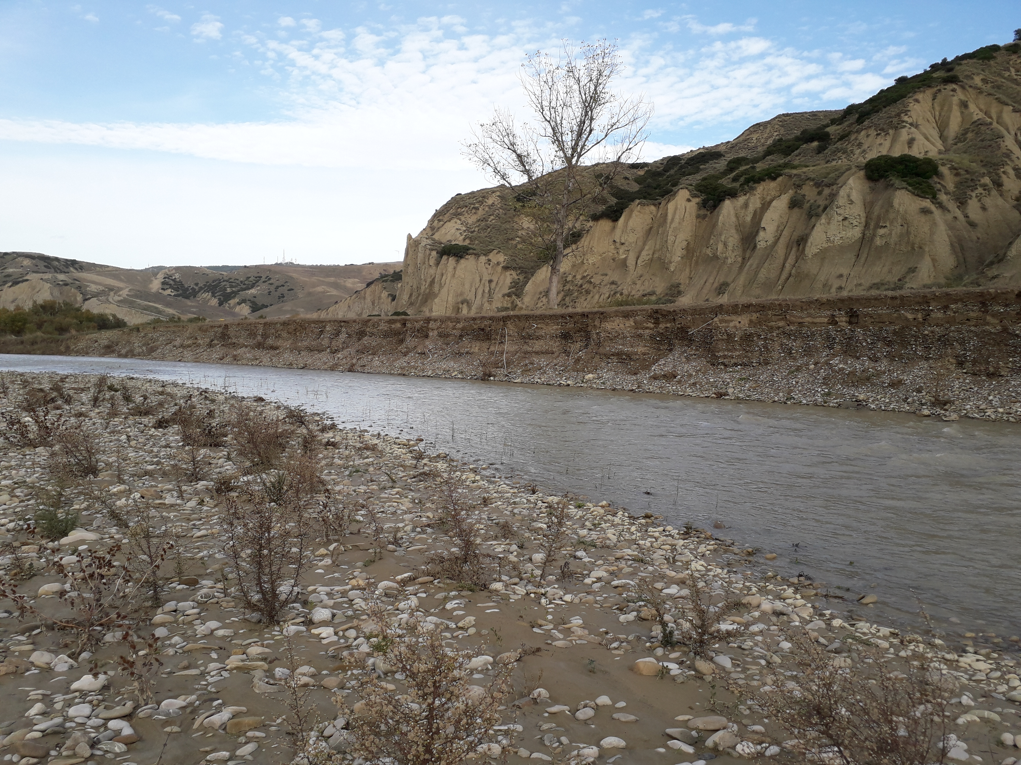
Thank you for your attention
rodolfo.roseto@uniba.it

