Slide 1
Influence of energetic particle precipitation on Antarctic stratospheric chlorine and ozone over the 20th century
Ville Maliniemi
University of Bergen, Norway
ville.maliniemi@uib.no
https://acp.copernicus.org/preprints/acp-2022-151/

Slide 2
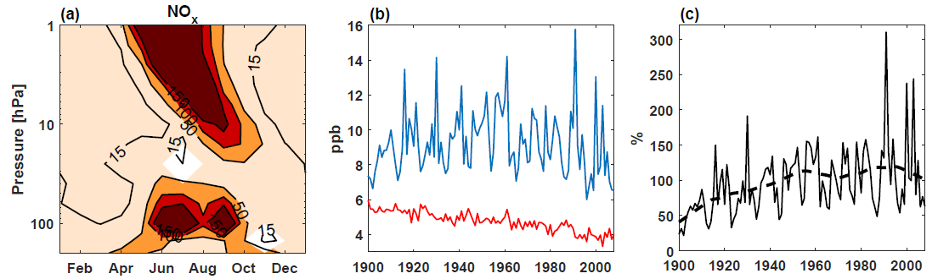
Energetic Particle Precipitation and NOx
Solar activity → energetic particles into the upper (polar) atmosphere
EPP = auroral electrons (<30 keV) and radiation belt electrons (>30 keV), solar proton events and galactic cosmic rays + everything else
noEPP = everything else (CO2, O3, TSI etc.)
Produce nitrogen oxides (NOx), which descends to stratosphere during winter
(EPP-noEPP)/noEPP
1979-2008
10-20 hPa Sep/Oct
EPP (blue) and noEPP (red)
10-20 hPa Sep/Oct
(EPP-noEPP)/noEPP

Slide 3
Antarctic 10-20 hPa O3 and ClO due to EPP
Ozone depletion 10-20 hPa (descending NOx)
ClO decrease 10-20 hPa
(EPP-noEPP)/noEPP
1979-2008

Slide 4
Antarctic 10-20 hPa O3 and ClO due to EPP
Ozone depletion 10-20 hPa (descending NOx)
ClO decrease 10-20 hPa→ production of reservoir agents HCl and ClONO2
(EPP-noEPP)/noEPP
1979-2008
10-20 hPa Sep/Oct
EPP (blue) and noEPP (red)
10-20 hPa Sep/Oct
(EPP-noEPP)/noEPP

Slide 5
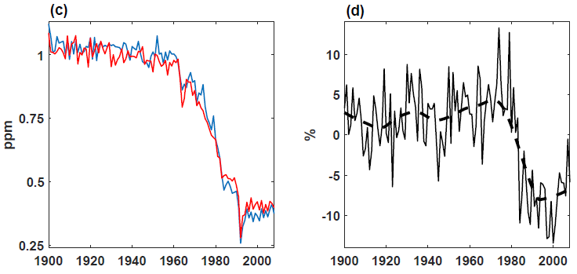
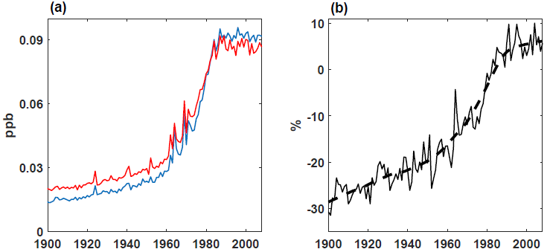
Antarctic 100 hPa O3 and ClO due to EPP
Ozone depletion 100 hPa
ClO increase at 100 hPa→ Heterogenous processing of reservoirs on PSCs
(EPP-noEPP)/noEPP
100 hPa Jul-Sep
EPP (blue) and noEPP (red)
100 hPa Jul-Sep
(EPP-noEPP)/noEPP

Slide 6
Antarctic 100 hPa ClO due to EPP
NO/NO2 ratio higher in CFC era than pre-CFC era
  Less 03 → less NO+O3 reaction forming NO2
Less ClONO2 reformation (ClO+NO2) after heterogenous processing in CFC era
Positive ClO response due to EPP in CFC era, negative ClO response in pre-CFC era

Slide 7
  https://acp.copernicus.org/preprints/acp-2022-151/

