Slide 1
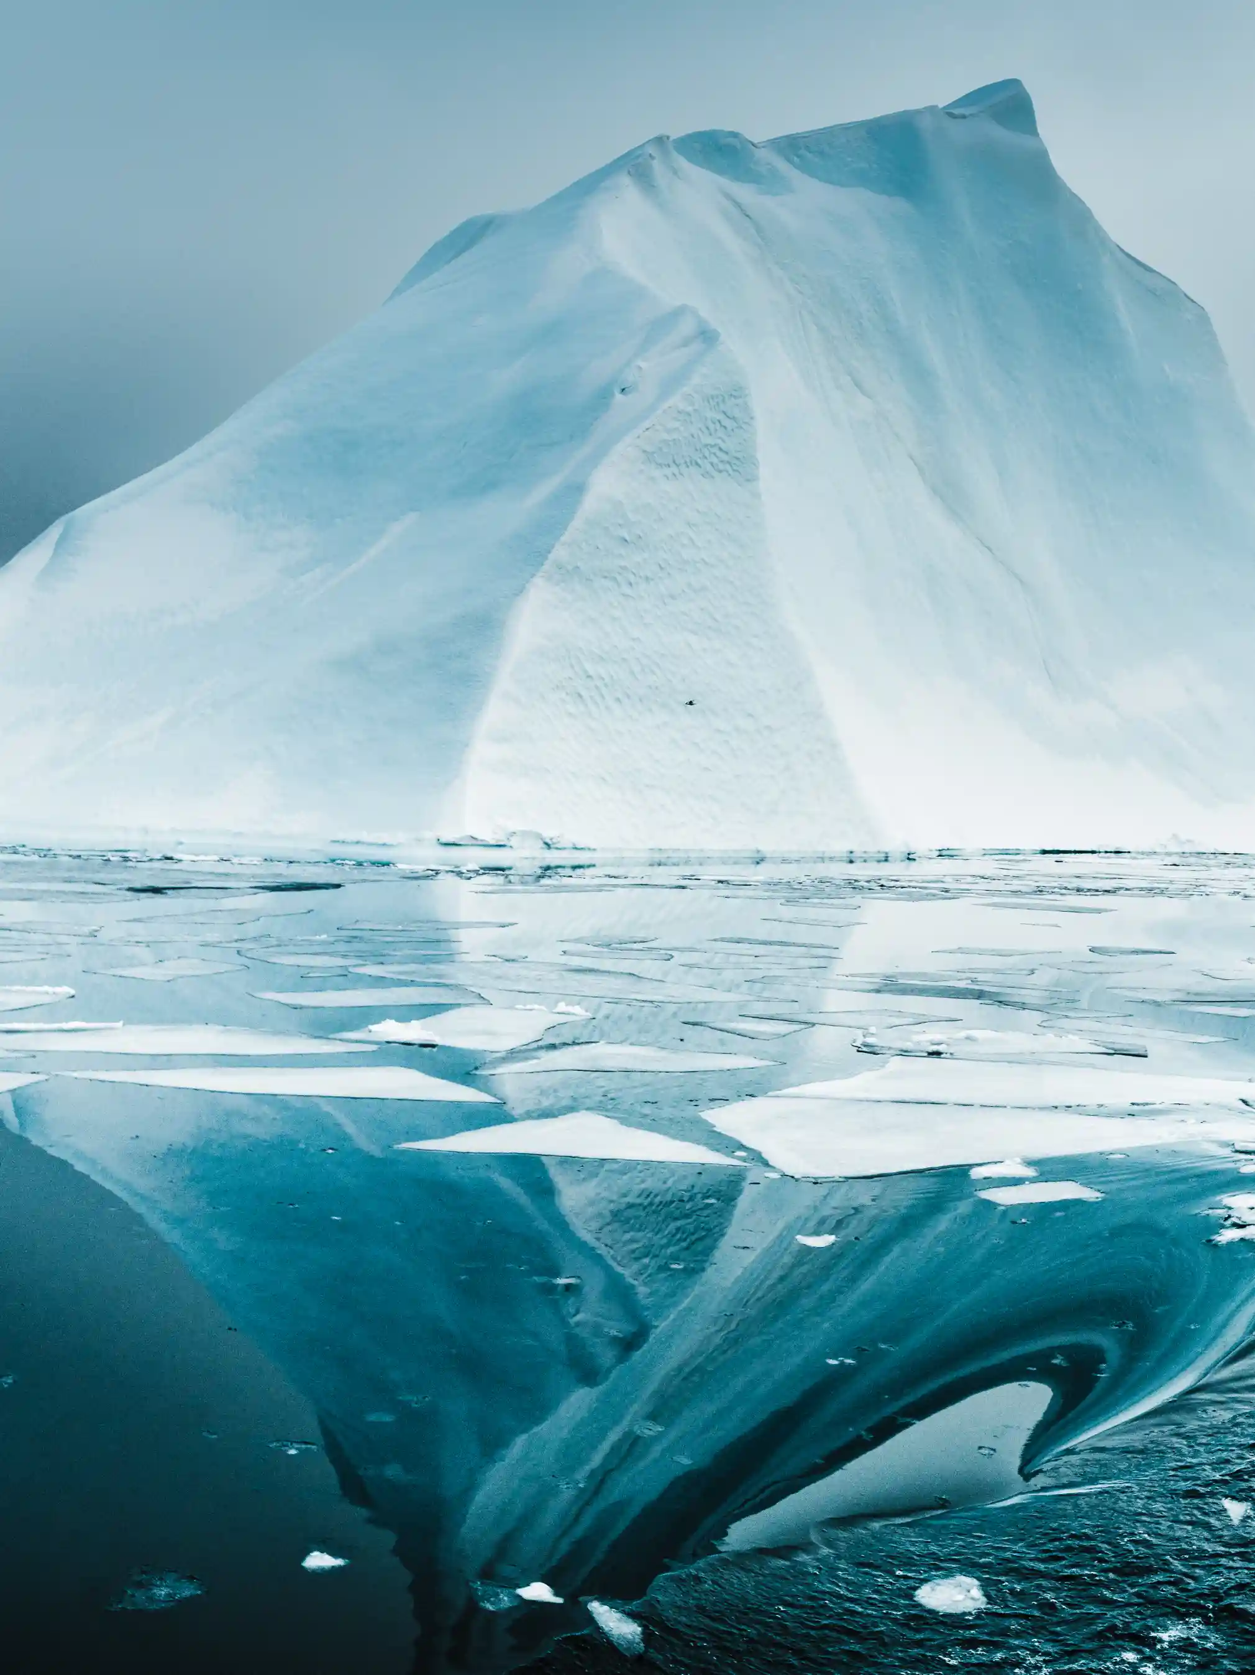
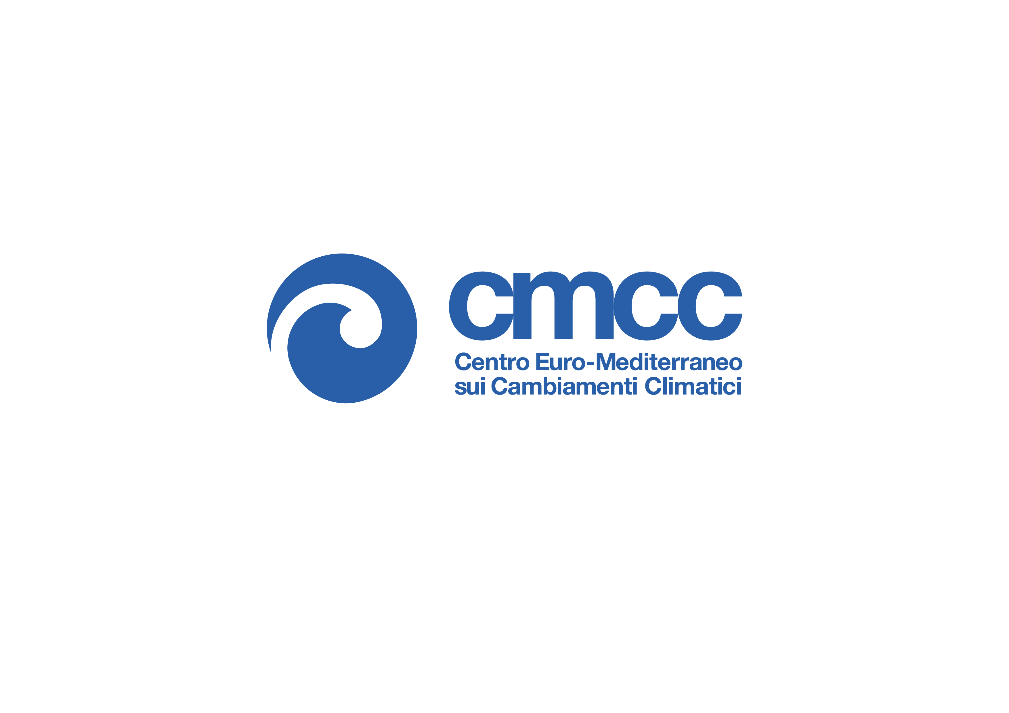



Arctic Ocean heat content as a driver of regional sea ice variability
Elena Bianco^{1,2}, Doroteaciro Iovino¹, Paolo Ruggieri^{1,3}, Stefano Materia¹ and Simona Masina¹
Euro-Mediterranean Center on Climate Change (CMCC), Bologna, Italy
Ca’ Foscari University of Venice, Venice, Italy
University of Bologna, Department of Physics and Astronomy, Bologna, Italy
OS1.6: Changes in the Arctic Ocean, sea ice and subarctic seas systems: Observations, Models and Perspectives
Credit: Benjamin Hardman

Slide 2
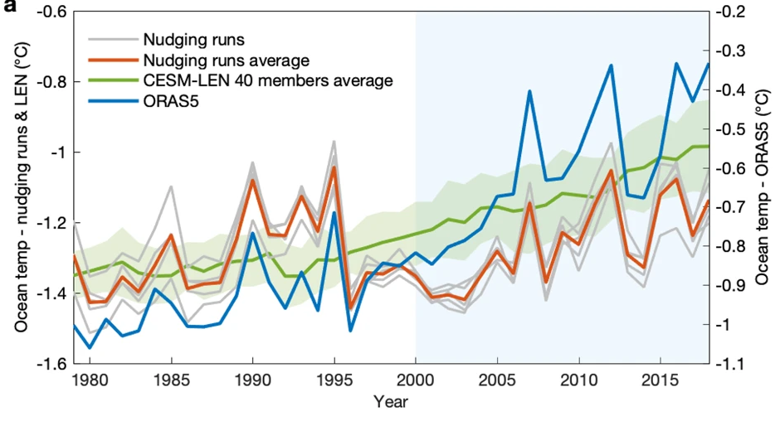
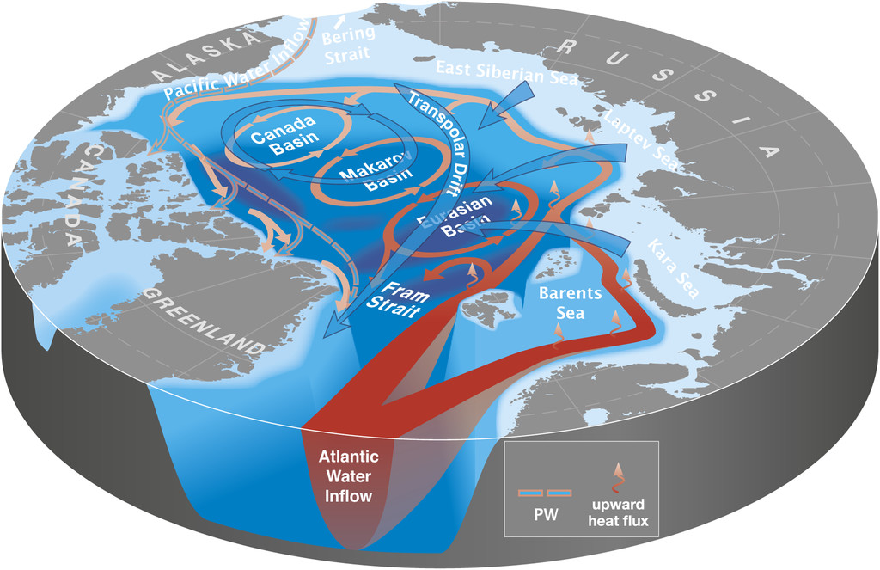
Changes in the Arctic upper ocean energy budget
Heat content in the surface layers of the Arctic Ocean is increasing as a result of stronger advection from the lower latitudes (e.g., Carmack et al. 2015; Barton et al. 2018; Woodgate et al. 2018), enhanced upward heat fluxes (Pokyakov et al. 2017; 2020) and higher absorption of shortwave radiation in seasonally ice-free regions (e.g., Stammerjohn et al. 2012)
There is evidence that a surplus of energy stored in the surface layers alters heat fluxes at the ice-ocean interface, promoting bottom melting and delaying autumn ice growth (Perovich et al. 2007; Serreze et al. 2016)
However, the role of upper ocean heat content in modulating sea ice variability is yet to be fully understood.
SON upper ocean temperature, 1979-2018, in nudging experiments, CESM-LE members, and ORAS5 [Li et al. 2022]
Carmack et al. (2015)
1/5
elena.bianco@cmcc.it EGU2022 OS1.6 25/05/22

Slide 3
Changes in the Arctic upper ocean energy budget
Heat content in the surface layers of the Arctic Ocean is increasing as a result of stronger advection from the lower latitudes (e.g., Carmack et al. 2015; Barton et al. 2018; Woodgate et al. 2018), enhanced upward heat fluxes (Pokyakov et al. 2017; 2020) and higher absorption of shortwave radiation in seasonally ice-free regions (e.g., Stammerjohn et al. 2012)
There is evidence that a surplus of energy stored in the surface layers alters heat fluxes at the ice-ocean interface, promoting bottom melting and delaying autumn ice growth (Perovich et al. 2007; Serreze et al. 2016)
However, the role of upper ocean heat content in modulating sea ice variability is yet to be fully understood.
SON upper ocean temperature, 1979-2018, in nudging experiments, CESM-LE members, and ORAS5 [Li et al. 2022]
Carmack et al. (2015)
1/5
elena.bianco@cmcc.it EGU2022 OS1.6 25/05/22
Notes:
Heat content in the upper layers of the Arctic Ocean is increasing (e.g., Li et al. 2022) as a result of stronger advection of heat from the lower latitudes (Carmack et al. 2015; Barton et al. 2018; Woodgate et al. 2018), vertical heat fluxes from the warmer AW layer (Polyakov et al. 2017; 2020) and higher absorption of solar radiation owing to a prolonged melt season and more extended regions of open-water (Stammerjohn et al. 2012).
The surplus of energy stored in the upper ocean is believed to exert strong influence on sea ice variability by promoting bottom melting and delaying growth onset (e.g., Perovich et al. 2007; Serreze et al. 2016)
However, due to the lack of sustained subsurface observations, our understanding of the role of upper ocean heat content as a driver of sea ice variability on short time scales is unclear.
The accelerating trends towards a thinner sea ice cover implicate a higher susceptibility to regional scale forcing (Perovich et al. 2012). This requires to adopt a new approach that takes into account the impact of locally generated anomalies on sub-regional sea ice variability.

Slide 4
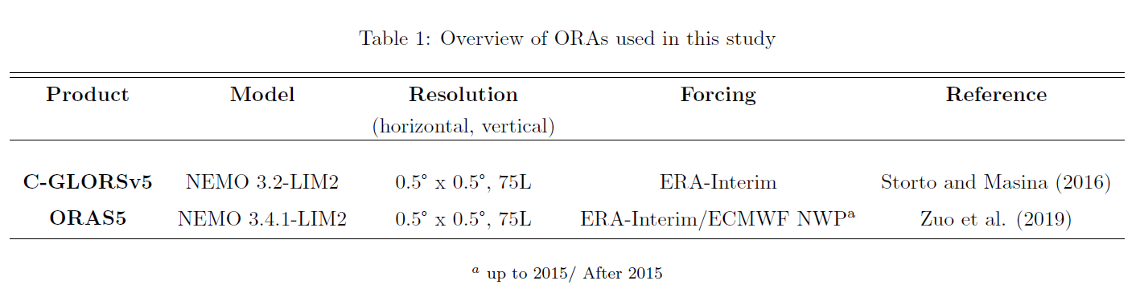
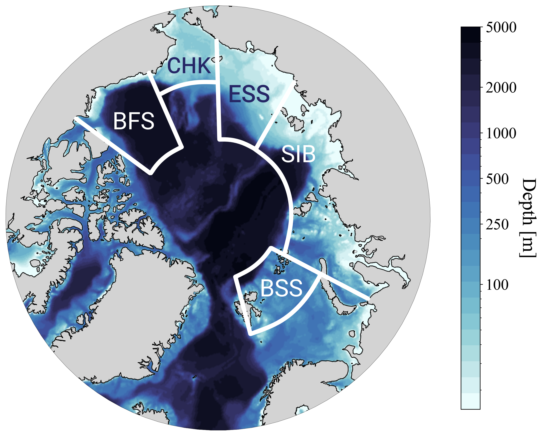

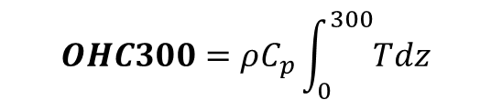
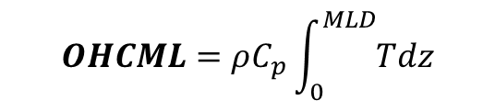
OHC – Sea ice link in two global ocean reanalyses
$$OHCML=ρC_{p}\int_{0}^{MLD}{Tdz}$$
Ocean heat content in the seasonally-varying mixed layer
$$OHC300=ρC_{p}\int_{0}^{300}{Tdz}$$
Ocean heat content in the upper 300 m
Figure 1: the five major Arctic regional seas
$$SIC [ERA5]$$
Sea ice concentration (detrended anomaly)
2/5
elena.bianco@cmcc.it EGU2022 OS1.6 25/05/22
Notes:
In this work we investigate the link between upper ocean heat content and sea ice variability in the 5 major regional seas of the Arctic ocean (Figure 1) using two ocean reanalyses: the CMCC C-GLORS reanalysis version 5 and the ECMWF ORAS5 reanalysis. Their long-term coverage (1980-2017) ensures statistical robustness for our analysis. Both C-GLORSv5 and ORAS5 are produced with the NEMO ocean model (Madec, 2008) coupled to the Louvain-la-Neuve Sea ice Model (LIM2, Fichefet and Morales Maqueda, 1997) and include advanced DA schemes. For each sub-domain, we obtain monthly fields of ocean heat content in the seasonally varying mixed layer and in the upper 300m depth. To assess the effect these two variables have on sea ice, we consider detrended anomalies of sea ice concentration obtained from the ECMWF ERA5 reanalysis and perform a time-lagged correlation within a sub-seasonal time frame.

Slide 5
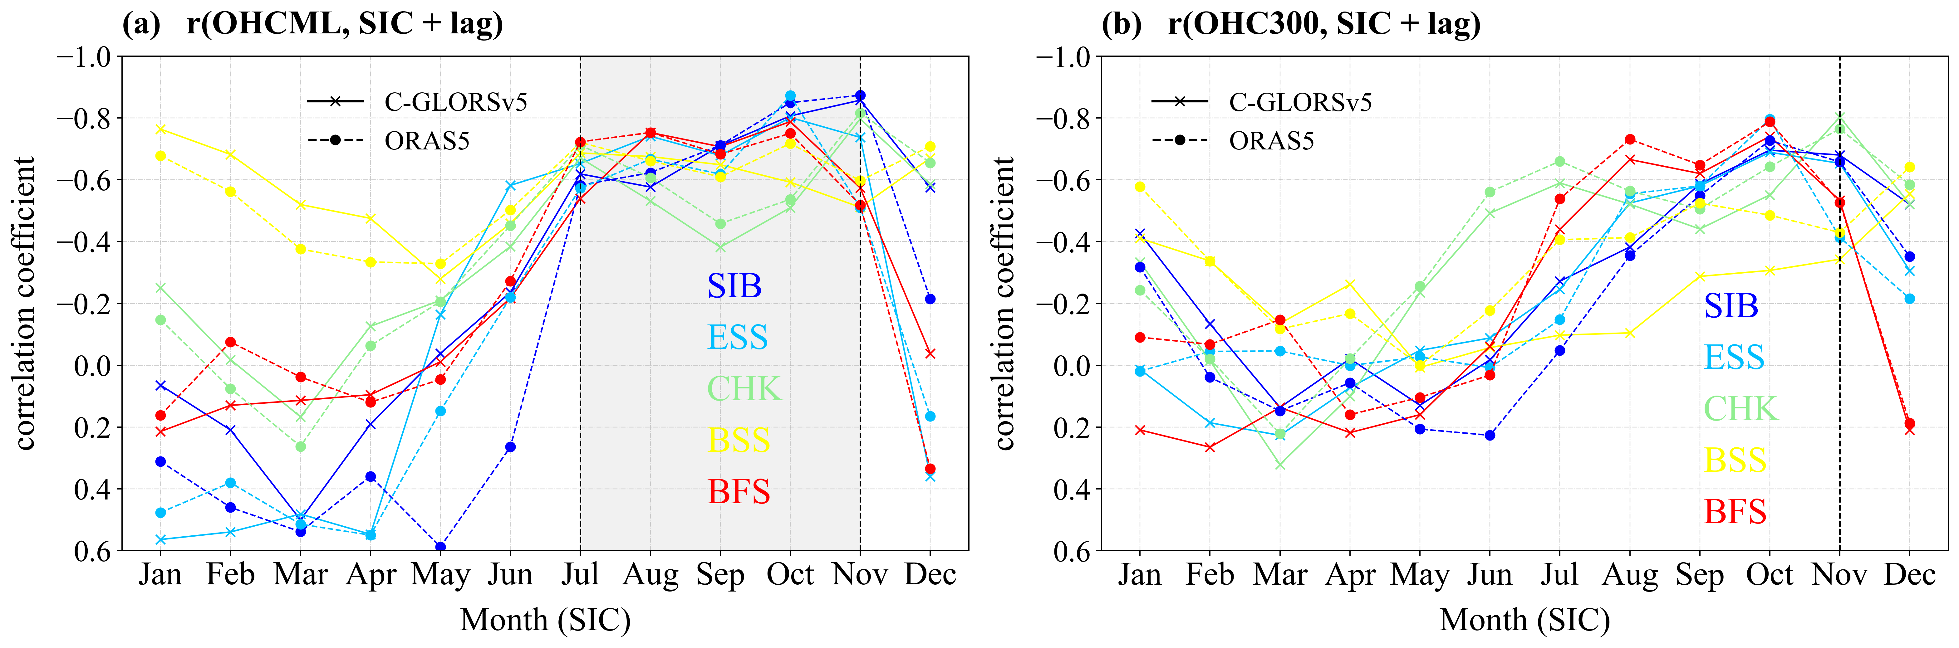
Is upper ocean heat content a good predictor of sea ice variability in the Arctic regional seas?
1-month lag correlations between SIC and OHC at both target depths are strongly season dependent, with progressive strengthening of anti-correlations from melt onset to early autumn
Figure 2: One-month lagged correlations between detrended anomalies of SIC and OHC in the mixed layer (a) and at 300m (b), with the ocean leading sea ice for the 5 Arctic regional seas
3/5
elena.bianco@cmcc.it EGU2022 OS1.6 25/05/22

Slide 6
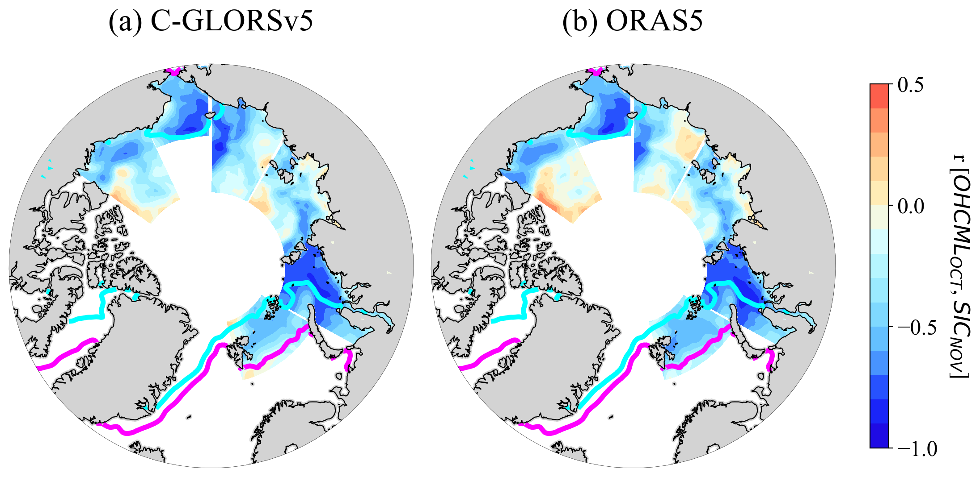
Is upper ocean heat content a good predictor of sea ice variability in the Arctic regional seas?
1-month lag correlations between SIC and OHC at both target depths are strongly season dependent, with progressive strengthening of anti-correlations from melt onset to early autumn
Figure 2: One-month lagged correlations between detrended anomalies of SIC and OHC in the mixed layer (a) and at 300m (b), with the ocean leading sea ice for the 5 Arctic regional seas
Peak correlations occur at freeze onset and are strongest in the Kara and Chukchi seas when sea ice starts to form in November
This result corroborates previous evidence of the link between anomalous summer heat uptake and delayed autumn freeze-up
Figure 3: Correlations between regionally-averaged October OHCML and the grid-point November SIC. Contour lines denote the climatological sea ice edge (magenta) and pack ice extension (cyan) for November
3/5
elena.bianco@cmcc.it EGU2022 OS1.6 25/05/22
Notes:
Figure 2 shows time-lagged correlations between detrended anomalies of SIC and OHC in the Mixed layer (a) and in the upper 300 m (b) with the ocean leading the sea ice by 1 month. The different colors denote the 5 regional seas in Figure 1. We observe a strong seasonality in these correlations, with progressive strengthening of negative correlations from melt onset (June) and a peak in Autumn (October-November, months refer to SIC). This relationship is especially strong for OHC in the mixed layer, where maximum co-variability is reached when the sea ice is in November.
By taking a closer look at correlations between OHCML in October (regionally-averaged) and SIC in November (grid-point), [Figure 3] it emerges this link is particularly pronounced in the Kara and Chukchi sub-domains. This is due to the combined effects of a longer melt season and a thinner, younger ice cover which exhibits substantial variability in these months. Overall, the stronger effect of surface heat anomalies on SIC variability around freeze-onset corroborates previous evidence of the existing link between anomalous heat uptake in summer and delayed ice formation in Autumn,

Slide 7
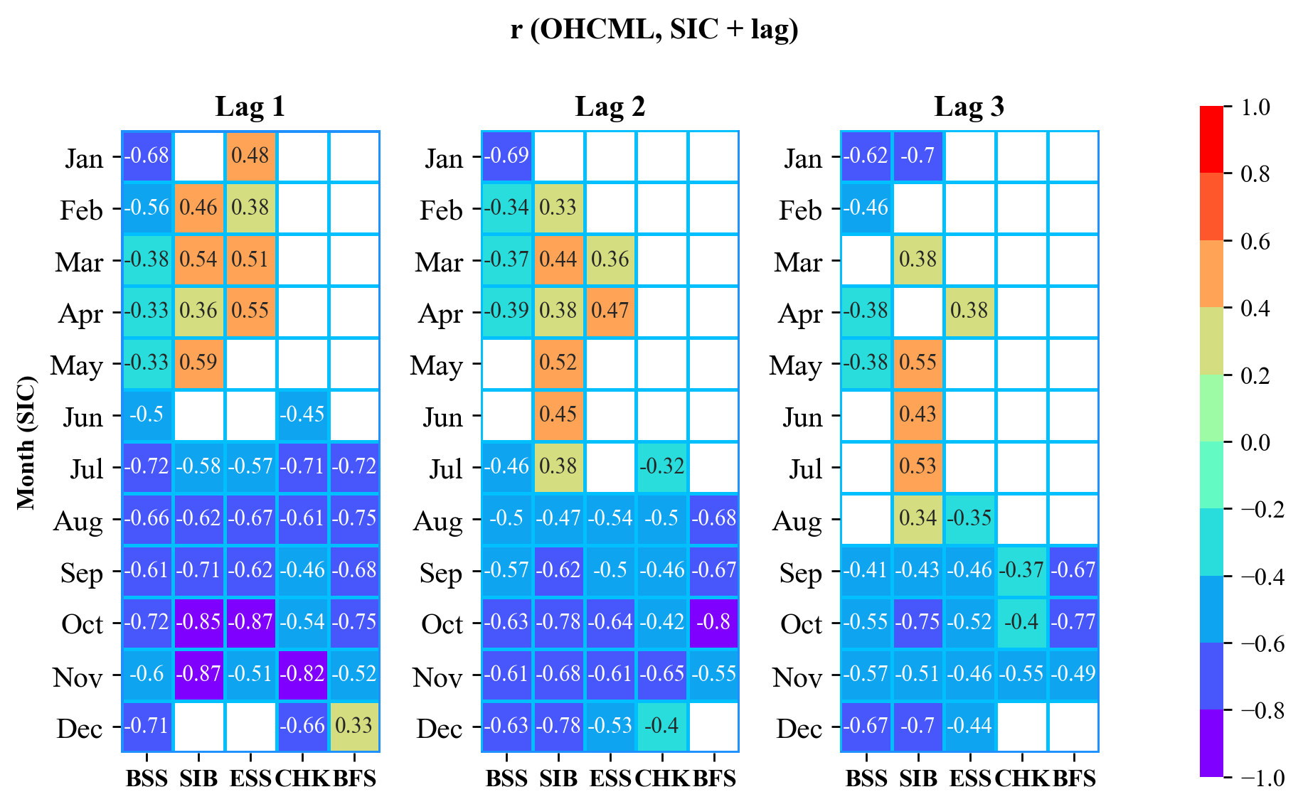
Mixed layer heat content as a predictor of sea ice variability on sub-seasonal time scales
Anomalous heat stored in the mixed layer between June and October is a precursor of SIC variability up to three months later
Regional variability is linked to the timing of heat release to the atmosphere and growth onset
Figure 4: Heatmaps of OHCML-SIC correlations at different monthly lags (ocean leading) and for the 5 regional seas. Non-significant values (Pearson’s, 95%) are masked out.
4/5
elena.bianco@cmcc.it EGU2022 OS1.6 25/05/22
Notes:
Additionally, we extended our analysis to longer lead times to investigate whether heat content in the mixed layer is a good predictor of regional sea ice variability on sub-seasonal time scales.
We find that significant correlations persist up to a lag of three months (ocean leading). Specifically, OHCML anomalies between June and October appear to be a strong precursor of SIC variability in all sub-domains, albeit regional differences emerge owing to differences in melt season duration.
For instance, the effect of OHCML anomalies on Beaufort Sea (BFS) sea ice wanes more quickly as the heat absorbed by the upper ocean is lost to the atmosphere in early autumn, allowing a full ice cover in winter. Conversely, the Atlantic/Eurasian sector (BSS; SIB; ESS) display substantial co-variability with mixed layer heat anomalies which extends into autumn and winter.

Slide 8
Concluding Remarks
Anomalous heat stored in the upper ocean during summer and early autumn is closely linked to sea ice variability up to 3 months later in all major Arctic regional seas.
This relationship is strongest for mixed layer heat content and peaks at the time of freeze-onset, suggesting a link between anomalous summer heat uptake and delayed ice formation.
Ice-albedo feedback
open water fraction
solar heat uptake
ocean-ice heat flux
e.g., Perovich et al. 2007; 2011; Li et al. 2022
Vertical entrainment from lower depths
solar heat uptake
Storage of heat anomalies below the ML
Delayed freeze-onset
Post-summer heat release
AW/PW inflow
e.g., Maykut & McPhee, 1995; Jackson et al. 2012; Ivanov et al. 2016
5/5
elena.bianco@cmcc.it EGU2022 OS1.6 25/05/22
Notes:
The key findings of this work are in general agreement with previous studies, and can be corroborated by two dominant physical mechanisms:
1) The Ice-albedo feedback: Increased open water fraction following melt onset promotes absorption of shortwave radiation by the surface mixed layer. Anomalous energy stored in the upper layers activates and sustains a positive ocean-ice flux.
2) Vertical entrainment from the lower depths: Heat anomalies which originate from solar radiation and / or from northward advection of Atlantic and Pacific Water can become trapped by stratification and be stored underneath the mixed layer during the summer season. When the mixed layer begins to deepen in autumn, turbulent mixing increases and heat anomalies are brought back to the surface via vertical entrainment. If this mechanism occurs after the initial sea ice edge advance, it can significantly slow down ice formation and contribute to negative SIC anomalies at the time of freeze-onset.

Slide 9
Thank you for your attention
Barton, B.I., Lenn, Y.D. and Lique, C., 2018. Observed Atlantification of the Barents Sea causes the Polar Front to limit the expansion of winter sea ice. Journal of Physical Oceanography, 48(8), pp.1849-1866.
Carmack, E., Polyakov, I., Padman, L., Fer, I., Hunke, E., Hutchings, J., Jackson, J., Kelley, D., Kwok, R., Layton, C. and Melling, H., 2015. Toward quantifying the increasing role of oceanic heat in sea ice loss in the new Arctic. Bulletin of the American Meteorological Society, 96(12), pp.2079-2105.
Ivanov, V., Alexeev, V., Koldunov, N.V., Repina, I., Sandø, A.B., Smedsrud, L.H. and Smirnov, A., 2016. Arctic Ocean heat impact on regional ice decay: A suggested positive feedback. Journal of Physical Oceanography, 46(5), pp.1437-1456.
Jackson, J.M., Williams, W.J. and Carmack, E.C., 2012. Winter sea‐ice melt in the Canada Basin, Arctic Ocean. Geophysical Research Letters, 39(3).
Li, Z., Ding, Q., Steele, M. and Schweiger, A., 2022. Recent upper Arctic Ocean warming expedited by summertime atmospheric processes. Nature Communications, 13(1), pp.1-11.
Maykut, G.A. and McPhee, M.G., 1995. Solar heating of the Arctic mixed layer. Journal of Geophysical Research: Oceans, 100(C12), pp.24691-24703.
Perovich, D.K., Light, B., Eicken, H., Jones, K.F., Runciman, K. and Nghiem, S.V., 2007. Increasing solar heating of the Arctic Ocean and adjacent seas, 1979–2005: Attribution and role in the ice‐albedo feedback. Geophysical Research Letters, 34(19).
Polyakov, I.V., Pnyushkov, A.V., Alkire, M.B., Ashik, I.M., Baumann, T.M., Carmack, E.C., Goszczko, I., Guthrie, J., Ivanov, V.V., Kanzow, T. and Krishfield, R., 2017. Greater role for Atlantic inflows on sea-ice loss in the Eurasian Basin of the Arctic Ocean. Science, 356(6335), pp.285-291.
Polyakov, I.V., Rippeth, T.P., Fer, I., Alkire, M.B., Baumann, T.M., Carmack, E.C., Ingvaldsen, R., Ivanov, V.V., Janout, M., Lind, S. and Padman, L., 2020. Weakening of cold halocline layer exposes sea ice to oceanic heat in the eastern Arctic Ocean. Journal of Climate, 33(18), pp.8107-8123.
Serreze, M.C., Crawford, A.D., Stroeve, J.C., Barrett, A.P. and Woodgate, R.A., 2016. Variability, trends, and predictability of seasonal sea ice retreat and advance in the C hukchi S ea. Journal of Geophysical Research: Oceans, 121(10), pp.7308-7325.
Stammerjohn, S., Massom, R., Rind, D. and Martinson, D., 2012. Regions of rapid sea ice change: An inter‐hemispheric seasonal comparison. Geophysical Research Letters, 39(6).
Woodgate, R.A., 2018. Increases in the Pacific inflow to the Arctic from 1990 to 2015, and insights into seasonal trends and driving mechanisms from year-round Bering Strait mooring data. Progress in Oceanography, 160, pp.124-154.
Credit: Benjamin Hardman

