Slide 1


Electron Dynamics in a Chorus Wave Field Generated from Particle-in-Cell Simulations
Zeyu An¹, Yifan Wu¹ and Xin Tao¹
¹CAS Key Laboratory of Geospace Environment, Department of Geophysics and Planetary Sciences,
University of Science and Technology of China, Hefei, China

Slide 2
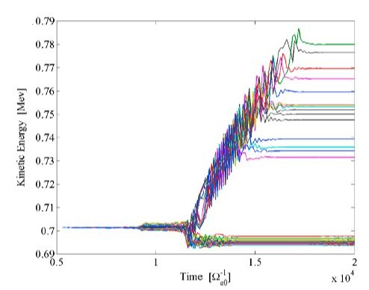
Basic Nonlinear Theory Prediction
Assumption: a coherent wave
Prediction: chorus-driven rapid electron acceleration/scattering
(phase-bunching and -trapping)
(Omura et al., 2018 JGR)

Slide 3
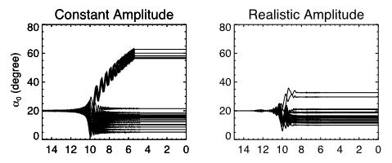
Applicability of Nonlinear Theory
Properties of realistic chorus waves:
- amplitude modulation (Tao et al., 2012 GRL, see the lower-right figure)
- phase decoherence (Zhang et al., 2020 GRL)
- dynamic evolution
(Tao et al.,2021 JGR), etc.
What will happen if we consider
a fully realistic chorus wave?

Slide 4
Construction of Chorus Wave Fields
WF_{PIC}: a PIC-generated, fully realistic chorus wave field
(considering no oblique propagation)
Why PIC? Self-consistent equations → realistic output
(see Zhang et al., 2021 JGR)
Control groups:
- WF_{AM}: amplitude of WF_{PIC} + smooth wave phase
- WF_{CA}: constant amplitude + smooth wave phase
(constructed following Tao et al., 2012 GRL)

Slide 5
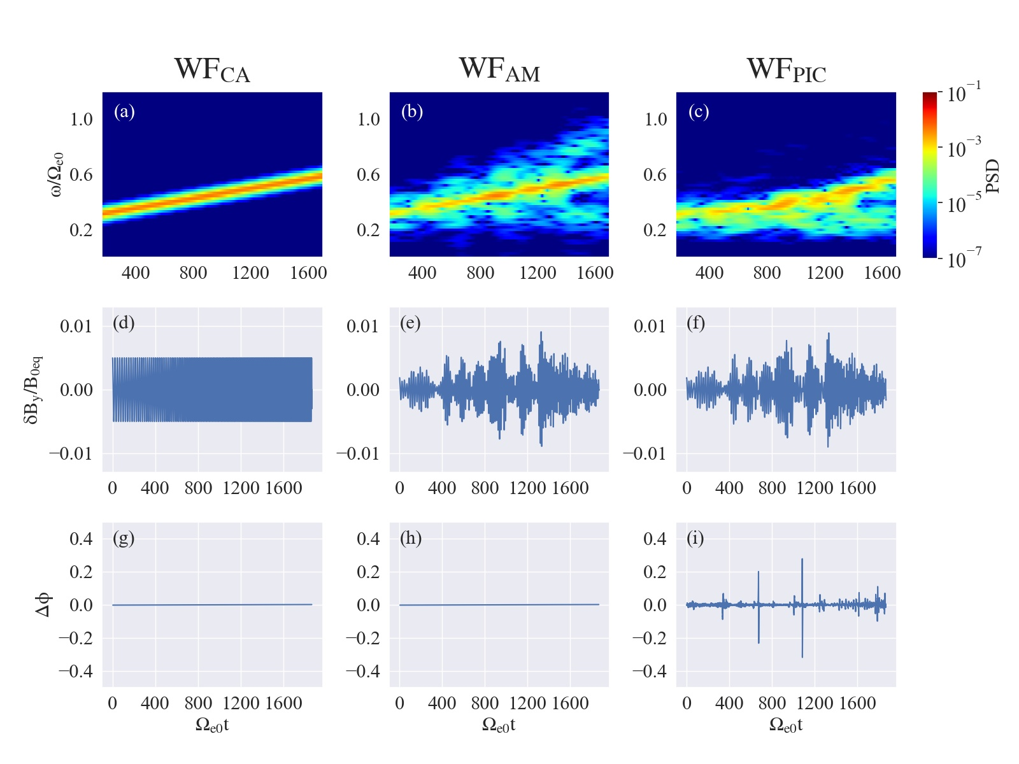
smooth
wave phase
fluctuating
wave phase

Slide 6
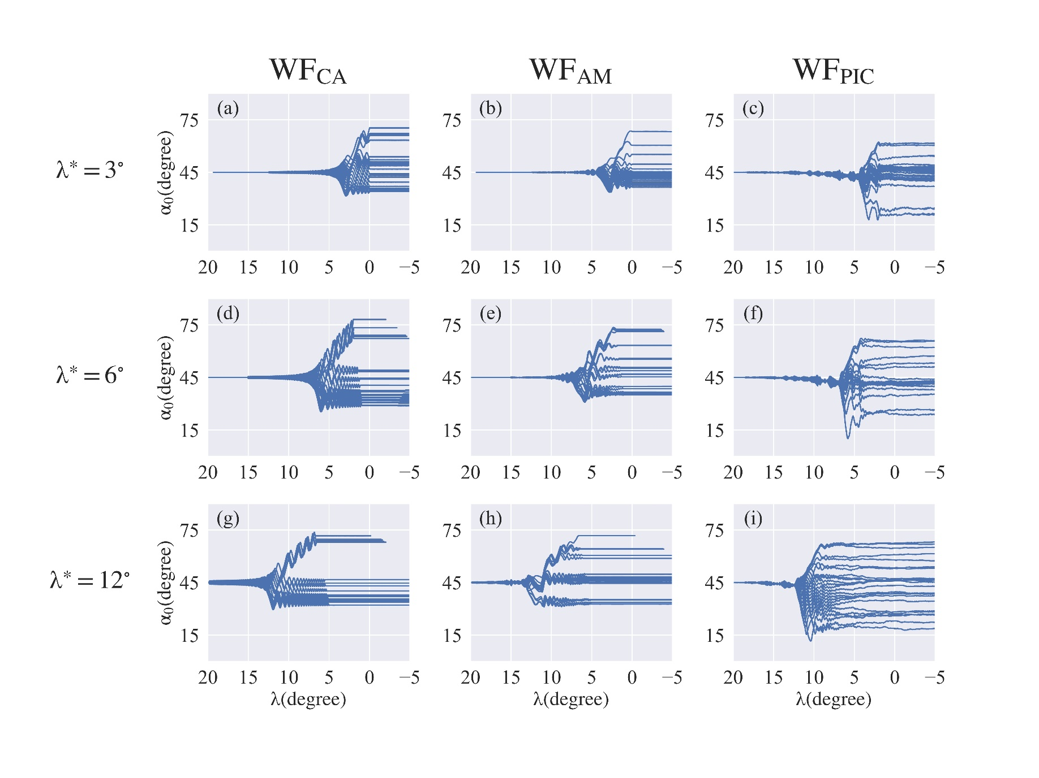
Test-Particle Simulation Results
“two-grouped”:
phase-bunching and -trapping

Slide 7
Summary
We present the first test-particle simulations which apply PIC-generated chorus waves as input
Nonlinear processes, especially phase-trapping, are suppressed by various properties of realistic chorus waves
Electron behavior could be close to being stochastic when considering fully realistic chorus waves in the radiation belt

