Slide 1
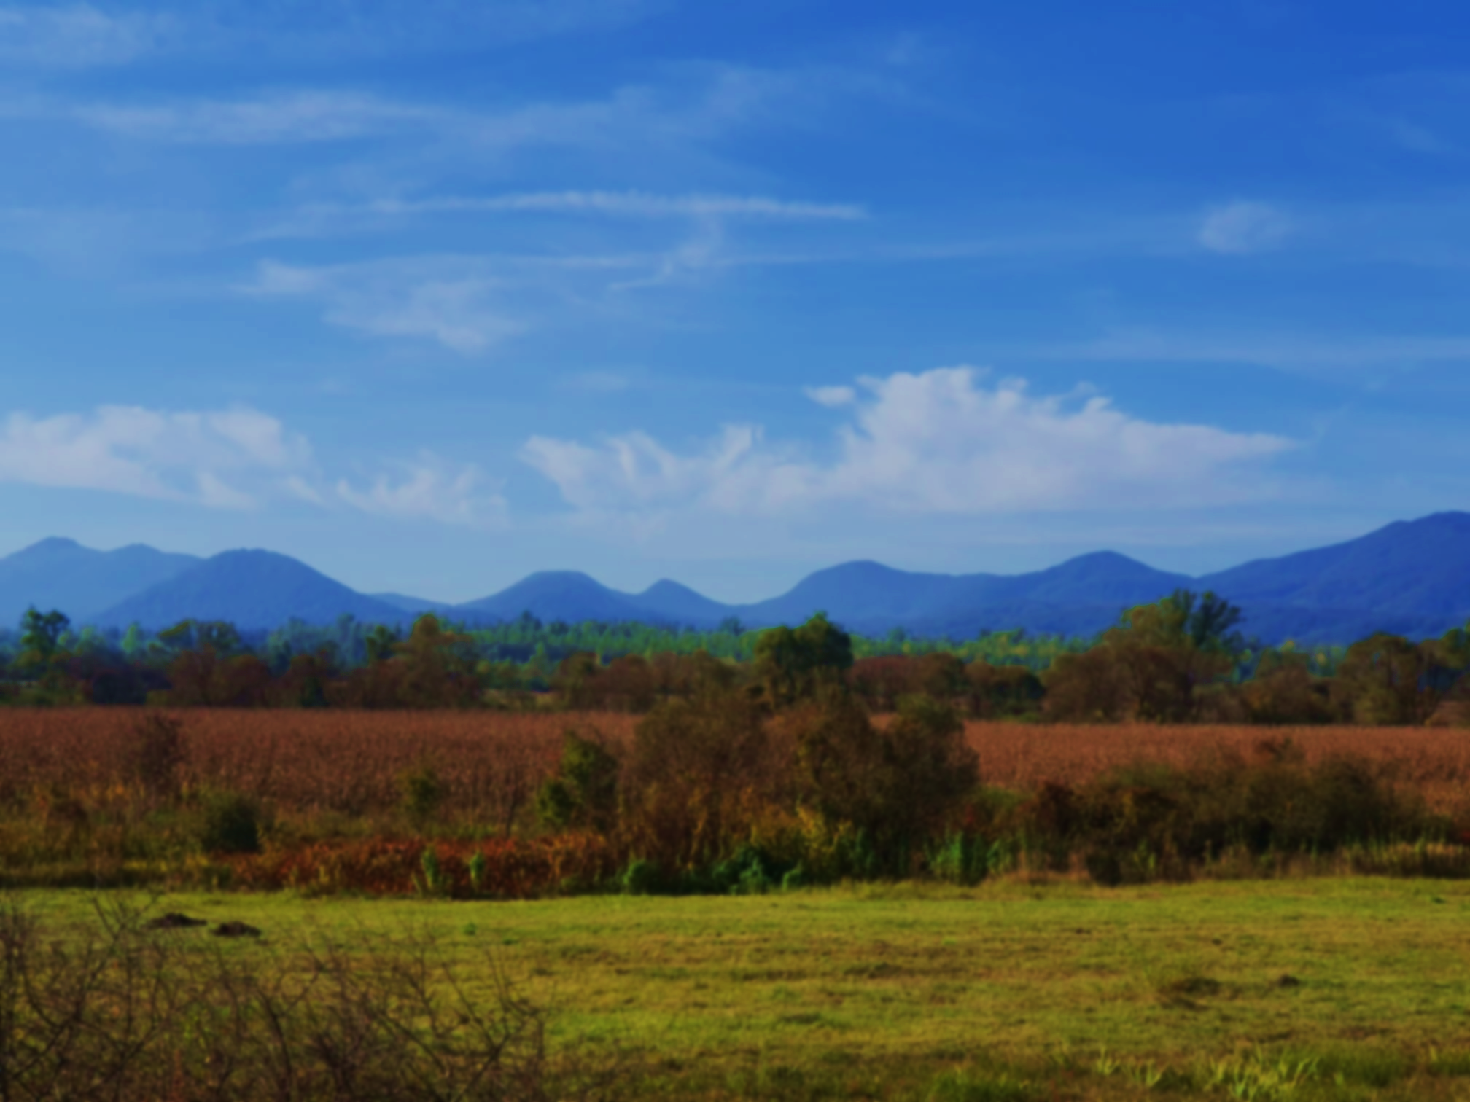






Reconstruction of the Ukrainian Carpathians fold-thrust belt
EGU 2022
Thursday 26th May, Vienna
QR code to my abstract
From low-temperature thermochronology and tectono-stratigraphic analysis
Marion Roger¹, Arjan de Leeuw¹, Peter van der Beek², and Laurent Husson³
1 ISTerre, Institut des sciences de la Terre, Université Grenoble-Alpes, France
2 Institut für Geowissenschaften Universität Potsdam, Germany
3 CNRS, ISTerre, Institut des sciences de la Terre, France
Contact: (marion.roger@univ-grenoble-alpes.fr)

Slide 2
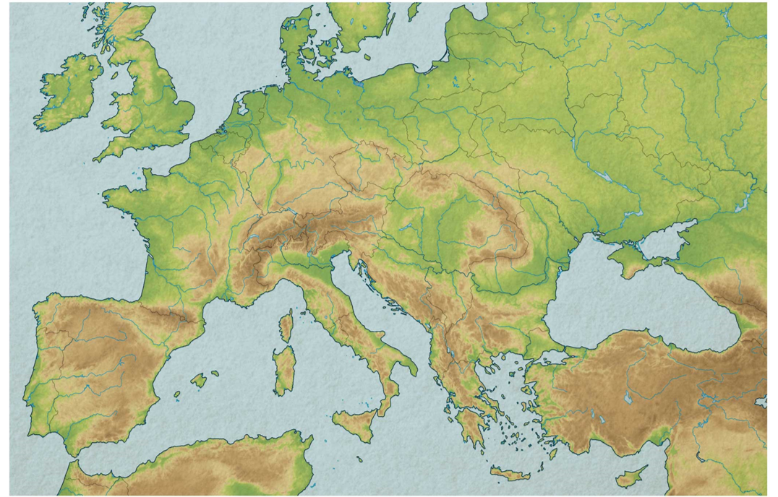
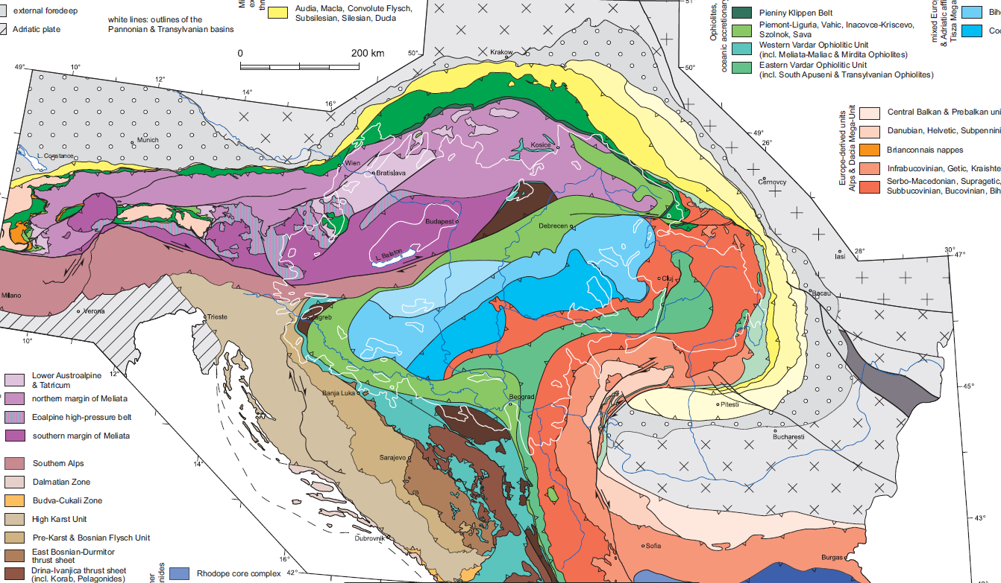
Formation of the Carpathians
Present
Ukrainian Carpathians
ALCAPA
Alps
Tizsa-Dacia
Dinarides
Balkans
Schmid et al.,2008
Notes:
In europe
Alpin belt

Slide 3
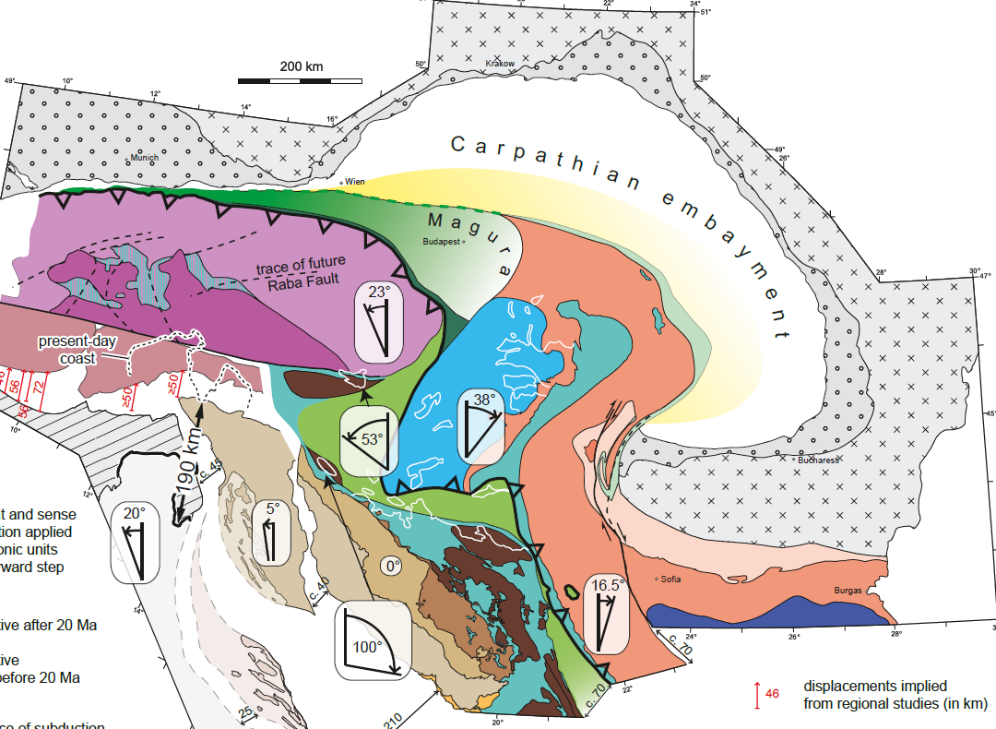
Formation of the Carpathians
Formation of the Carpathians
Early Miocene
Flysch basin
ALCAPA
Tizsa
Dacia
Dacia
Ustaszewski et al., 2008
Notes:
Contraction of plate in embayment

Slide 4
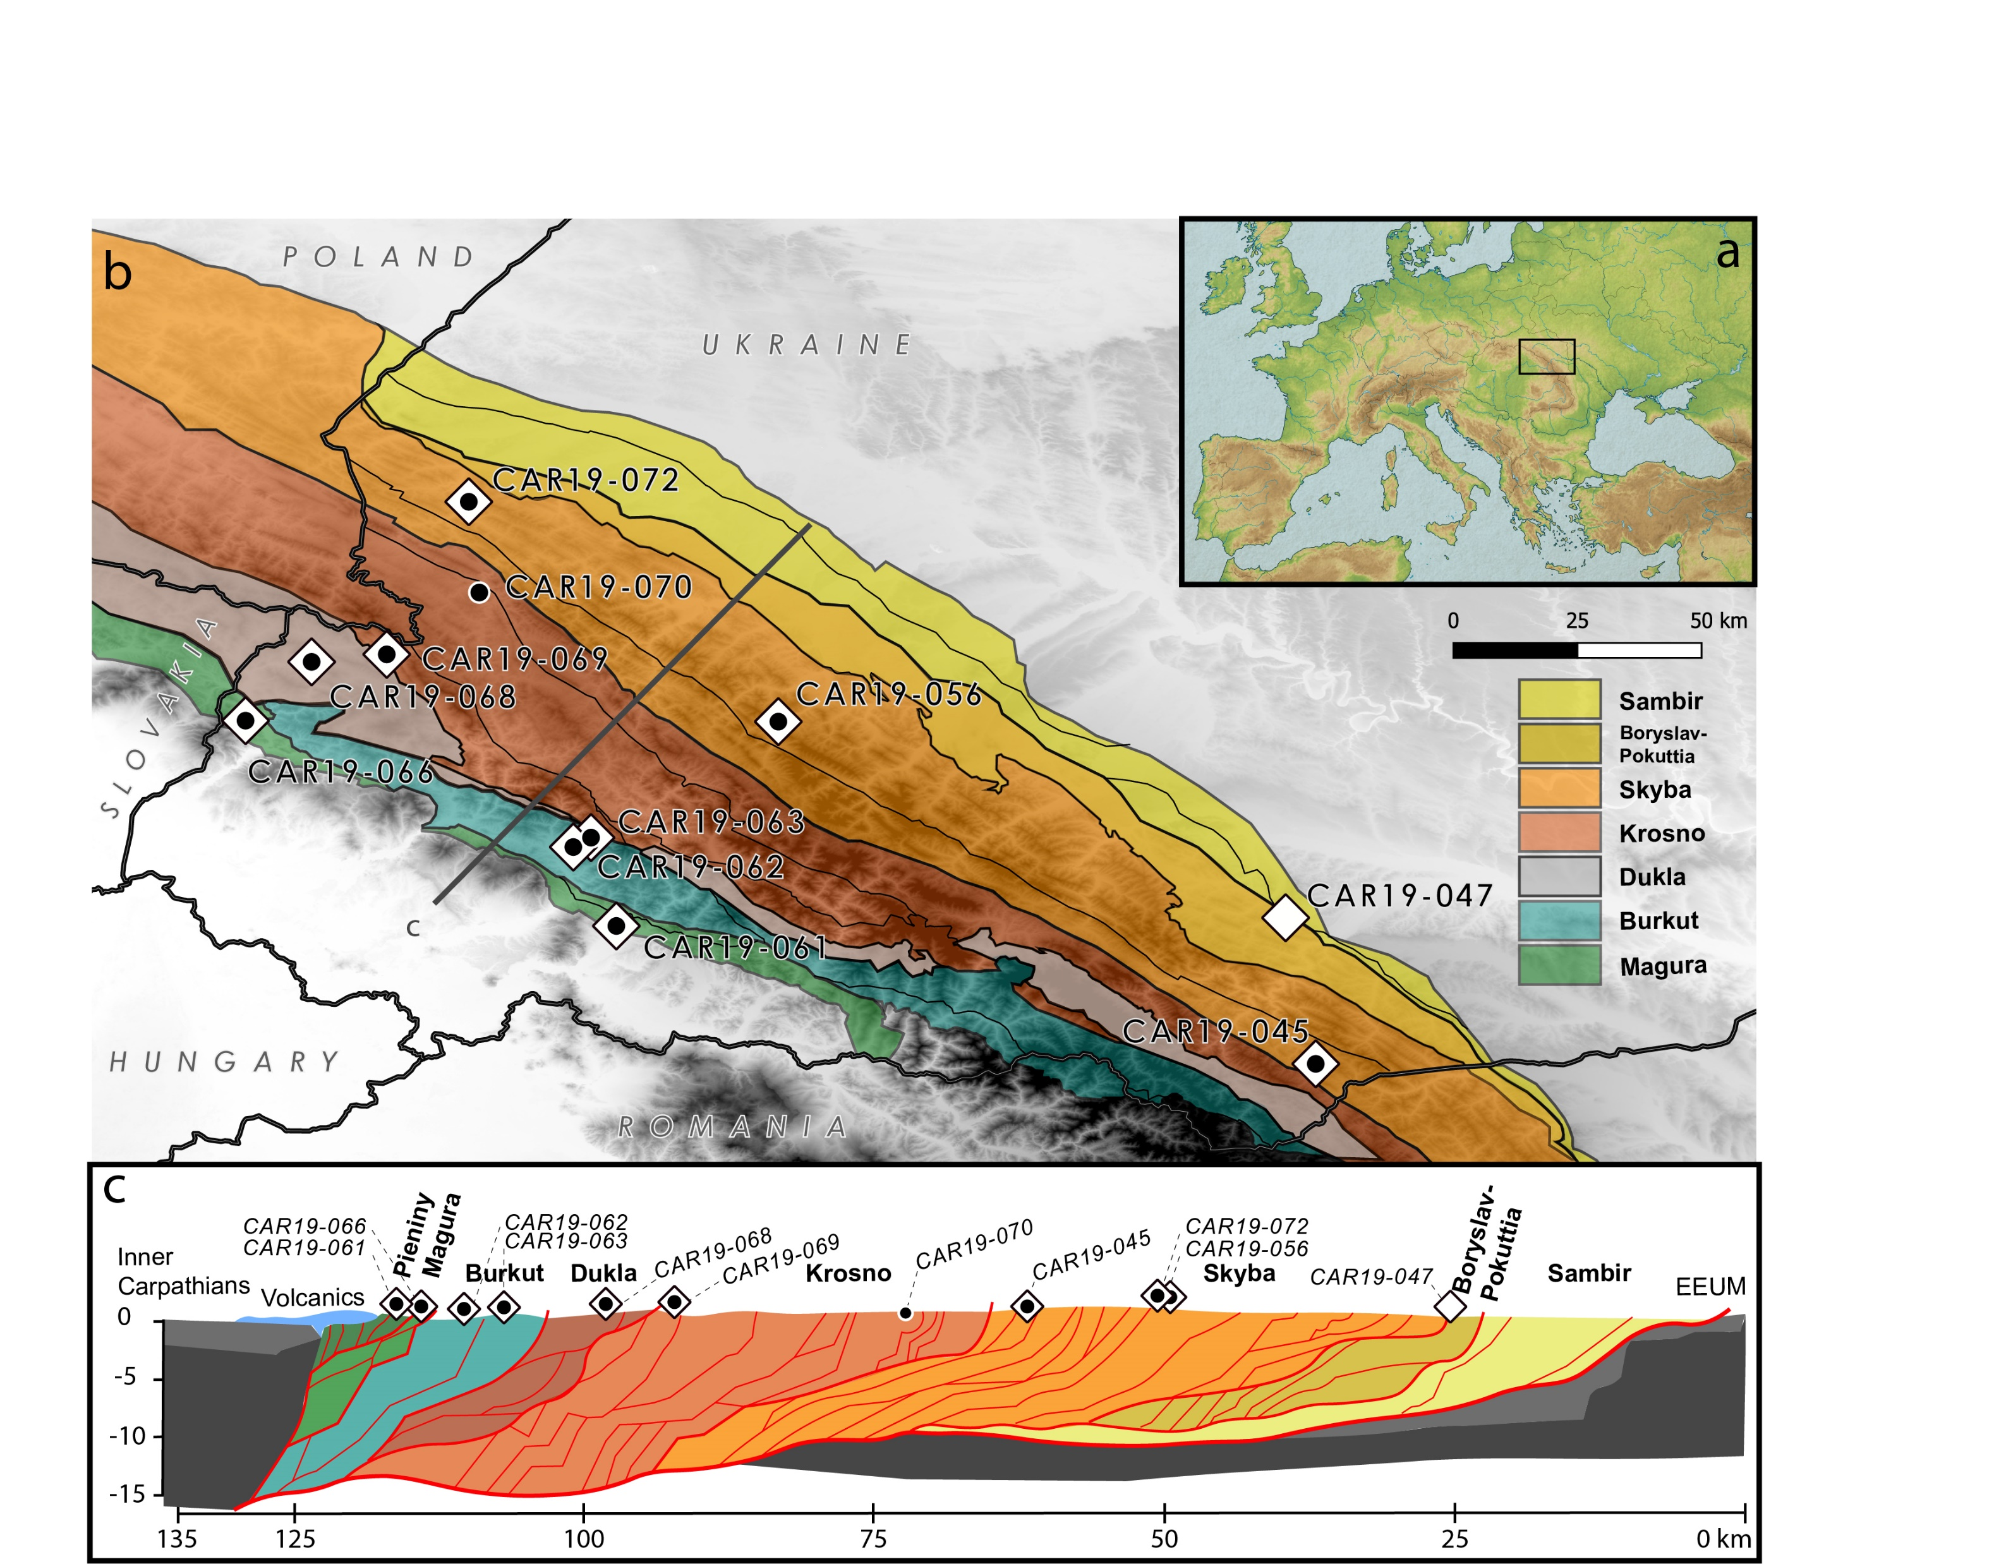
Formation of the Carpathians
Roger et al.,(in prep)
ALCAPA
Alps
Tizsa-Dacia
Dinarides
Balkans
Schmid et al.,2008
Notes:
The Ukrainian part of the belt
Diff nappes in colors

Slide 5
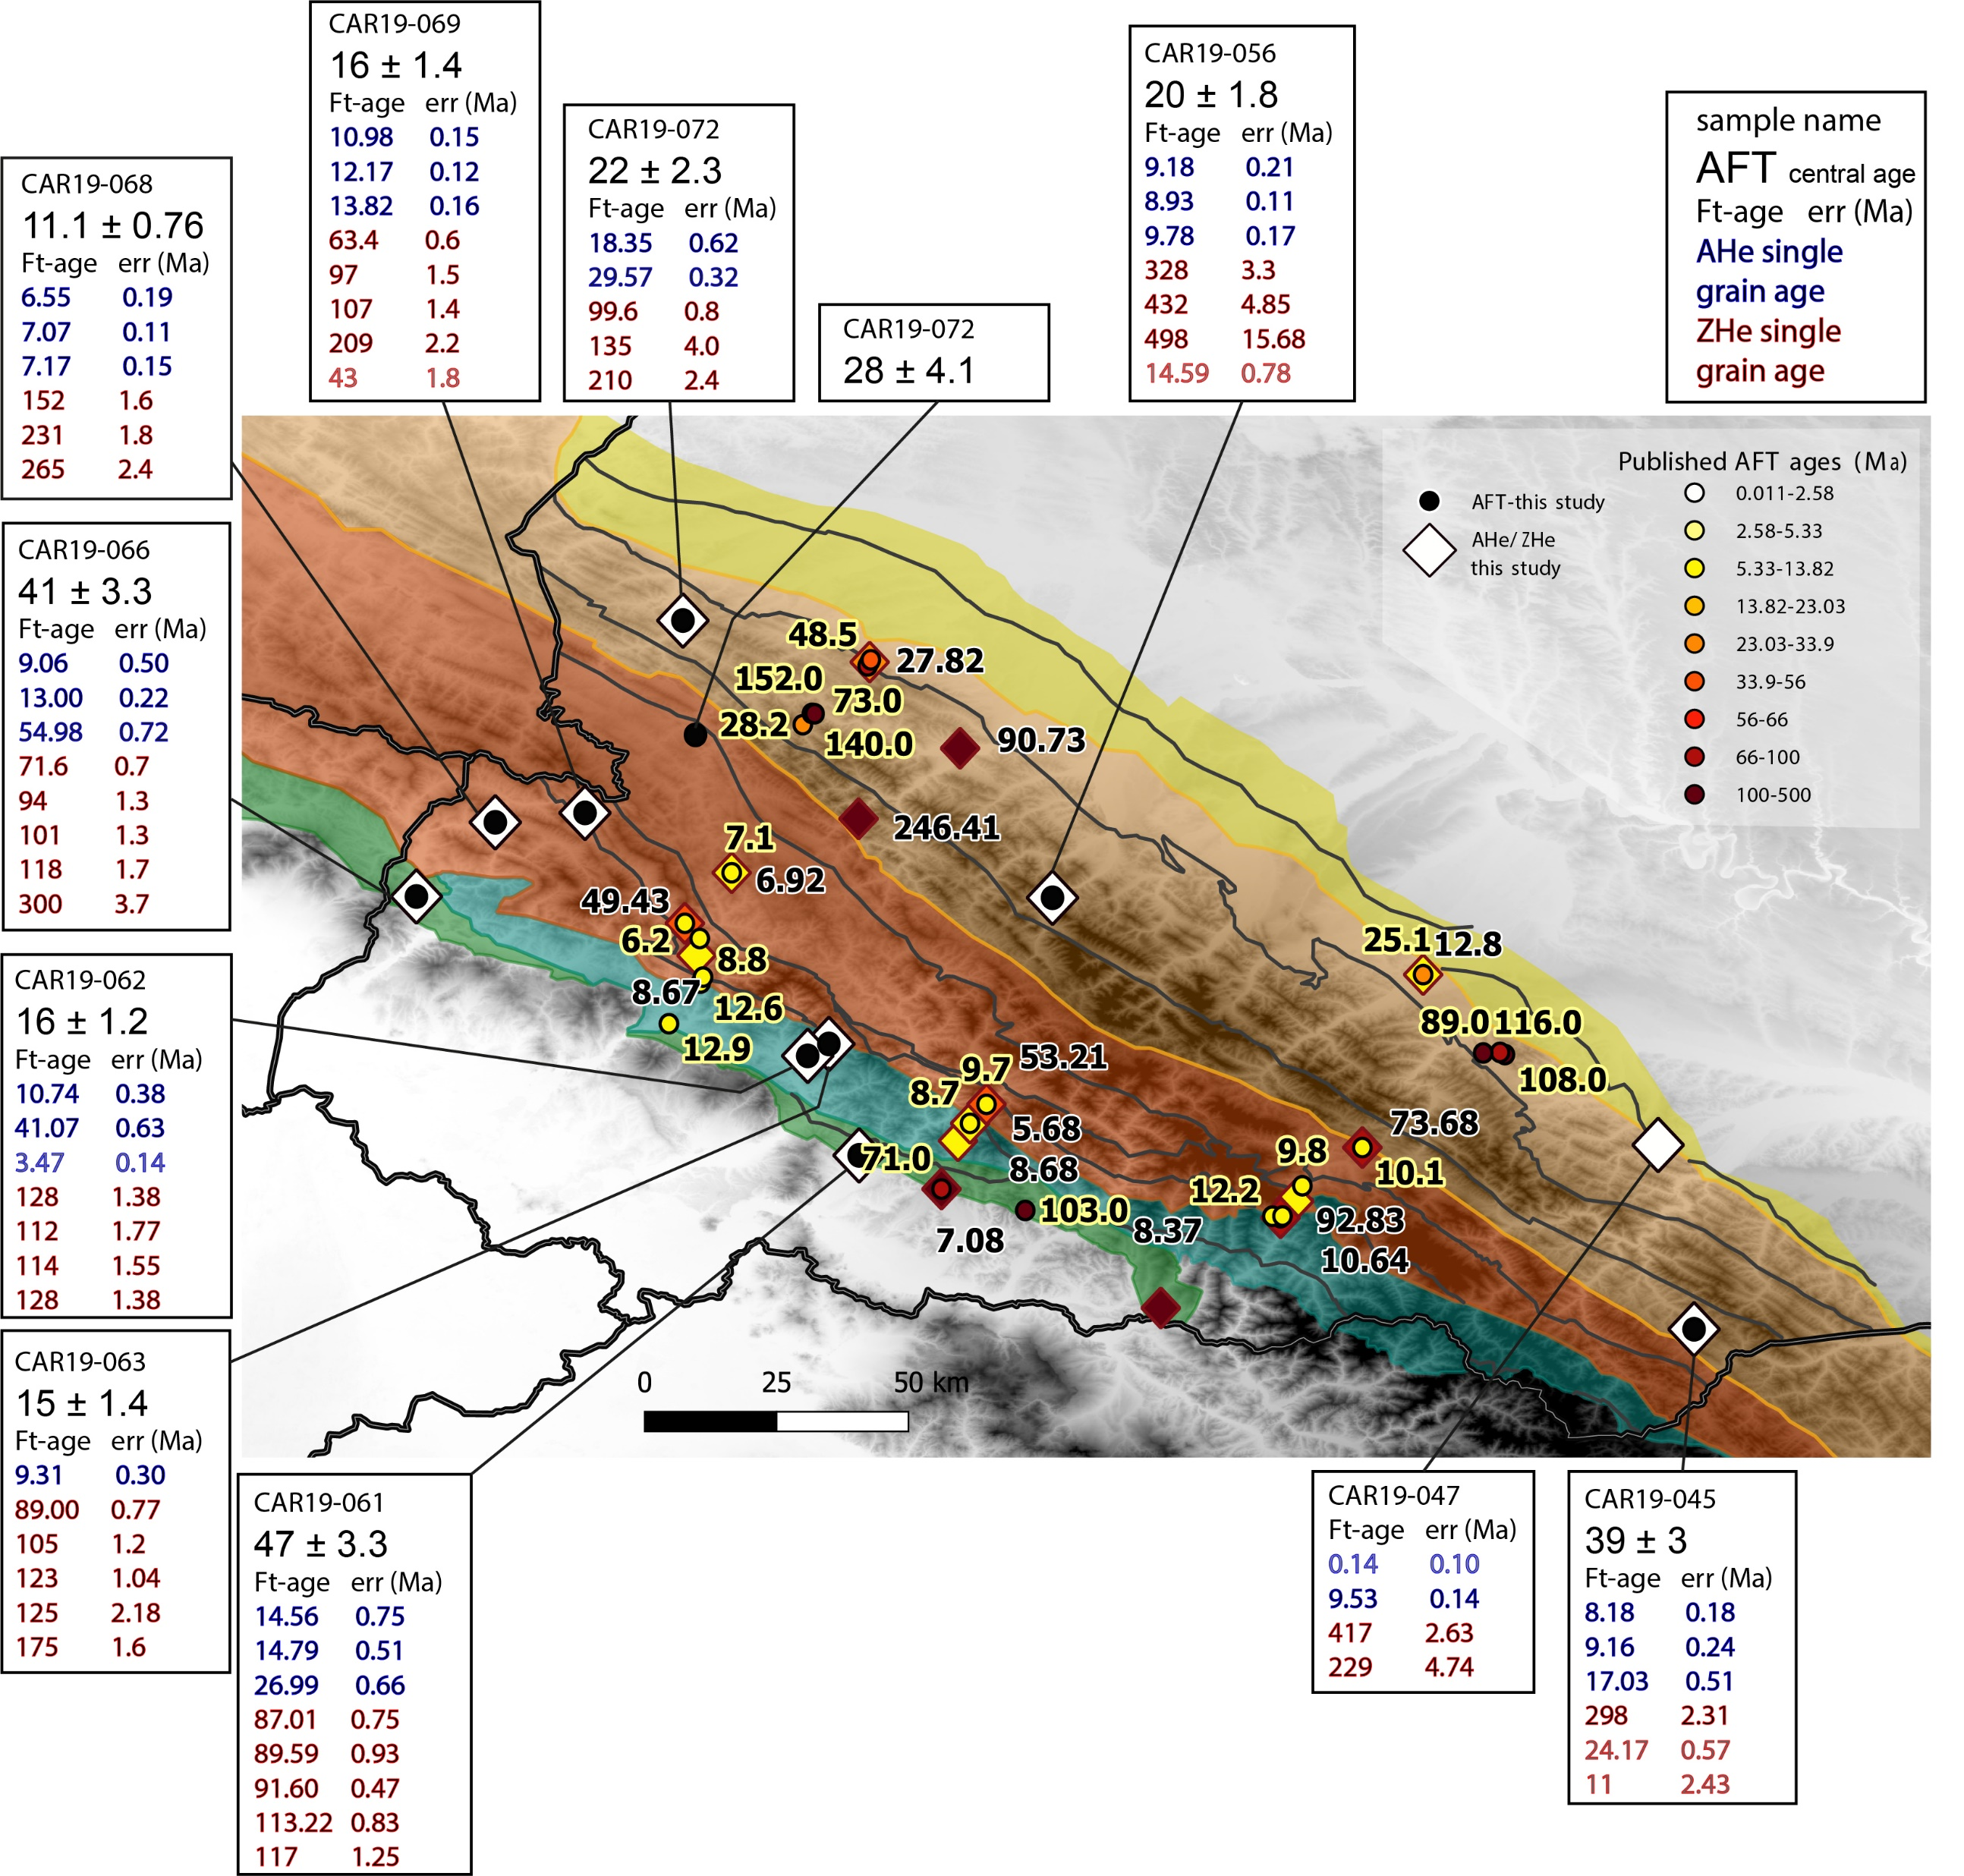
Thermochronology: AFT, AHe, ZHe
Notes:
Thermochronometers, compared with other publiches ages
BETTER WAY TO LOOK AT AGES REPARTITION

Slide 6
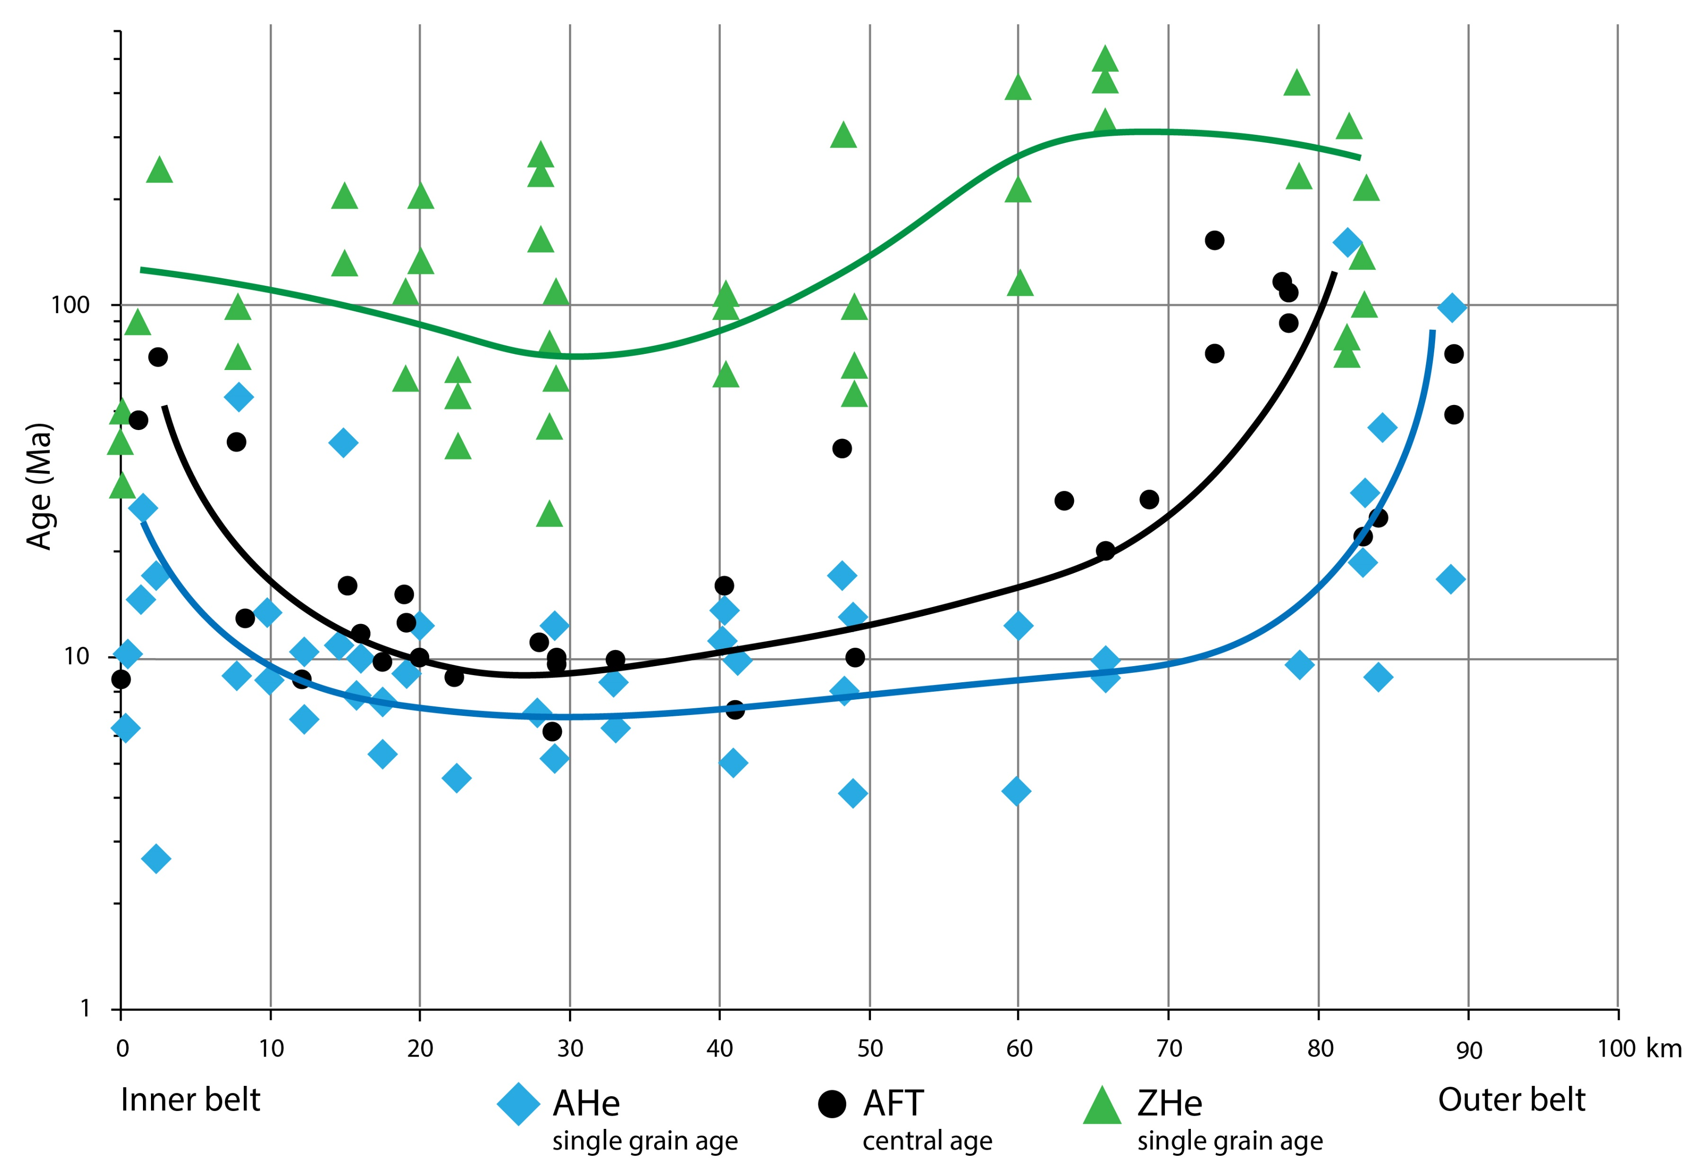
Thermochronology: AFT, AHe, ZHe
Roger et al., in prep
Compiled thermochronology data from our study, Andreucci et al., 2015 and Nakapelyukh et al., 2018
Notes:
Thermochronometer ages VS location on the BELT!! Inner belt to outer belt
Core of the wedge == reset

Slide 7
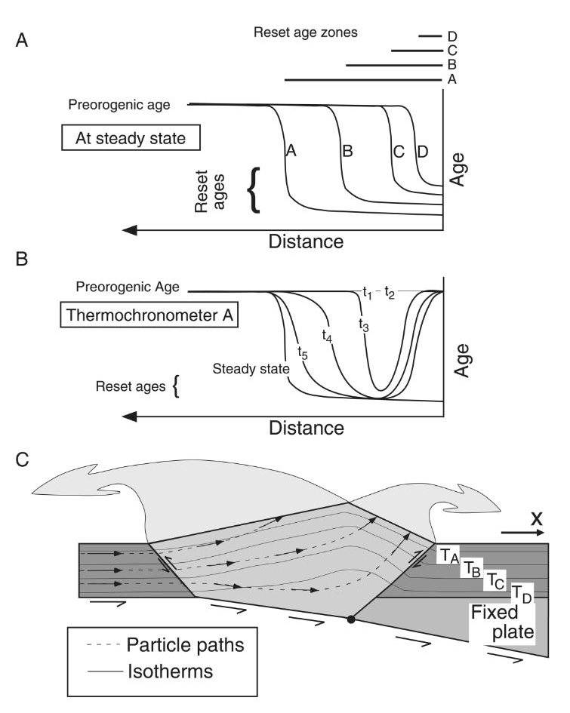

Thermochronology: AFT, AHe, ZHe
Roger et al., in prep
Reset zone ZHe
Reset zone
AFT-AHe
Willett and Brandon, 2002
Compiled Thermochronology data from our study, Andreucci et al., 2015 and Nakapelyukh et al., 2018
Notes:
Pattern typical of doubly vergent wedge

Slide 8
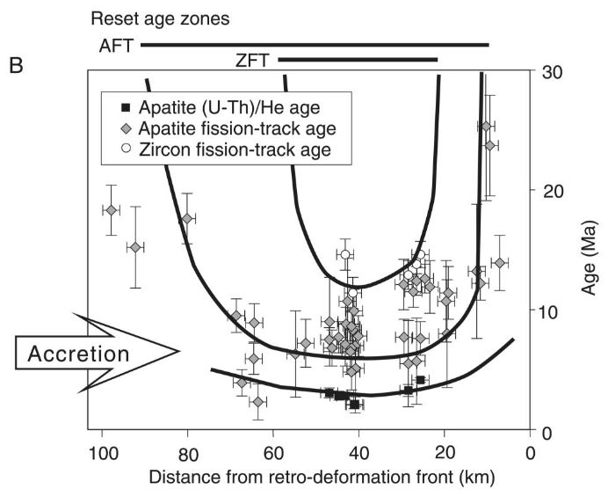
Thermochronology: AFT, AHe, ZHe
Example of the Olympic Mountains (Washington st, USA),
(Bat et al., 2001)
Roger et al., in prep
Reset zone ZHe
Reset zone
AFT-AHe
Willett and Brandon, 2002
Compiled Thermochronology data from our study, Andreucci et al., 2015 and Nakapelyukh et al., 2018
Notes:
EXAMPLE
2sigma sur les AFT
Dans la légende les single grain or CA
Erica erlanger apenin

Slide 9
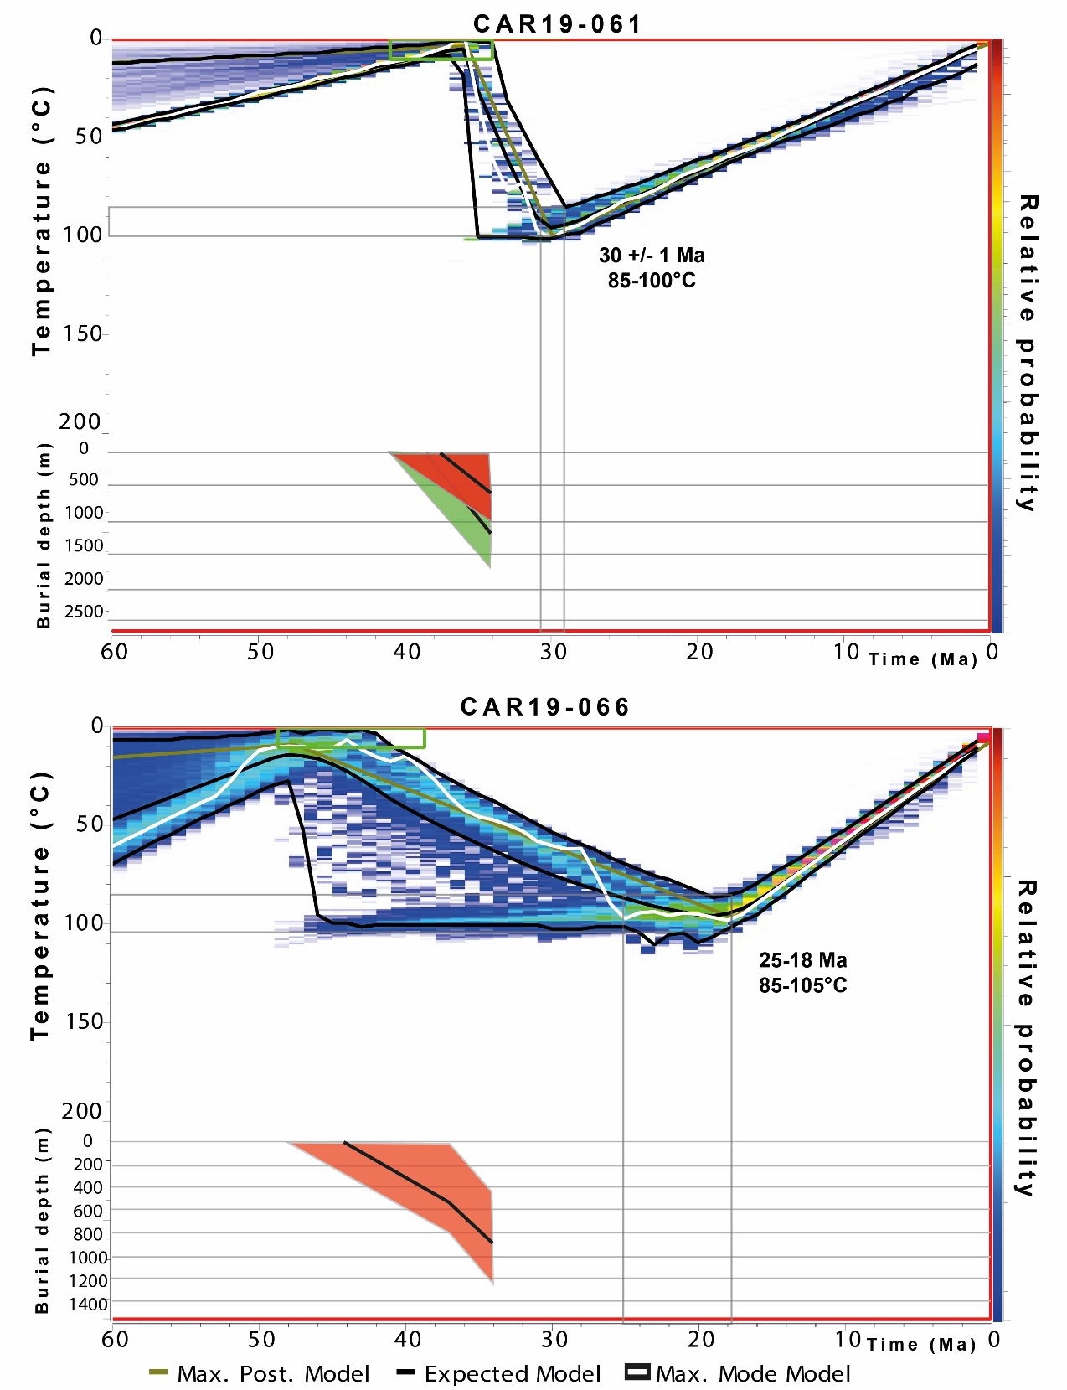
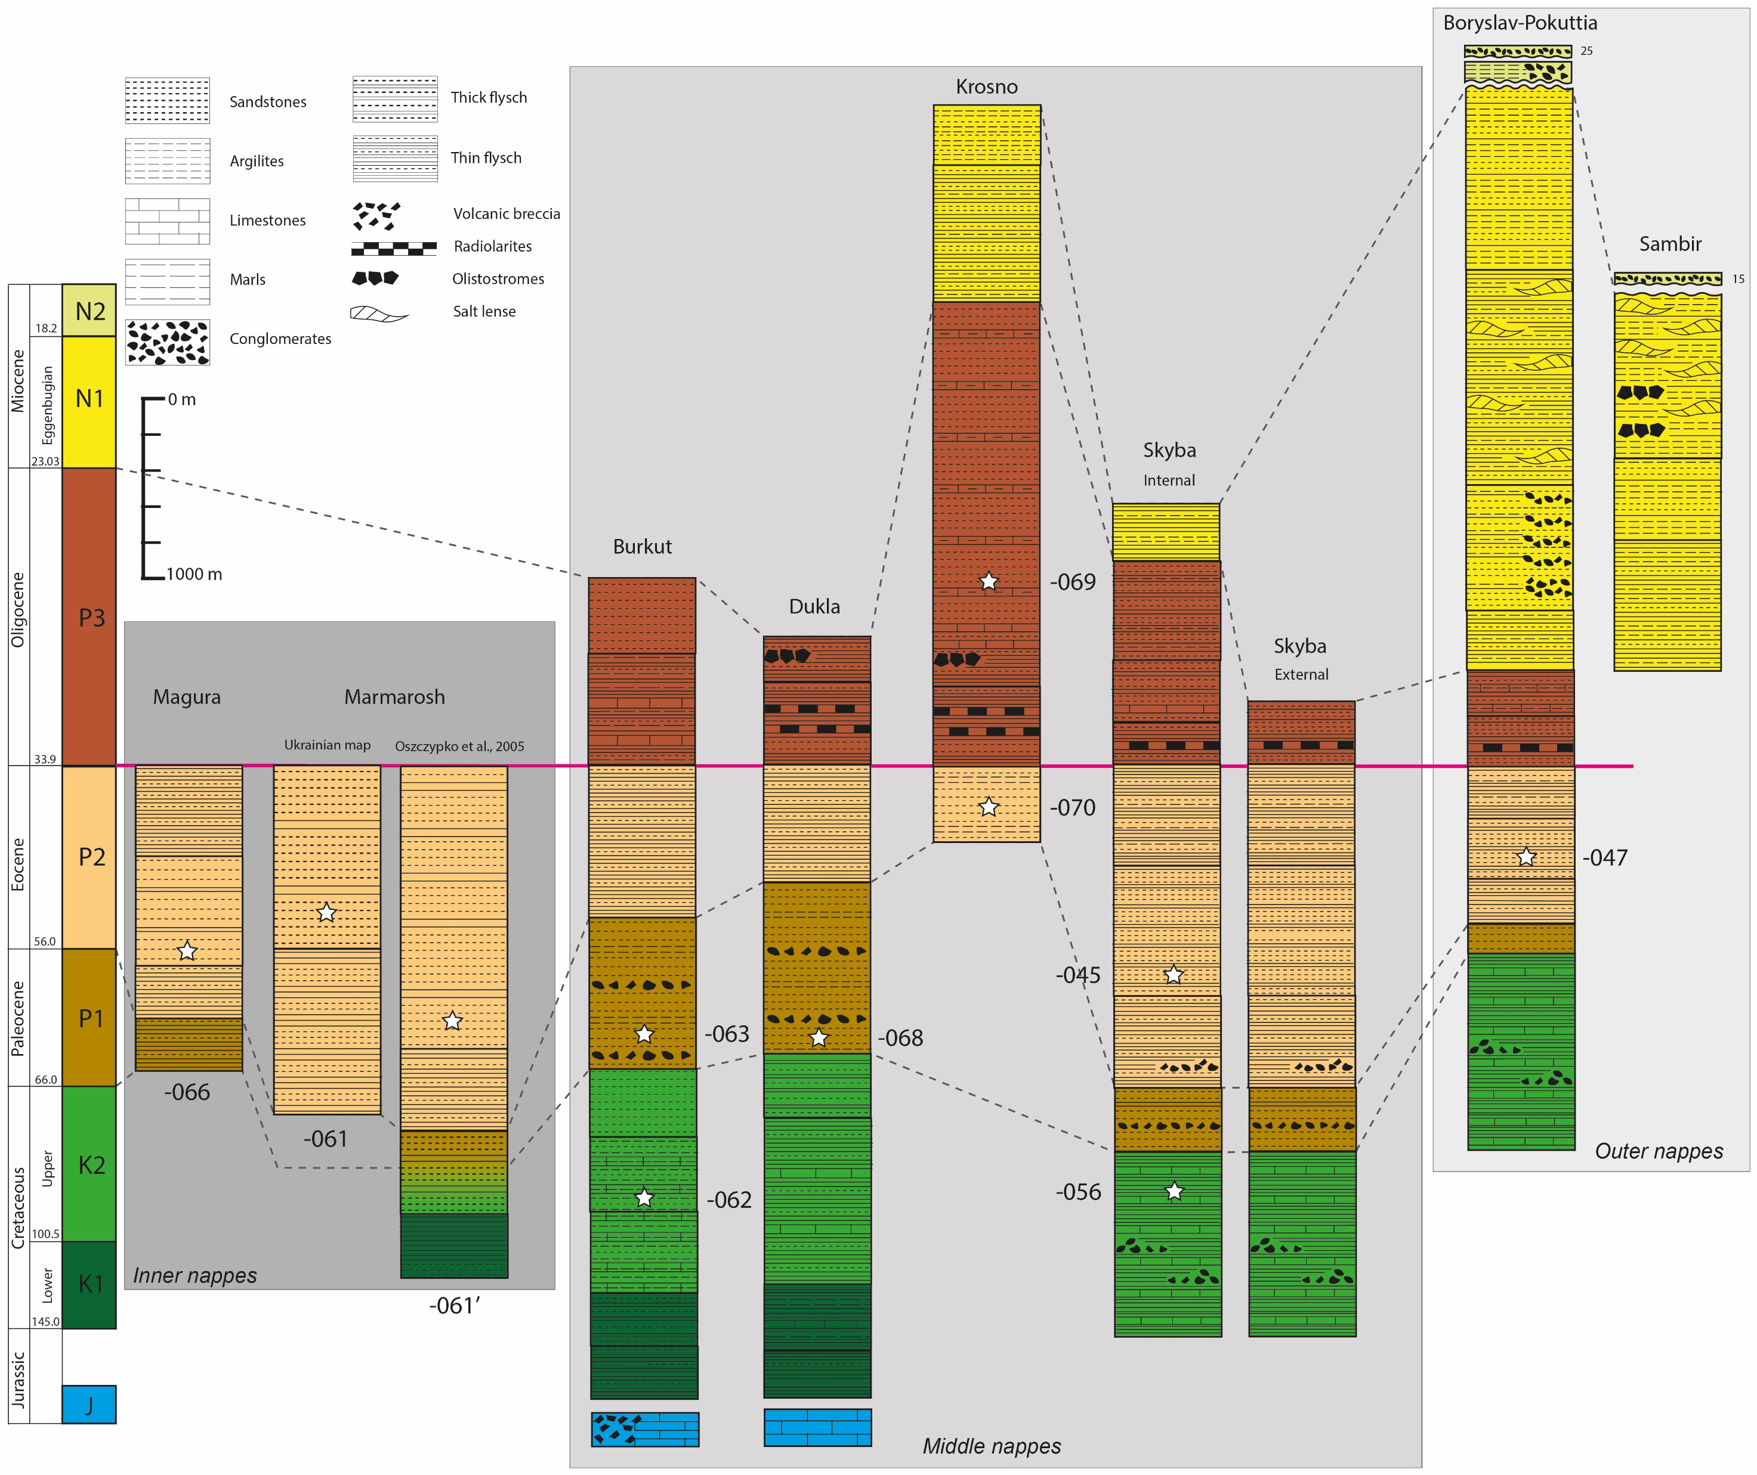
Thermal model: sedimentary/tectonic burial → exhumation
Thermal modelisation with AFT and AHe
Burial diagram from the local stratigraphy
For each nappe, a sample have been modelled
Roger et al., in prep
Notes:
We studied the wedge with thermal models → RIGHT
They are combioned to Burial diagrams derived from the regional stratigraphy (LEFT)
We did that for each nappe (AS YOU CAN SEE ON THE TOP)

Slide 10
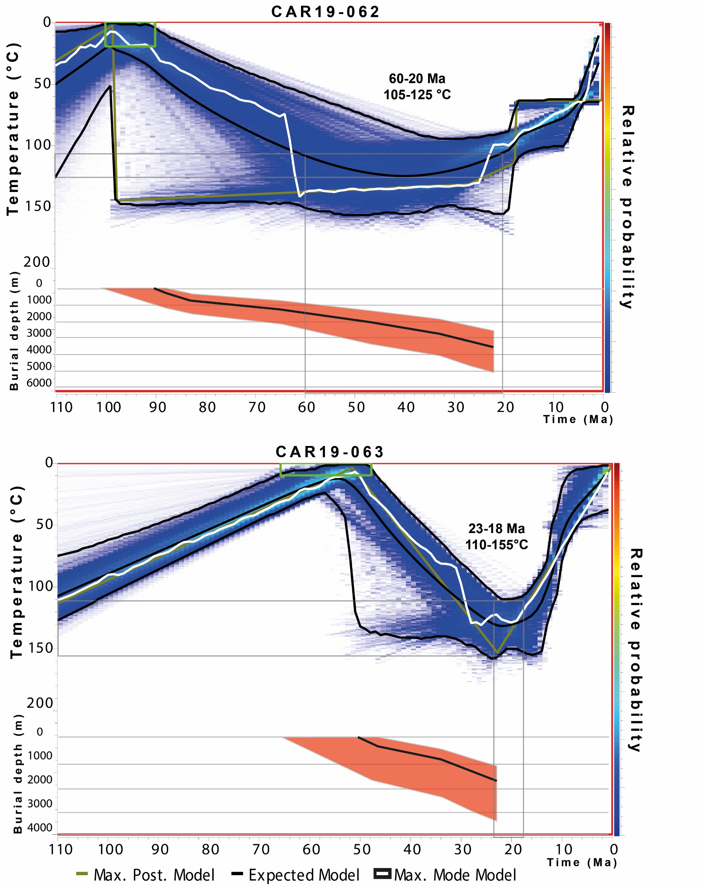
Thermal model: sedimentary/tectonic burial → exhumation
Thermal modelisation with AFT and AHe
Burial diagram from the local stratigraphy
For each nappe, a sample have been modelled
Thermal model < 200°C
Constrains on peak burial temperature depend on datasets
Roger et al., in prep
Notes:
Stages of the thermal model
Burial == heating
Exhumation == cooling

Slide 11
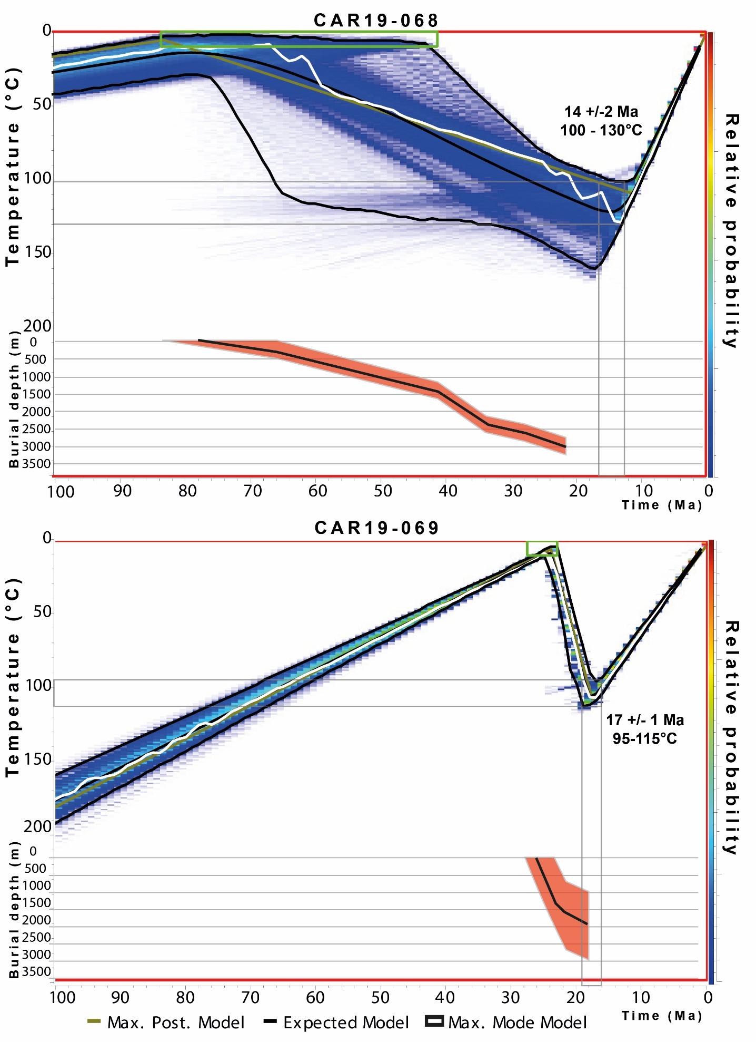
Thermal model: sedimentary/tectonic burial → exhumation
Thermal modelisation with AFT and AHe
Burial diagram from the local stratigraphy
For each nappe, a sample have been modelled
Thermal model < 200°C
Constrains on peak burial temperature depend on datasets
Exhumation phase start at the cooling of the samples
Roger et al., in prep
Notes:
Peak temperature is too hight to be the result of only sed burial assuming normal geothermal gradient → INVOKE tectonic burial to reach max temperature

Slide 12
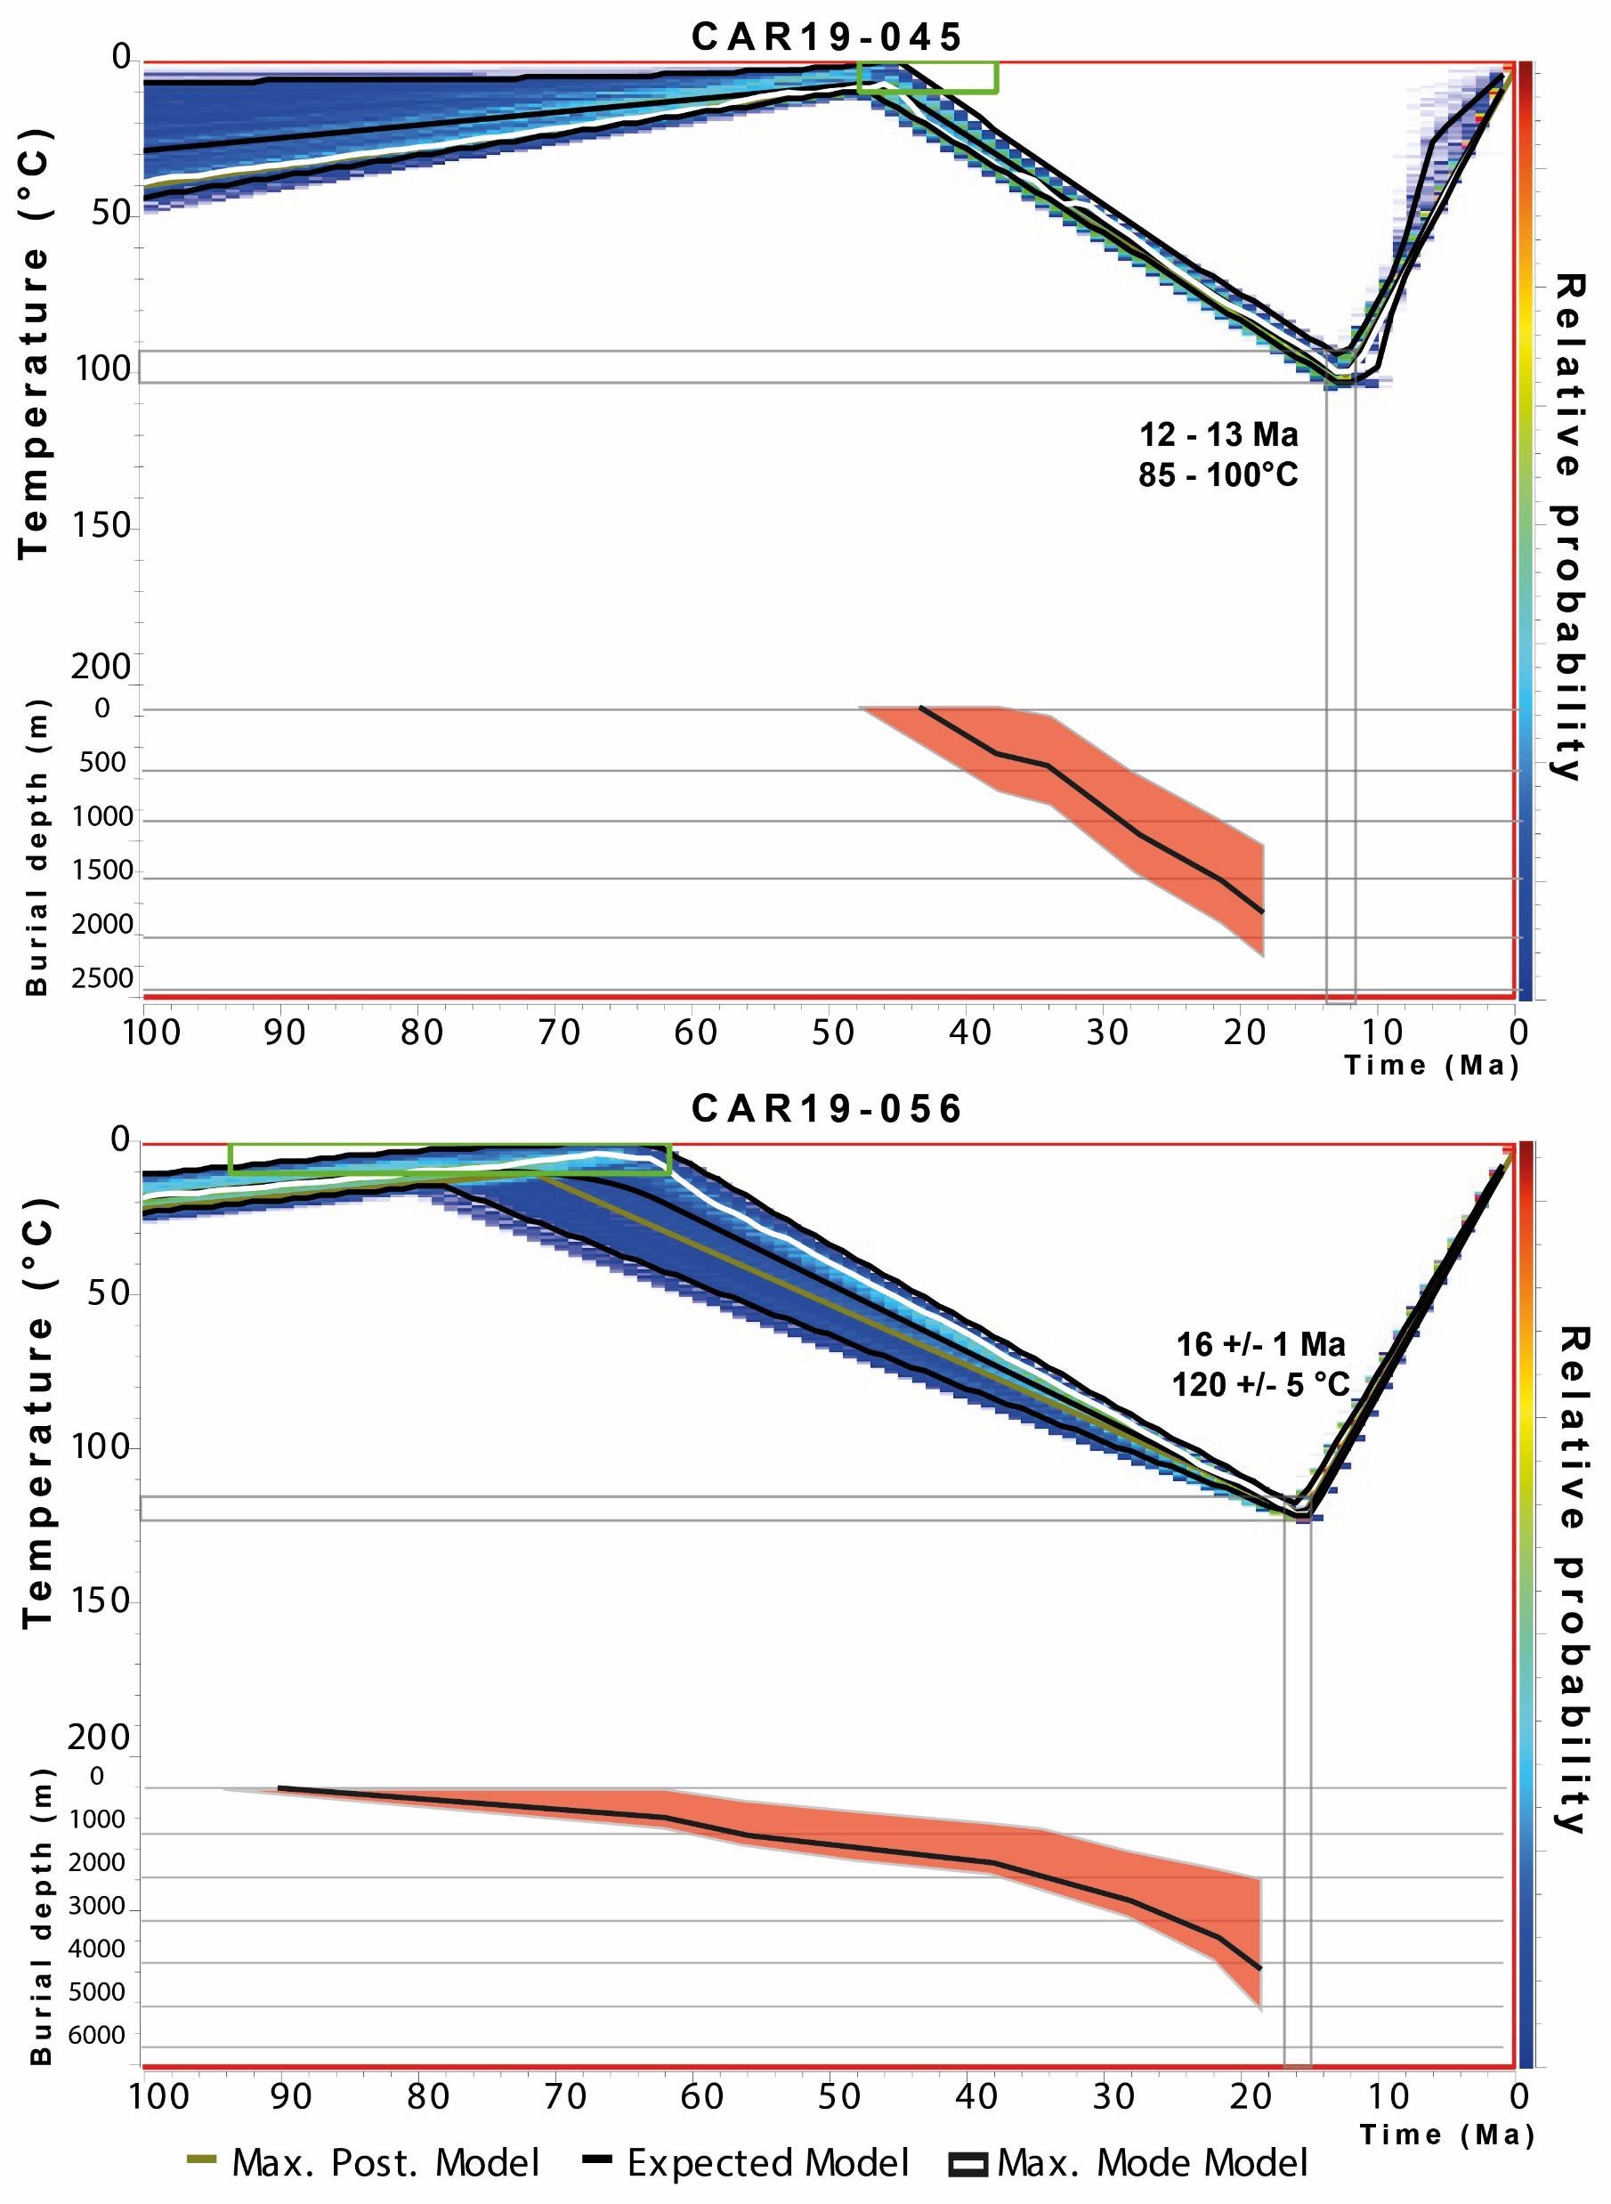
Thermal model: sedimentary/tectonic burial → exhumation
Thermal modelisation with AFT and AHe
Burial diagram from the local stratigraphy
For each nappe, a sample have been modelled
Thermal model < 200°C
Constrains on peak burial temperature depend on datasets
Exhumation phase start at the cooling of the samples
With a geothermal gradient of 25°C/km we obtain depth over time diagrams
Roger et al., in prep
Notes:
We calculated the sed burial and tectonic burial for each samples

Slide 13
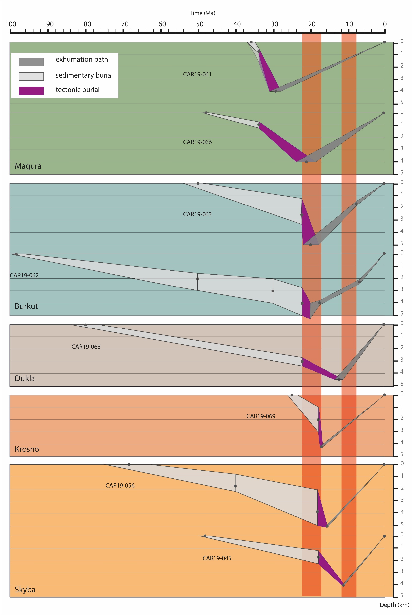
Thermal model: sedimentary/tectonic burial → exhumation
With time-depth diagrams we see:
Inner nappes are starting a tectonic burial sooner than for other nappes (~34 Ma)
Inner nappes start their exhumation from 30-20 Ma with a slow exhumation rate (~1,2 km/My)
Roger et al., in prep
Notes:
We obtain the time-depth evolution of ours rock – discribe napppe activity
Beginig of the tectonic burial → START OF ACCRESION

Slide 14
Thermal model: sedimentary/tectonic burial → exhumation
With time-depth diagrams we see:
Inner nappes are starting a tectonic burial sooner than for other nappes (~34 Ma)
Inner nappes start their exhumation from 30-20 Ma with a slow exhumation rate (~1.2 km/My)
A phase of tectonic activity in the wedge happened from 22-18 Ma, with exhumation of most of Middle nappes
One nappe is in out-of-sequence with the others
The second tectonic phase is around 12-8 Ma for outer nappes, and changes of exhumation in the Middle nappes
Exhumation rates for the second tectonic phase are around 0.3-0.4 km/My
Roger et al., in prep

Slide 15
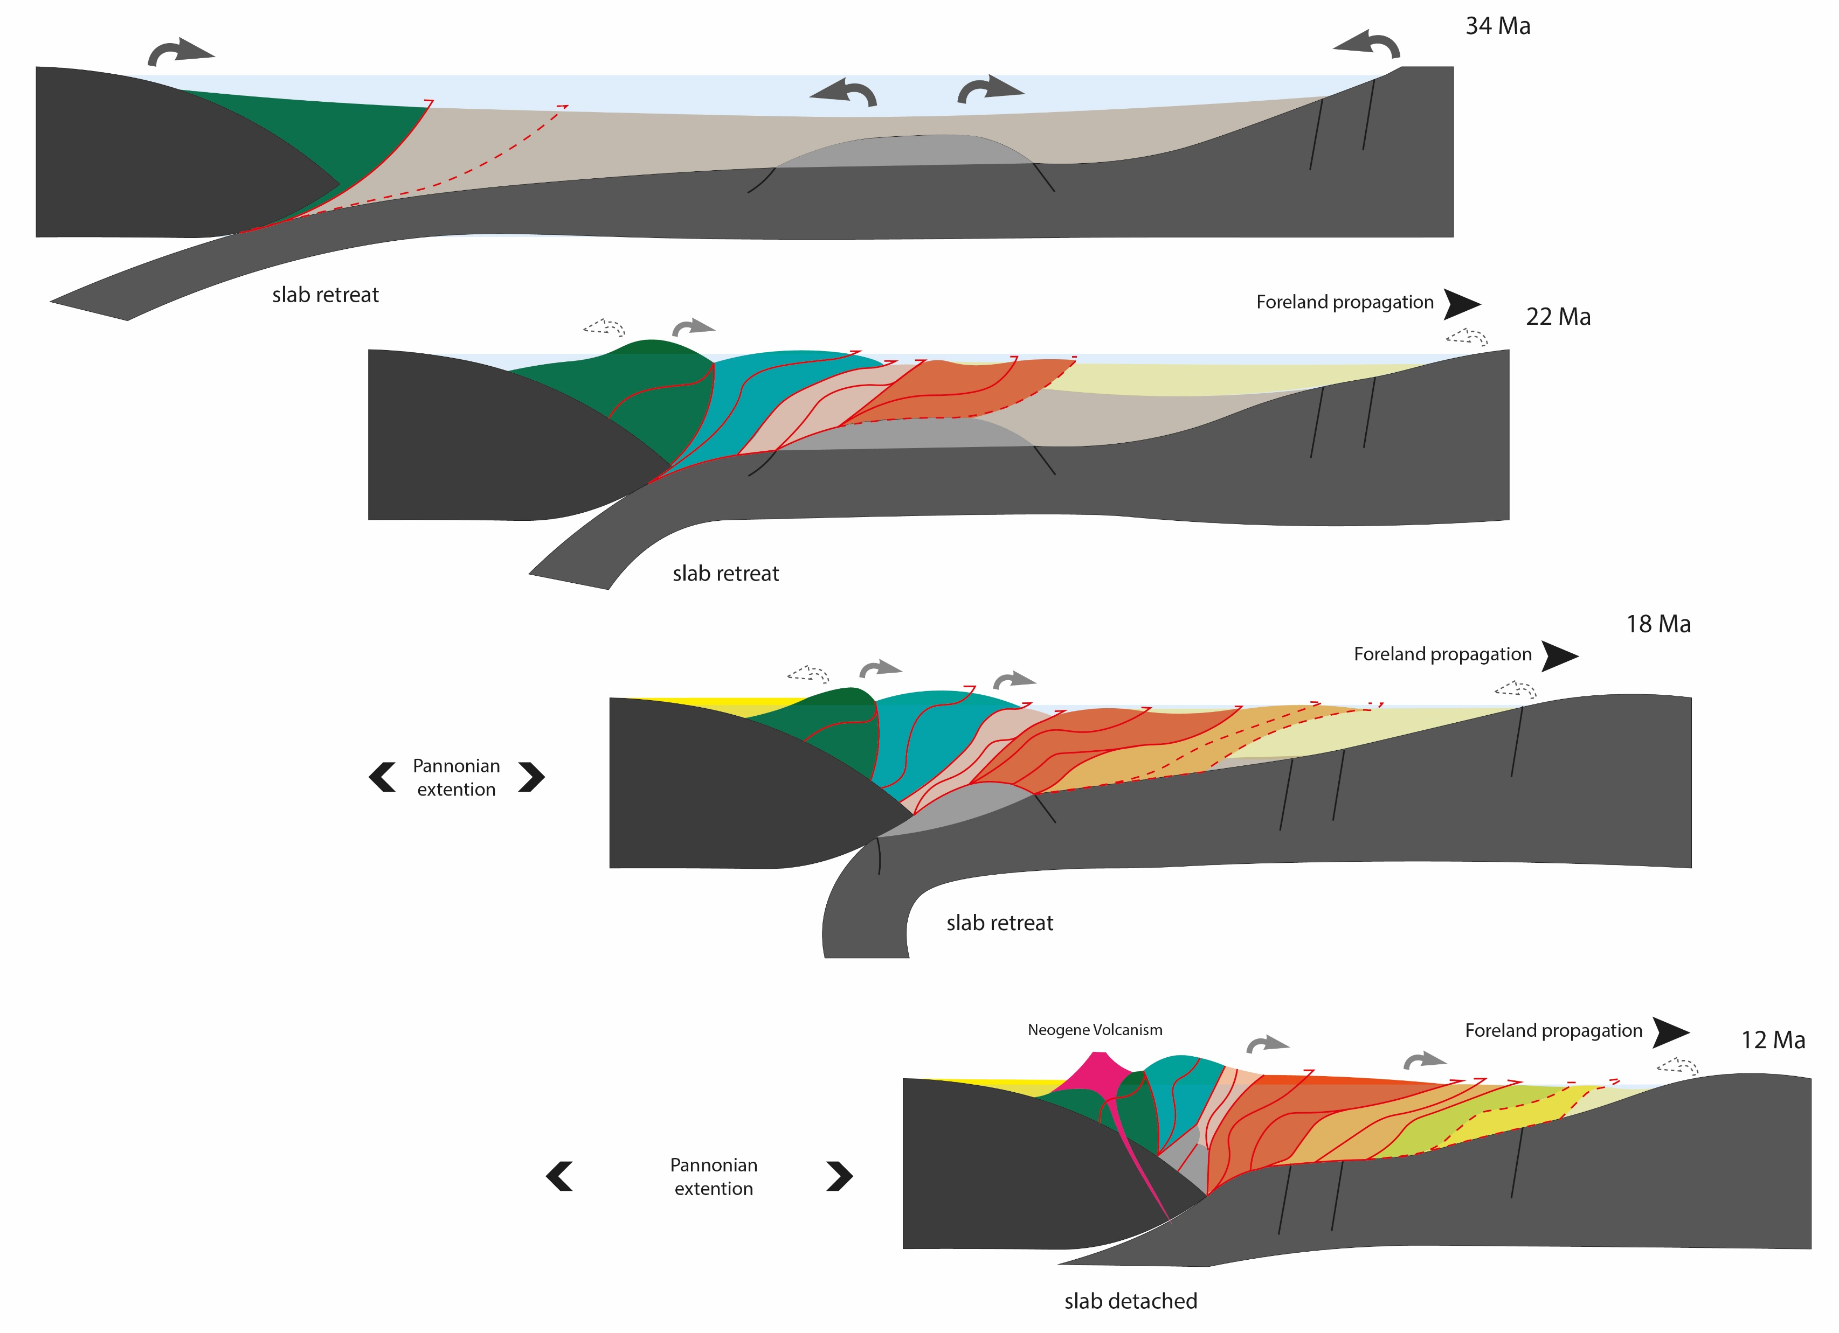
Ukrainian Outer Carpathians (UOC) wedge reconstruction
Deposition in the basin from Cretaceous, sediments are provided from the Inner Carpathians, intra-basinal highs and the East European Margin (EEUM).
Around 34 Ma, Inner nappes of the UOC are accreted to form the early wedge.
Notes:
DO NOT SOURCE SED (take too much time !)

Slide 16
Ukrainian Outer Carpathians (UOC) wedge reconstruction
Deposition in the basin from Cretaceous, sediments are provided from the Inner Carpathians, intra-basinal highs and the East European Margin (EEUM).
Around 34 Ma, Inner nappes of the UOC are accreted to form the early wedge.
Retreat of the subduction zone drive the advancement of the wedge, at ~20 Ma, the Middle nappes started their accretion.
At 20 Ma, Inner nappes are exhumed by < 1km, sediments are mainly provided by intra-basinal highs or the EEUM.

Slide 17
Ukrainian Outer Carpathians (UOC) wedge reconstruction
Deposition in the basin from Cretaceous, sediments are provided from the Inner Carpathians, intra-basinal highs and the East European Margin (EEUM).
Around 34 Ma, Inner nappes of the UOC are accreted to form the early wedge
Retreat of the subduction zone drive the advancement of the wedge, at ~22 Ma, the Middle nappes started their accretion
At 20 Ma, Inner nappes are exhumed by < 1km, sediments are mainly provided by intra-basinal highs or the EEUM
By 18 Ma, all the Middle nappes are accreted and some started their exhumation, providing sediments to the Outer nappes and to the foreland

Slide 18
Ukrainian Outer Carpathians (UOC) wedge reconstruction
Deposition in the basin from Cretaceous, sediments are provided from the Inner Carpathians, intra-basinal highs and the East European Margin (EEUM).
Around 34 Ma, Inner nappes of the UOC are accreted to form the early wedge
Retreat of the subduction zone drive the advancement of the wedge, at ~22 Ma, the Middle nappes start their accretion
Inner nappes are exhumed by < 1km, sediment are mainly provided by intra-basinal highs or the EEUM
By 18 Ma, all of the Middle nappes are accreted and some started their exhumation, providing sediments to the Outer nappes and to the foreland
At 12 Ma the wedge is accreted and transported to the EEUM, the frontal thrust propagation stopped (~11.5 Ma), and all erroded sediment are transported to the Carpathians foreland basin.

Slide 19
Take home points:
The Ukrainian Outer Carpathians are a doubly vergent wedge
Early wedge formed from 34-20 Ma
Middle nappes were all accreted from 22 to 18 Ma
Exhumation started at two periods: - from 20-18 M
- from 12-8 Ma
From 12 Ma, all the eroded sediments are transported to the Carpathians Foreland Basin
QR code to my abstract
If you liked my presentation, you can vote for OSPP
Marion Roger
marion.roger@univ-grenoble-alpes.fr

Slide 22
