Slide 1
EGU General Assembly 2022
Hydrological Impact Assessment of Climate Change on a Tropical River Basin in Southern India
Swatantra Kumar Sharma^{1*}, Rakesh Kumar Sinha¹ & Eldho T.I¹.
¹Department of Civil Engineering, Indian Institute of Technology Bombay, Mumbai, India
*Corresponding Author: Swatantra Kumar Sharma, Department of Civil engineering, Indian Institute of Technology Bombay, Mumbai, India, 400076
Email: er.swatantra@gmail.com

Slide 2
Study Area and Data
Input Data | Scale/Resolution | Description of Data/ Sources
Digital Elevation Model (Tile No. - C43Q and C43R) | 30 m | NRSC Cartosat-1 DEM (https://bhuvan.nrsc.gov.in)
Soil | 30 arc-second | Harmonized World Soil Database (FAO)
Rainfall | 0.25˚ (daily) | Indian Meteorological Department (IMD)
Temperature (Max and Min) | 0.50˚ (daily) | Indian Meteorological Department (IMD)
Solar radiation, wind velocity and relative humidity | 0.25˚(daily) | Climate Forecast System Reanalysis (CFSR)
Streamflow | Daily | Central Water Commission (https://www.india-wris.nrsc.gov.in)
Land use | 30 m | Landsat images (https://earthexplorer.usgs.gov/)
The study area is part of the Western Ghats and is situated in the state of Kerala, India. The entire basin is bounded within a latitudinal range of 9˚ 1' 12" − 9˚ 39' 53" N and longitudinal range of 76˚ 26' 34" − 77˚ 17' 00" E and covers 3721.5 km² in area, with a maximum elevation of 1966 m above the mean sea level.
The historical data from 1984 to 2015 are considered in the present study, in terms of meteorological and hydrological data.
The SWAT model was calibrated and validated at three gauging station shown in Figure 1 located at three river streams(Top to bottom: Manimala, Pamba, and Achankovil).
Figure 1.

Slide 3
Methodology
The entire work may be categorized as follows: 1)LULC map preparation from Landsat data; 2) Hydrological model setup that includes calibration and validation at three gauging stations; 3) assessment of climate change in the basin with the downscaled CMIP 5 data for RCP 4.5 and RCP 8.5.
Prepared LULC map of 2015 was considered for the present study.
For calibration and validation of the SWAT model, Latin Hypercube (LH) one factor at a time approach that incorporated in Sequential Uncertainty Fitting algorithm (SUFI-2) of SWAT-CUP has been used.
The Simulated results from ArcSWAT for the base period (1984-2015) and projected climate data for the near future (2016 -2030) was assessed there upon, by keeping the LULC (2015) of the study region as constant (Sinha and Eldho, 2018).
Ref: Sinha, R. K., & Eldho, T. I. (2018). Effects of historical and projected land use/cover change on runoff and sediment yield
in the Netravati river basin, Western Ghats, India. Environmental earth sciences, 77(3), 111.
https://doi.org/10.1007/s12665-018-7317-6

Slide 4
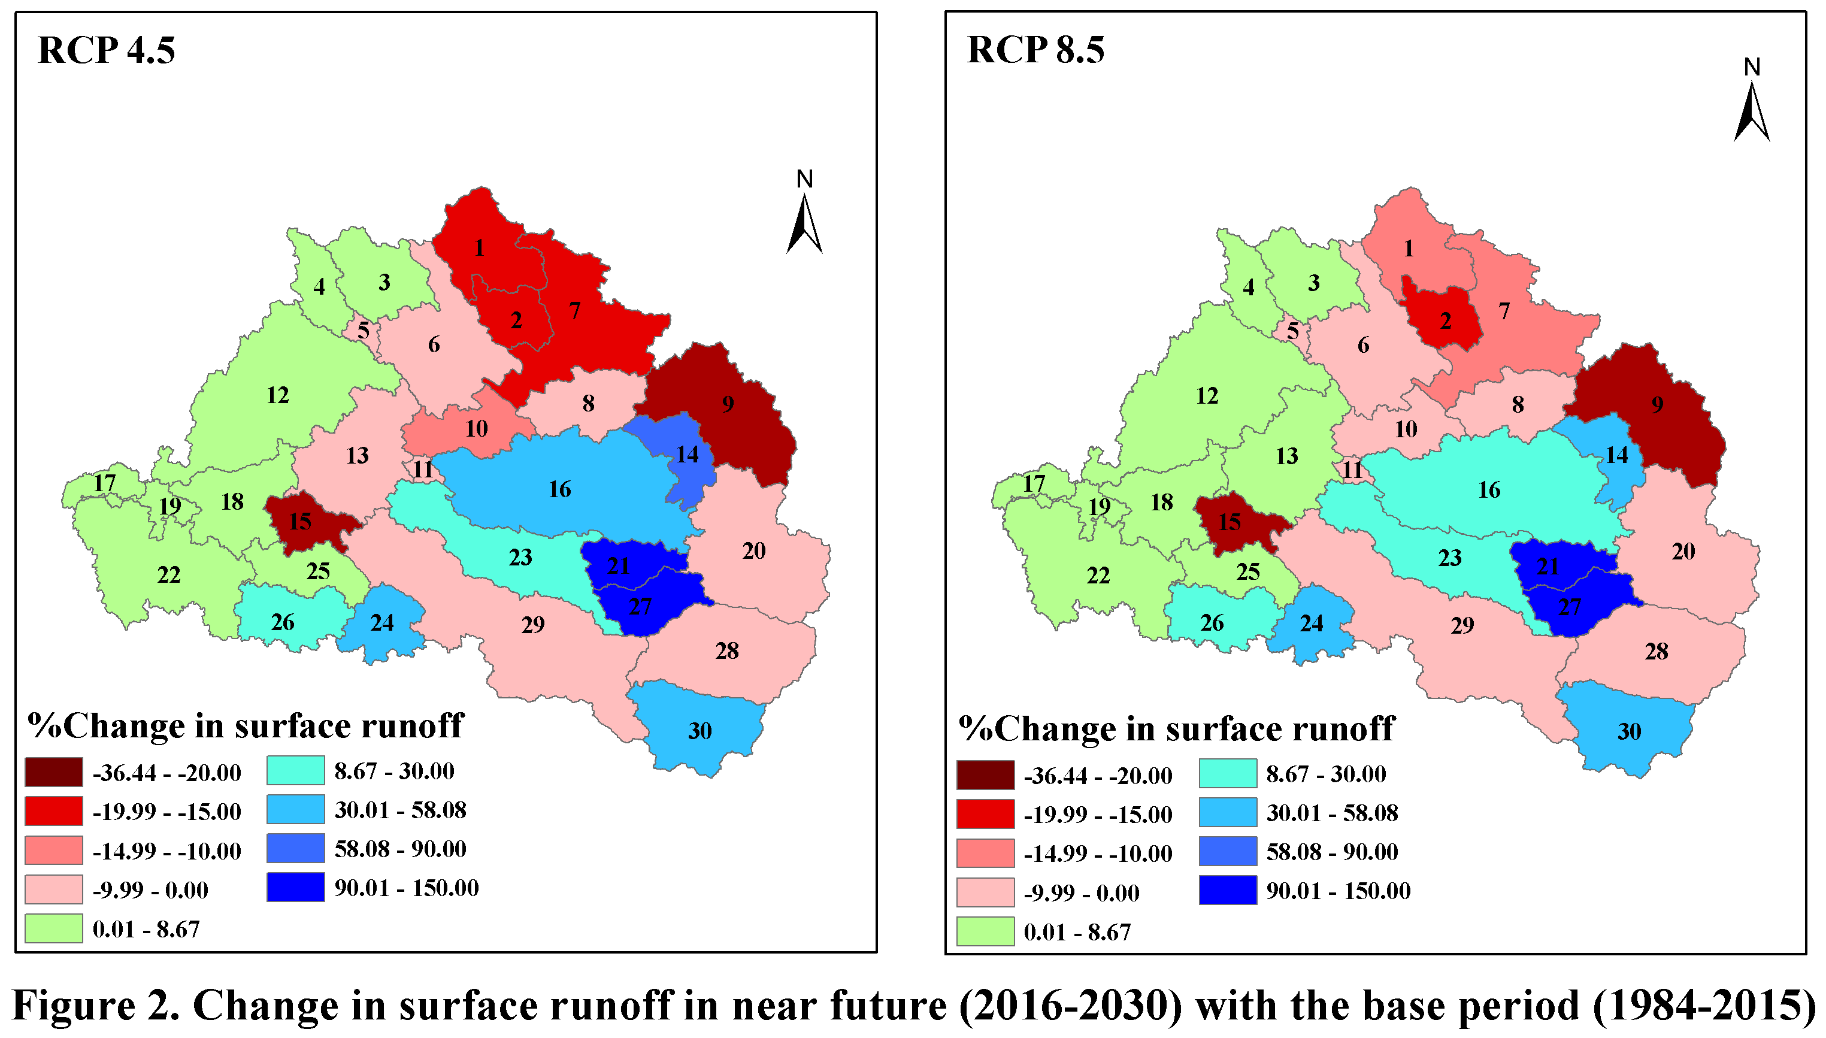
Results: Sub-basin Scale
The overall mean surface runoff for the period 2016-2030 may increase by 1.4% and 3% in RCP 4.5 and RCP 8.5 respectively, compared to base period (1984-2015).
In general, the upstream of the Pamba River Basin (PRB) may observe the decrease in the surface runoff, whereas downstream shows increase.
The maximum decrease at sub-basin is around 36% and 24% in the RCP 4.5 and RCP 8.5 respectively. While, increase may be observed up to 146% and 150% for the same.

Slide 5
Results: Monthly and seasonal Scale
At monthly scale, it was observed that from May to September there is a decrease in the runoff. Rest of the other months runoff is increasing.
At seasonal scale, monsoon is showing a decreasing surface runoff trend. In contrast, winter and summer are observed with increase in runoff.
However, annually there is increase in the surface runoff.
Magnitude of increase in runoff in the basin is more in RCP 8.5, whereas, magnitude of decrease in the runoff is more in RCP 4.5.

Slide 6
Conclusion
The surface runoff in the entire basin may increase in the near future (2016-2030), with mean increase of around 1.4% and 3% for the RCP 4.5 and RCP 8.5.
Notably, Monsoon witnesses a negative trend in both the scenarios with -18.6% and -15.5% runoff change from the base period.
At seasonal scale, winter shows a tremendous increase in the runoff with around 37% increase in both RCP 4.5 and RCP 8.5, followed by summer with 17.9% and 18.6% for RCP 4.5 and RCP 8.5 scenarios respectively.
The increase in runoff is more in case of RCP 8.5 scenario. Likewise, decrease in runoff at basin scale is more in RCP 4.5 scenario.

Slide 7
Thank You

